Slide 1
Present status and future prospect on the initial realignment at the KEKB injector linac
T. Suwada, T. Higo, K. Kakihara, T. Kamitani, M. Satoh,
R. Sugahara, M. Tanaka,
Accelerator Laboratory, KEK

Slide 2
Introduction
The Super KEK B-Factory project (SuperKEKB) is a next-generation B-factory under construction at KEK after the KEKB project, which was discontinued in 2010.
The KEKB injector linac is concurrently being upgraded for the SuperKEKB and is also in progress of the recovery works from the heavy damage due to the previous earthquake in Mar. 2011.
The initial realignment is very important in the linac upgrade.
The initial realignment with the high-precision laser-based alignment system is now ongoing.

Slide 3
Super KEKB Accelerator Complex
The Super KEKB : an electron-positron collider with asymmetric energies
Y. Ohnishi, et al., Prog. Theor. Exp. Phys. 2013 , 03A011.
I_{b} =3.6A
e⁺ E = 4 GeV
e⁻ E = 7 GeV
I_{b} =2.6A
Target Luminosity@SuperKEKB
L = 8 × 10³⁵ cm⁻²s⁻¹
40 times higher than the previous KEKB
L = 2 × 10³⁴ cm⁻²s⁻¹
500-m-long straight section for the laser-based alignment
#2
#3
#1
600-m-long injector linac
Tsuyoshi Suwada /KEKB Injector Linac

Slide 4
Strategies of the initial realignment
The required precisions in the initial realignment are 0.1 mm over a sector (~80 m) and 0.3 mm over the long straight section (~500 m).
For the two long straight sections, independent laser-based alignment systems are applied to the alignments for accelerator girder units.
Regarding the 180º arc section, the refinement works have been performed in which the arc is smoothly connected to the two straight sections.
Regarding the accelerator component alignment, target bases for the accelerator structures and quadruple magnets have been newly fabricated and mounted for conventional laser-tracker-based alignment measurements.
The girder units were improved to increase the earthquake resistance by mounting a new support table for restricting the displacements in both the transverse and axial directions.
We have observed non-negligible long-term drift of the floor level in the linac tunnel along with daily range of the dynamical displacements due to tidal motion.

Slide 5
KEKB linac layout and two laser fiducial lines
Two long straight sections, AB (125m) and C5 (475m)
Two new laser-based alignment systems enable the high-precision alignment for each section independently.
M. Akemoto, et al., Prog. Theor. Exp. Phys. 2013 , 03A002.
e⁻ E = 1.5 GeV
Primary e⁻ E = 3.5 GeV
e⁻ E = 7 GeV
e⁺ E = 4 GeV

Slide 6
Accelerator girder unit structure
Quadrant silicon Photo-Diode:QPD
Target for a laser tracker
T. Suwada, et al.,Rev. Sci. Instrum 81, 123301 (2010).

Slide 7
Short-range component alignment on the girder
Reflectors for laser tracker (Leica AT-401)
2
Accelerator structure
Reference rail
Reference point extended from laser QPD
Girder
1
3
Align and check with laser tracker
Laser QPD
reference

Slide 8
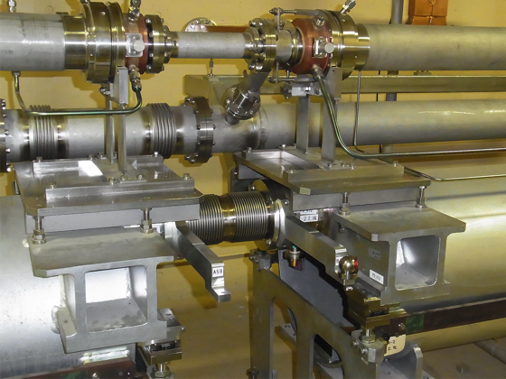
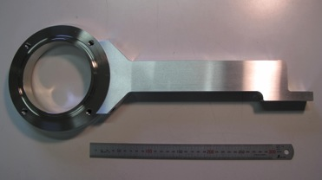
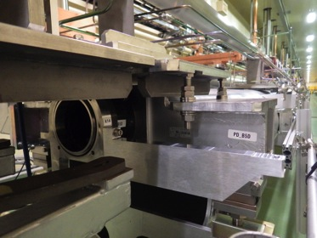
Fiducial points for the girder unit
Mechanical jig for target
Points to be aligned
400mm
Laser fiducial
QPD
Tracker fiducial
Mechanical jig for tracker target

Slide 9
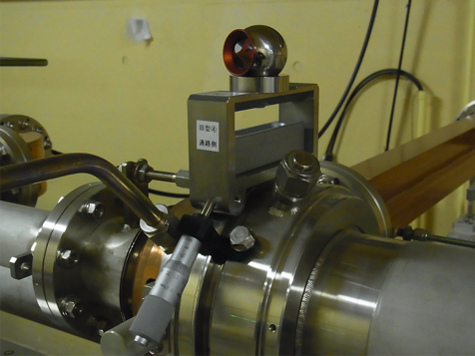
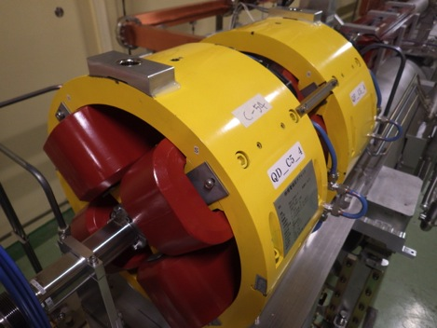
Fiducial points for the accelerator components
New target base mounted on a coupler surface
New target base mounted on quadrupole doublet
Target base for accelerating structure
Target base for quads
Waveguide
Coupler
Accelerating structure
Quadrupole doublet

Slide 10
Alignment results for the accelerating structures at sectors C5
Horizontal
Vertical

Slide 11
Laser optical system – simple dioptric system using dioptric lenses and reflecting mirrors –
Wide beam for Fresnel lens method
T. Suwada, et al.,Rev. Sci. Instrum 84, 093302 (2013).
10mW (or 1mW)
y
Rotation around x and y axes
Translation along x and y axes
x
y
For injection angle tuning
x
Narrow beam for QPD method
For translation tuning

Slide 12
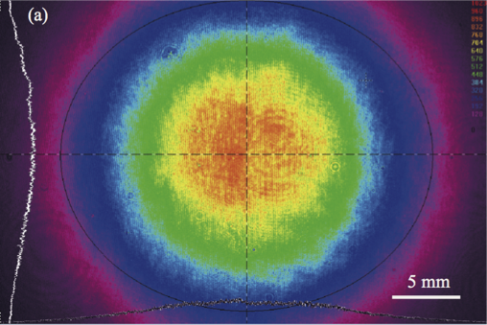
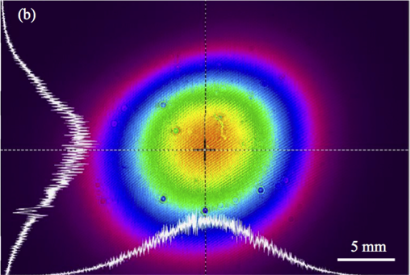
Laser profiles at the initial and last QPDs
@ Exit of the optical system (z = 0) Wx ≈ Wy ≈ 29 mm (4σ width)
@ Last QPD (z = 500 m)
Wx ≈ 21.2 mm, Wy ≈ 17.8 mm

Slide 13
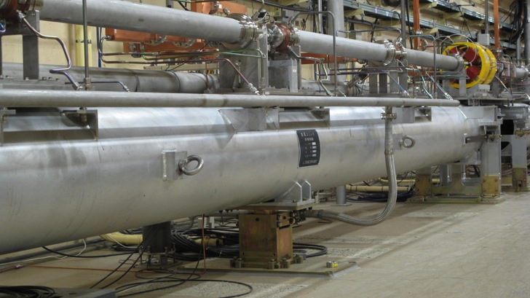
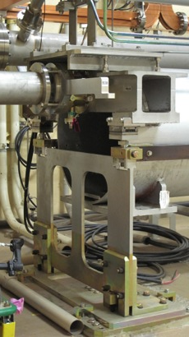
New support table installed for restricting the displacements of the girder unit
Design concept changed from "flexible structure" to "rigid structure"
L-shape support plate
No restriction
Axially restricted
Horizontally restricted
New support table
Increase of thickness
12 mm from 10 mm

Slide 14
Variational plots of the power spectrum density of the girder unit
Resonant frequency
~3Hz
Resonant frequency
> ~13Hz
Before the restoration
(“flexible structure”)
After the restoration
(“rigid structure”)

Slide 15
Initial realignment in the 180-degree arc section
Transverse plane
Vertical plane
Inlet
Old AB Line of the KEKB
New AB Line of the SuperKEKB
ARC exit
New arc
New AB & C5 Line
α/2
15000 mm
+ d mm
γ
Rotation center
α
Old arc
Old B–A Line
Old C5 Line
Exit
= 0.114 mrad
d = 13 mm
γ = 0.0498 mrad

Slide 16
Initial realignment at the 180-degree arc section
Required alignment vector from the design
Residual alignment vector from the design
Before the initial realignment
After the initial realignment

Slide 17
Initial realignment in the 180-degree arc section
The deign orbit
After the realignment
Before the realignment
Before and after the initial realignment

Slide 18
Dynamical motion of the tunnel floor & future prospects
We have observed dynamical motion of the floor level (or ground motion) in the linac tunnel during the laser-based alignment measurements although the present system is based only on static measurements.
By using other several methods, tilt meters, micro-gauges, we also observed the dynamical motion.
The amount of the displacements is not negligible, and particularly, their directions seem to be in certain systematic directions across expansion joints.
Now we do not well understand the mechanism of the dynamical motion and the amounts of the displacements along the entire linac.
In order to investigate such mysterious phenomena, we are now fabricating remote-controlled QPDs.

Slide 19
Variational plots of the x and y displacements of the girder units along the half of the linac
After 45 days
After 20 days
After 45 days
After 20 days
unit 28
unit C1
unit 28
unit C1
QPD locations from units C1 to 28
QPD locations from units C1 to 28

Slide 20
Variational plots of the x and y displacements of the FB-controlled linear stage
Variational plots of the FB controlled linear stage at the optical system during 17 days.
During these days, the laser fiducial was fixed at the center positions of the final QPD at the linac end and the laser-based alignment measurements were well under the feedback control; the injection angles of the laser fiducial could be automatically controlled at the optical system.
0.13 mm/day in the ver.
0.05 mm/day in the hor.
Ver.
Hor.
17 days
Variations of the FB controlled laser positions at the linac end

Slide 21
Summary
The initial realignment of the injector linac is successfully in progress for the SuperKEKB. We may need one more rounds to fully complete the initial realignment.
The laser-based alignment system is now fully operational to the high-precision initial realignment.
The first realignment of the 180º arc section has been completed, and however, we need one more round.
Many girder units were restored with increasing the earthquake resistance.
The initial realignment for the accelerating structures were almost completed with a precision level of 20 μm in one sigma, and that for the quad. magnets is still ongoing.
In order to investigate the dynamical motion of the tunnel floor level along the entire linac, we have started to fabricate remote-controlled QPDs.

Slide 22
Back-up files

Slide 23
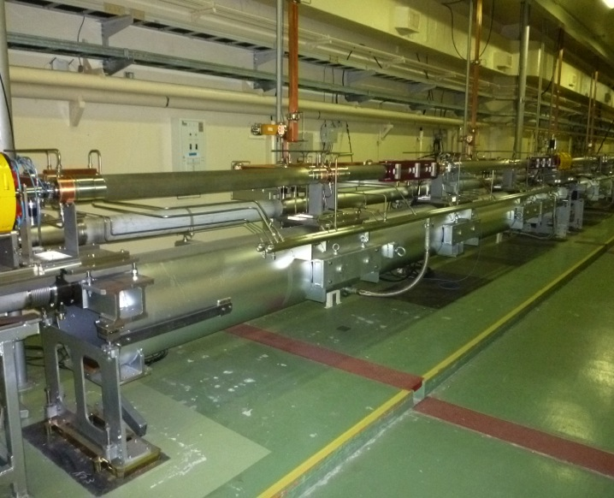
Girder unit for accelerating structures
4 x S-band structures
e- beam
Quad
1200mm high
QPD
Laser axis
780mm high
QPD
Girder unit
8.44m long
Laser pipe
PD
基本ユニット

Slide 24
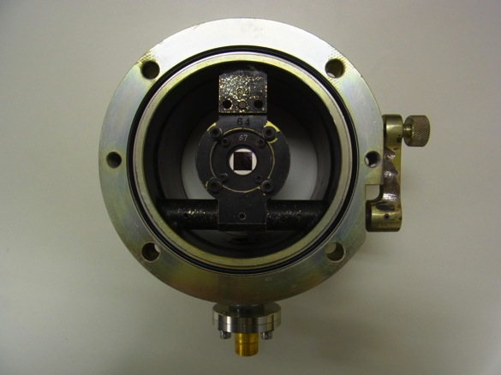
Quadrant Silicon Photo-Diode (QPD)
stopper
QPD: OSI Optoelectronics
SPOT-9D (D=10mmϕ)
QPD is mounted in the center of a sub-holder.
The sub-holder can stand upright by rotation of a lever through hinge structure. The inner diameter of the holder is 130mmϕ.
The QPD holder is connected to a laser pipe (SUS) by flange-flange joining.
QPD sensor
QPD sub-holder
130mmϕ
QPD holder
signal pick-up
QPD target

Slide 25
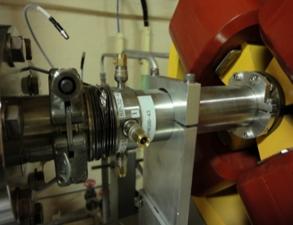
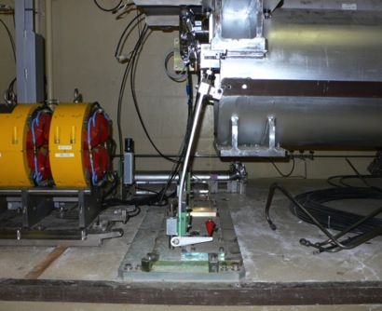
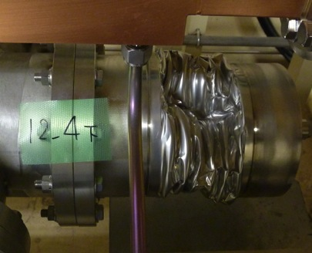
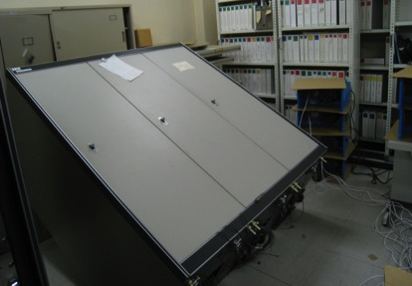
Heavy mechanical damages in 11 Mar. 2011)
BPM damage
Accelerator girder
Vacuum manifold
Sub-control room

Slide 26
Alignment results for the accelerating structures at sectors AB
Horizontal
Vertical

Slide 27
Remote-controlled QPD
The purpose with the use of remote QPDs is to investigate the dynamic displacements of the girder units along the entire linac beam line.
A new remote-controlled QPD is under development.
They are controllable based on push-pull mechanism of an air cylinder drive.

Slide 28
Developments for the laser-based alignment system
Our laser-based alignment system was first implemented at the construction stage in 1982; however, the high stabilization of the laser-based fiducial line has not been realized until now.
At long last, a laser line with high stabilization has been implemented as a 500-m-long fiducial line for alignments in March 2013.
We experimentally investigated the propagation and stability characteristics of the laser line passing through metallic pipes in vacuum.
Pointing stability at the last fiducial point with the transverse displacements of ±40 μm level in one standard deviation by applying a feedback control was successfully obtained. This pointing stability corresponds to an angle of ±0.08 μrad. This system is now fully exhibiting the successful results for the high-precision alignment of the injector linac currently in progress.

Slide 29
Two alignment systems for girders and components
Long-range laser-based alignment system
Long-range alignment system for girders (accuracy σ ~ 100μm)
  The girder units are aligned based on the laser-based alignment.
Short-range alignment system for components (accuracy σ ~ 50μm)
  The accelerator components on a girder unit are aligned based on a standard laser-tracker technique.

Slide 30
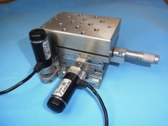
Feedback control for laser axis
– for injection angle stability –
FB control for injection angle stability of the laser axis based on translation of f5000 lens in the transverse plane
Stage with pico-motors for f5000 lens (Crucial for stable laser axis)
M-562-XYZ/Newport, translational resolution 30nm/step → ~1nrad/step
The drive shaft is rotated by frictional force of piezoelectric element and the stage translates in the transverse plane.

Slide 31
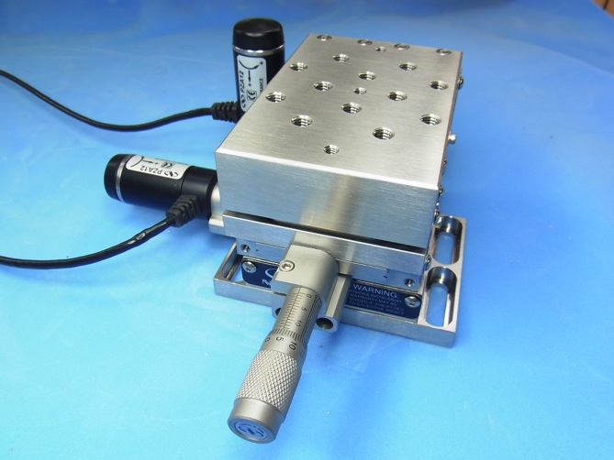
Ultrafine stage to stabilize the laser pointing
30nm/step
e- beam
PD
Laser pipe
Accelerator Girder
NewPort, Co. (M-562-XYZ )
Ultra fine pico-motor stage

Slide 32
Optical system
Optical system
10-mW He-Ne laser
Solid and large optical table
Vacuum system
Two scroll pumps (1000l/min)
Vacuum level ~3 [Pa]
Parallel plate for translation tuning
f5000 lens for injection angle tuning
Optical table (1500×900×112^{t}mm³)
Girder (Fe)
Iron plate (1510×500×20^{t}mm³)
Isolated floor separated from the tunnel floor by a 100-mm gap (1510×500mm²)

Slide 33
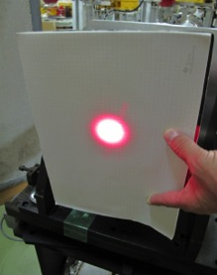
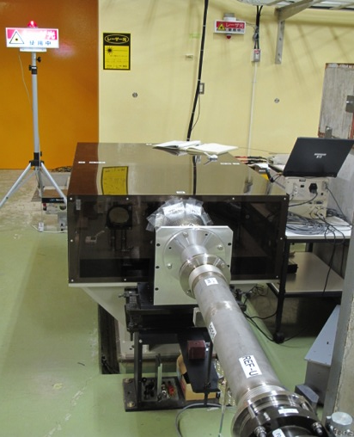
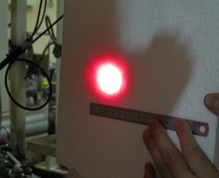
He-Ne Laser beam first successful delivering up to 500 m in 20 July 2012
W~30mm (FW)
at the injection point
W~30mm (FW)
at the 500m-long linac
end point
Vacuum level ~5Pa in laser pipes
with two scroll pumps (1000l/min)

Slide 34
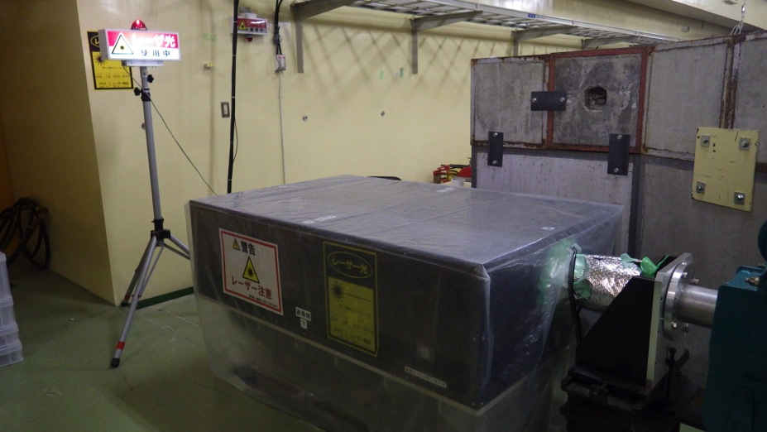
Laser system under operation

Slide 35
Results of the laser size measurements along the linac
Direct beam size meas.
Δ: with CCDs at two end points
Indirect beam size meas.
•: by a mapping with a movable QPD in the x and y directions at the middle locations, while the laser axis is fixed
Based on a least-square fitting procedure with standard Gaussian laser optics, the widths propagating along the z-axis were obtained as follow:
Rayleigh lengths zRx ~ 308 m, zRy ~ 321 m,
Waist locations zx0 ~ 358 m, zy0 ~ 399 m,
Beam sizes at waist locations Wx0 ~ 18.8 mm, Wy0 ~ 18.0 m,
Fitting function

Slide 36
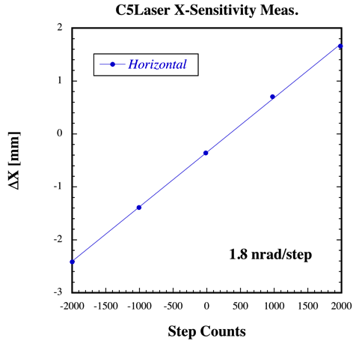
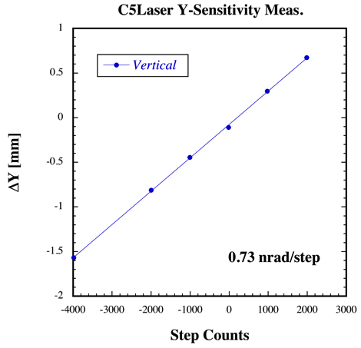
Sensitivity measurements of the laser axis at z = 500m
Horizontal
Vertical

Slide 37
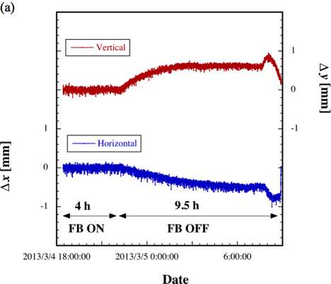
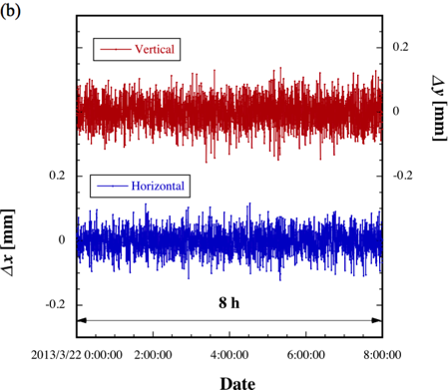
Stability measurements of the laser axes at z=500 m
Time traces of the horizontal and vertical position displacements of the laser beam at the last QPD (a) with the feedback control on and off during 13.5 h
Time traces of the horizontal and vertical position displacements of the laser beam at the last QPD (b) with the feedback control on during 8 h.

Slide 38
Variational plots of the x and y displacements of the FB-controlled linear stage
0.13 mm/day in the ver.
0.05 mm/day in the hor.
Ver.
Hor.
17 days
Variations of the FB controlled laser positions at the linac end
Variations of the FB controlled linear stage at the optical system

Slide 39
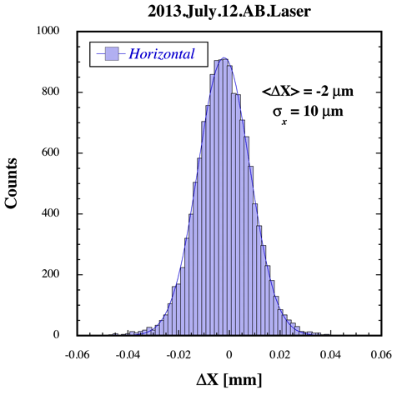
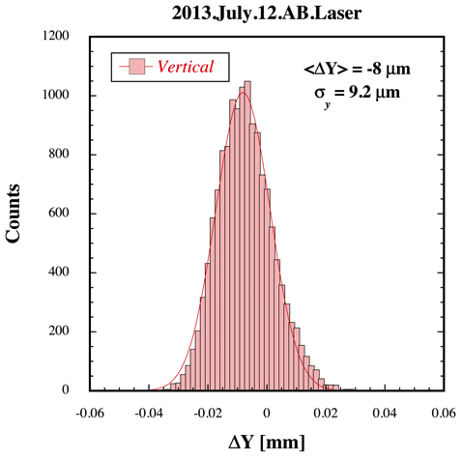
Position displacement distribution of the laser axes for 132-m-long straight line
Horizontal
Vertical

Slide 40
Position displacement distributions of the laser axes for 500-m-long straight line
Horizontal
Vertical

Slide 41
Expected error sources and estimations for the laser fiducial
Errors
Source of errors
rms error (μm)
Systematic error
Mechanical
Mounting error of QPD 10
Mounting error of QPD holder 30
Reproducibility of QPD position 30
Electrical
Detection (offset) error of QPD 12
Laser Shape
Profile error 10
Summation (rms sum) 46
Laser stability
Laser axis stability ± 40
Statistical error

Slide 42
Near future
Our present laser-based alignment system was basically constructed more than 30 years before (very old).
There are several drawbacks, for example, this system is not radiation-hard, and also not transparent for the QPD targets.
Another laser-based alignment system based on the SLAC method is more excellent because the system itself is radiation-hard, transparent and very stable without any feedback controls.
We are also preparing a similar laser-based alignment system.

Slide 43
Laser size measurements along the linac
The beam widths were directly measured at the two fiducial points (z=0 and z=500m).
At other locations, they were analyzed by taking mapping data obtained with the help of mechanically movable QPDs while the laser beam was fixed. The mapping data were obtained by measuring the variations in the signal levels obtained from the QPD depending on the transverse displacements with respect to the fiducial line.
The beam widths were analyzed by a least-square fitting procedure with a two-dimensional Gaussian function for the obtained mapping data.

Slide 44
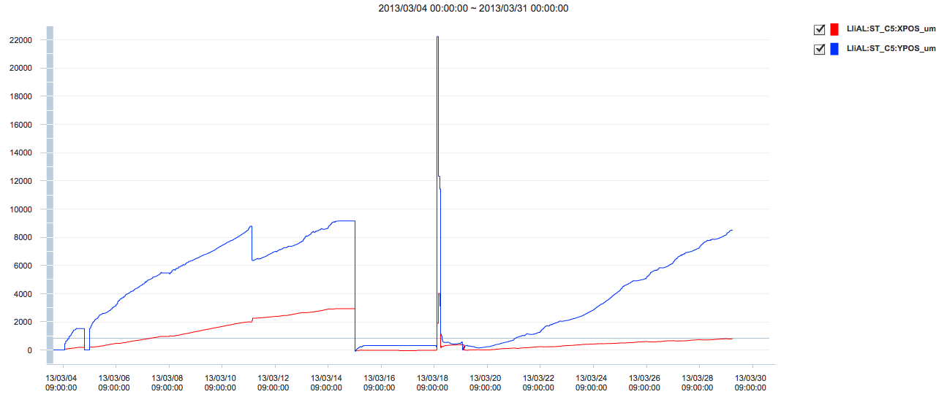
Long-term motions of the stage of f5000 lens with FB control on
Stage motion during FB control on：
The direction of motion of the stage in the vertical direction is one way upward.
The direction of motion of the stage in the horizontal direction is also one way eastward.
There are never opposite directional motions during the FB control on while the laser axes are stabilized at the center of the last QPD.
Is the last QPD dynamically fluctuating for the laser axis?
[μm]
Mar04
Mar15
Mar19
Mar30.2013
FB ON
Offset tuning of the stage
Laser tuning
Resume of FB ON
Vertical stage
0.83mm/day
Horizontal stage
0.38mm/day
Date

Slide 45
Isolated floor structure at the optical ystem
Isolated floor (Area:500x1500x1750^{t} mm²) with a gap of 100 mm
Tunnel floor
450 mmΦ
1750 mm
5000 mm
PHC: Prestressed High-strength Concrete pile

Slide 46
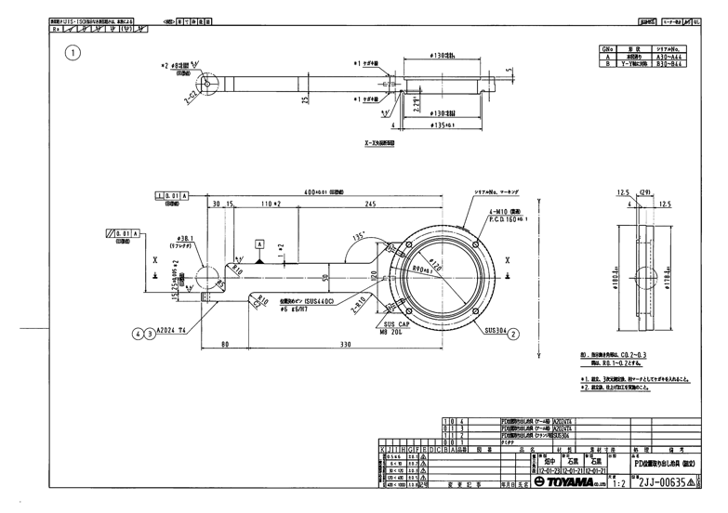
Mechanical jig for fiducialization of tracker target
target
400mm
SUS304 flange
Center of laser axis
Al A2024

Slide 47
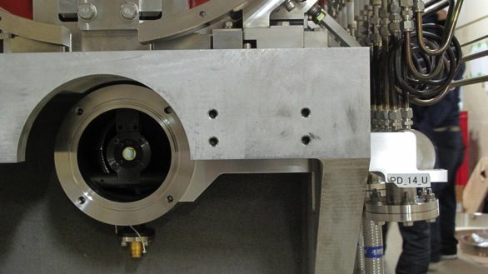
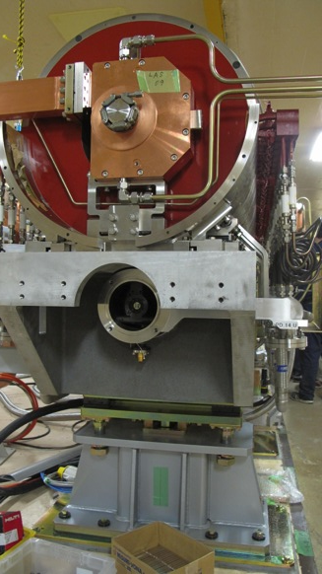
Component alignment on the girder
QPD
Laser
Tracker target
Special jig for fiducialization of tracker target

Slide 48
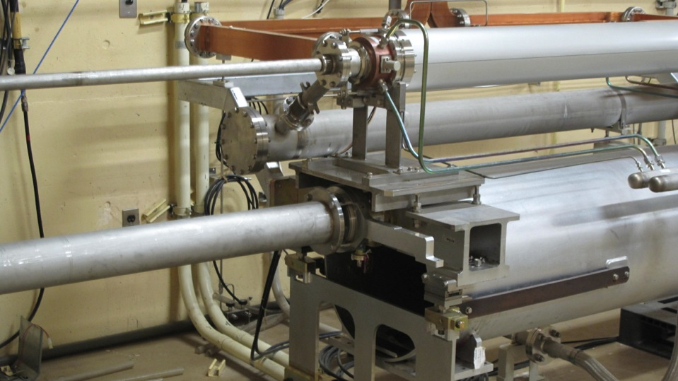
Laser pipe with a viewing port
Laser
Laser window

Slide 49
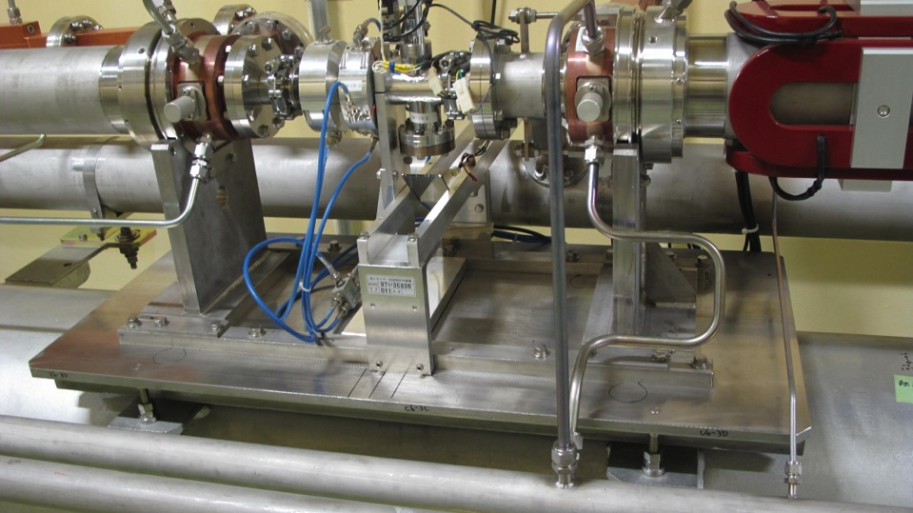
Support of accelerating structures
Laser
Support of accelerating
structure
Reference rails
Support table

Slide 50
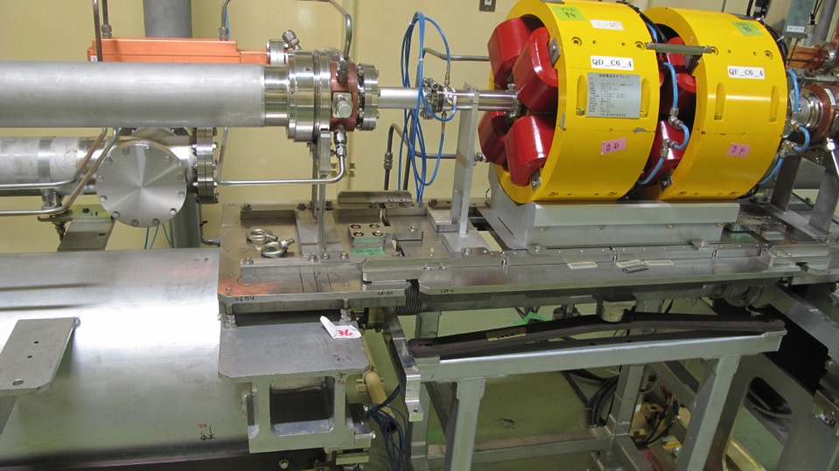
Connection between accelerating structure and Quad
Support table for quads

Slide 51
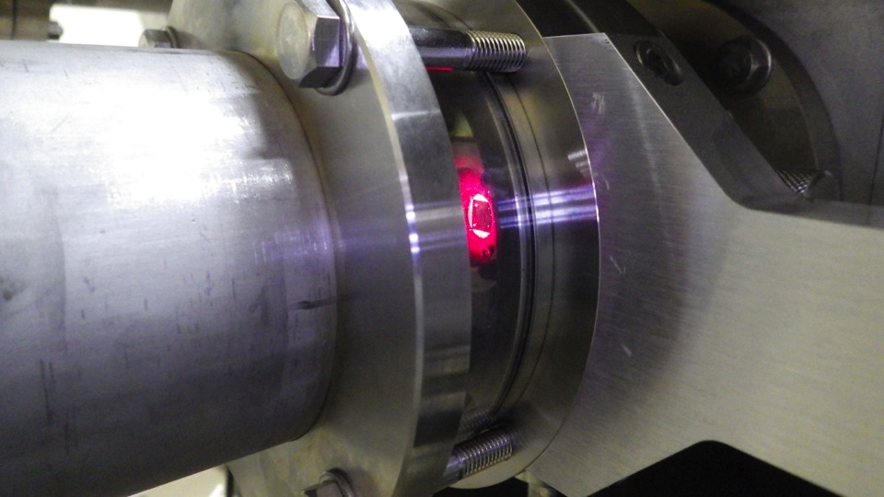
Laser window
Transparent window for laser

Slide 52
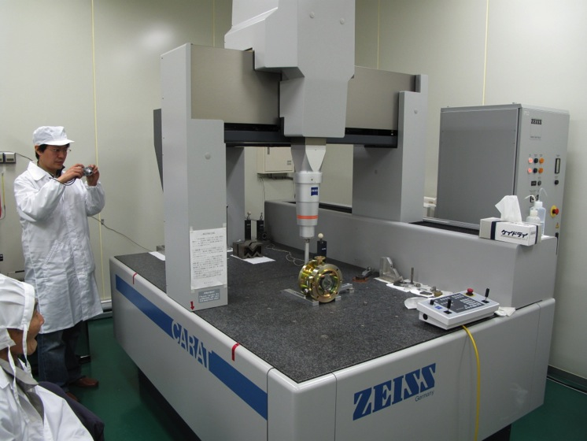
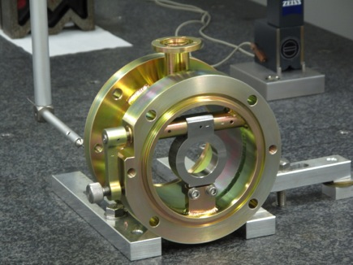
3D mechanical precision measurement in QPD holder

Slide 53
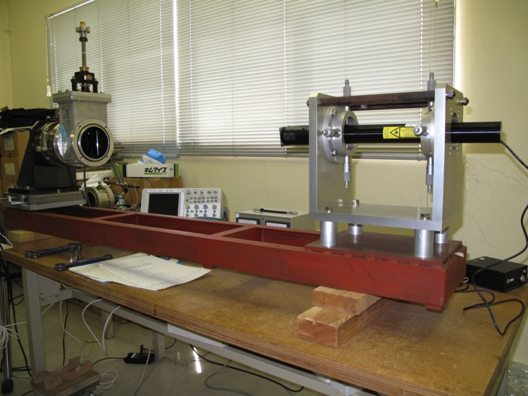
Test bench in QPD setting calibration

Slide 54
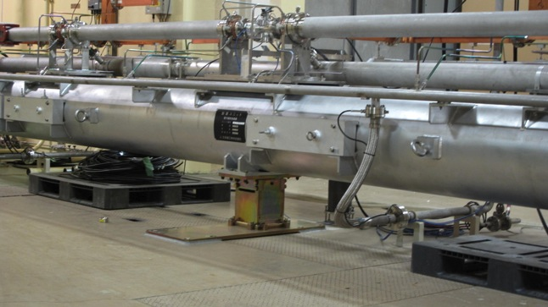
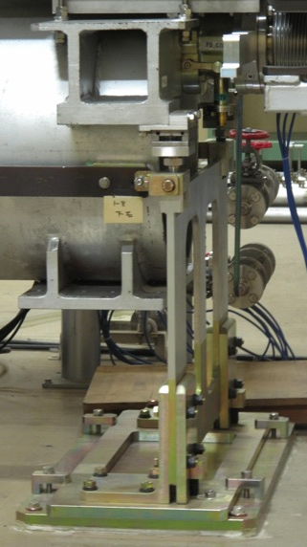
Reinforced girder unit
Center support added
L-shape leg reinforced

