Slide 1
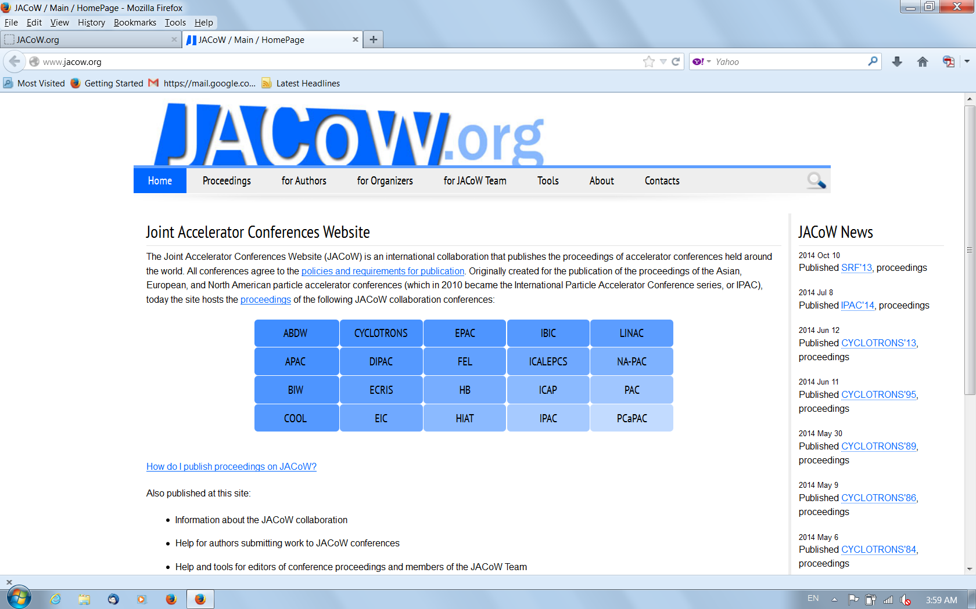

Slide 2
From the International Organizing Committee
There was an IOC meeting yesterday and made the following decisions and comments.
Workshop proceedings:
Formal proceedings published via JACoW is required by ICFA for all ABDW workshops.
This was stated in a letter to all conveners as well as in an e-mail on Sept 5th to all speakers.
We have 70 talks, 54 abstracts submitted. But only 24 papers received.
We will have a 2-week grace period to continue to receive papers. After that you will no longer be able to submit your paper.
We ask for your kind cooperation.
Next workshop:
The IOC decided to continue this workshop.
The next one will be one year from now in Europe.
Organizers: Marica Biagini (INFN), Alain Blondel (U. Geneva), Frank Zimmermann (CERN)
We will propose it to the ICFA for approval.
Number of parallel sessions should be reduced and joint sessions encouraged.
Parallel sessions should aim at people with different interest, e.g., calculations vs. technical systems.
There should be an invited talk on Super KEKB in the plenary session.
There should be a dedicated discussion session.
Remote presentation should be allowed if necessary.

Slide 3
Good Bye!
再见!
Au revoir!
Auf Wiedesehen!
Ciao!
Adios!
до свидания!
さようなら!
Have a safe trip home
and
See you next year in Europe!

