Slide 1
Beam Lifetime and Injection Considerations of CEPC
Speaker: Cui Xiaohao
2014.10.10
55th ICFA Advanced Beam Dynamics Workshop

Slide 2
Beam lifetime
Beam-Gas Scattering
quantum lifetime
Radiative BhaBha
Beamstrahlung
Touschek lifetime

Slide 3
Beam Gas Scattering
In Our calcuation, the vacuum pressure is supposed to be 1E-8 Torr, and the gas is composed of 80% H2, 20% CO
 | Lifetime | Unit
Elastic H2 | 189 | hours
Elastic CO | 15 | hours
Inelastic H2 | 149 | hours
Inelastic CO | 14 | hours

Slide 4
quantum lifetime
 | lifetime | Units
Transverse | 2218 | hours
Longitudinal | Inf
Radiative BhaBha and Beamstrahlung
 | lifetime | Units
Radiative BhaBha | 51 | mins
Beamstrahlung (Simulation) | 80 | mins

Slide 5
Touschek lifetime
 | lifetime | Units
2% Energy acceptance | 2500 | hours
1% Energy acceptance | 530 | hours
Total lifetime ~ 30 mins

Slide 6
Injection Considerations
Introduction
Time Structure
Geometrical Arrangement
Injection Mode
Bump Height and Acceptance
Possible magnet strength
Work to be done

Slide 7
Introduction
Energy Ramp
6 ->120GeV
6 GeV
Electron
Linac
Booster
Positron
Collider
120 GeV

Slide 8
 | Main Collider | Booster
Energy (GeV) | 120 | 6 ->120
Circumference (Km) | 50 | 50
Bunch Number | 50 | 50
Emittance x/y (nm.rad) | 6.8/0.02 | 24/
Life time (min) | 30
Beam Current (mA) | 16.9 | 0.84

Slide 9
Injection time structure
Lifetime | Lum Drop | Booster Bunch harge | Injection period
30 Mins | 10% | 2.7 nC | 90 s
Injection period
Injection time
~10s：

Slide 10
Injection period
Injection into the booster
Ramp Up
Injection time
Injection into the main collider
Ramp Down

Slide 11
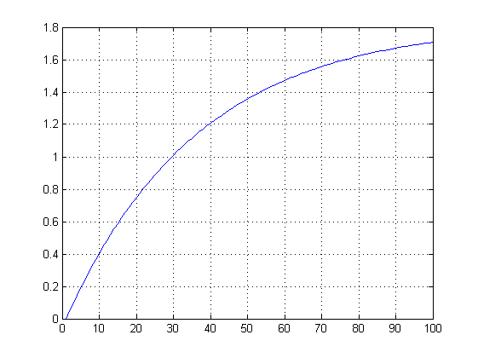
For injection from zero current, higher injection frequency is needed, 60s for instance
I/Ipeak
It takes 30 mins to reach the peak current !
Time(min)

Slide 12
Geometrical Arrangement
Booster
Booster
2 m
Collider
Main Collider

Slide 13
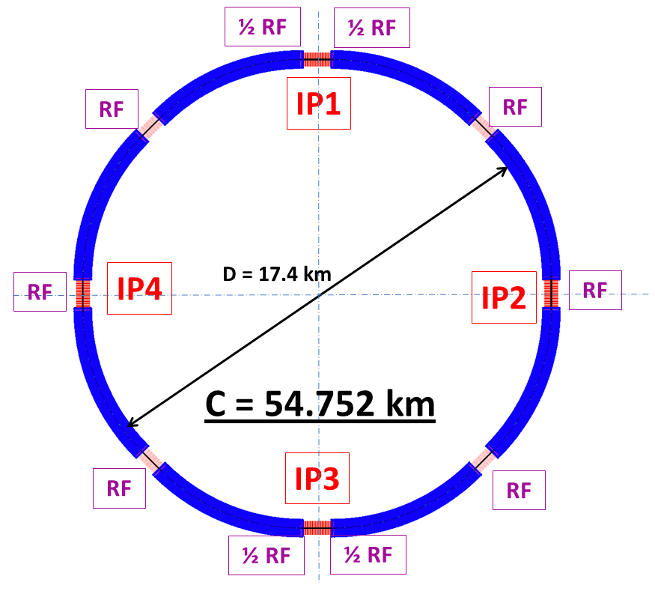

Slide 14
Injection Mode: Betatron Injection
Injected Beam
Circulating Beam
Closed orbit kickers
Three Kickers are added in the circulating ring

Slide 15
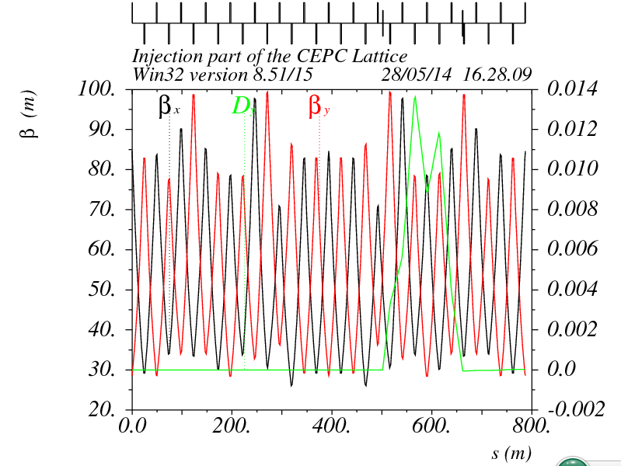
Septum
Kicker
Twiss Parameters of the injection region

Slide 16
Bump Height and Acceptance
Bumped
Stored beam
Septum
Injected beam
Acceptance
5σ_{xc}
5σ_{xi}
X’
B = 10σ_{xi} + S
X
5σ_{xc} + 5σ_{xi} + S

Slide 17
Bump height> 10 σ_{x}+S
Distance between injected beam and circulating beam> 5σ_{xc}+5σ_{xi}+S
Acceptance length> 5σ_{xc}+10σ_{xi}+S
For $ε_{x}=6.9×{10}^{−9}{ ,ε}_{y}=2.1×{10}^{−11}$, S=4mm, Beta function ~80m, we can get
bump height > 12mm
Acceptance length > 15 mm

Slide 18
Possible magnet strength
Kicker strength
For Beta function ~80m
Bump height 20mm,kicker length 2m,then the strength of the kickers are about 500 Gauss
Septum strength
If the Septum is 20m, the strength needed is much higher.
As a result, we tried to use 4 separate septum instead of a single one.
Their magnet strength are: 0.64T, 0.32T, 0.16T, 0.08T and their thickness are 16mm,8mm,4mm,2mm separately.

Slide 19
Work to be Done
Detector considerations: Protection of the detector, detector veto
Detailed injection Simulation : Kickers, septa, phase advances optimization, injection efficiency, back ground, apertures
Effect of errors: Betatron mismatch, alignment errors, kicker strength and timing matching

Slide 20
Thank you

