Slide 1




Constraints on the FCC-ee lattice from the compatibility with the
FCC hadron collider
Bastian Haerer (CERN, Geneva; KIT, Karlsruhe), Wolfgang Bartmann, Michael Benedikt, Bernhard Johannes Holzer, John Osborne, Daniel Schulte, Rogelio Tomas, Jorg Wenninger, Frank Zimmermann (CERN, Geneva), Michael James Syphers (MSU, East Lanning, Michigan), Ulrich Wienands (SLAC, Menlo Park, California)

Slide 2

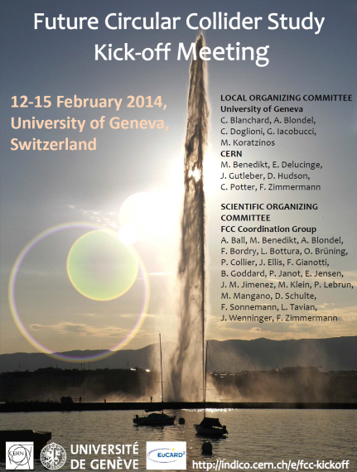
Future Circular Collider Study

Slide 3
Future Circular Collider Study
Consists of three sub-studies:
FCC-hh: 100 TeV proton collider
FCC-ee: 91-350 GeV lepton collider
FCC-he: electron-proton option
Each study has its own requirements, but technology for FCC-hh is most challenging!

Slide 4
Constraints on FCC-hh
Magnet technology (Nb₃Sn)
Shape (racetrack vs. circle)
Geology
Overlap with LHC (if used as injector)
Injection, beam dump, experiments
Not covered today:
Constraints from housing FCC-hh and FCC-ee in the tunnel at the same time
Constraints from FCC-he

Slide 5
1) Bending radius
Proton beam energy: 50 TeV
Beam rigidity: Bρ = p/e ≈ 1.67×10⁵ Tm
B = 20 T: → ρ = 8.5 km
B = 16 T: → ρ = 10.7 km
B = 16 T achievable with Nb₃Sn technology!
(FCC-ee: B = 55 mT)

Slide 6
2) Circumference
Approx. 67% of circumference C are bends:
B = 20 T, ρ = 8.5 km → C = 80 km
B = 16 T, ρ = 10.7 km → C = 100 km
RF frequency should be a multiple of RF frequency of LHC (bunch to bucket transfer)
→ C = 3×26.7 km = 80.1 km
→ C = 4×26.7 km = 106.8 km

Slide 7
3) Layout objectives
Hadron machine
Max. momentum limited by
→ High fill factor
→ As few straight sections as possible
Lepton machine
Limited by synchrotron radiation power
→ High fill factor
→ High bending radius
→ Many straight sections for RF to limit sawtooth effect

Slide 8
FCC-ee: Sawtooth effect
12 RF sections
4 RF sections
Energy loss per turn
(175 GeV beam energy): U₀ = 7.7 GeV (4.3 %)

Slide 9
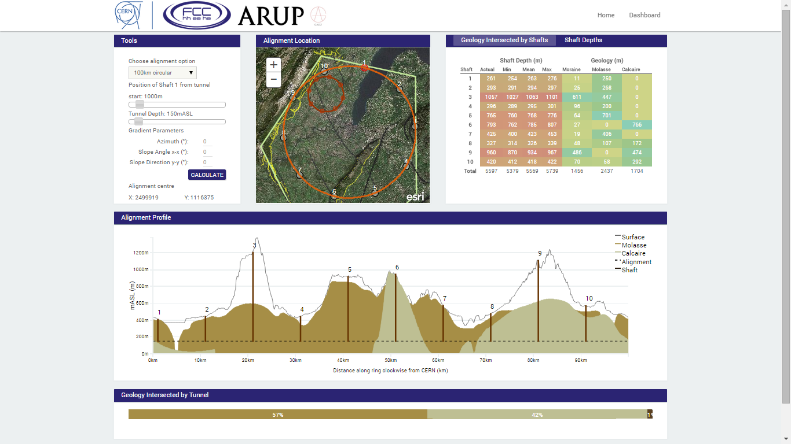
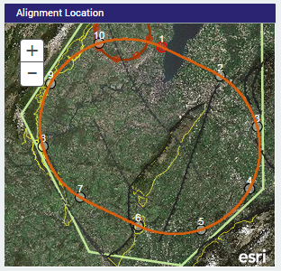
4) Shape
Circular shape (like LHC)
Preferred for lepton collider
Racetrack (like SSC)
Most of the infrastructure can be concentrated at two main sites
Chromaticity correction easier
A
Courtesy: John Osborne et al.

Slide 10
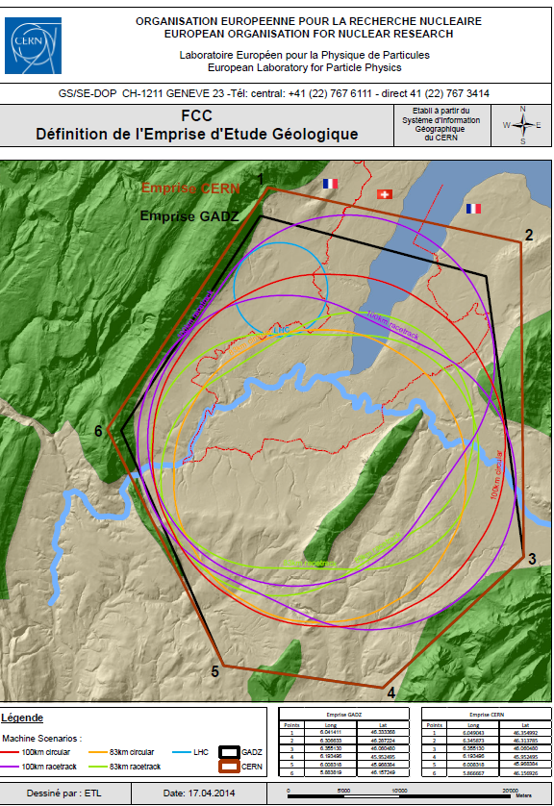
5) Geology
Boundary Limits:
East: Pre-Alps
South: Rhone, Vuache Mountain
West: Jura
North: Lake Geneva
Courtesy: John Osborne

Slide 11
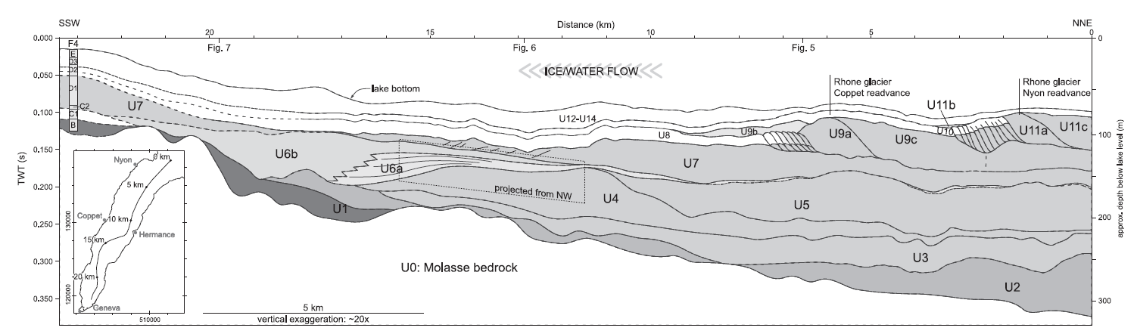
Lake Geneva
mASL
370
Riverbed
320
210
Molasse Rockhead
Courtesy:
John Osborne
The lake gets deeper to the North
The Molasse rockhead as well
→ The tunnel level must be deeper in the earth

Slide 12
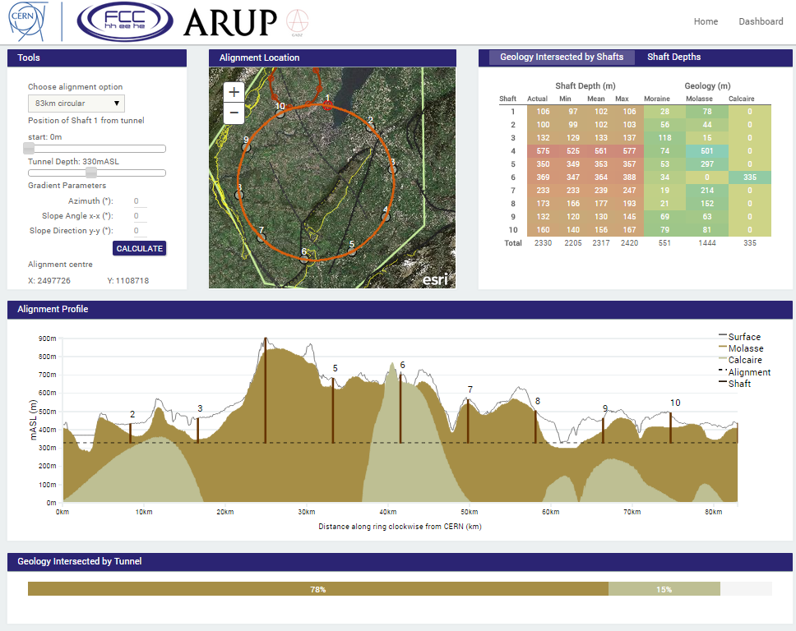
80 km circle
Courtesy:
John Osborne, Yung Loo

Slide 13
100 km circle
Courtesy:
John Osborne, Yung Loo

Slide 14
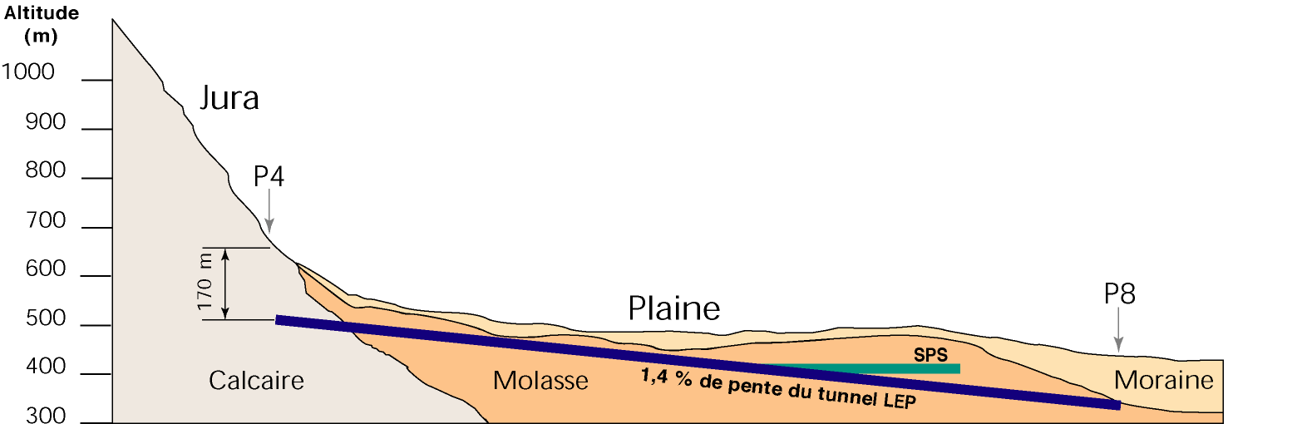
Tilting the tunnel
LEP/LHC: 1.42 %
→ Maximize tunnel extend in Molasse, minimize tunnel extend in Limestone and Moraines
→ Minimize the depth of the access shafts
(450m)
(359m)
(350m)
P3
P1
P7
Limestone
Courtesy: John Osborne

Slide 15

100 km circle with tilt
Courtesy:
John Osborne, Yung Loo

Slide 16
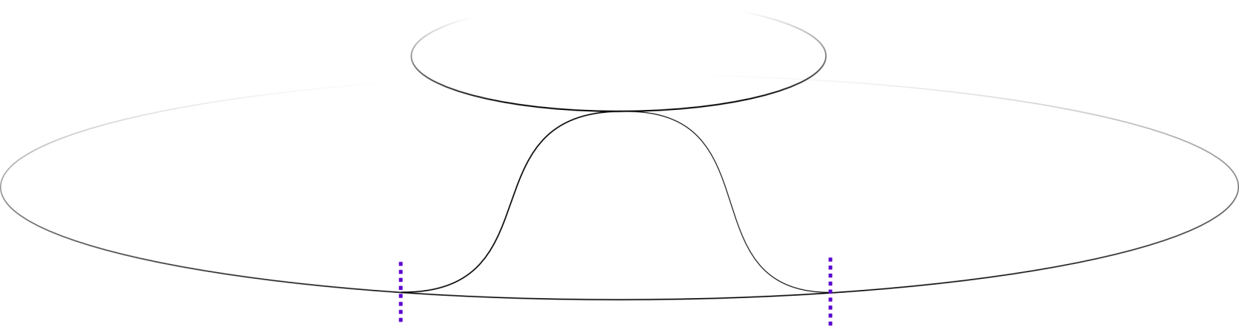
6) Location relative to LHC
LHC
d
FCC
Courtesy: W. Bartmann
L
FCC and LHC should overlap, if LHC is used as injector
Required distance L for transfer lines depends on:
Difference in depth d
Magnet technology
Beam energy
Max. slope of tunnel 5%

Slide 17
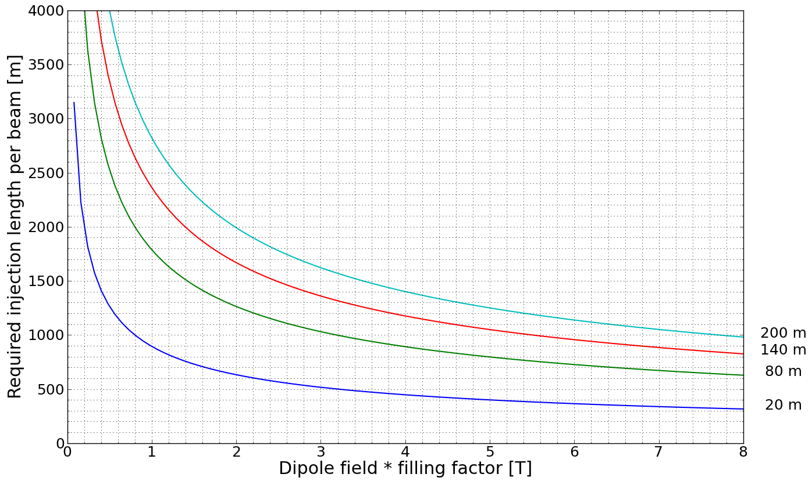
Distance for transfer lines
L
Beam energy: 3.5 TeV
Filling factor: 0.75
1.8 T TI 2/8 dipoles
2.6 T CF JPARC magnets
3.9 T Tevatron dipoles
8.3 T LHC dipoles
d
Courtesy:
Wolfgang Bartmann
Required length: L = 500 – 1500 m

Slide 18
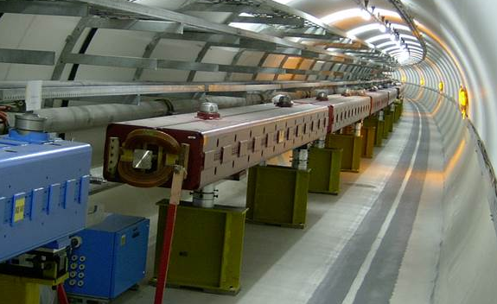
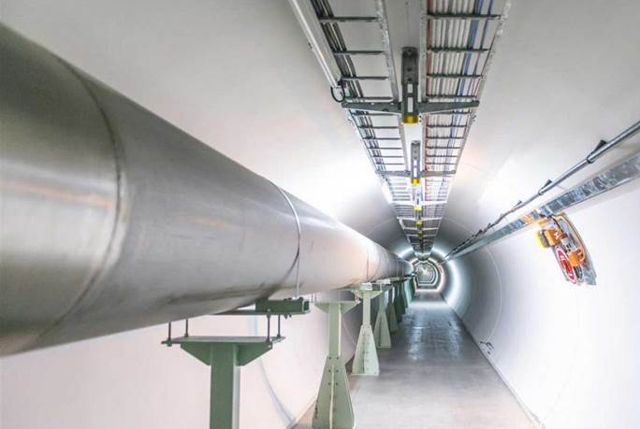
7) Length of Long Straight Sections
Space for septum, kicker magnet and absorbers for machine protection
Injection: Energy: 3.5 TeV
600 m
Beam dump: Energy: 50 TeV
800 m – 1000 m (?)
Collimation?

Slide 19
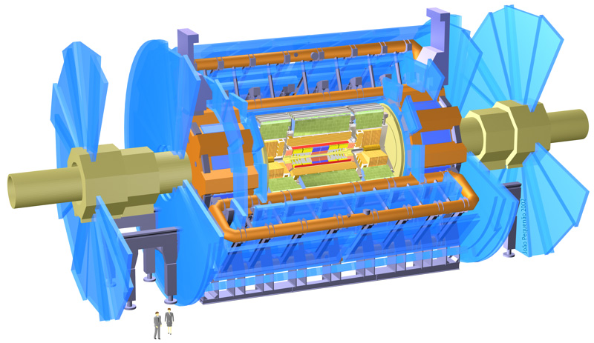

8) Experiments

Slide 20
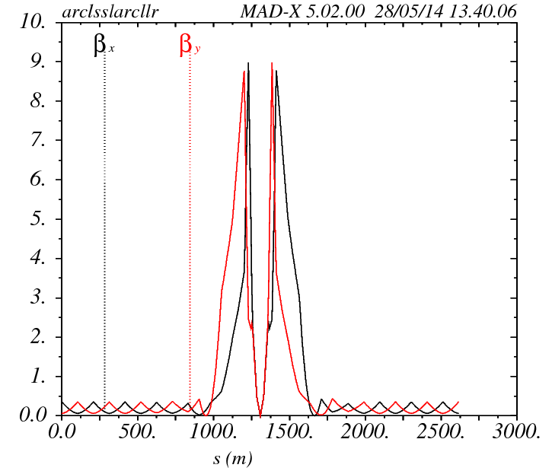
FCC-hh Interaction Region
β (m)
Interaction region (IR) design for
Huge Detectors
→ L* = 46 m !!!
Length of single IR: → ≈ 1100 m
Small crossing angle: → 11 μrad
→ β* = 1.1 m
Court. R. Alemany, B. Holzer

Slide 21
FCC-ee Interaction Region
Local chromaticity
correction scheme
β_{y}* = 1 mm, L* = 2 m !!!
Large crossing angle
→ 30 mrad, 11 mrad
IR even longer
More about IR design:
Roman Martin’s presentation

Slide 22
Current FCC-ee design
Circular shape,
100 km circumference
12 straight sections
→ Length: 1.5 km
4 experiments
Length of arcs: 6.8 km
→ ρ ≈ 10.6 km
RF
RF
RF
RF
IP
RF
RF
IP
IP
RF
RF
IP
RF
RF
RF
RF
Details of the FCC-ee lattice were presented yesterday in my other talk

Slide 23
Resume
Magnet technology sets constraints on bending radius and circumference
Injection, beam dump, collimation and experiments define length of the straight sections
Compromise for the layout must be found
Geology and transfer lines define location of FCC

Slide 24
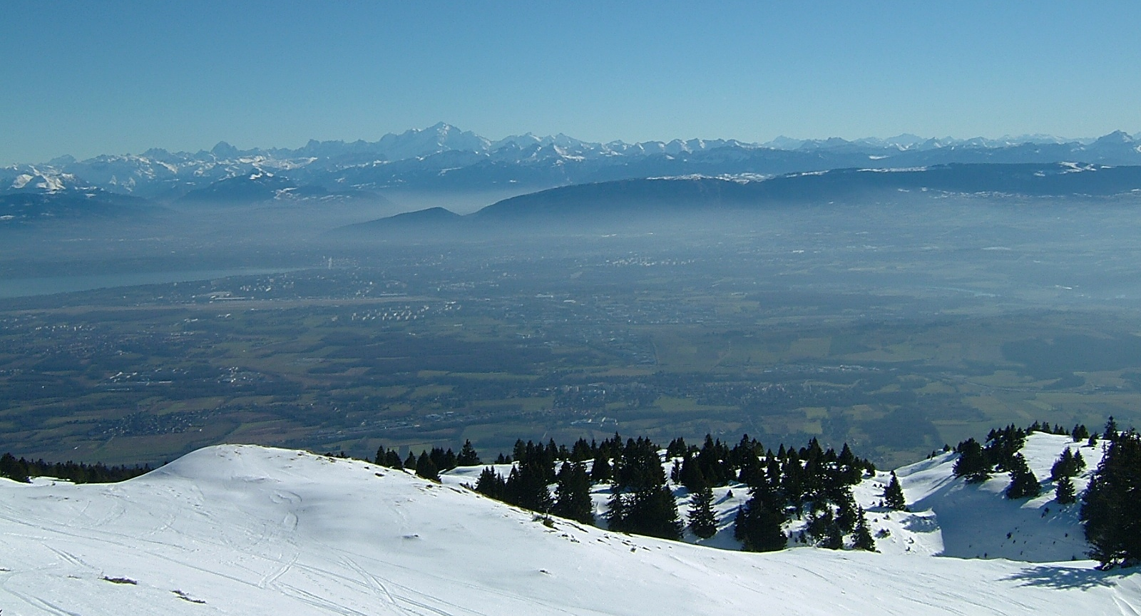
Thank you for your attention!
Court. J. Wenninger

Slide 25
Unequally distributed RF

Slide 26
Experiments FCC-ee
Completely different IR design:
Large crossing angle
β_{y} = 1 mm, L* = 2 m !!!
Local chromaticity correction scheme
IR length: even larger
More about IR design:
Roman Martin’s presentation
Court. R. Martin

Slide 27
FCC-he design parameters

Slide 28
LHeC: IR layout
Courtesy Max Klein
A similar interaction scheme needs to be designed for FCC-he

