Slide 1
Cost Consideration and
Possible Construction Timeline
Weiren Chou
Fermilab
ICFA HF2014 Workshop
October 9-12, 2014, Beijing, China

Slide 2
CEPC Design – Guidelines
To build an underground tunnel for a Higgs factory
To use the same tunnel for a future pp collider:
  The tunnel cross section should be big enough to accommodate an e+e- collider, a booster and a pp collider
  The straight sections should be long enough to accommodate large detectors and complex collimation systems of a pp collider
  It should allow to run both e+e= and pp experiments simultaneously
  Within the budget limit, the tunnel circumference should be made as large as possible
Target for construction cost: RMB 20B (~USD 3.3B)
Target for power consumption: 300 MW
A possible timeline:
  A Preliminary Conceptual Design Report (Pre-CDR) this year
  Get ready for R&D to start in 2016 in the government’s 13th Five-Year Plan (2016-2020)
  Get ready for construction to start in 2021 in the 14th Five-Year Plan (2021-2025)
  Get ready for experiments to start in 2028 in the 15th Five-Year Plan (2026-2030)

Slide 3
CEPC-SppC
CEPC is an 240 GeV Circular Electron Positron Collider, proposed to carry out high precision study on Higgs bosons, which can be upgraded to a 70 TeV or higher pp collider SppC, to study the new physics beyond the Standard Model.
e+
IP1
e-
LTB
SppC HE Booster
e+ e- Linac
BTC
BTC
SppC ME Booster
Proton Linac
SppC LE Booster
IP4
IP2
CEPC Booster
50 km in circumference
CEPC Collider Ring
IP3
SppC Collider Ring

Slide 4
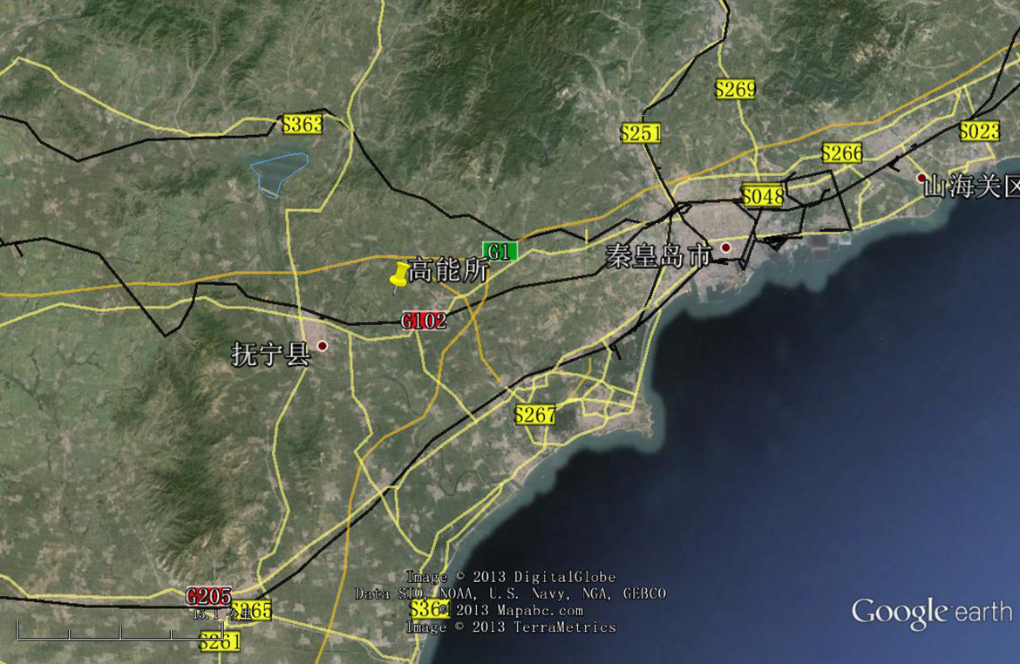
CEPC – Site Investigation
300 km from Beijing
3 hours by car; 1 hours by high speed train
A good example is 秦皇岛:
Y. F. Wang

Slide 5
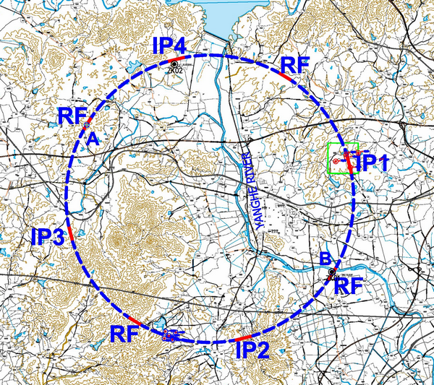
钻孔情况
本阶段在秦皇岛抚宁县场址布置了2个钻孔，进尺共200m。ZK1布置于线路东南部洋河南岸，了解工程区覆盖层可能的最大深度；ZK2布置于刘各庄西侧，了解残坡积厚度，深变质岩风化带分带特征。

Slide 6
CEPC Design – Top Level Parameters
Parameter | Design Goal
Particles | e+, e-
Center of mass energy | 240 GeV
Integrated luminosity (per IP per year) | 250 fb⁻¹
No. of IPs | 2
SPPC Design – Top Level Parameters
Parameter | Design Goal
Particles | p, p
Center of mass energy | 70 TeV
Integrated luminosity (per IP per year) | (TBD)
No. of IPs | 2
6

Slide 7
CEPC Design - Baseline
Tunnel circumference: ~54 km
Tunnel size: ~6.5 m (LEP tunnel: 3.76 m)
8 arcs and 8 straight sections: 4 straight for IPs and RF, another 4 for RF, injection and beam dump, etc.
A 6 GeV linac on the surface (with the option for an FEL in the future)
A full-energy 120 GeV Booster in the tunnel
A 240 GeV e+e- Collider in the same tunnel underneath the Booster
A single beam pipe for both e+ and e- beams (similar to LEP, CESR)
Synchrotron radiation budget: 50 MW per beam
Two SRF systems:
  Booster: 1.3 GHz 9-cell cavity, similar to the ILC, XFEL, LCLS-II
  Collider: 650 MHz 5-cell cavity, similar to the ADS, PIP-II

Slide 8
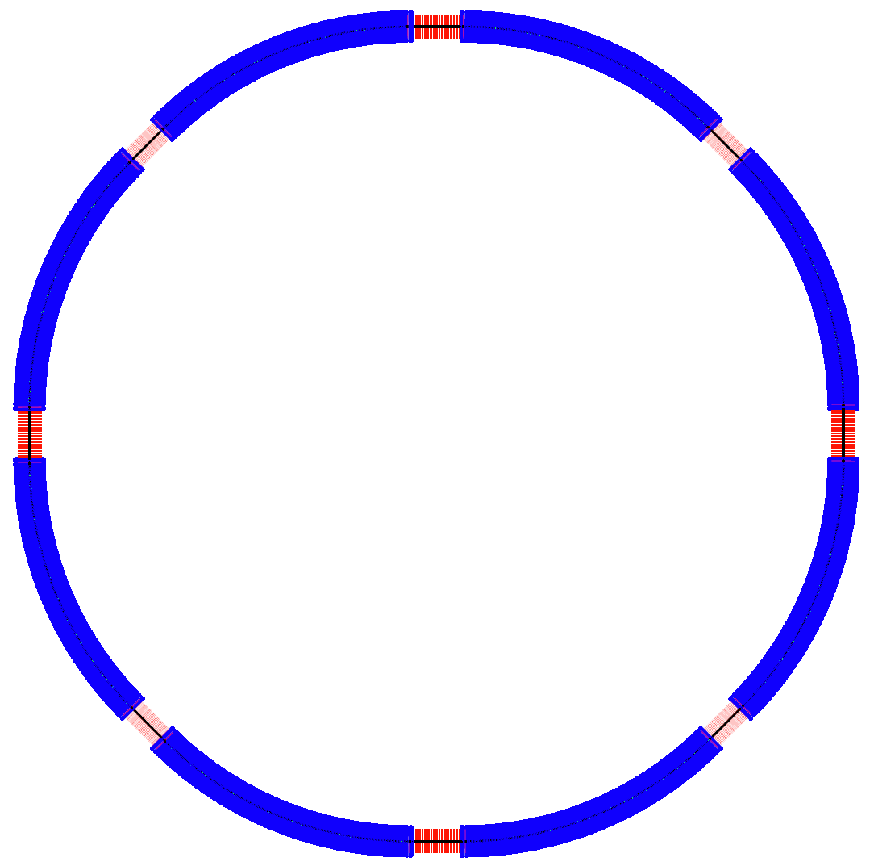
CEPC Lattice Layout (September 24, 2014)
½ RF
½ RF
One RF station:
650 MHz five-cell SRF cavities;
4 cavities/module
12 modules, 10 m each
RF length 120 m
P.S.
IP1
RF
RF
P.S.
(4 straights, 849.6 m each)
(4 IPs, 1038.4 m each)
(8 arcs, 5852.8 m each)
IP4
D = 17.3 km
RF
IP2
RF
C = 54.374 km
IP3
RF
RF
P.S.
P.S.
½ RF
½ RF

Slide 9
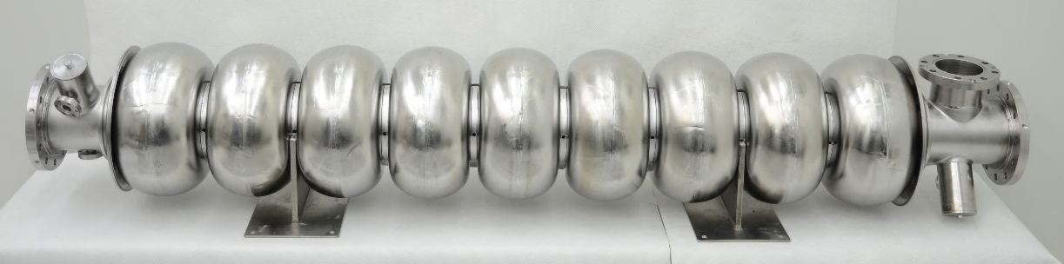
IHEP 1.3 GHz and 650 MHz Cavity
1.3 GHz 9-cell cavity vertical test (VT) in 2013. In module horizontal test (HT), the cavity performance will have degradation.
 | ILC TC-1 | CEPC
VT E_{acc} | 20 MV/m | 22 MV/m
VT Q₀ | 1.4E10 | 3E10
HT E_{acc} | 18 MV/m | 20 MV/m
HT Q₀ | 1E10 | 2E10
ADS 650 MHz β=0.82 5-cell cavity
Vertical test soon

Slide 10
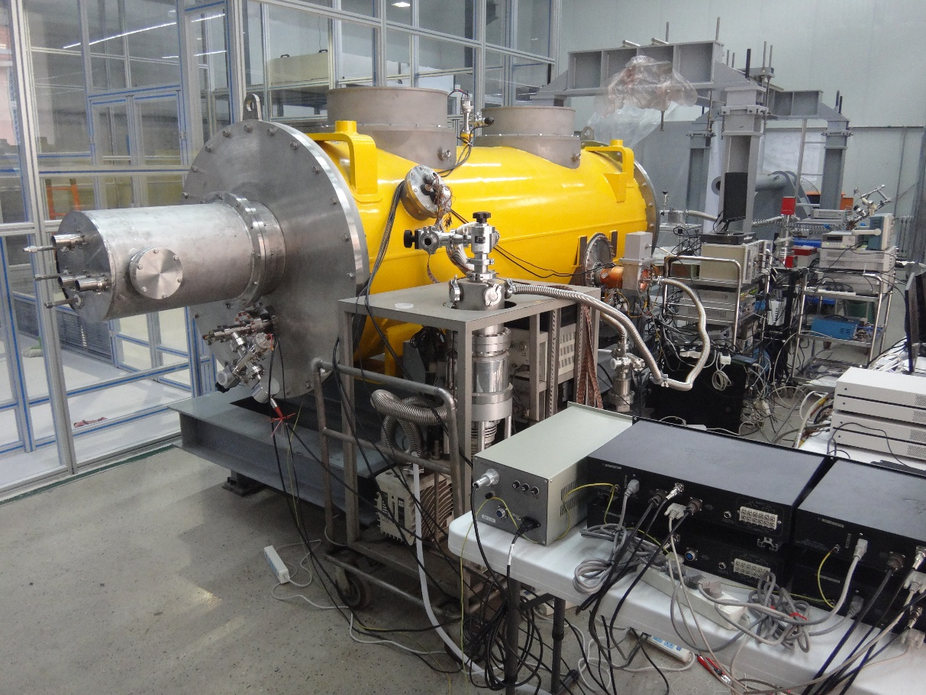
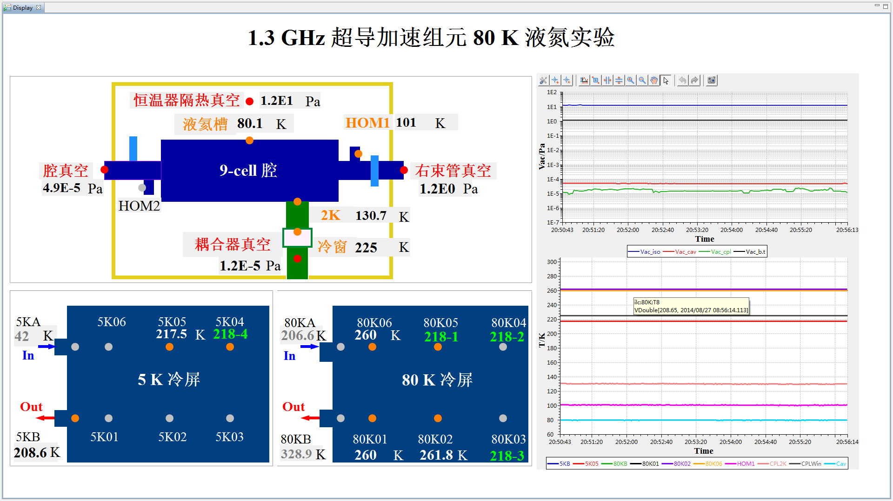
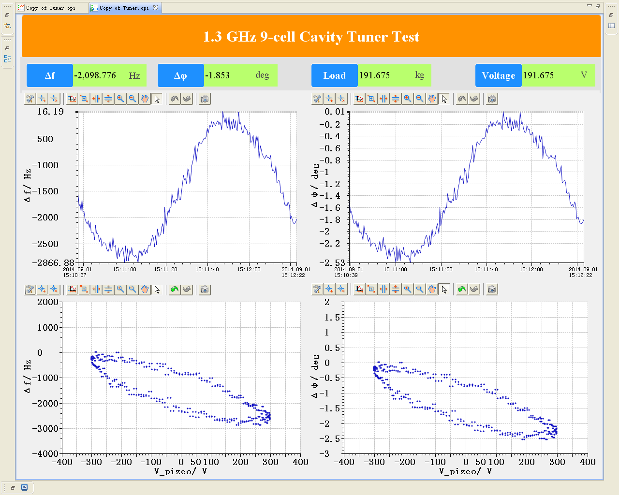
IHEP 1.3 GHz 9-cell Cavity Cryomodule
Final assembly and liquid nitrogen 80K cooling down experiment

Slide 11
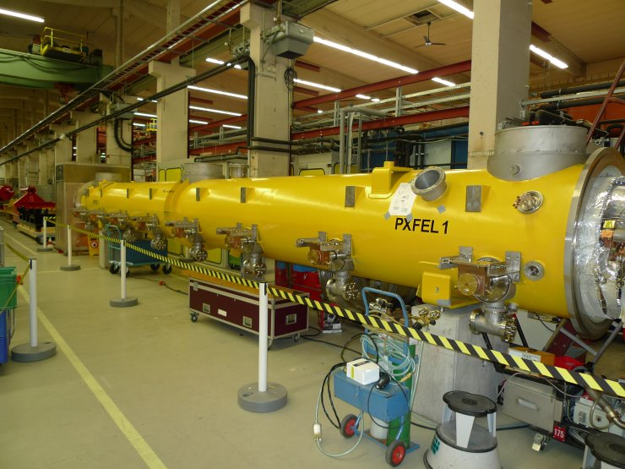
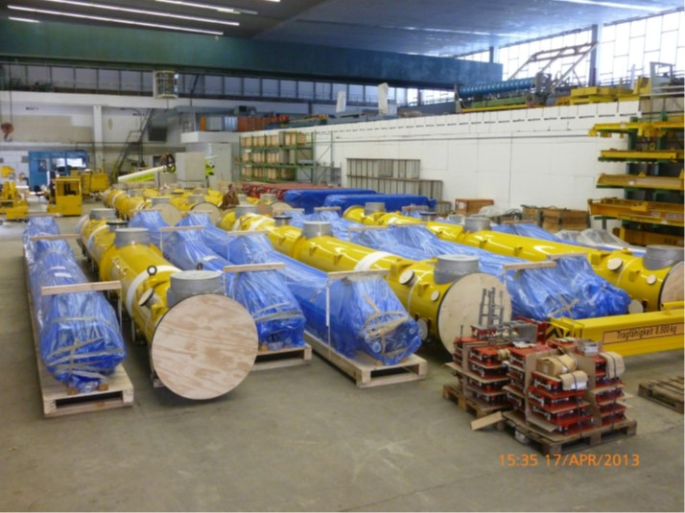
IHEP Cryomodules for XFEL
(58 module, 12 m long each)

Slide 12
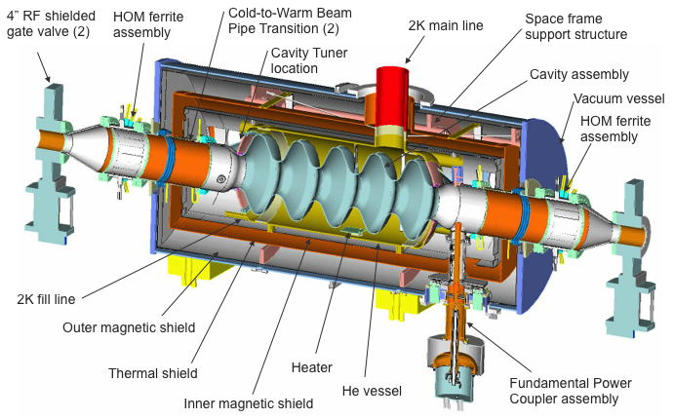
BNL 704 MHz 5-cell Cavity for ERL R&D

Slide 13
LHC Tunnel – Magnet Section
3.76 m

Slide 14
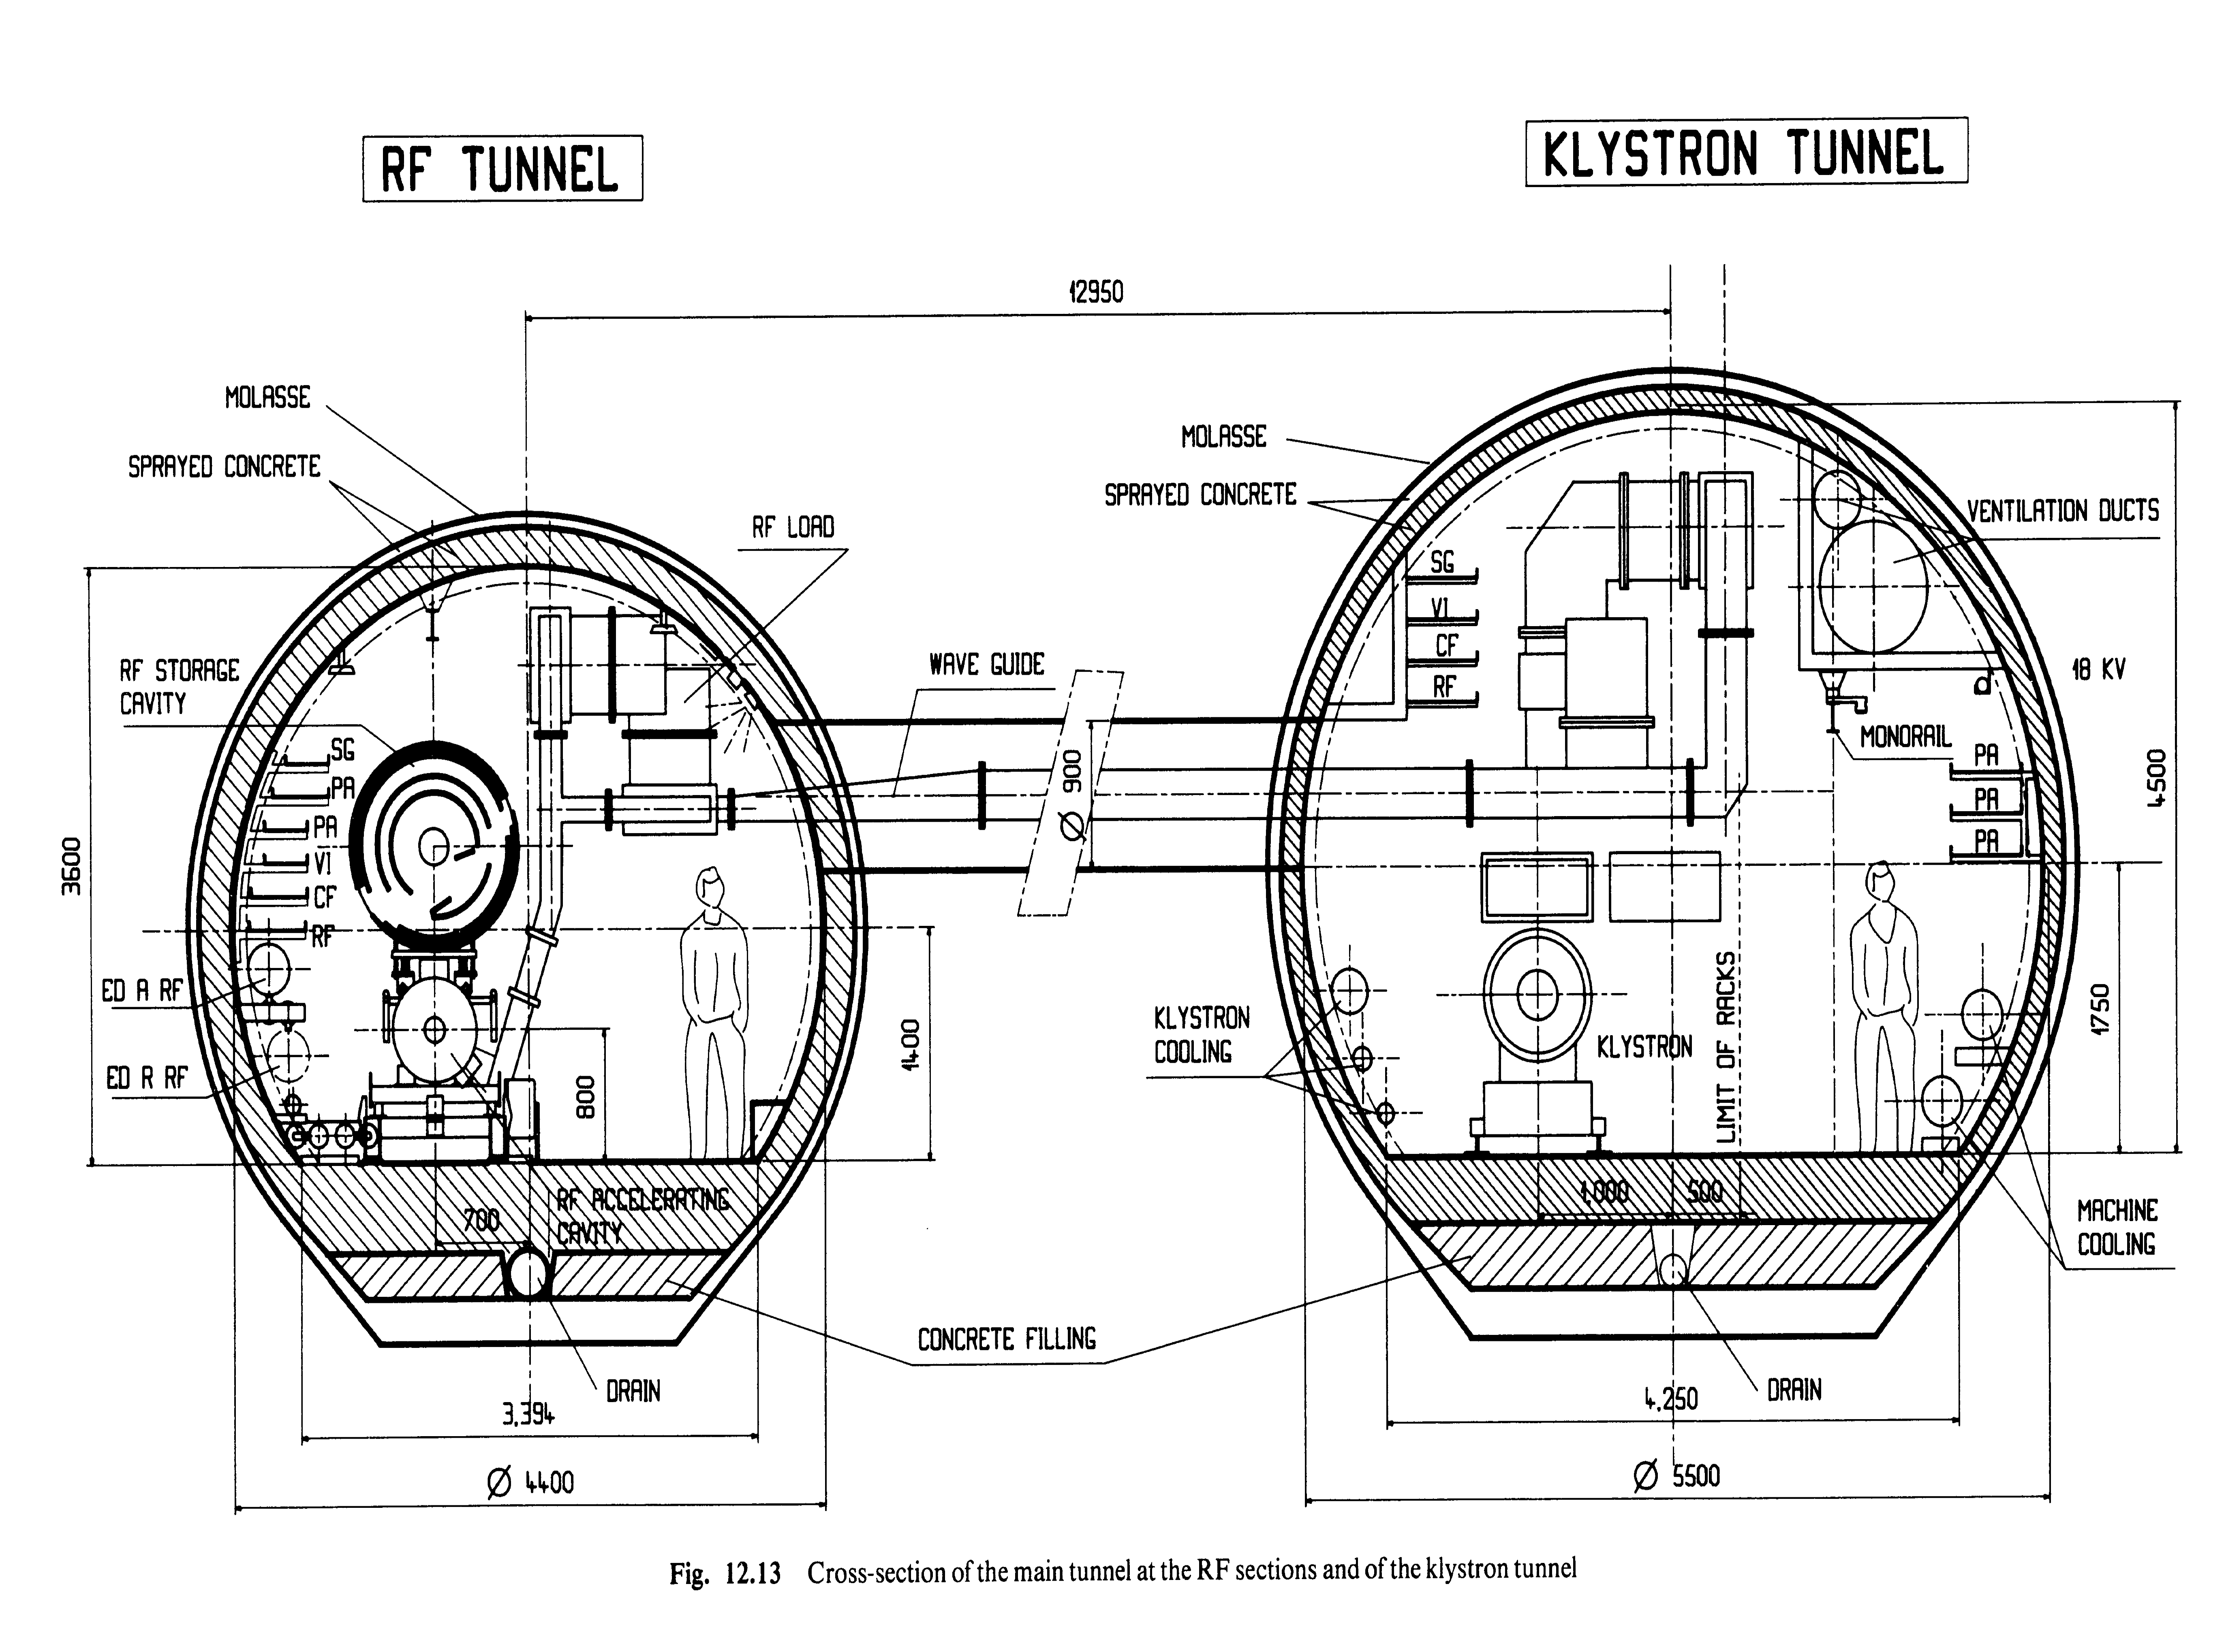
LEP Tunnel – RF Section
4.40 m

Slide 15
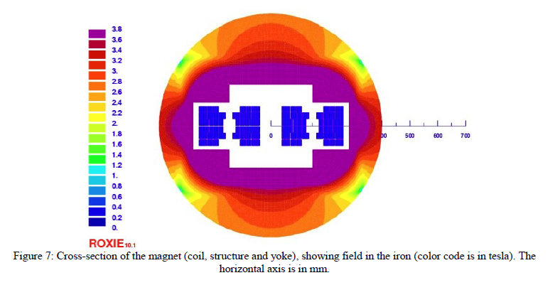
CERN 20 Tesla Magnet Design (Rossi and Todesco)
Coldmass 40% larger than the LHC magnet (800 mm vs 570 mm)
Corresponding to a cryostat of 1.4 m
Ramesh Gupta suggested to use 1.5 m to avoid saturation in the iron

Slide 16
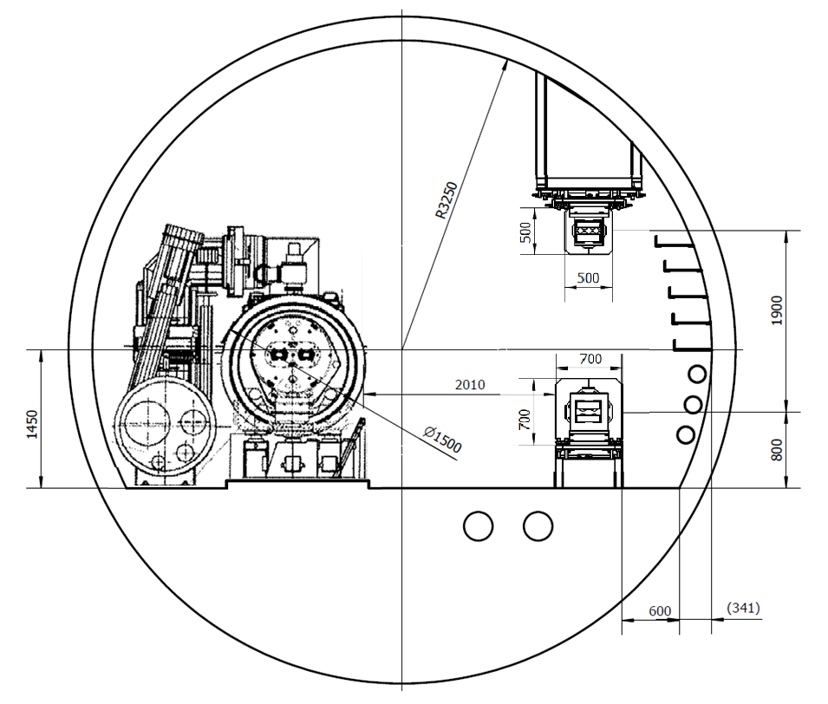
Tunnel Cross Section – SPPC + CEPC Magnets
TBM Method

Slide 17
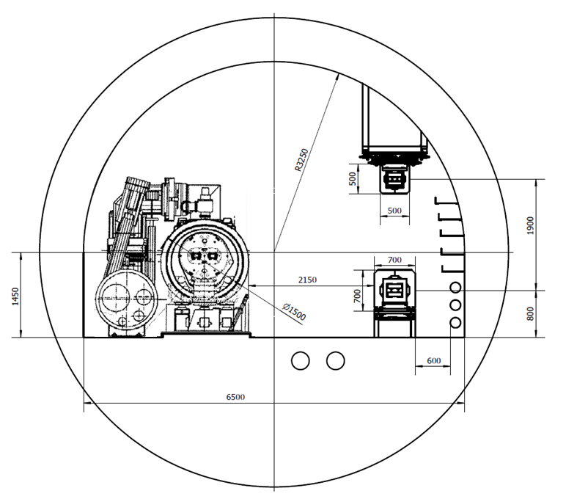
Tunnel Cross Section – SPPC + CEPC Magnets
Explosion Method

Slide 18
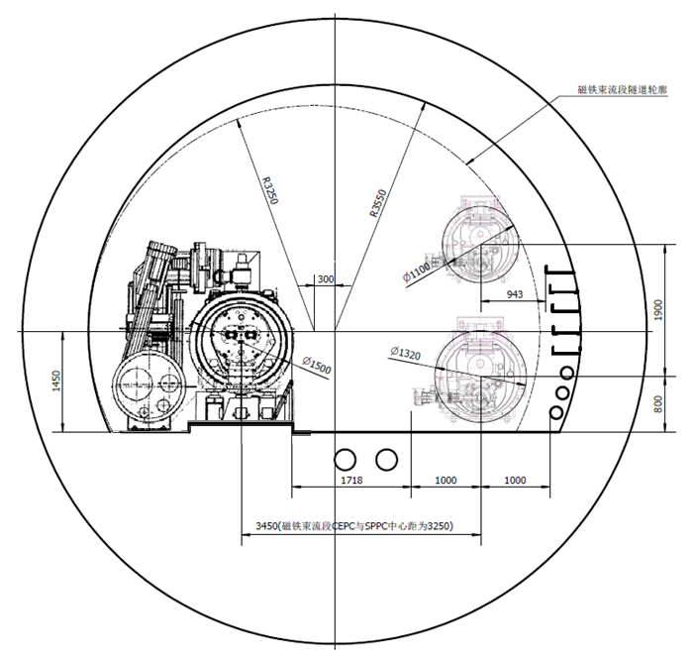
Tunnel Cross Section – SPPC + CEPC SRF
TBM Method

Slide 19
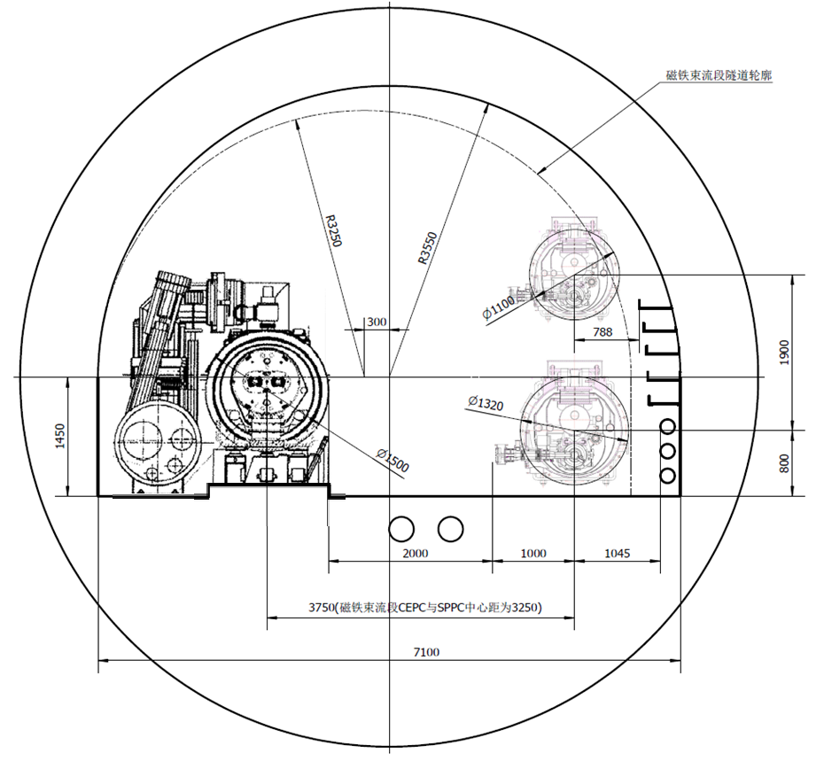
Tunnel Cross Section – SPPC + CEPC Magnets
Explosion Method

Slide 20
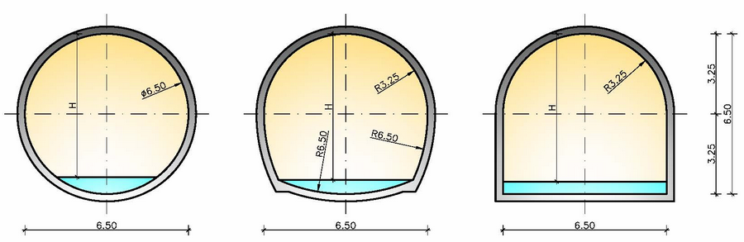
结构及防水初步方案
断面型式选择
圆型 马蹄型 城门洞型
使用面积比约为：1 : 1.05 : 1.10

Slide 21
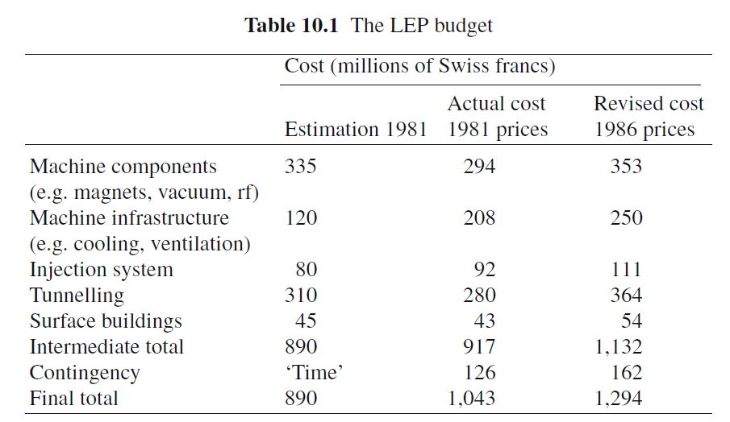
Cost Reference A – LEP1 & LEP2
LEP1
LEP2
288 SC RF cavities for ~0.5 BCHF (S. Myers)
LEP1 + LEP2
1.3B + 0.5B = 1.8 BCHF
Today’s price including inflation: 2.6 BCHF

Slide 22
Cost Reference B – LCLS-II
LCLS-II project cost: USD 895M
Two major technical systems:
  A 4 GeV SRF CW linac (1.3 GHz, 0.3 mA)
  Two independently tunable undulators
The 4.2 GV SRF system:
  Eight 9-cell cavities in a cryomodule, cost USD 2.7M per module, total USD 105M for 38 modules
  This cost does not include non-superconducting RF cost, such as: injector, bunch compressors, klystrons, modulators, RF distribution, transport lines, civil construction, installation, etc.

Slide 23
CEPC Cost Consideration
If we would build the LEP today in Switzerland: 2.6 BCHF
CEPC is twice as large as the LEP, plus a Booster ⇒ ~7 BCHF if built in Switzerland
Cost in China can be lower. The goal is to reduce it by 50%
However, a simple cost scaling won’t work, e.g.,
  Civil construction in China is much cheaper than in Switzerland
  But the klystron price is about the same
Two “blind tests” for cost estimate exercise:
  We asked the IHEP magnet group to estimate the cost if the LEP magnets were built in China, but we did not tell them the actual cost
  We asked the IHEP vacuum group to do the same exercise for the LEP vacuum system
The results showed:
  The LEP magnet cost could be lower by ~30% if fabricated in China
  But the reduction for the LEP vacuum system was smaller because China does not have the advanced aluminum extrusion technology

Slide 24
Cost Reduction Consideration
To develop the needed technology in China for the CEPC-SPPC project because things “made in China” are less costly.
If there are several options for technology, the cheaper one is chosen for the baseline.
Example 1 – klystron vs. solid state:
  Solid state is more reliable and easier to maintain. However, it is also more expensive and less efficient.
  So klystron is in the baseline design.
  Baseline uses one klystron for each cavity. But we are investigating if there can be a significant saving for one klystron driving 4 cavities.
  The new CPD klystron with efficiency 70-80% being developed in Japan is very attractive
Example 2 – TBM vs. explosion method:
  China are not yet able to build large size TBM. To purchase from abroad is expensive. So the explosion method was chosen (cost saving: 20-30%).
Because the beam emittance in the CEPC is smaller than in the LEP, magnet aperture is reduced by 20% to save both the construction and operation costs.

Slide 25
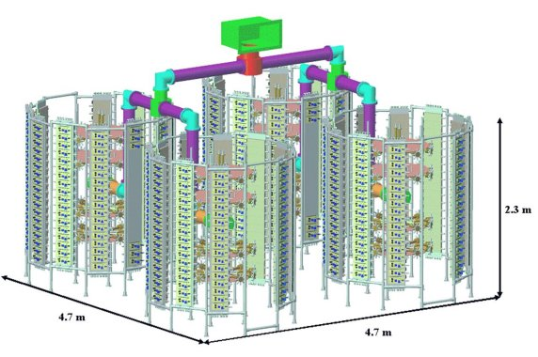
法国SOLEIL光源 4*190KW 全固态机SSA
单机3千多模块组成、每模块350W no HV, no Vacuum
运行九年, 年均替换约50模块
ESRF七台150kW替换了klystron
Beam operation since 2005

Slide 26
CEPC vs LEP Parameters
Parameter | LEP | CEPC | Ratio
ε_{x} (nm) | 22.5 | 6.79 | 3.3
ε_{y} (nm) | 0.29 | 0.02 | 14.5
β_{x} (m) | ~150 | 82 | 1.8
β_{y} (m) | ~150 | 82 | 1.8
σ_{x} (mm) | 1.84 | 1.2 | 1.5
σ_{y} (mm) | 0.21 | 0.041 | 5.1
Aperture of bend (mm) | 100 | 80
Aperture of quad (mm) | 125 | 100
Aperture of sext. (mm) | 150 | 110-120
Size of vacuum chamber (mm) | 131*70 | 100*55 (好场区)

Slide 27
Pre-CDR Table of Contents
Machine R&D Estimate
Machine Cost Estimate

Slide 28
Work Breakdown Structure (WBS)
Light Sources
Accelerators
Civil Construction
Utilities
Detectors

Slide 29
CEPC Relative Cost Estimate
10%
4%
26%
2.4%
10%
2%
12%
19%
12%

Slide 30
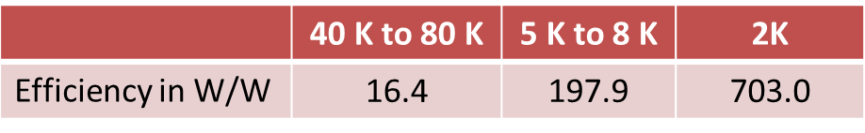
A Note on the Cryogenic System Cost
Both Booster 1.3 GHz and Collider 650 MHz SRF will operate at 2 K.
The efficiency is assumed as follows:
Because of the high beam current (16.6 mA for each beam), HOM loss in the cavity is significant (2.3 kW per beam). Our cost estimate for the cryogenic system assumes a highly effective HOM damper system. How to design and implement such a system is a critical R&D item.
 | 40 K to 80 K | 5 K to 8 K | 2 K
HOM heat load distribution | 3% | 0.3% | 0.1%

Slide 31
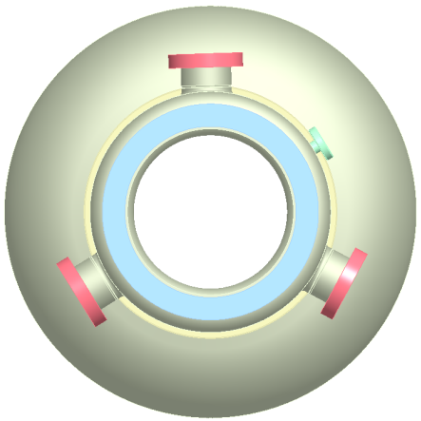
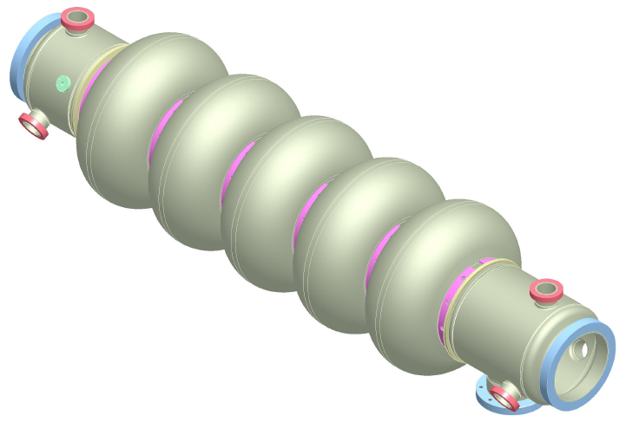
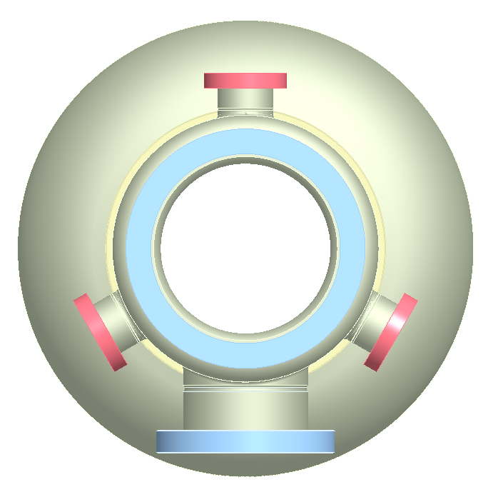
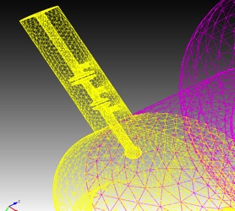
Five-cell cavity with strong HOM damping
HOM ports
FPC port
Six antenna-type couplers will be attached to the large diameter beam pipes and will provide strong HOM damping while maintaining good fill factor for the linac.
Two HOM filters are currently under consideration: a high pass filter made of lumped elements and a ridge waveguide filter.
Total HOM power to be extracted in eRHIC is about 7.3 kW per cavity.

Slide 32
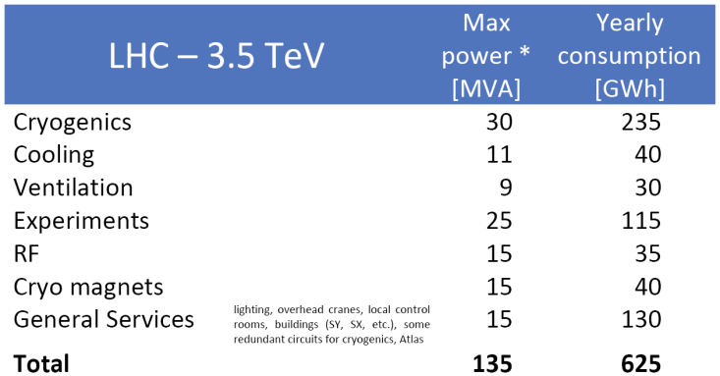
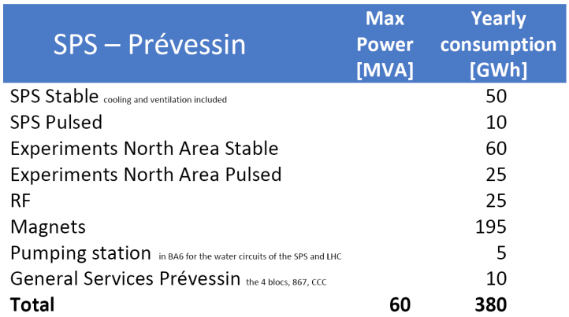
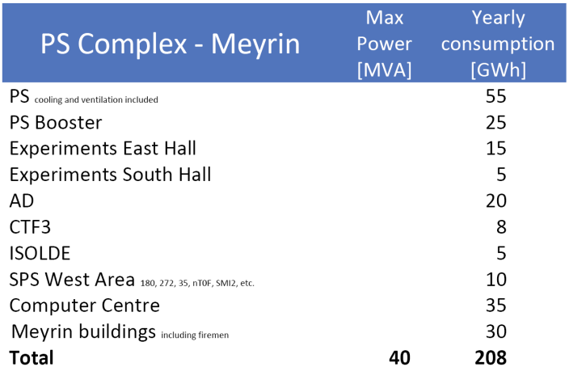
Power Consumption at CERN & Fermilab
CERN: 2012 average 183 MW (R. Saban)
Fermilab: 2010 average 58 MW (D. Wolff)

Slide 33
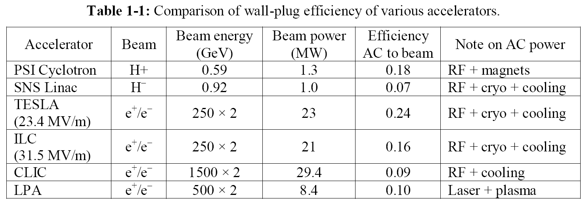
Electricity Bill and Wall Plug Efficiency
Fermilab current electricity bill:
  $ 440k per MW-year
  $ 20M a year
If increased to 300 MW:
  $ 130M a year
  i.e., 35% of the lab budget
CERN current electricity bill:
  1,200 GWh /year
  CHF 65M a year
Yesterday Perret-Gallix’s talk: ILC wall plug efficiency: 9.6%

Slide 34
CEPC Relative Power Consumption
2%
3%
9%
10%
6%
16%
5%
48%

Slide 35
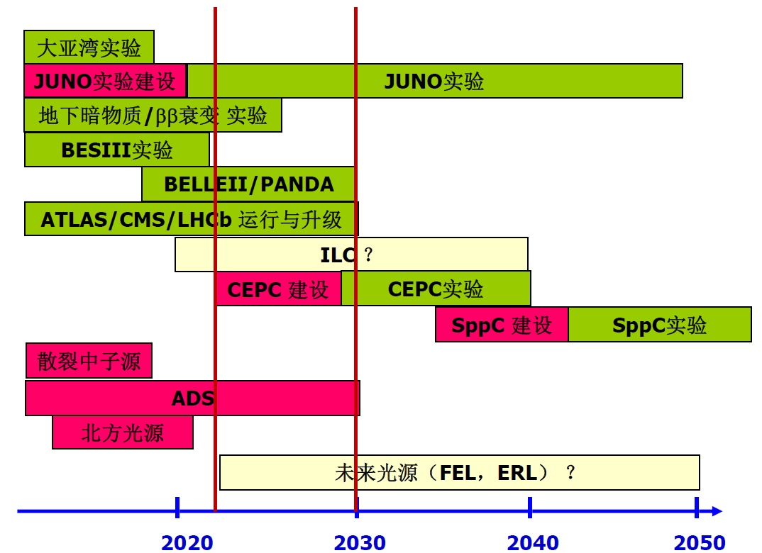
A Window of Opportunity for CEPC-SPPC
CSNS
HEPS

Slide 36
SRF R&D Plan for the Project Timeline
The critical path of the project is to have a successful R&D for the SRF
CEPC will require two large SRF systems:
  Collider: 650 MHz, 384 cavities in 96 cryomodules
  Booster: 1.3 GHz, 256 cavities in 32 cryomodules
This would be the largest SRF installation in the world. To succeed with designing, fabricating, commissioning and installation of such a system, a significant investment in R&D, infrastructure and personnel is necessary.
The R&D has two parts:
  Prototyping as well as technology development for several critical components, in particular, the HOM damper
  Pre-series production:
    15-20 1.3 GHz cavities and 30-35 650 MHz cavities
    A large RF facility similar to that in Jlab, Fermilab and DESY for cavity inspection and tuning set ups, RF lab, several vertical test stands, clean rooms, HPR systems, FPC preparation and conditioning facility, cryomodule assembly lines, horizontal test stations, high power RF equipment, a cryogenic plant, etc.
    Capable to assemble 1 Booster modules and 2 Collider module each month
    To have at least two vendors for each type of RF
    Personnel development

Slide 37
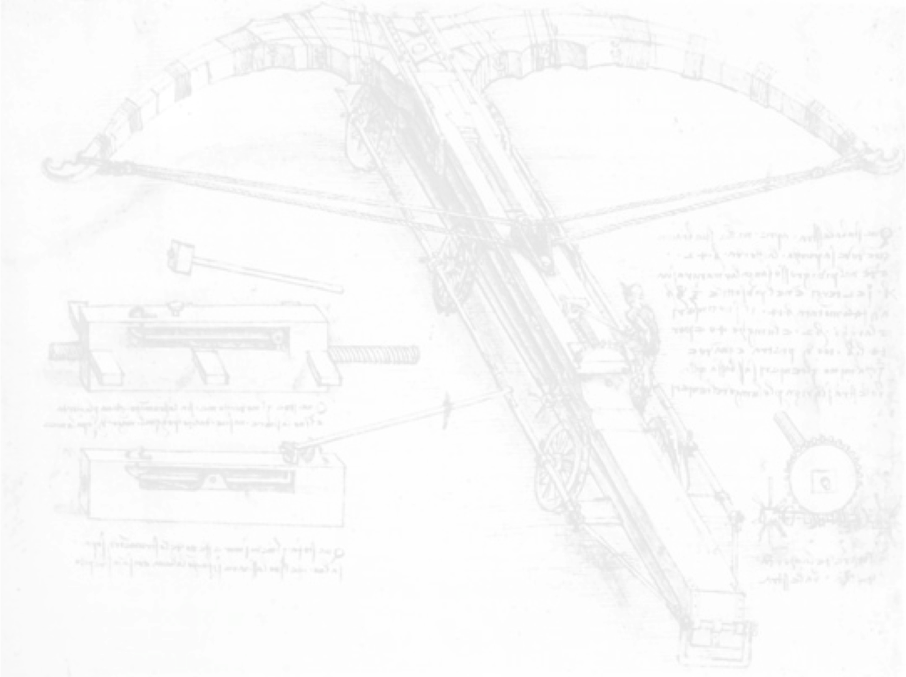

CEPC-SppC Project Timeline (dream)
CEPC
 |  | 2015 |  |  |  |  | 2020 |  |  |  |  | 2025 |  |  |  |  | 2030 |  |  |  |  | 2035
Pre-studies (2013-2015)
R&D Engineering Design (2016-2020)
Construction (2021-2027)
Data taking (2028-2035)
1st Milestone: pre-CDR (by the end of 2014) → R&D funding request to Chinese government in 2015 (China’s 13th Five-Year Plan 2016-2020)
SppC
 |  | 2020 |  |  |  |  |  |  | 2030 |  |  |  |  |  |  |  |  | 2040
R&D (2014-2030)
Engineering Design (2030-2035)
Construction (3035-2042)
Data taking (2042-2055)

Slide 38
Summary
A baseline design for the CEPC is in advanced stage.
It is by no means most cost effective. But it is consistent and able to reach the design goal.
A bottom-up cost estimate – for both construction cost (in RMB) and operation cost (in MW) – for each technical system is nearly complete.
The critical R&D items have been identified.
The construction timeline is aggressive. Its success depends on many factors, some under our control, some beyond our control.
The completion of the Pre-CDR is an important step in order to get this project into the government’s Five-Year Plan.
Among all the things under our control, perhaps the most important is to train young generations of accelerator physicists and engineers for this project (which is true for both CEPC and FCC). Old soldiers never die, but they will fade away. Before they fade away, we need to recruit and prepare a young army so the baton can be passed on. The planning about how to do it will start soon. (The successful ILC schools are a good example.)

Slide 39
Questions?

Slide 40
CEPC Design – Main Parameters
Parameter | Unit | Value | Parameter | Unit | Value
Beam energy [E] | GeV | 120 | Circumference [C] | m | 54752
Number of IP[N_{IP}] |  | 2 | SR loss/turn [U₀] | GeV | 3.11
Bunch number/beam[n_{B}] |  | 50 | Bunch population [Ne] |  | 3.79E+11
SR power/beam [P] | MW | 51.7 | Beam current [I] | mA | 16.6
Bending radius [ρ] | m | 6094 | momentum compaction factor [α_{p}] |  | 3.36E-05
Revolution period [T₀] | s | 1.83E-04 | Revolution frequency [f₀] | Hz | 5475.46
emittance (x/y) | nm | 6.12/0.018 | β_{IP}(x/y) | mm | 800/1.2
Transverse size (x/y) | μm | 69.97/0.15 | ξ_{x,y}/IP |  | 0.118/0.083
Bunch length SR [σ_{s.SR}] | mm | 2.14 | Bunch length total [σ_{s.tot}] | mm | 2.65
Lifetime due to Beamstrahlung | min | 47 | lifetime due to radiative Bhabha scattering [τ_{L}] | min | 51
RF voltage [V_{rf}] | GV | 6.87 | RF frequency [f_{rf}] | MHz | 650
Harmonic number [h] |  | 118800 | Synchrotron oscillation tune [ν_{s}] |  | 0.18
Energy acceptance RF [h] | % | 5.99 | Damping partition number [Jε] |  | 2
Energy spread SR [σ_{δ.SR}] | % | 0.132 | Energy spread BS [σ_{δ.BS}] | % | 0.096
Energy spread total [σ_{δ.tot}] | % | 0.163 | n_{γ} |  | 0.23
Transverse damping time [n_{x}] | turns | 78 | Longitudinal damping time [n_{ε}] | turns | 39
Hourglass factor | Fh | 0.68 | Luminosity /IP[L] | cm⁻²s⁻¹ | 2.04E+34

