Slide 1
Jlab MEIC concept RF systems
Jlab EIC concept is a high luminosity ring-ring collider
RF systems are extremely challenging
  High current
  High voltage
  Not a lot of space (is there ever?)
  Large amount of RF power needed for synchrotron radiation
Requirements are similar to proposed Higgs factories
Nearest existing technology is from B-factories, but packing factor is too low.
MEIC has additional demand of high frequency
750 MHz working design
1.5 GHz desired by physicists!
New technology needed!

Slide 2
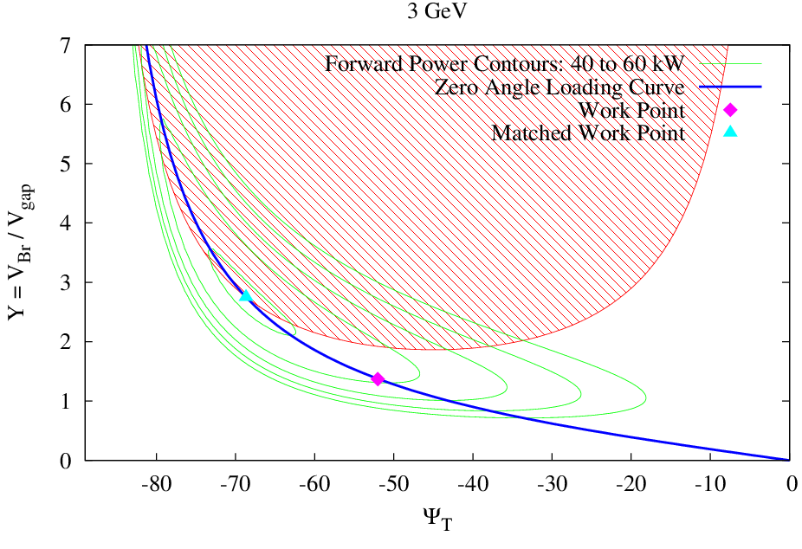
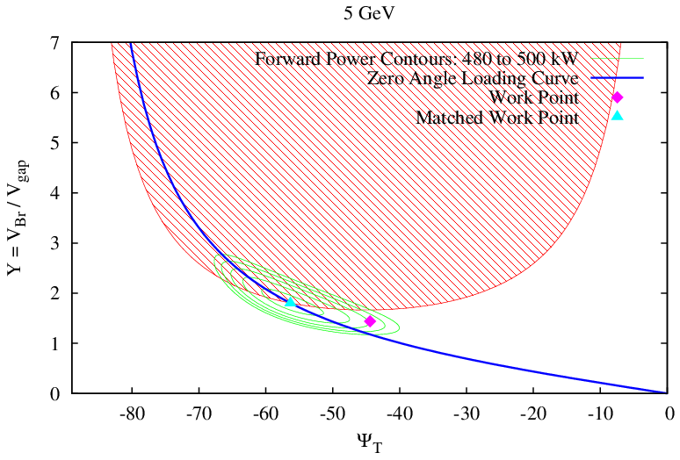
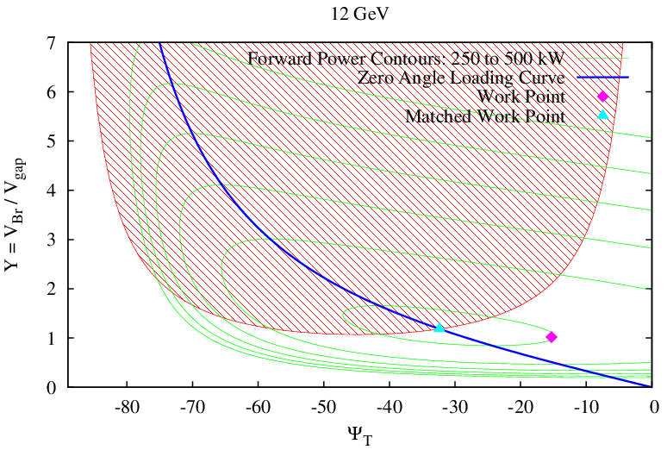
MEIC e Ring RF related Parameters
Circumference |  | 1415.853 |  | m
Rev Frequency |  | 0.212 |  | MHz
RF frequency |  | 748.500 |  | MHz
Harmonic Number |  | 3535
Radius of Dipole |  | 57.940 |  | m
Dipole Bend Angle |  | 1.980 |  | degree
Crossing Angle |  | 60.000 |  | degree
Angle Factor |  | 1.333
Arc Length |  | 445.340 |  | m
Beta Function at RF Cav |  | 4.000 |  | m
Momentum Compaction |  | 7.600E-04
Bunch Length |  | 7.5 |  | mm
Linear SR Power Limit |  | 10 |  | kW/m
Total SR Power Limit |  | 5 |  | MW
CavityActiveLength |  | 0.2 |  | m
Cavity Insertion Length |  | 1.91 |  | m
temperature |  | 2.1 |  | K
BCS Resistance |  | 7.918 |  | nΩ
Residual Resistance |  | 13 |  | nΩ
Surface Resistance |  | 20.9 |  | nΩ
Geometric Factor |  | 270
R/Q |  | 105
Qzero |  | 1.29E+10
Shunt Impedance |  | 1.36E+06 |  | MΩ
Energy | 3 | 5 | 12 |  | GeV
gamma | 5871.8 | 9785.7 | 23484.4
Current | 0.24 | 3.00 | 0.11 |  | A
Energy Spread | 3.40E-04 | 5.60E-04 | 1.35E-03
Phase Slip Factor | 7.6E-04 | 7.6E-04 | 7.6E-04
SR power per ring | 0.04 | 3.82 | 4.85 |  | MW
Energy Loss per Turn | 0.17 | 1.27 | 42.27 |  | MeV
SR power per unit length | 0.080 | 7.874 | 10.000 |  | kW/m
Veff | 0.17 | 1.27 | 42.27 |  | MV
Vpeak | 0.45 | 2.30 | 50.04 |  | MV
Syn. Phase | 21.33 | 33.67 | 57.64 |  | degree
Vgap | 0.45 | 0.29 | 2.50 |  | MV
Gradient | 2.270 | 1.436 | 12.509 |  | MV/m
Syn. Tune | 0.008 | 0.013 | 0.031
Power fed to beam per Cavity | 39.0 | 477.7 | 242.7 |  | kW
Forward Power | 43.84 | 490.99 | 249.28 |  | kW
Cavity Power Loss | 7.60E-05 | 3.04E-05 | 2.31E-03 |  | kW
Reflected Power | 4.9 | 13.3 | 6.6 |  | kW *
Coupling Beta | 1.03E+06 | 1.96E+07 | 1.22E+05
δf | -38.1 | -557.4 | -1.0 |  | kHz
Qext | 1.26E+04 | 6.58E+02 | 1.06E+05
Qloaded | 1.26E+04 | 6.58E+02 | 1.06E+05
Long. SR Damping Time | 85.81 | 18.54 | 1.34 |  | mS
Tran. SR Damping Time | 171.63 | 37.07 | 2.68 |  | mS
Active Cavity Number | 1 | 8 | 20
* Non zero reflected power is for choosing stable work point as illustrated in left graphs

Slide 3
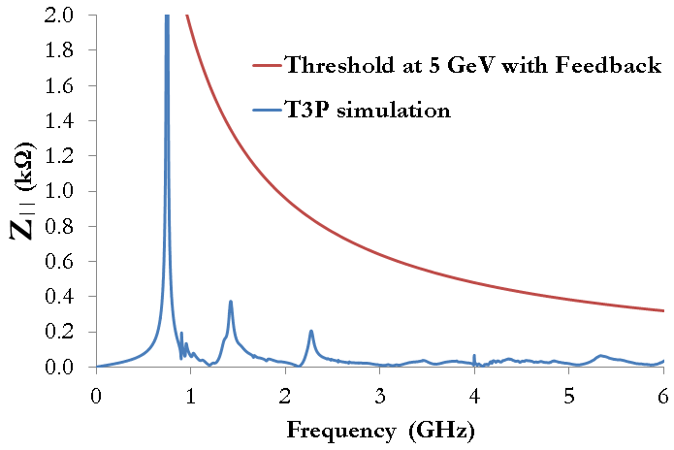
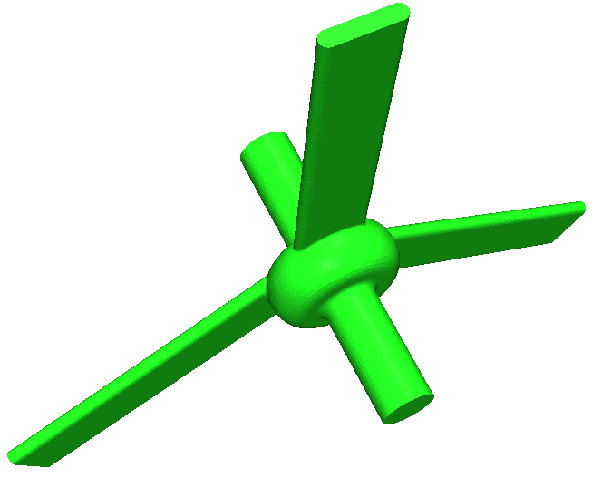
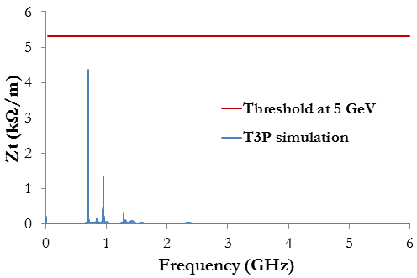
Impedance Threshold in e Ring
“On-cell” damper concept can meet these requirements.
Waveguide HOMs can handle high power.
Many technical challenges remain!

Slide 4
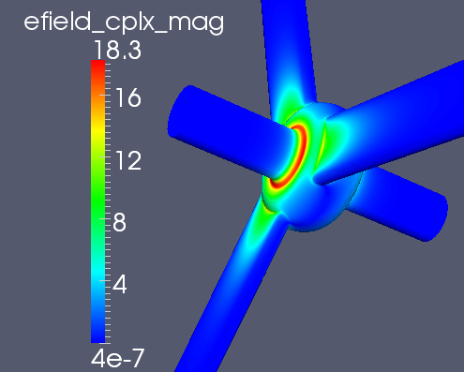
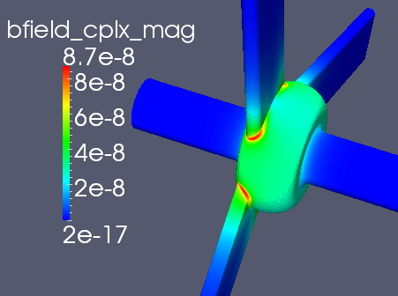
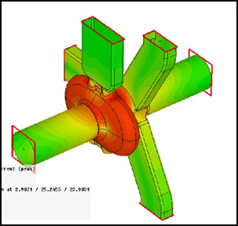
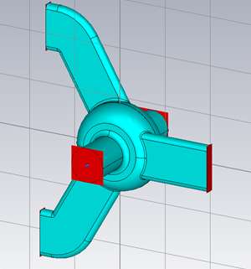
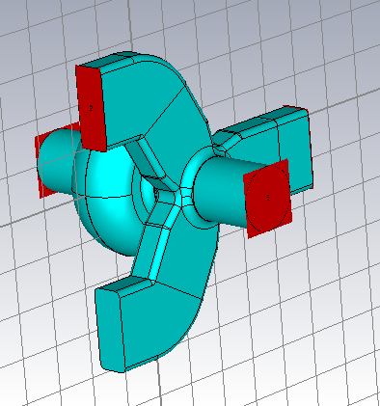
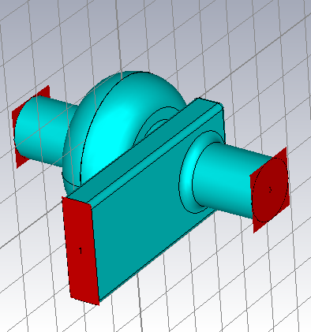
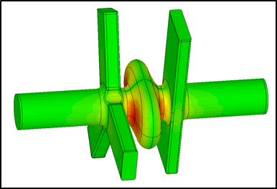
RF Cavity Geometry studies
750 MHz MEIC e-ring cavity concepts
ANL SPX 2.82GHz crab cavity with on-cell damper

Slide 5
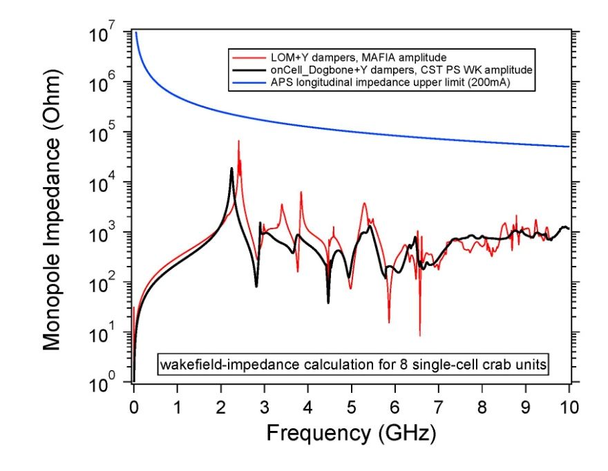
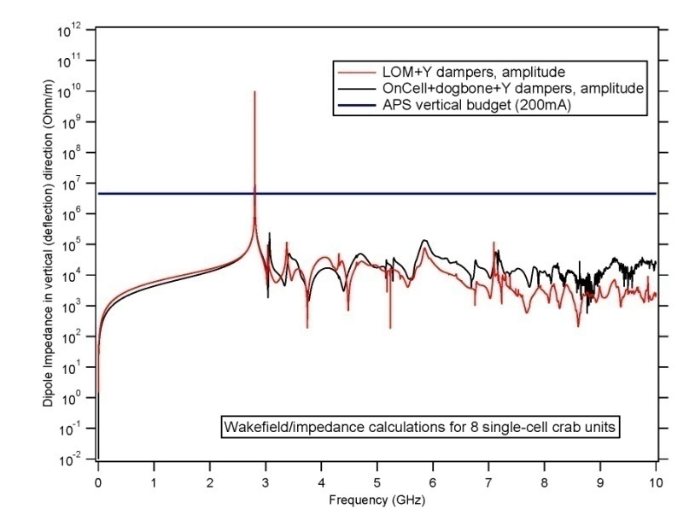
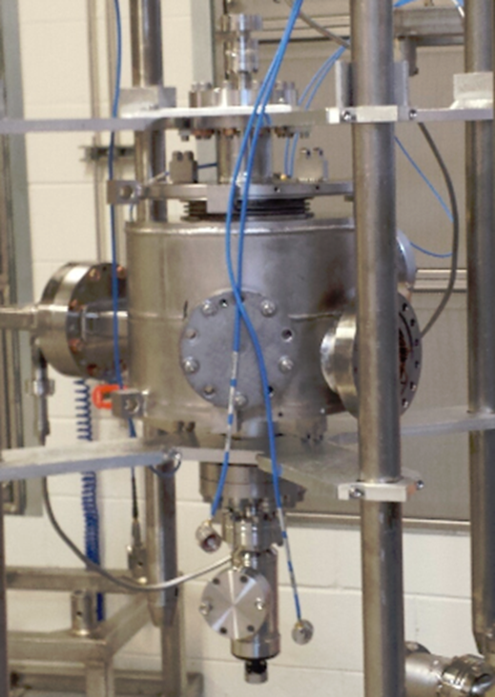
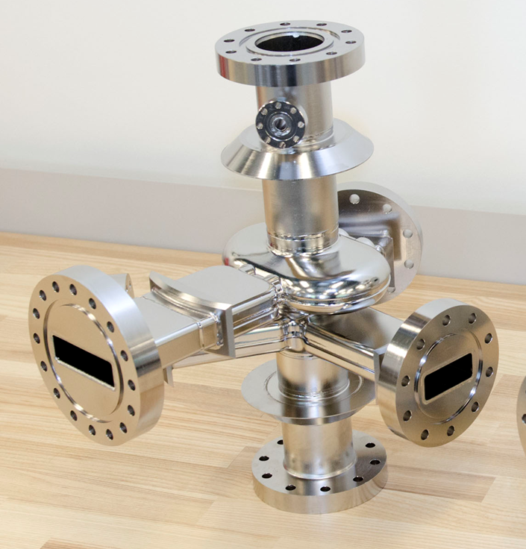
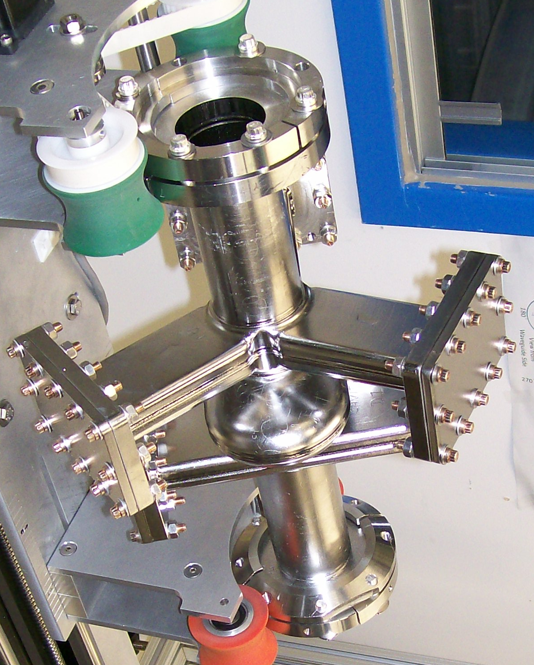
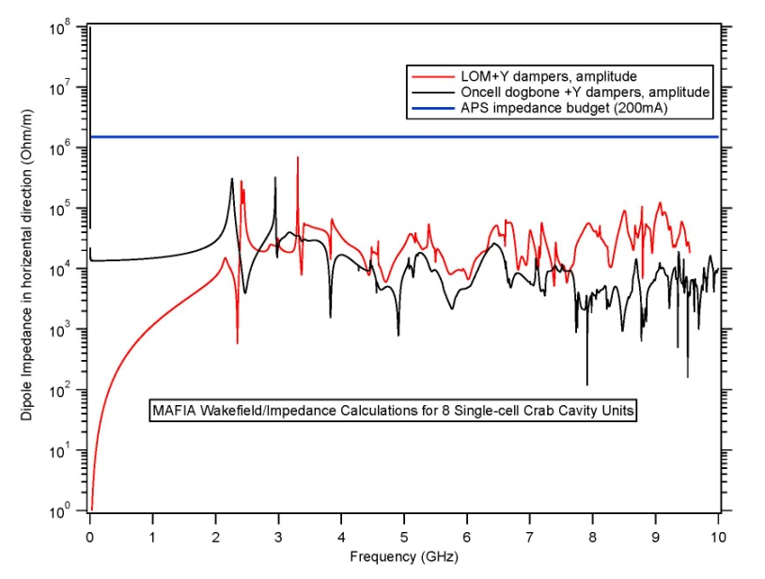
ANL-JLab Crab Cavity and Cryomodule Development for SPX
Monopole Impedance
Vertical Dipole Impedance
Stability Threshold
Stability Threshold
Horizontal Dipole Impedance
On-cell waveguide damper
Stability Threshold
Beam pipe waveguide dampers

Slide 6
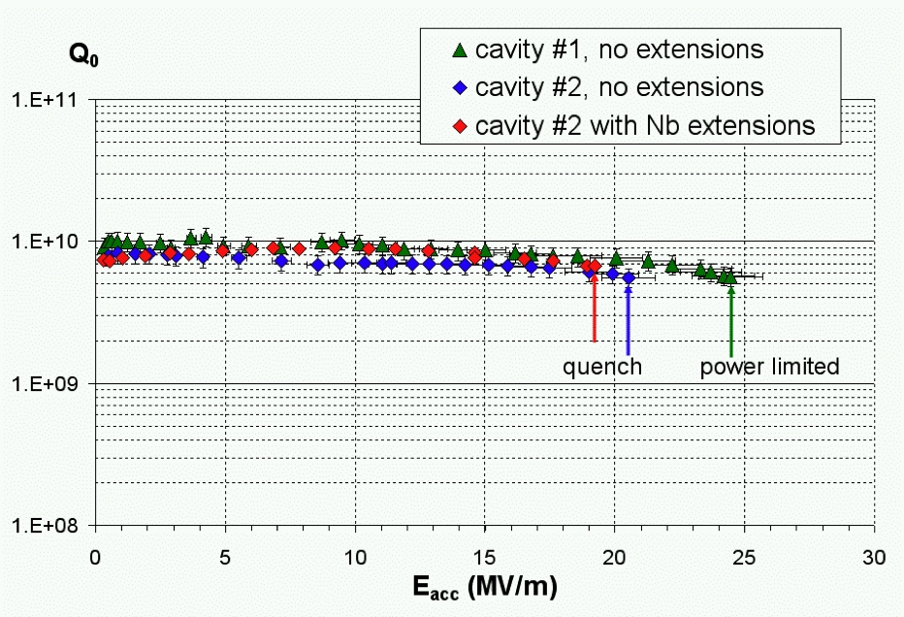
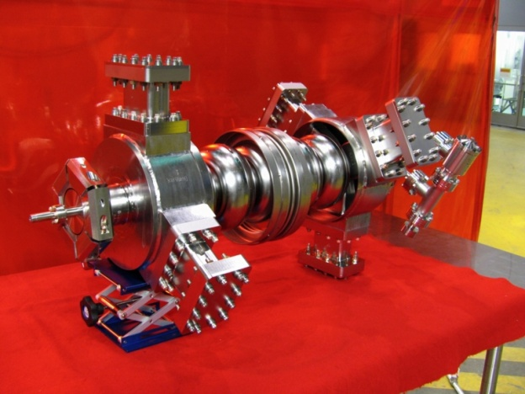
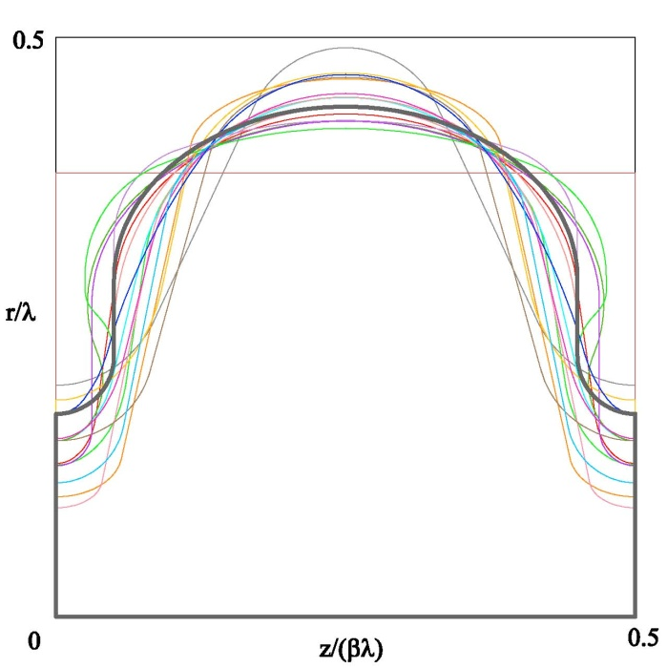
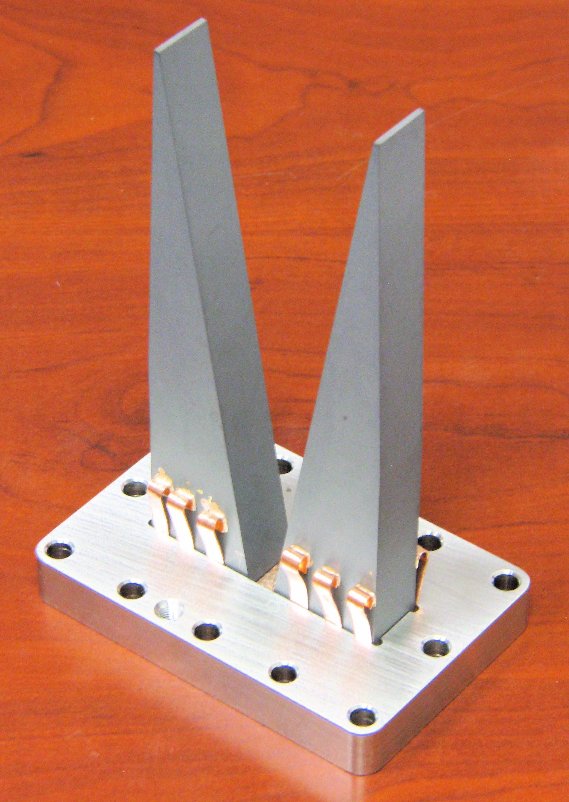
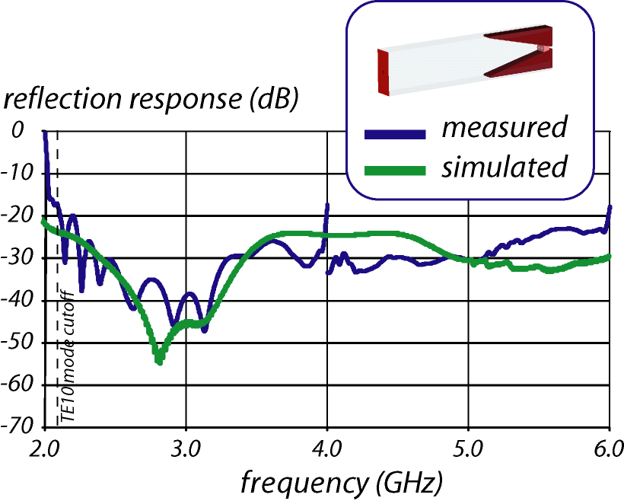
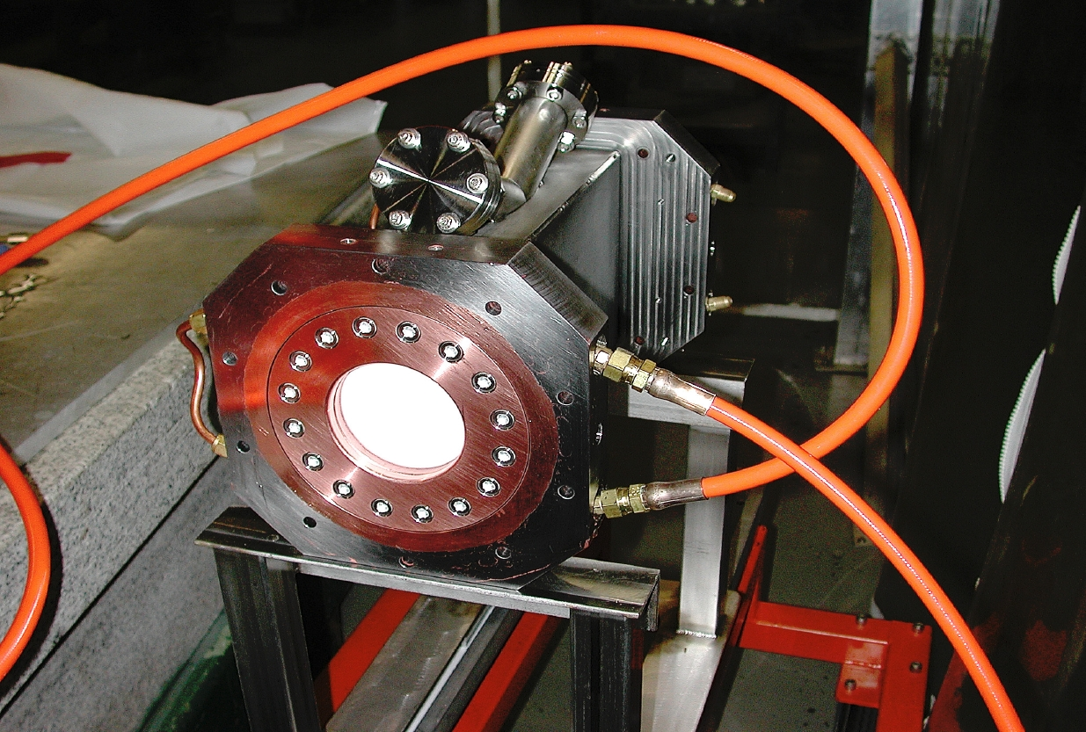
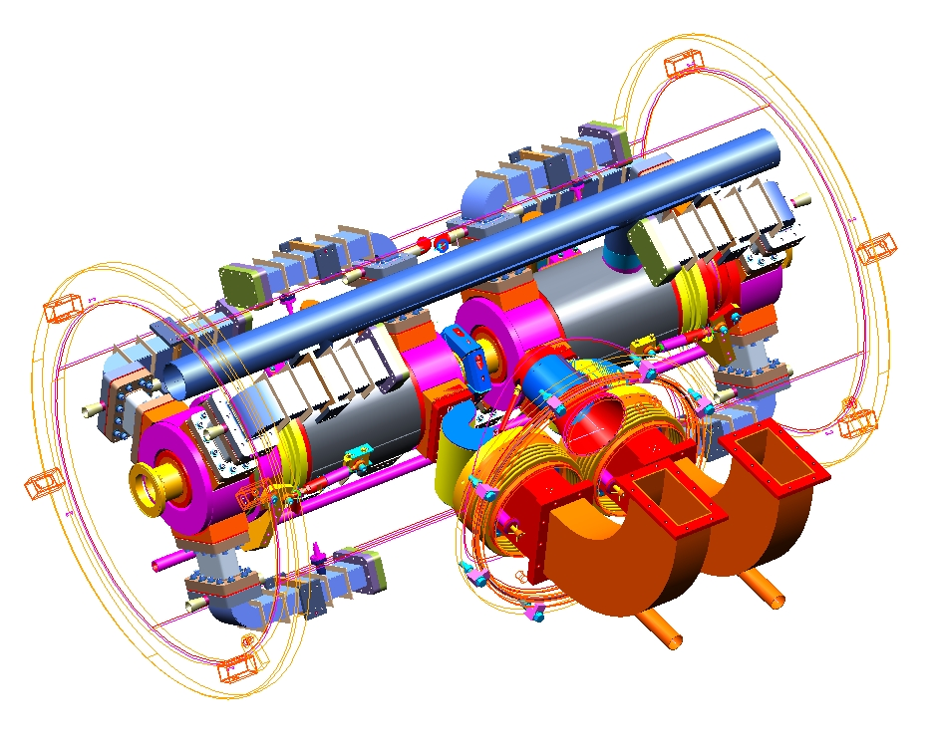
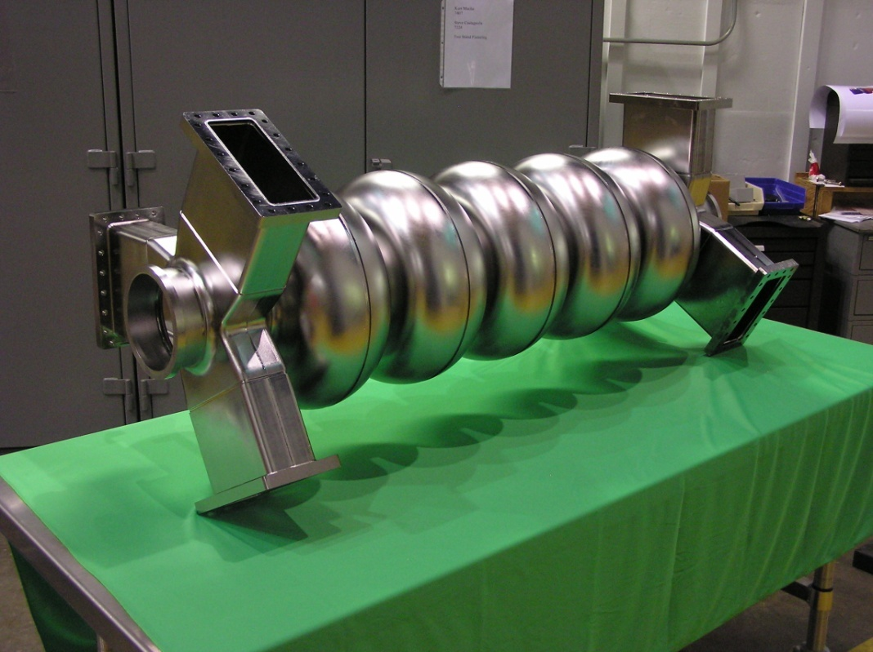
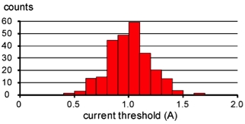
JLab high-current cavities
Two 1.5 GHz, one 750 MHz prototypes built and tested
  Results exceed requirements
  High power RF window demonstrated to > 60 kW CW
1.5 GHz ERL cavities
1.5 GHz ERL cavity
Shape optimization for BBU/HOM power
HOM load concept
1.5 GHz window
750 MHz ERL cavity
BBU simulations for 1.5 GHz ERL
Module concept

Slide 7
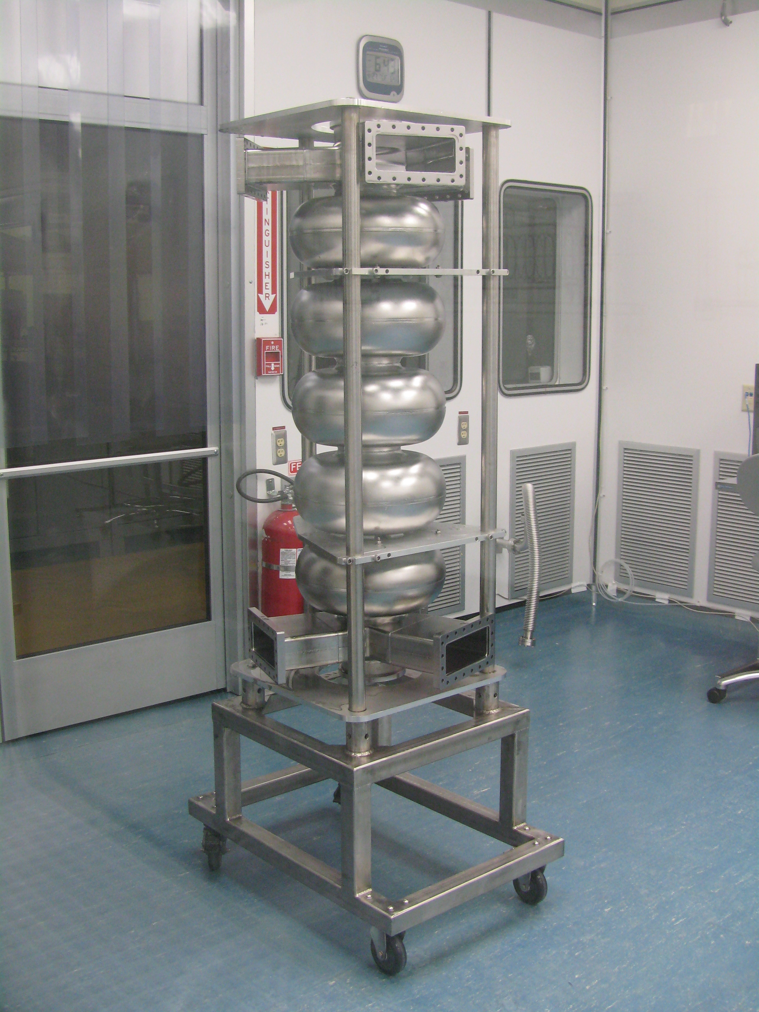
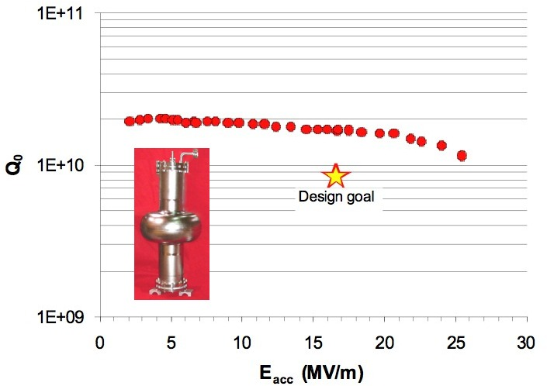
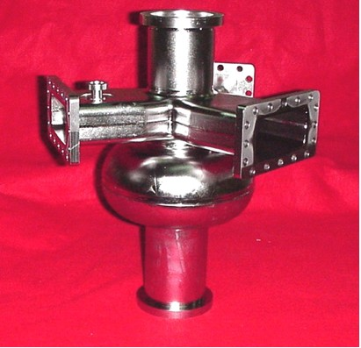
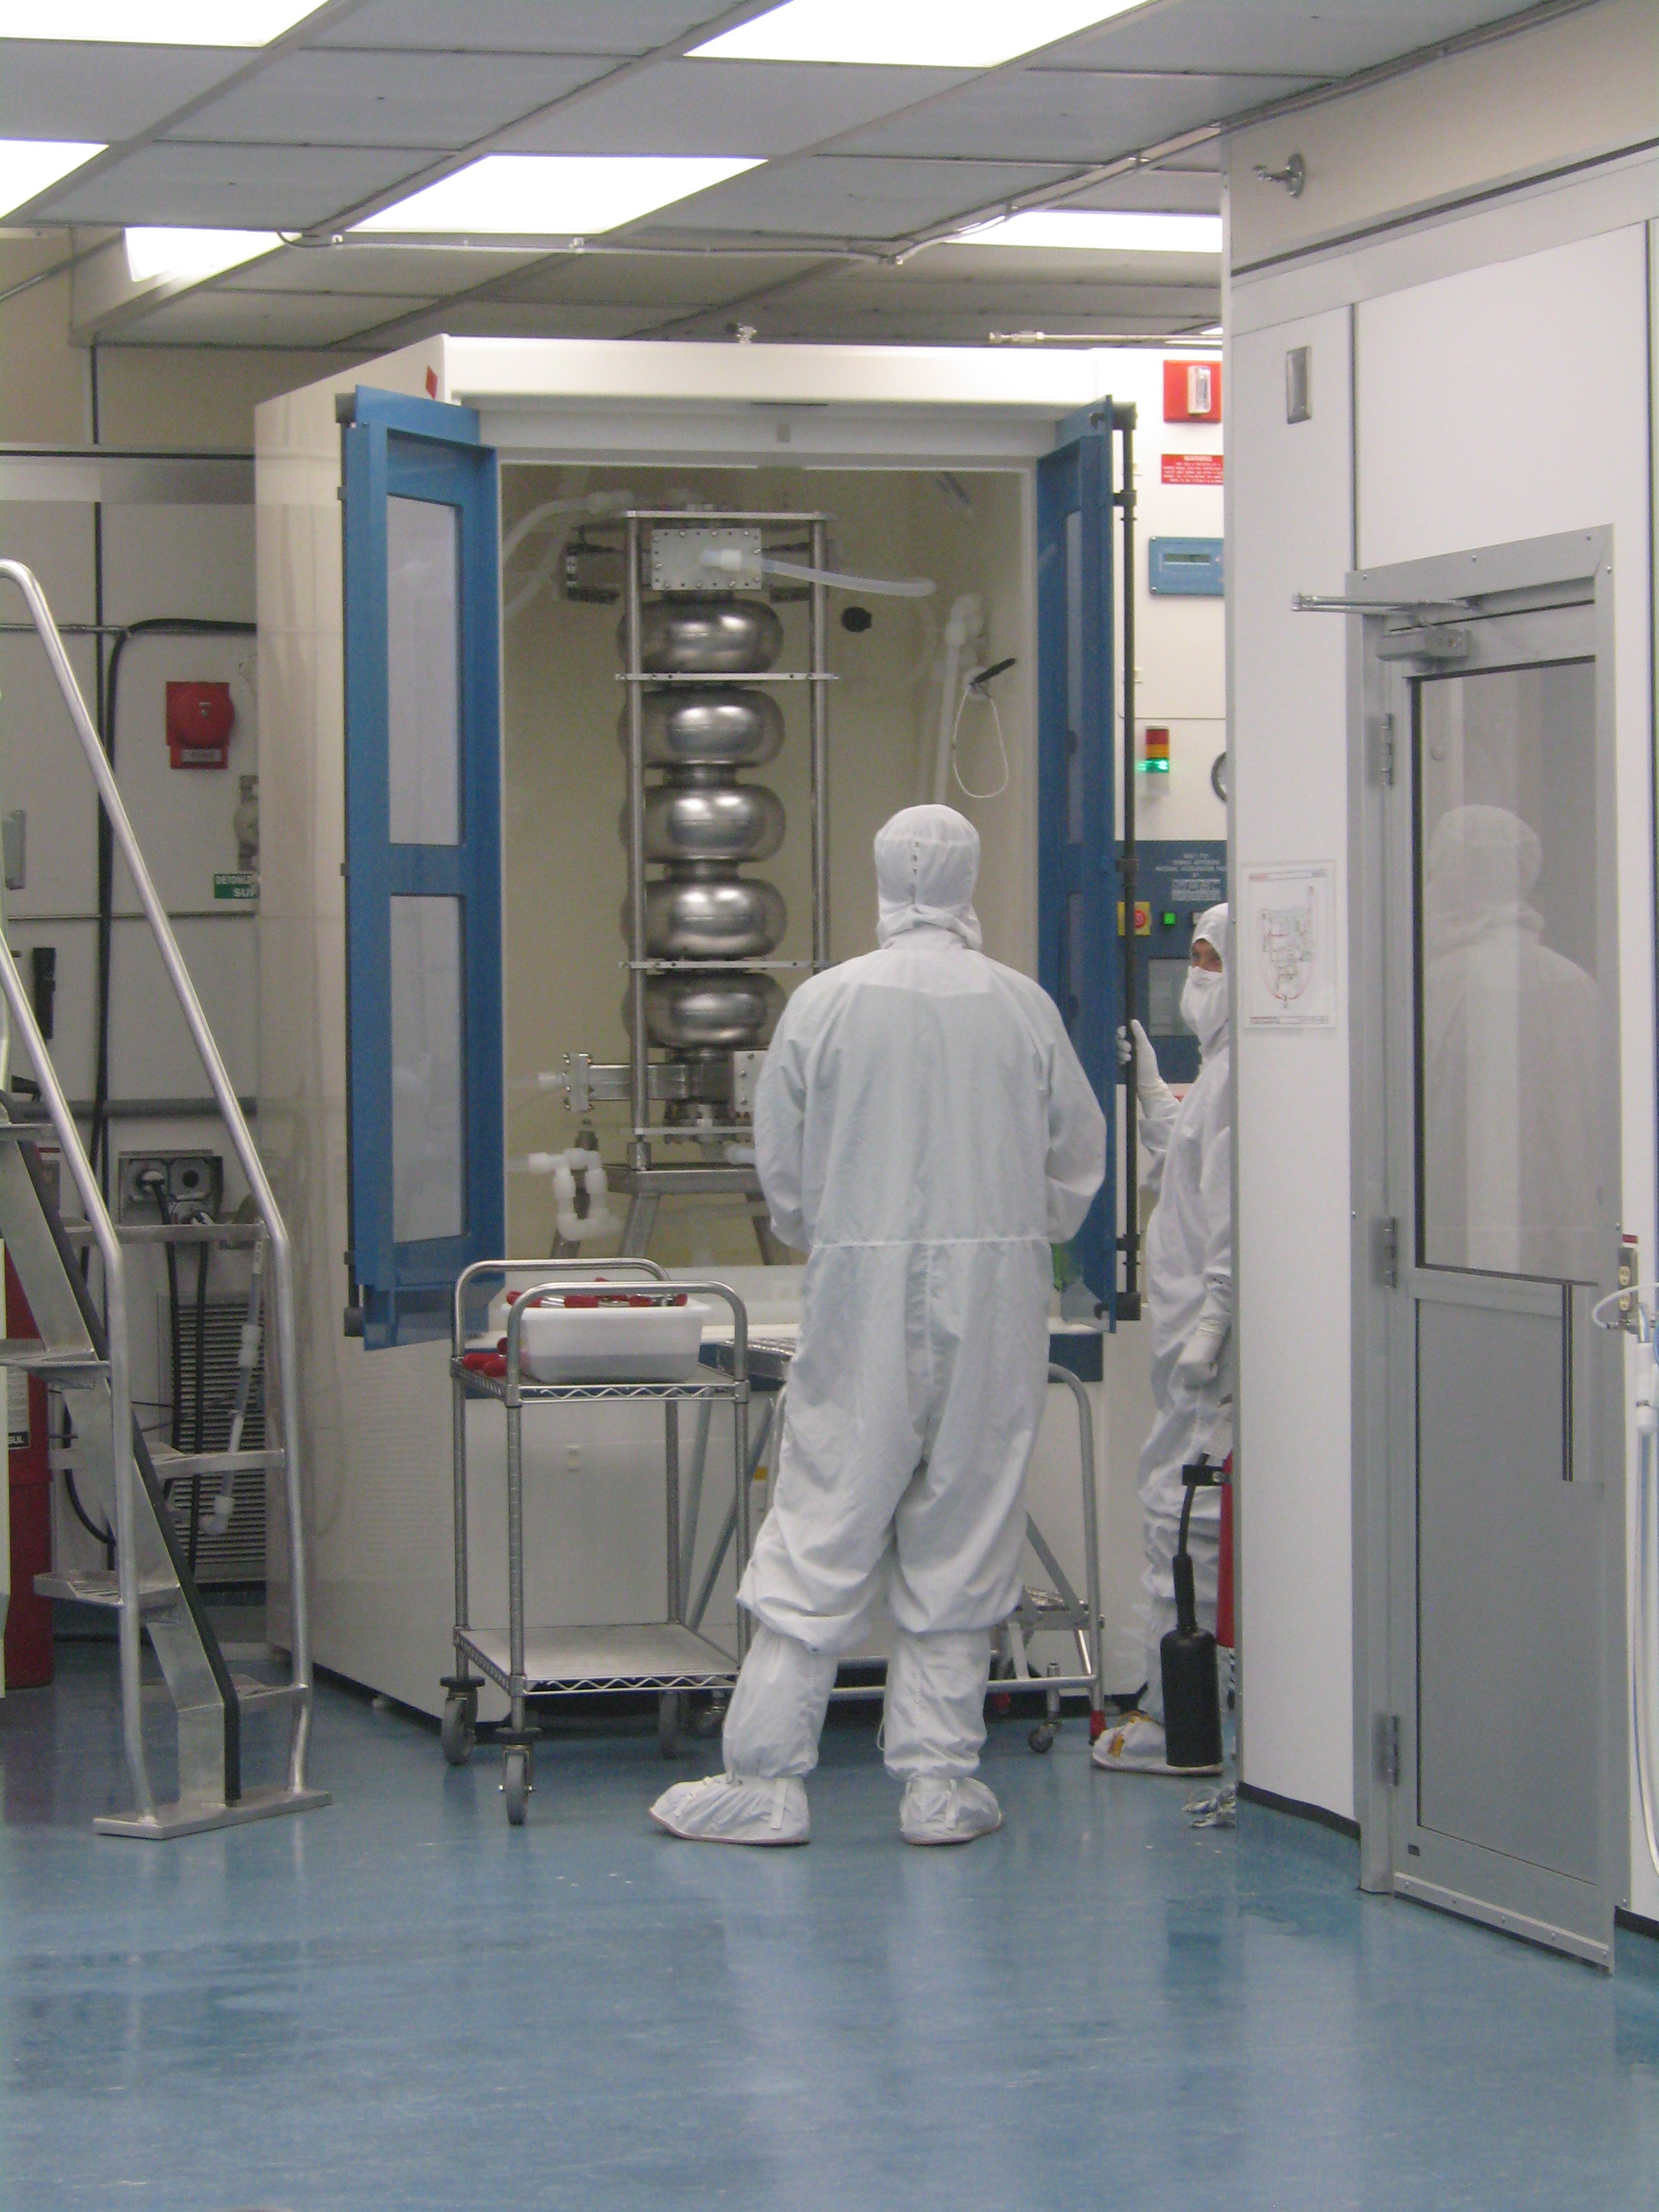
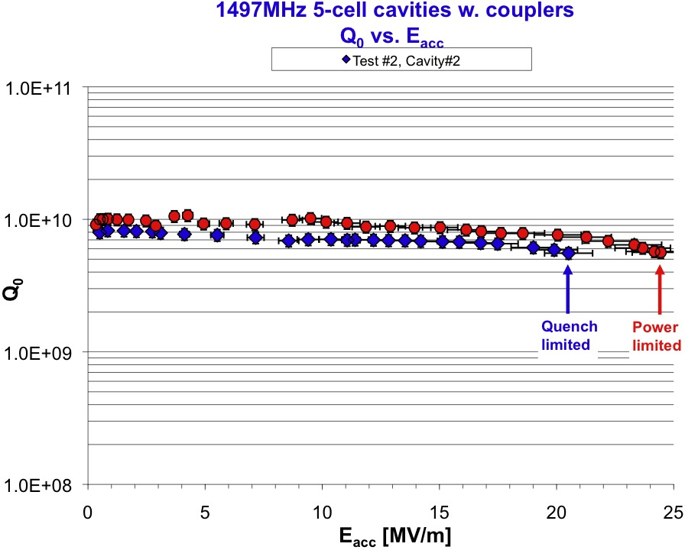
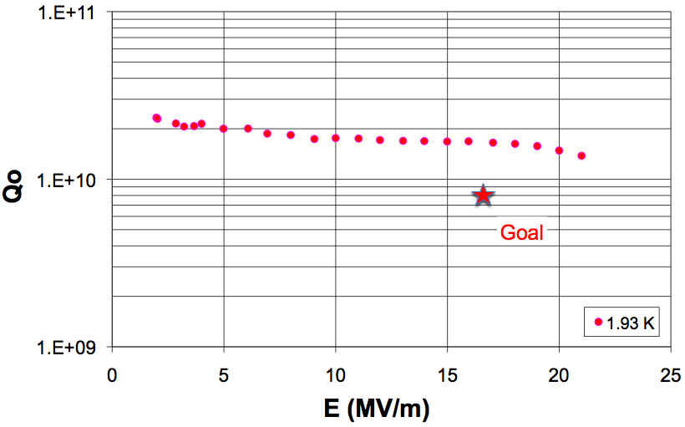
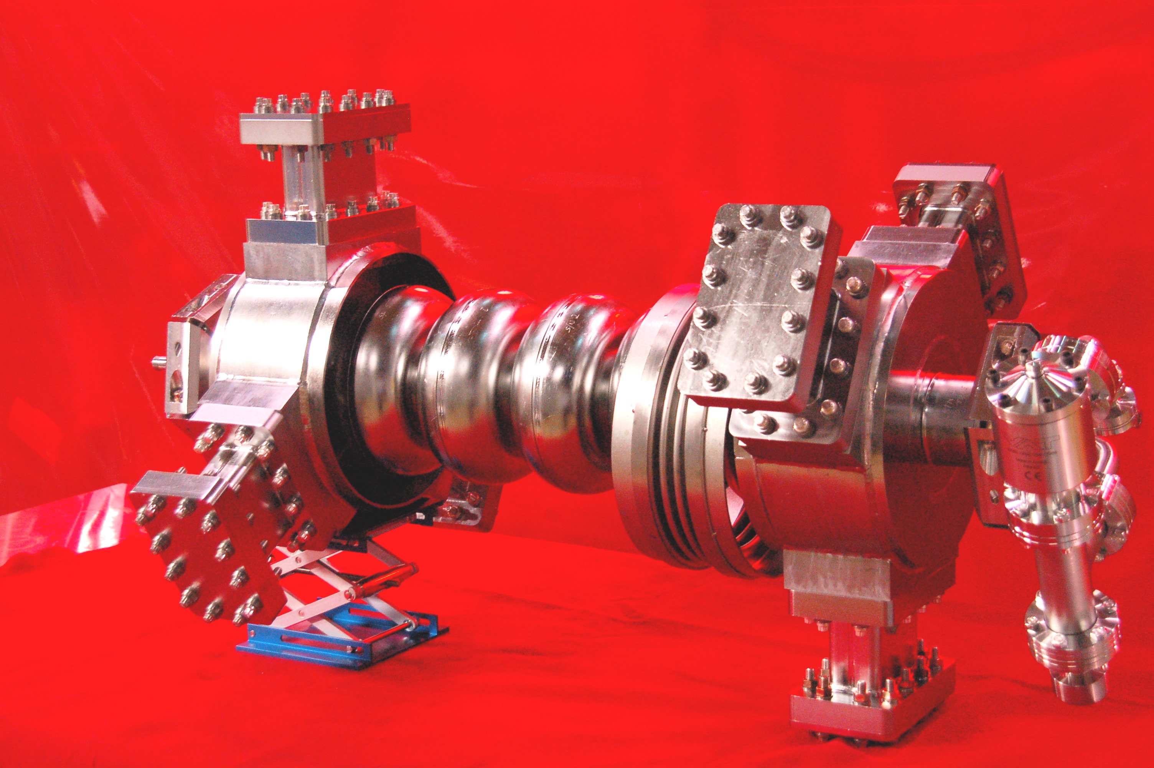
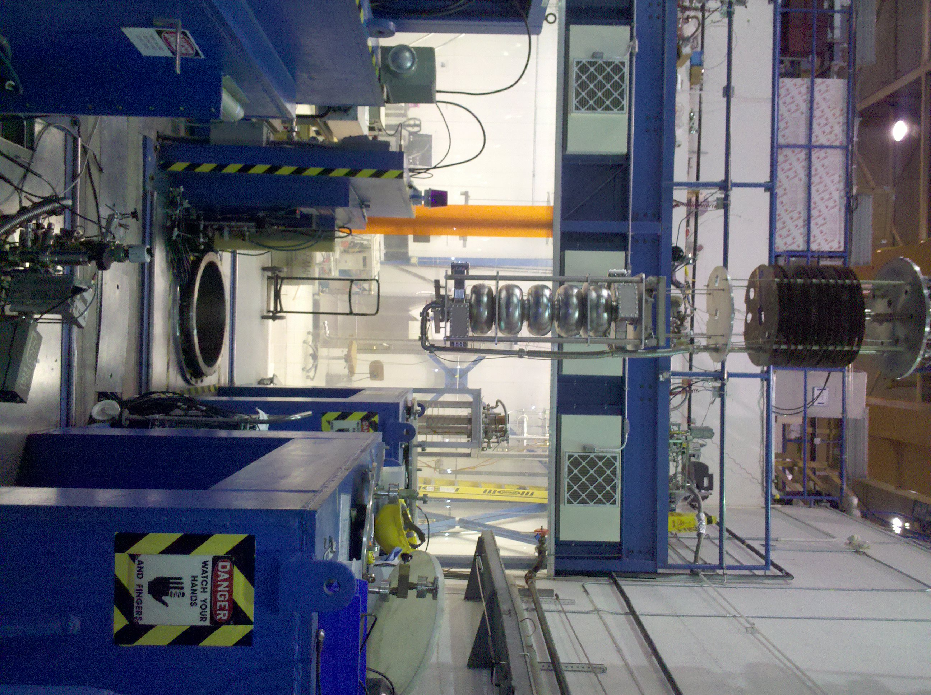
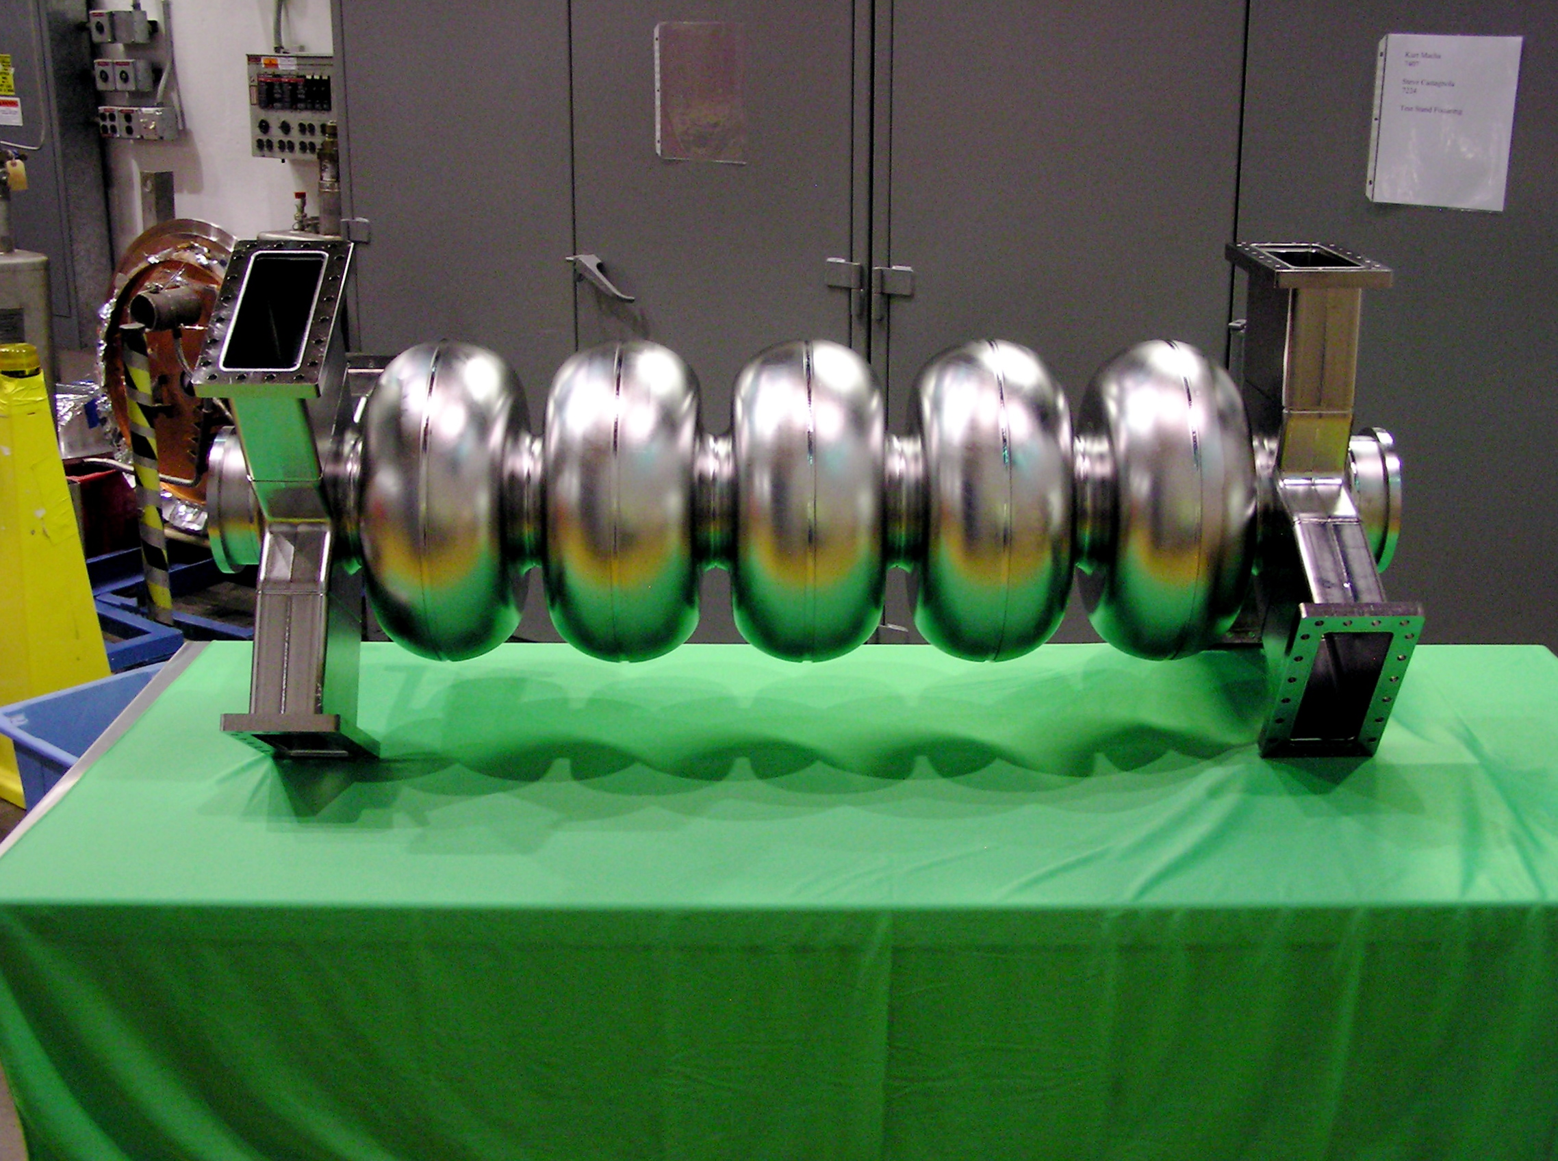
High-current cavity test results
1.5 GHz 750 MHz
Multipacting seen from low gradient but processed away

