Slide 1

HOM Damper Hardware Considerations for Future Energy Frontier Circular Colliders
The 55th ICFA Advanced Beam Dynamics Workshop on
High Luminosity Circular e+e- Colliders – Higgs Factory (HF2014)
S. Belomestnykh
Brookhaven National Laboratory, Upton, NY 11973-5000, U.S.A.
and
Stony Brook University, Stony Brook, NY 11794, U.S.A.

Slide 2
Introduction
Future high-luminosity energy frontier circular colliders will operate with high average beam currents. Radio-frequency systems in these machines will utilize superconducting RF structures with strong damping of higher order modes.
There is a wide variety of HOM damper designs for SRF cavities.
However, very few of those are designed to handle high average HOM power and even fewer demonstrated this in operation.
In this presentation I will review designs of the HOM dampers, existing and under development, with an emphasis on applicability to future energy frontier circular colliders.

Slide 3
Outline
HOM damper types
Examples & experience: beam pipe absorbers; rectangular waveguide & radial line couplers; loop couplers
HOM coupler R&D for kW level HOM power
Summary

Slide 4
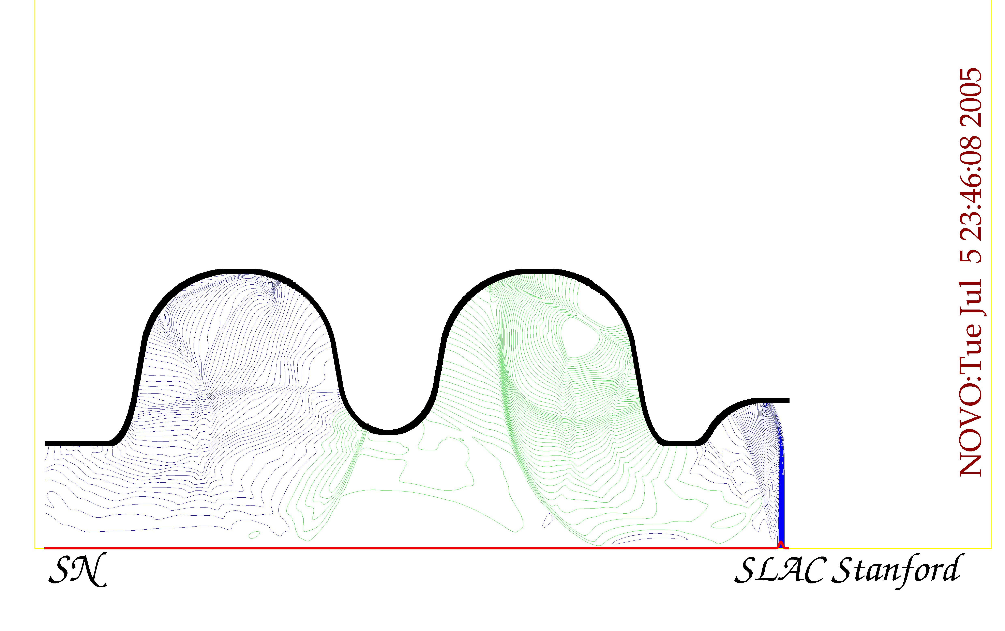
Why do SRF cavities need HOM dampers?
Extremely low RF losses that make SC cavities so attractive in the first place are a handicap when we consider higher-order modes (HOMs).
The parasitic interaction of a beam with HOMs can cause additional cryogenic loss, excite multi-bunch instabilities, beam energy loss, etc.
High-current storage rings require damping of HOM’s quality factors in the 10²…10⁴ range. HOM couplers will have to handle ~1 kW level power.

Slide 5
HOM damper types
There are three main design types, which use different transmission lines/coupling circuits: beam pipe HOM absorbers (beam pipe = circular waveguide), rectangular waveguide HOM couplers, and loop HOM couplers to a coaxial line.
Waveguide couplers have a cut-off frequency and therefore do not need a filter to reject the fundamental RF frequency. Thus they are inherently more broad band.
The cavity beam pipe is opened to facilitate propagation of the lowest frequency HOMs toward the absorber. The absorber is a section of the beam pipe with a layer of microwave absorbing material (ferrite or ceramics).
Coaxial lines can transmit TEM waves (hence no cut-off) and therefore HOM couplers based on these lines need special means to reject the fundamental RF. Coaxial loop couplers are more compact than other types.

Slide 6
Beam pipe absorbers
Originally developed at Cornell University and KEK for very high average power absorption.
Widely used in high-current storage rings, where they operate at room temperature outside the cryomodule.
Achieved Q_{HOM} ≈ 10²…10³ in single-cell storage ring cavities.
Cornell developed an HOM load operating at 80 K for ERL cavities with dissipating capacity of ~200 W. KEK is also developed beam pipe HOM loads for cERL.
DESY developed a beam pipe absorber for XFEL to complement loop HOM couplers.
However, the absorbers designed to operate at cryogenic temperatures are not capable of dissipate kW level HOM power.
Dampers of this type are arguably the most efficient and likely will be required to absorb very high frequency portion of HOM power, which propagates along the beam pipe.
Drawbacks of beam pipe absorbers:
  most absorber materials are brittle, can create particulates that contaminate SRF cavities;
  parasitic beam-absorber interaction is significant and contributes to the overall HOM power;
  the main disadvantage for large SRF systems is that they occupy real estate along the beam axis and thus reduce the fill factor.

Slide 7
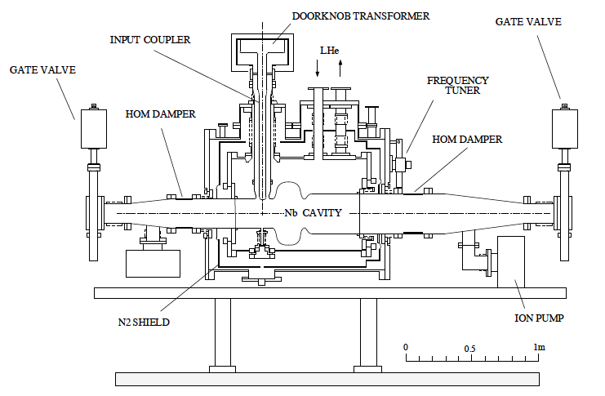
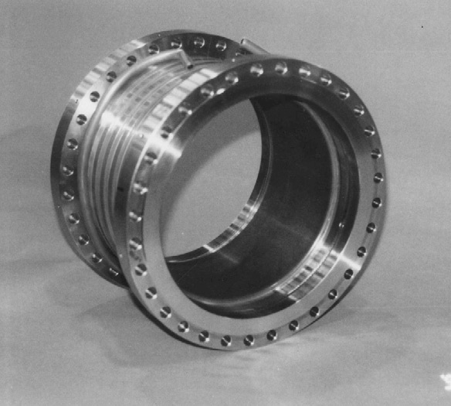
KEKB HOM beam pipe absorbers
Ferrite is bonded to copper plated steel housing using HIP process.
Absorbers of this design are used at KEKB and BEPC-II.
Designed to for 2.5 kW absorption, reached 8 kW in operation.
HOM power in Super KEKB will be ~15 kW per absorber.

Slide 8
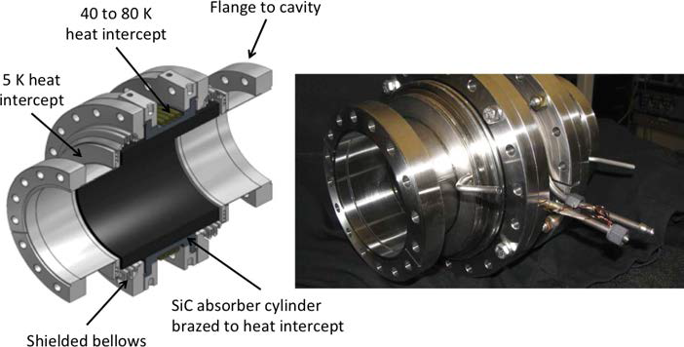
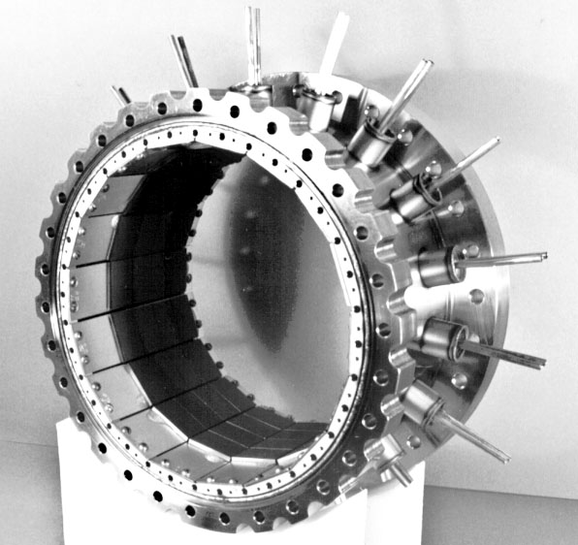
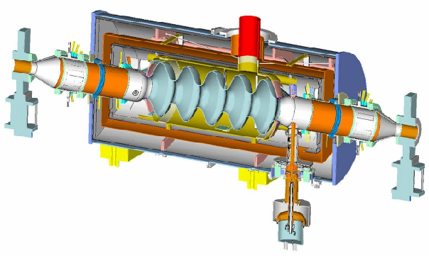
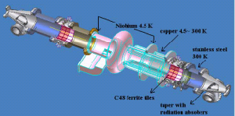
Cornell HOM loads
CESR HOM load
Ferrite tiles are soldered to water-cooled Elkonite plates, which in turn are mounted inside a stainless steel shell.
CESR-type HOM loads are used at CESR, TLS, CLS, Diamond, SSRF, and R&D ERL at BNL.
Absorbed up to 2.9 kW in operation.
ERL HOM load
Use graphite-loaded SiC material to cover frequency range > 40 GHz.
Operate at 80 K, cooled by cold He gas.
Dissipating capacity of ~200 W.
BNL ERL cryomodule
Cornell ERL cavity

Slide 9
European XFEL beam pipe absorber
Needed to cover the high frequency part of the HOM spectrum.
Absorbers will be installed between 8-cavity cryomodules.
5.4 W of microwave power per lossy ceramic ring during nominal operation of XFEL.
Capable to dissipate up to 100 W.

Slide 10
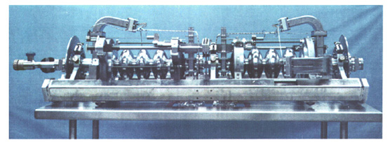
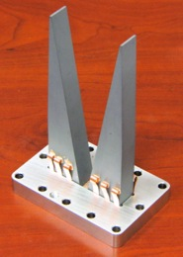
Rectangular waveguide HOM couplers
Used in CEBAF and JLab FEL SRF linacs.
New designs are being developed primarily at Jefferson Lab.
Proposed for JLab’s Ampere-class cryomodule (748.5 MHz) and “100 mA” cryomodule (1497 MHz).
While can provide very efficient damping in broad frequency range and don’t compromise the fill factor, waveguides significantly complicate the cavity and cryomodule design.
CEBAF: WG absorbers at 2 K
Ampere-class cryomodule: WG absorbers at RT
HOM load concept

Slide 11
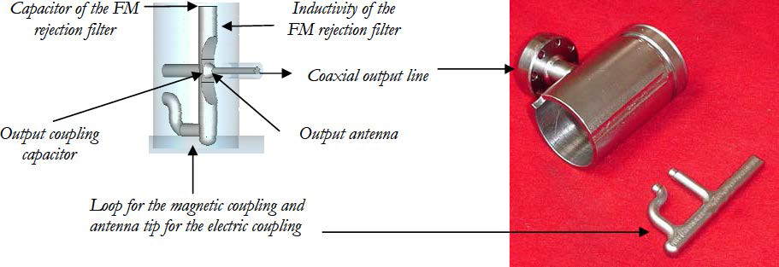
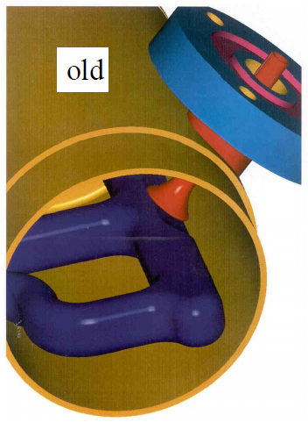
Antenna/loop HOM couplers
Couplers of this type were proposed and developed for HERA and LEP in mid-80’s.
LEP-type couplers were later adapted for SOLEIL, LHC, and Super-3HC cryomodules at SLS and ELETTRA.
TESLA HOM couplers were derived from HERA couplers with a simplified RF design due to more moderate damping specs (Q_{HOM} ~ 10⁵).
Later scaled for use at SNS (805 MHz), Fermilab (3.9 GHz) and 12 GeV CEBAF upgrade (1.5 GHz) cryomodules though there were some difficulties.
Dampers of this type can provide strong damping depending on a particular RF design.
Their main disadvantage is fundamental RF rejection filters, which must be carefully tuned.

Slide 12
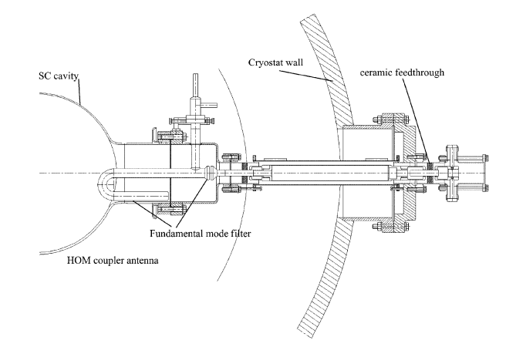
LEP/LHC couplers
LEP2 cavities had two “hook” type couplers, where the hook was filled with liquid helium for cooling.
The notch filter can be adjusted after installation.
In addition to LEP2 dipole mode couplers, LHC cavities have broadband couplers.

Slide 13
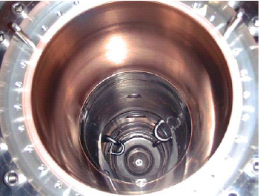
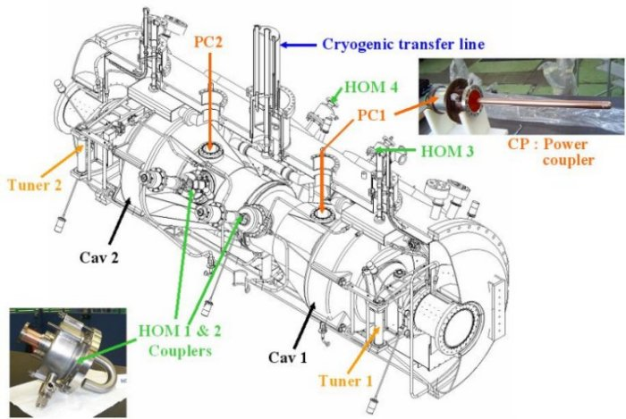
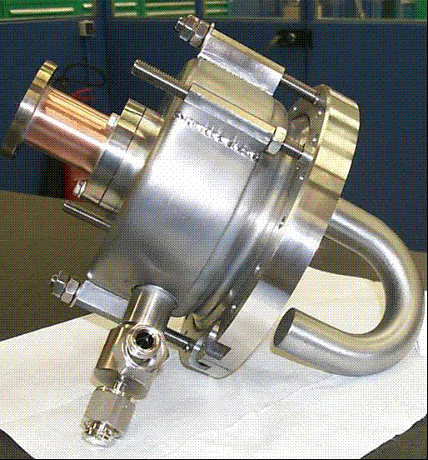
SOLEIL/Super-3HC couplers
Two types of HOM couplers: for dipole and monopole modes.
Much higher coupling factor than in LEP or TESLA cavities.
Observed in operation HOM power is just a few W.
What the beam sees passing
through the SOLEIL module
SOLEIL cryomodule
SOLEIL HOM coupler

Slide 14
HOM couplers under development
WG HOM damping geometry studies at JLab
eRHIC / high current applications at BNL
HL-LHC crab cavities at BNL

Slide 15
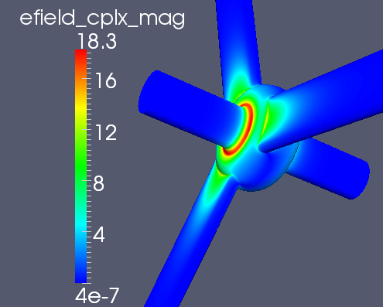
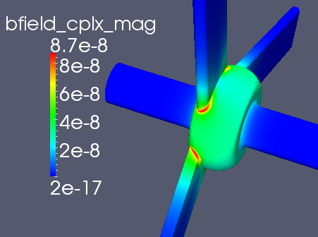
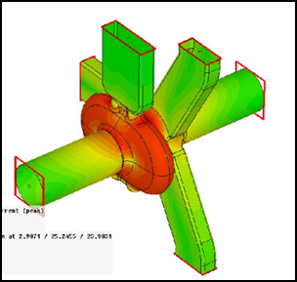
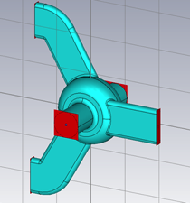
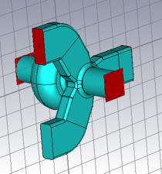
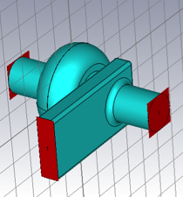
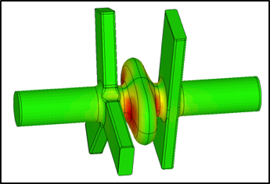
RF cavity geometry studies at JLab
750 MHz MEIC e-ring cavity concepts
ANL SPX 2.82GHz crab cavity with on-cell damper

Slide 16
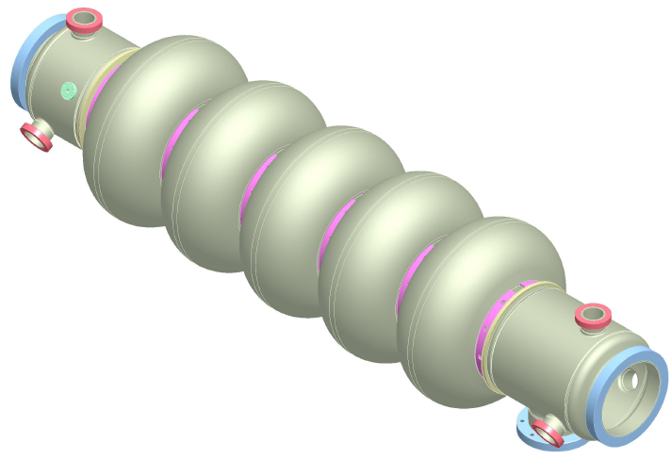
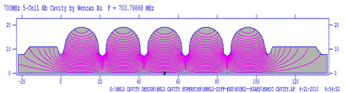
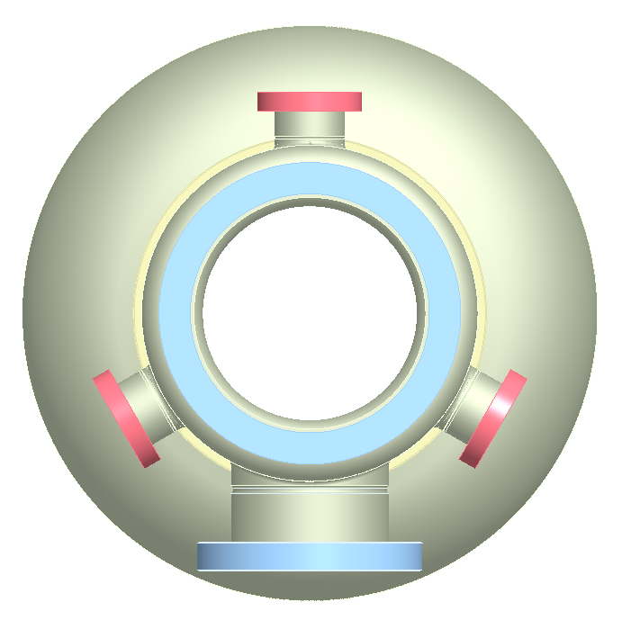
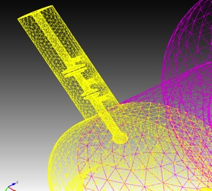
BNL3 cavity
A 704 MHz superconducting cavity has been developed at BNL for high-current applications.
The cavity, BNL3, has an optimized geometry that supports strong damping of higher order modes (HOMs) while maintaining good properties of the fundamental mode.
The damping is accomplished via six antenna-type couplers attached to the large diameter beam pipes. The coupler should handle ~1 kW of HOM power.
More details were provided in Wencan Xu’s talk.
HOM ports
FPC port

Slide 17
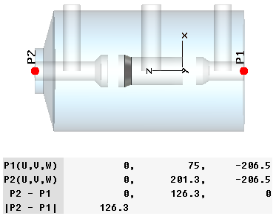
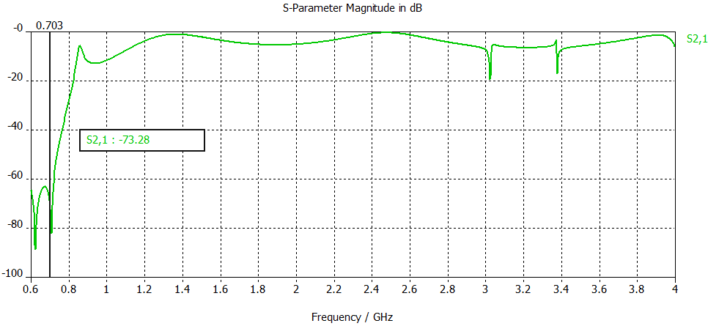
HOM damping R&D for eRHIC:
1. Two-stage filter HOM coupler
50 Ohm transmission line to room temperature
D = 72 mm
Between the two notches, S21 < -65 dB, 1st HOM is at 0.82 GHz, S21 = -23 dB.
It has good damping at high frequencies.
Work on filter optimization continues.

Slide 18
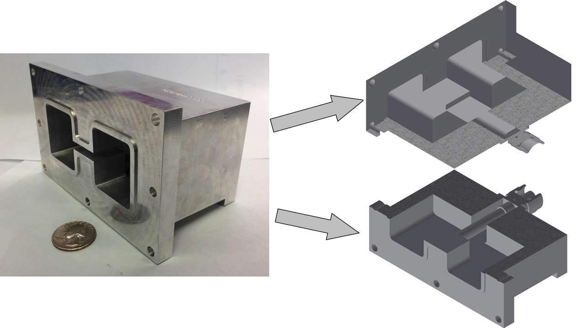
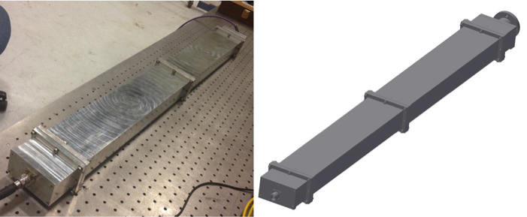
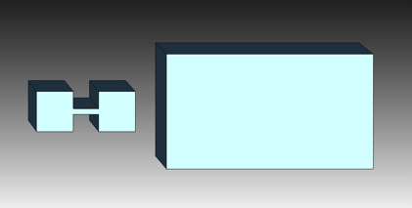
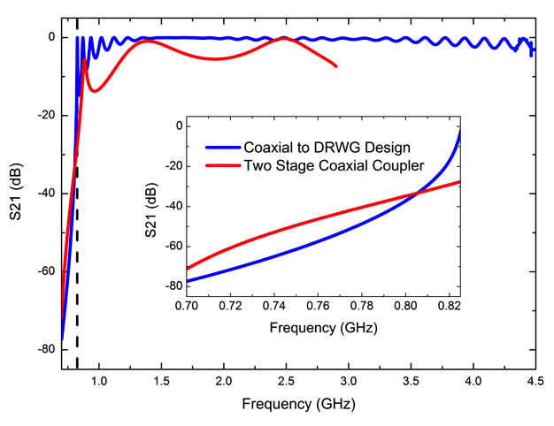
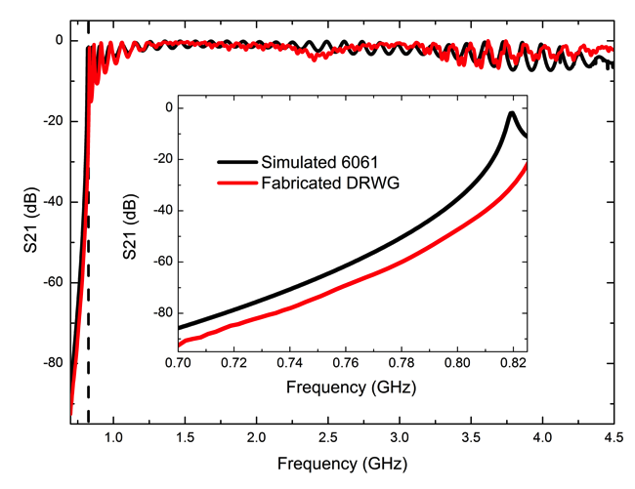
HOM damping R&D for eRHIC:
2. Dual ridge waveguide HOM coupler
More compact than rectangular waveguide.
A very good broadband coax-to-waveguide transition.
Better transmission than that of the 2-stage coaxial coupler.

Slide 19
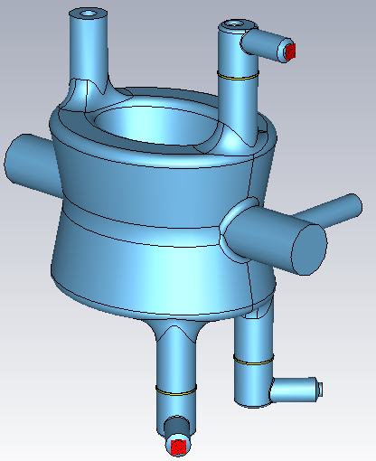
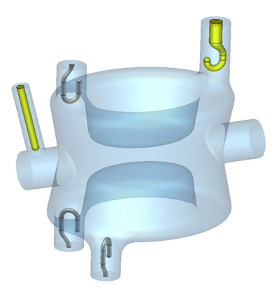
HOM damping for HL-LHC DQW crab cavities
FPC
HOM coupler
RF pick-up
beam
HOM couplers

Slide 20
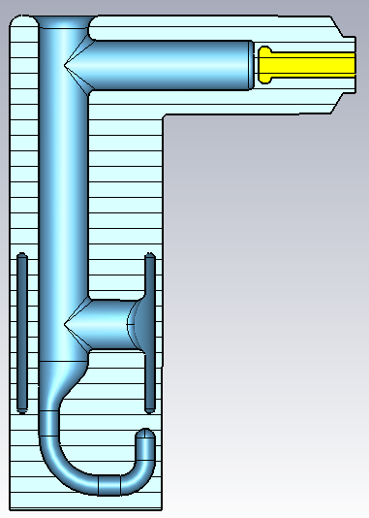
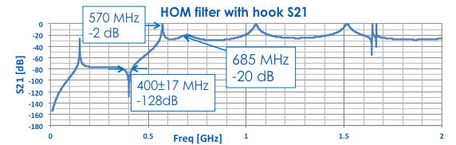
HOM damping for HL-LHC crab cavities
Cooling channel is capable of extracting 0.8 W power from HOM hook (<300 mW dynamic loss on each filter based on 10 nOhm resistance).
Band stop structure to provide minimum loss on Cu gasket (mW range RF loss).
Loss on Cu pin is negligible (µW range RF loss)
Coupling to 400 MHz: 7.9x10⁹ (1.1 W at each port to outside load).
Peak magnetic field on the cavity is 71.3 mT at 3.34 MV kick.
Peak magnetic field on HOM is 86% of that on cavity.
Designed to handle ~1 kW of HOM power per cavity.
Cooling channel, diameter >10 mm
Cu pin for RF feedthrough to outside load
Conflat flange to separate HOM filter from the cavity.

Slide 21
Summary
There are many proven designs of HOM dampers.
However, only beam pipe absorbers demonstrated so far power levels of interest to future circular colliders.
LHC type couplers were designed for ~1 kW HOM power levels, but operates at lower HOM power levels.
There are also several new designs under development, which might be suited for future circular colliders.

