Slide 1

704 MHz BNL3 cavity as an option for CEPC/FCC
BROOKHAVEN SCIENCE ASSOCIATES
Wencan Xu
Brookhaven National Lab

Slide 2
Outline
Brief introduction for 704 MHz BNL1 (ECX) cavity for the ERL prototype
Design and test results of 704 MHz BNL3 cavity
HOM damping scheme and HOM coupler
Summary

Slide 3
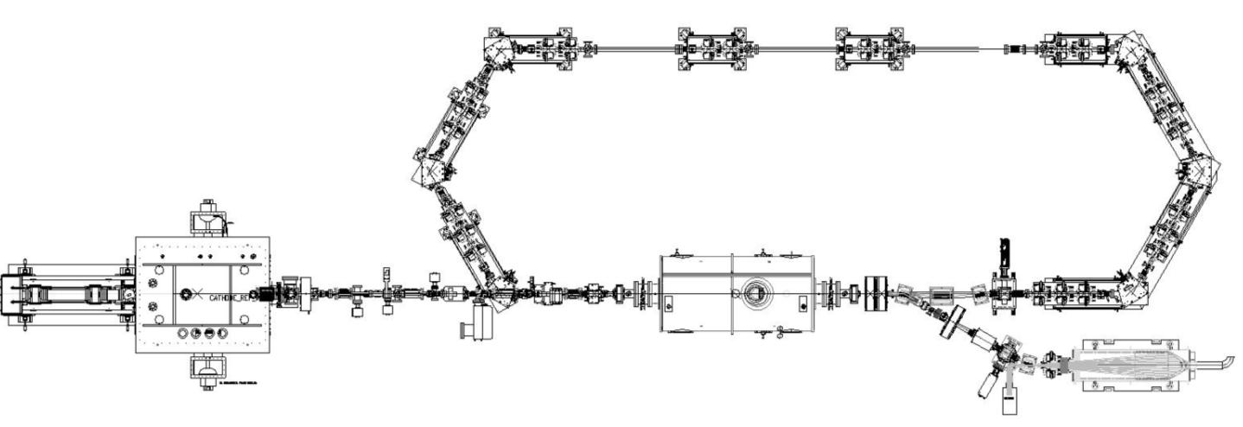
The R&D Energy Recovery Linac at BNL
Straight section is 7m long
20 MeV
SC RF Gun
20 MeV
20 MeV
2-3 MeV
2-3 MeV
2-3 MeV
SC 5 Cell cavity
Beam dump
Will serve as a test-bed for future RHIC projects:
  ERL-based electron cooling;
  10-to-20 GeV ERL for electron-ion collider eRHIC;
  Low Energy RHIC electron cooler (LEReC).
Will be able to test the key components of the High Current ERL based solely on SRF technology
  704 MHz SRF Photo-injector: preservation of beam quality for high-charge, low emittance;
  High current 5-cell SRF linac test with HOM absorbers;
  Stability criteria for CW beam current;
  Attainable ranges of electron beam parameters in SRF ERL.
SRF linac was commissioned and ready to accept beam;
SRF gun is undergoing beam commissioning.
Notes:
SRF photo-injector includes SRF cavity, HTS, laser, merger…

Slide 4
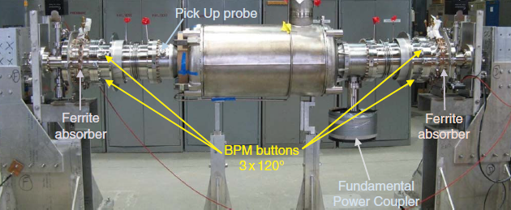
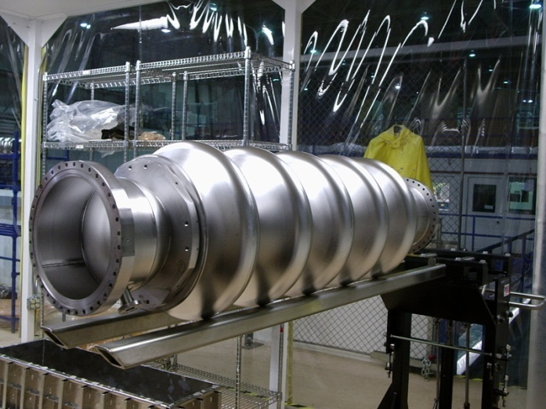
BNL1 5-cell linac for R&D ERL
Enlarged beam tube: to attenuate the fundamental mode but propagate all the HOMs.
RT ferrite as HOM damper: HOM measurement at both room temperature and low temperature showed extremely good damping. However, the real-estate gradient is reduced because of the RT damper;
50 kW CW fundamental power coupler: SNS type, water cooling on the RF window, no cooling for the inner conductor.
First horizontal test in March, 2009 and several tests were carried out after that(Q₀ ~ 10¹⁰ at 18 MV/m).
Mechanical tuner with 112 kHz tuning range, piezo provides 9 kHz fast tuning

Slide 5
BNL3 cavity for Conventional Lattice eRHIC
Parameters | eRHIC
Bunch charge [nC] | 3.5
Beam current [mA] | 50
RMS bunch length [mm] | 2
Beam energy [GeV] | 5-30
Number of passes | 6
Operation mode | CW
Design of BNL3 cavity, a universal cavity for high current SRF linac, SPL and eRHIC.
50 mA, 6 passes High current ERL based
All in the RHIC existing tunnel: high real-estate gradient
The luminosity can exceed 10³⁴ cm⁻²s⁻¹

Slide 6
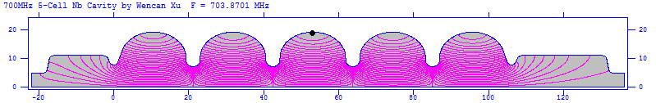
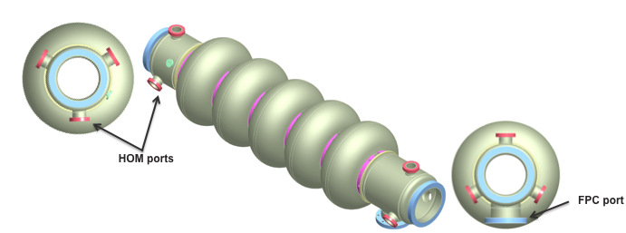
BNL3 cavity for Conventional Lattice eRHIC
Parameters | BNL I | BNL III
Frequency [MHZ] | 704 | 703.87
beta | 1 | 1
Cells No. | 5 | 5
Geometry Factor | 225 | 283
(R/Q)/cell [Ω/cell] | 80.8 | 101.26
Epeak/Eacc | 1.97 | 2.46
Bpeak/Eacc [mT/MV/m] | 5.78 | 4.26
Coupling factor [%] | 3.00 | 3.02
Length with HOM damper (cm) | 272 | 160 (eRHIC)
Beam pipe radius (mm) | 120 | 110

Slide 7
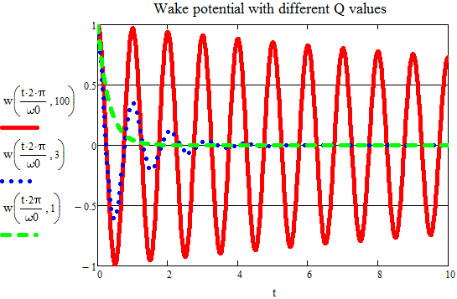
HOM damping scheme
High-Q HOMs linger inside the cavity for some time, depending on the time decay constant, and can strongly act back on the particles in the trailing bunches and/or the same bunch.
HOM power built up in a CW machine (one monopole mode):
Resonant exciting
Non-resonant exciting
Beam-Break-Up induced by one dipole mode:

Slide 8
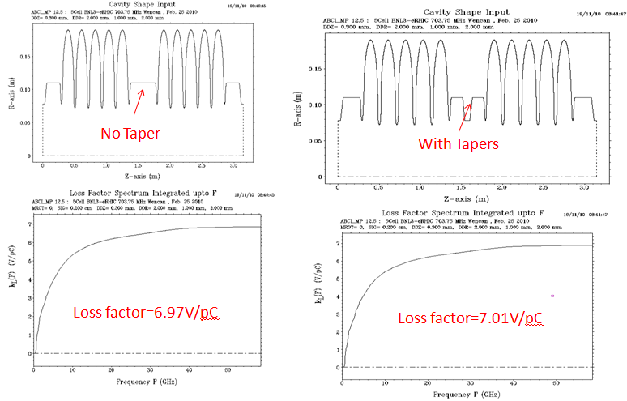
Monopole mode damping
The average monopole modes’ power:
For conventional lattice eRHIC: 50 mA x 3.5 nC x 3.47 V/pC x 12 passes => 7.3 kW /cav.
For CEPC collider: 16.6 mA x 61.6 nC (37.1*1.66) x3.47 V/pC*0.877 (2.66 mm) => 3.1 kW/cav
Impact of taper:
*Quasi symmetric taper will not affect the loss factor.
Notes:
Comparison of the (R/Q)Qe obtained by the R/Q corresponding to the eRHIC cavity design (blue diamonds) with the requirement for 50 mA (red squares) and 300 mA (green triangles) in 3 passes through the ERL

Slide 9
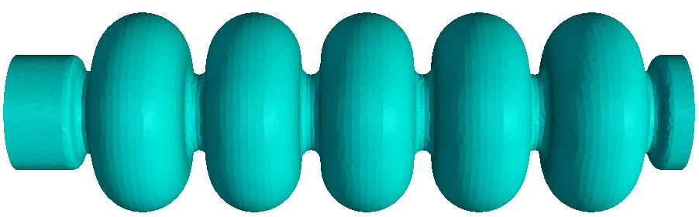
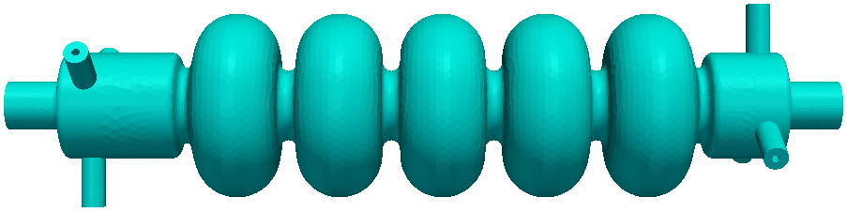
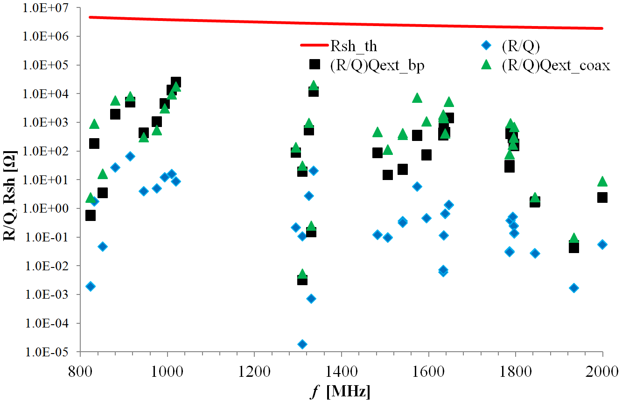
BBU threshold for conventional lattice eRHIC
Ideal damping:
WG
WG
Real damping scheme:
Coaxial HOM coupler has similar damping capability with the ideal case;
BBU threshold current is way above the operation current from BBU simulation (GBBU code).

Slide 10
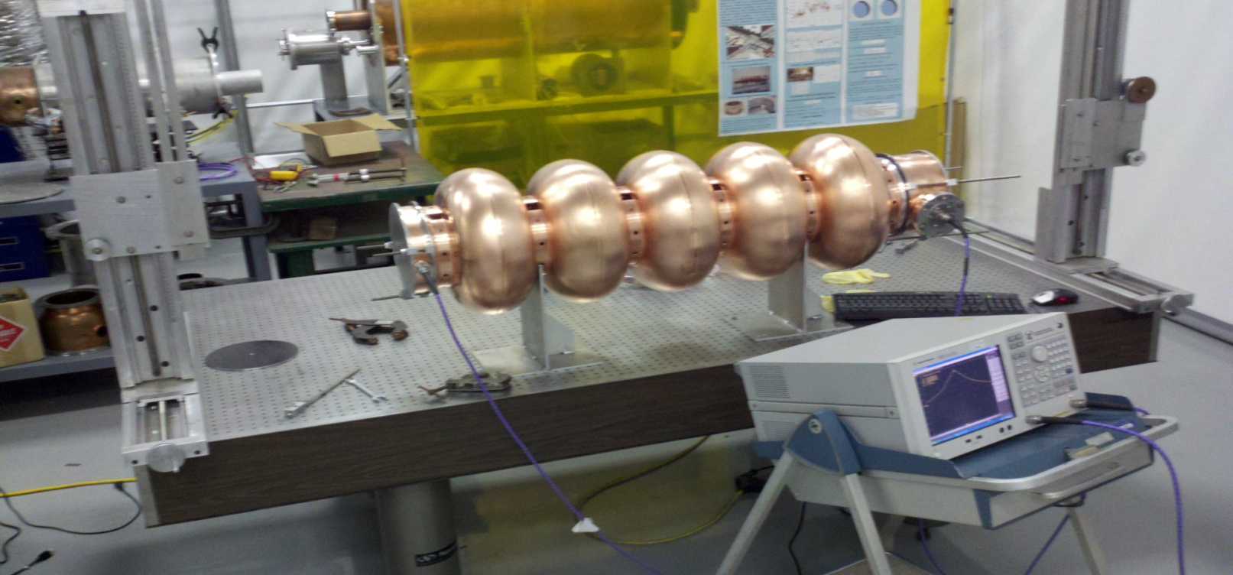
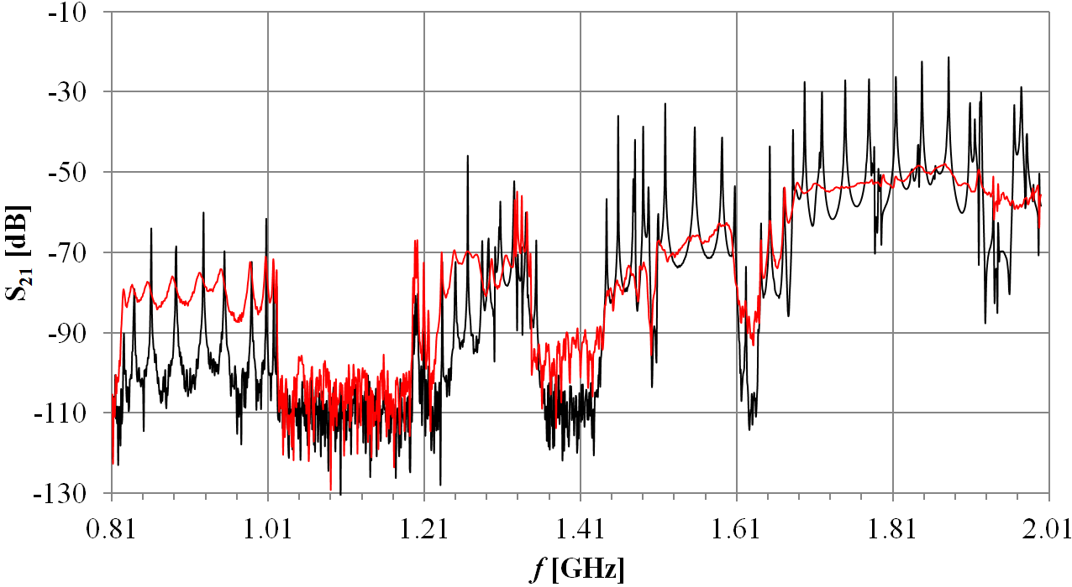
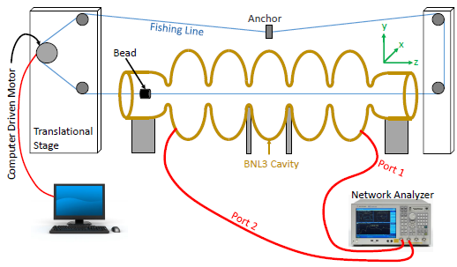
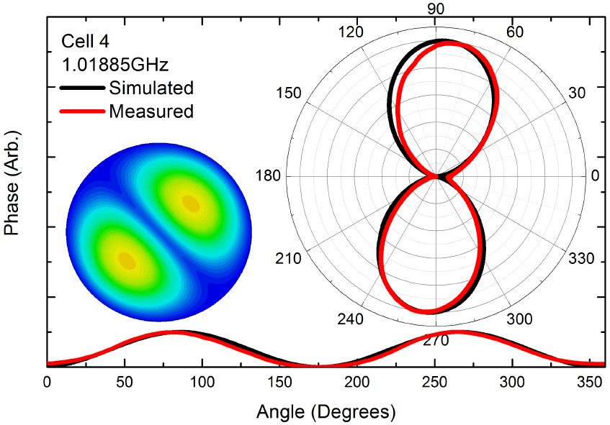
HOM measurements
HOM damping capability
Black: closed
Red: Open
Quadrupole
Dipole
Change Boundary Condition
HOMs indentified by 3-D bead-pull setup
Notes:
Field flatness: benefit from the large cell-to-cell coupling, the Cu and Nb cavities have good field flatness after fabrication.
The detachable beam pipes gave us a lot of freedom in the RF measurement;
The comparison of the S₂₁ measurements for open and closed beam pipe verifies the excellent propagating properties of the BNL3 cavity through the dramatic reduction of the loaded Q values in the open beam pipe case.

Slide 11
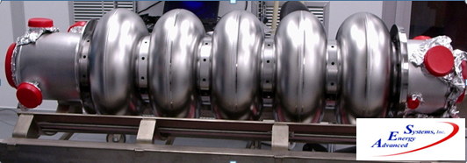
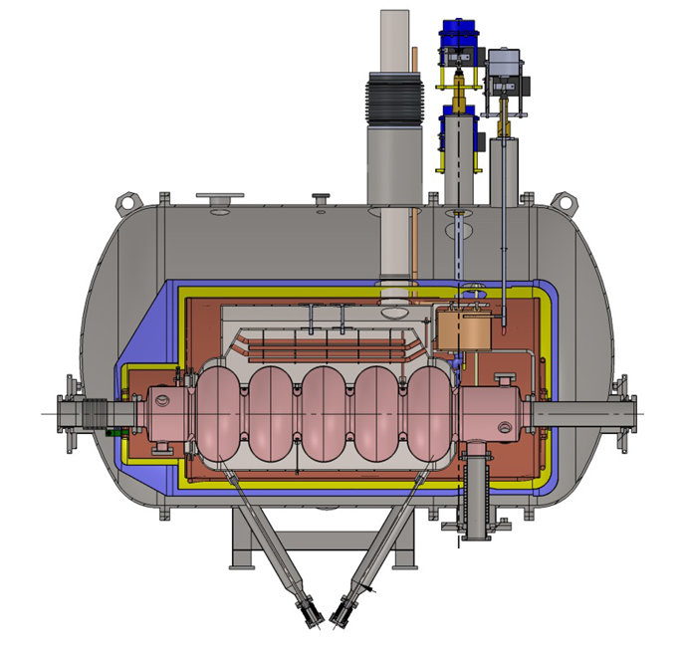
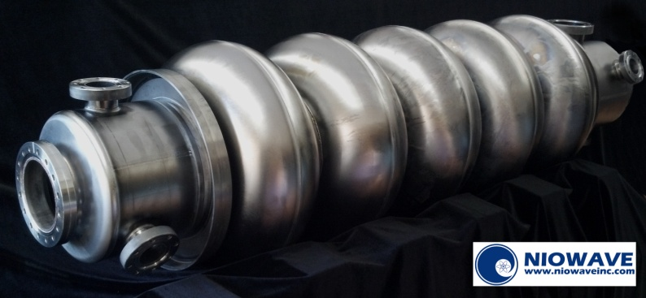
Two Nb cavities
BNL3-AES cavity
Vertical test results shows that BNL3-AES cavity has great performance. It is using for CEC POP.
BNL3-Niowave cavity
BNL3 cavity cryomodule for CeC PoP (Ordered from Niowave)
The BNL3-Niowave cavity needs to be re-welded in the equator areas ( strong FE at very low field and not able to process through).

Slide 12
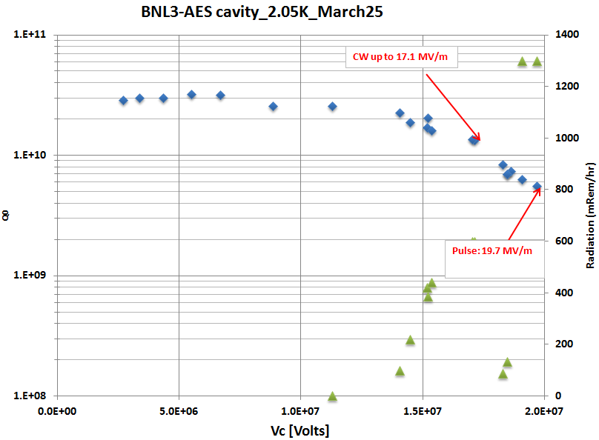
BNL3 AES cavity preliminary test result
Radiation tripped RF
Vertical test measured the gradient up to 19.7 MV/m with field emission and administration. The safety administration limitation was 20 MV/m. With HPR, this cavity should be able to reach field level higher than 20 MV/m.
Notably, the Q0 value reached 3.2E10, which residual resistance is about 4.5 n Ohm.
We are confident/happy with the cavity’s performance. And it is now at Niowave for cryo-module assembly.

Slide 13
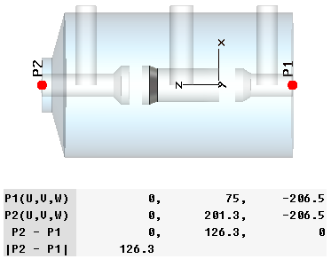
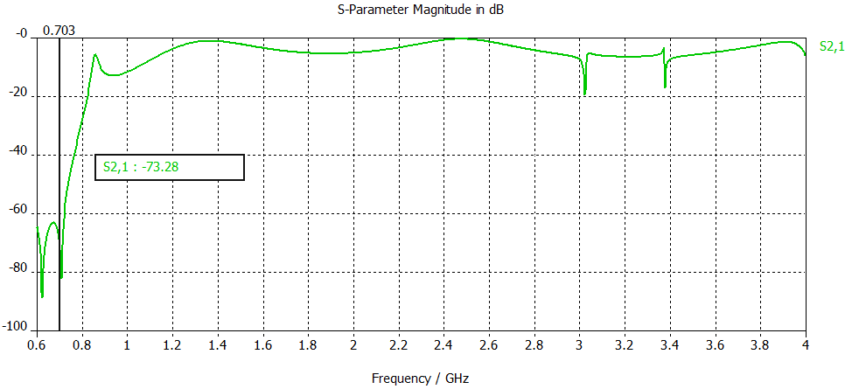
2-stage HOM coupler design for eRHIC
50 Ω transmission line to room temperature
D = 72 mm
Between the two notches, s21 < -65 dB, 1st HOM is 0.82 GHz, S21 = -23 dB,
It still has good damping at high frequency
Capacitors can be add to the transmission line to reduce the thermal conduction

Slide 14
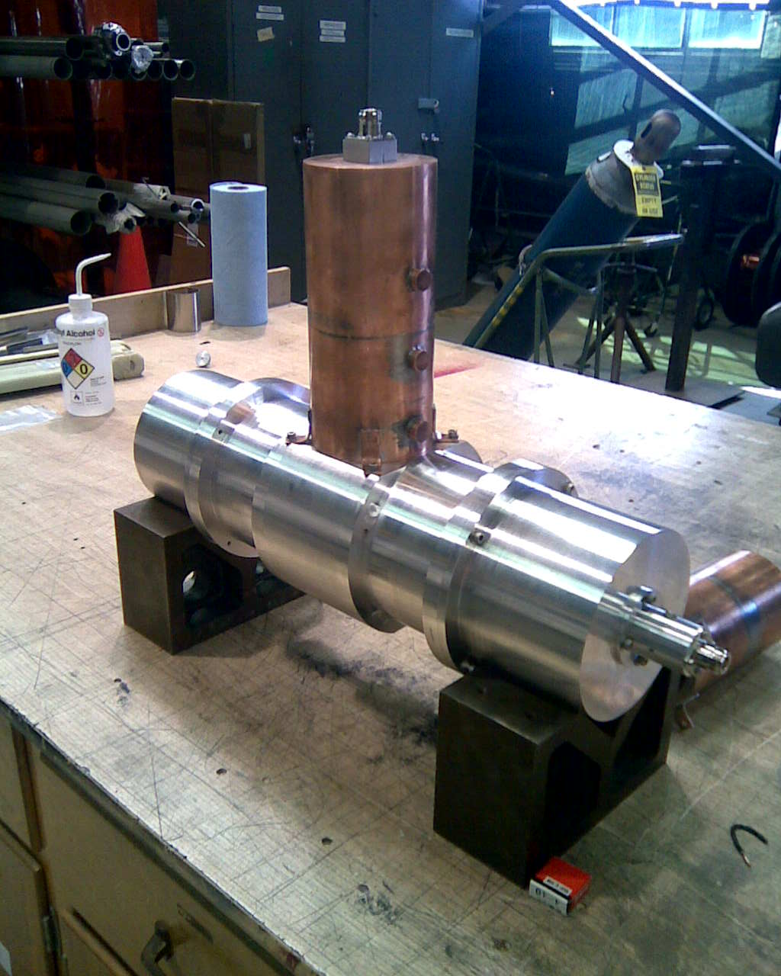
2-stage HOM coupler-model test
The test by transmission line verified the design.
Because of the big diameter(D = 72 mm) of the HOM couplers, the transmission line’s diameter is so big that some HOM appears.

Slide 15
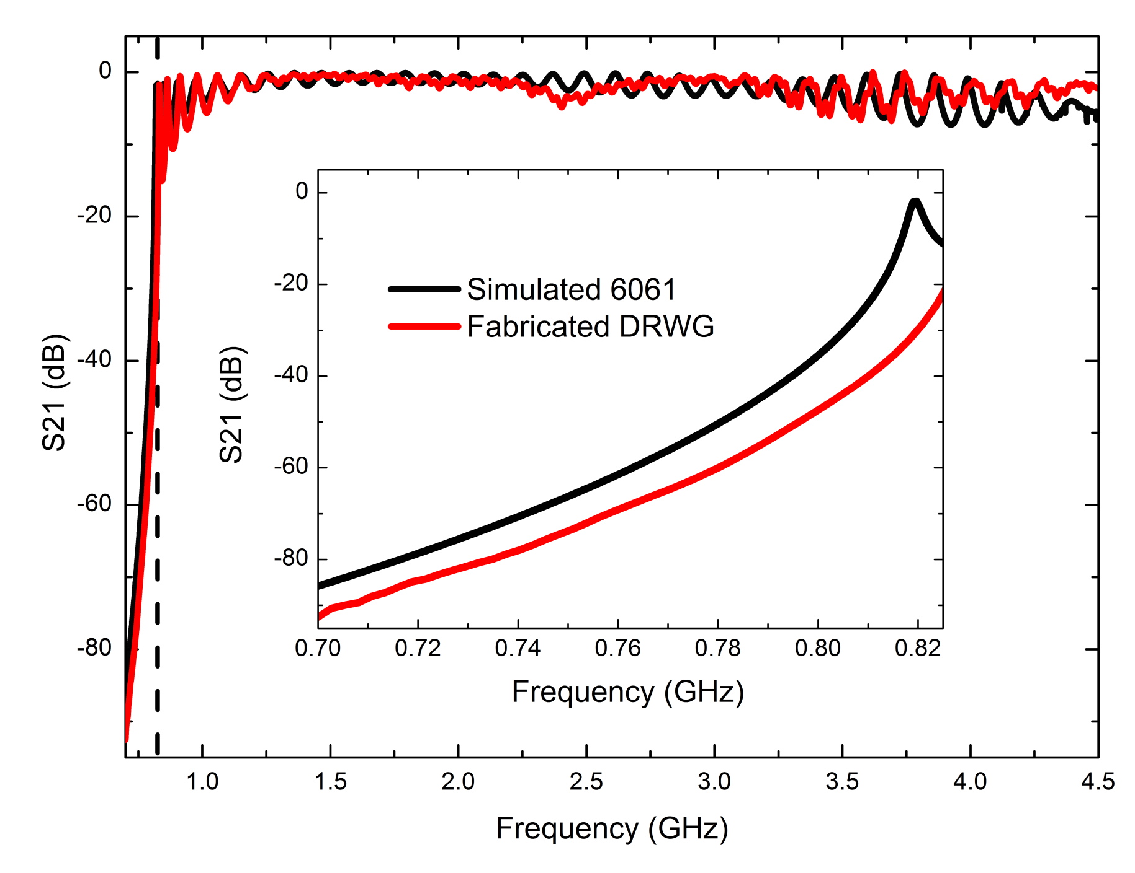
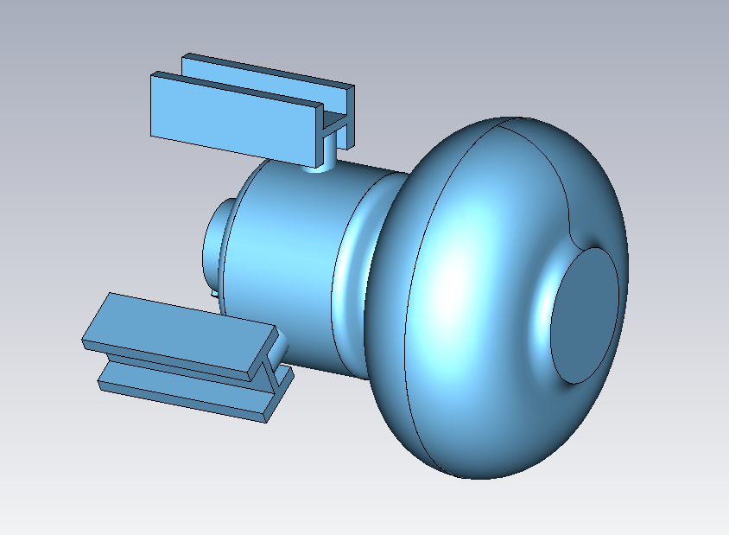
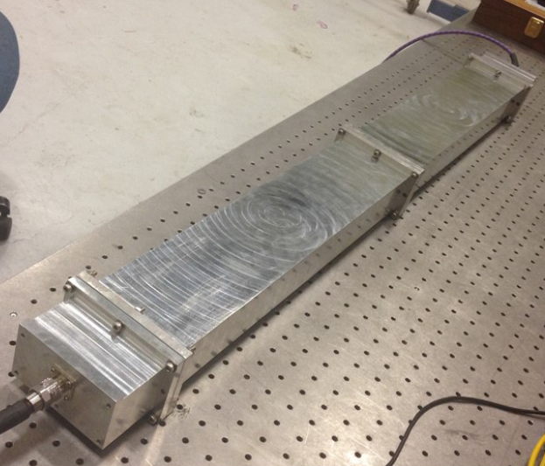
Dual-Ridge Waveguide HOM coupler
  Waveguide as a natural high pass filter is also considered as an option for high power HOM damper;
  Dual ridge waveguide HOM filter is chosen to minimize WG geometry size;
  A prototype was fabricated the demonstrated the RF performance as expected.

Slide 16
Summary
We have got a lot of experience during the operation of the BNL1 cavity in ERL prototype.
BNL3 cavity has been designed for the conventional lattice eRHIC and SPL.
HOM measurements and studies were carried out on the detachable copper prototype. And it shows that the HOMs were well-damped.
Two Nb cavities were fabricated by AES and Niowave, one will be used for POP CEC and the other will be used for performance study. The BNL3-AES cavity test results shows good performance and is using for CEC POP cryomodule. BNL3-Niowave cavity has to be tested more with additional processing.
The 2-stage coaxial HOM coupler was designed and tested. The dual-ridge waveguide HOM coupler has been designed and its prototype has been test as well.

Slide 17
Acknowledgement (incomplete list)
BNL: S. Belomestnykh, I. Ben-Zvi, R. Calaga (at CERN now), L. DeSanto, H. Hahn, Y. Hao, J. Huang, L. Hammons, D. Kayran, B. Kellerman, V. Litvinenko, C. Marques, G. McIntyre, R. Porqueddu, V. Ptitsyn, T. Seda, J. Tuozzolo, B. Sheehy, R. Than, D. Trbojevic, D. Weiss, B. Xiao, A. Zaltsman…
AES: D. Holmes, M. Cole, T. Schultheiss
Niowave: C. Boulware, T. Grimm.

