Slide 1
Partial summary of WG3
M. Sullivan and Y. Funakoshi

Slide 2
List of Talks
(1) CEPC IR optics : Yiwei Wang (IHEP)
(2) Status of the FCC-ee interaction region design : Roman Martin (CERN)
(3) Crab waist interaction region : Anton Bogomyagkov (BINP)
(4) Choice of L* I: SR and other issues (Joint with WG4) : Michael Sullivan (SLAC)
(5) Choice of L* II: IR optics and dynamic aperture : Eugene Levichev (BINP)
(6) Choice of L* III: requirement from detector : Gang Li (IHEP)
(7) Lost particles in the IR and Touschek effects : Manuela Boscolo (INF)
(8) Detector beam background simulations for CEPC : Hongbo Zhu (IHEP)
(9) SuperKEKB background simulations : Hiroyuki Nakayama (KEK)
(10) Beam-beam limit vs. number of IPs and energy I: beam-beam simulation : Kazuhito Ohmi (KEK)
(11) Beam-beam limit vs. number of IPs and energy II: scaling law : Ming Xiao (IHEP)
(12) Long-range beam-beam interaction with the bunch train operation : David Rice (Cornell U.)

Slide 3
Initial Study of Synchrotron Radiation Issues for the CEPC Interaction Region
M. Sullivan
SLAC National Accelerator Laboratory
for the
CEPC14 Workshop
Oct. 9-13, 2014

Slide 4
Summary of talk
Primary source of SR
  Last bend magnet before the IP
  The final focus magnets
  Bend Magnets in the Chromaticity Correction sections
An initial study of SR issues for CEPC has been done.
Some FF quad changed were suggested.
List of issues to keep in mind for future study were shown.

Slide 5
Summary
There is quite a bit of SR power in the earlier design of the CEPC local chromaticity correction
  9 MW (currently 1.7 MW) – twice this for 2 IRs
  The new chromaticity correction schemes with the softer bend magnets help a lot
The final focus magnets may need further optimization and perhaps the magnet strengths can be further lowered

Slide 6
Summary (cont.)
I do not think the beam pipe under the final focus magnets can be cryogenic – there is probably too much SR power very close by
  One has to protect the beam pipe from not only primary photons but also secondary and perhaps even tertiary photons (Single bounce and double bounce photons and shower debris from higher energy gammas)

Slide 7
Suggested FF quad change
Would like to suggest some changes to the FF quads
Suggest increasing the length of the magnets and moving them farther apart
  Make both magnets 1 m long
  May need to make longer to get to possible field strengths (see E. Paoloni’s talk)
  2 m drift between Q2 and Q1 (was 1.44 m)
If we can move the Q1 down to a 2 m L* then the maximum beta comes down from nearly 6 km to about 4 km
  This makes the chromaticity correction a little easier
  New design has L* of 1.5 m which is even better

Slide 8
FF change (cont.)
These proposed changes reduce the SR power from the FF quads by a factor of 2 which is a big help
Making βy* larger is a big help
May need to do more to improve dynamic aperture?
This change increases the amount of SR hits on the IP beam pipe mainly due to backing up the X focusing magnet (Q2)
  Smaller angle tracks can now strike the detector beam pipe

Slide 9
Choice of L* for FCCee:
IR optics and DA
A.Bogomyagkov, E.Levichev, P.Piminov
Budker Institute of Nuclear Physics
Novosibirsk

Slide 10
Summary of talk
Estimate nonlinear features of FCCee final focus as a function of L* and β*.
  They took nonlinear detuning coefficient α as FF nonlinearity figure of merit.
  considered nonlinearity
    kinematic term
    fringe fields of final focus quadrupoles
    paired sextupoles of local chromaticity sections
  compare several colliders
Design several lattices of FF (from IP to beginning of the arc) for several L*.
DA study
Conclusions

Slide 11
Kinematics
For the extremely low β* and large transverse momentum the first order correction of non-paraxiality is given by
The main contribution comes from the IP and the first drift:
where 2L* is the distance between 2 QD0 quads around the IP.

Slide 12
α_{yy}-test for different lattices
 | Super C-Tau¹⁾ Novosibirsk | SuperB V.16¹⁾ LER Italy | SuperKEKB²⁾ LER Japan | LEP³⁾ CERN | FCCee/TLEP⁴⁾ CERN
10³ β*(m) | 0.8 | 0.27 | 0.27 | 10 | 1
L*(m) | 0.6 | 0.32 | 0.77 | 3.5 | 3.5
-2μ′_{y} | 1500 | 2400 | 5700 | 700 | 7000
-K₁(m⁻²) | 1.3 | 5.4 | 5.1 | 0.11 | 0.19
L_{QD0}(m) | 0.2 | 0.5 | 0.33 | 2 | 2.2
10⁻⁶ α^{f} (m⁻¹) | 0.07 | 0.4 (0.6)⁵⁾ | 5.1 (4)⁶⁾ | 0.008 | 1.3
10⁻⁶ α^{k} (m⁻¹) | 0.11 | 0.5 (0.62)⁵⁾ | 1.26 (1.2)⁶⁾ | 0.004 | 0.42
10⁻⁶ α^{sp} (m⁻¹) | -0.35(-0.41) | -0.7(-0.7)⁵⁾ | -0.65 (-0.6)⁶⁾
Note: Different lattice versions may have different parameters. Black – estimation, blue –simulation.
¹⁾ CDR
²⁾ K.Oide, FCC Kick-off Meeting, Geneva, 14 Feb 2014
³⁾ T.M.Taylor, PAC 1985
⁴⁾ H.G. Morales, TLEP Meeting, CERN, 18 Nov 2013
⁵⁾ A.Chance, SuperB Internal Note, July 30, 2010 (simulation)
⁶⁾ E.Levichev, P.Piminov, SuperKEKB Internal Report, Feb 11, 2010 (simulation)

Slide 13
Our design, different L*
β* = 1 mm, K₁ = 0.16 m⁻¹, Ls = 0.5 m, η_{s}= 5 cm
K1(QD0) ≈const
L*(m) | 0.7 | 1 | 2 | 3
-2μ′_{y} | 1400 | 2000 | 4000 | 6000
10⁻⁶ α^{k} (m⁻¹) | 0.08 | 0.11 | 0.24 | 0.34 | ∼L*
10⁻⁶ α^{f} (m⁻¹) | 0.009 | 0.025 | 0.21 | 0.71 | ∼L*³
10⁻⁶ α^{sp} (m⁻¹) | -8 | -16 | -64 | -144 | ∼L*²
This estimation is very approximate and just shows the trend. We did not take into account realistic beta and dispersion behavior, magnets other but QD0, etc. All these issues are included in simulation.

Slide 14
Theoretical conclusions
FF nonlinearities may increase as L* in high power.
Major part of the vertical nonlinearity for the extra-low beta IP comes from chromatic sextupoles due to the finite length effect.
The finite length effect in the –I sextupole pair can be improved by additional (low-strength) sextupole correctors.
Nonlinear errors in the quads with high beta may be a problem. Correction coils (for instance, the octupole one) can help.
Third order aberrations including the fringe field and kinematics can be mitigated by a set of octupole magnets located in proper beta and phase.

Slide 15
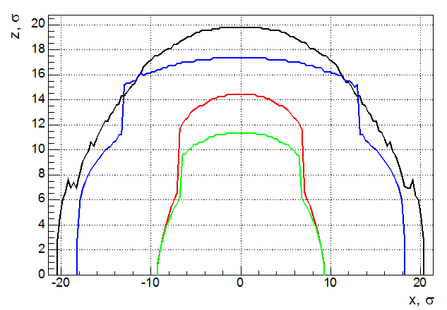
Initial DA
Finite sextupole length breaks exact cancellation of the geometrical aberrations. Only the second order terms are cancelled while the higher remains and degrade DA.
Black: L* = 0.7 m
Red: L* = 1 m (aperture ↓)
Green: L* = 1.5 m (aperture ↓)
Blue: L* = 2 m (SURPRISE! APERTURE ↑)
σ_{x}=3.24 10⁻⁵m, σ_{y}=6.52 10⁻⁸m, β*_{x}=0.5m, β*_{x}=0.001m

Slide 16
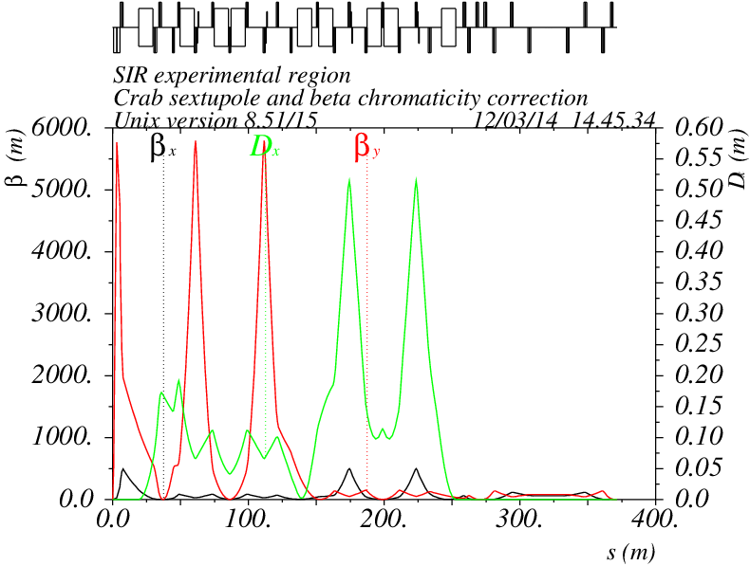
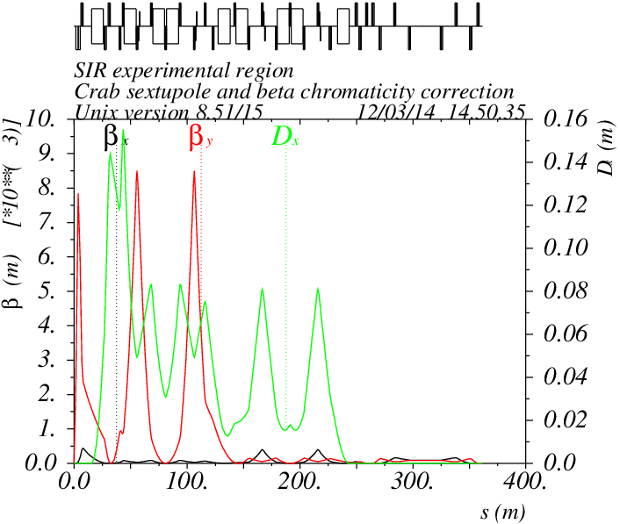
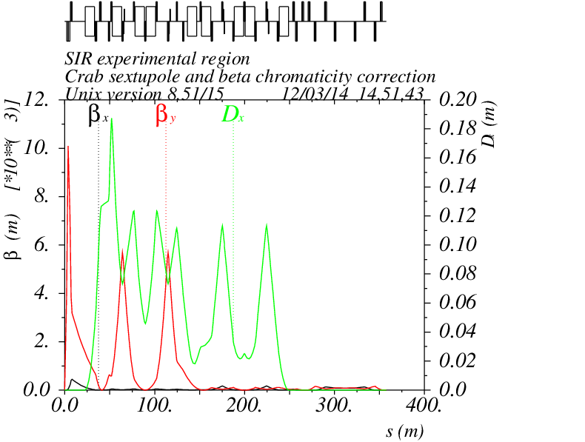
Explanation
Y chromaticity correction section is a main source of nonlinear perturbation. Produced aberration is proportional to η_{s}⁻²
L*=0.7 m, K2=-12 m⁻³,
β_{y}=5255 m
L*=1.5 m, K2=-14 m⁻³ ,
β_{y}= 7707 m
L*=2 m, K2=-14 m⁻³ ,
β_{y}= 5149 m
η_{s} ≈ 0.05 m
η_{s} ≈ 0.09 m
For L* = 2 m the FF chromaticity increased (~L*) but the dispersion increased also, so to compensate the chromaticity we need the beta and the sext strength the same as for L* = 0.7 m → same DA

Slide 17
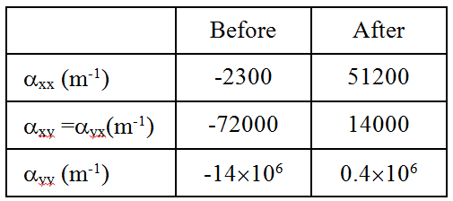
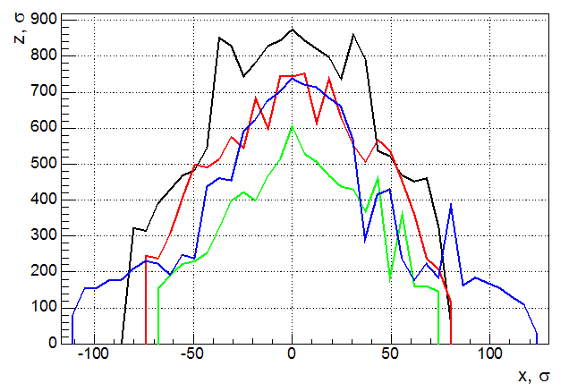
Corrected DA
Alpha before and after correction
With correctors
S1 – main (chromatic sextupoles)
S2 – low strength (~10% of the main strength) correction sextupoles can mitigate a finite length effect

Slide 18
Conclusion
The major source of the DA limitation for the CW FCCee IR is the –I Y chromatic correction section through the sextupole length effect.
Simple calculation of α_{yy} confirms it well, however for details computer simulation is necessary.
DA dependence on L* differs for different nonlinearities: kinematics ~L*, -I sextupole pair ~L*² and fringes ~L*³.
Large dispersion in the sextupole is welcomed.
Nonlinear corrections works well.
For L*=2 m we have Ax > 100σ_{x} and Ay > 700σ_{y} which seems quite enough to start.

Slide 19
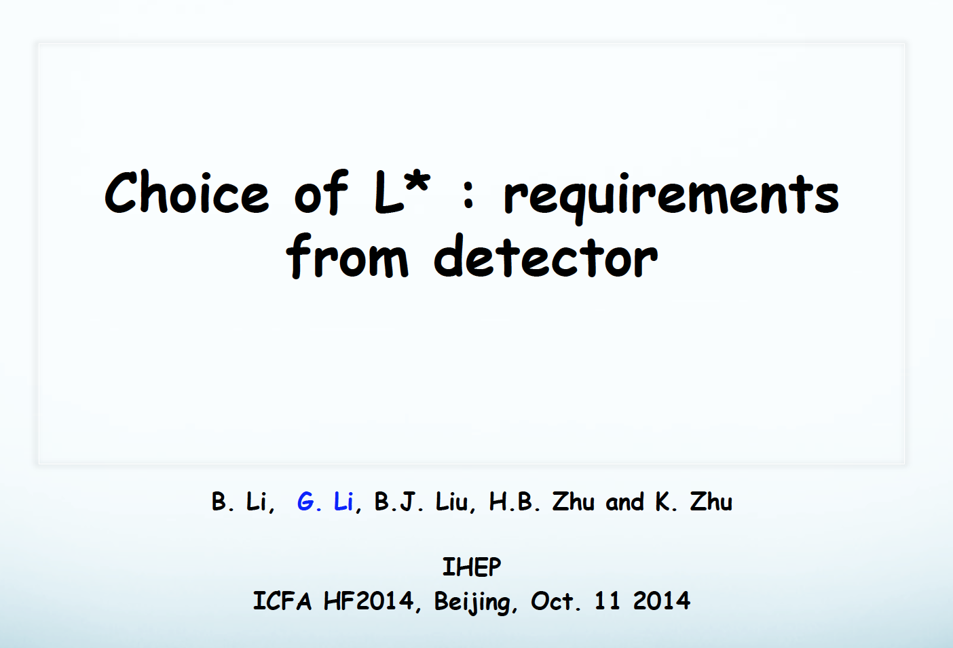

Slide 20
Summary of talk
Shorter L* brings some challenges for detector
Possible problems
  Momentum resolution may got worse (leakage magnetic field from QD0)
    Problems may be overcome by optimizing the VXD/FTD and by a precise mapping of field
  The jet flavor tag efficiency loses some efficiency and jet resolution (smaller coverage of detector)
    The statistics will compensate.
  Luminosity measurement is really a big challenge. (short distance from IP and LumiCal (detector for precise measurement of the Bhabha event rate)
  Others?
    Calorimeter, support of QD0, cooling, …

Slide 21
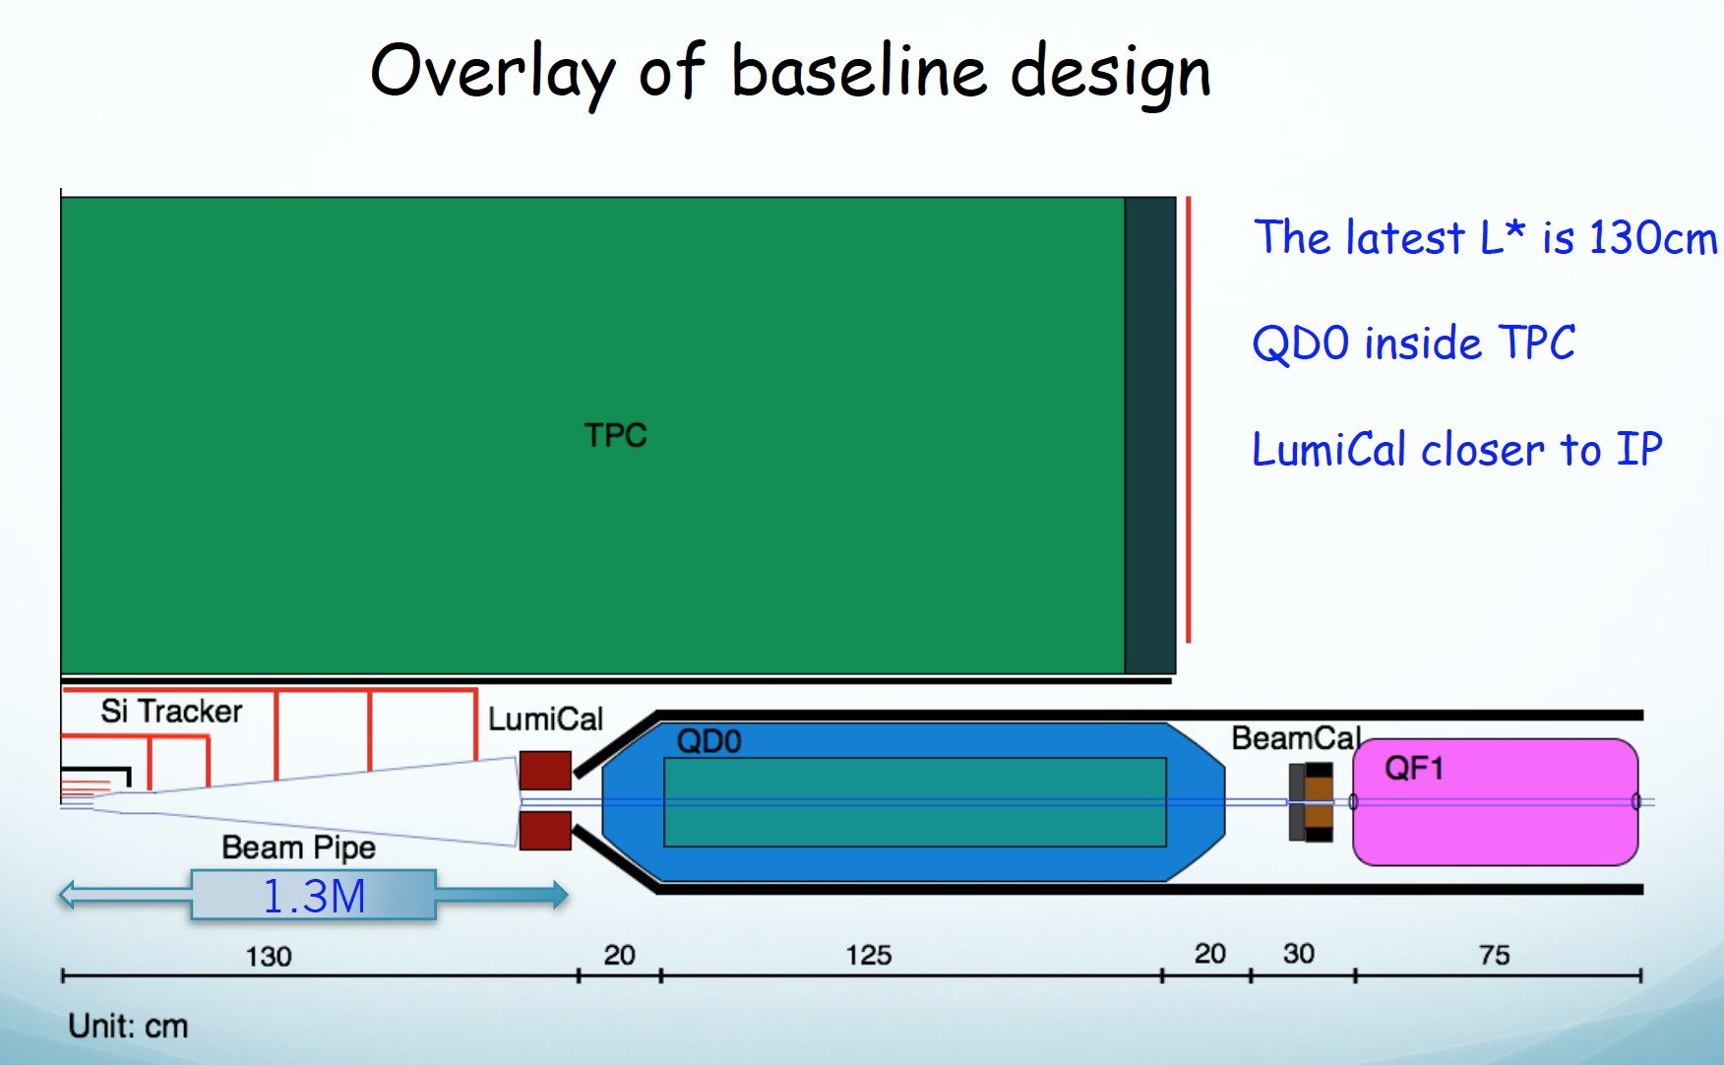

Slide 22
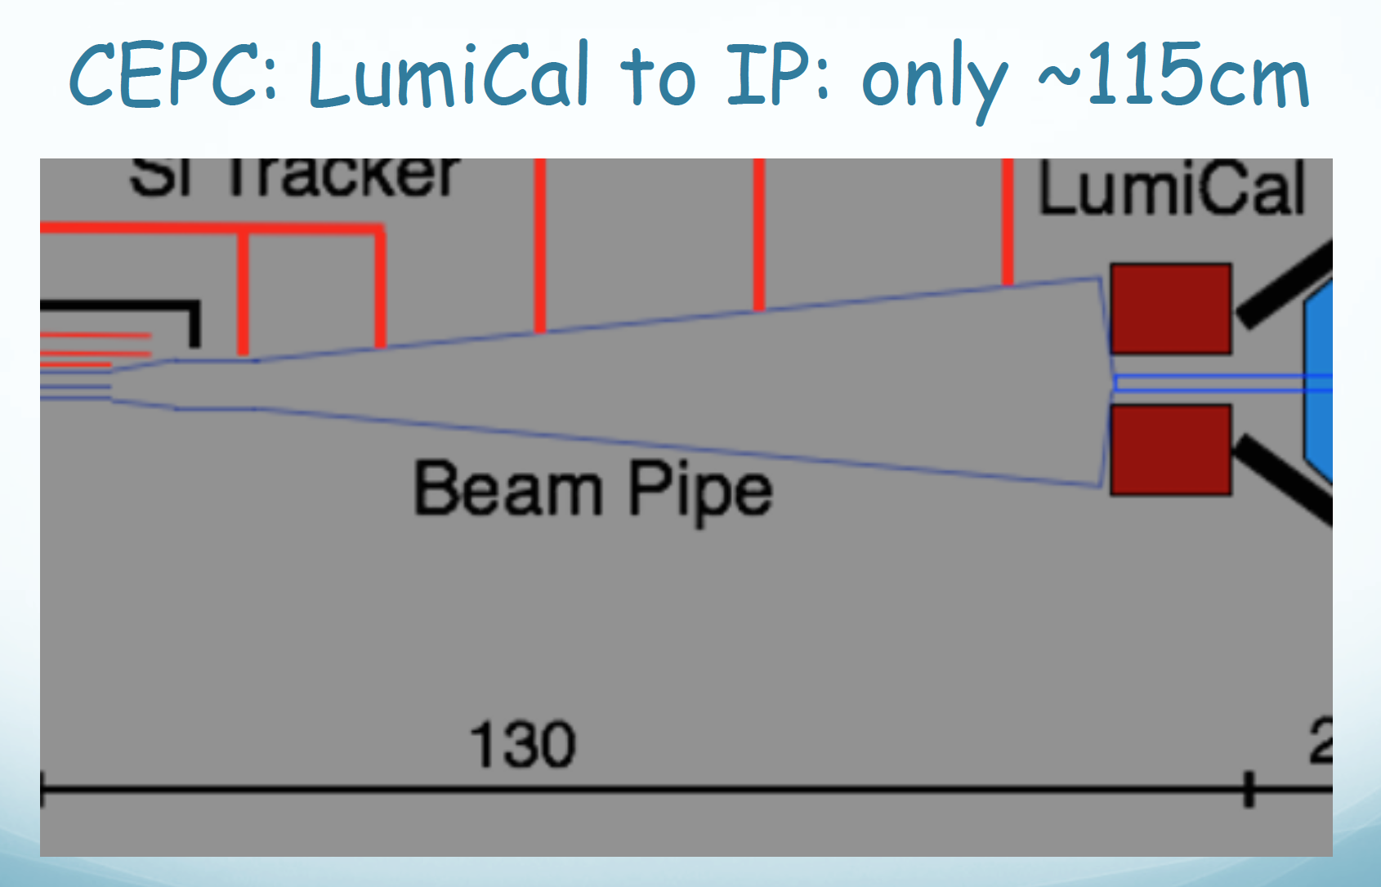

Slide 23
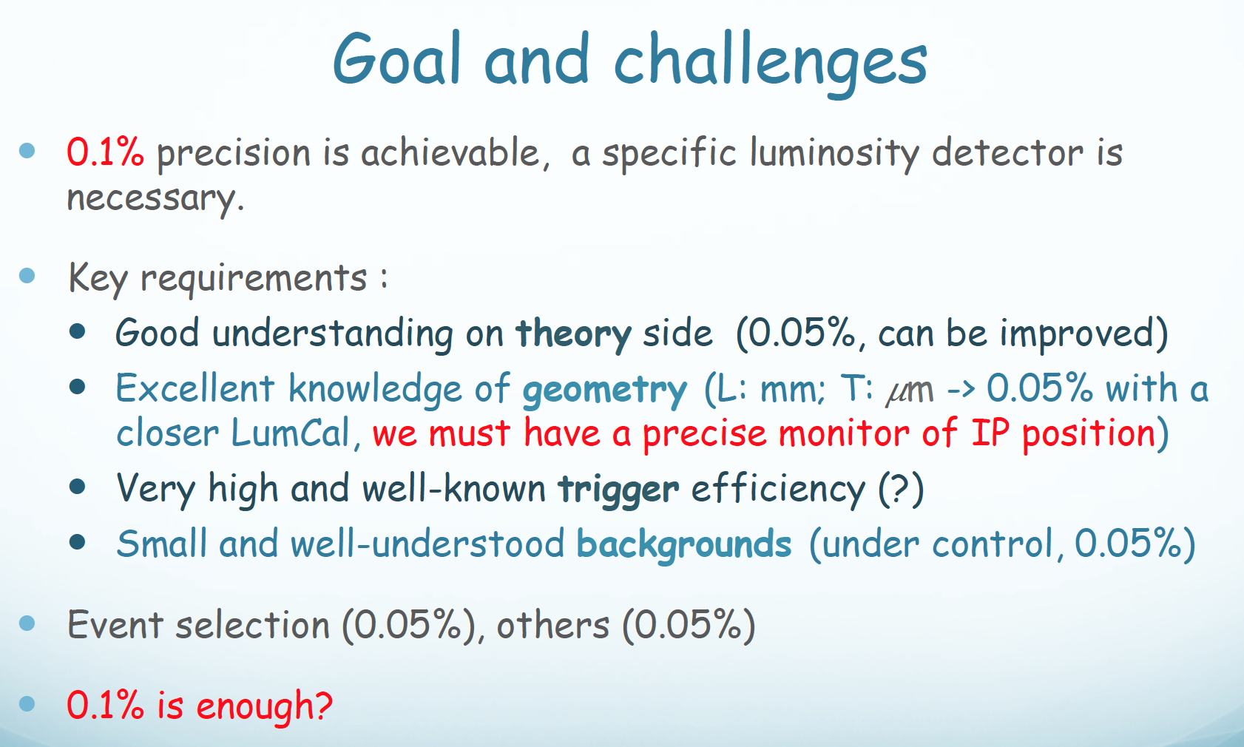

Slide 24
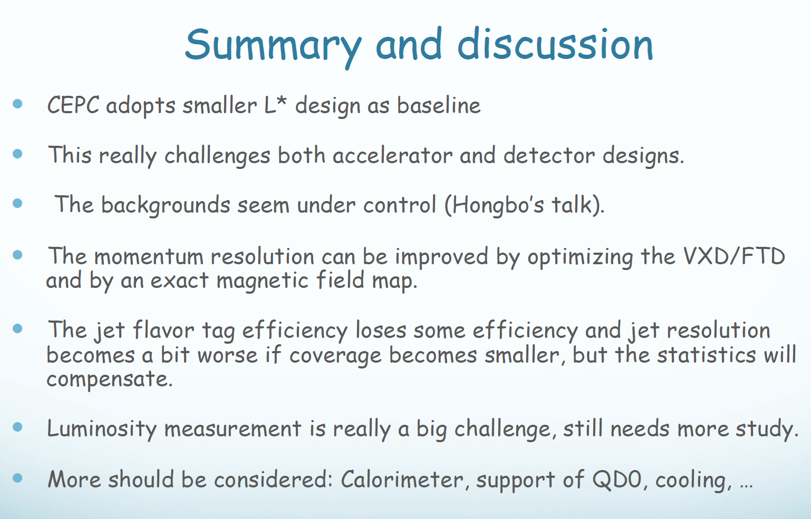

Slide 25
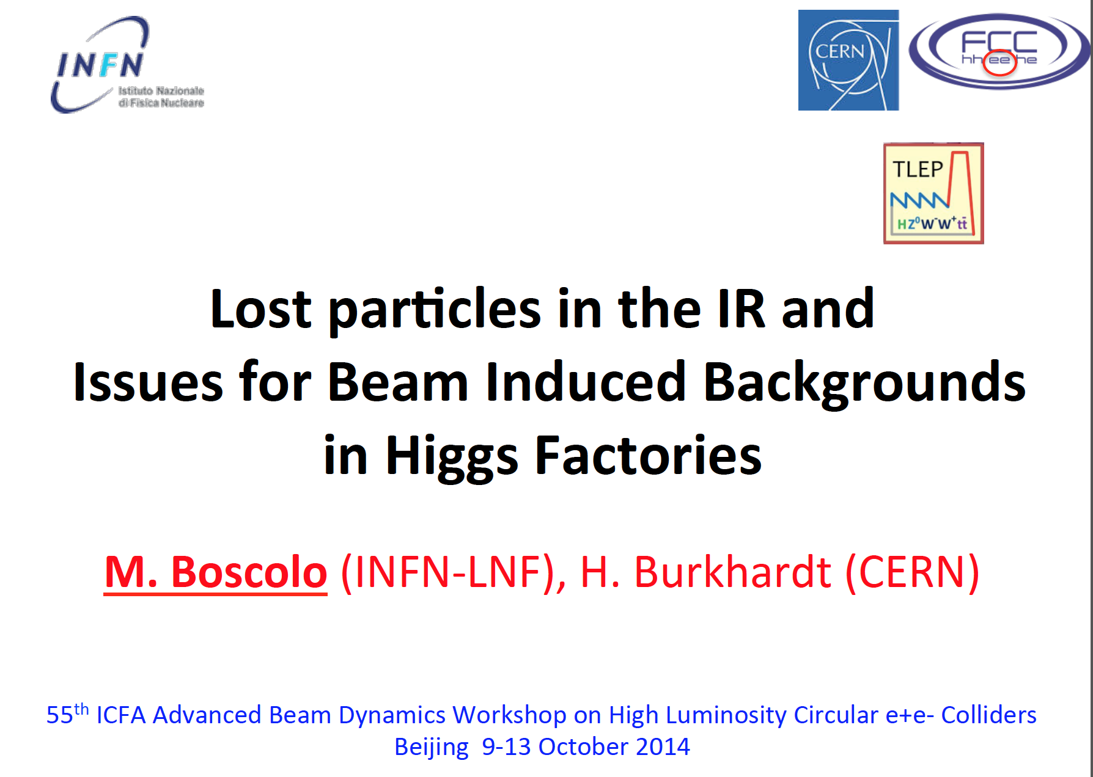

Slide 26
Summary of talk
Very comprehensive talk
  Beam loss processes
    Touchek, Radiative Bhabha, Beam-gas scattering, Beamstrhlung, two photon process
  SR
  Machines
    SuperB, LEP, LHC, KEKB, SuperKEKB, DAΦNE, FCC-ee, CEPC (preliminary consideration)
FCC-ee study
  SR in IR seems to be a key issue
  The study team is preparing a generic tool for FCC IR studies
Comparison with real machines (LEP, DAΦNE)
Conclusions

Slide 27
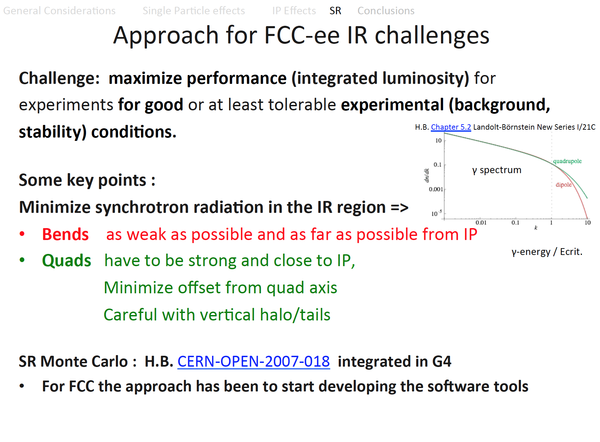

Slide 28
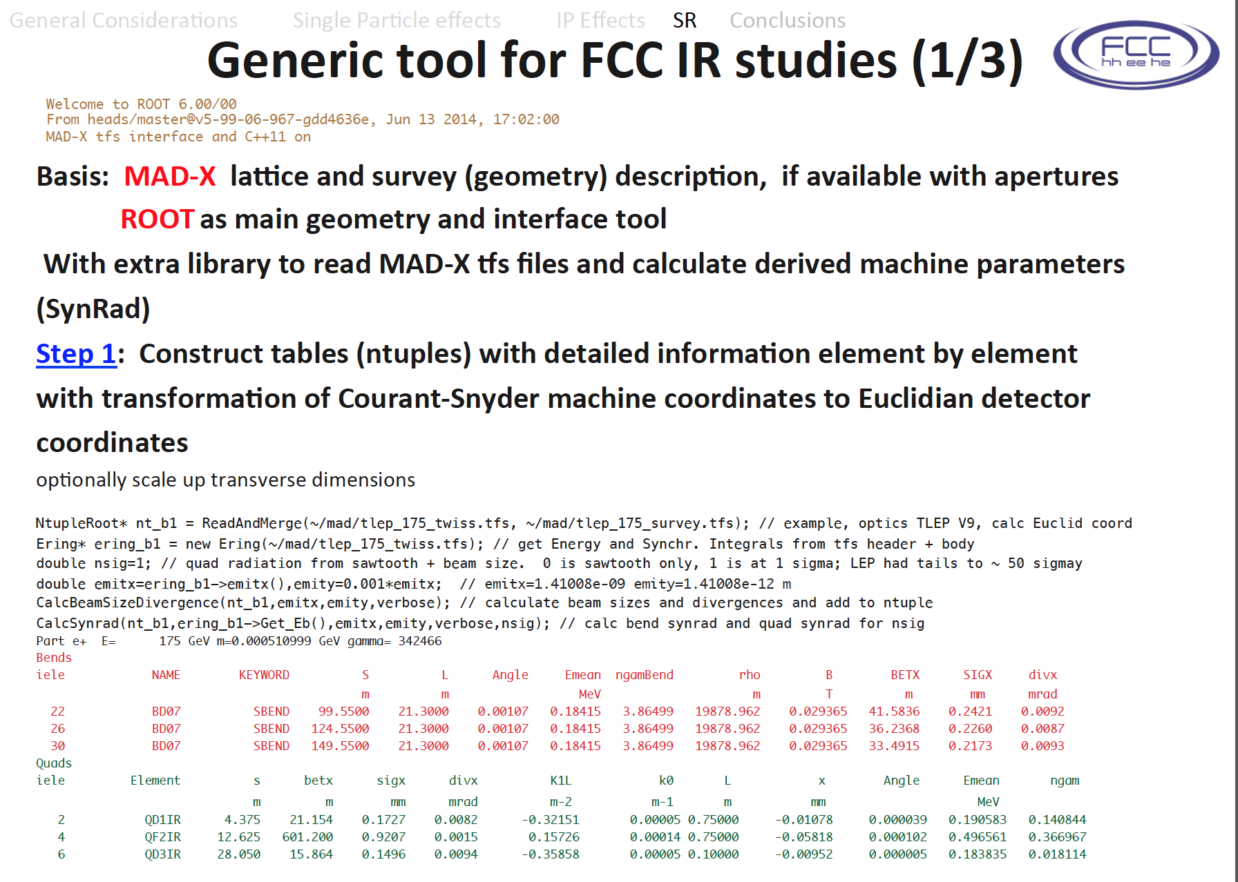

Slide 29
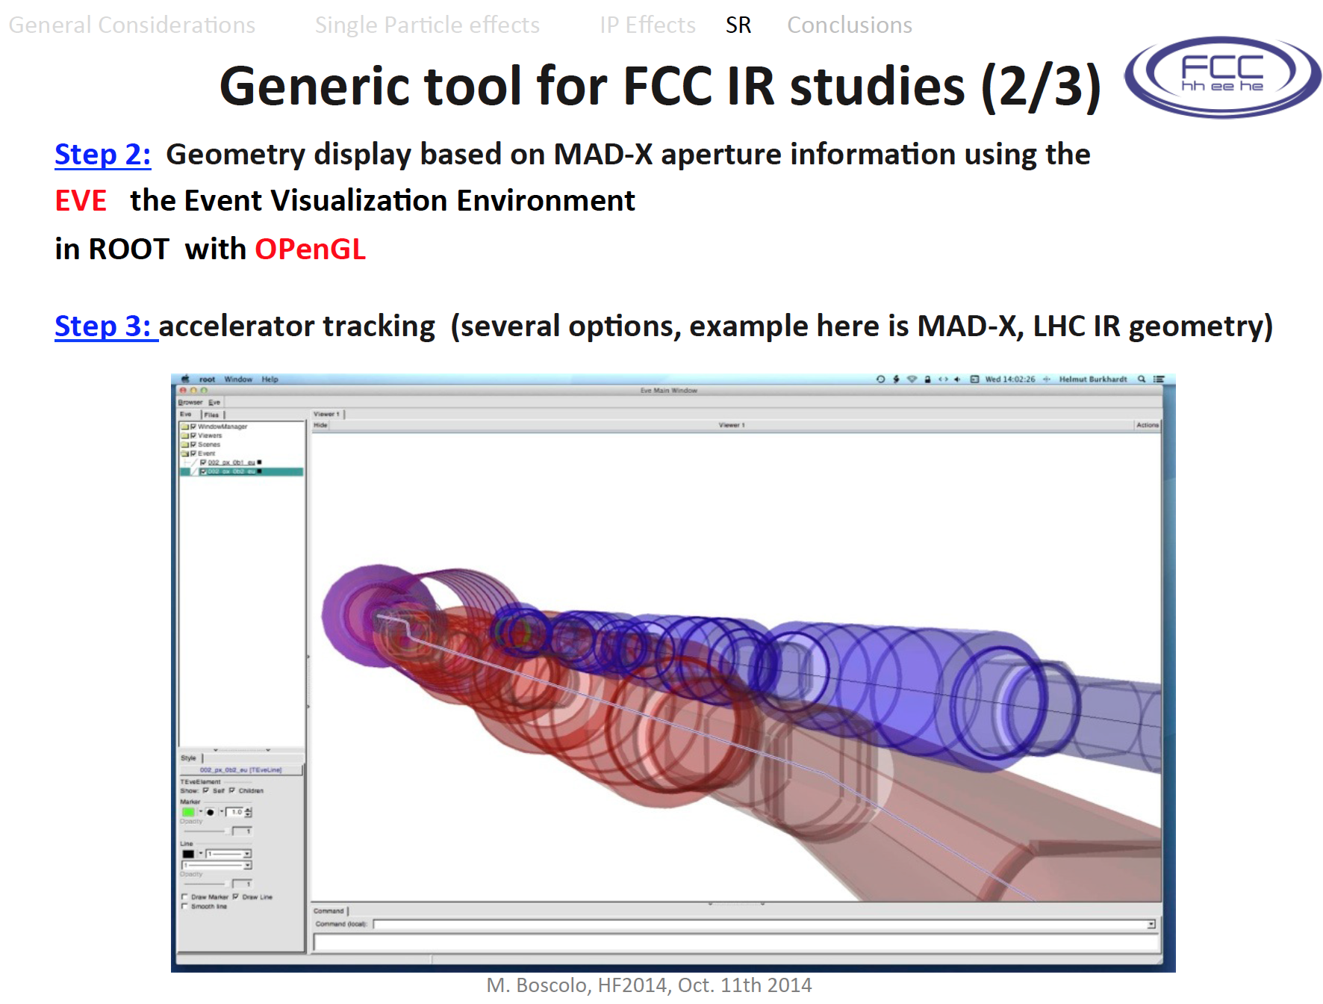

Slide 30
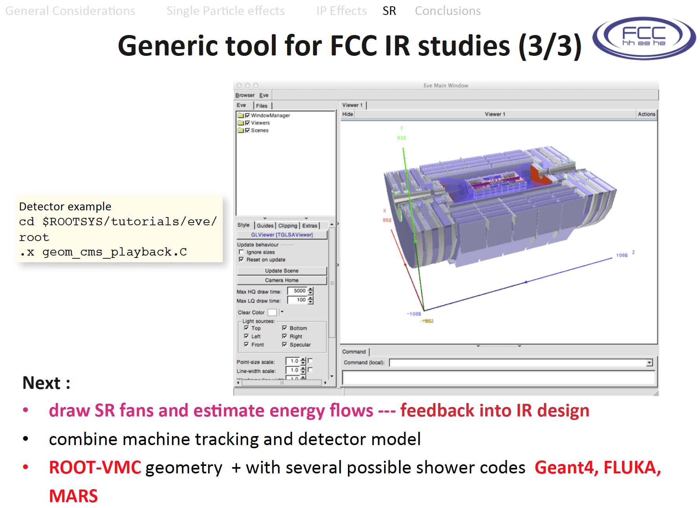

Slide 31
