Slide 1
HF2014 WG4 Summary
“Synchrotron Radiation and Shielding”
Marica Biagini (INFN-Frascati)
John Seeman (SLAC)
October 12, 2014
HF2014 IHEP Beijing

Slide 2
Synchrotron Radiation and Shielding Talks Presented
Z. Ma (IHEP): Monte Carlo Simulations of Synchrotron Radiation for CEPC Vacuum System
R. Kersevan (CERN): Vacuum System requirements for a HF e+e- Accelerator
Y. Papaphilippou (CERN): Synchrotron Radiation Effects in the HF Injector
L. Esposito (CERN): Shielding of Electrons in the Tunnel
M. Maltseva (TENZOR): Infrared Synchrotron Methods and Systems for Monitoring and Controlling Particle Beam in Real Time
M. Boscolo (INFN-Frascati): Lost Particles in the IR and Beam Induced Backgrounds in a Higgs Factory
J. Seeman (SLAC): Synchrotron Radiation Absorption and Vacuum Issues in the IR

Slide 3
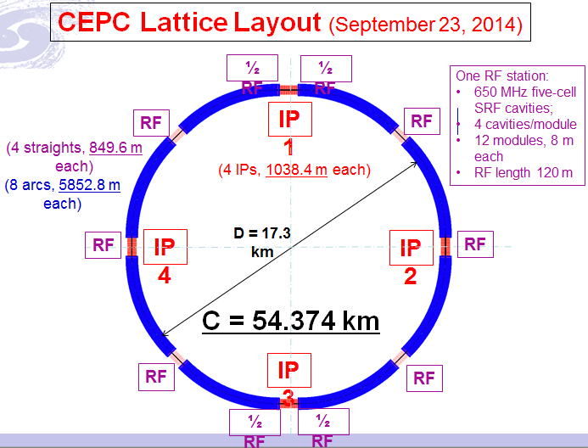
Ma: CEPC Vacuum Layout and Radiation Effects

Slide 4
Ma: Radiation protection topics:
Synchrotron radiation shielding
The thickness of the main tunnel
Shielding for straight tunnel, beam dump, collimate station, injection section, maze, duct, shielding doors, RF station, etc;
Induced radioactivity analysis: cooling water, ventilation air, accelerator component, local shielding concrete, ground water, environmental samples, etc;
Personal safety interlock system
Radiation dose monitoring system

Slide 5
Ma: Limits for shielding design of CEPC-sPPC
Area | Design Value | example
Radiation monitored area | < 2.5 μSv/h | Outer of the tunnels, where worker can stay long
Radiation controlled area | < 25 μSv/h | Outer of the tunnels, where worker can stay occasionally
Forbidden area | >>1mSv/h | Inner of the tunnels, worker cannot get in during accelerator operation
Site boundary | 0.08 mSv/year
All the areas should be clearly defined after the functional structures are determined.

Slide 6
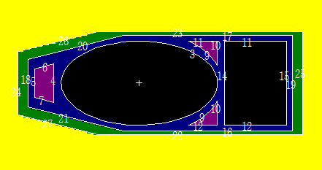
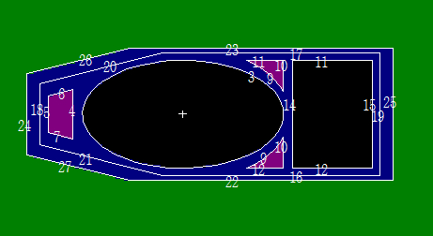
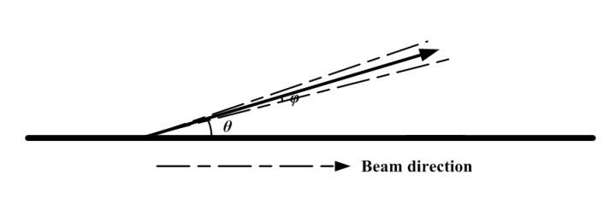
Ma: MCNP simulation
Simulation model for beam pipe
LEP’s Vacuum chamber was adopted:
But two materials: Composed by a few millimeters of Al covered by 3 or 8mm of Pb or totally by a few millimeters of Cu
Synchrotron radiation hits the vacuum chamber at a grazing angle of 3.1669mrad
The cros section of vacuum chamber
(Above: Al&Pb Below: Cu)
Solid degree of synchrotron radiaiton：<10⁻⁵rad
Bending angle Between beam and SR: 3.1669 mrad
Synchrotron radiation source analysis

Slide 7
Ma: Simulations
The spectrum of photons in the air
Mass attenuation coefficients
Energy of most of photons is between 100keV and 300keV
The flux out of Cu is obviously lower than Al&Pb’s.
The mass attenuation coefficients of Cu are between Al and Pb
Vacuum chamber fabricated by Cu may instead of Al and Pb

Slide 8
Ma: Summary and Future Tasks
The dose rate in the tunnel for CEPC is mainly dominated by synchrotron radiation.
Above 65% heat were deposited in the chamber
Cu may be a good material for beam pipe from the point of radiation protection, also have to be consider from the manufacture/price and other point of view
Dose rate, which level to be deduced is depend on the radiation resistant of the electron component
Detailed simulation have to be conducted next: reliability verification, actual structure, thermal analysis, etc.

Slide 9
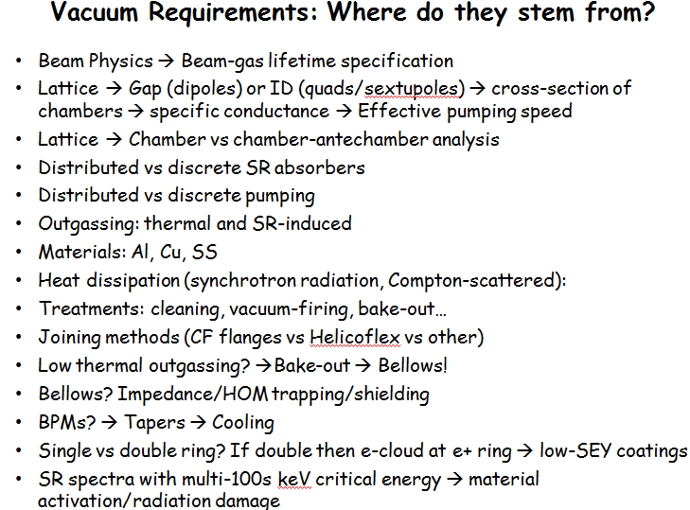
Kersevan: Requirements on HF Vacuum Systems

Slide 10

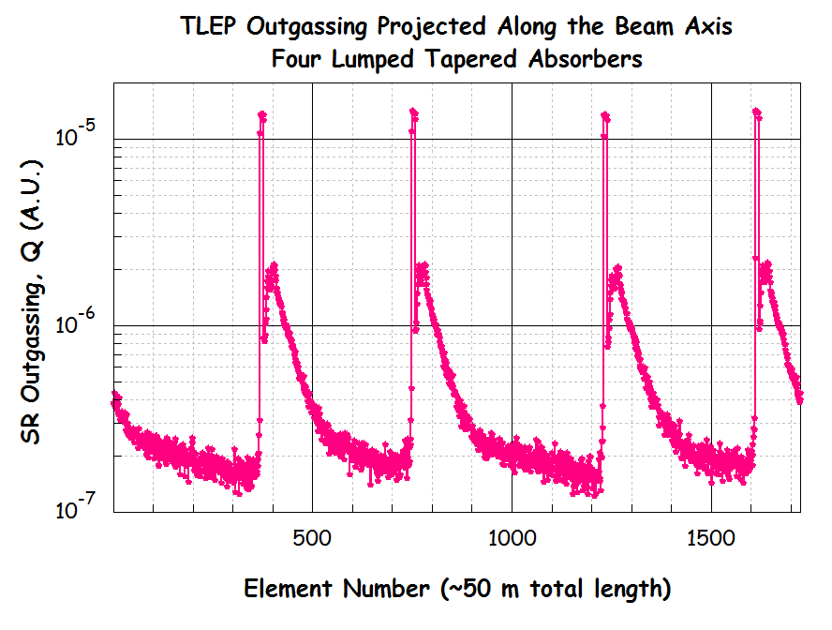
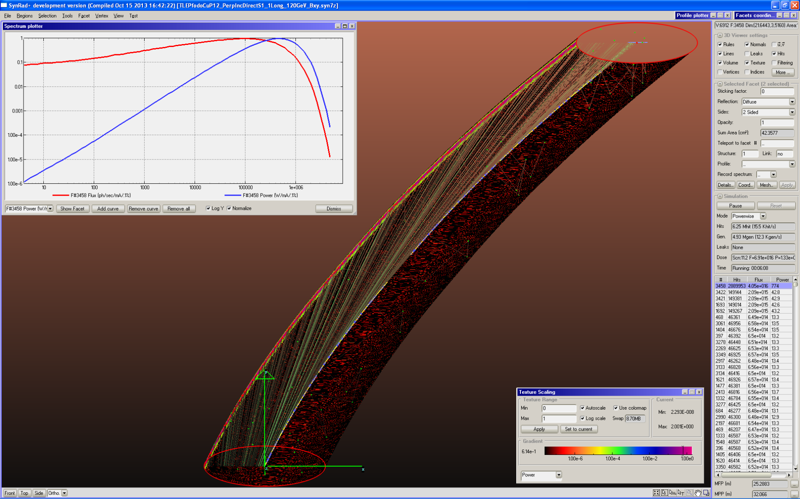
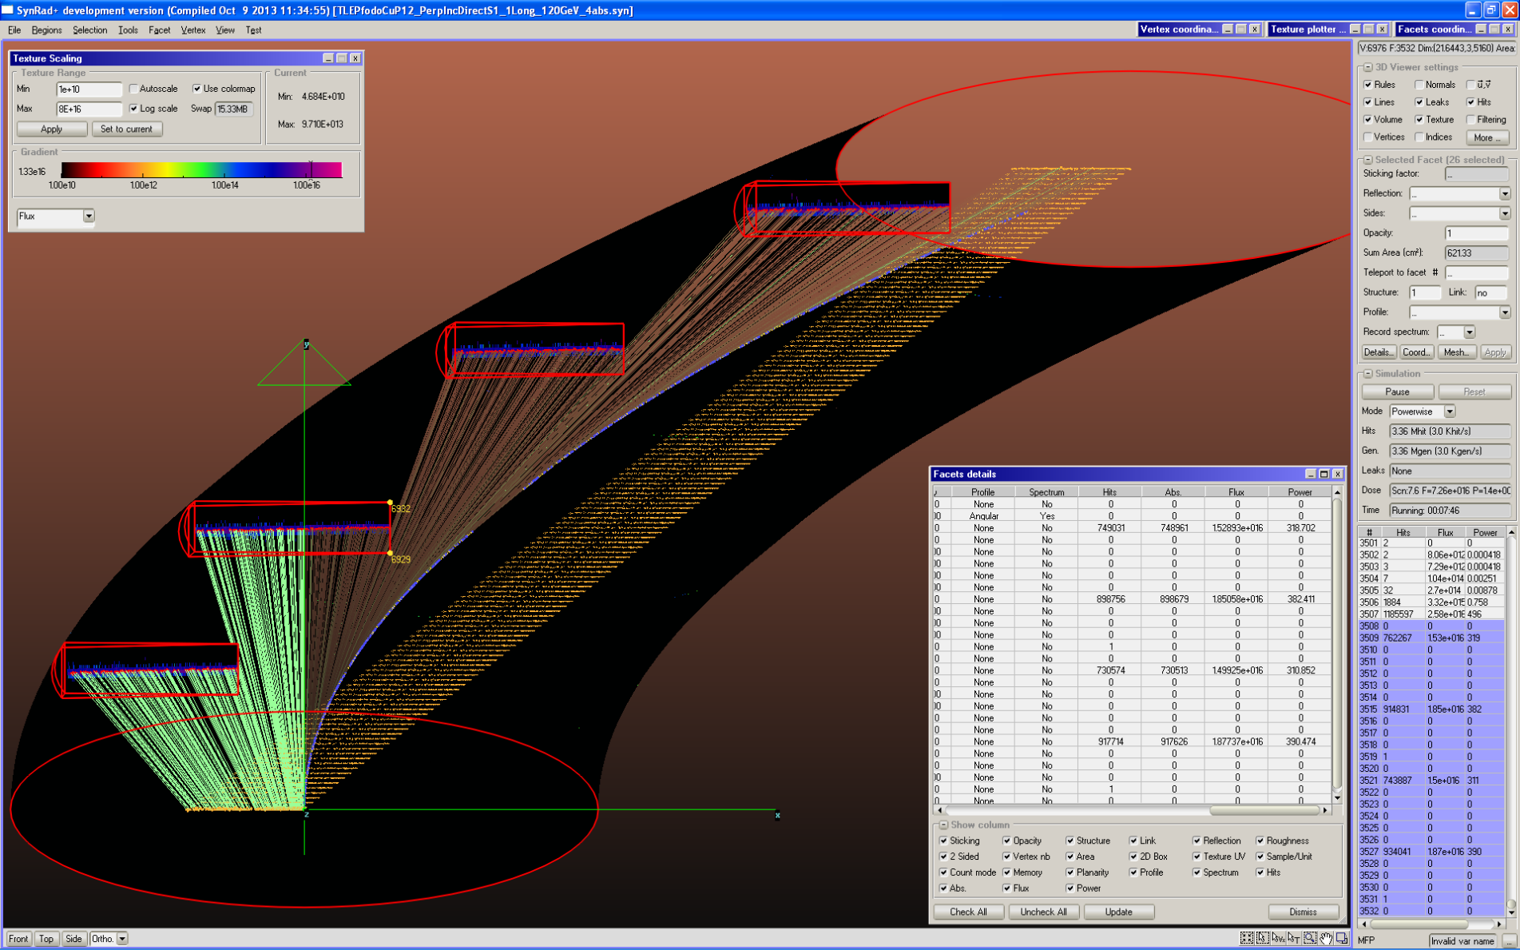
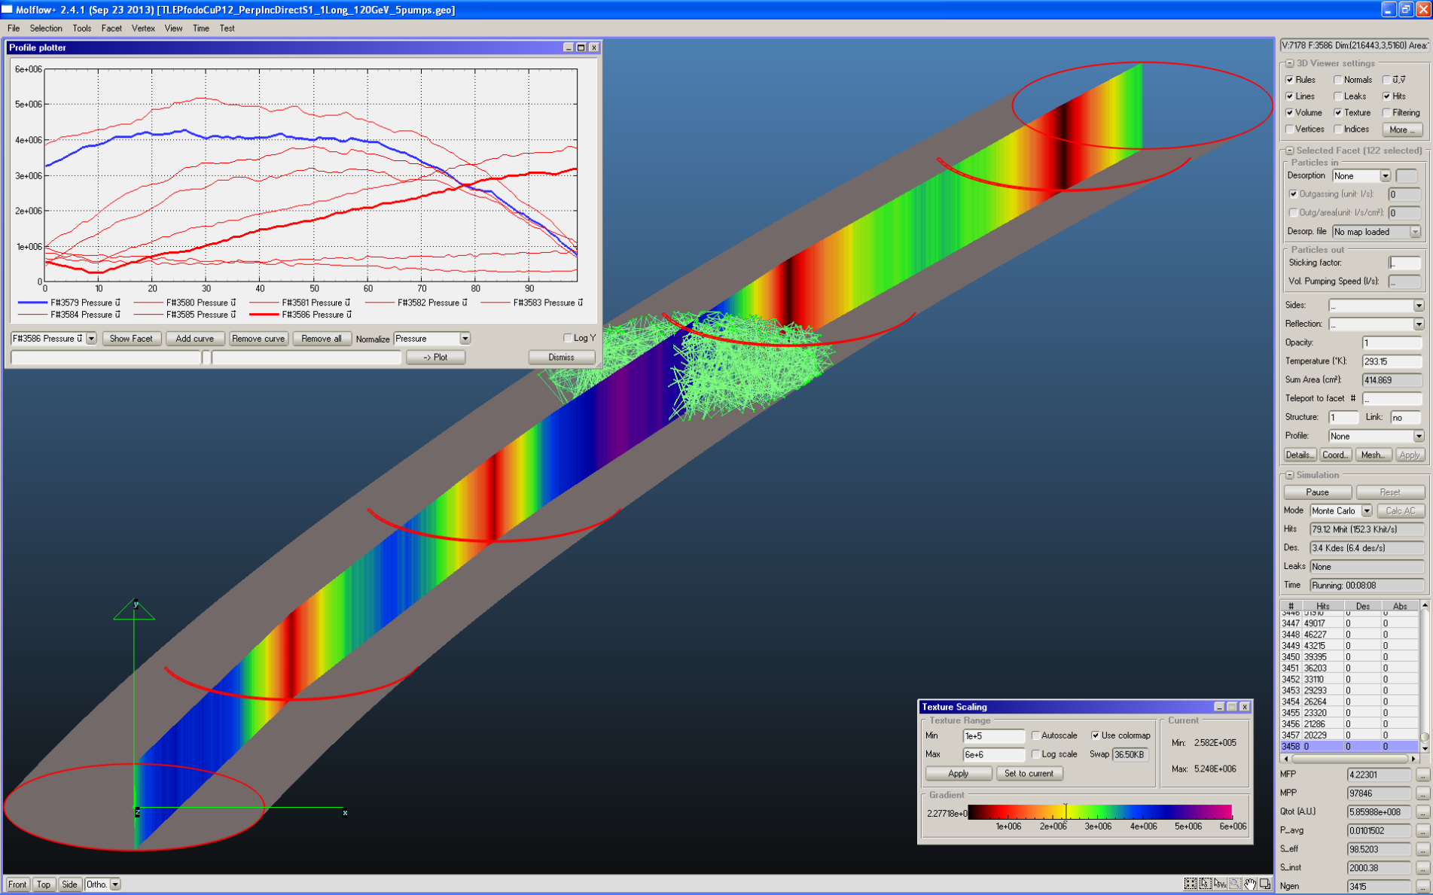
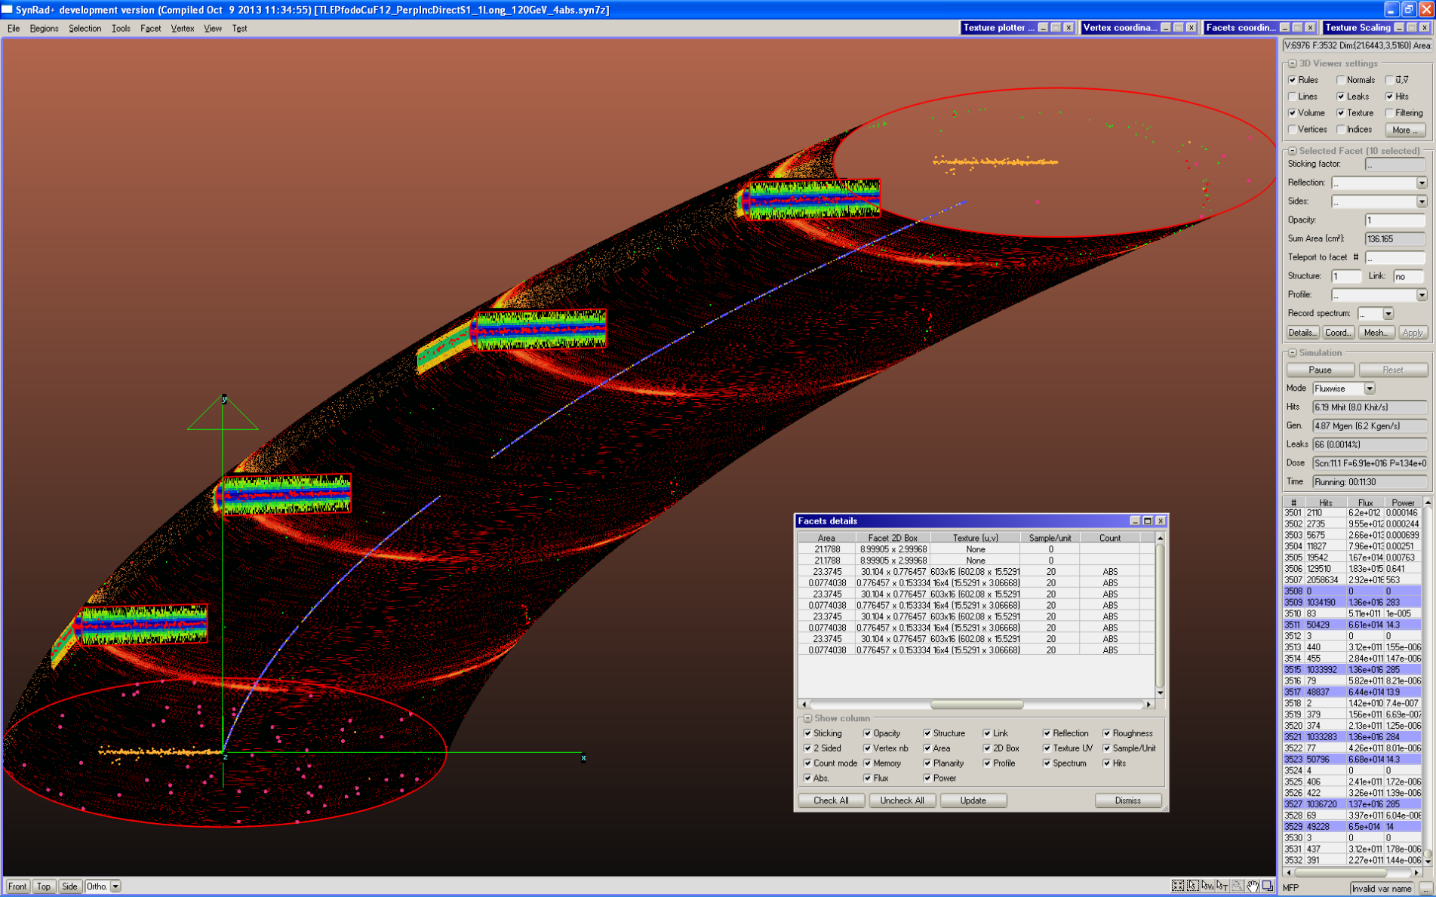
SR fan at FCC-ee 90x30 mm² 1/2x FODO cell (25 m)
Distributed SR fan vs localized absorbers: Ray-tracing (SYNRAD+)
Photon fan profiles converted into outgassing profiles via η(mol/ph)
Pressure profile calculation via 3D Montecarlo code (Molflow+)
R. Kersevan, “Vacuum System Requirements for a HF e+e- Accelerator – 55th ICFA – Beijing – 10 Oct 2014

Slide 11
Kersevan: Conclusions
Any design of a Higgs Factory with beam energies in the 45~175 GeV range inevitably makes a powerful source of SR
Comprehensive ray-tracing analysis of SR fans: mandatory! Especially for delicate areas, such as IR, SRF, wigglers!
Careful choice of vacuum chamber material
Vacuum system geometry and pumping system must be carefully analysed and designed
Special care has to be taken for any cross-sectional changes (tapers), and devices (BPMs, stripline kickers, RF cavities, gate-valves, etc…): proper shielding from SR and cooling for HOMs
The operation of LEP and B-factories, and the design of low-emittance light sources can help a lot in the design of a HF’s vacuum system
The chamber vs chamber/antechamber solutions must be carefully evaluated
The distributed vs discrete pumping solutions must be carefully evaluated
Low-SEY coatings for e-cloud in the e⁺ beam chamber
Although not easy to implement, in-situ bake-out is recommended
R. Kersevan, “Vacuum System Requirements for a HF e+e- Accelerator – 55th ICFA – Beijing – 10 Oct 2014

Slide 12
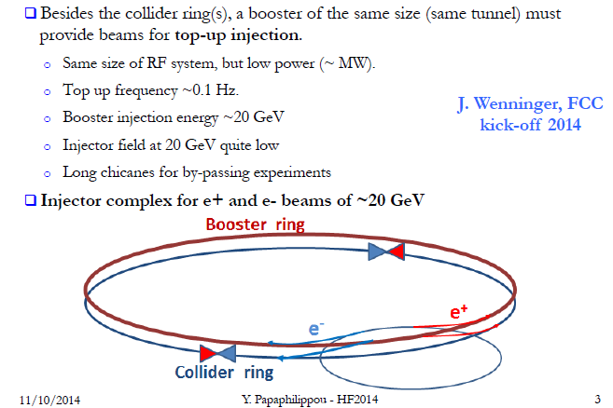
Papaphilippou: HF Injector SR Considerations

Slide 13
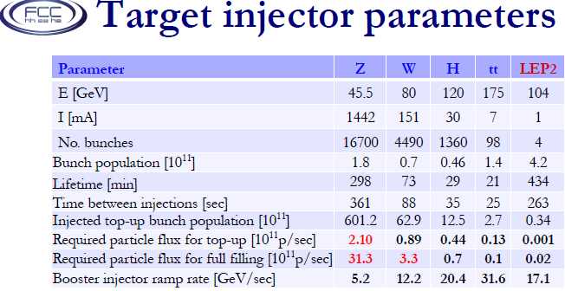
Papaphilippou: HF Injector

Slide 14
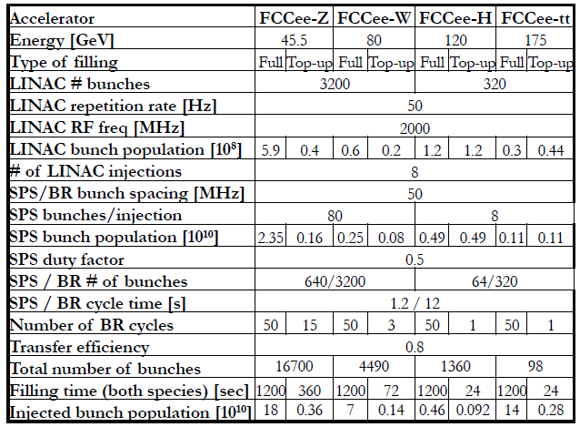
Papaphilippou: Injector possibilities

Slide 15
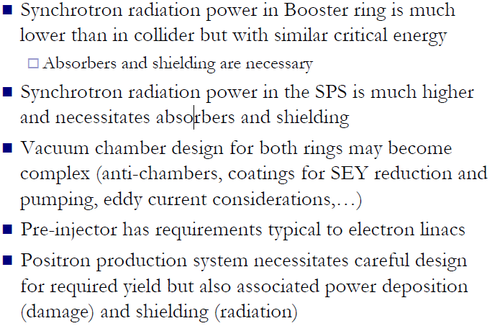
Papaphilippou: Outlook

Slide 16
Esposito: Tunnel Shielding-- What are we talking about?
CNGS 2007 physics run, 8 10¹⁷ p.o.t. delivered ( ≈2% of a nominal CNGS year )
Gy per 4.5 10¹⁹ p.o.t.
Predicted dose levels
in agreement with measurements
Electronics
Ventilation Units
CV,crane,
fire
R2E=Rad to Electronics
Single event upsets in ventilation electronics caused ventilation control failure and interruption of communication

Slide 17
Mitigation Options
RELOCATION
SHIELDING
RAD-TOL DESIGN
CIVIL ENGINEERING

Slide 18
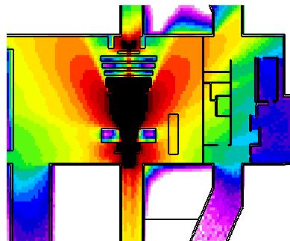
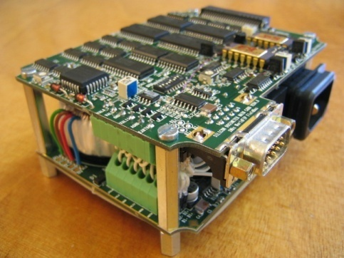
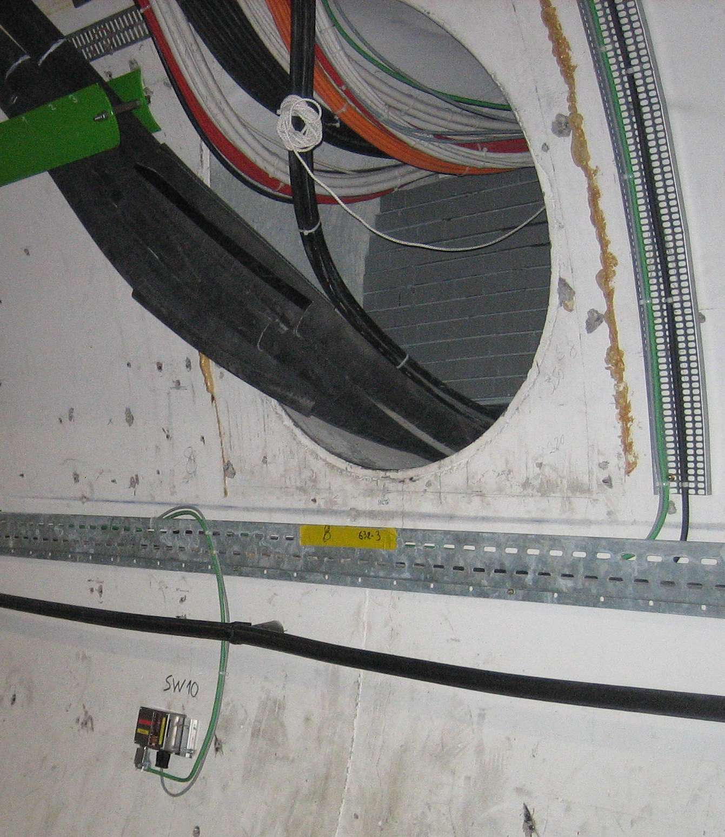
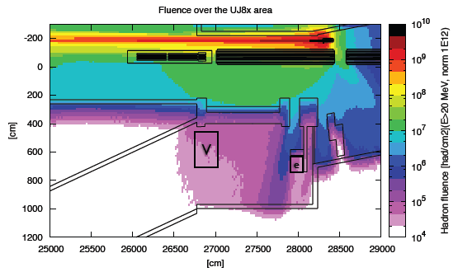
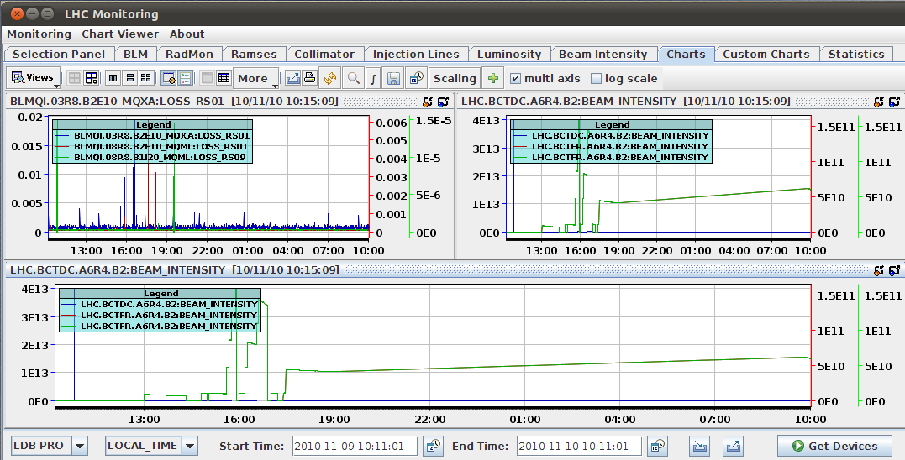
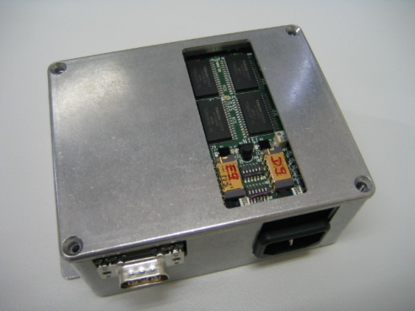
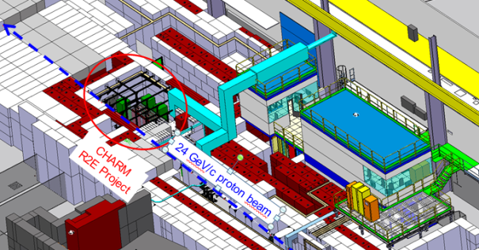
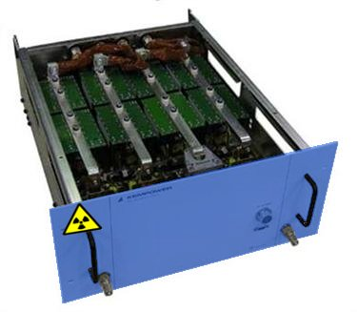
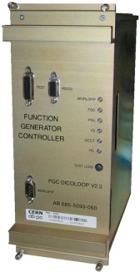
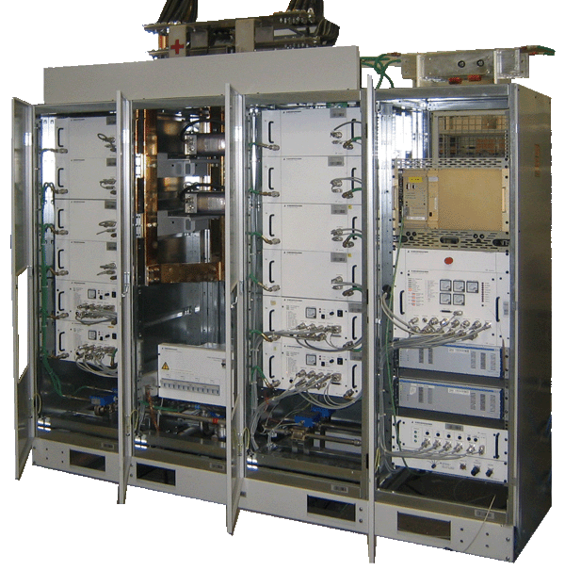
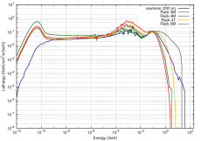
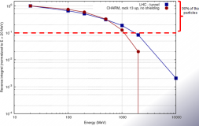
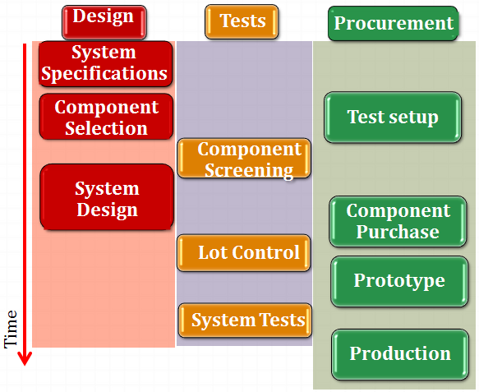
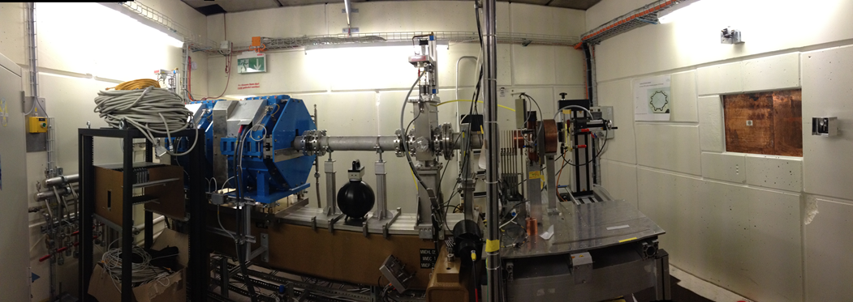
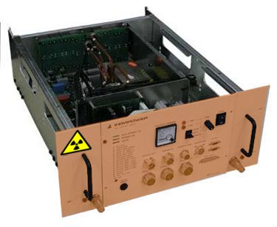
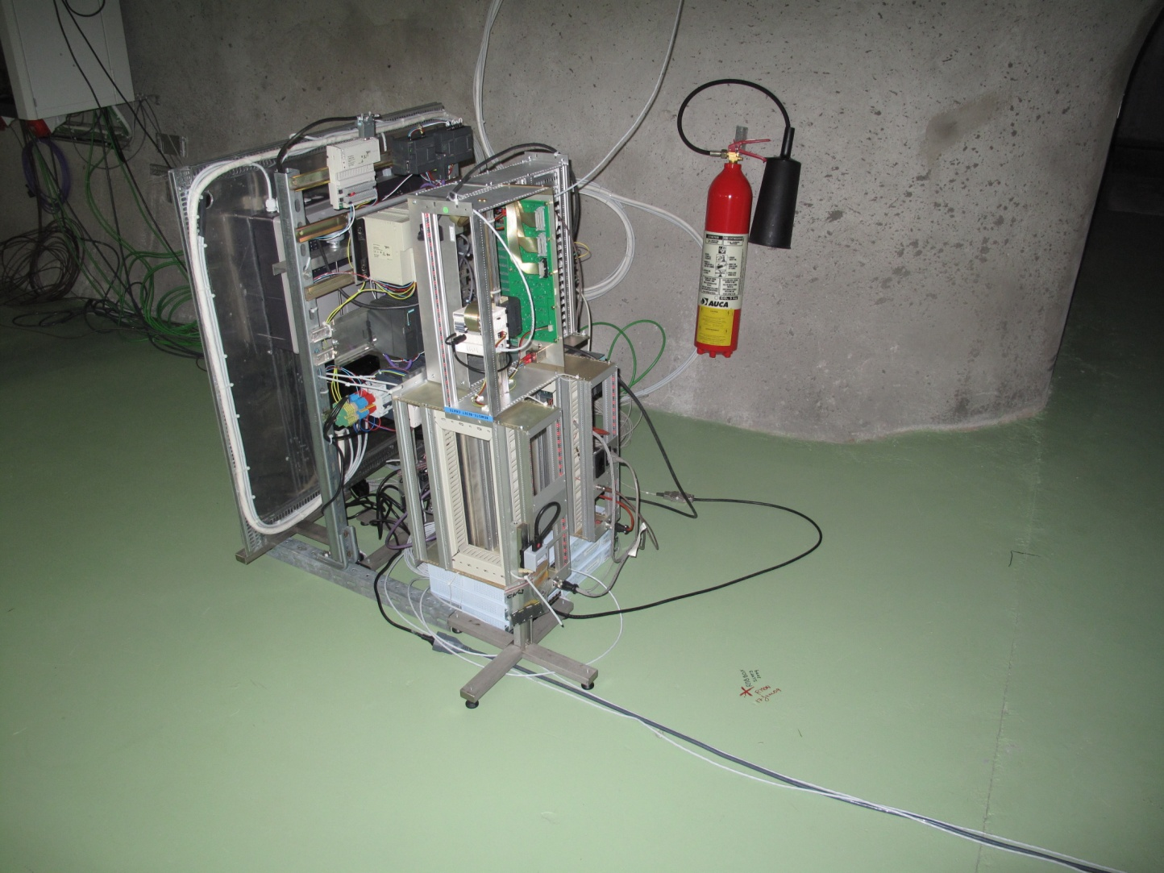
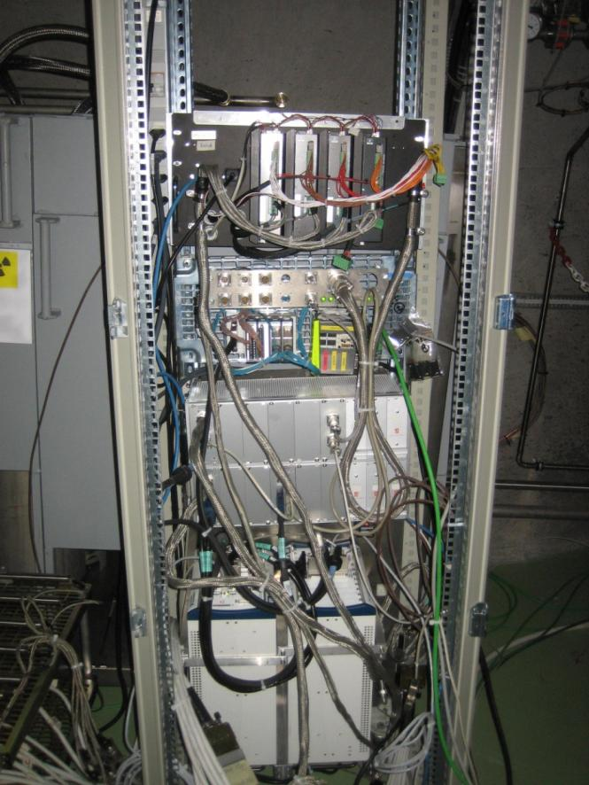
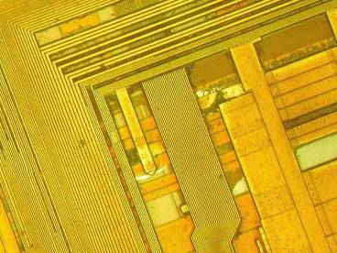
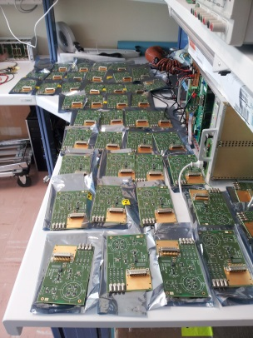
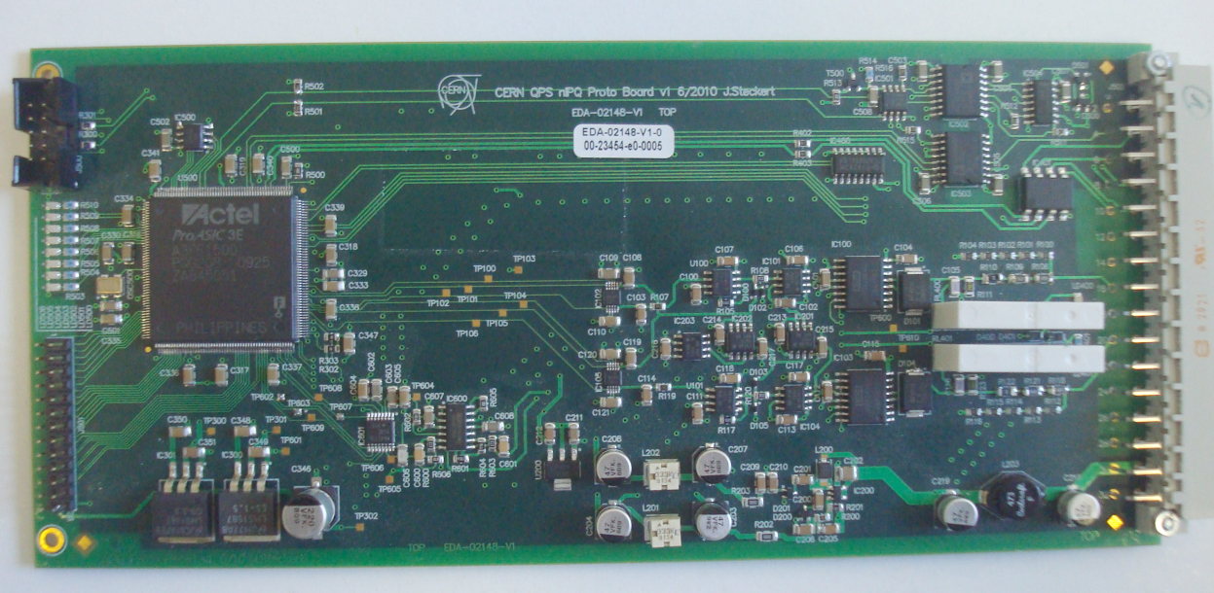
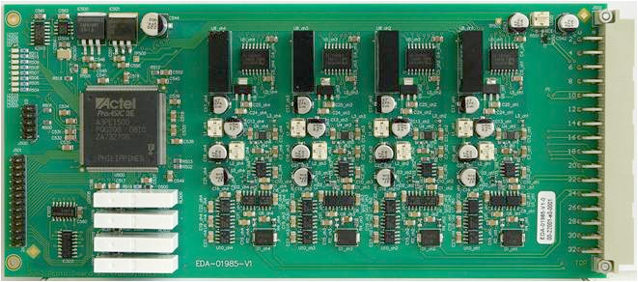
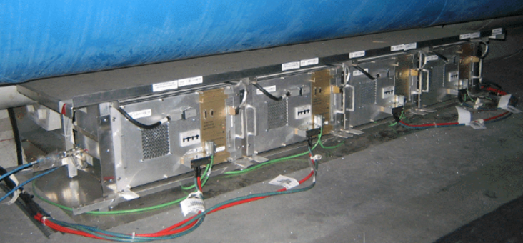
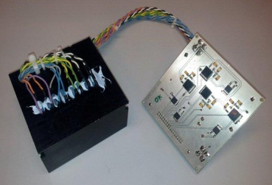
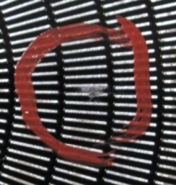
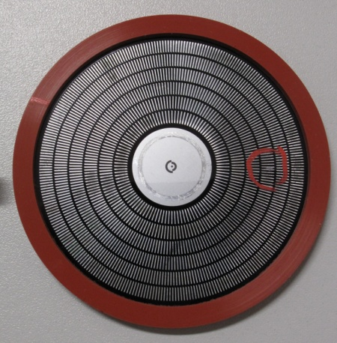
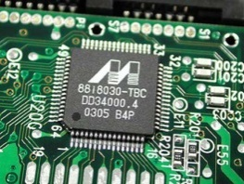
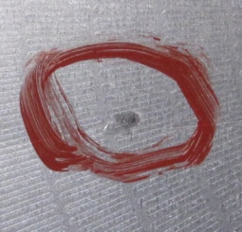
R2E Project Building Blocks
Radiation Monitoring
Calculations
Test Facilities
Developments
Radiation Tests
Production & Implementation

Slide 19
Esposito: Radiation field in the FCC tunnel
Neutrons from photo-nuclear interactions

Slide 20
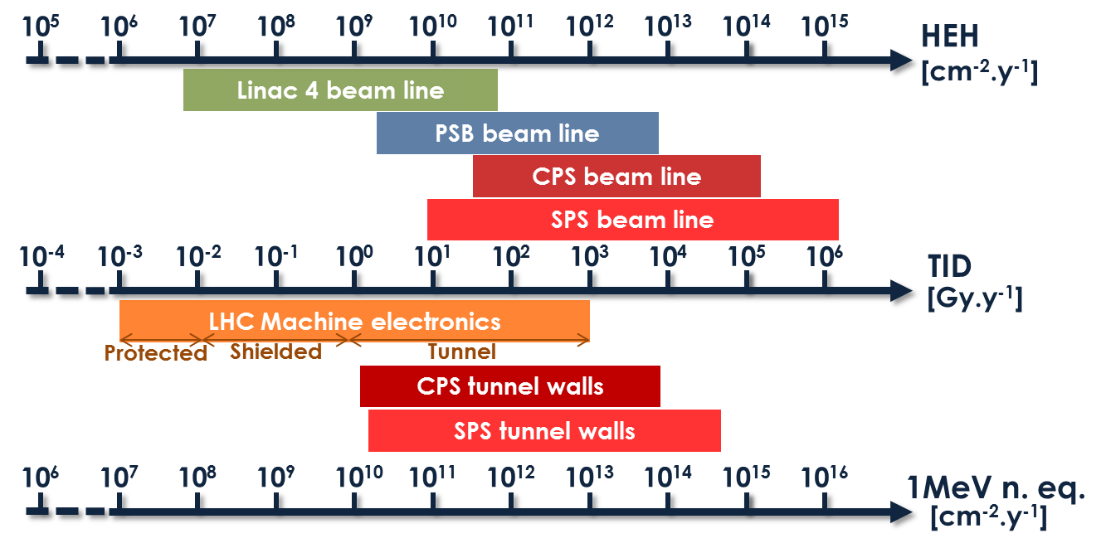
Radiation levels in FCC-e⁺e⁻
FCC-e⁺e⁻
LHC + Experiments
FCC-e⁺e⁻
FCC-e⁺e⁻
COTS Systems
Hardened Electronics
Electronics
Custom Boards with COTS
Damage
20

Slide 21
Esposito: Conclusions
R2E represents a crucial issue to be taken into account as design criterion of any high energy and intensity machine
The R2E project at CERN allowed to create a diffuse knowledge and expertise covering all the aspects of radiation hardening
Total Integrated Dose effect has to be mitigated through a carefully shielding design

Slide 22
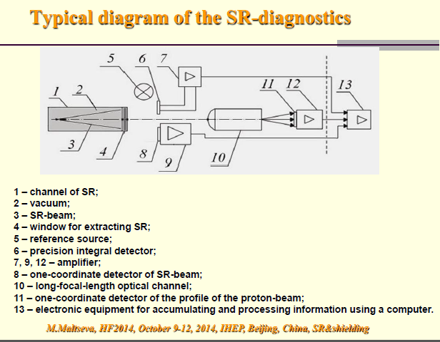
Maltseva: Synchrotron Radiation Diagnostics

Slide 23
Maltseva: SR Diagnostics
Important to have:
Non-destructive monitors
High resolution IR optical devices
Wide spectral range
Distributions of SR power can be calculated
Use modern devices for infrared and ultraviolet
Computerized optoelectronics (>100 microseconds)
Spectrometric detection systems (0.4 – 40 microns)
Non-cryogenics systems

Slide 24
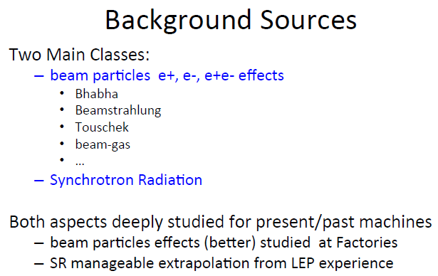
Boscolo: IR Particle Losses and Beam Backgrounds

Slide 25
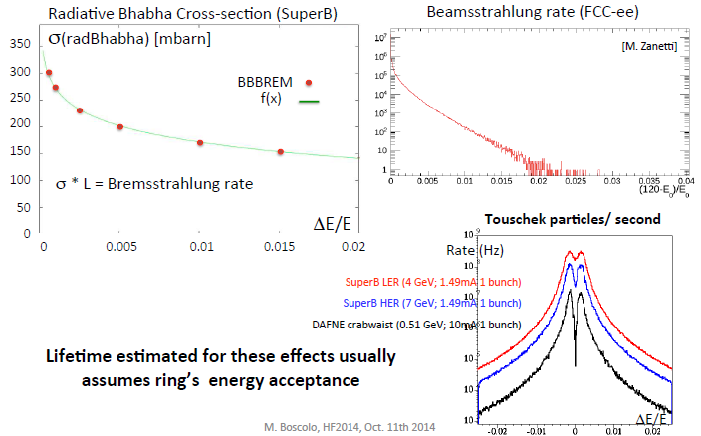
Boscolo: Energy Acceptance Important

Slide 26
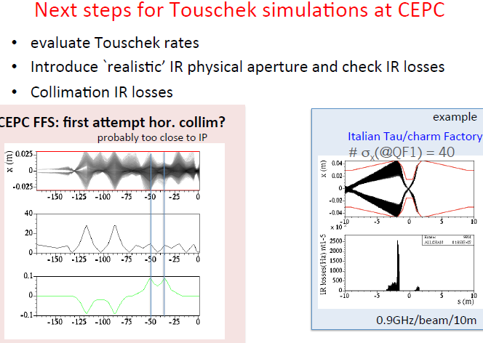
Boscolo: Touchek

Slide 27
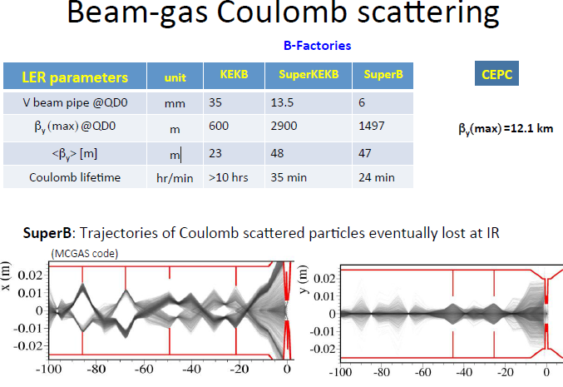
Boscolo: Beam-Gas

Slide 28
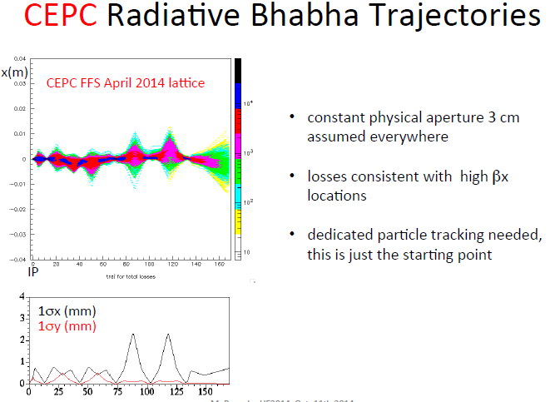
Boscolo: Radiative Bhabha

Slide 29
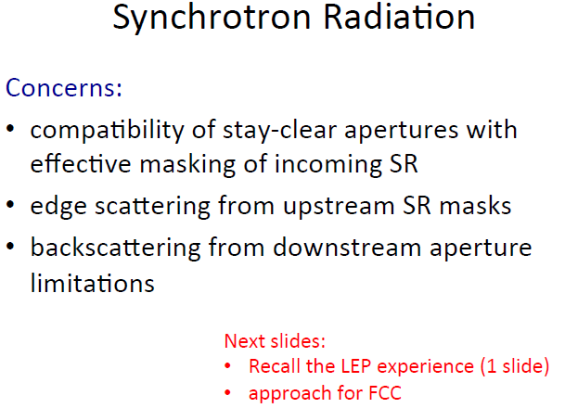
Boscolo: IR SR

Slide 30
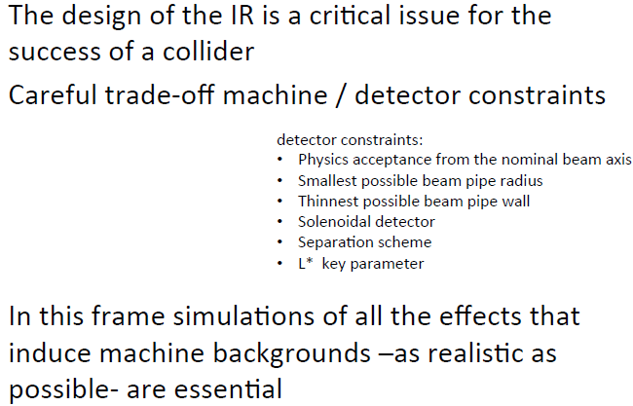
Boscolo: Conclusions

Slide 31

Seeman: CEPC Horizontal Trajectory near the IR

Slide 32

Bends (Quads) make X-ray fans:
PEP-II IR HER X-ray Fans (M. Sullivan)

Slide 33


Seeman: Design vacuum chamber masking for power absorption, backgrounds, and HOMs
PEP-II IR masking near BaBar

Slide 34
WG4: Key Future Topics :SR+Shielding in a Higgs Factory
Stabilize the storage ring parameters so that the injector parameters and power losses will stabilize.
Carryout the next layer of design of the injector chain
Develop a tunnel design with shafts/cranes/CV etc to study surrounding radiation effects and electronics shielding
Design a vacuum system for the hard areas: SCRF, injection, IR, wigglers
Need a next layer (realistic?) of IR design.
Study in detail the SR power lost in the Interaction Region
Develop a vacuum pumping scheme for the IR.
Develop a masking scheme for the detector from x-rays and lost particles.
Develop non-destructive diagnostics with wide spectral range and high sensitivity.

