Slide 1
Summary WG 9
Instrumentation and Control
Oct 12, 2014
M. Minty, H. Schmickler
1 session: 2 presentations
1 contribution
discussion

Slide 2
Lessons Learned from the B-Factories and Implications for a High-Luminosity Circular e+e- Higgs Factory
Yoshihiro Funakoshi (KEK)

Slide 3
Electron Clouds
~5%
Difference in averaged specific luminosity: ~5%
Electron clouds still restrict the KEKB performance severely!
Bunch-by-bunch Luminosity by ZDLM
Average of all bunches in the equivalent
buckets in the train.
J. Flanagan
Oct. 12, 2014 - HF 2014 – Y. Funakoshi

Slide 4
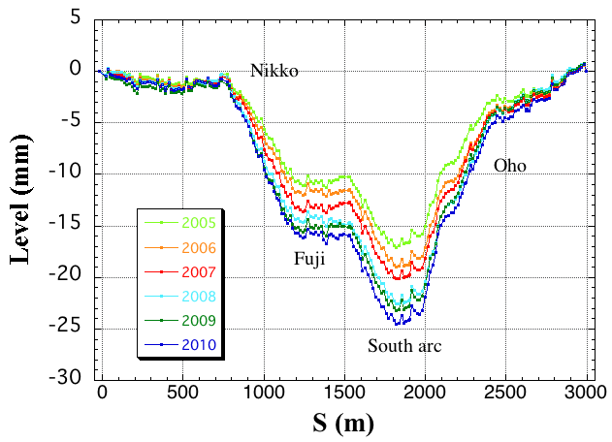
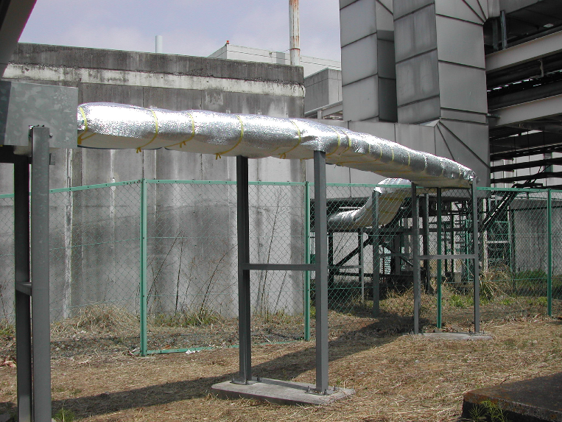
BPMs – Optics Corrections and Day-Night Effect
Normal optics correction procedure:
coupling, dispersion and beta-functions tuned iteratively
Day/night variations: “conspicuous” in 2003, “serious” in 2005 (up to 20%
reduction in luminosity)
Final diagnosis: thermal effect in BPM cables → bad optics corrections
Problem resolution: thermal insulator sheets

Slide 5
Collision Feedback and Luminosity Tuning
Some experiences of orbit feedback at KEKB
In double ring colliders such as KEKB, an orbit feedback system for maintaining the beam orbits around IP is vital.
  Without such a system, we cannot maintain the luminosity even for a short period.
With the system based on BPM measurement, we could prevent luminosity loss due to orbit change almost completely.
One of the problems with the system was the stability of the target values of the feedback.
  To trace their changes, we frequently (typically once an 8-hour shift) had to do the target scan for optimum values.
  The origin of the target change was thought to be mechanical movement of the BPMs or the QCS magnets.
    We experienced that the target changes greatly after beam aborts.
    Our observations have shown that heating of vacuum chambers brings sizable mechanical movement of the vacuum chamber and BPMs (and even of the quadrupole magnets).
    Counter-measures: Reinforcement of the cooling power of the IR vacuum chambers, displacement sensors for BPMs, introduction of continuous beam injection scheme
c
Oct. 12, 2014 - HF 2014 – Y. Funakoshi

Slide 6
Challenges in Beam Instrumentation and Control for Large Ring Colliders
- Based on the LHC Experience -
Manfred Wendt (CERN)

Slide 7
(from presentation summary)
LHC beam operation, instrumentation & control
  Many lessons learned, most are also applicable to e⁺-e⁻ colliders
  Non or minimum invasive instrumentation techniques are crucial!
  Machine protection & beam collimation are mission critical!
  Wakefield and impedance “surprises”
    RF heating, instabilities, impedance budget
Large ring collider beam instrumentation
  Quantities, costs, reliability
  BPMs: Workhorse of the beam diagnostics
  Requires radiation tolerant front-end electronics
    Fibers instead of copper cables
    Performance OK, but be aware: Wakepotential of the BPM pickups sum up!
  Be prepared for accelerator commissioning and
  modifications throughout the accelerator lifespan!
    Mods and changes on BI hardware may be very painful and expensive!
Oct. 12, 2014 - HF 2014 – M. Wendt

Slide 8
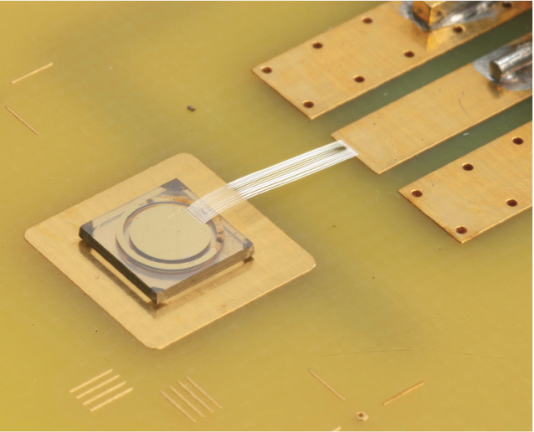
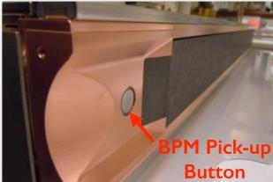
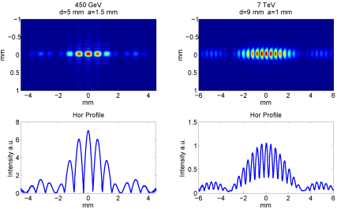
Examples of Instrumentation Evolution
BLM Relocation for UFO Detection
“Cryogenic” BLMs
Collimators with embedded BPMs
Beam halo mitigation: hollow E-Lens
High brightness, small beam size measurement
challenge : synchrotron light
beam-gas vertex detector

Slide 9
Beam Instrumentation of CEPC
Junhui Yue (IHEP)
Principle of design
Detailed information of sub-system
R&D of Beam instrumentation of CEPC
Digital electronics for BPM
High vacuum feed through for BPM and kicker
Pin diode type BLM monitor development
Luminosity measurement

Slide 10
Oct. 12, 2014 - HF 2014 – J. Yue

Slide 11
Discussion: general considerations
Difficult choice between placement of electronics in alcoves (long cable runs) versus distributed electronics ---- cost, performance, shielding
Design for all machine phases: commissioning, experiments and stable operation
- early written functional specifications (LHC: “bible of BI”)
generic versus different for FCC and CEPC?
- additional acquisition modes independent of machine tuning
- sufficient dynamic range
Effect of (high E_{c}) synchrotron radiation on
instrumentation?
electronics?
Discussion: instrumentation checklist (started)

Slide 12
(Some) specific challenges for large e+e- collider
A Sample of Essential Quantities:
Physics programs need precise measurements of
beam energy
beam energy “spectrum”
Many talks from other WGs, for example
“Polarization issues and schemes for energy calibration”, I. Koop
“FCC-ee beam energy measurement suggestion”, N. Muchnoi
“Possible application of wave-beam interaction for energy
measurement and obtaining of polarization at FCCe+e-”, S. Nikitin

