Slide 1
Beam-beam limit vs. number of IP's and energy
K. Ohmi (KEK-ACCL)
HF2014, Beijing
Oct 9-12, 2014
Thanks to Y. Funakoshi

Slide 2
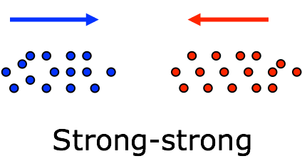
3D beam-beam interaction
A bunch is divided into several slices which contain many macro-particles.
Potential of colliding beam is evaluated by Particle in Cell method using 2D mesh.
Collision is calculated slice by slice.
$$F_{x(y)}=−\frac{∂φ_{PIC}}{∂x(y)}$$
drift between slices

Slide 3
3D symplectic integrator for slice-by-slice collision
Potential is calculated at s_{f} and s_{b}.
Potential is interpolated to s_{i} between s_{f} and s_{b}.
s_{f}
s_{f}
s_{b}
s_{b}
s_{i}
s_{i}
Since the interaction depends on z, energy kick should be taken into account dφ/dz.
We repeat the same procedure exchanging particle and slice.

Slide 4
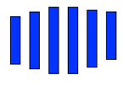
Weak-strong simulation
Strong beam is sliced. Macro-particles in weak beam collide with the strong beam.
$$\prod_{i=1}^{N_{sl}}{exp⁡[−V_{0}^{−1}(s_{i})}{φ }_{G,i}V_{0}(s_{i})]$$
$$\frac{dp_{x}}{ds}=−\frac{∂{φ }_{G}}{∂x}=−\frac{{4n}_{e}r_{e}}{γ}F_{x}$$
weak
$$F_{y}+iF_{x}=\sqrt{\frac{π}{2(σ_{x}^{2}−σ_{y}^{2})}}\left[w\left(\frac{x+iy}{\sqrt{2(σ_{x}^{2}−σ_{y}^{2})}}\right)−exp\left(−\frac{x^{2}}{2σ_{x}^{2}}−\frac{y^{2}}{2σ_{y}^{2}}\right)w\left(\frac{(σ_{y}/σ_{x})x+i(σ_{x}/σ_{y})y}{\sqrt{2(σ_{x}^{2}−σ_{y}^{2})}}\right)\right]$$
$$\frac{dδ}{ds}=−\frac{∂{φ }_{G}}{∂z}=−\frac{{2n}_{e}r_{e}}{γ}G$$
$$G=\frac{1}{2(σ_{x}^{2}−σ_{y}^{2})}\left\{\frac{dσ_{x}^{2}}{ds}\left[xF_{x}+yF_{y}+\frac{σ_{y}}{σ_{x}}exp\left(−\frac{x^{2}}{2σ_{x}^{2}}−\frac{y^{2}}{2σ_{y}^{2}}\right)−1\right]−\frac{dσ_{y}^{2}}{ds}\left[xF_{x}+yF_{y}+\frac{σ_{x}}{σ_{y}}exp\left(−\frac{x^{2}}{2σ_{x}^{2}}−\frac{y^{2}}{2σ_{y}^{2}}\right)−1\right]\right\}$$

Slide 5
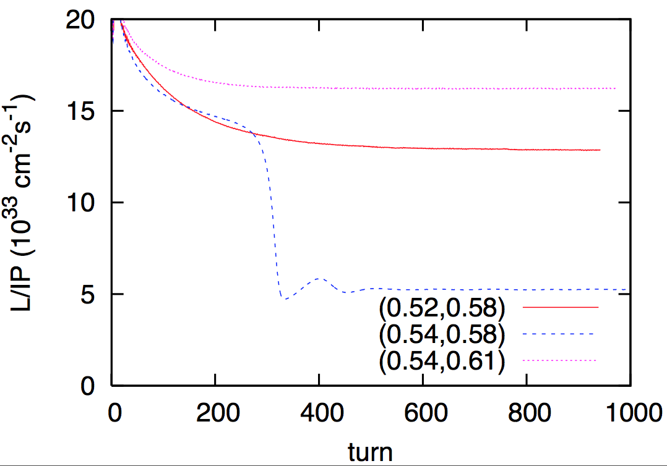
Strong-strong simulation for CEPC
Luminosity behavior depends on tune operating points.

Slide 6
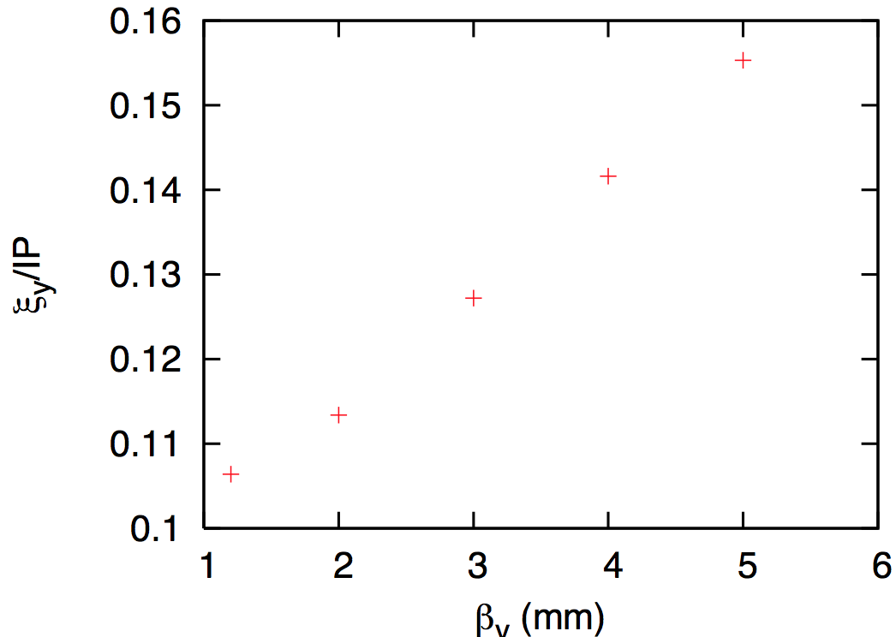
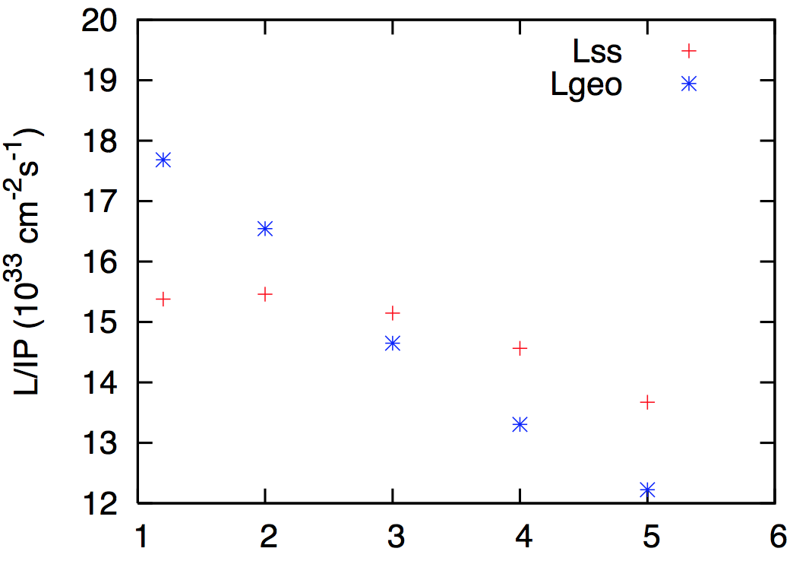
Dependence on β_{y}* (CEPC)
Tune shift including bunch length due to beamstrahlung, σ_{z}~2.8mm
Simulated luminosity as function of β_{y}*.
β_{y}*=2mm is better.

Slide 7
Tolerance for Vertical dispersion at IP in CEPC
$$σ_{y}=0.16 μm$$
$$σ_{δ}=0.16 −0.17 \%$$
$$η_{y,tol}≪\frac{σ_{y}}{σ_{δ}}=0.1 mm$$
Luminosity degradation is visible for $η_{y,tol}>0.02mm$

Slide 8
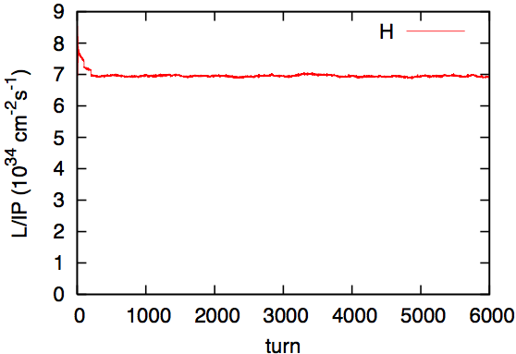
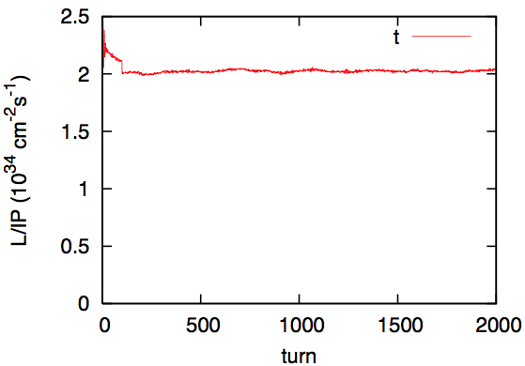
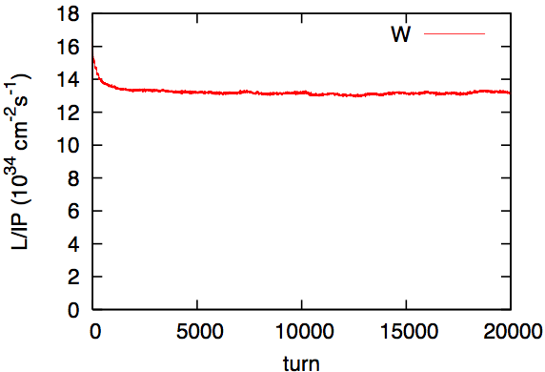
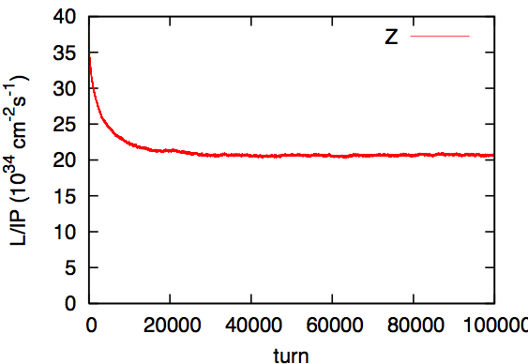
Weak-strong simulation for TLEP
H L_{design}=6x10³⁴ t L_{design}=1.8x10³⁴
W L_{design}=12x10³⁴ Z L_{design}=28x10³⁴

Slide 9
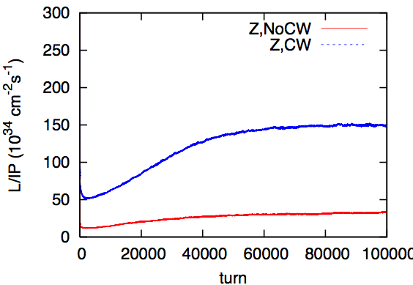
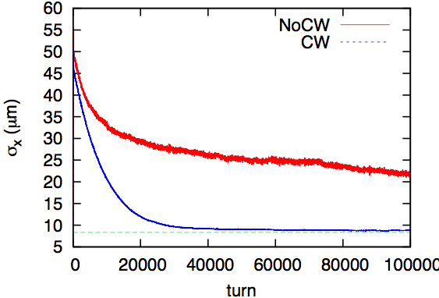
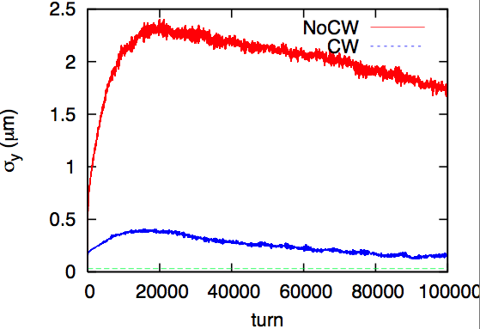
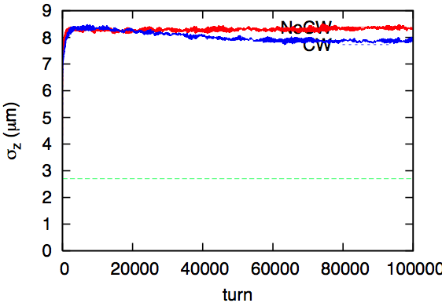
Crab waist option for TLEP-Z
L
L
L_{design}=219
σ_{x}
σ_{y}
σ_{z}

Slide 10
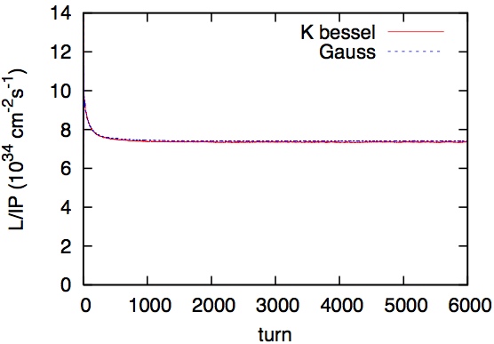
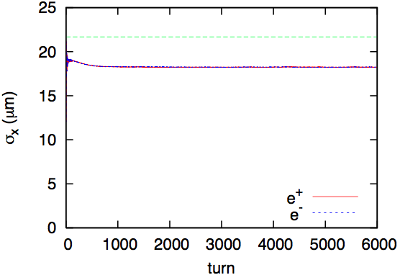
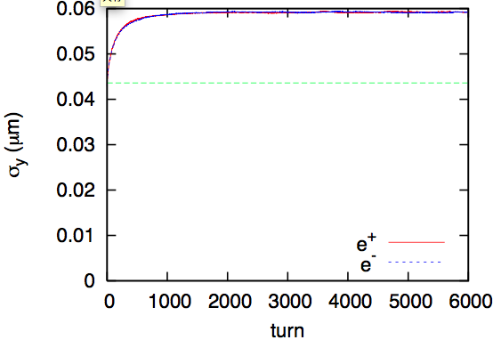
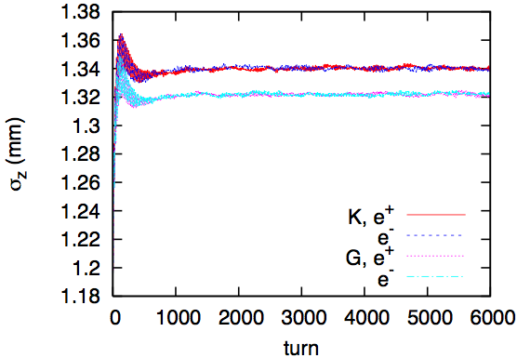
Strong-strong simulation for TLEP-H
L
L
σ_{x}
The difference is not seen in CEPC
σ_{y}
σ_{z}

Slide 11
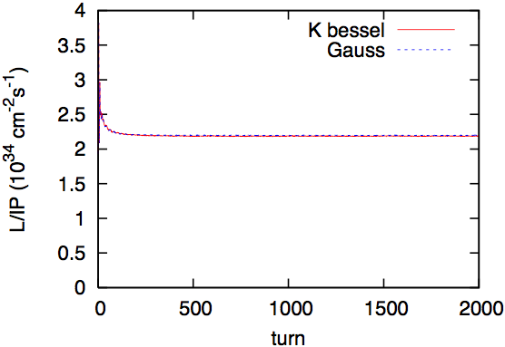
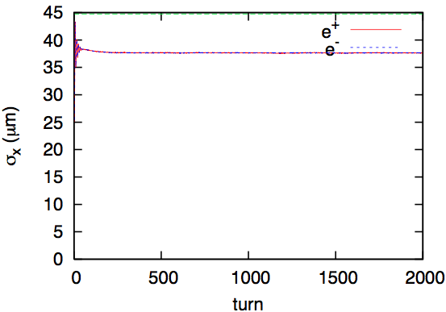
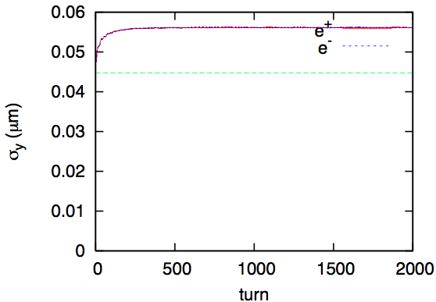
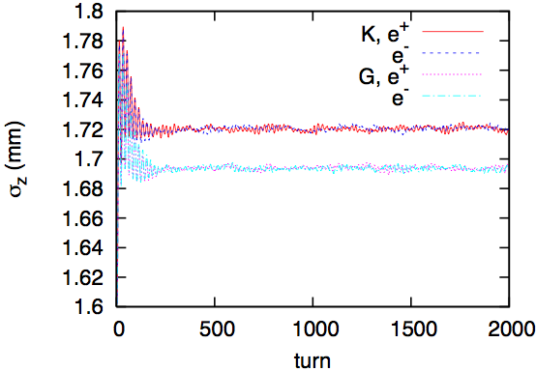
Strong-strong simulation for TLEP-t
L
L
σ_{x}
σ_{y}
σ_{z}

Slide 12
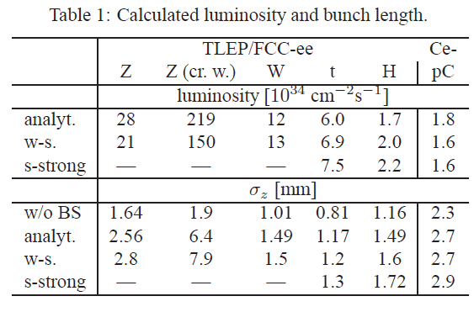
Summary of luminosity simulation
H
t

Slide 13
Systematic study for beam energy LEP experiences
LEP1: E=45.6 GeV, τ_{y}/IP=2888 turns, Ne=1.2x10¹⁰, ν_{x}, ν_{y}=(0.5775,0.0425)/IP,ξ_{y0}=0.044 , ξ_{y}=0.044
LEP1.5: E=65 GeV τ_{y}/IP=1000 turns, Ne=2.0x10¹⁰, ν_{x}, ν_{y}=(0.5645,0.0415)/IP, ξ_{y0}=0.051 , ξ_{y}=0.051
LEP2: E=94.3 GeV τ_{y}/IP=326 turns, Ne=4.0x10¹⁰, ν_{x}, ν_{y}=(0.5713,0.0388)/IP, ξ_{y0}=0.075 , ξ_{y}=0.073
LEP21: E=97.8 GeV τ_{y}/IP=293 turns, Ne=4.0x10¹⁰, ν_{x}, ν_{y}=(0.585,0.045)/IP, ξ_{y0}=0.079 , ξ_{y}=0.0785
Courtesy of H. Barkhardt

Slide 14
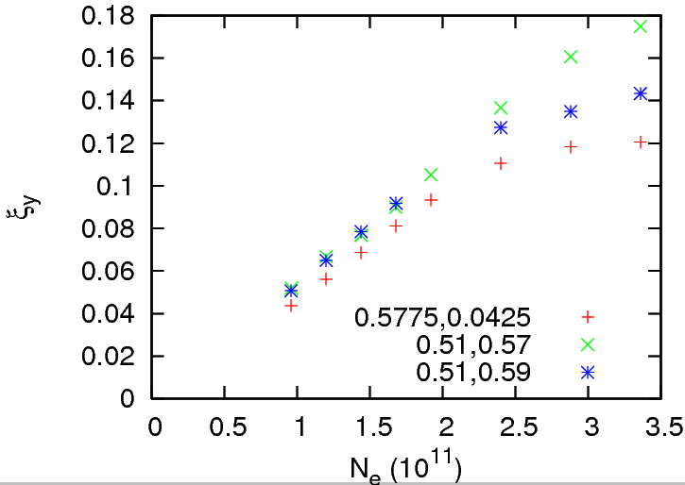
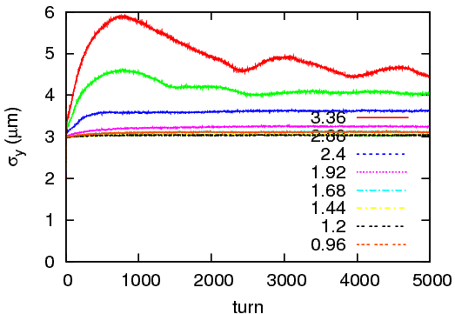
Current dependence of luminosity in LEP1 (strong-strong)
ξ_{y} is saturated at 0.12 for ν_{x}, ν_{y}=(0.5775,0.0425)

Slide 15
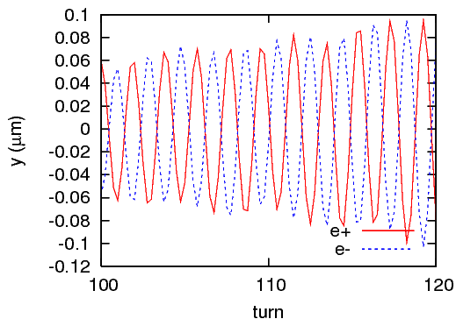
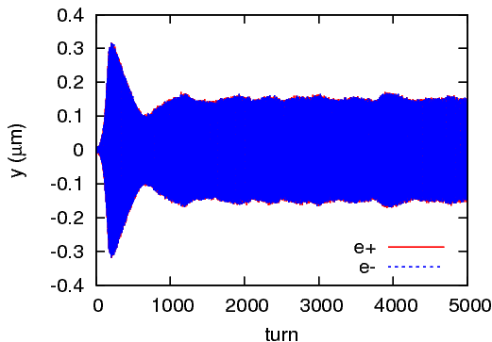
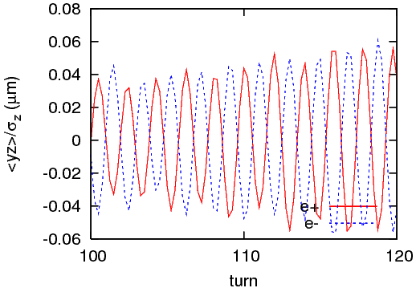
Why is ξ_{y} saturated
Vertical synchro-beta coherent motion is seen.

Slide 16
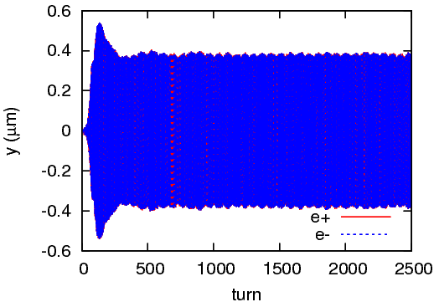
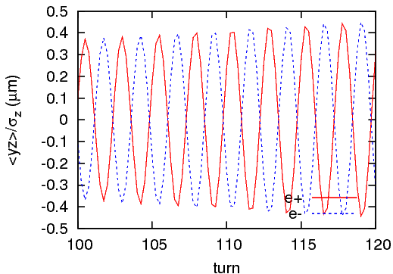
Current dependence of luminosity in LEP1.5 (strong-strong)
Vertical synchro-beta coherent motion is seen at ξ_{y}=0.05.

Slide 17
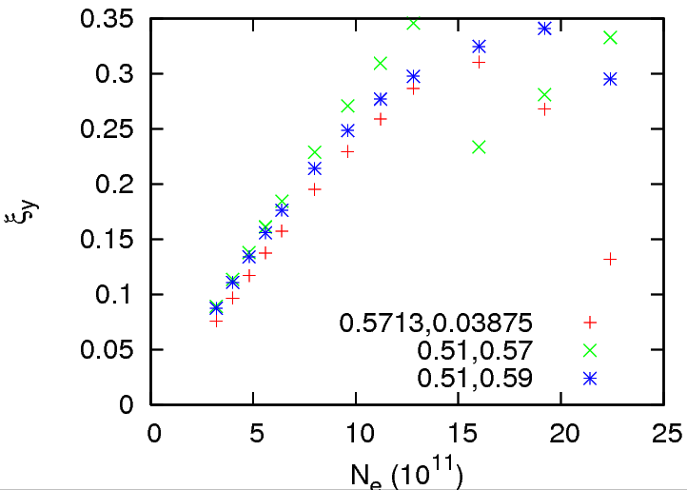
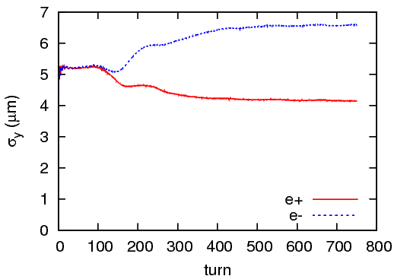
Current dependence of luminosity in LEP2 (strong-strong)
ξ_{y} limits at 0.3.
No coherent instability is seen.
Beam size flip/flop

Slide 18
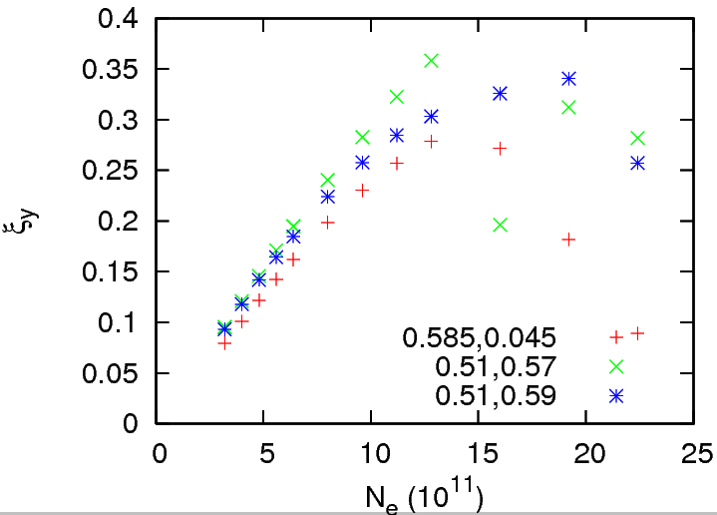
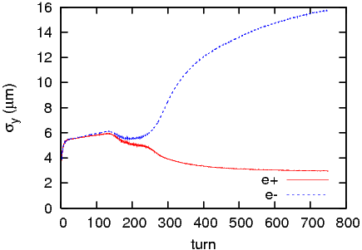
Current dependence of luminosity in LEP2.1 (strong-strong)
ξ_{y} limits at 0.3.
No coherent instability is seen.
Beam size flip/flop

Slide 19
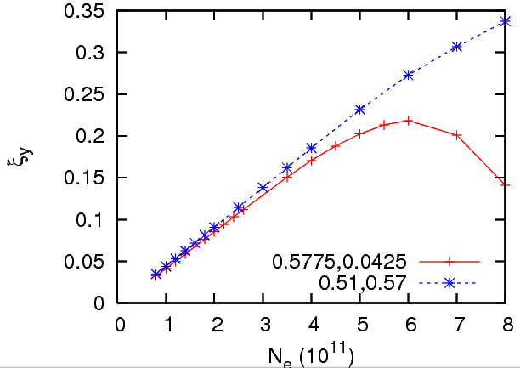
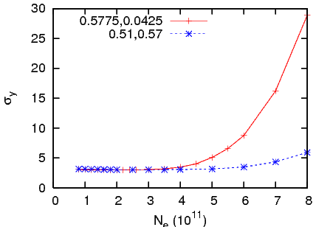
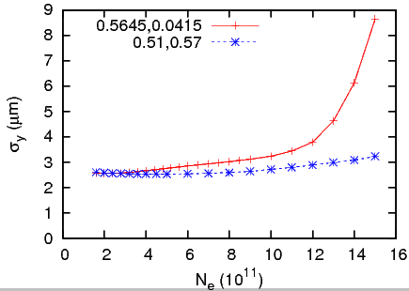
Weak-strong simulation
Only incoherent effects can be studied.
LEP1 ξ_{y,max}=0.22 LEP1.5 ξ_{y,max}=0.33

Slide 20
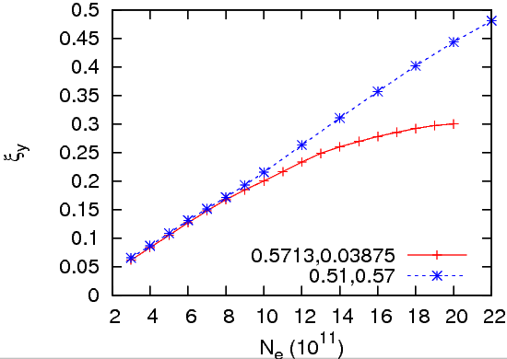
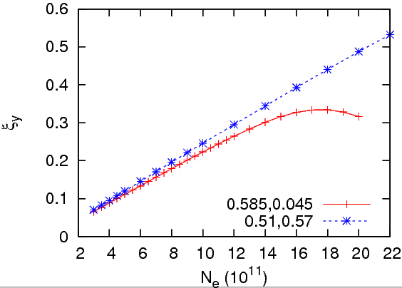
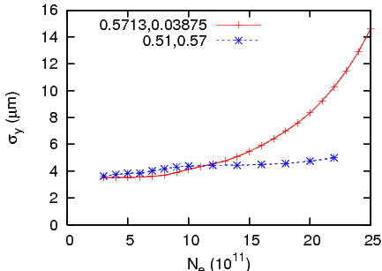
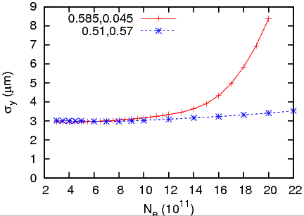
Weak-strong simulation
LEP2 ξ_{y,max}=0.3 LEP1.5 ξ_{y,max}=0.34

Slide 21
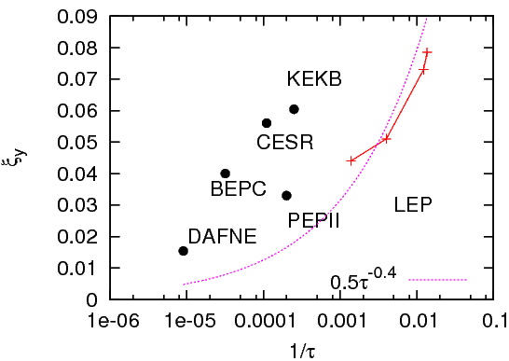
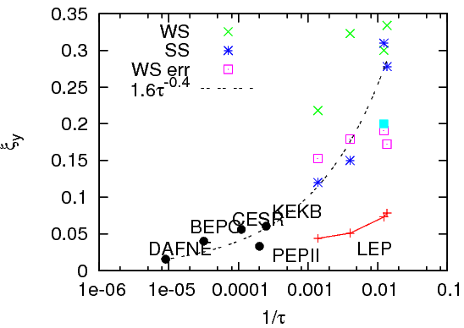
Damping rate
Beam-beam tune shift evaluated by luminosity
Simulation shows very high tune shift.

Slide 22
Number of IP
When the super-periodicity is perfect, simulations using IP phase difference are correct.
Betatron phase between IP’s modulates.
IP Twiss parameters, β, x-y coupling, η are not equal in every IP’s.
IP offset also shifts in each IP.

Slide 23
Vertical betatron Phase modulation
A sample
(1) Δφ₁₂,Δφ₂₃,Δφ₃₄=0.01, 0.02, 0.01,
(2) Δφ₁₂,Δφ₂₃,Δφ₃₄=0.02, 0.04, 0.01,
(3) Δφ₁₂,Δφ₂₃,Δφ₃₄=0.0417, -0.02, -0.01
ΔN_{e}=0.1N_{e}
r₂=0.0024, -0.0024,0.0048,-0.0024 (KEKB level)
Δy/σ_{y}=0, 0.25, 0.5,-0.25

Slide 24
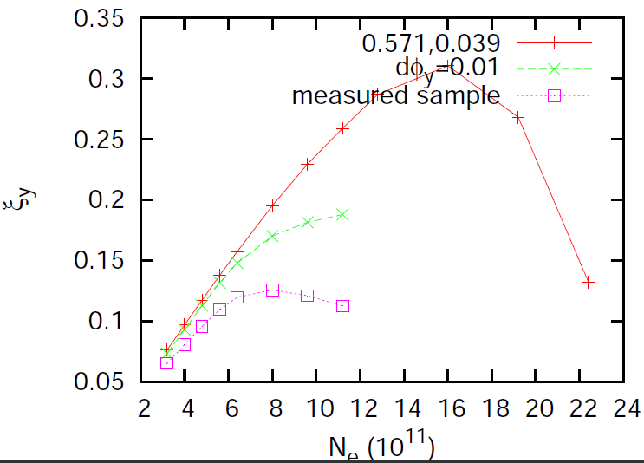
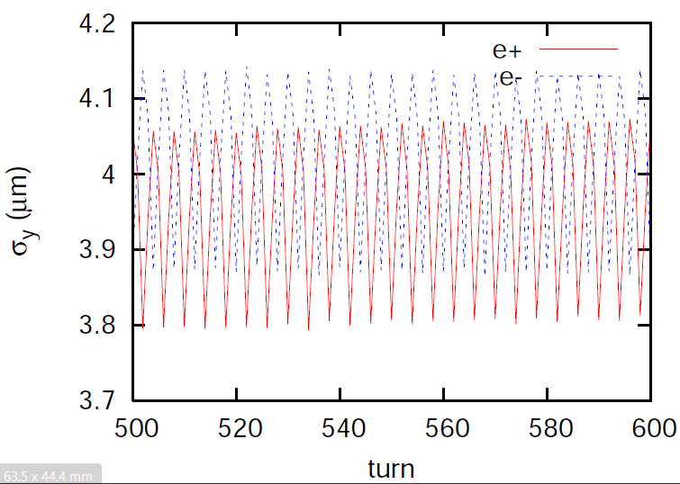
Effect of phase error in strong-strong simulation for LEP2

Slide 25
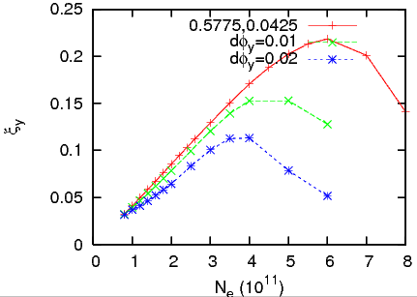
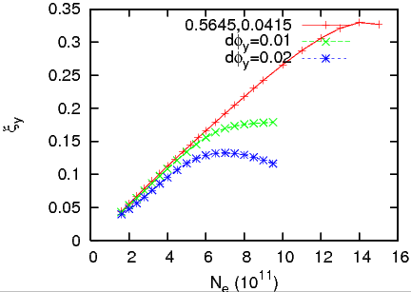
Effect of phase error in weak-strong simulation
LEP1 LEP15
ξ_{y,max} degrades drastically.

Slide 26
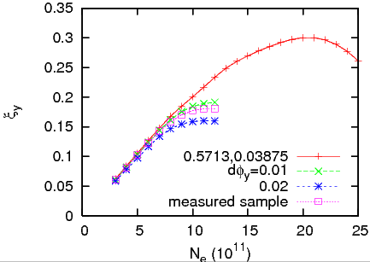
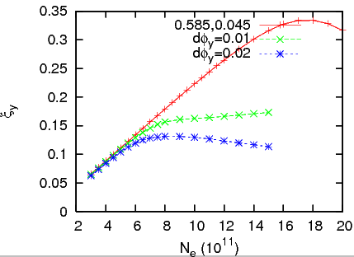
Effect of phase error in weak-strong simulation
LEP2 LEP21

Slide 27
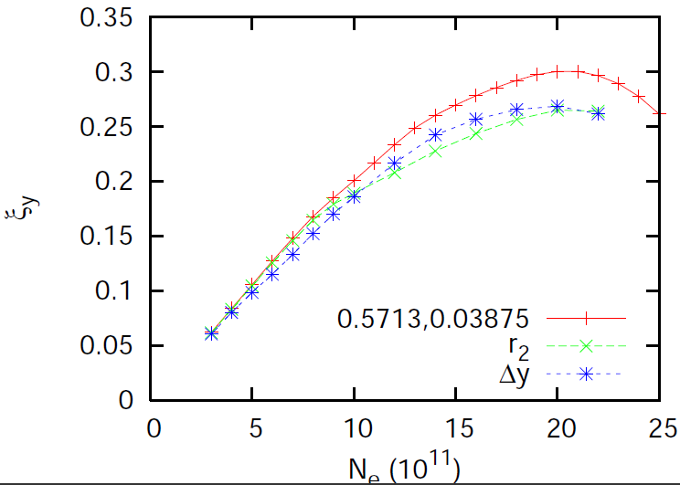
x-y coupling, collision offset

Slide 28
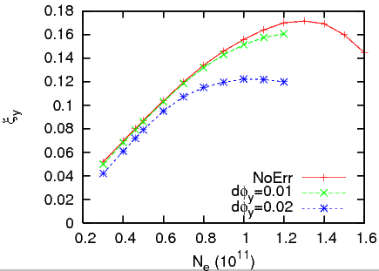
Effect of phase error in weak-strong simulation
TLEP

Slide 29
Summary
Luminosity simulation has been performed for TLEP, CEPC and LEP using weak-strong and strong-strong model.
Design luminosity can be achievable for TLEP and CEPC in the simulations.
Effects of energy and number of IP’s have been studied using LEP parameters.
The beam-beam limit in simulation is much higher than LEP experiments.
Erros, for example betatron phase error between IP’s affect the beam-beam performance.
Which is correct scaling for the bam-beam parameter.
${\begin{aligned} \\ ξ\end{aligned}}_{y}=0.5τ^{−0.4}$ or $1.6τ^{−0.4}$

