Slide 1
Top-Up Injection for PEP-II and Applications to a Higgs Factory
John Seeman,
SLAC
October 11, 2014
HF2014 Beijing

Slide 2
Abstract: Top Injection for PEP-II
Top-off injection was developed in PEP-II from the linac injector to allow constant luminosity with the BaBar detector being fully operational during injection. The electron beam top-off was developed initially as its lifetime was the shortest and thus made the luminosity nearly constant. Second, the positron beam top-off was developed making the luminosity fully constant. Either electrons or positron could be injection up to 30 Hz if needed, deciding pulse-by-pulse which beam (bunch) was desired. Technical details of PEP-II top-off will be presented. The implications for top-off into a circular Higgs factory will also be discussed. The injected beam emittances and septum parameters are presented.

Slide 3
Topics for Top-up Injection for Higgs Factory
What is needed for Top-Up injection
PEP-II /BaBar top-up injection
Required injection parameters for a Circular Higgs Factory
Inital injector parameters
Detector masking

Slide 4
Definitions (for this talk)
Trickle injection = Top-Off = Top-Up

Slide 5
PEP-II Overview

Slide 6
PEP-II Parameters for 3.1 GeV x 9.0 GeV
Parameter | Units | Design | April 2008 Best | 2008 Potential
I+ | mA | 2140 | 3210 | 3700
I- | mA | 750 | 2070 | 2200
Number bunches |  | 1658 | 1722 | 1740
β_{y}* | mm | 15-25 | 9-10 | 8.5
_{Bunch length} | mm | 15 | 11-12 | 9
ξ_{y} |  | 0.03 | 0.05-0.06 | 0.07
Luminosity | x10³³ | 3 | 12 | 20
Int lumi / day | pb⁻¹ | 130 | 911 | 1300
4 times design
7 times design

Slide 7
Technical Items Needed for Top-Up injection
Measure each bunch charge in real time and determine when it needs refilling.
In the injector time a bunch to deliver it to the needed particular bunch (bucket) in the ring.
Inject the bunch(es) into the collider with very low losses.
Determine the injected beam backgrounds in the particle physics detector and find cures using collimation.
Develop methods to monitor relevant backgrounds in real time for accelerator operators to tune on.
Develop trigger masking for the detector physics taking by turn and with azimuthal variation.

Slide 8
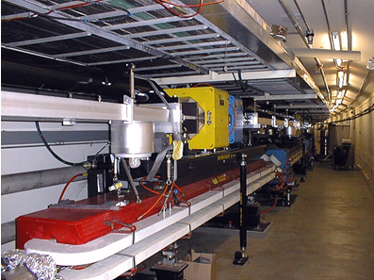
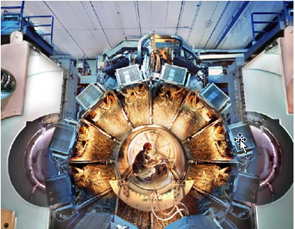
PEP-II / BaBar Top-Up (Trickle) Injection
Energy = 3.5 x 9 GeV
Circumference = 2200 m
One collision point (IR) at Lum = 1.2 x 10³⁴
Full energy injection from Linac+Damping Rings
Number of bunches = 1732 / ring
Beam currents = 2.1 A x 3.2 A
Particles = 1.0/1.5 x 10¹⁴ / beam (HER/LER)
Lifetimes:
Vacuum = ~10 hours
Touschek = ~3 hours (LER)
Luminosity = ~1 hour
Lost particles per second = 4.2 x 10¹⁰ / second
Top-up injection = one bunch / pulse
Injection rate: ~3-15 Hz (30 Hz max)
Particles per injection: 3 to 9 x 10⁹ / pulse
Bunch injection controller: pick the lowest bunch
Injection efficiency = ~ 80%
Injection kicker pulse length = 0.4 μsec
Ring path length = 7.3 μsec
PEP-II
BaBar

Slide 9
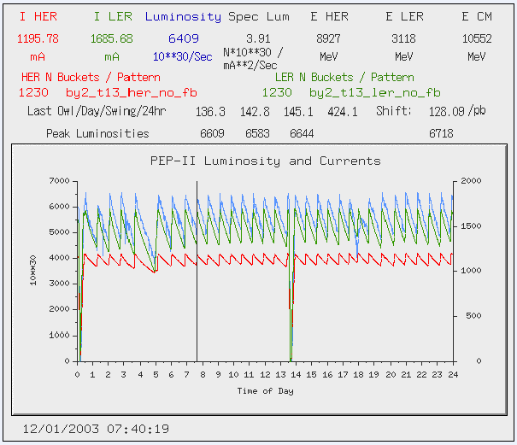
Running before Trickle (Continuous) Injection

Slide 10
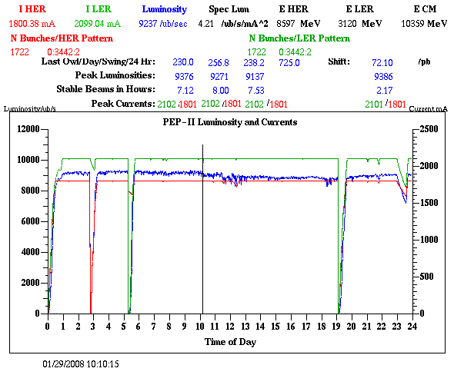
Continuous Injection for PEP-II

Slide 11
Trickle Injection lengthened the average fill length

Slide 12
PEP-II Run Time Changes with Top-Up Injection

Slide 13
Top-Up Injection increased Higher Average Luminosity

Slide 14
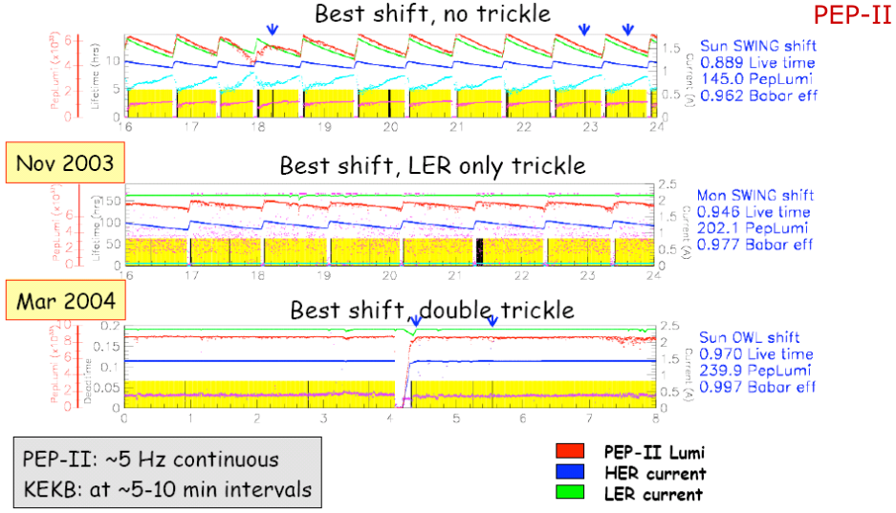
Trickle or Continuous Injection In PEP-II

Slide 15
PEP-II/BaBar Top-Up Injection (Accelerator)
Improved peak and average luminosity.
Before Top-Up Injection
After Top-Up Injection

Slide 16
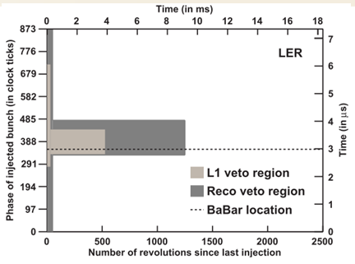
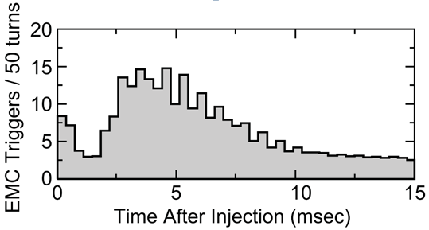
PEP-II/BaBar Top-Up Injection and Detector Trigger Masking
One
turn
BaBar trigger masking:
Mask all of ring a few tens of turns.
Mask injected bunch area for 1250
turns or about 0.9 msec.

Slide 17
BaBar Vetoes versus bunch number and turn number.

Slide 18
CEPC Accelerator Parameters

Slide 19
CEPC Injection Phase Space
Septum blade
Stored Beam Orbit
Injection orbit
β_{x} at injection septum (stored) = ~200m
β_{x} at injection septum (injection) = ~30m
ε_{xstored} (stored) =6 nm
ε_{xinj} (injected) =40 nm
σ_{xstored} at septum (stored) = 1.1 mm
σ_{xinj} at septum (injected) = 1.1 mm
X_{s} = Septum blade thickness =~ 5 mm
X_{c} = septum clearance distance = ~6σ_{x}
Xinj < A_{x}
Xinj = 4σinj+X_{s}+Xc = ~16 mm
A_{x} = machine aperture > ~20 mm
Stored beam
Injection bump on
Injection bump
x_{c}
Injected beam
(+/- 2 σ_{xinj})
x_{inj}
A_{x}
Injection bump off
(~one turn later)
x_{inj}

Slide 20
Electron and Positron Production
CEPC stores about 2 x10¹³ e+ per ring.
CEPC with 1 hr lifetime needs 1.25 x10¹³ e-/e+ per hour or
~3.5 x10⁹ e+ and e- per second at full energy.
Past:
CERN: LEP injection complex delivered ~10¹¹ e+ per second.
SLAC: SLC injection complex delivered ~6 x 10¹² e+ per second.

Slide 21
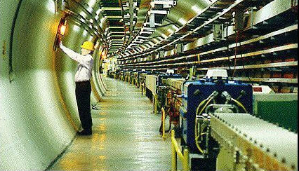
Option 1: “Ramped Storage Ring” as a CEPC Injector
Top-up injection = 50 bunches / pulse / beam
Slow ramp due to magnet laminations
Injection rate: Once every 4 minutes.
Particles per ring injection: 8.4 x 10¹¹ / pulse
Particles per injected bunch: 1.7 x 10¹⁰ / pulse
Bunch injection controller: Fill all bunches at once
Tailor each bunch separately.
Ring path length = 182 μsec
Injection kicker pulse length = 182 μsec.
Kickers = 13 stronger than PEP-II but long flat top.
→ Luminosity varies from 100% to 74% over 8 minutes with 4 minutes per ring.
CERN LEP: 26.7 km
Ramping speed is 0.5 GeV/sec
→ 120 GeV in 4 minutes.
120 GeV
DR 1.5 GeV
3 GeV
Injector
Storage Ring
e-
CEPC
Linacs
e+

Slide 22
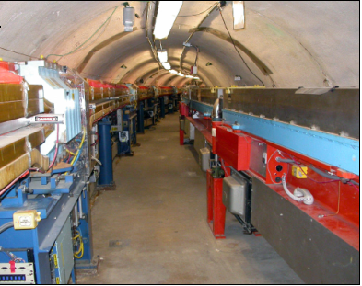
Option 2: “Synchrotron” as a CHF Injector
Top-up injection = 50 bunch / pulse
Cycle rate = 3 Hz
Injection rate: 1 Hz e+, 1 Hz e-, 1 Hz e- to make e+
Particles per injection:4 x 10⁹ / pulse over 50 bunches
with 90% injection efficiency
→ 8 x 10⁷ /bunch → means low instability effects and RF.
Bunch injection controller: Tailor the charge of each bunch
Magnet laminations same as AC transformers.
Injection kicker pulse length = 183 μsec (= 53 km)
Kickers = 13 stronger than PEP-II but 7 times slower.
Ring path length = 183 μsec (53 km)
→ Luminosity stays within 0.12% of the peak.
Cornell synchrotron: 768 m
Sine wave-magnet excitation
0.2 GeV to 12 GeV in
8.3 msec at 60 Hz.
Does not affect CESR
storage ring operation just
2 m away.
120 GeV
2 GeV
DR
CHF
Synchrotron
e-
e-
e+

Slide 23
Detector Masking
Detectors for CEPC need to mask injection bunches.
Ramped storage ring injector:
Mask all of ring for ~10 msec every 4 minutes. But luminosity is only constant to ~16%.
Synchrotron injector:
Mask all of ring for ~10 msec at 1 Hz but injected bunch and injection charge is 200 times smaller and luminosity is constant to 0.1%.
Need to make initial full design of a full energy 1 Hz synchrotron injector.

Slide 24
Conclusions
Top-up injection will work for a Circular Higgs Factory.
A full energy injector is needed because of beam lifetime.
A synchrotron injector will work the best but is more than is needed. (60 Hz)
A rapidly ramped storage ring is adequate. (4 sec)
A slowly ramped storage ring injector doesn’t make the luminosity constant enough.
The detectors will need to mask out the buckets with damping injected bunches during data taking.

