Slide 1
Status of CEPC lattice design
H. Geng, G. Xu, W. Chou, Y. Guo, N. Wang, Y. Peng, X. Cui, Y. Zhang, T. Yue, Z. Duan, Y. Wang, D. Wang, S. Bai, Q. Qin, J. Gao, F. Su, M. Xiao
IHEP, CAS, China
HF2014 Workshop, Beijing, China
October 9th-12th, 2014

Slide 2
Outline
Introduction
Lattice design of the ring
Pretzel scheme design
Work to be done
Acknowledgement

Slide 3
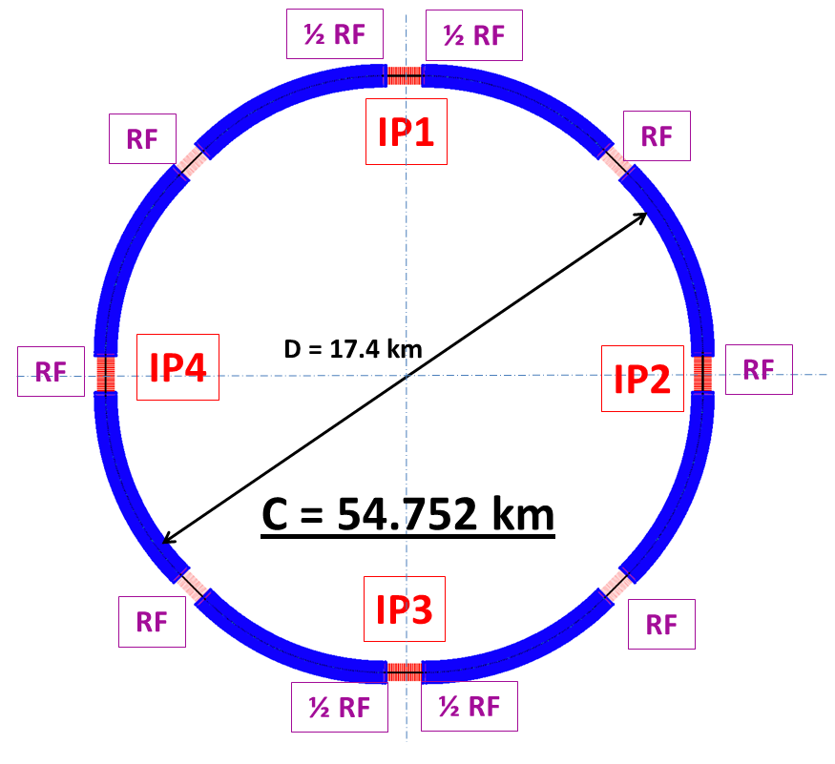
Introduction
CEPC is a Circular Electron Positron Collider to study the Higgs boson
Critical parameters:
Beam energy: 120GeV
Circumference: 54 km
SR power: 51.7 MW/beam
8*arcs
2*IPs
8 RF cavity sections (distributed)
Filling factor of the ring: ~70%
Length of the straight sections are compatible with SppC requirement

Slide 4
CEPC parameter list
Parameter | Unit | Value | Parameter | Unit | Value
Beam energy [E] | GeV | 120 | Circumference [C] | m | 54752
Number of IP[N_{IP}] |  | 2 | SR loss/turn [U₀] | GeV | 3.11
Bunch number/beam[n_{B}] |  | 50 | Bunch population [Ne] |  | 3.79E+11
SR power/beam [P] | MW | 51.7 | Beam current [I] | mA | 16.6
Bending radius [ρ] | m | 6094 | momentum compaction factor [α_{p}] |  | 3.36E-05
Revolution period [T₀] | s | 1.83E-04 | Revolution frequency [f₀] | Hz | 5475.46
emittance (x/y) | nm | 6.12/0.018 | β_{IP}(x/y) | mm | 800/1.2
Transverse size (x/y) | μm | 69.97/0.15 | ξ_{x,y}/IP |  | 0.118/0.083
Beam length SR [σ_{s.SR}] | mm | 2.14 | Beam length total [σ_{s.tot}] | mm | 2.65
Lifetime due to Beamstrahlung (simulation) | min | 47 | lifetime due to radiative Bhabha scattering [τ_{L}] | min | 52
RF voltage [V_{rf}] | GV | 6.87 | RF frequency [f_{rf}] | MHz | 650
Harmonic number [h] |  | 118800 | Synchrotron oscillation tune [ν_{s}] |  | 0.18
Energy acceptance RF [h] | % | 5.99 | Damping partition number [Jε] |  | 2
Energy spread SR [σ_{δ.SR}] | % | 0.132 | Energy spread BS [σ_{δ.BS}] | % | 0.119
Energy spread total [σ_{δ.tot}] | % | 0.163 | n_{γ} |  | 0.23
Transverse damping time [n_{x}] | turns | 78 | Longitudinal damping time [n_{ε}] | turns | 39
Hourglass factor | Fh | 0.658 | Luminosity /IP[L] | cm⁻²s⁻¹ | 2.04E+34

Slide 5
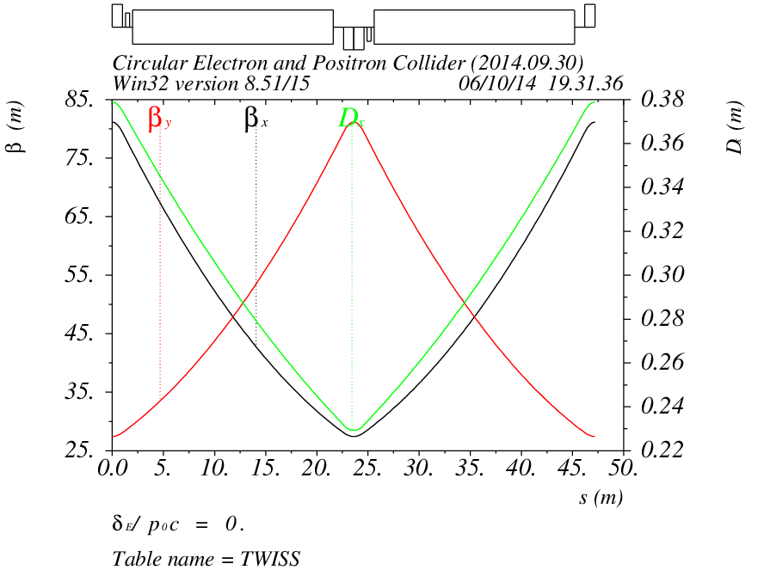
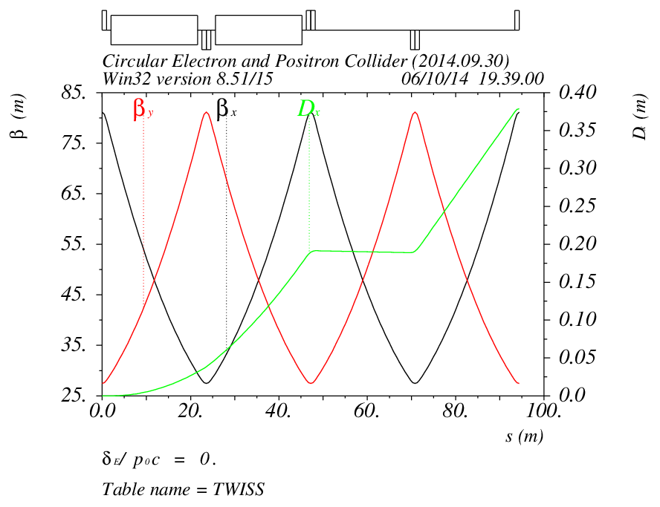
Lattice of arc sections
Length of FODO cell: 47.2m
Phase advance of FODO cells: 60/60 degrees
Dispersion suppressor on each side of every arc
Length: 94.4m

Slide 6
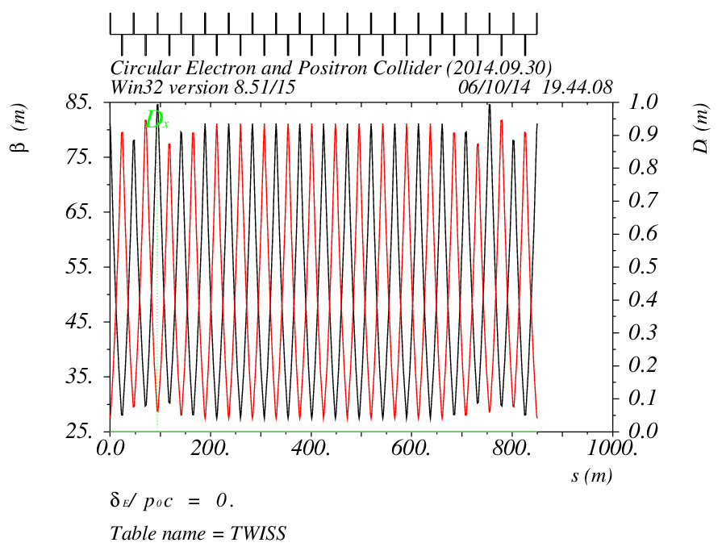
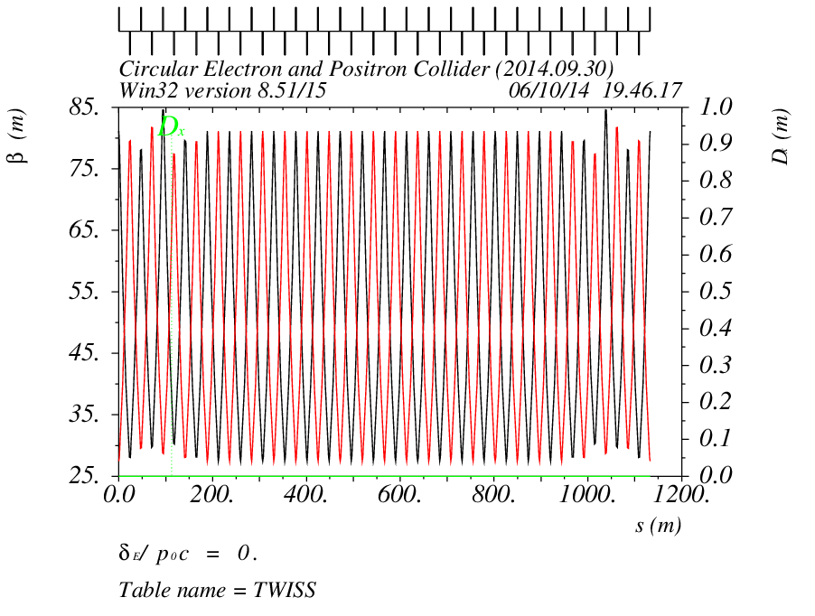
Lattice of straight sections
Short straight: 18 FODO cells
Length: 849.6
Long straight: 24 FODO cells
Length: 1132.8m

Slide 7
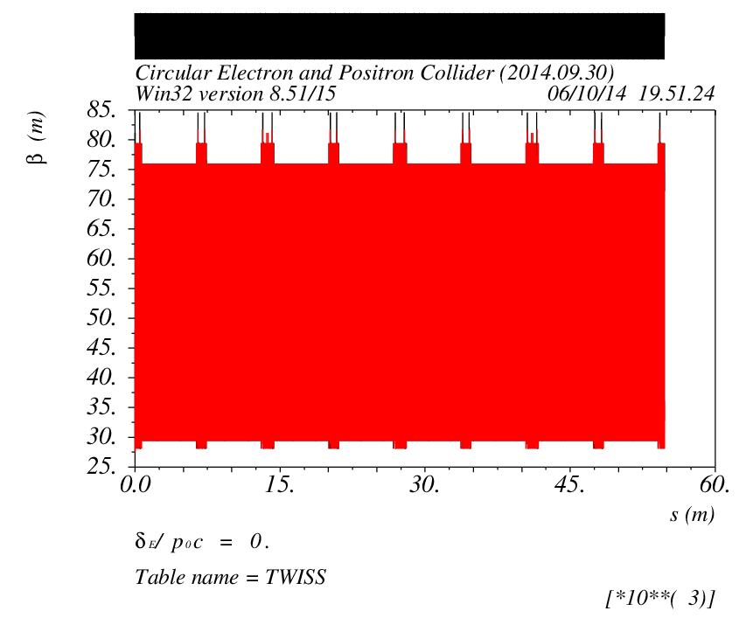
Lattice of the main ring
Four superperiod, with 2 IPs
Total length is 54.752km

Slide 8
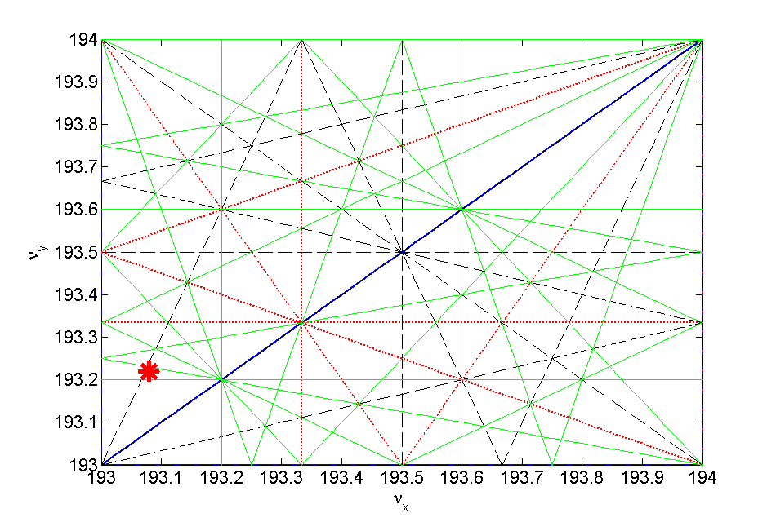
Work point
The working point is chosen as: 193.08/193.22 in horizontal and vertical
Optimization is done with beam-beam simulations, to have a high luminosity

Slide 9
Chromatic correction (1)
Two families of sextupoles: one family for horizontal, one family for vertical plane
One sextupole next to each quadrupole in the arc section

Slide 10
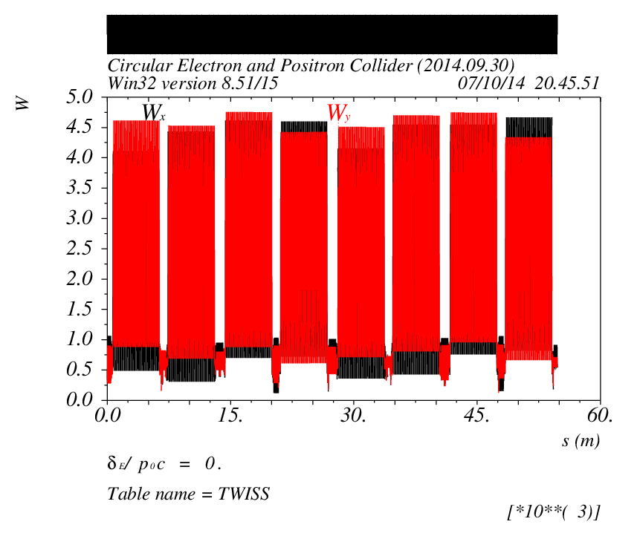
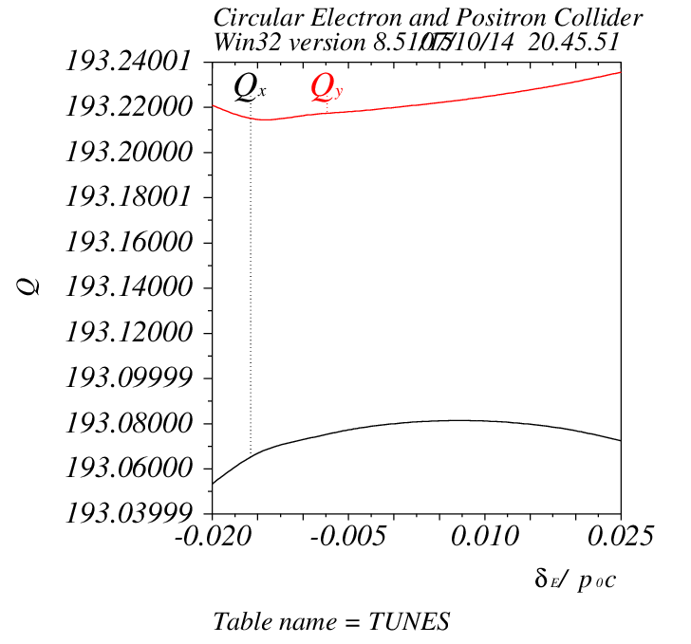
Chromatic correction (2)
The W function for the ring is only a few
The chromaticity in both planes has been corrected to a positive value

Slide 11
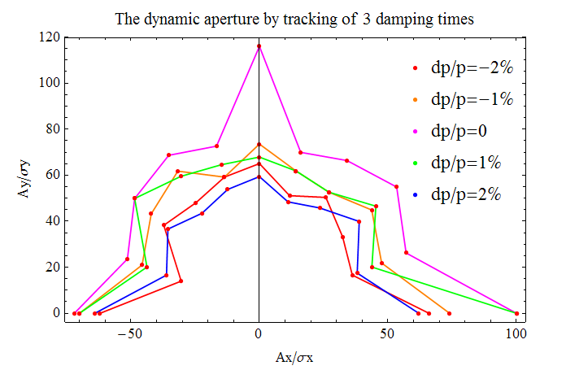
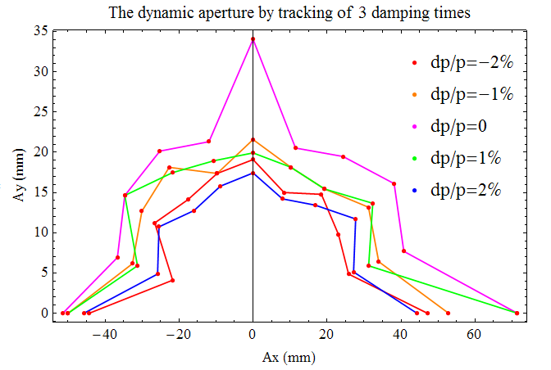
Dynamic aperture
240 turns is tracked for dynamic aperture
Full coupling is assumed for vertical plane
The dynamic aperture is: ~ 60σ_{x}/60σ_{y} or 40mm/16mm in x and y for ±2% momentum spread

Slide 12
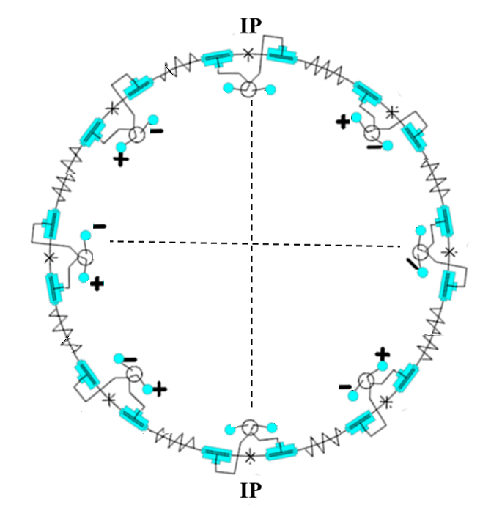
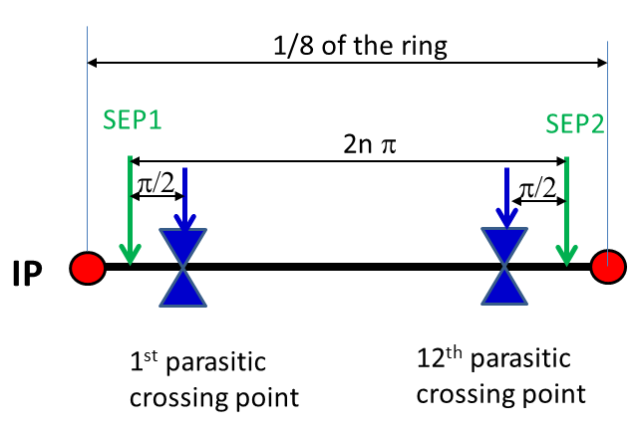
Pretzel scheme (1)
Horizontal separation is adopted to avoid big coupling
No orbit in RF section to avoid beam instability and HOM in the cavity
One pair of electrostatic separators for each arc

Slide 13
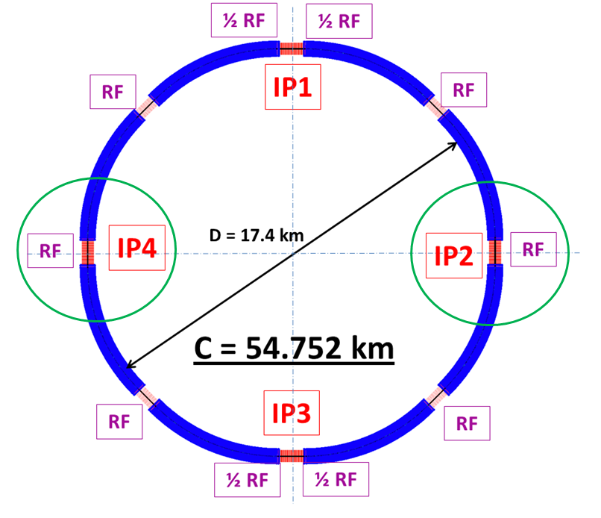
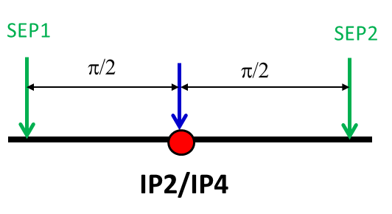
Pretzel scheme (2)
IP2 and IP4 are parasitic crossing points, but have to avoid collision
Two more pairs of electrostatic separators for IP2 and IP4

Slide 14
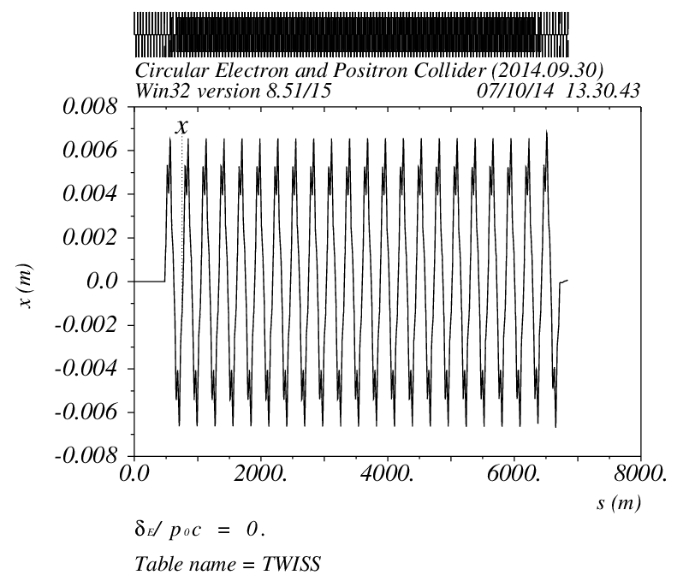
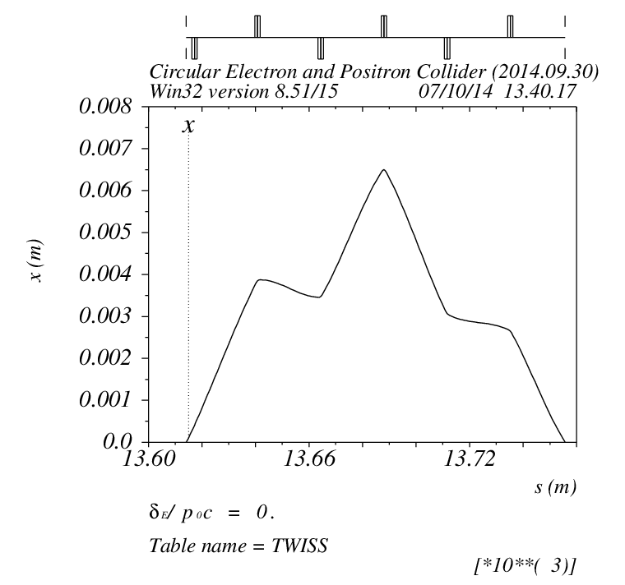
Pretzel scheme (3)
Separation distance: 5 σx for each beam
Maximum separation distance is : 6.5 mm
Orbit for the first 1/8 ring
Orbit for IP2/IP4

Slide 15
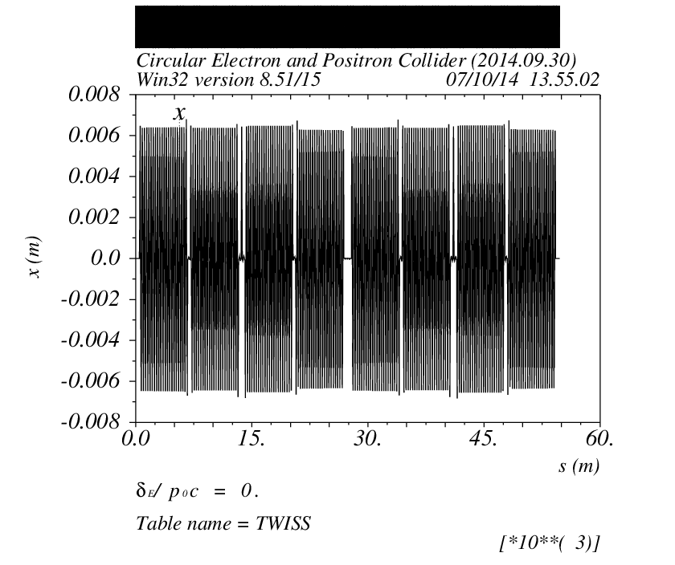
Pretzel scheme (4)
Orbit of the ring

Slide 16
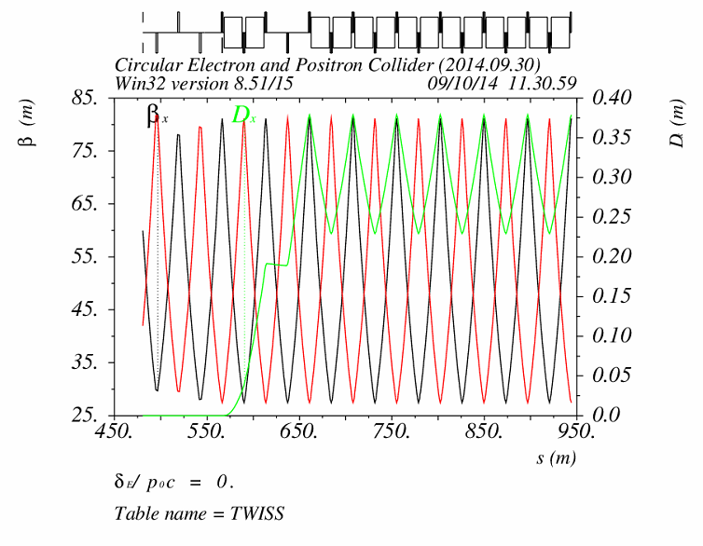
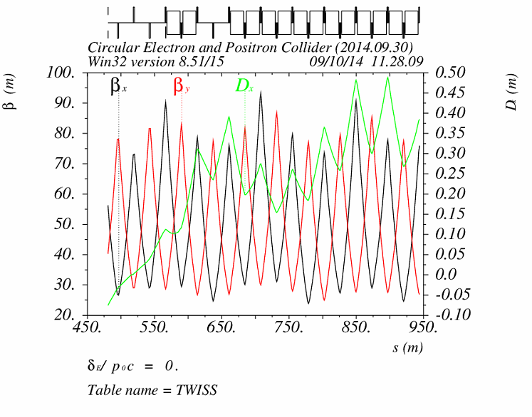
Effects of pretzel orbit (1)
Pretzel orbit has effects on:
Beta functions, thus tune
Dispersion function, thus emittance
Dynamic aperture
Sextupoles ON
w/o pretzel orbit
w/ pretzel orbit

Slide 17
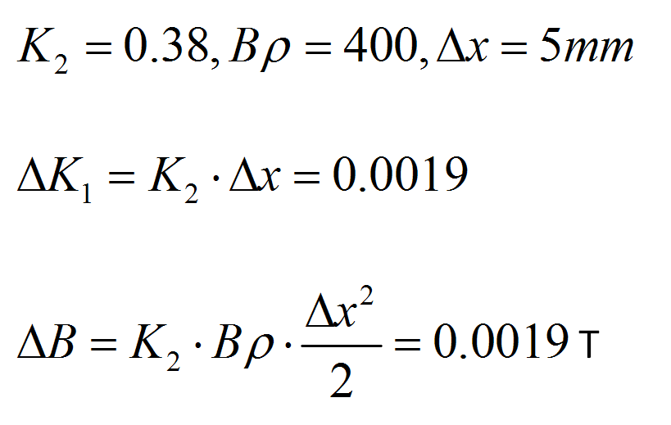
Effects of pretzel orbit (2)
Estimation of dipole field strength in quadrupole
Dipole field of the ring 0.066T.
Estimation of quadrupole field strength in sextupole
Quadrupole field of the ring K₁=0.022.
Dipole field of the ring 0.066T.
This explains why the dispersion function has been changed so much.

Slide 18
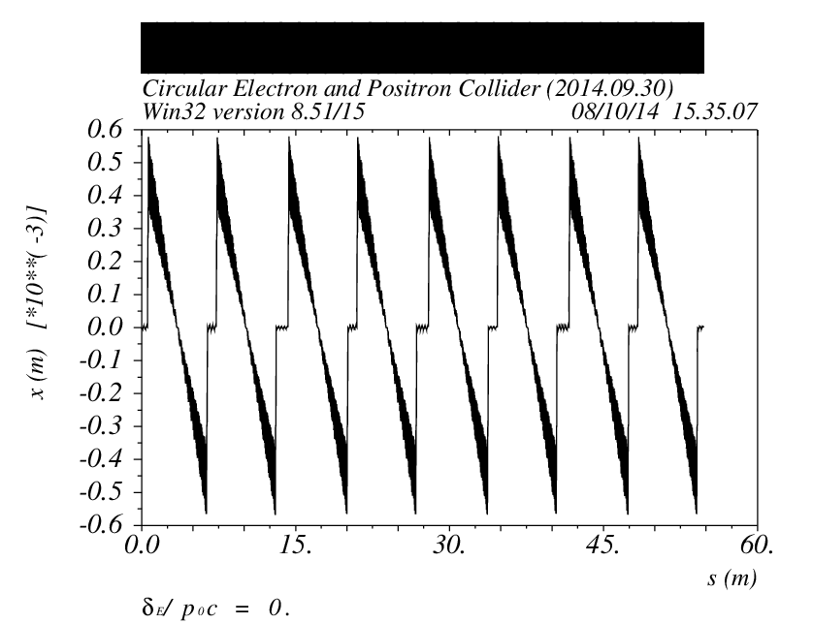
Sawtooth orbit (1)
The energy sawtooth phenomenon has been raised by K. Oide in HF2012
The total synchrotron radiation energy loss in CEPC ring is 3GeV
The beam will have 0.3% energy difference between the entrance and exit of each arc
The maximum orbit distortion is ~0.6 mm

Slide 19
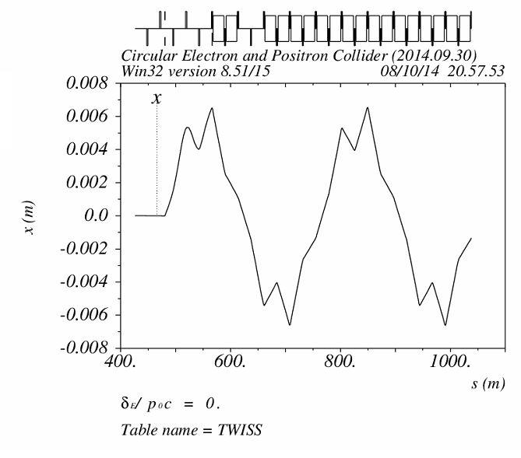
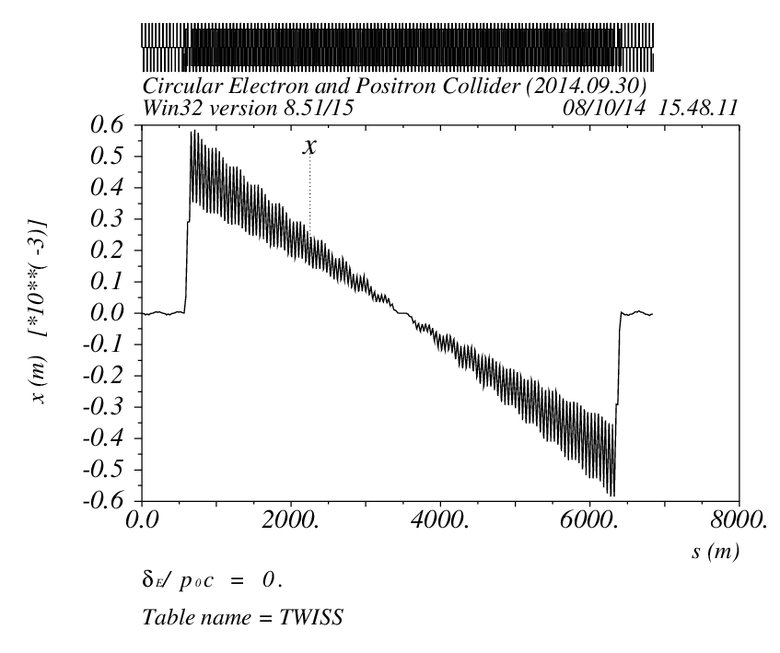
Sawtooth orbit (2)
Sawtooth orbit amplitude is one order smaller than pretzel orbit, how much will it affect DA ?
How to correct sawtooth orbit if two beams stay in one ring ?
Pretzel orbit
Sawtooth orbit

Slide 20
Work to be done (1)
Try more families of sextupoles
Optimize for a larger dynamic aperture
Integrate with FFS

Slide 21
Work to be done (2)
Matching of distance between adjacent parasitic crossing points and FODO cell length
For 50 bunches per beam, which means,
If we keep the FODO cell length 47.2m , then
m

Slide 22
Work to be done (3)
Design an orbit such that the parasitic crossing point is at the maximum orbit separation point
To lower the intensity of electrostatic separators, the parasitic crossing points locates at the position where the beta function is minimum is preferable

Slide 23
Work to be done (4)
Sawtooth orbit correction (correctable or not ?)
Dynamic aperture optimization with pretzel and/or sawtooth
Integration with FFS, error study ….

Slide 24
Acknowledgement
We would like to thank Yunhai Cai, Richard Talman, Dave Rice, Yoshihiro Funakoshi, Dmitry Shatilov , Kazuhito Ohmi , Yuhong Zhang, and those who are not mentioned here, for their help and useful discussions !

Slide 25
Thank you !

