Slide 1
A Green CEPC using the power of nuclear waste
Zhenchao Liu, Jie Gao
IHEP, 2014.10.9

Slide 2
Contents
Introduction on CEPC
Energy problem in China
ADS Project
Green CEPC in the future
Summary

Slide 3
CEPC and IHEP
CEPC: the development in energy frontier of particle physics.
The next step for BEPC and BEPCII.
Research on the Higgs particle of standard model.
CEPC: will be a huge machine that ever built in china in fundamental research
Non profit
High construction cost(much more than BEPC)
High operation cost
Huge energy consuming (several hundreds MW)

Slide 4
Accelerator studies in China, Qing Qin

Slide 5
Accelerator studies in China, Qing Qin

Slide 6
High power consuming
Synchrotron radiation:
One beam 50MW, two beams 100MW
Total: ~300MW
including power source, cryogenic system (LHe,LN₂) and so on.
Compare with LHC and ILC
CERN at peak 180MW, ~140MW average (24/7), one year 1.2TWh, 50-60M€/year(40-50 €/MWh)
ILC: 300MW for 500GeV and 500MW for 1TeV, 160M€/year for 500GeV (135 €/MWh)
Denis Perret-Gallix, LCWS, Tokyo Univ. Nov. 2013

Slide 7
Energy problem in China
China population is >1.3billion, average energy consumption per person is <1/2 of the world level, <1/10 of the developed country’s level.
Fast development of economy at annual rate of 7-10% has been kept for >20 years.
China has been the 2nd largest energy producing and consumption country
Yican Wu, ICENES talk

Slide 8
Energy problem in China
Population will be 1.5 billion at 2050, conservatively predicted capacity of electricity will be 1200~1500GWe
China will probably be the 1st largest CO₂ producer at 2025
Serious pollution &Energy shortage
Renewable/sustainable energy, Nuclear Energy

Slide 9
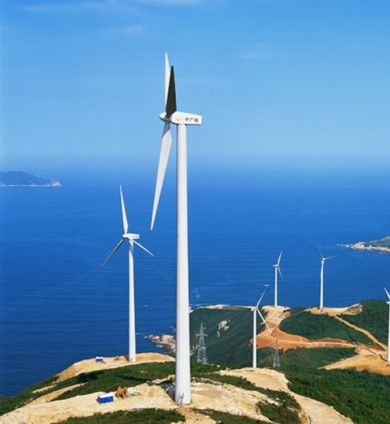
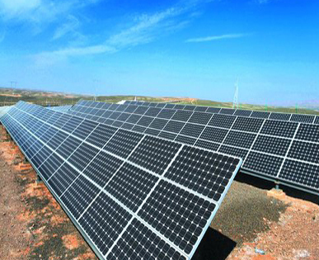
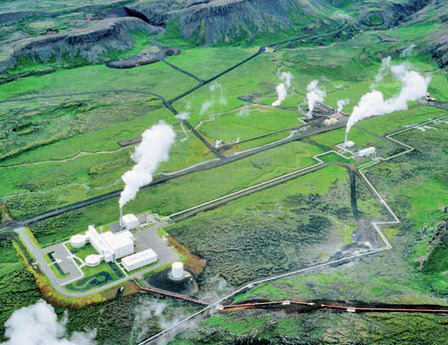
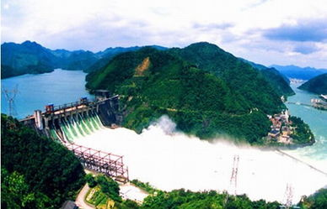
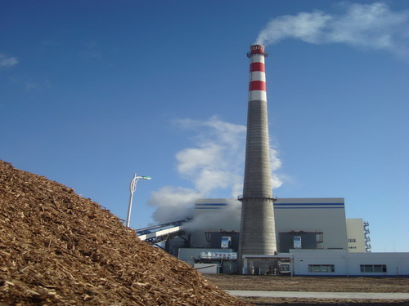
Renewable Energy in China
wind
solar
geothermal
hydropower
biomass

Slide 10
All kinds of electric capacity in China
by the end of 2012, Installed power generation capacity 1144910MW, hydropower 248900MW, thermal power 819170MW(71.5%), nuclear power 12570MW, wind 60830MW, solar power3280MW.
by the end of Aug. 2013,wind 68450MW,solar 8980MW, nuclear power 14780MW,biomass energy 8000MW. (8.5% of total)
来源：全国人大常委会执法检查组在关于检查 《中华人民共和国可再生能源法》实施情况报告

Slide 11
2015 forecast for renewable energy
hydropower 2900000MW, wind 100000MW, nuclear 40000MW, solar 35000MW, biomass 13000MW.
~32% of the total electricity power

Slide 12
Investment on renewable energy in 2013
China 56 billion U.S. dollar, for the first time more than Europe
Europe 48 billion U.S. dollar
USA 36 billion U.S. dollar
India 6 billion U.S. dollar
Brazil 3 billion U.S. dollar

Slide 13
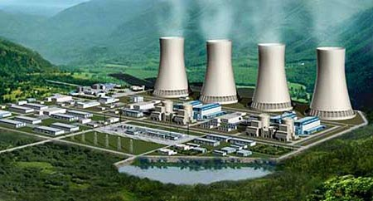
Nuclear Power
Electric energy production: 14780MW(2013.8)
1.23% of total electric energy production (~1200000MW)

Slide 14
Yican Wu, ICENES talk

Slide 15
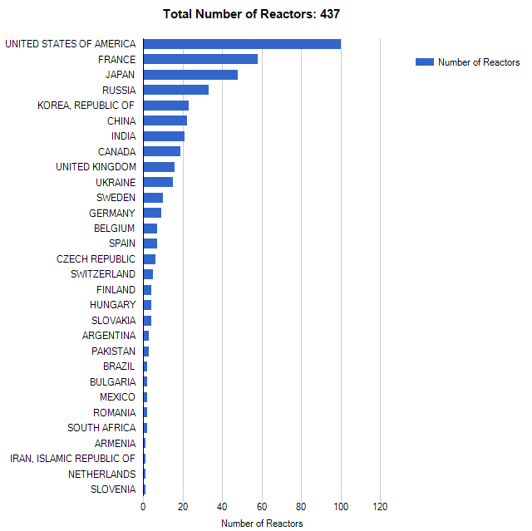
Number of reactors in operation
21
Data from IAEA/PRIS

Slide 16
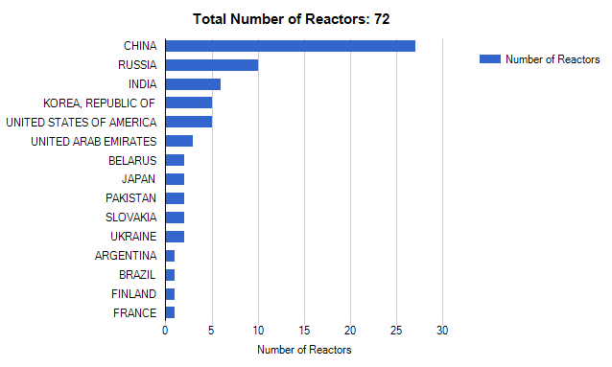
Number of reactors under construction
27
Data from IAEA/PRIS

Slide 17
Current Plan on Fission
2020: 58GW (in operation, 4% of total electricity capacity)+30GWe (under construction, ~2%)
~7 new units to be constructed per year from now to 2020
~2050: 240GW
Yican Wu, ICENES talk

Slide 18
Nuclear waste
1000MW nuclear power plant:
10s of tons nuclear waste per year
After processing, it becomes 4m³ high radiation nuclear waste, 20m³ medium radiation nuclear waste, 140m³ low radiation nuclear waste, 200m³ non-radiation nuclear waste.
150 tons of high radiation nuclear waste per year in China (2008 data)
3200 tons per year in 2030
中国核废料处置库

Slide 19
ADS program
Nuclear waste is a bottle neck for nuclear power development in China
ADS has been recognized as a good option for nuclear waste transmutation.
ADS has been supported by CAS as a long-term program.
Many accelerator technologies have been developed by the ADS R&D, such as SC technology, RF power source, SC magnet…
ADS can provide electric power to the society as a nuclear plant. The fuel can be nuclear waste or thorium (Th-232) since it is three times as abundant in the earth‘s crust as uranium.

Slide 20
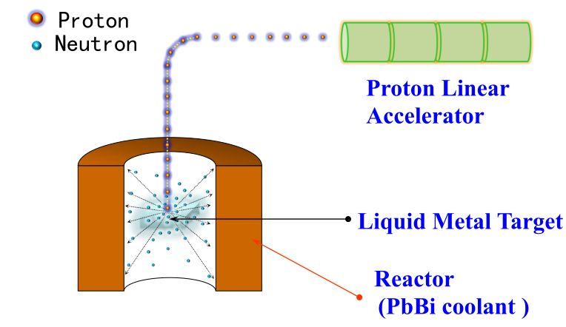
Principle of ADS

Slide 21
ADS program
Launched in 2011 and plan to construct demonstration ADS transmutation system ~2030s through three stages

Slide 22
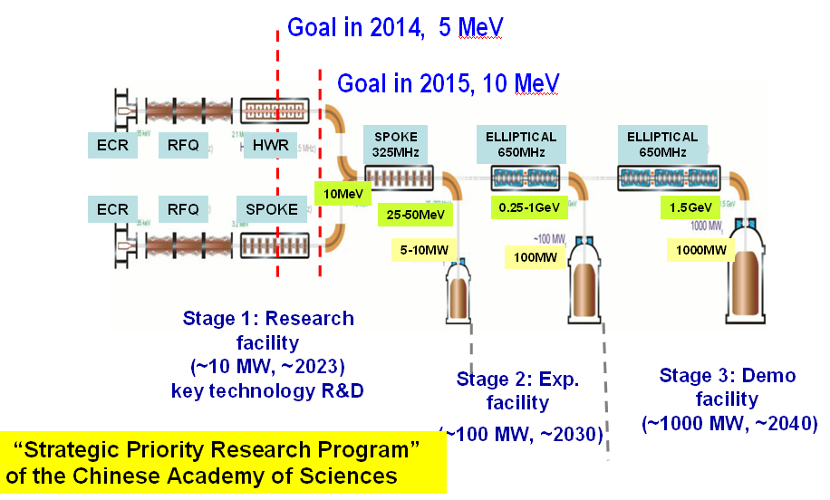
China-ADS Roadmap
Notes:
22

Slide 23
Technology shared by CEPC and ADS
Shared Tech. | CEPC | ADS
Superconducting technology |  | 
RF system |  | 
Power source |  | 
Cryogenic system |  | 
SC Magnet |  | 
Vacuum |  | 

Slide 24
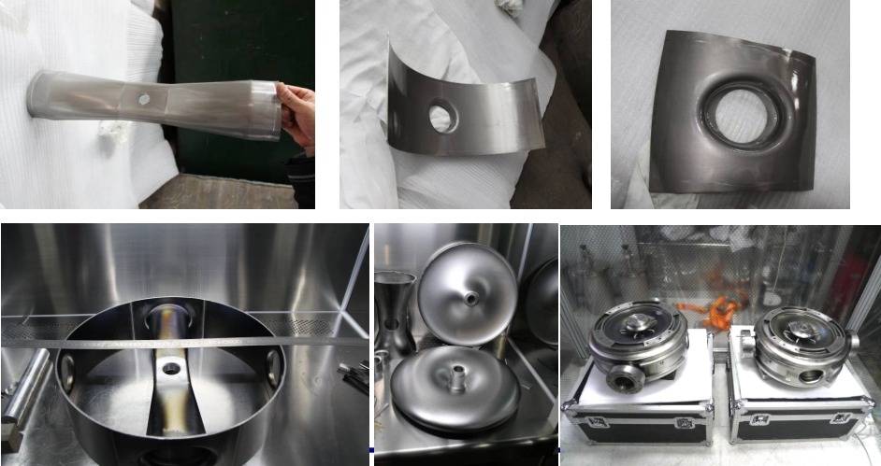
SC Technology

Slide 25
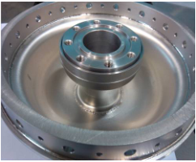
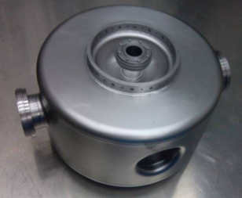
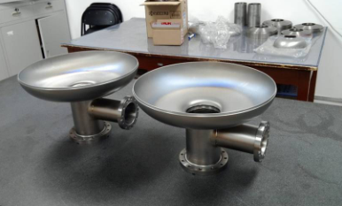
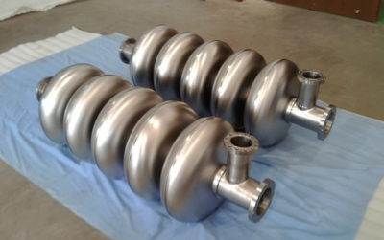
SC Technology

Slide 26
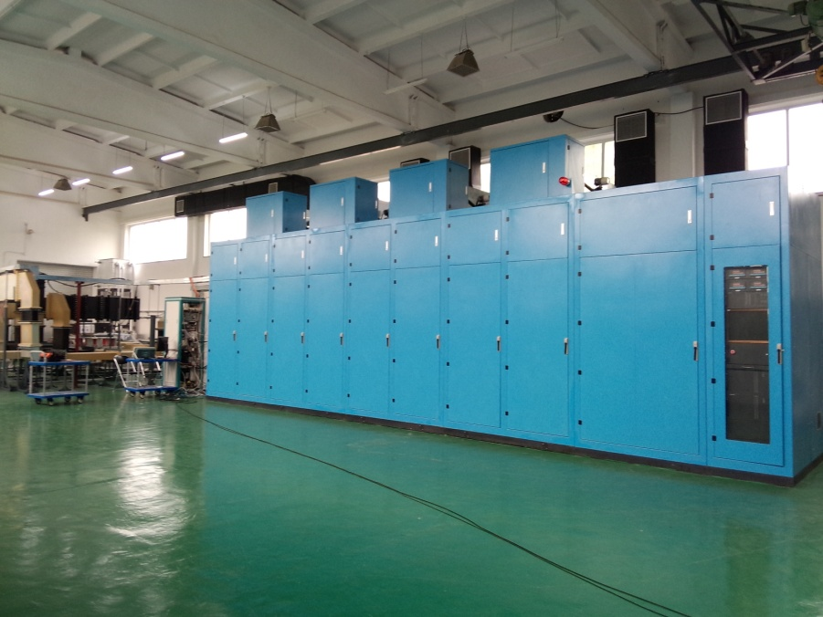
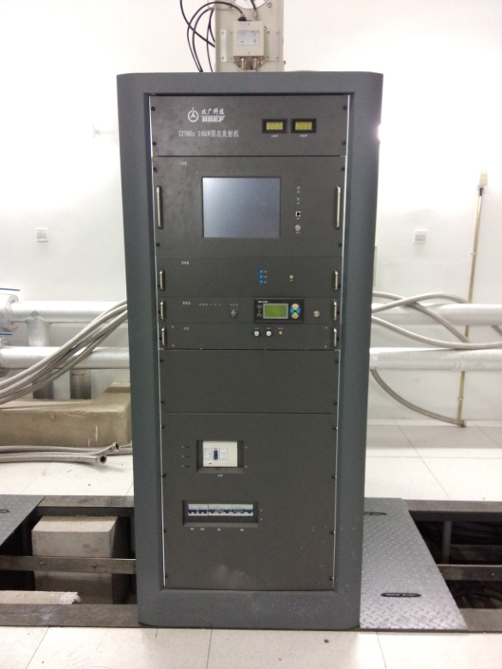
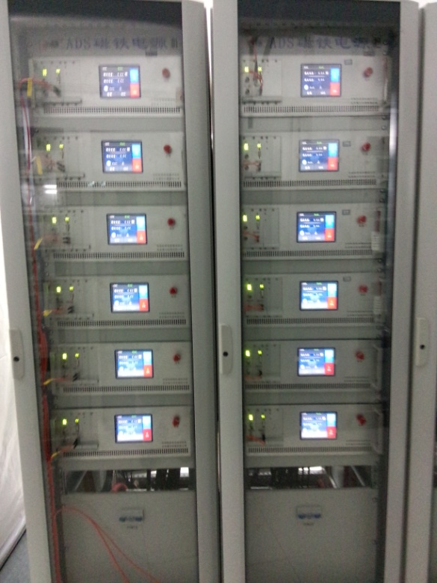
Power Source

Slide 27
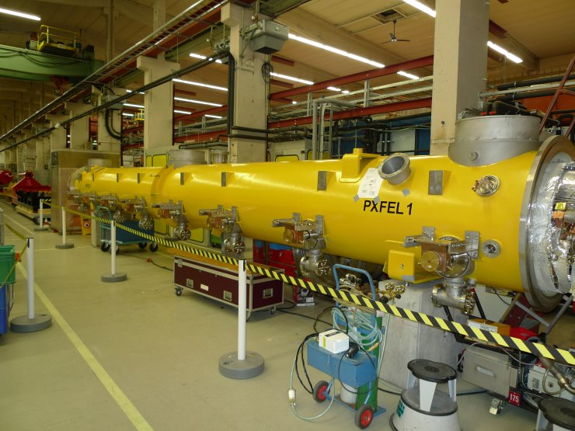
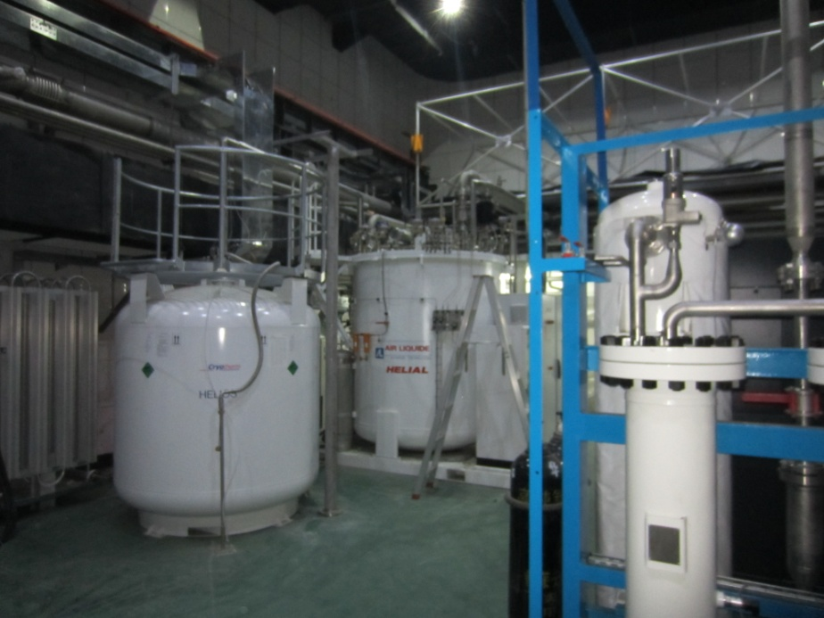
Cryogenic system
Superconducting cavity cryomodule
2K cryogenic LHe system
12 meters long cryomodule for Euro-XFEL
2K helium system

Slide 28
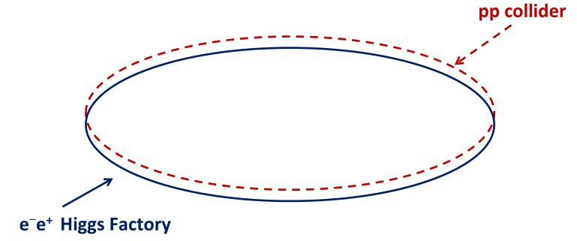
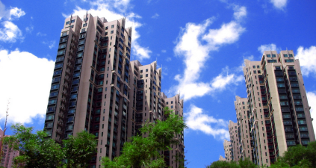
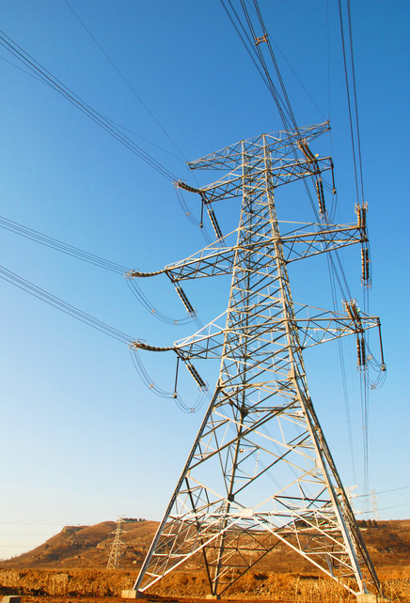
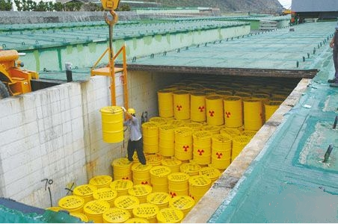
Green CEPC in the future
society
CEPC
300MW
Share tech.
Power plant based on ADS
1000MW
Nuclear waste
Smart grid

Slide 29
Summary
CEPC is a large machine and need huge power of 300MW, ~ 2 times of LHC
China is developing nuclear power, but the bottle neck of nuclear power development is the nuclear waste, ADS can safely solve this problem and provide electric power.
ADS is under development by CAS.
CEPC and ADS based on a lot of same technology, such as superconducting technology and so on. The CEPC construction can be motivated by the ADS technology improvement.

Slide 30
Thanks!

