Slide 1
Beam Instrumentation of CEPC
Yue Junhui（岳军会）
for the BI Group
Accelerator Center, IHEP

Slide 2
Outline
Principle of design
Detailed information of sub-system
R&D of Beam instrumentation of CEPC

Slide 3
1.Principle of design
The beam instrumentation system, which consists of various beam monitors and signal processing electronics, is one of the important parts of CEPC. This system must provide precise and sufficient information of the beam and machine so that accelerator physicists and machine operators can improve the injection efficiency, optimize the lattice parameters, monitor the beam behaviors and increase the luminosity.
In the field of beam instrumentation for CEPC there are some new problems specific to the large size of the ring, at the same time, the positron and electron pass by the same monitor.
The main design philosophy should be followed as the below:
To satisfy the requirement of long-term stable operation
Appropriate precision and speed for the parameter measurement
Large dynamic range
Coupling impedance must be as small as possible
The home-made products should be used as more as possible to save money

Slide 4
2,detailed information of sub-systems
 | item | method | parameter | amounts
Storage ring | Bunch current | BCM | Resolution:1/255 | 2
 | Average current | PCT | Range:0.1mA~50mA； | 2
 | Beam position monitor | Button electrode BPM | Resolution: ~µm | 2324
 | Beam profile | Wire scanner | Resolution:0.2 µm | 10
 |  | Double slit interferometer and x ray pin hole | Resolution:0.2µm | 1
 | Beam length | Streak camera | Resolution:1ps | 1
 | TUNE measurement | Frequency sweeping method | Resolution:0.001 | 2
 |  | FFT | Resolution:0.001
 | Beam loss monitor | PIN-diode | Dynamic range:120 dB Maximum counting rates≥10 MHz | 2000
 | Feedback system | TFB | Damping time<=0.5*rise time | 2
 |  | LFB | Damping time<=0.5*rise time | 1
 | Luminosity measurement | calorimeter |  | 4

Slide 5
2,detailed information of sub-systems
Beam position monitor
Beam current monitor
Beam loss monitor
Beam profile and length measurement
Beam collimator
Tune measurement system
Feedback system
Luminosity measurement system

Slide 6
Beam Position monitor
1，To provide the beam position and orbit, the base of other machine parameters measurement;
2，Apart from some specific BPMs, there will be one BPM at every Q-magnet, so the total number of BPM is 2324;
3，Button type electrode will be adopted because of its good high frequency response and small beam impedance;
4，The sample rates will be fast enough to meet the requirements of bunch by bunch. For the mid-arc, bunch space is 3.3us(1km),the ADC sample frequency will be 1MHz, but at the nearby of the IP, bunch space will be several tens nanoseconds, the ADC sample frequency will be 100MHz.

Slide 7
Beam Position monitor
5，Along the entire tunnel, 32 Auxiliary short tunnels can be used as the local station to install electronics of some BPM. The shielding is enough to ensure people can work there.
6，For IP point, the BPMs maybe take part in orbit feedback system, so we can put analog electronics in the tunnel and digital electronics in the auxiliary short tunnels; for mid-arc, we install the electronics in the tunnel and to sent the data to the local station by the optical fiber.
7, In order to measure the beam position of positron and electron, we sample the x and y signal, at the same time, the sum signal also be digitize by ADC, it can label the positron or the electron with positive and negative sign.
7，The resolution of BPM will be ~um level.

Slide 9
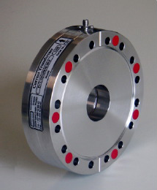
Beam current monitor
Including BCM (bunch current monitor) and DCCT (for average current)
We can used Bergoz-type PCT to measure the average current of the beam and to calculate the life time of beam. The resolution will be µA level;
Bunch current monitor can give current of every bunch, we can used FCT or data acquisition system to measure the sum signal of BPM.
We need two sets of them

Slide 10
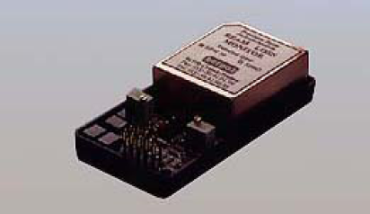
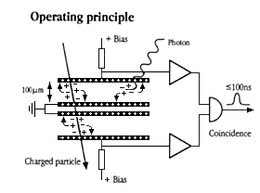
Beam loss monitor
1，This system can be used to study the beam loss and to understand the beam behavior, its one of inputs of machine protection system.
2，We can use the pin diode type monitor，it can separate from the synchrotron radiation to real beam loss.
3，We hope the number is same as the BPMs。

Slide 11
Beam profile and length measurement
Wire scanner for the profile of the straight section
Beam size measurement based on synchrotron light, Double Slit Interferometer and x ray pinhole will be used；
Streak camera can be used to measure the bunch length, the resolution will be ~ps (the beam length is 9ps)
The dedicated beam line from bending magnet is necessary for to routine study

Slide 12
Beam collimator
At any IP point, in order to protect the detector from radiation, 4 collimator are necessary, 2 of them for the vertical direction and 2 for the horizontal direction. For CEPC, total 8 set of them are ok.
To use stepper motor to driver the collimator, the adjust resolution is um level.

Slide 13
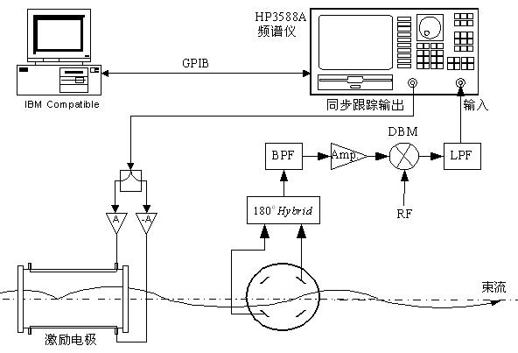
Tune measurement system
Tune is one of the important parameters of the machine, need to be show in real time.
Frequency sweeping method with gated pulse or FFT analyzing to the data from the digital BPM. We can measure the tune from positron and electron separately.
The BPM monitor, signal processing unit and the kicker form the entire system.

Slide 14
Feedback system
100 bunches fill in the ring and total current is 16.5mA,bunch space is 16.7us（distance is 1km）
Coupled bunch instabilities is inevitable due to the resistive wall impedance and HOMs, the nature damping time in not enough to damping the beam(damping times of three direction are 14.3ms/14.3ms/7.15ms)。
Three sets of feedback system for x/y/z.
The strip-line kicker with one end shorted are ok for both beams in three directions; a horizontal beam pickup signal can be used for both horizontal direction and longitudinal direction.

Slide 15
Luminosity measurement
Use compact silicon-tungsten calorimeters to measure the luminosity of every bunch.
We have no experience on this and need to investigate in detail.

Slide 16
R&D of Beam instrumentation of CEPC
Digital electronics for BPM need to R&D, radiation protection need to be considered in design;
High vacuum feed through for BPM and kicker need to study and control the technique.
Pin diode type BLM monitor need to study and fabricated by ourselves.
Luminosity measurement based on silicon-tungsten calorimeters need to investigate.

Slide 17
Thanks for your attention !

