Slide 1
Summary of WG2
Y Cai and K. Ohmi
HF2014@Beijing

Slide 2
Thanks to all speakers
(1) Overall consideration, main challenges and goals, Yunhai Cai (SLAC)
(2) Single ring multi-bunch operation and beam separation, Richard Talman (Cornell U.)
(3) Challenges and status of the FCC-ee lattice design, Bastian Harer (CERN)
(4) Status of the CEPC lattice design, Huiping Geng (IHEP)
(5) Analysis of nonlinear dynamics, Yunhai Cai (SLAC)
(6) Dynamic aperture optimization in SuperKEKB, Yukiyoshi Ohnishi (KEK)
(7) The effect of IR imperfection on dynamic aperture in SuperKEKB / dynamic aperture study of CEPC, Hiroshi Sugimoto (KEK)
(8) Beam lifetime and Injection consideration, Cui Xiaohao (IHEP)
(9) CEPC IR optics, Yiwei Wang (IHEP)
(10) Status of the FCC-ee interaction region design, Roman Martin (CERN)
(11) Crab waist interaction region, Anton Bogomyagkov (BINP)
(12) Beamstrahlung and energy acceptance, Kazuhito Ohmi (KEK)
(13) Interaction region magnets, Eugenio Paoloni (INF)
(14) Beam-beam effects in the CEPC, Yuan Zhang (IHEP)
(15) Wide-band long-focus optics for detection systems infrared synchrotron accelerator diagnostics, Marina Maltseva (TENZOR)

Slide 3
Main challenges and goals Yunhai Cai
I is limited by synchrotron radiation power.
Small β_{y} and high ξ_{y}.
Large ρ for more I.
Low emittance lattice at high energy
High packing factor of magnets
Strong final focusing
Large momentum acceptance
Short bunches

Slide 4
Important Questions for Optics
Is FODO better for high packing factor, or any other possibility?
Is the emittance hard to achieve in the reasonable sextupole strength?
How is the degree of freedom in the design of final focus system?
How is chromaticity correction well done mainly in IR design?
Possibility for wider momentum acceptance and dynamic aperture.

Slide 5
FCC-ee arc lattice design Bastian Harer
Design Compatible lattice for Z, W, H and t.
Lattices for H and t are compatible without changes.

Slide 6
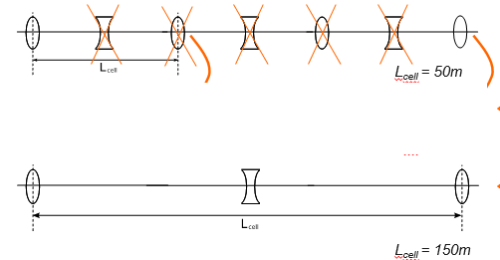
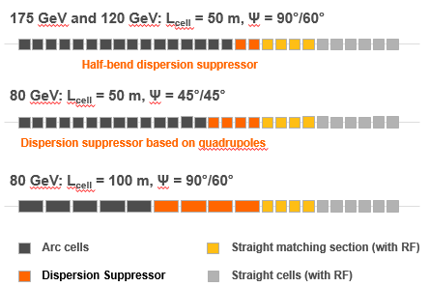
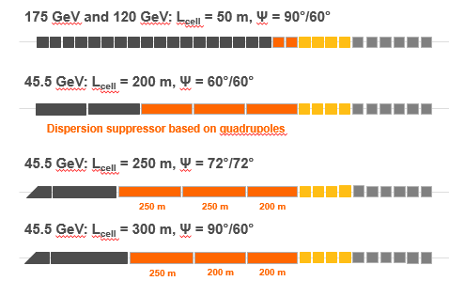
Emittance control is necessary for Z and W.
Change cell length 50->150m
Change phase advance per cell.
W(80 GeV) and Z(45.5GeV)

Slide 7
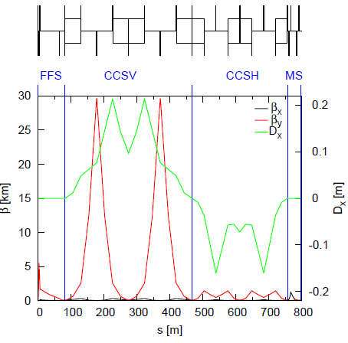
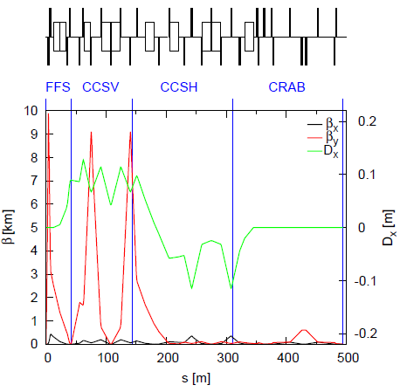
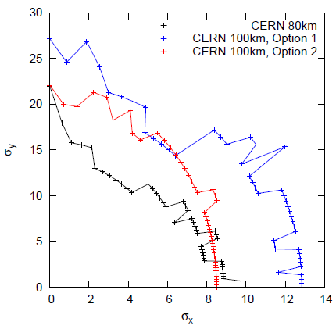
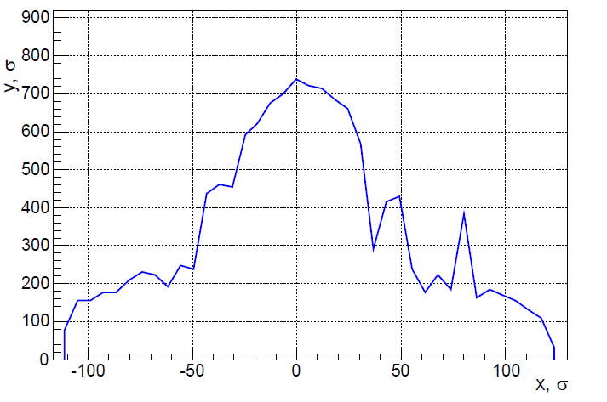
FCC-ee IR design Roman Martin, Anton Bogomyagkov
L*=2m CERN deign BINP design 30mrad crossing
crab waist for Z and W

Slide 8
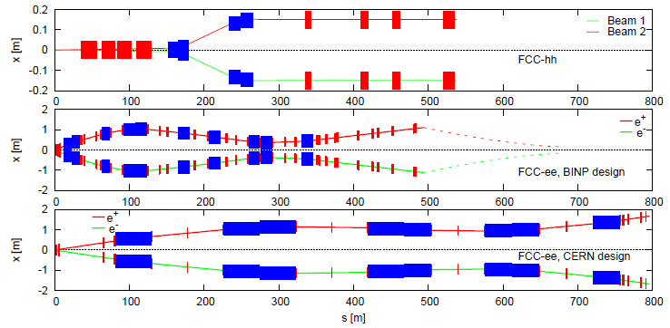
Layout of IR
FCC-hh
FCC-ee BINP
FCC-ee CERN
Momentum acceptance
CERN: highest Momentum acceptance from −0.6% to 0.9%
BINP: from −0.6% to 1.2%

Slide 9
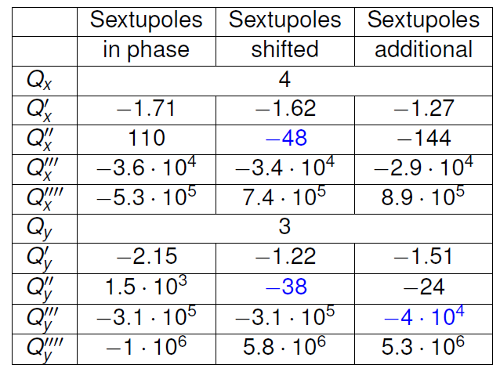
BINP design for FCC-ee
Optimize b,h at sextupoles
Δβ/β is also corrected.
A version of interaction region with crab waist is ready.
Synchrotron radiation is low.
Beam lines are symmetrical, making tunnel straight.

Slide 10
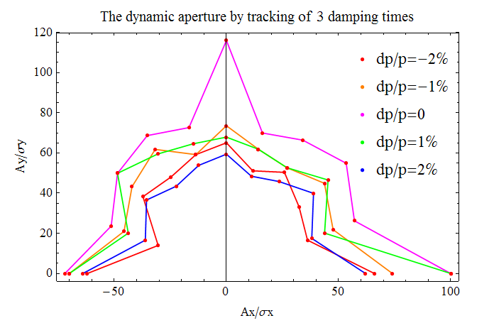
CEPC arc lattice design Huiping Geng
Sufficient dynamic aperture for lattice only arc.

Slide 11
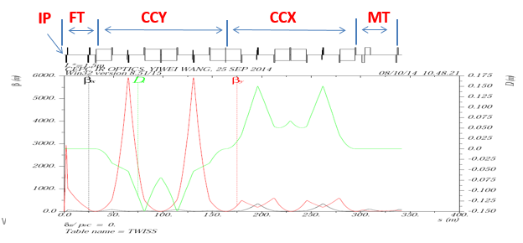
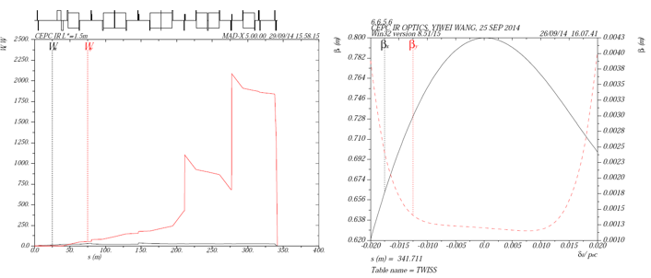
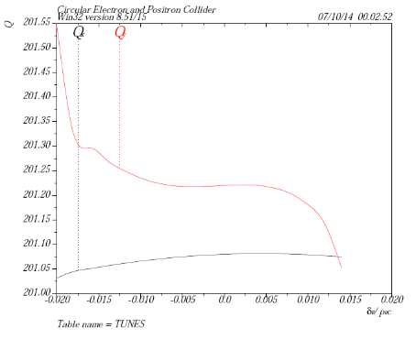
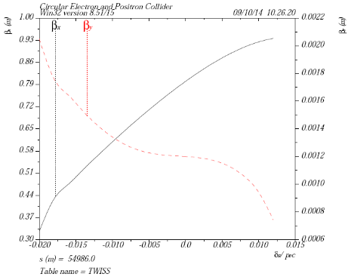
CEPC IR optics Yiwei Wang
L*=1.5m
Chromaticity correction ; Wx=7, Wy=6(IP)

Slide 12
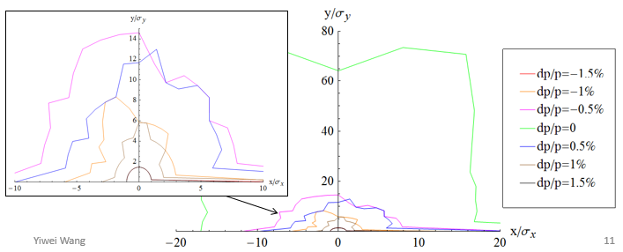
Dynamic aperture for CEPC whole lattice
need a lot of optimization to get a reasonable dynamic aperture for the whole ring
optimize dynamic aperture for on momentum particles
Optimize the strength of the additional sextupoles
One more sextupole to cancel x and px simultaneously
need efforts to achieve bandwidth ±2%
Match W function and its phase between FFS and the ARC
with more families of sextupoles in the ARC
with octupoles
aberration analysis for the whole ring need to be carried out

Slide 13
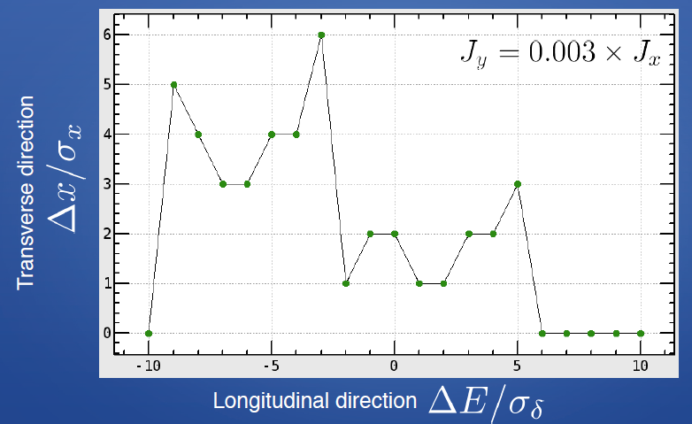
Dynamic aperture studies for CEPC H. Sugimoto
Possible lattice structure except FODO? Keeping packing factor
Which is better Δφ_{x}(IP,XLCC)=3π or 2π.
Optimization of β and η at LCC sextupoles.

Slide 14
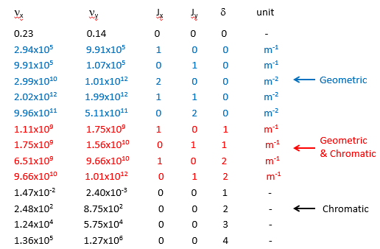
Nonlinear dynamics Yunhai Cai
Order by order analysis
2ν_{x}-2ν_{y}, J_{x}² J_{x}J_{y} , J_{y}² ….

Slide 15
Design Issues
Tune shits vs. amplitudes are very large due to interlaced sextupoles in the arcs.
“Second-order dispersion” in the interaction region leads out to the arcs.
Second-order chromatic optics is not yet well matched between the arcs and the interaction region.
Huge geometric-chromatic aberration seen in 5th-order Lie operators in the interaction region. They may well be the bottle neck of the lattice.

Slide 16
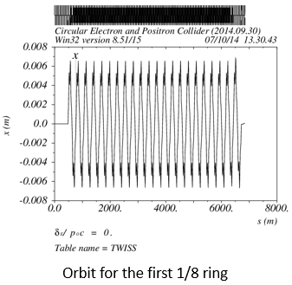
Effects of Pretzel orbit Huiping Geng
Pretzel scheme
Effect of pretzel orbit, interference with sextupoles
Optimizaton of pretzel orbit
Effect and correction of sawtooth orbit due to beam energy variation.
Dynamic aperture with the pretzel and sawtooth orbit is being studied.

Slide 17
Multibunch beam separation R. Talman
Betatron phase advance(60/60)/cell length and bunch separation.
The scheme used 8 primary separators and 2 trim separators with the separation bumps continuing through the 4 IP’s

Slide 18
Beam lifetime of CEPC Cui Xiaohao
Beam-Gas Scattering: 10 nTor, 80% H2, 20% CO, 15h
quantum lifetime 2218h
Radiative BhaBha 51min
Beamstrahlung 80min
Touschek lifetime >530h

Slide 19
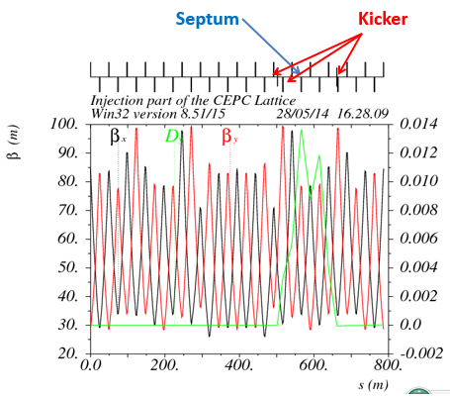
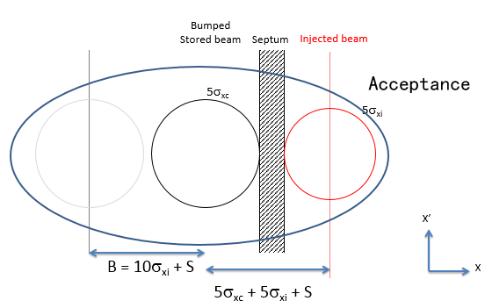
Injection consideration of CEPC Cui Xiaohao
Betatron injection
Designing kicker and septum
Bump height
s=4mm
bump height > 12mm
Acceptance length > 15 mm

Slide 20
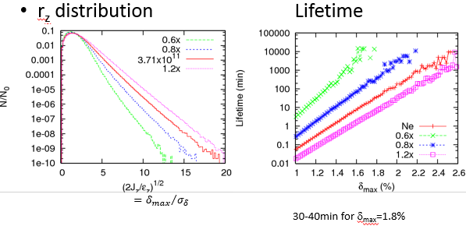
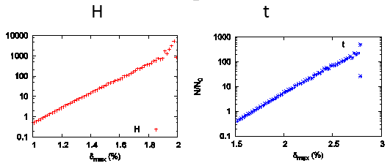
Beamstrahlung and momentum acceptance requirement K. Ohmi
Beam-beam simulation with beamstrahlung
Energy distribution and lifetime is calculated.
CEPC
Control of dynamic beta/emittance may result better lifetime.
TLEP
δ_{max}~2% is preferable for H.

Slide 21
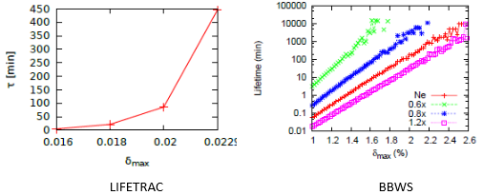
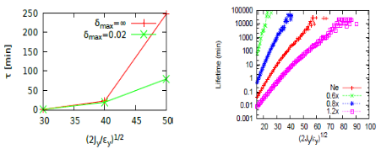
Code benchmark for lifetime, Lifetrack and BBWS Yuang Zhang
Lifetime for Energy tail
Lifetiem for Transverse tail
δ_{max}=2%
Lifetrack 222 (85: w Gauss fit)
BBWS 250
y_{max}=40σ_{y}
Lifetrack 202 (22: w Gauss fit)
BBWS 250
Good agreement without Gaussian fit

Slide 22
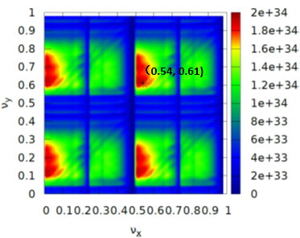
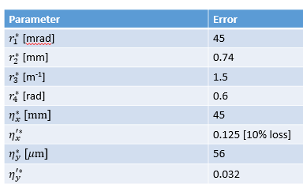
Beam-beam simulation for CEPC Y. Zhang
Choice of Tune, (0.54,0.61)
Dynamic beam-beam effects
β* dependence, possibility of β_{y}∗=1.2-> 2mm
Current dependence
Error tolerance for IP coupling and dispersion
Beam tilt

Slide 23
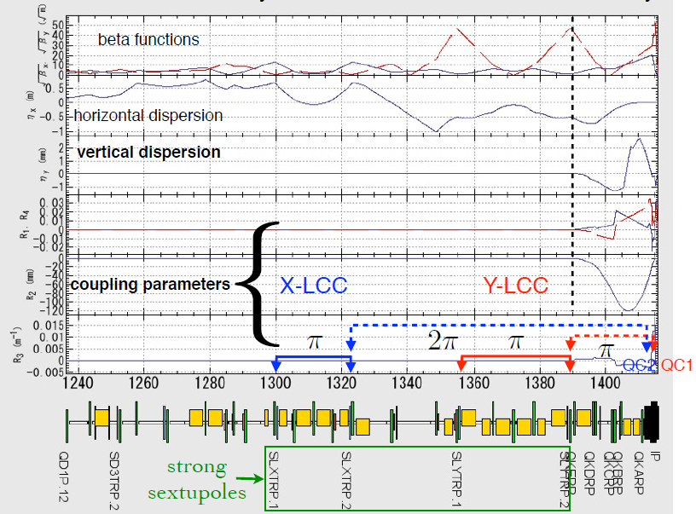
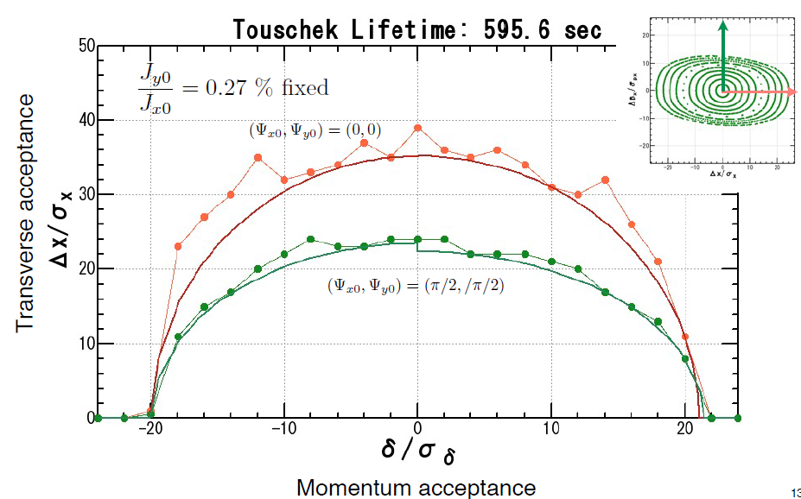
Dynamic aperture optimization at SuperKEKB Y. Ohnishi
X-LCC corrects QC2 chromaticity and Y-LCC corrects QC1 chromaticity locally.

Slide 24
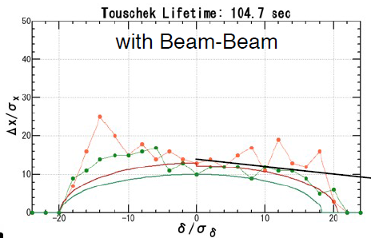
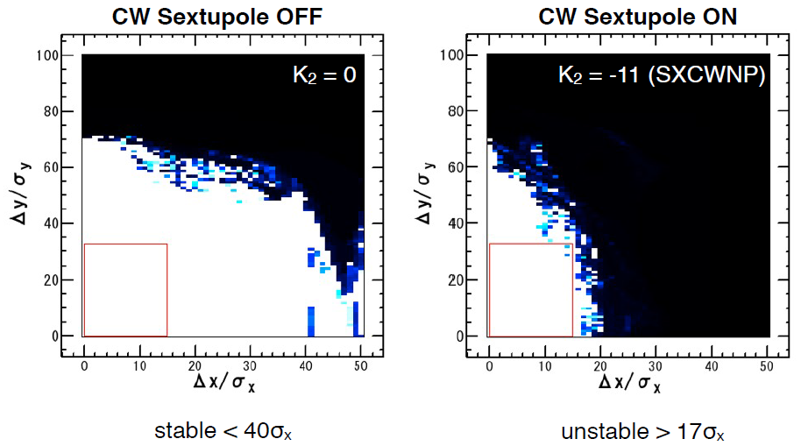
Difficulty in Large Piwinski Angle scheme
Dynamic aperture shrink due to Beam-beam force
Crab waist helps this difficulty.
However crab waist scheme makes shrink dynamic aperture due to nonlinearity in IR.
BINP approach may help this difficulty.

Slide 25
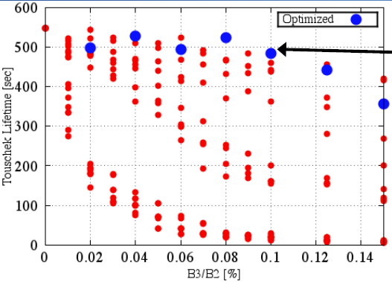
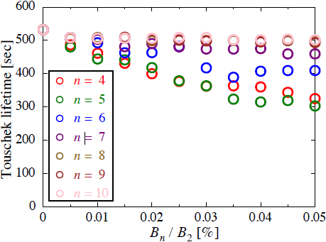
How to manage IR multipoles H. Sugimoto
recover dynamic aperture by correction coils

Slide 26
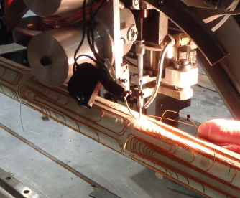
IR magnet design (SuperB & SuperKEKB) Euginio Paoloni
IR magnet where two beams crosses
SuperKEKB separate magnet, leakage of LER QC1 affects e- beam
Direct winding of collector coil
SuCanceling coils to null the terms B3,B4,B5 and B6 of the field leaking from the QC1RP: B1 and B2 are retained

Slide 27
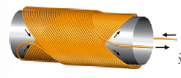
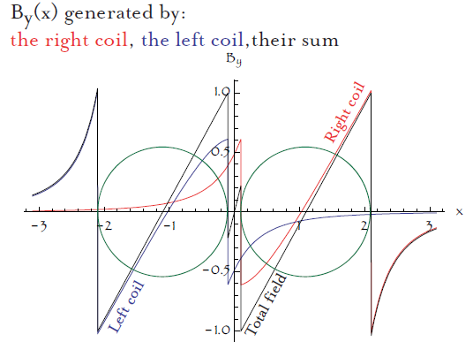
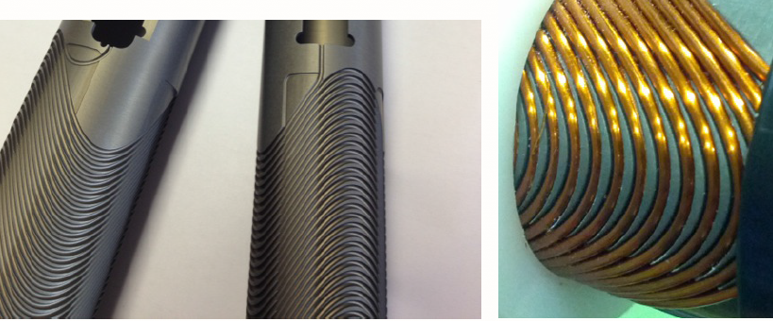
SuperB approach
Double Helix Coils
A cold test is done by mod 2015
100T/m double bore

Slide 28
Broadband long-focusing mirror optical system for infrared diagnostics Marina Maltseva
The system works in the UV and IR ranges of spectrum (Δλ~ 0.3-40 μ m).
Photographic resolutions are: 7Photographic 7⁻¹mm in the focal plane of the tract; 7^{–1} mm in points shifted at ±5 mm; 7^{–1}mm, at ±10 mm; 7^{–1}mm, at ±15 mm; and 5^{–1}mm, at ±20 mm.

Slide 29
Conclusions of WG2
Many progresses have been made since the last meeting (Feb, 2014), but the momentum aperture of the collider with realistic arcs is still too small. Possible solutions:
Add octupoles near the final focusing quadrupole like SuperKEKB Consider asymmetric dispersion at the paired sextupole in the interaction region
Consider to increase circumference to accommodate other type of cells with non-interlace sextupoles in arcs
Further to simplify the transition between CCX and CCY to reduce the phase advance from 3π to 2π
2) Consider to increase β_{y}* to 2-3 mm since the bunch length is already too long already 2.8 mm
Not much loss of luminosity
Help to solve the dynamic aperture problem
Refinement of the momentum acceptance requirement
3) Technical issues:
300 T/m gradient of quadupole is feasible but may not easier
Consider to make a thin septum (2 mm)
Dipole in the interaction region may be still too strong
Injected beam may be too large, especially with a pretzel scheme

Slide 30
Thank you for excellent talks and contributions

