Slide 1
Monte-Carlo simulation of synchrotron radiation in the design of CEPC vacuum chamber
Ma zhongjian Ding yadong Wang qingbin
Wu qingbiao
Radiation Protection Group/IHEP

Slide 2
Outline
Introduction
Shielding Design Criteria
Monte-Carlo simulation of synchrotron radiation
Simulation for thickness of the main tunnel
Summary

Slide 3
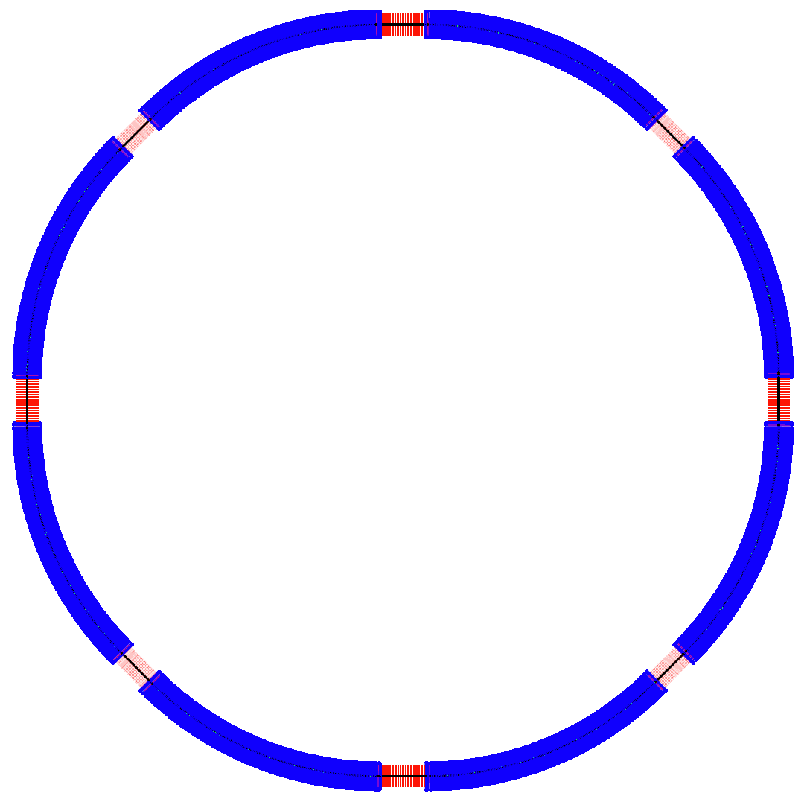
CEPC Lattice Layout (September 23, 2014)
½ RF
½ RF
One RF station:
650 MHz five-cell SRF cavities;
4 cavities/module
12 modules, 8 m each
RF length 120 m
P.S.
IP1
RF
RF
P.S.
(4 straights, 849.6 m each)
(4 IPs, 1038.4 m each)
(8 arcs, 5852.8 m each)
IP4
D = 17.3 km
RF
IP2
RF
C = 54.374 km
IP3
RF
RF
P.S.
P.S.
½ RF
½ RF

Slide 4
Radiation protection tasks
Synchrotron radiation shielding
The thickness of the main tunnel
Shielding for straight tunnel, beam dump, collimate station, injection section, maze, duct, shielding doors, RF station, etc;
Induced radioactivity analysis: cooling water, ventilation air, accelerator component, local shielding concrete, ground water, environmental samples, etc;
Personal safety interlock system
Radiation dose monitoring system

Slide 5
Shielding Design Criteria
Dose limitation in regulations
  The national standard of the People’s Republic of CHINA, “Basic standards for protection against ionizing radiation and for the safety of radiation Source”, GB 18871-2002.
  The national standard of the people’s republic of china, “The rule for radiation protection of particle accelerators”, GB 5172 1985.
  ICRP publication 103, “The 2007 Recommendations of the International Commission on Radiological Protection”.

Slide 6
Radiation dose limit for person in the regulations
 |  | Worker | Public
Effective Dose | Average in 5 years | 20mSv/year | 1mSv/year
 | Max. in single year of the 5 years | 50mSv/year | 5mSv/year
Equivalent Dose | Lens eye | 150mSv/year | 15mSv/year
 | Skin | 500mSv/year | 50mSv/year

Slide 7
Limits for shielding design of CEPC-sPPC
Area | Design Value | example
Radiation monitored area | < 2.5 μSv/h | Outer of the tunnels, where worker can stay long
Radiation controlled area | < 25 μSv/h | Outer of the tunnels, where worker can stay occasionally
Forbidden area | >>1mSv/h | Inner of the tunnels, worker cannot get in during accelerator operation
Site boundary | 0.08 mSv/year
All the areas should be clearly defined after the functional structures are determined.

Slide 8

Concentration limit of induced activity
Residual dose rate < 1mSv/h for the workers to get into the tunnel ( 30cm, 4 h down ) (refer SNS)
The exempt value for activation is pointed out according to GB18871-2002: “if there are more than one kind of radionuclide, only if the ratio of activity (or specific activity) to its exempt value of each kind of the radionuclide was less than 1, it is exemptible.”
Soil and ground water activation: the prompt dose rate is ~5.5mSv/h in the thickness of 1m soil to ensure it’s below the exempt value of above.
$$\sum_{i=1}^{n}{\frac{S_{i_saturation}}{S_{i_exempt}}<1}$$

Slide 9
Synchrotron Radiation
Synchrotron radiation will induce:
  Heating of the vacuum chamber
  Radiation damage to machine elements
  Formation of ozone and nitrogen oxides in the air
  Leading to corrosion of machine components and health hazards for personnel
  Other issues……

Slide 10
Synchrotron Radiation parameters
Comparison between LEP2 and CEPC
Parameters of synchrotron radiation |  |  | CEPC values | LEP2 values
Beam energy | E | GeV | 120 | 100
Beam current | I | mA | 16.60 | 5.5
Bending radius | ρ | m | 6094 | 3104
Power per unit length | P | W/m | 1305.06 | 804.89
Critical energy | Ec | keV | 628.93 | 708.76
Bending angle | θ | mrad | 3.1669 | 6.4
Solid degree | φ | μrad | 4.2582 | 5.1097

Slide 11
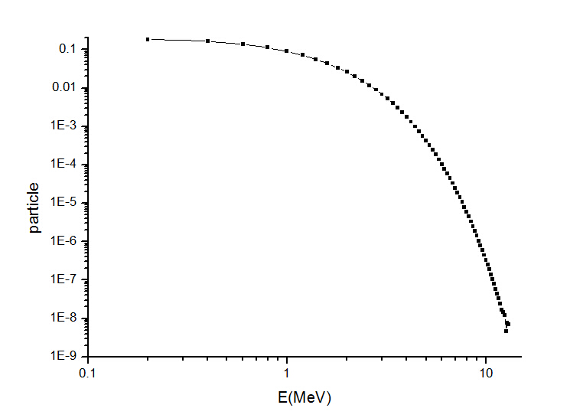
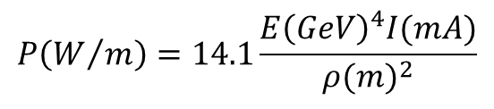
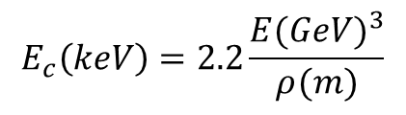
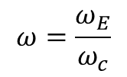
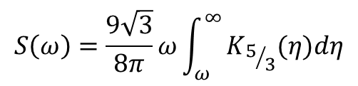
Synchrotron radiation spectrum analysis
SR critical energy：
$$E_{c}\left(keV\right)=2.2\frac{{E(GeV)}^{3}}{ρ(m)}$$
~ 628.93 keV
SR Power：
$$P\left(W/m\right)=14.1\frac{{E\left(GeV\right)}^{4}I(mA)}{{ρ(m)}^{2}}$$
~ 1305.06 W/m
SR spectrum：
The average energy of photons is 0.9466MeV from the photon spectrum(E>200keV)
Total number of photons is 8.62×10¹⁵S⁻¹m⁻¹
$$S\left(ω\right)=\frac{9\sqrt{3}}{8π}ω\int_{ω}^{∞}{K_{5/3}(η)dη}$$
$$ω=\frac{ω_{E}}{ω_{c}}$$

Slide 12
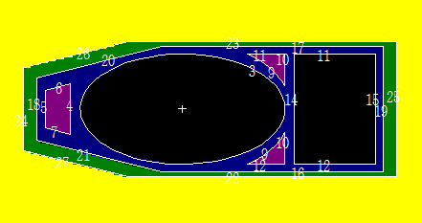
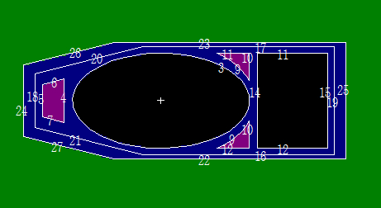
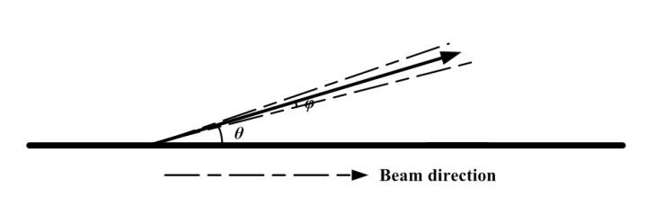
MCNP simulation
Simulation model for beam pipe
LEP’s Vacuum chamber was adopted:
But two materials: Composed by a few millimeters of Al covered by 3 or 8mm of Pb or totally by a few millimeters of Cu
Synchrotron radiation hits the vacuum chamber at a grazing angle of 3.1669mrad
The cros section of vacuum chamber
(Above: Al&Pb Below: Cu)
Solid degree of synchrotron radiaiton：<10⁻⁵rad
Bending angle Between beam and SR: 3.1669 mrad
Synchrotron radiation source analysis

Slide 13
Hypothesis in the simulation
  A straight chamber replace the arc structure
    The 80 meters long tunnel and linear source
    Radius of curvature of main ring is up to 6000m, while the chamber seems as a straight line in tens of meters distance
  Synchrotron radiation cone angle is neglected
    Cone angle is 4.26 μrad, which focus 85% power of synchrotron radiation
  Photon energy higher than 200keV for heat and dose simulation
    Energy lower than 200keV only contributes to heat in the vacuum chamber

Slide 14
Comparison of two structures
Energy deposition, dose rate and heat load per equivalent photon in different structure parts
Al&Pb
Materials | Energy deposition (MeV/g) | Dose rate (Gy/h) | Heat (W/m)
Left H₂O | 4.0×10⁻⁸ | 1.5888×10⁴ | ------
Right H₂O | 1.2×10⁻⁷ | 4.7664×10⁴ | ------
Al | 5.3×10⁻⁷ | 2.1052×10⁵ | 7.092×10²
Pb | 7.5×10⁻⁸ | 2.9790×10⁴ | 2.990×10²
Air | 3.5×10⁻¹⁰ | 1.3902×10² | ------
Cu
Materials | Energy deposition (MeV/g) | Dose rate (Gy/h) | Heat (W/m)
Left H₂O | 2.4×10⁻⁸ | 9.5328×10³ | ------
Right H₂O | 5.0×10⁻⁸ | 1.986×10⁴ | ------
Inner Cu | 2.18×10⁻⁷ | 8.6594×10⁴ | 9.673×10²
Outer Cu | 1.9×10⁻⁸ | 7.5468×10³ | 8.43×10¹
Air | 2.9×10⁻¹⁰ | 1.1519×10² | ------

Slide 15
The spectrum of photons in the air
Mass attenuation coefficients
Energy of most of photons is between 100keV and 300keV
The flux out of Cu is obviously lower than Al&Pb’s.
The mass attenuation coefficients of Cu are between Al and Pb
Vacuum chamber fabricated by Cu may instead of Al and Pb

Slide 16
CEPC-sPPC main tunnel simulation
Simulation result for shielding thickness of the main tunnel of CEPC-sPPC
Beam loss parameter: 1W/m for 120GeV electrons and 45 TeV protons, the material of the beam pipe is Fe and 1 cm thickness

Slide 17
Radiation shielding design principle
  The shielding thickness of the main tunnel was determined by the radiation level caused by average beam loss along the tunnel, other hot spots, such as places for IP, injection, collimation and beam dump, have to be locally shielded to the equal radiation level respect to the former situation
  Radiation levels caused by other beam loss parameters can be deduced through proper conversion coefficient
Average beam loss parameter
  According to the cumulated number of particles and the lifetime of the beam

Slide 18
Beam loss calculation
  For CEPC: ~0.0013 W/m
  For sPPC: ~0.0019 W/m@arc section, ~0. 19W/m@straight section, main beam loss@ collimator section,
So, the dose rate in the arc tunnel is about several hundreds μSv/h
Dose rate is very low compared to value caused by synchrotron radiation

Slide 19
summary
The dose rate in the tunnel for CEPC is mainly dominated by synchrotron radiation.
Above 65% heat were deposited in the chamber
Cu may be a good material for beam pipe from the point of radiation protection, also have to be consider from the manufacture/price and other point of view
Dose rate, which level to be deduced is depend on the radiation resistant of the electron component
Detailed simulation have to be conducted next: reliability verification, actual structure, thermal analysis, etc.

Slide 20
Thank you！

