Slide 2



Vacuum System Requirements for a Higgs Factory e⁺e⁻Accelerator
R. Kersevan
CERN, Technology Department
Vacuum, Surfaces and Coatings Group
R. Kersevan, “Vacuum System Requirements for a HF e+e- Accelerator – 55th ICFA – Beijing – 10 Oct 2014

Slide 3
Vacuum Requirements: Where do they stem from?
Beam Physics → Beam-gas lifetime specification
Lattice → Gap (dipoles) or ID (quads/sextupoles) → cross-section of chambers → specific conductance → Effective pumping speed
Lattice → Chamber vs chamber-antechamber analysis
Distributed vs discrete SR absorbers
Distributed vs discrete pumping
Outgassing: thermal and SR-induced
Materials: Al, Cu, SS
Heat dissipation (synchrotron radiation, Compton-scattered):
Treatments: cleaning, vacuum-firing, bake-out…
Joining methods (CF flanges vs Helicoflex vs other)
Low thermal outgassing? →Bake-out → Bellows!
Bellows? Impedance/HOM trapping/shielding
BPMs? → Tapers → Cooling
Single vs double ring? If double then e-cloud at e+ ring → low-SEY coatings
SR spectra with multi-100s keV critical energy → material activation/radiation damage
R. Kersevan, “Vacuum System Requirements for a HF e+e- Accelerator – 55th ICFA – Beijing – 10 Oct 2014

Slide 4
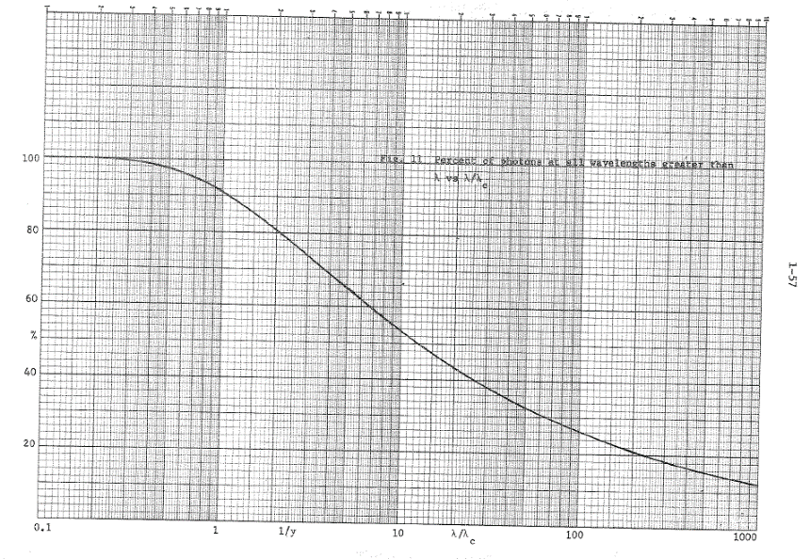
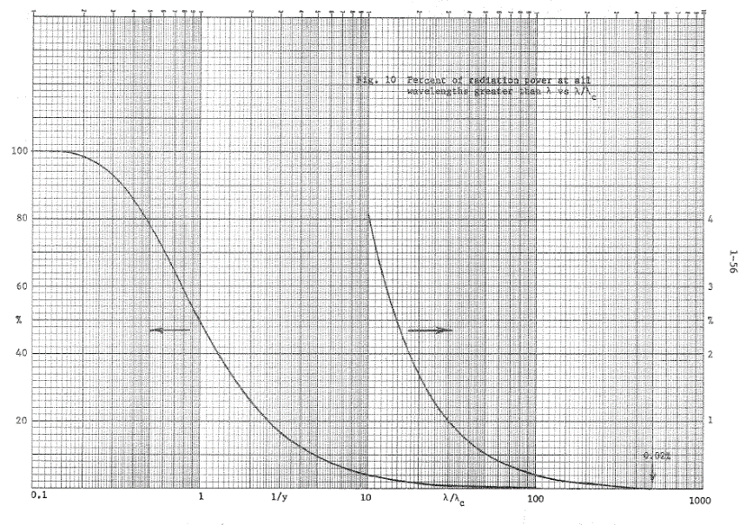
Synchrotron radiation in high-energy e⁺e⁻ colliders
SR linear photon flux density as a function of E, I:
where K_{F} is the fraction of SR flux generated within the photon energy range (ε_{min}, ε_{max}), ρ the dipole radius
SR Linear power density as a function of E, I, ρ:
where ρ(m) is local radius of curvature in meters, and K_{P} the fraction of SR power generated within the photon energy range (ε_{min}, ε_{max})
SR critical energy as a function of γ:
ε_{C} is defined as the median of the photon power spectrum, ½ of the power is generated above ε_{C}, and ½ below it.
→So: 91% of the photon flux is generated BELOW the critical energy←
R. Kersevan, “Vacuum System Requirements for a HF e+e- Accelerator – 55th ICFA – Beijing – 10 Oct 2014

Slide 5
Synchrotron radiation in high-energy e⁺e⁻ colliders
SR-induced gas load:
where K_{mol} is a conversion factor giving the number of molecules per mbar·liter: K=2.47E+19, and η is the photodesorption yield, in molecules/ph.
So, since F depends uniquely on non-vacuum parameters, is reducing η the only way to reduce the dynamic outgassing load?
The answer is NO!
In reality, the geometry of the chamber, with respect to the SR, and the trapping efficiency of the SR-induced gas load, are both important.
R. Kersevan, “Vacuum System Requirements for a HF e+e- Accelerator – 55th ICFA – Beijing – 10 Oct 2014

Slide 6
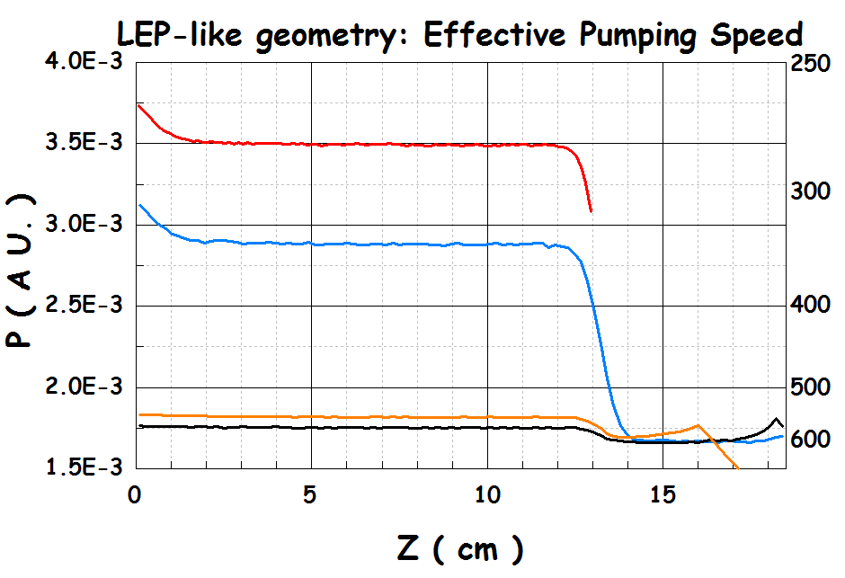
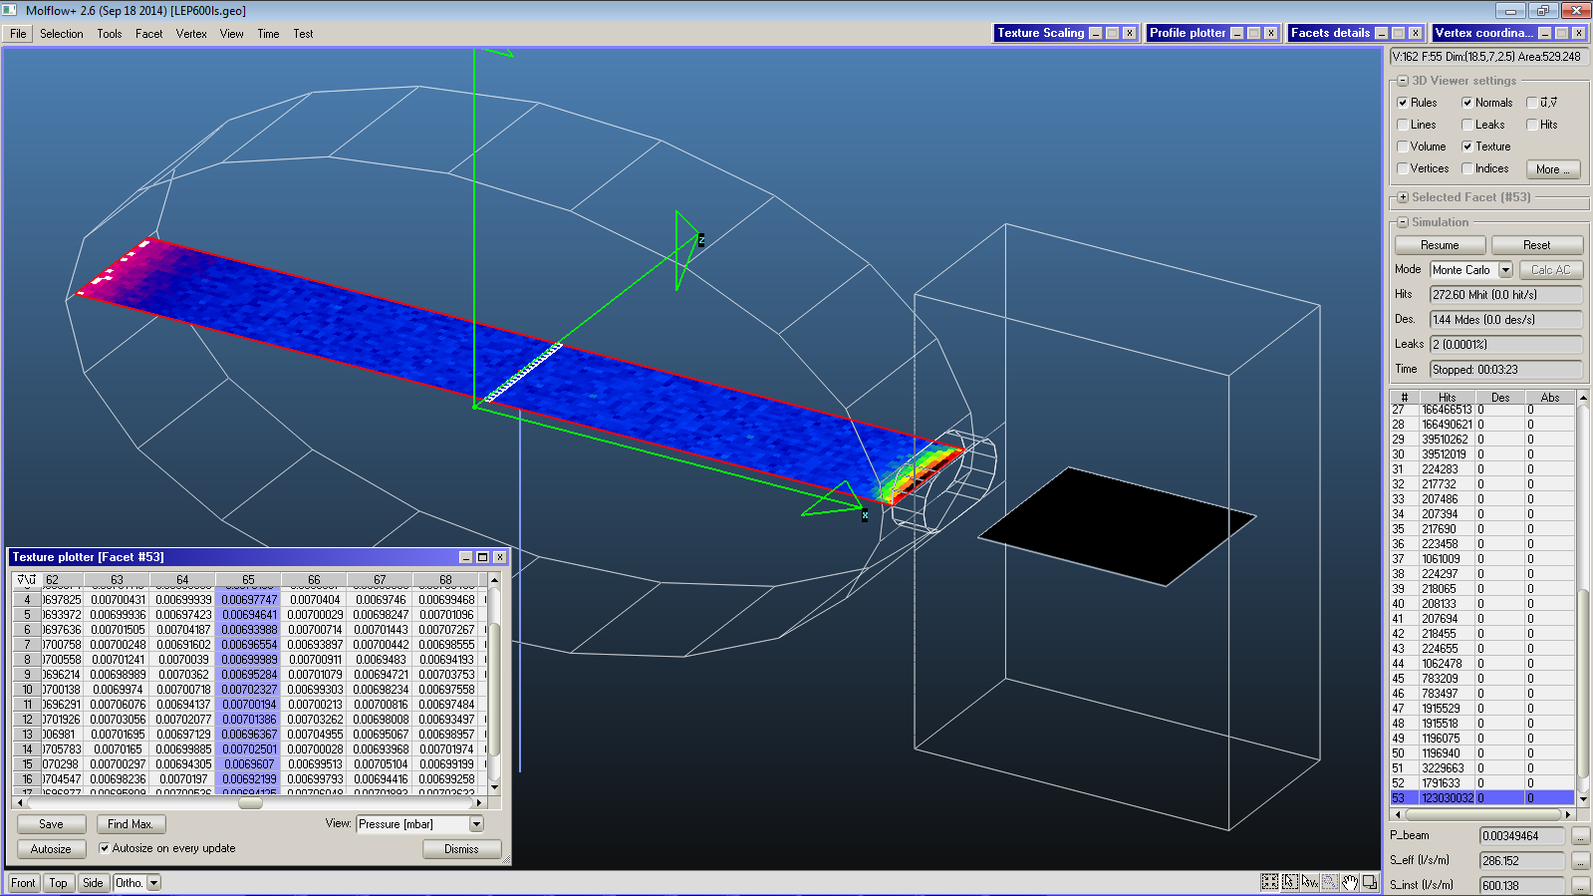
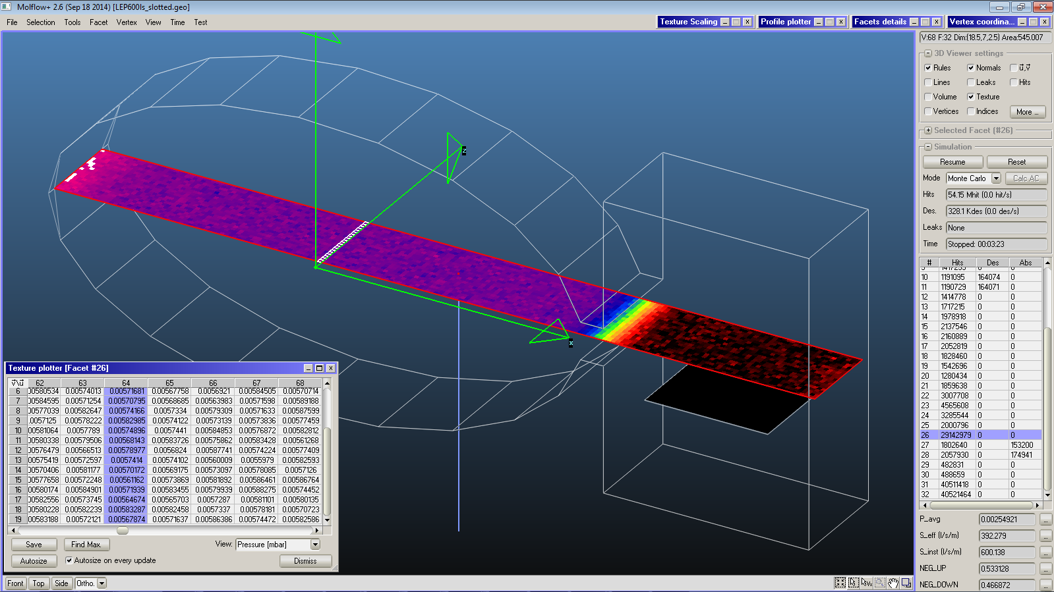
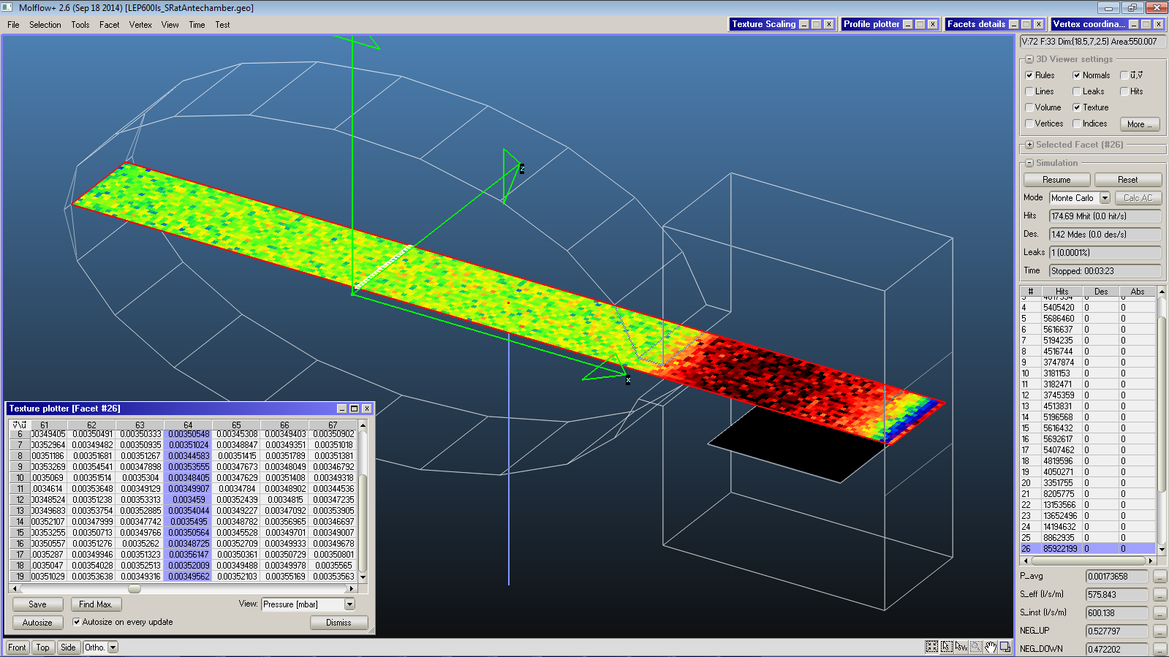
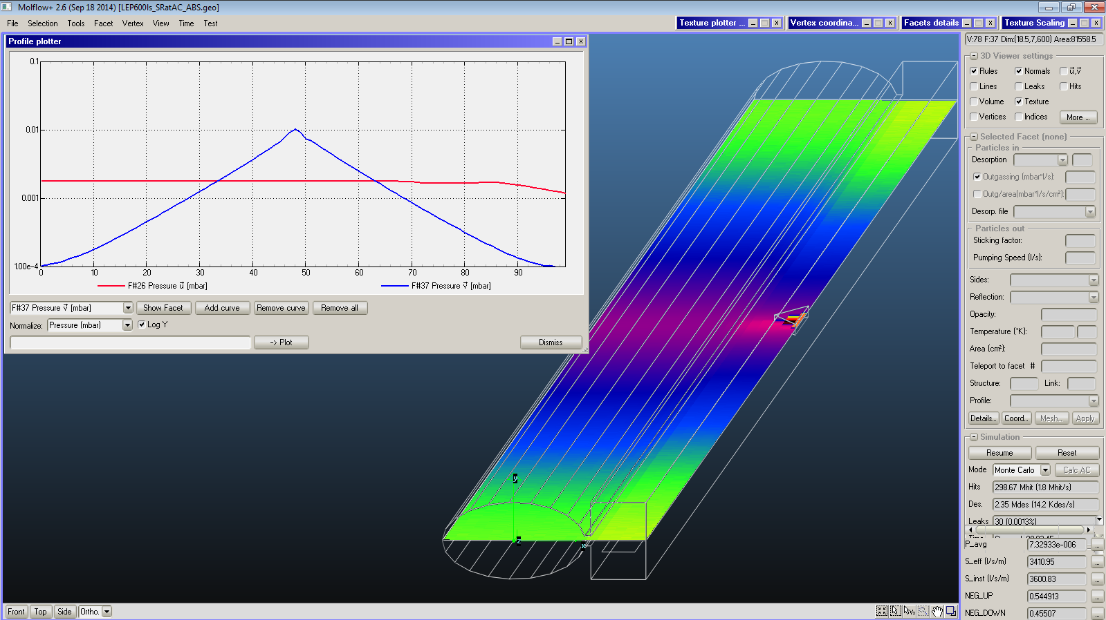
Vacuum chamber geometry and SR-induced outgassing
One example with 4 cases: LEP-style chamber , 130x70 mm², with slot and rectangular antechamber with NEG-strip;
Same installed pumping speed: 600 l/s/m; same total outgassing Q;
Case 1 is LEP-like: SR on the chamber,
Case 2 has continuous slot,
Case 3: SR through slot in antechamber;
Case 4: same as 3 but with discrete absorber in the antechamber (25 cm long)
The effective pumping speeds are these:
Case 1: 286 l/s/m; Case 2: 392 l/s/m; Case 3: 575 l/s/m; Case 4: 568 l/s/m
R. Kersevan, “Vacuum System Requirements for a HF e+e- Accelerator – 55th ICFA – Beijing – 10 Oct 2014

Slide 7

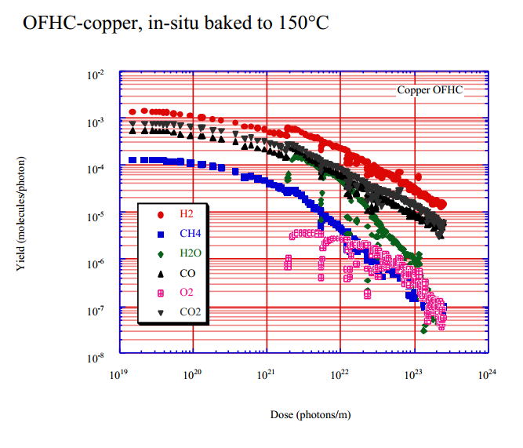
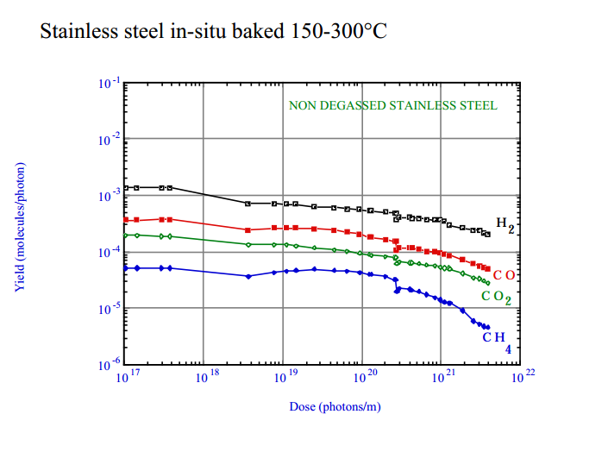
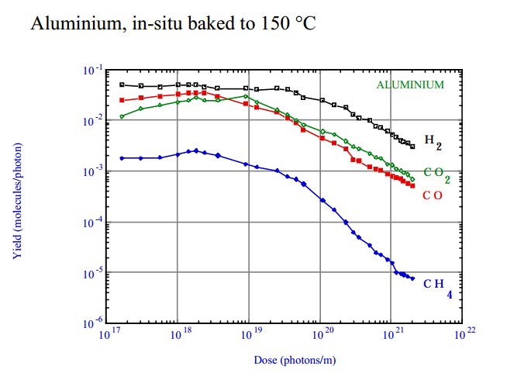
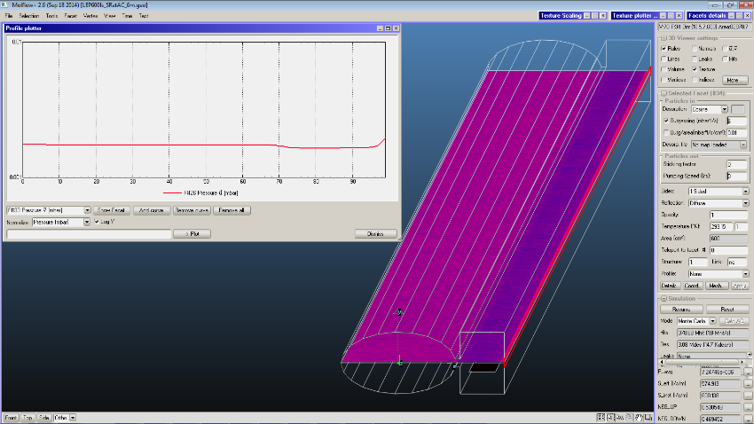
Vacuum chamber geometry and SR-induced outgassing
So, case 3, distributed SR along the wall of the ante-chamber, seems to be marginally better than case 4, which has the primary SR all intercepted by one discrete absorber… but…
… but this is true only under the assumption of equal photodesoption yield η(mol/ph), which is experimentally known to be dependent on the local photon dose, i.e. the amount of photons accumulated at any specific location…
… but case 3 is also worse with respect to case 4 in terms of ease to install shielding and minimize activation of materials in the tunnel (see L. Esposito’s talk)
→ F’(case 4)~ 20x F’(case 3) ←
R. Kersevan, “Vacuum System Requirements for a HF e+e- Accelerator – 55th ICFA – Beijing – 10 Oct 2014

Slide 8
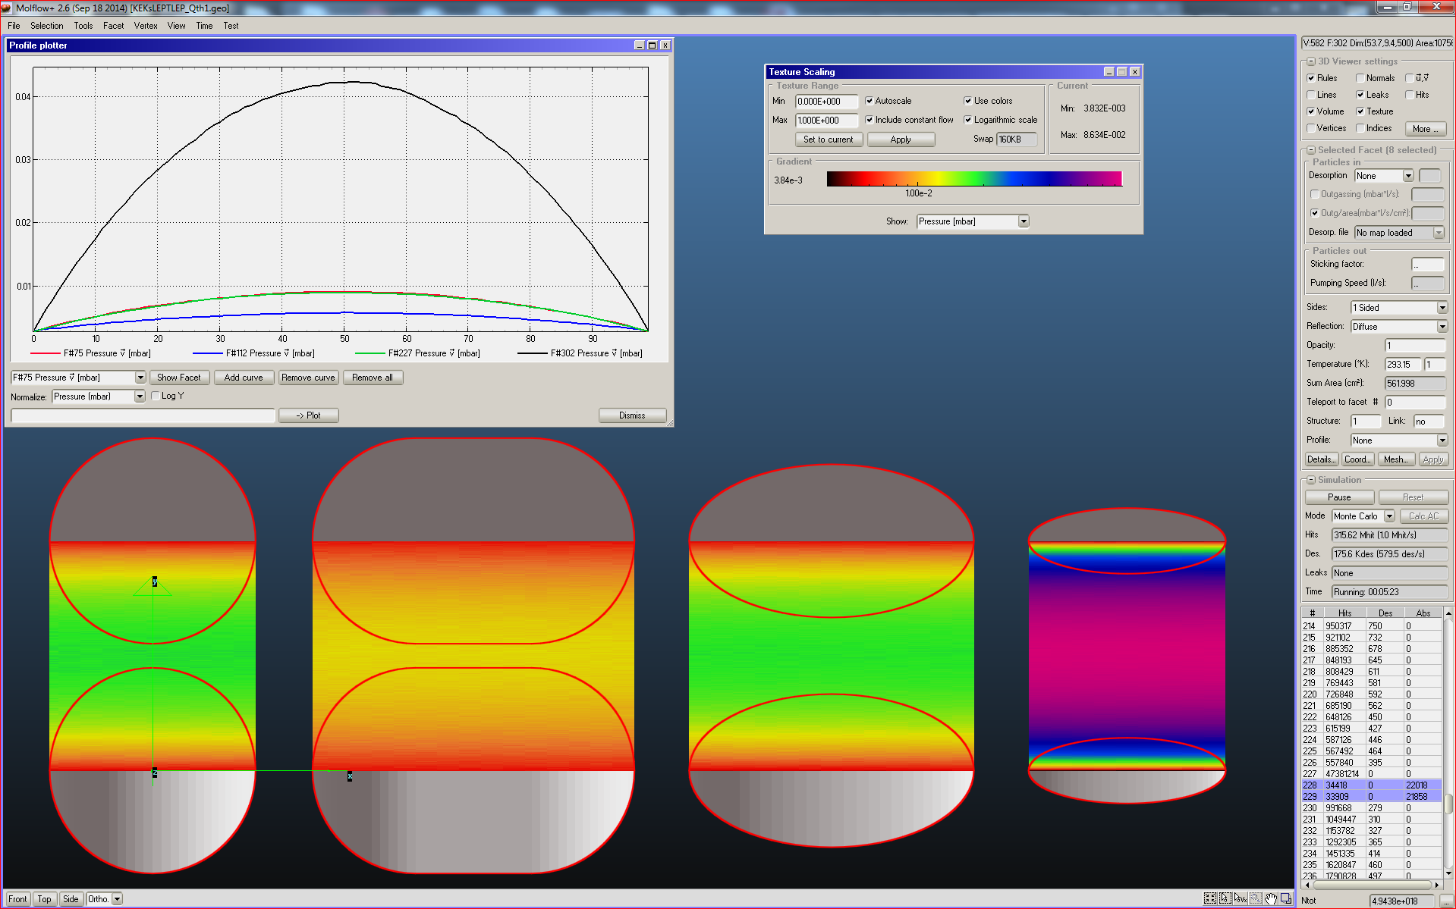
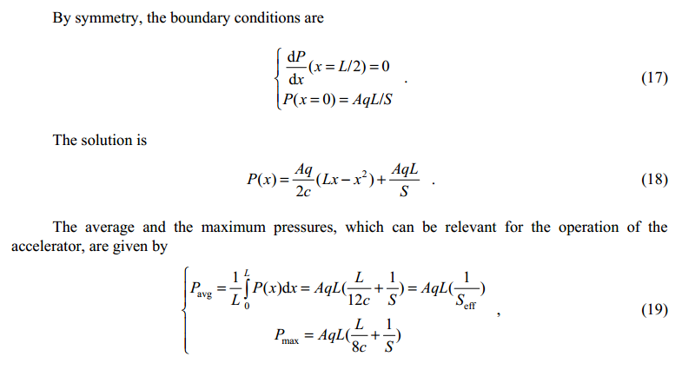
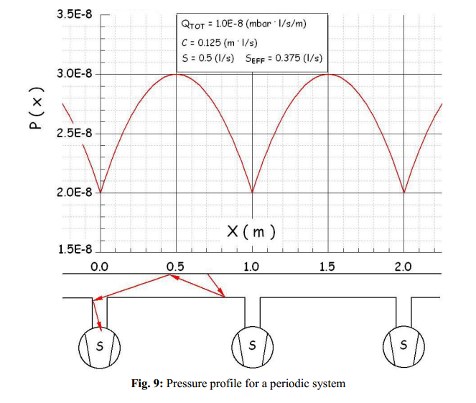
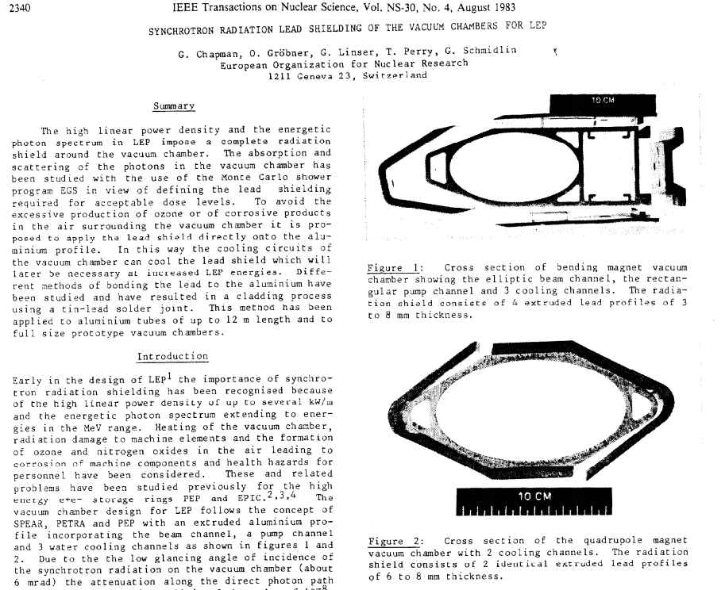
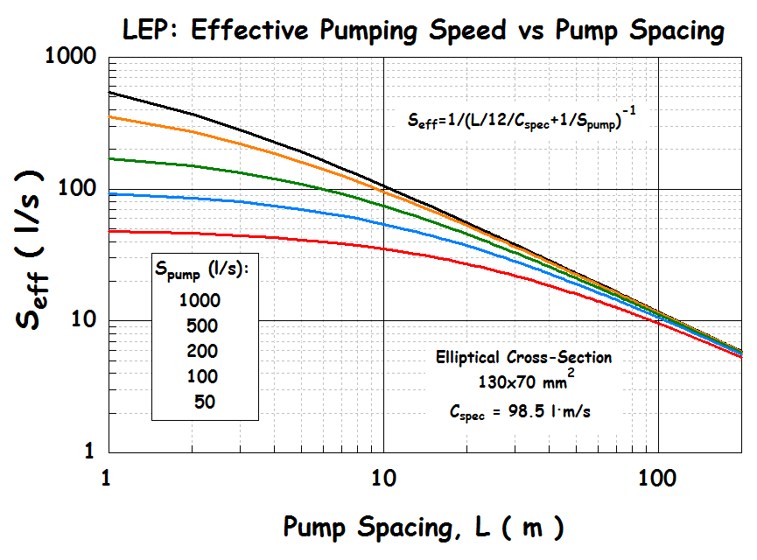
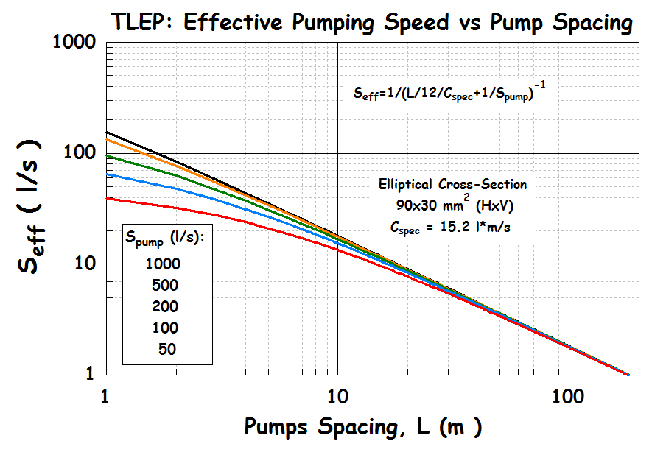
Vacuum chamber geometry:
Maximization of the conductance of the vacuum chamber: why?
For a large machine like any HF, it comes natural to think of using discrete pumps evenly spaced along the lattice, let’s say one after every dipole magnet in a FODO lattice
What kind of vacuum pressure can we expect from such a vacuum system?
R. Kersevan, “Vacuum System Requirements for a HF e+e- Accelerator – 55th ICFA – Beijing – 10 Oct 2014

Slide 9
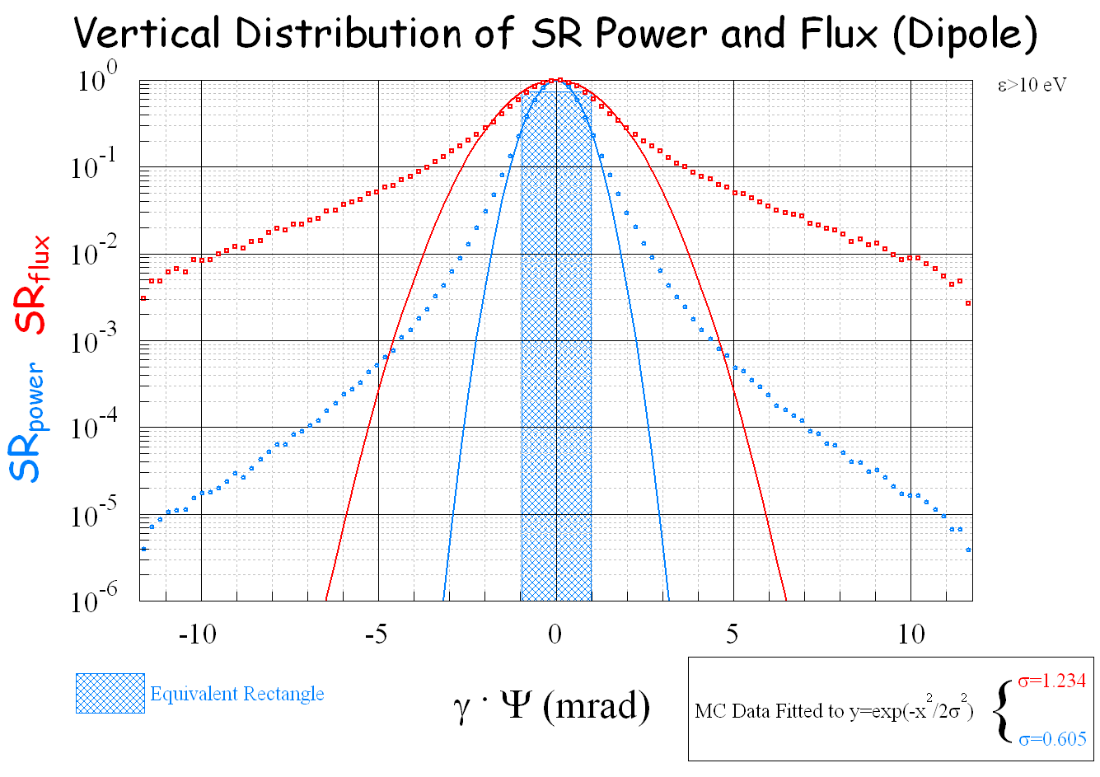
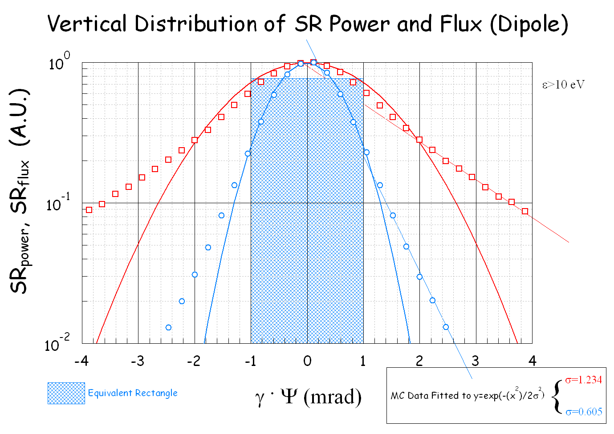
Vertical opening angle of dipole radiation power:
  ~gaussian distribution with opening ±1/γ
Vertical distribution of the SR from a dipole: notice marked deviation from gaussian approximation (solid lines), especially for the photon flux.
For FCC-ee at 45.5 GeV, γ ≈ 89,000, so γψ=10 means 0.112 mrad, or a photon fan strip of ±3.4 mm at a point ~30 m away.
So, in case of a chamber-antechamber solution, a 9 mm vertical slot size should be able to let practically all primary SR photons through (with provision for some vertical misalignment… but watch for any large vertical orbit bumps!
R. Kersevan, “Vacuum System Requirements for a HF e+e- Accelerator – 55th ICFA – Beijing – 10 Oct 2014

Slide 10
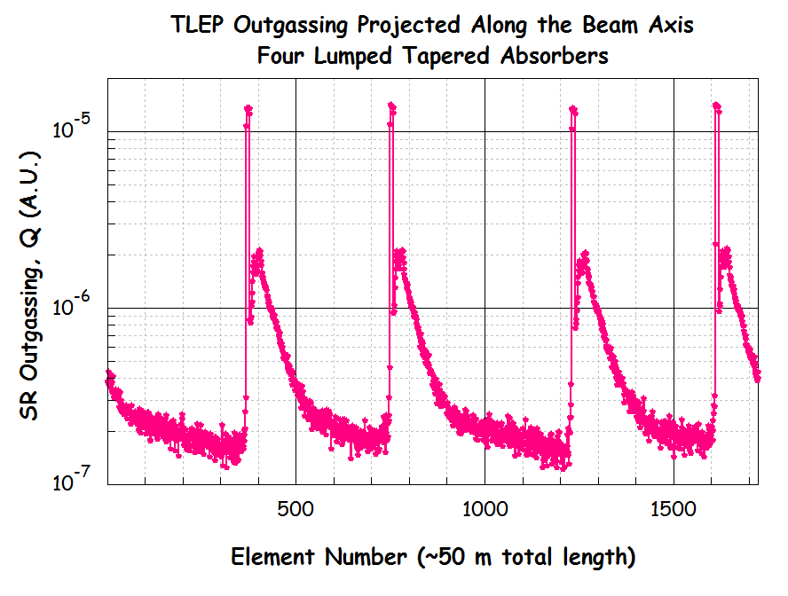
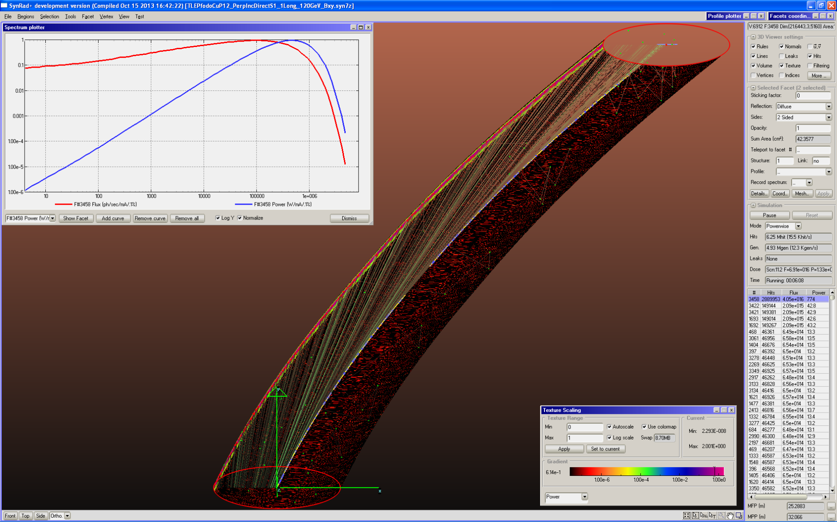
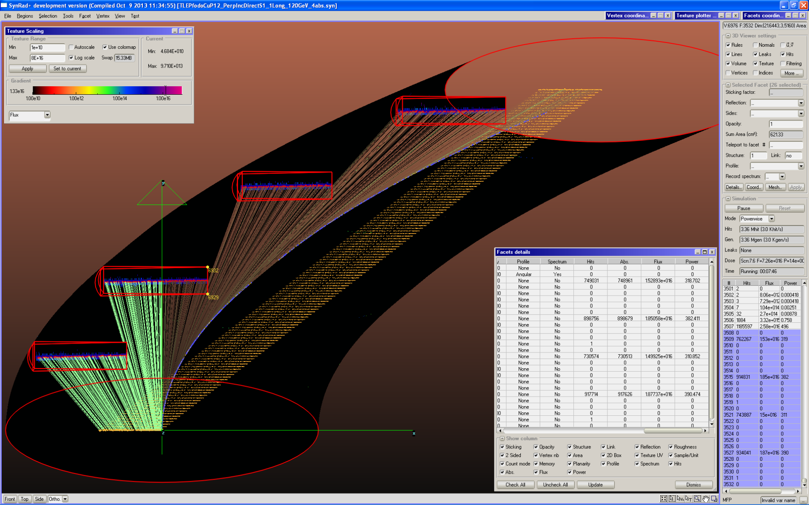
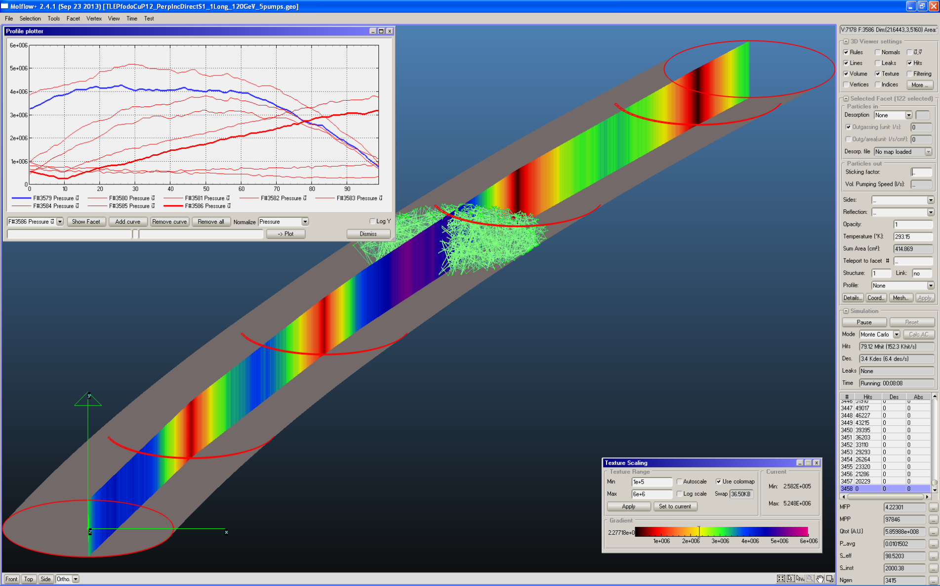
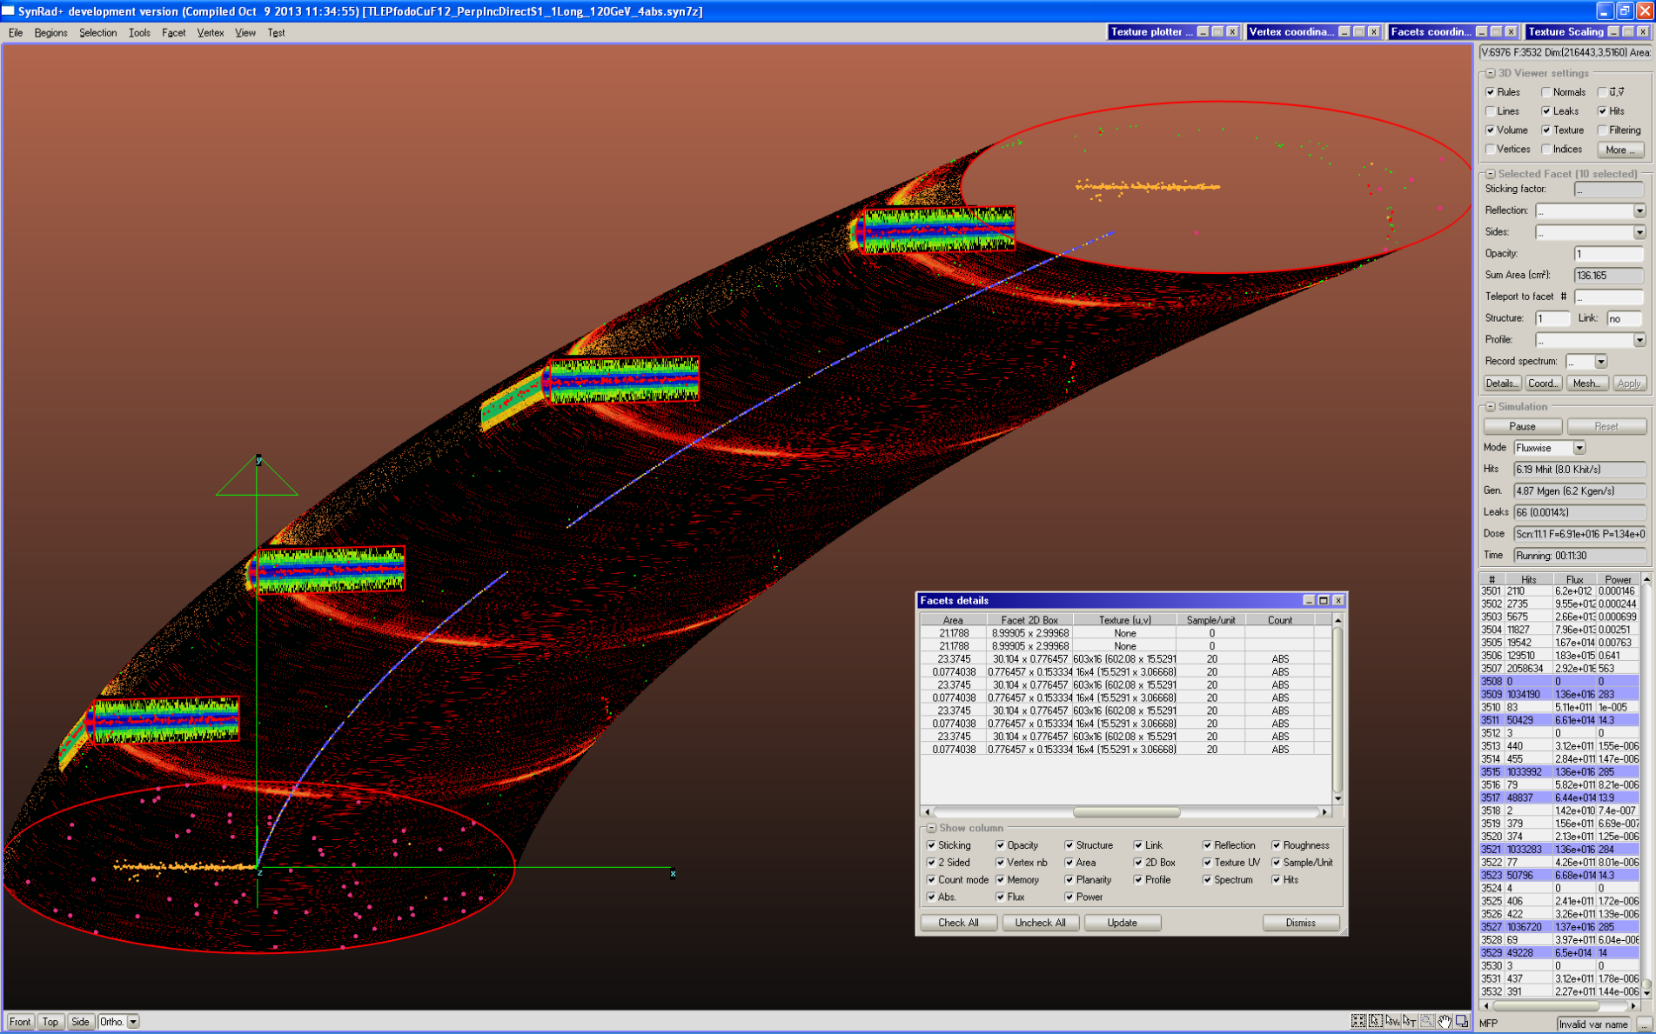
SR fan at FCC-ee 90x30 mm² 1/2x FODO cell (25 m)
Distributed SR fan vs localized absorbers: Ray-tracing (SYNRAD+)
Photon fan profiles converted into outgassing profiles via η(mol/ph)
Pressure profile calculation via 3D Montecarlo code (Molflow+)
R. Kersevan, “Vacuum System Requirements for a HF e+e- Accelerator – 55th ICFA – Beijing – 10 Oct 2014

Slide 11
Conclusions
Any design of a Higgs Factory with beam energies in the 45~175 GeV range inevitably makes a powerful source of SR
Comprehensive ray-tracing analysis of SR fans: mandatory! Especially for delicate areas, such as IR, SRF, wigglers!
Careful choice of vacuum chamber material
Vacuum system geometry and pumping system must be carefully analysed and designed
Special care has to be taken for any cross-sectional changes (tapers), and devices (BPMs, stripline kickers, RF cavities, gate-valves, etc…): proper shielding from SR and cooling for HOMs
The operation of LEP and B-factories, and the design of low-emittance light sources can help a lot in the design of a HF’s vacuum system
The chamber vs chamber/antechamber solutions must be carefully evaluated
The distributed vs discrete pumping solutions must be carefully evaluated
Low-SEY coatings for e-cloud in the e⁺ beam chamber
Although not easy to implement, in-situ bake-out is recommended
R. Kersevan, “Vacuum System Requirements for a HF e+e- Accelerator – 55th ICFA – Beijing – 10 Oct 2014

Slide 12
Acknowledgements
F. Cerutti, and L. Esposito, FLUKA Team, C.Garion (Vacuum Group) are gratefully acknowledged for their contributions and suggestions.
Some of the figures have been taken from papers/publications referenced in the workshop proceedings’ paper FRT4B2.
-------------*-------------
Any questions?
R. Kersevan, “Vacuum System Requirements for a HF e+e- Accelerator – 55th ICFA – Beijing – 10 Oct 2014

Slide 14
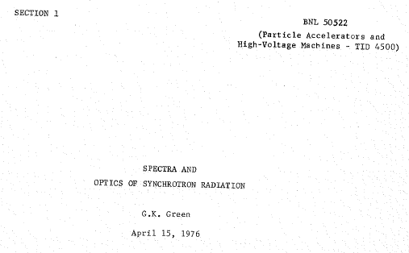
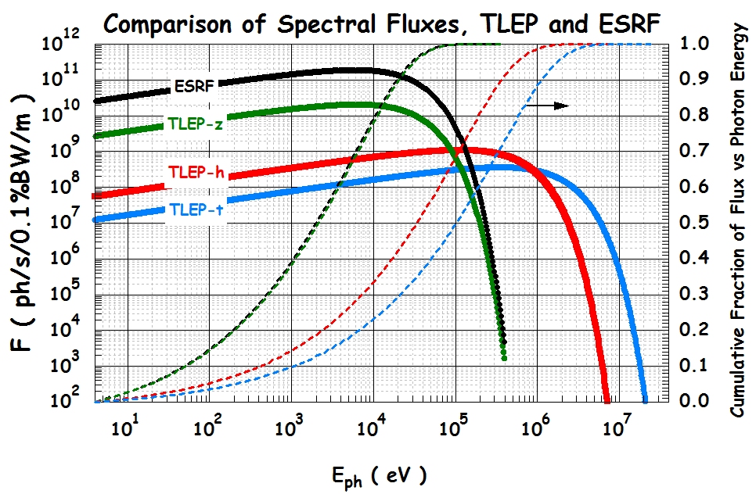
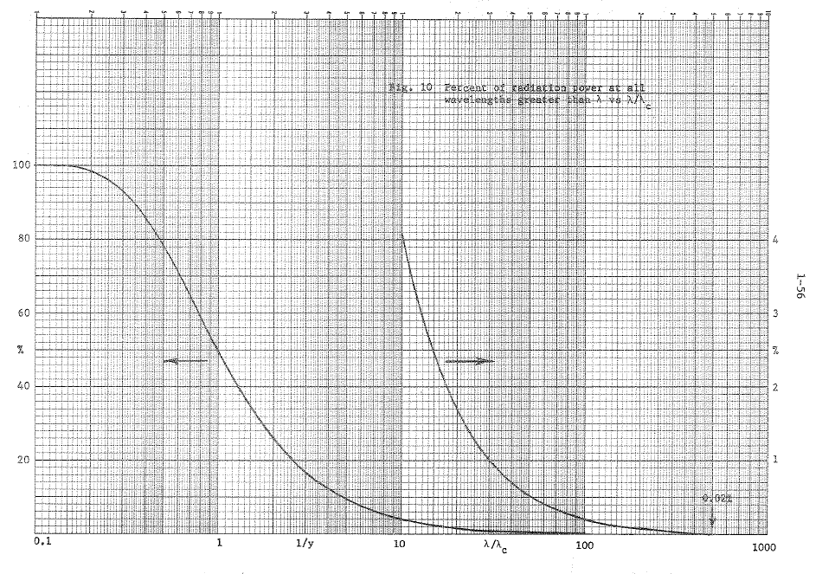
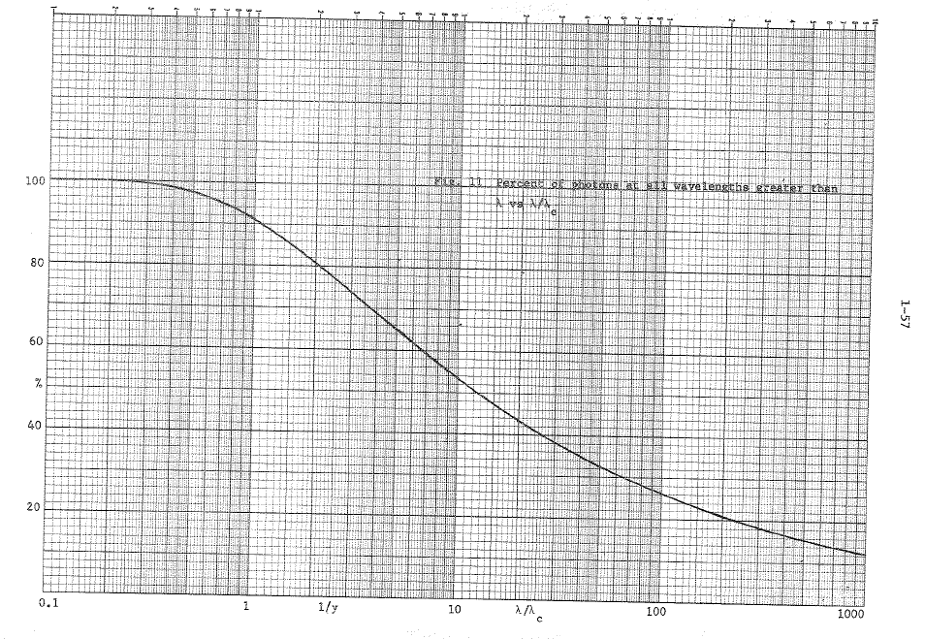
BONUS SLIDES
Synchrotron radiation in high-energy proton colliders
  Relevant formulae
The fractions of SR flux and power generated within a selected photon energy range can be found in literature, or easily calculated numerically.
Percent of POWER at all wavelengths greater than λ vs λ/λ_{C}.
Percent of FLUX at all wavelengths greater than λ vs λ/λ_{C}.
R. Kersevan, “Vacuum System Requirements for a HF e+e- Accelerator – 55th ICFA – Beijing – 10 Oct 2014

Slide 15
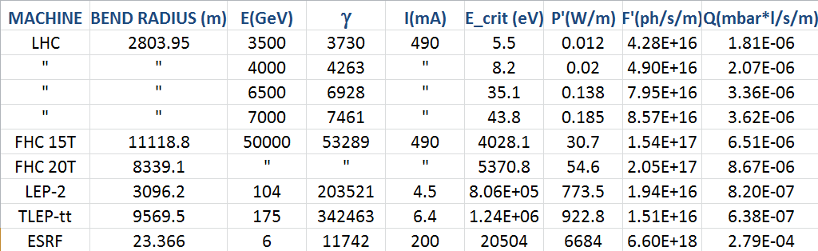
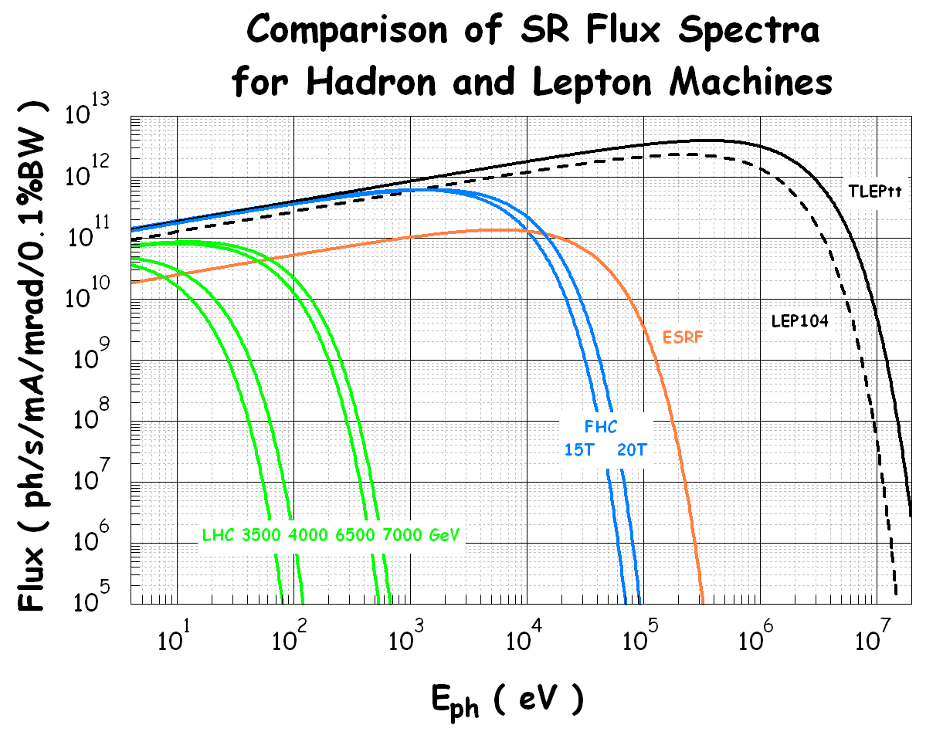
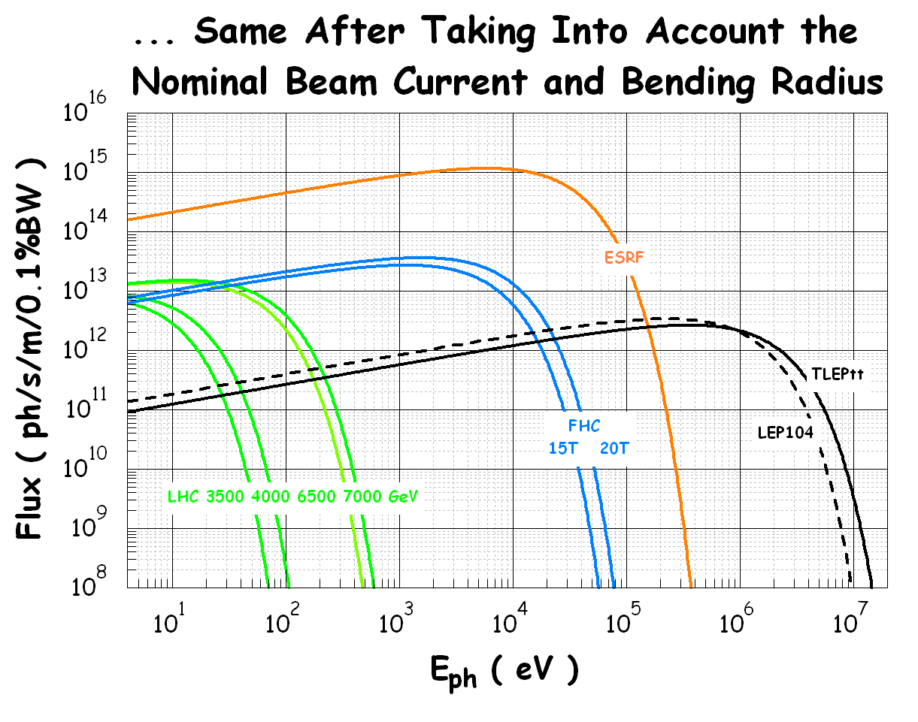
Synchrotron radiation in high-energy proton colliders
  Relevant formulae and spectra
How strong is going to be the FHC as a SR photon source?
P, F and Q with NO correction factor!
The critical energy is much higher than that of the 7 TeV LHC (LHC-7), in the X-ray region
The two FHC versions generate between 170x and 300x the SR specific power with respect to the LHC-7!
The specific flux is not much higher than that of LHC-7 (~2x)
The specific outgassing is about 2~3x that of LHC-7, and therefore a comparably higher specific pumping speed is necessary in order to obtain the same molecular density and gas scattering lifetime (with further correction for higher energy)
-

Slide 16
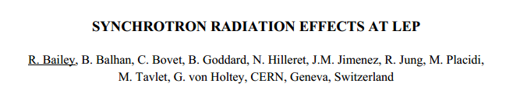
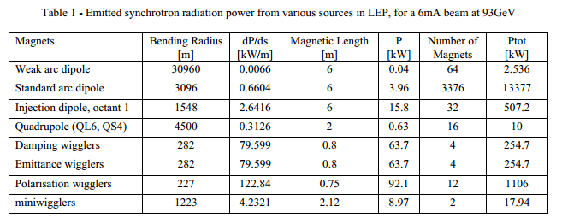
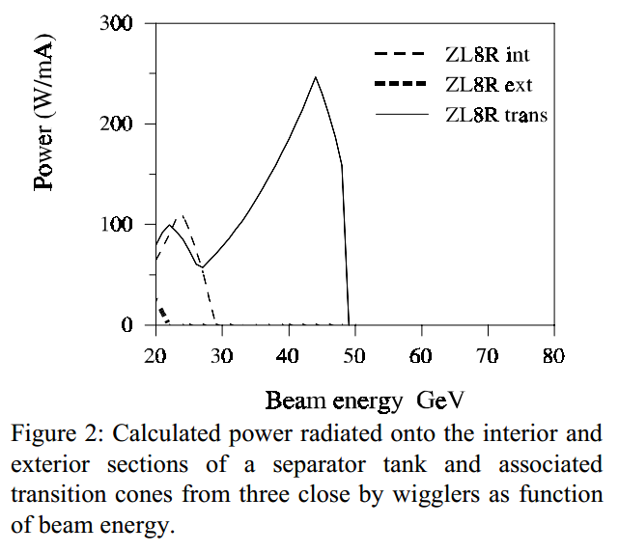
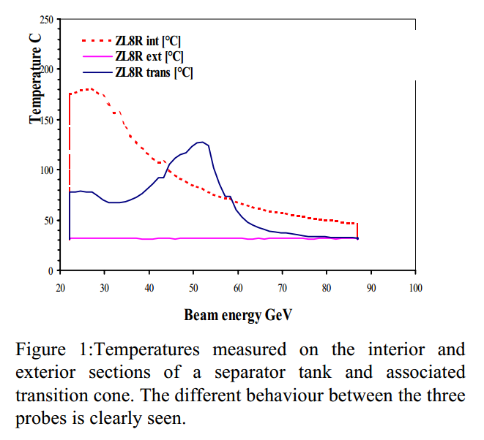
LEP Experience: few examples
-

Slide 17
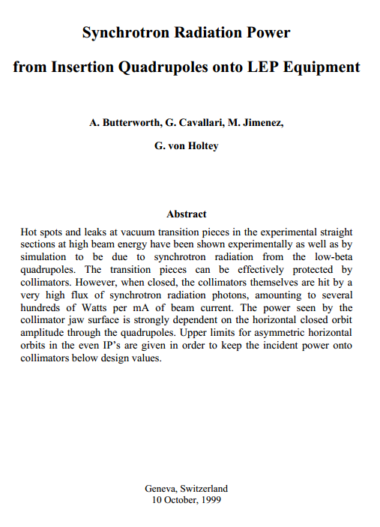
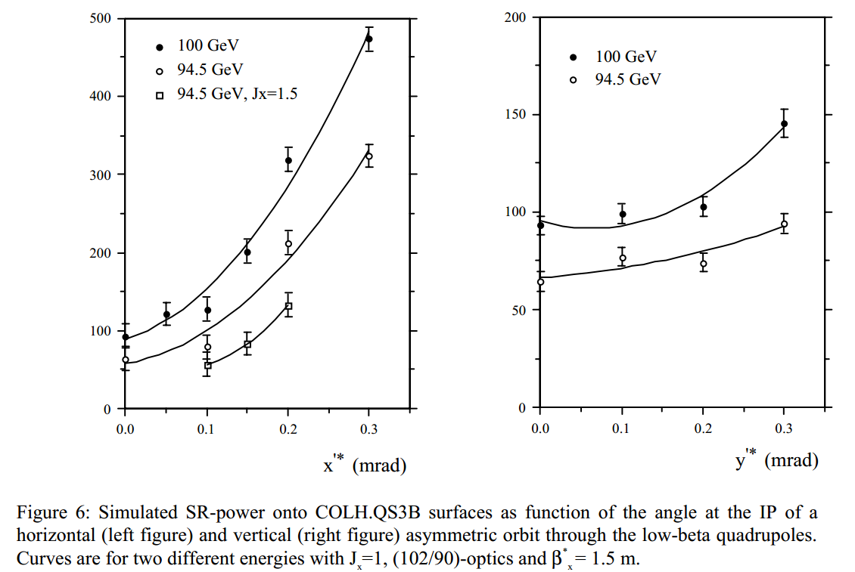
LEP Experience: few examples
-

Slide 18
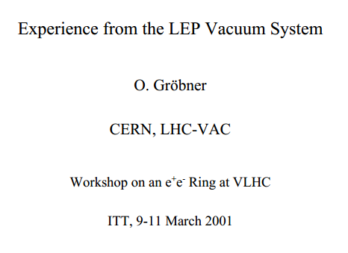
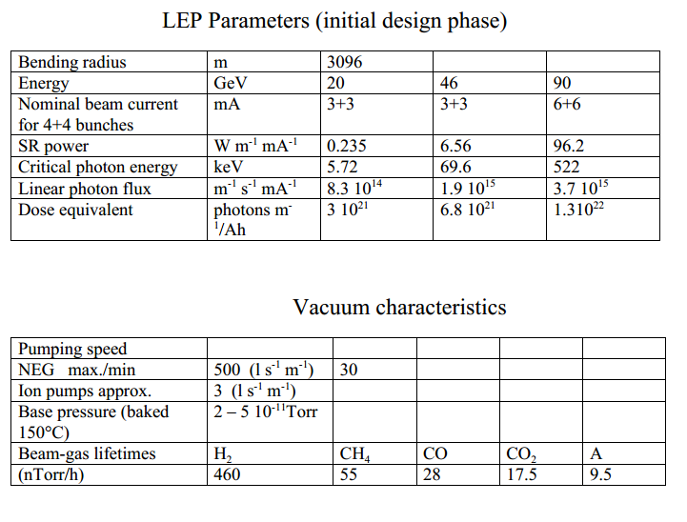
LEP Experience: few examples
-

Slide 19
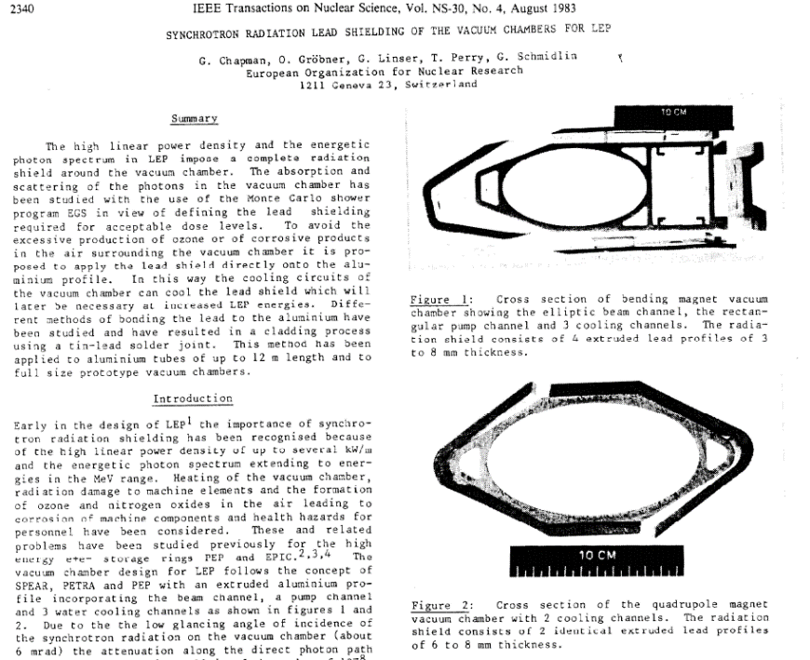
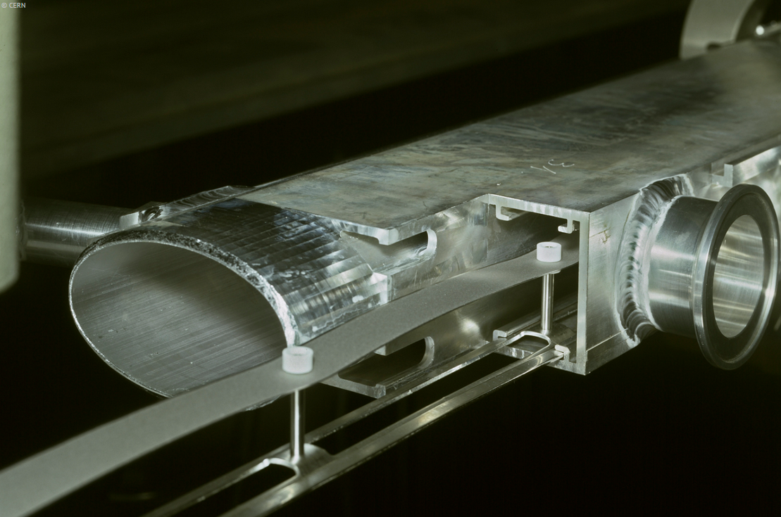
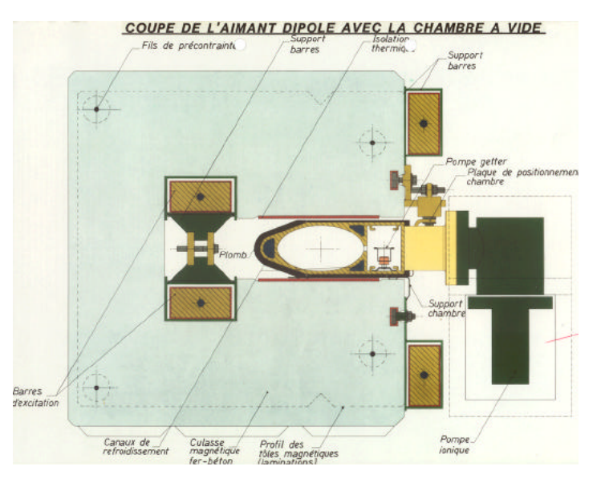
LEP Experience: few examples
-

Slide 20
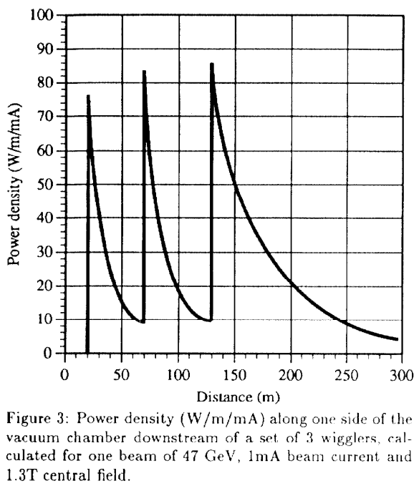
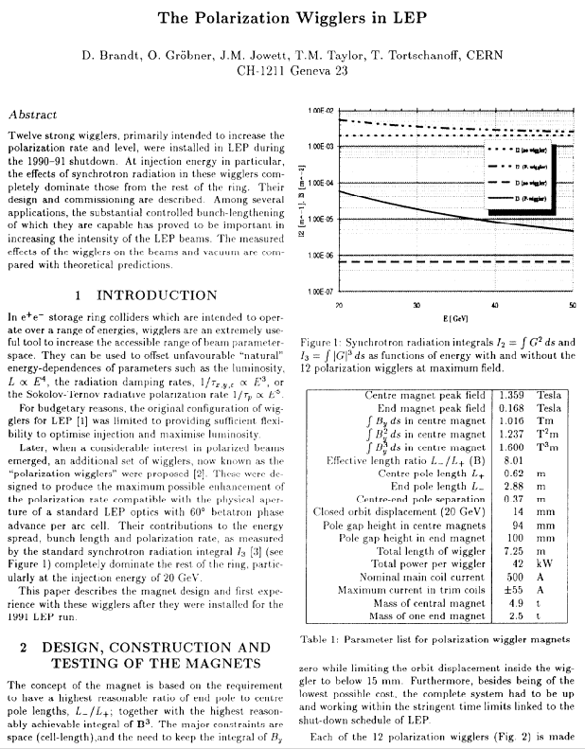
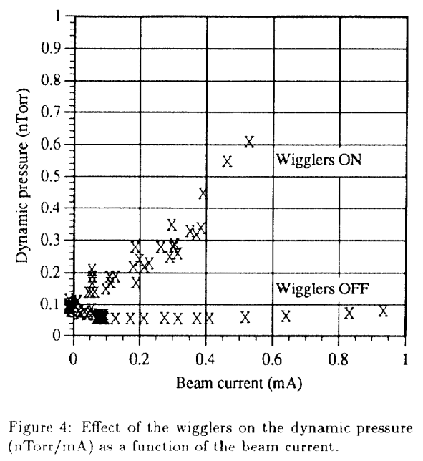
LEP Experience: few examples
-

Slide 21
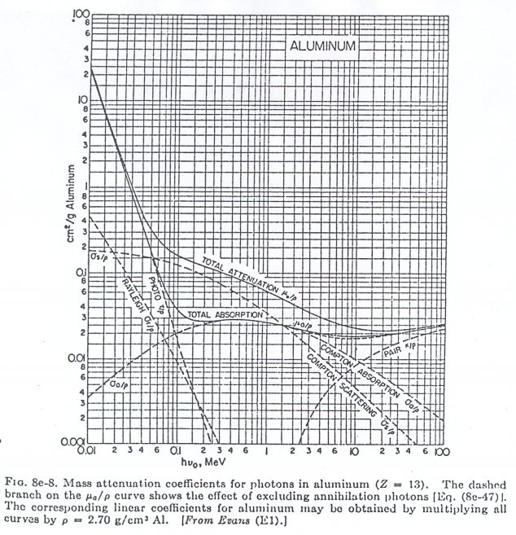
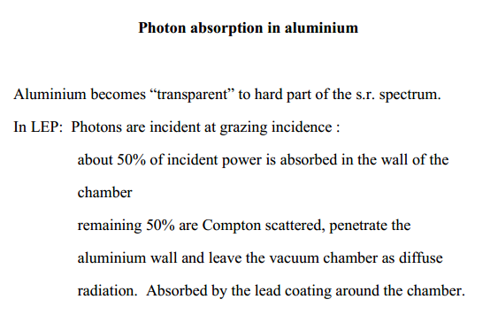
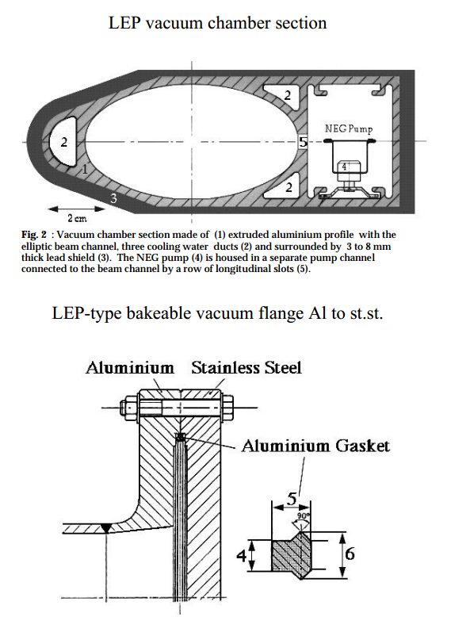
LEP Experience: few examples
-

Slide 22
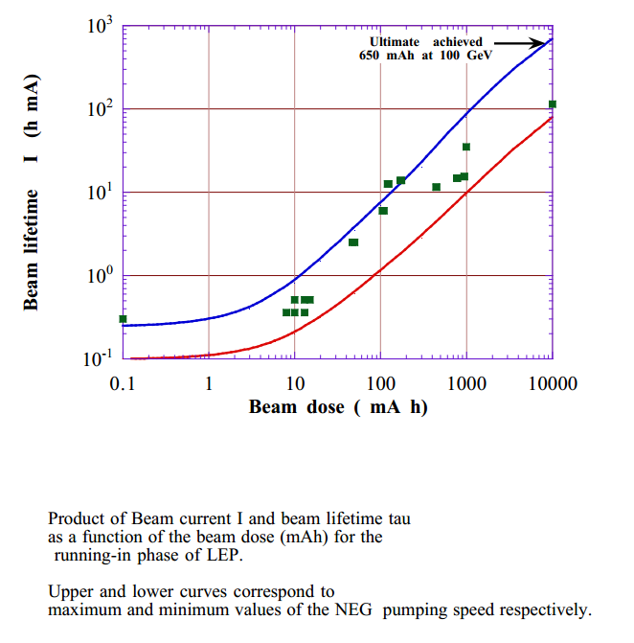
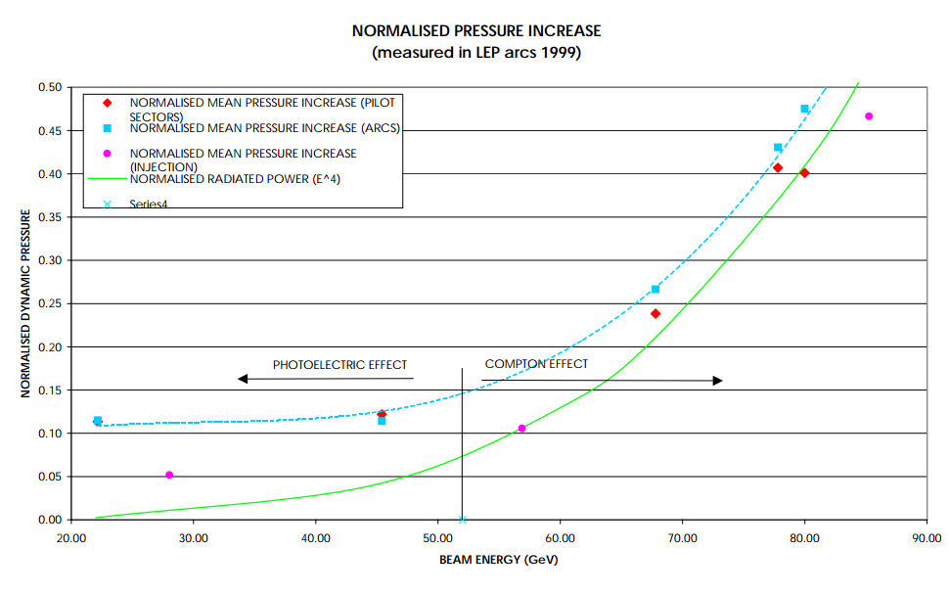
LEP Experience: few examples
-

