Slide 1
Choice of L* for FCCee:
IR optics and DA
A.Bogomyagkov, E.Levichev, P.Piminov
Budker Institute of Nuclear Physics
Novosibirsk

Slide 2
Outline
Introduction (goals, assumptions, tools)
FF optical blocks
Comparison of nonlinear sources of FF (theoretical)
Simulation results
Conclusions

Slide 3
Goals, assumptions, tools
Estimate nonlinear features of FCCee final focus as a function of L* and β*. Assuming domination of the vertical plane.
Design several lattices of FF (from IP to beginning of the arc) for several L*.
Close the ring with linear matrix providing tunes good for luminosity. Find DA, detuning. Optimize DA.

Slide 4
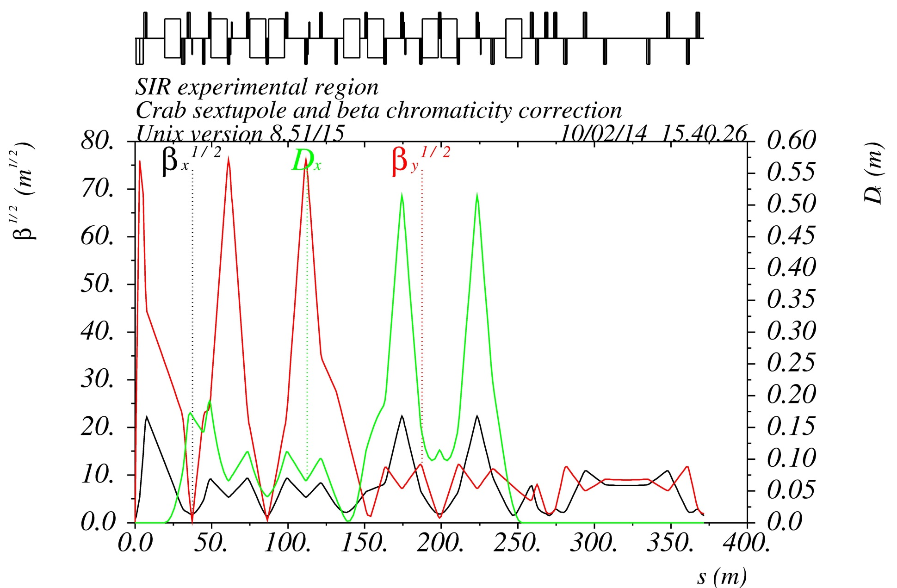
IR optics blocks
Y1
Y2
X1
X2
CRAB
First quad fringes: large strength and beta
IP: Kinematic terms: extremely low IP beta
-I
-I
Chromatic section:
strong sextupoles, large beta
FFT
YXCCS
CRAB

Slide 5
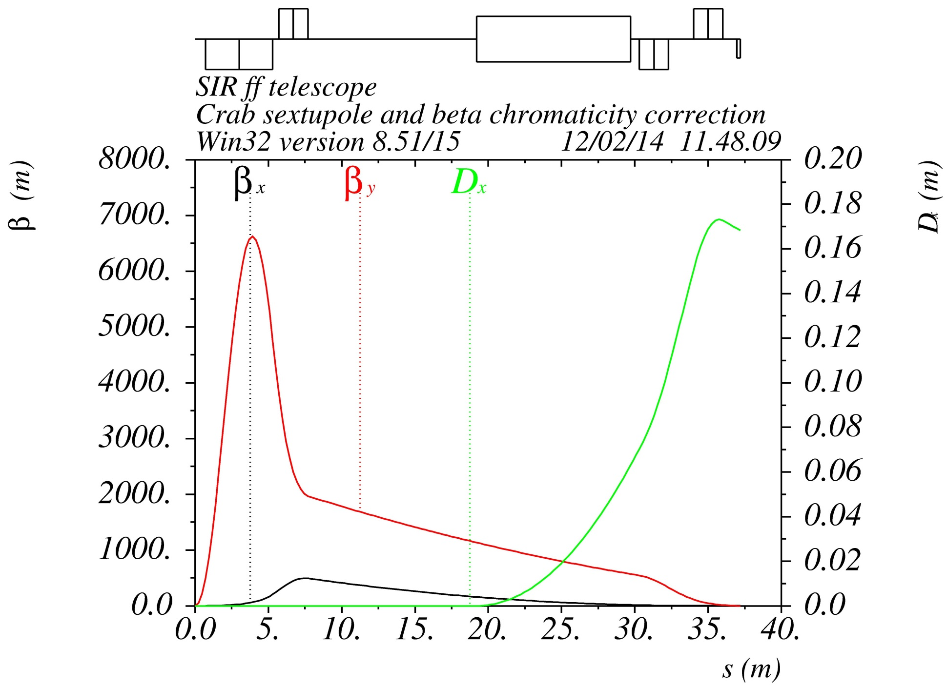
Final focus
L*(D0)
QD0
D0=0.7 m
Q0: L=4.6 m, G=95 T/m @ 175 GeV
D1=0.4 m
Q1: L=2 m, G=96 T/m @ 175 GeV
IP

Slide 6
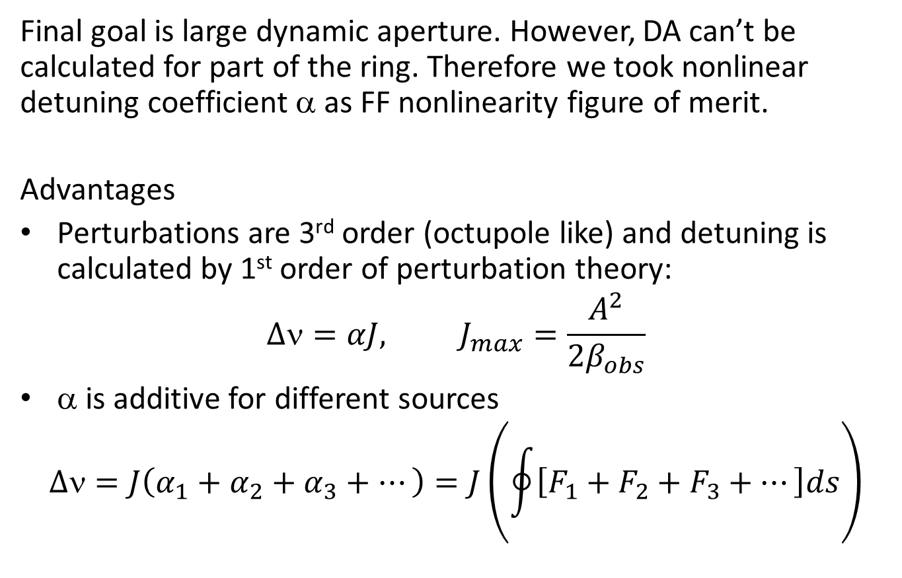
Nonlinearity: figure of merit
Final goal is large dynamic aperture. However, DA can’t be calculated for part of the ring. Therefore we took nonlinear detuning coefficient α as FF nonlinearity figure of merit.
Advantages
Perturbations are 3rd order (octupole like) and detuning is calculated by 1st order of perturbation theory:
$$∆ν=αJ, J_{max}=\frac{A^{2}}{2β_{obs}}$$
α is additive for different sources
$$∆ν=J\left(α_{1}+α_{2}+α_{3}+⋯\right)=J\left(\oint{\left[F_{1}+F_{2}+F_{3}+⋯\right]ds}\right)$$

Slide 7
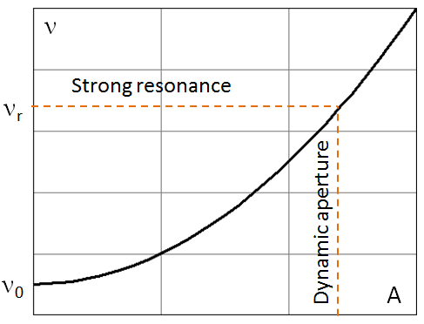
Detuning and DA scaling
Naive approach:
where
Octupole resonance fixed point:
→
∼ zero Fourier harmonic
h ∼ resonance driving Fourier harmonic (we believe that both are of the same magnitude order)

Slide 8
Final quad QD0 and chromaticity
Defining the QD0 focusing requirements as α_{o} = –α_{I} one can find
The beta and its derivative in the end of L* are given by
FF vertical chromaticity(half of FF):
QD0 natural chromaticity
Correction by sextupoles
Note: For FF μ’ corresponds to the chromatic function excitation introduced by B.Montague (LEP Note 165, 1979)

Slide 9
Kinematics
For the extremely low β* and large transverse momentum the first order correction of non-paraxiality is given by
The main contribution comes from the IP and the first drift:
where 2L* is the distance between 2 QD0 quads around the IP.

Slide 10
QD0 Fringe Fields
Quadrupole fringe field nonlinearity is defined by
and the vertical detuning coefficient is given by^{*)}
Or, with above assumptions (k₁₀ is the central strength, 2xQD0):
^{*)} E.Levichev, P.Piminov, arXiv: 0903.3028
A.V.Bogomyagkov et al. IPAC13, WEPEA049, 2615

Slide 11
Octupole error in QD0
An octupole field error (or corrector) in QD0:
If a field quality at the quad aperture radius r_{a}
One can rewrite the vertical octupole detuning (for 2 QD0) as

Slide 12
Chromatic sextupoles
Vertical chromatic sextupole pair separated by –I transformer gives the following coordinate transformation in the first order^{*)}
Pair of sextupoles
Octupole
By analogy to the octupole and using the expression for the FF chromaticity we found for the vertical detuning (1 IR arm)
^{*)} A.Bogomyagkov, S.Glukhov, E.Levichev, P.Piminov http://arxiv.org/abs/0909.4872

Slide 13
α_{yy}-test for different lattices
 | Super C-Tau¹⁾ Novosibirsk | SuperB V.16¹⁾ LER Italy | SuperKEKB²⁾ LER Japan | LEP³⁾ CERN | FCCee/TLEP⁴⁾ CERN
10³ β*(m) | 0.8 | 0.27 | 0.27 | 10 | 1
L*(m) | 0.6 | 0.32 | 0.77 | 3.5 | 3.5
-2μ′_{y} | 1500 | 2400 | 5700 | 700 | 7000
-K₁(m⁻²) | 1.3 | 5.4 | 5.1 | 0.11 | 0.19
L_{QD0}(m) | 0.2 | 0.5 | 0.33 | 2 | 2.2
10⁻⁶ α^{f} (m⁻¹) | 0.07 | 0.4 (0.6)⁵⁾ | 5.1 (4)⁶⁾ | 0.008 | 1.3
10⁻⁶ α^{k} (m⁻¹) | 0.11 | 0.5 (0.62)⁵⁾ | 1.26 (1.2)⁶⁾ | 0.004 | 0.42
10⁻⁶ α^{sp} (m⁻¹) | -0.35(-0.41) | -0.7(-0.7)⁵⁾ | -0.65 (-0.6)⁶⁾
Note: Different lattice versions may have different parameters. Black – estimation, blue –simulation.
¹⁾ CDR
²⁾ K.Oide, FCC Kick-off Meeting, Geneva, 14 Feb 2014
³⁾ T.M.Taylor, PAC 1985
⁴⁾ H.G. Morales, TLEP Meeting, CERN, 18 Nov 2013
⁵⁾ A.Chance, SuperB Internal Note, July 30, 2010 (simulation)
⁶⁾ E.Levichev, P.Piminov, SuperKEKB Internal Report, Feb 11, 2010 (simulation)

Slide 14
Our design, different L*
β* = 1 mm, K₁ = 0.16 m⁻¹, Ls = 0.5 m, η_{s}= 5 cm
K1(QD0) ≈const
L*(m) | 0.7 | 1 | 2 | 3
-2μ′_{y} | 1400 | 2000 | 4000 | 6000
10⁻⁶ α^{k} (m⁻¹) | 0.08 | 0.11 | 0.24 | 0.34 | ∼L*
10⁻⁶ α^{f} (m⁻¹) | 0.009 | 0.025 | 0.21 | 0.71 | ∼L*³
10⁻⁶ α^{sp} (m⁻¹) | -8 | -16 | -64 | -144 | ∼L*²
This estimation is very approximate and just shows the trend. We did not take into account realistic beta and dispersion behavior, magnets other but QD0, etc. All these issues are included in simulation.

Slide 15
Theoretical conclusions
FF nonlinearities may increase as L* in high power.
Major part of the vertical nonlinearity for the extra-low beta IP comes from chromatic sextupoles due to the finite length effect.
The finite length effect in the –I sextupole pair can be improved by additional (low-strength) sextupole correctors.
Nonlinear errors in the quads with high beta may be a problem. Correction coils (for instance, the octupole one) can help.
Third order aberrations including the fringe field and kinematics can be mitigated by a set of octupole magnets located in proper beta and phase.

Slide 16
Simulation
Scenario:
We use the following lattice and tracking codes: MAD8 and Acceleraticum¹⁾ (BINP home made).
The FF structure is closed optically by a linear matrix .
The tunes are fixed at (0.53, 0.57) to get large luminosity .
Dynamic aperture and other nonlinear characteristics are defined from tracking.
DA is increased by additional sextupole and octupole correctors properly installed.
¹⁾ D.Einfeld, Comparison of lattice codes, 2nd NL Beam Dynamics Workshop, Diamond Light Source, 2009

Slide 17
α comparison for L*=0.7 m
 | Kin | Fringe | Sextupole pair
Simulation
α_{xx} (m⁻¹) | 60 | 1100 | -2300
α_{xy} =α_{yx} (m⁻¹) | 380 | 15300 | -0.07×10⁶
α_{yy} (m⁻¹) | 0.075×10⁶ | 0.1×10⁶ | -14×10⁶
Estimation
α_{yy} (m⁻¹) | 0.084×10⁶ | 8700 | -8×10⁶
A discrepancy is due to the simulation takes into account all quads fringes (included those strong in the Y chromatic section) and realistic beta behavior

Slide 18
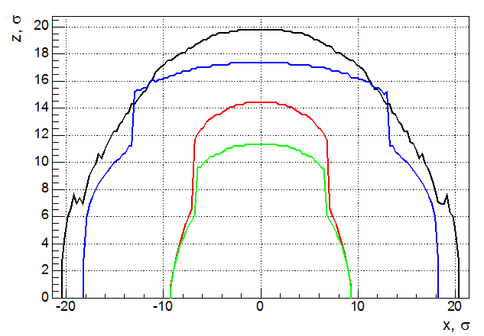
Initial DA
Finite sextupole length breaks exact cancellation of the geometrical aberrations. Only the second order terms are cancelled while the higher remains and degrade DA.
Black: L* = 0.7 m
Red: L* = 1 m (aperture ↓)
Green: L* = 1.5 m (aperture ↓)
Blue: L* = 2 m (SURPRISE! APERTURE ↑)
σ_{x}=3.24 10⁻⁵m, σ_{y}=6.52 10⁻⁸m, β*_{x}=0.5m, β*_{x}=0.001m

Slide 19
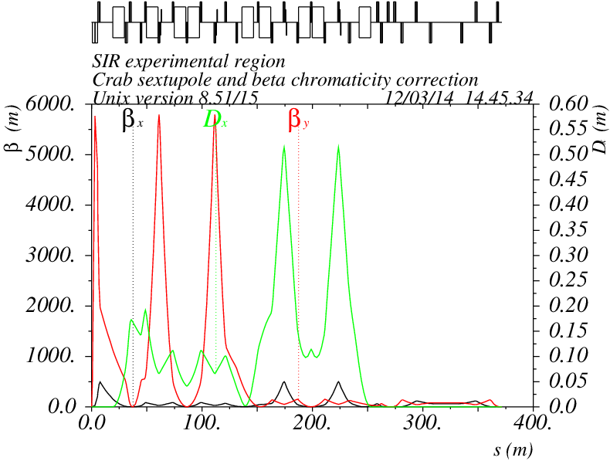
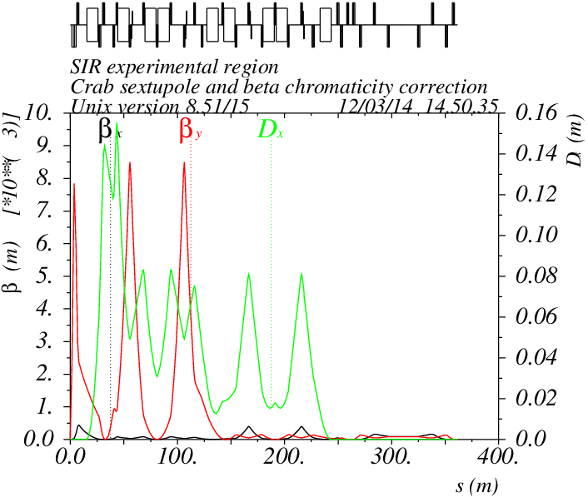
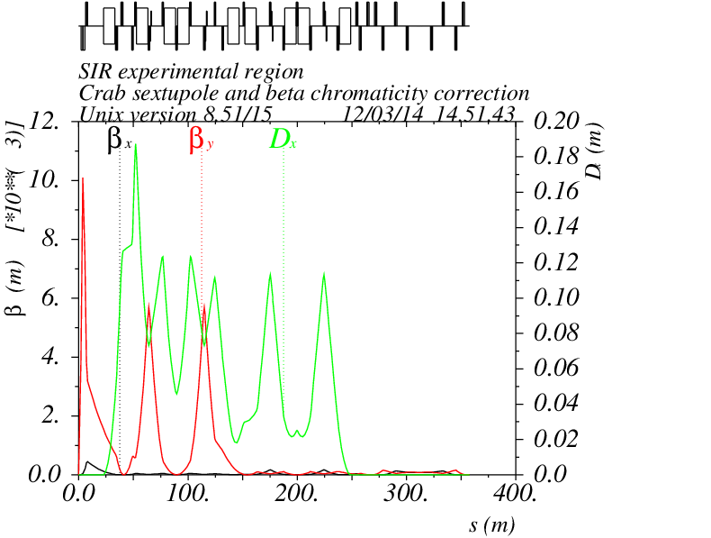
Explanation
Y chromaticity correction section is a main source of nonlinear perturbation. Produced aberration is proportional to η_{s}⁻²
L*=0.7 m, K2=-12 m⁻³,
β_{y}=5255 m
L*=1.5 m, K2=-14 m⁻³ ,
β_{y}= 7707 m
L*=2 m, K2=-14 m⁻³ ,
β_{y}= 5149 m
η_{s} ≈ 0.05 m
η_{s} ≈ 0.09 m
For L* = 2 m the FF chromaticity increased (~L*) but the dispersion increased also, so to compensate the chromaticity we need the beta and the sext strength the same as for L* = 0.7 m → same DA

Slide 20
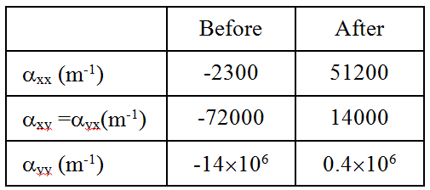
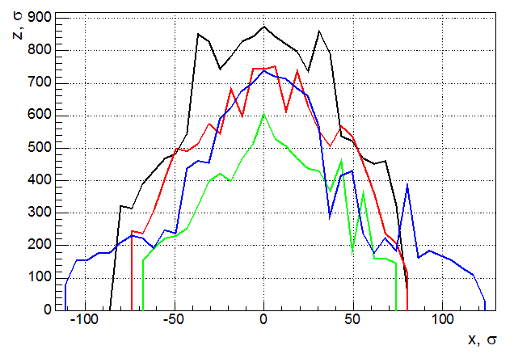
Corrected DA
Alpha before and after correction
With correctors
S1 – main (chromatic sextupoles)
S2 – low strength (~10% of the main strength) correction sextupoles can mitigate a finite length effect

Slide 21
Conclusion
The major source of the DA limitation for the CW FCCee IR is the –I Y chromatic correction section through the sextupole length effect.
Simple calculation of α_{yy} confirms it well, however for details computer simulation is necessary.
DA dependence on L* differs for different nonlinearities: kinematics ~L*, -I sextupole pair ~L*² and fringes ~L*³.
Large dispersion in the sextupole is welcomed.
Nonlinear corrections works well.
For L*=2 m we have Ax > 100σ_{x} and Ay > 700σ_{y} which seems quite enough to start.

