Slide 1
Synchrotron Radiation Absorption and Vacuum Issues in the IR at PEP-II and a Higgs Factory
John Seeman,
SLAC
October 11, 2014
HF2014 Beijing

Slide 2
Abstract: Synchrotron Radiation Absorption and Vacuum Issues in the IR
The beams in a circular e+e- collider emit synchrotron radiation photons in the dipoles and quadrupoles in the interaction region and deposit them in the nearby vacuum chambers. These photons must be absorbed in the vacuum chambers with the deposited power taken away and the emitted gasses pumped away not to cause beam-gas backgrounds. A discussion of how this was done in the PEP-II IR will be presented and implications for a Higgs Factory will be shown.

Slide 3
Topics
PEP-II /BaBar Interaction Region
HF Parameters
Absorption
Pumping

Slide 4
PEP-II Parameters for 3.1 GeV x 9.0 GeV
Parameter | Units | Design | April 2008 Best | 2008 Potential
I+ | mA | 2140 | 3210 | 3700
I- | mA | 750 | 2070 | 2200
Number bunches |  | 1658 | 1722 | 1740
β_{y}* | mm | 15-25 | 9-10 | 8.5
_{Bunch length} | mm | 15 | 11-12 | 9
ξ_{y} |  | 0.03 | 0.05-0.06 | 0.07
Luminosity | x10³³ | 3 | 12 | 20
Int lumi / day | pb⁻¹ | 130 | 911 | 1300
4 times design
7 times design

Slide 5
PEP-II Horizontal Beam Line Offsets near IR

Slide 6
PEP-II Vertical Offsets near IR

Slide 7
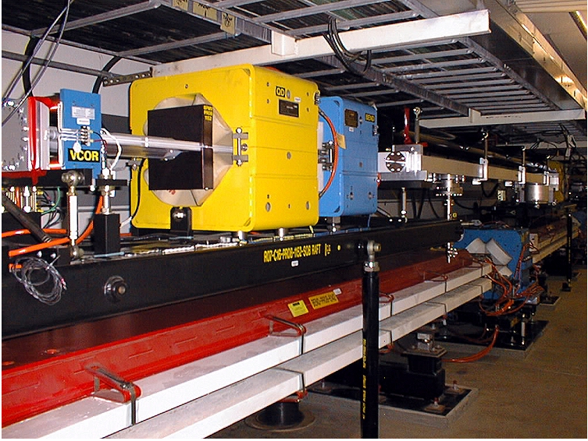
Most PEP-II LER Dipoles and Quadrupoles made at IHEP

Slide 8
PEP-II HER and LER Trajectories through IR

Slide 9
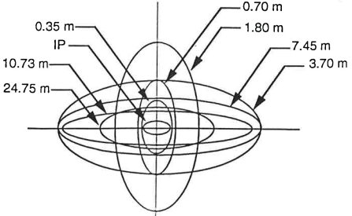
HER and LER beam sizes versus Longitudinal Position

Slide 10
PEP-II IR LER X-ray Fans (M. Sullivan)

Slide 11
PEP-II IR HER X-ray Fans (M. Sullivan)

Slide 12
Synchrotron Radiation Deposition in the IR Region: HER

Slide 13
HER High Power Dump Power Loading

Slide 14
Outgassing Rate versus Integrated Amp-Hrs

Slide 15
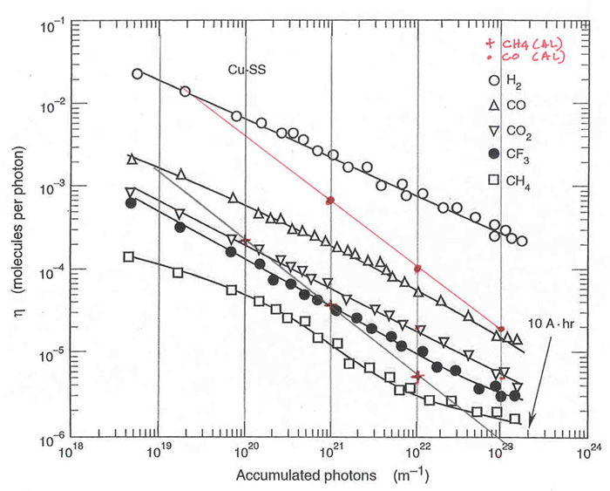
Vacuum Calculations (N. Kurita)
“best guess” parameters:
Gas temperature
Tgas = 303
Pump speed multiplier
pumpm = 0.5
TSP speed
TSP = 750
Thermal outgas rate
ogas = 2e-12
PSD rate factor
eta = 1e-6
Beam energy & current
ebeam = 3, ibeam = 500
PSD rates have been shown to be approaching 1e-6.

Slide 16
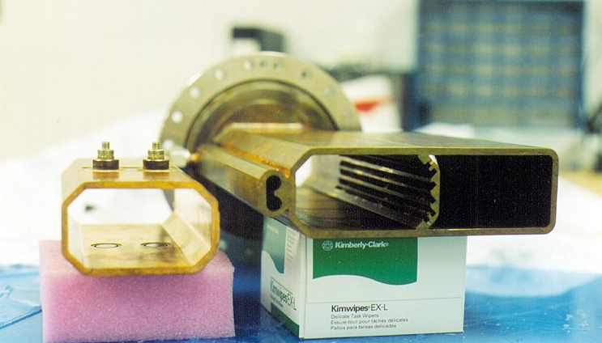
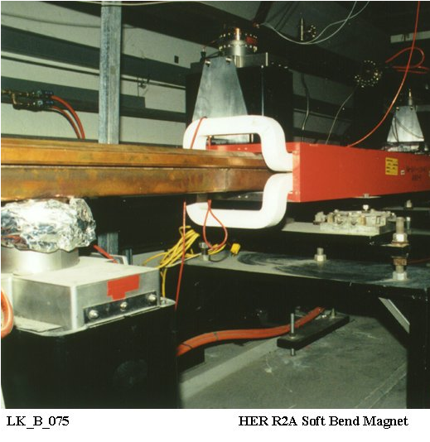
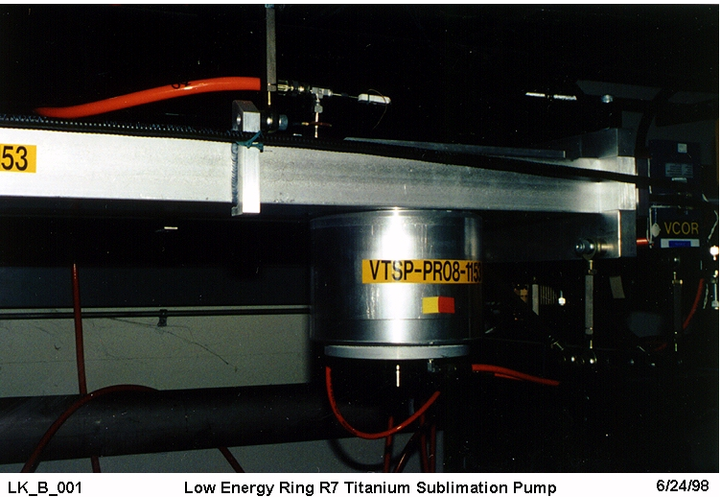
IR Vacuum Pumps
Distributed
Ion Pump
NEG
LER TSP Pumps
Lumped ion pump

Slide 17
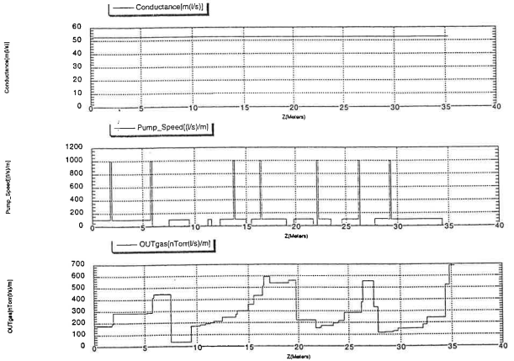
LER Vacuum Pressure Upstream IR
Resulting Pressure
Conductance, pumping, outgassing
Longitudinal Distance

Slide 18
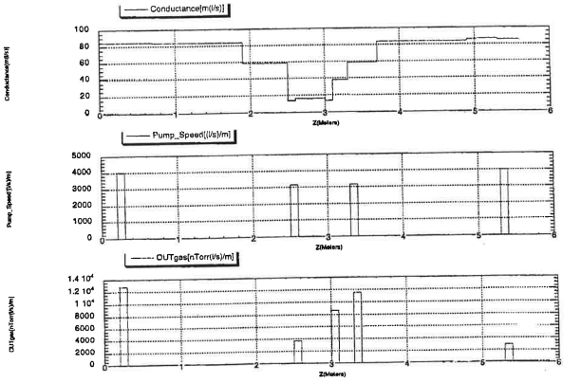
Vacuum Conditions Near the IP
Conductance, Pumping, Outgassing
Pressure
Longitudinal position

Slide 19
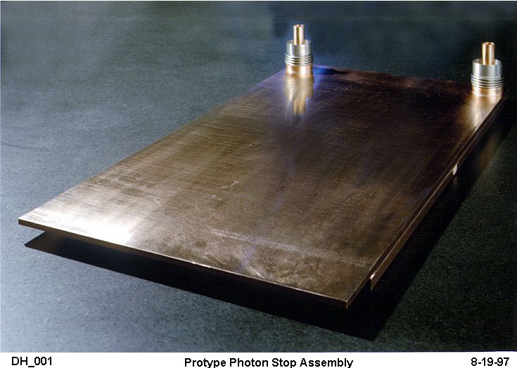
LER Photon Stops

Slide 20
PEP-II Support Tube and Permanent Magnet Schematic

Slide 21
IR Be Chamber and Permanent Magnets

Slide 22
B1 Vacuum Chamber

Slide 23
LER B1 Chamber with X-ray masks

Slide 24
Q2 Chamber Back Mask 1: Three dimensional

Slide 25
HER Incoming Beam Chamber

Slide 26
Back End Q2 A-Chamber Mask

Slide 27
Q4-Q5 IR Vacuum System

Slide 28
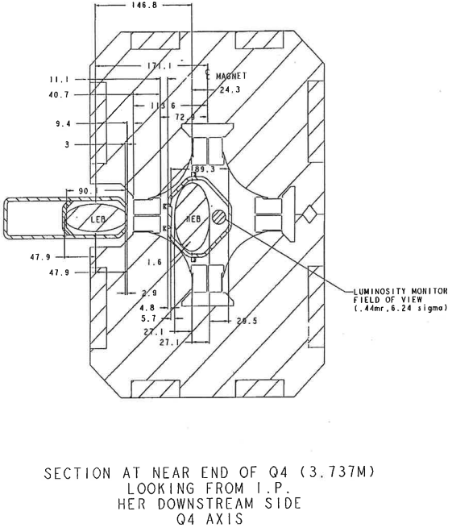
Q4 Magnet and Vacuum chamber

Slide 29
Q2 Septum Chamber (Y)

Slide 30
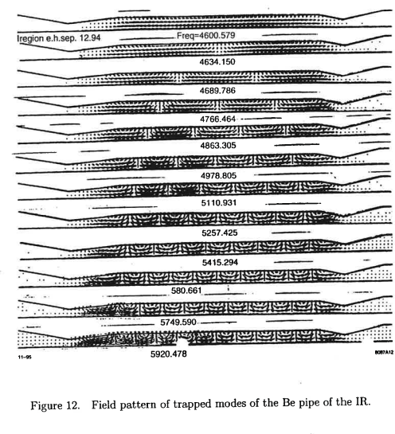
IR looking at HOM Modes

Slide 31
HOM Spectrum and Power Calculations
HOM power:
IR Be chamber has 3 KW
IR Y chamber (at 3 m) 16 KW

Slide 32
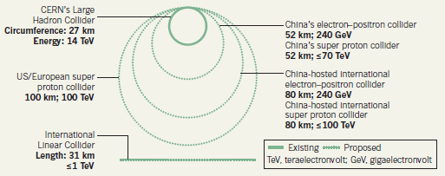
Circular Higgs Factory Ring Parameters for Injection (TLEP-H)
Energy = 120 x 120 GeV
Circumference = 54 km
Two collision points (IR)
Full energy injection
Number of bunches = 50 / ring
Particles = 4.1 x 10¹³ / beam
Particles = 5.1 x 10¹¹ / bunch
Lifetimes:
Vacuum = ~10 hours
Touschek = ~5 hours
Luminosity = 0.5 hour
Lost particles per second = 2.1 x 10¹⁰ / second per ring
Injection efficiency = ~ 80%.
→ Needed for injection: e+ and e- at ~2.6 x10¹⁰ / second at full energy.
CEPC

Slide 33
HF: CEPC Horizontal Trajectory near the IR

Slide 34
HF: CEPC IR Beta Functions

Slide 35
Synchrotron Radiation Comparison (N. Kurita)
 | PEPII | SPEAR3 | LEP3 | TLEP-Z | TLEP-H | TLEP-t
E (GeV) | 9 | 3 | 120 | 45.5 | 120 | 175
I (A) | 3 | 0.5 | 0.0072 | 1.18 | 0.0243 | 0.0054
rho (m) | 165 | 7.86 | 2625 | 9000 | 9000 | 9000
Linear Power (W/cm) | 101.8 | 92.3 | 30.5 | 8.8 | 8.8 | 8.8
CEPC has 2 beams so SR = 61 W/cm
Thermal stresses from the SR striking the vacuum chamber should be manageable (lower than PEP-II and SPEAR3)
Critical photon energy = 1.4 - 2 MeV
Radiological risk, activation (see Zimmerman’s talk)
Use discrete masks to minimize the radiation shielding and materials activated.

Slide 36
Conclusions
Minimize the SR power lost in the Interaction Region
Find any way possible to provide pumping near the IR
Find a way to add pumping inside the detector
Shield carefully the detector from x-rays and lost particles.

