Slide 1
Energy consumption and savings potential of CLIC
Philippe Lebrun
CERN, Geneva, Switzerland
55th ICFA Advanced Beam Dynamics Workshop on
High Luminosity Circular e⁺e⁻ Colliders – Higgs Factory
Beijing, 9-12 October 2014

Slide 2
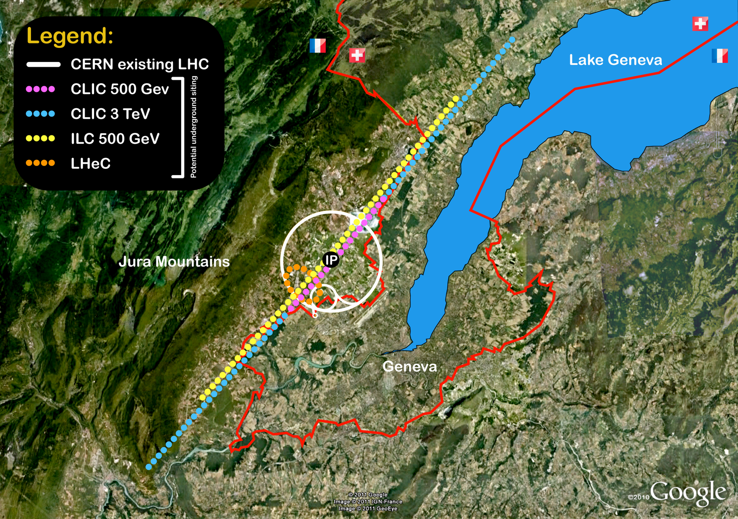
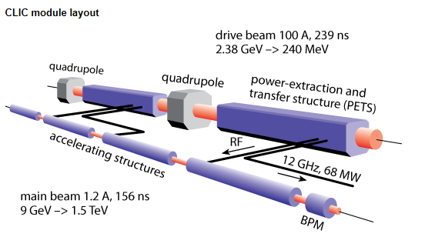
CLIC linear e⁺ e⁻ collider study

Slide 3
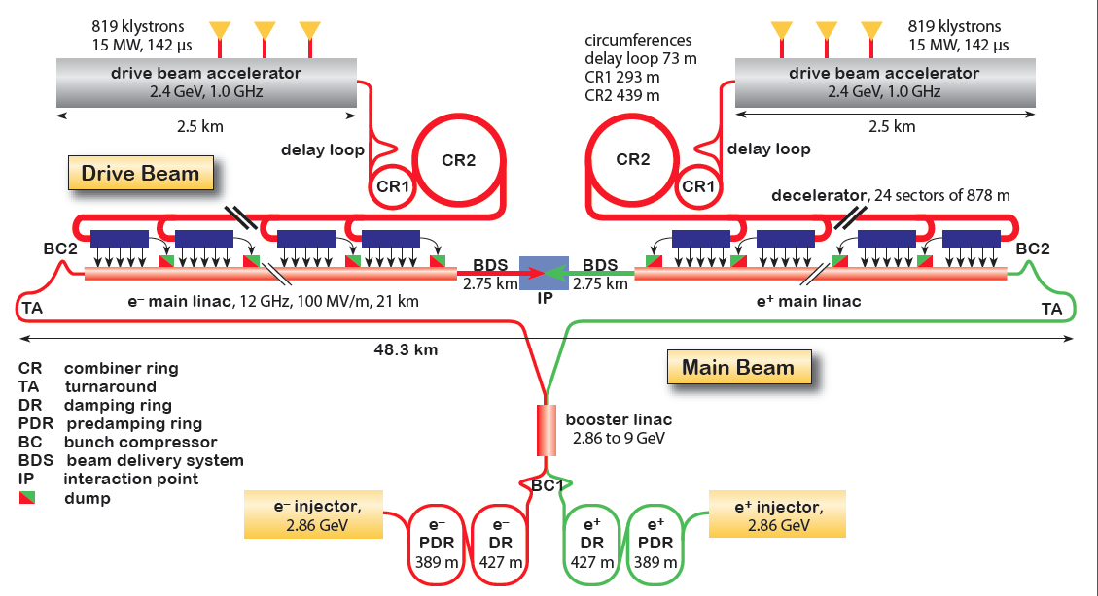
CLIC complex schematic

Slide 4
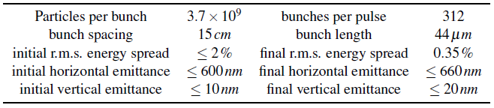

Energy, luminosity and power consumption of linear colliders
Lower-energy regime (small beamstrahlung)
  $$ℒ \sim \frac{1}{\sqrt{β_{y}ε_{y}}}η\frac{P}{E}$$
High-energy regime (large beamstrahlung)
  $$ℒ \sim \frac{1}{\sqrt{σ_{z}}}\frac{1}{\sqrt{ε_{y}}}η\frac{P}{E}$$
Grid power
Beam energy
Grid-to-beam efficiency
Vertical beta at collision
Vertical emittance
Bunch length
CLIC

Slide 5
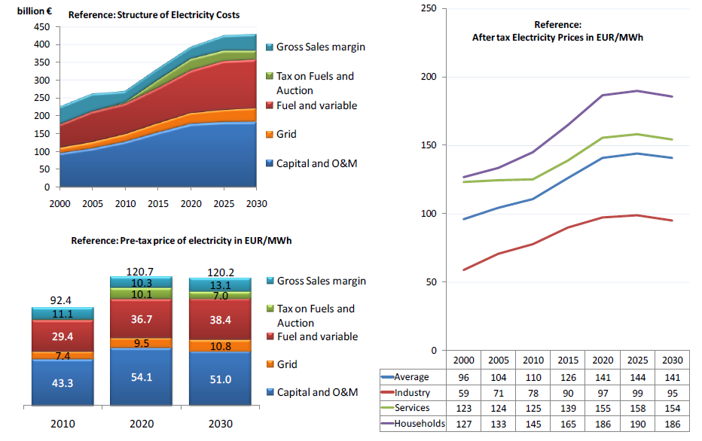
Electricity price projections
European Commission, Directorate-General for Energy
EU energy trends to 2030, Reference Scenario 2010
CERN average

Slide 6
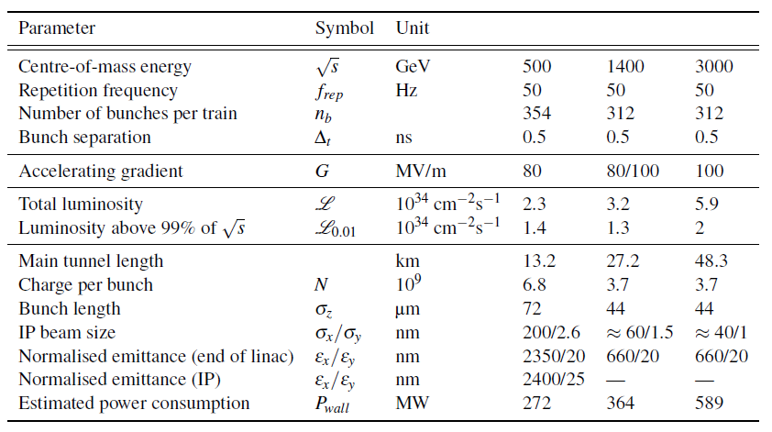
CLIC CDR parameters for Scenario A
« optimized for luminosity at 500 GeV »

Slide 7
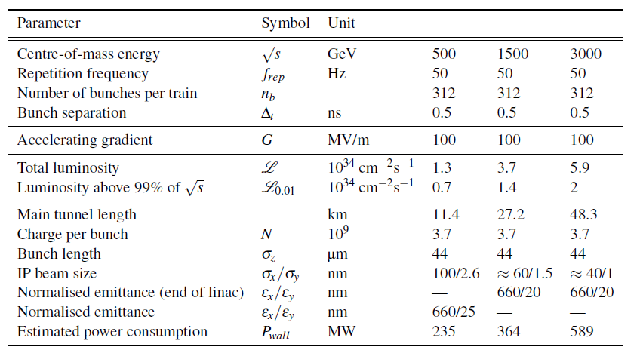
CLIC CDR parameters for Scenario B
« lower entry cost »

Slide 8
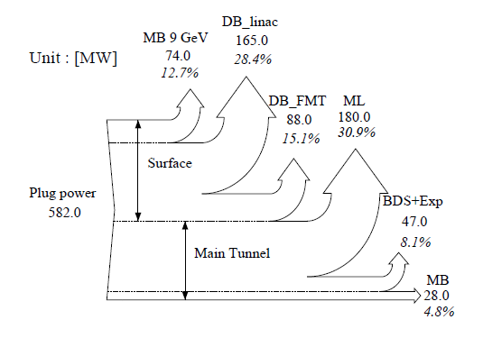
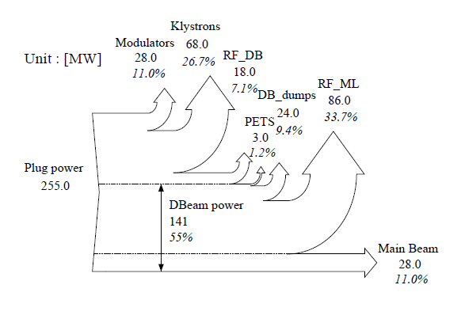
CLIC power flow
Power flow for the main RF system of CLIC at 3 TeV
Overall power flow for CLIC at 3 TeV

Slide 9
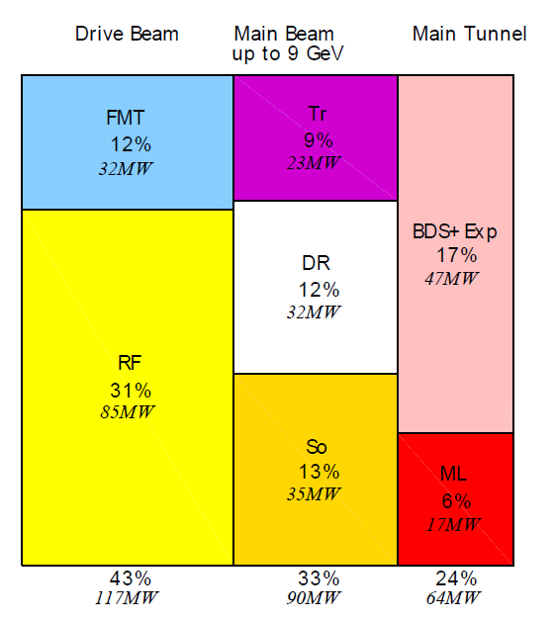
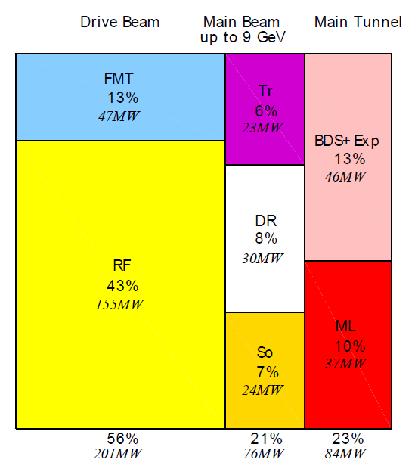
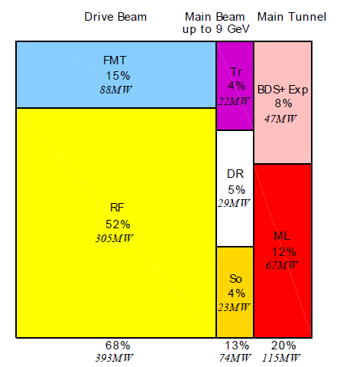
CLIC power consumption by WBS domain
Power consumption of ancillary systems ventilated pro rata of and included in numbers by WBS domain
500 GeV A
Total 272 MW
1.5 TeV
Total 364 MW
3 TeV
Total 589 MW
RF: drive beam linac, FMT: frequency multiplication & transport, So: sources & acceleration up to 2.5 GeV, DR: damping rings, Tr: booster linac up to 9 GeV & transport, ML: main linacs, BDS: beam delivery system, main dump & experimental area

Slide 10
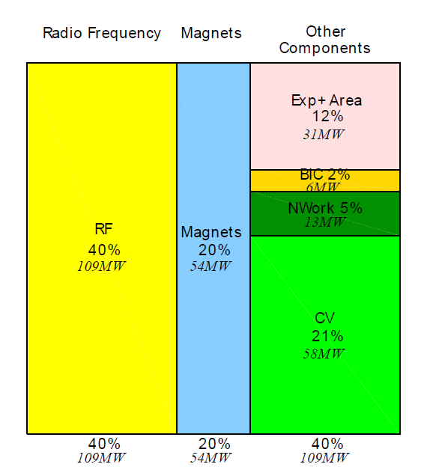
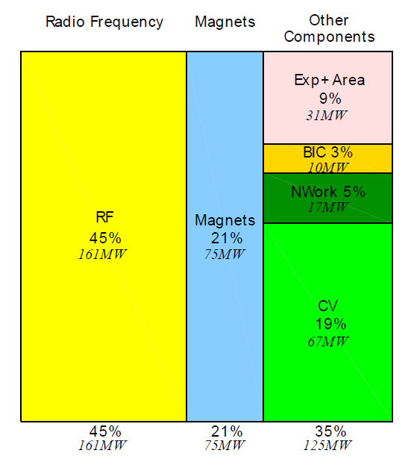
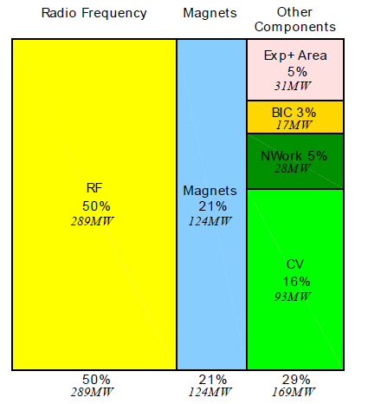
CLIC power consumption by technical system
500 GeV A
Total 272 MW
1.5 TeV
Total 364 MW
3 TeV
Total 589 MW
CV: cooling & ventilation, NW: electrical network losses, BIC: beam instrumentation & control

Slide 11
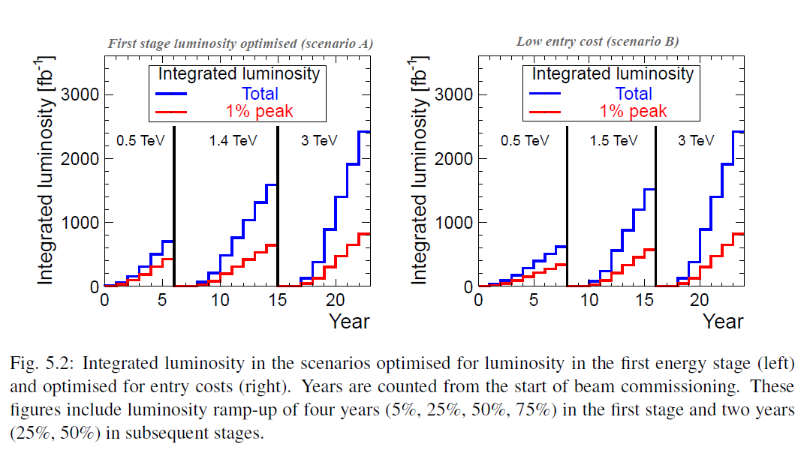
CLIC CDR
Integrated luminosity/Collision energy scenarios

Slide 12
From power to energy
CLIC CDR assumptions
For each value of CM energy
177 days/year of beam time
188 days/year of scheduled and fault stops
First year
  59 days of injector and one-by-one sector commissioning
  59 days of main linac commissioning, one linac at a time
  59 days of luminosity operation
  All along : 50% of downtime
Second year
  88 days with one linac at a time and 30 % of downtime
  88 days without downtime
Third year
  Still only one e+ target at 0.5 TeV, like for years 1 & 2
  Nominal at 1.5 and 3 TeV
Power during stops: scheduled (shutdown), unscheduled (fault), downtime

Slide 13
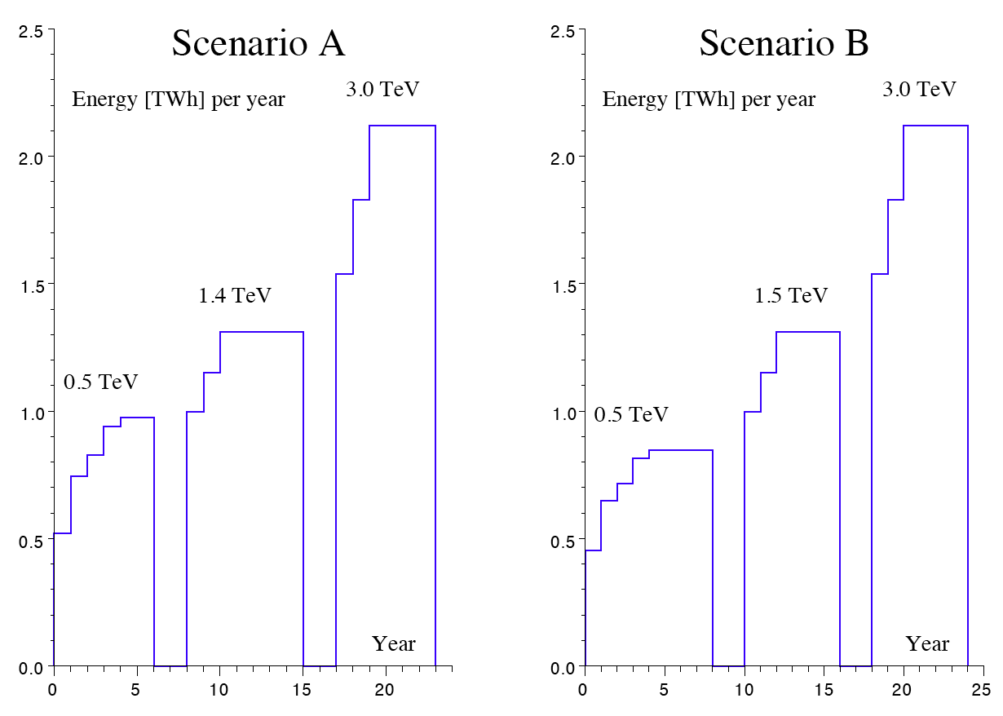
CLIC CDR
Yearly energy consumption
Integral over the whole programme
  Scenario A : 25.6 TWh
  Scenario B : 25.3 TWh

Slide 14

The four pillars of energy economy
waste heat recovery
sobriety
energy management
efficiency

Slide 15
Paths to power & energy savings
Sobriety
Reduced current density in normal-conducting magnets
  Magnets & overheads (electrical network losses, cooling & ventilation) represent 27 % of overall power at 3 TeV
  For given magnet size and field, power scales with current density
  Compromise between capital & real estate costs on one hand, and operation costs on the other hand
Reduction of ventilation duty
  Most heat loads already taken by water cooling
  Possible further reduction in main tunnel by thermal shielding of cables
  Possible reduction in surface buildings by improved thermal insulation, natural ventilation, relaxation of temperature limits

Slide 16
Paths to power & energy savings
Efficiency
Grid-to-RF power conversion
  R&D on klystrons
  R&D on modulators, powering from the grid at HV
RF-to-beam power conversion
  Re-optimization of accelerating structures and gradient
Permanent or super-ferric superconducting magnets
  Permanent magnets
    distributed uses, e.g. main linac DB quads
    fixed-field/gradient or mechanical tuning
  Super-ferric superconducting magnets
    « grouped » and DC uses, e.g. combiner rings, DB return loops in main linacs
Total potential for further power savings at 3 TeV
- RF already taken at high efficiency
- magnets ~ 86 MW
- cooling & ventilation ~24 MW

Slide 17
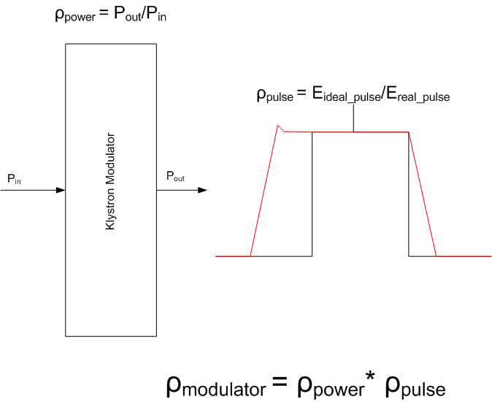
Development of high-efficiency modulators
Useful flat-top Energy | 22MW*140μs = 3.08kJ
Rise/fall time energy | 22MW*5μs*2/3= 0.07kJ
Set-up time energy | 22MW*5μs = 0.09kJ
Pulse efficiency | 0.95
Pulse forming system efficiency | 0.98
Charger efficiency | 0.96
Power efficiency | 0.94
Overall Modulator efficiency | 89%
D. Nisbet & D. Aguglia

Slide 18
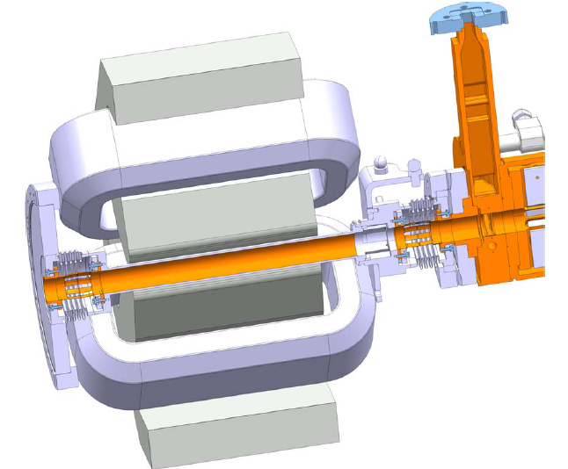
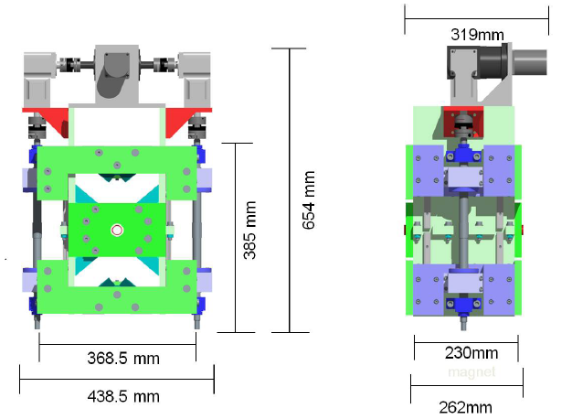
Main linac DB quadrupoles
Conventional electromagnet
Tunable permanent magnet
M. Modena, B. Shepherd

Slide 19
Paths to power & energy savings
Energy management
Low-power configurations in case of beam interruption
Modulation of scheduled operation to match electricity demand
  Seasonal load shedding
  Diurnal peak shaving

Slide 20
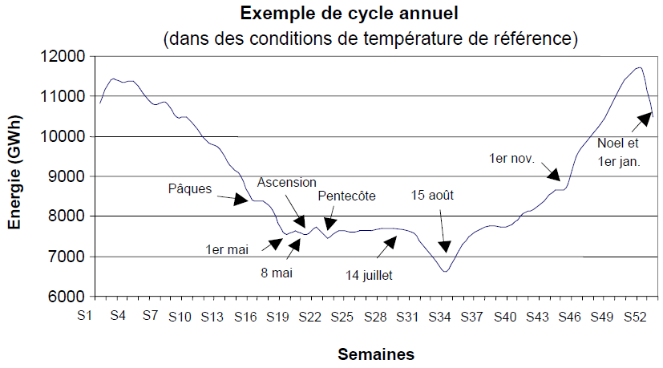
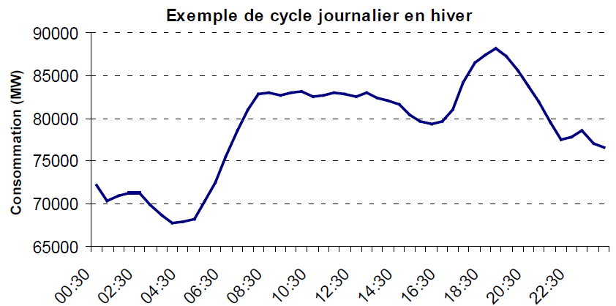
Variations of electricity demand in France
(source: RTE)
Annual variations of power consumption (integrated weekly)
Diurnal variations of power consumption (winter day)

Slide 21
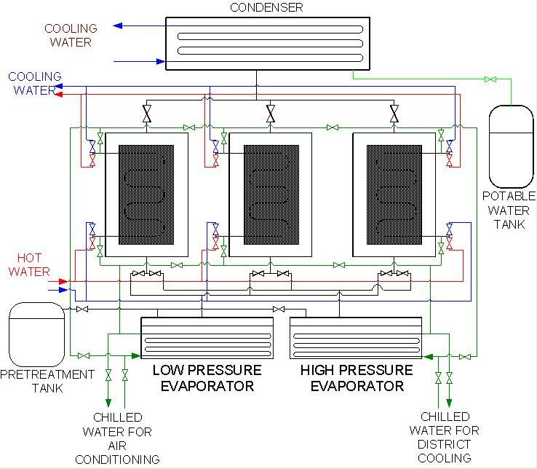
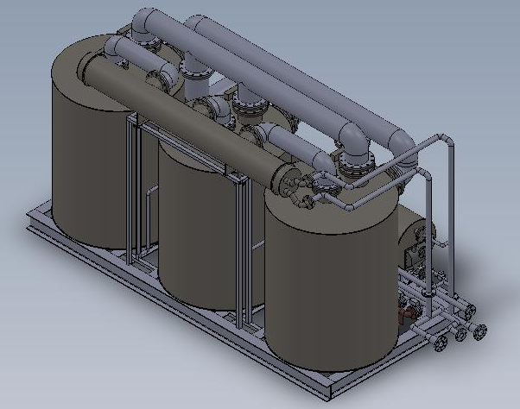
Paths to power & energy savings
Waste heat recovery
Possibilities of heat rejection at higher temperature, e.g. beam dumps
Valorization of low-grade waste heat for concomitant needs, e.g. residential heating or absorption cooling
Three-bed, two evaporator adsorption chiller
(Wroclaw Technology Park)

Slide 22
Is waste heat worth recovering?
Consider heat rejection Q at temperature T with environment at T₀
What are the recovery options?
  use as such
    Is there a concomitant need for heat Q at T=T_{use}?
  use as heat at higher temperature T_{use}>T
    Minimum work required for heat pump W_{min} = Q (T_{use}/T – 1)
    Example: for raising waste heat from 40 °C to 80 °C, W_{min} = 0.13 Q
    In practice, W_{real} may be 2 to 3 times higher
    May still be an interesting option
  use to produce work
    Maximum work produced (Carnot machine) W_{max} = Q (1 – T₀/T)
    This can also be written W_{max} = Q – T₀ ΔS = Exergy
    Example: with T = 40 °C and T₀ = 15 °C, W_{max} = 0.08 Q
    In practice, W_{real} is only a fraction of this
    Very inefficient unless one operates at higher T
⇒ Investigate all options, using both energy and exergy as f.o.m.

Slide 23
Energy & exergy in CLIC magnet systems
T cooling water = 40 °C
100 drawn from network produces only 82.9 used in magnet
Waste heat in water contains 84.3% of consumed energy, but only 6.7% of consumed exergy: waste heat recovery is therefore interesting for final use as heat, not as source of electrical/mechanical energy
Exergy economy should target improvement of electrical efficiency upstream the magnets, rather than waste heat recovery

Slide 24
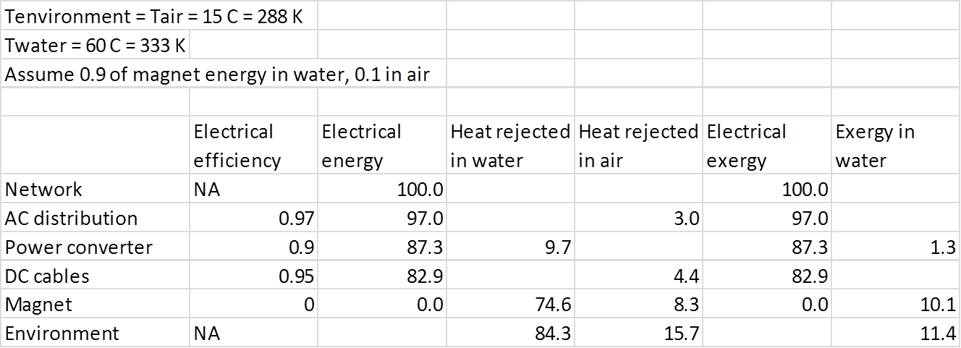
Energy & exergy in CLIC magnet systems
T cooling water = 60 °C
Increasing cooling water temperature to 60 °C raises its exergy content to 11.4%

Slide 25
Energy & exergy in CLIC RF systems
T cooling water = 40 °C
100 drawn from network produces only 53.8 in PETS, 43.7 in AS, of which 10.9 goes into the main beam
Waste heat in water contains 92.6% of consumed energy, but only 7.4% of consumed exergy: waste heat should rather be valorized as heat
Exergy economy should target improvement of electrical efficiency upstream the magnets, rather than waste heat recovery

Slide 26
Energy & exergy in CLIC RF systems
T cooling water = 40 °C & 80 °C (klystrons & b. dumps)
Increasing klystron and beam dump cooling water temperature to 80 °C raises its exergy content to 8.4%, i.e. 12.1% in total (water1 and water2)

Slide 27
Conclusions
Power consumption of CLIC and other large accelerator projects at the energy frontier has become a major issue in their technical feasibility, economic affordability and social acceptance
Power and energy savings are therefore essential aspects of the study of such machines from the conceptual design phase
Paths towards this goal must combine sobriety, efficiency, optimal energy management and waste heat recovery and valorisation
Exergy content of CLIC waste heat remains low at acceptable recovery temperatures
  Conversion to mechanical work is inefficient
  Use for heating/cooling may be economical, provided one finds concomitant needs

