Slide 1
Overview CMD-3 results at
e+e- collider VEPP-2000
Fedotovich G.V.
On behalf of CMD-3 collaboration
Budker Institute of Nuclear Physics
Novosibirsk State University
phipsi15,
USTC, Hefei, China
23 – 26 September
1

Slide 2

Outline
Motivation
Collider and detector
Experiment
Recent results:
  Processes with pions
  Processes with kaons
  Processes with pions & kaons
  Other processes
Perspectives and plans
Conclusion

Slide 3

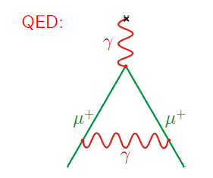
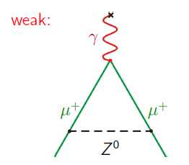
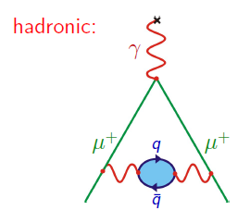
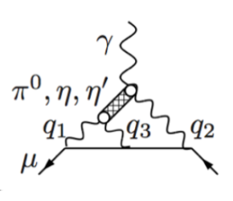
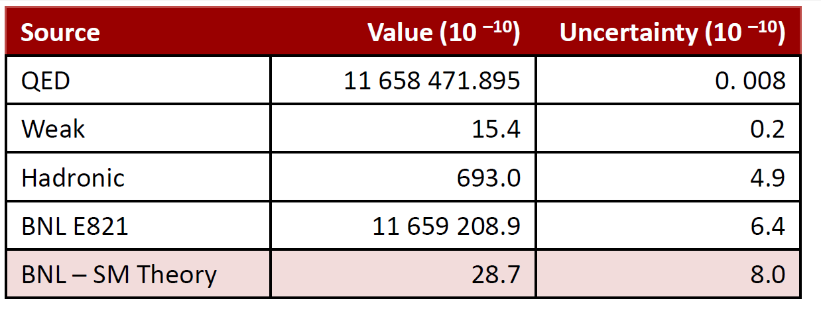
Motivation
Muon anomaly, a_{m} = (g-2)_{m}/2
QED
WEAK
HADRONIC
LbL
(M. Davier et al., EPJC71(2011)1515)
Experimental input is needed! Major contribution to (g-2)/2 coming from VEPP-2000 energy range gives 92% and determine it’s uncertainty

Slide 4
VEPP-2000 collider (2010-2013)
ILU
CMD-3
3 MeV
Linac
B-3M
VEPP-2000
250 MeV
BEP
synchro-
e⁺,e⁻
betatron
booster
825-1000 MeV
SND
e⁻ → e⁺
converter
Maximum c.m. energy is 2 GeV, project luminosity is L = 10³² 1/cm²s at √s = 2 GeV
Unique optics with used “round beams”, allows to reach higher luminosity
Experiments with two detectors, CMD-3 and SND, started by the end of 2010
4

Slide 5
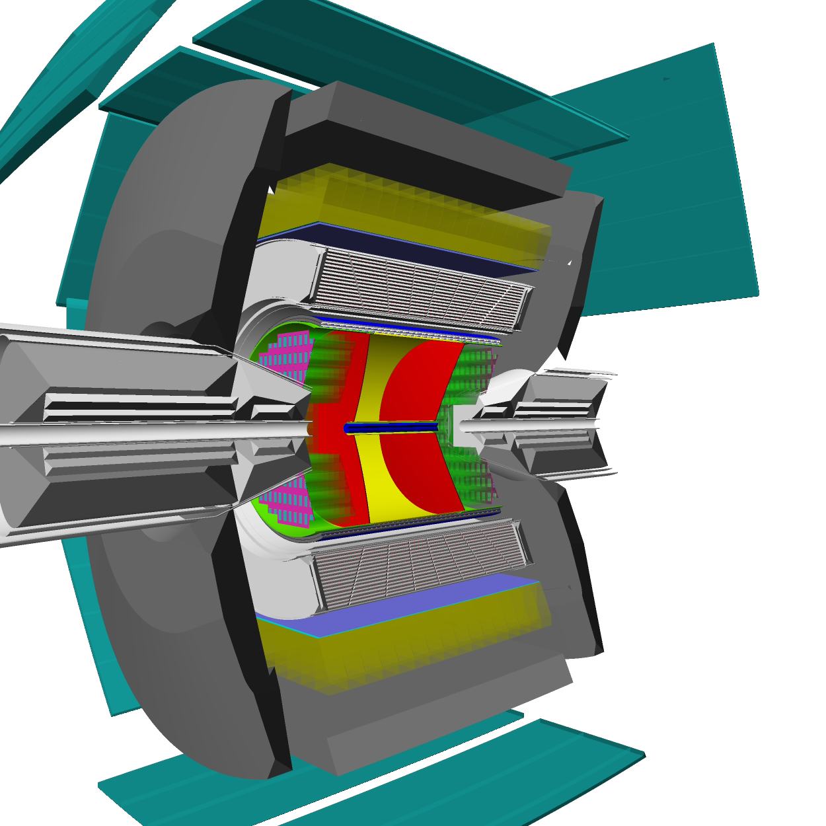
3D view CMD-3 detector
DC – 1218 hexagonal cells with sensitive
wires, W-Re alloy, 15 μ in diameter, spatial resolution ∼ 100μ.
Z-chamber – start FLT, precise determine
z-coordinate ~ 500 μ (detector acceptance)
LXe calorimeter thickness 5,1X₀, 196 towers & 1286 strips. Spatial resolution 1 – 2 mm, measurement of conversion point for g’s measurement of shower profile
TOF – 16 counters, time resolution ~ 1ns
Calorimeter with CsI crystals (∼3,5 t), 8 octants, number of crystals - 1152, 8 X₀.
MR system – 8 octants (cosmic veto, ~ 1ns ) particle id (mainly p, n)
Project magnetic field - 1,5 T
(current value 1.3 T while)

Slide 6
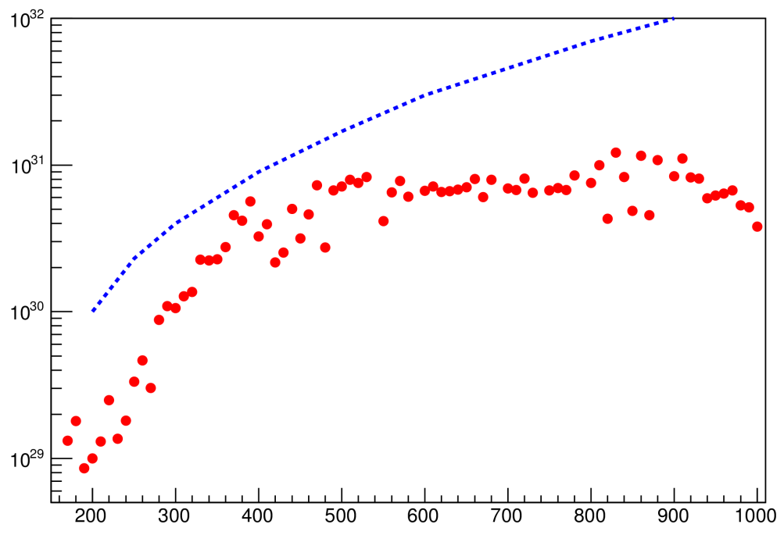
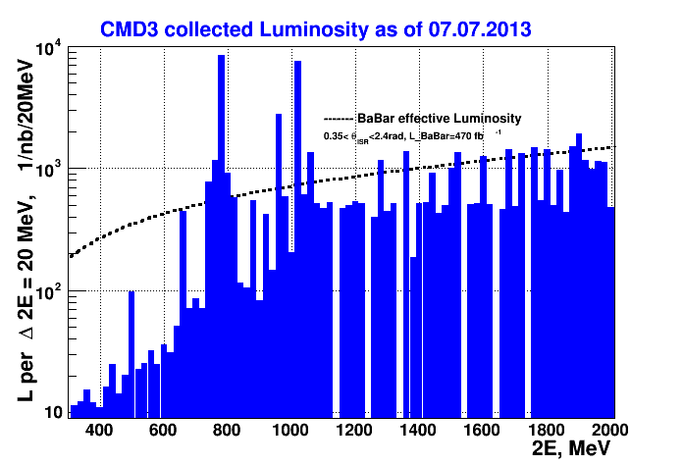
Collected luminosity
CMD-3 data, average per run
Beam-beam limit, peak L
Luminosity, 1/cm²s
Limited e⁺ production
Energy ramping
Beam energy, 2E, MeV
Today the peak luminosity is limited by a deficit of positrons (650 MeV) and limited energy of the booster (from 825 MeV).
After upgrade (ongoing) we expect increasing of luminosity by a factor of 10 at maximum beam energy.
Collected L ~ 60 pb⁻¹ per detector
8.3 pb⁻¹ ω-region
9.4 pb⁻¹ region below 1 GeV ( except ω)
8.4 pb⁻¹ ϕ-region
34.5 pb⁻¹ region higher than ϕ
PHOTON 2015 conference Recent results from VEPP-2000
6

Slide 7
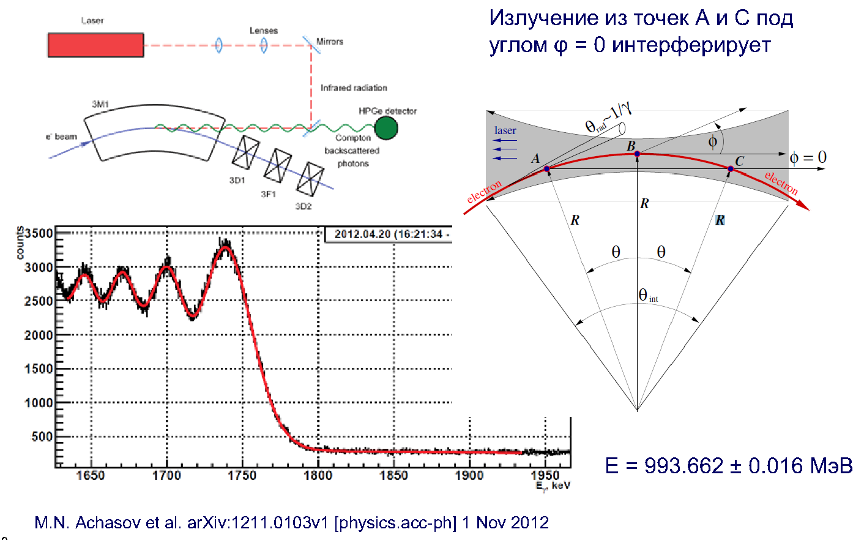
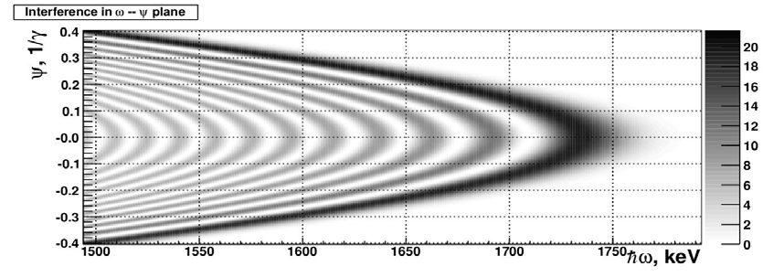
Energy measurement
Starting from 2012, energy is monitored continuously using compton backscattering techneques
Radiation coming from A and C points
under angle ϕ = 0 is interference
E.V. Abakumova et al., Phys. Rev. Lett. 110 (2013) 14, 140402,
E.V. Abakumova et al.,Nucl.Instrum.Meth. A744 (2014) 35-40
7

Slide 8
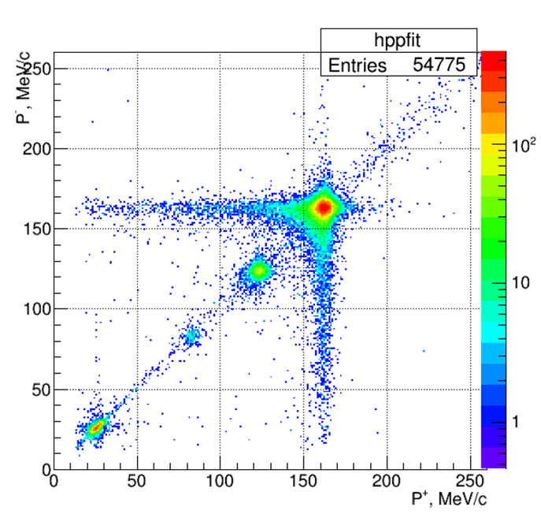
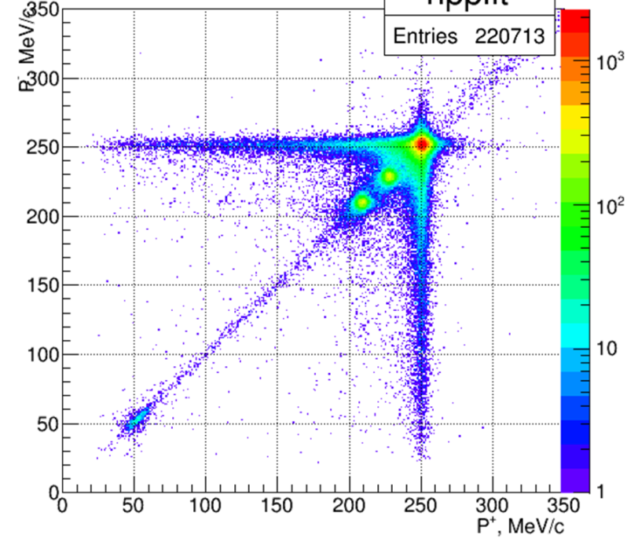
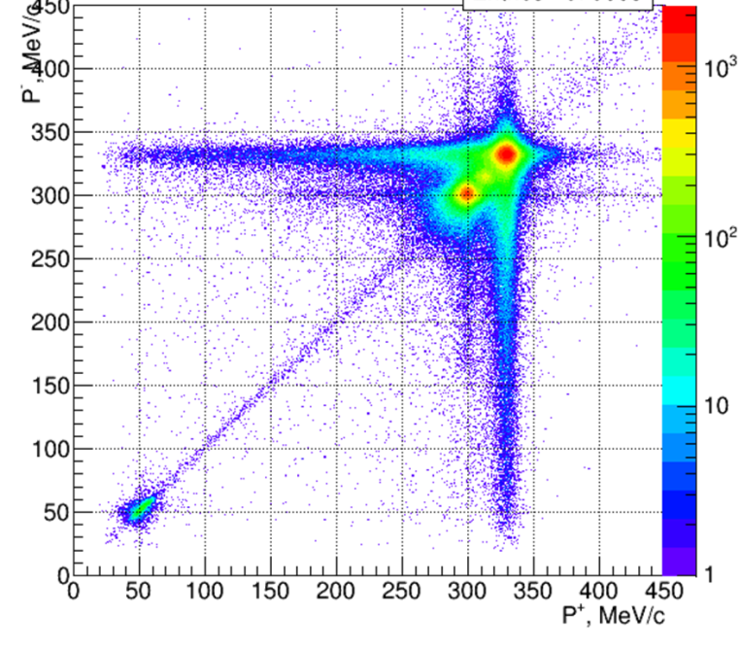
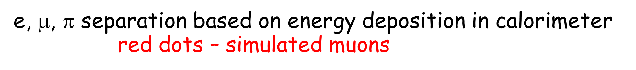
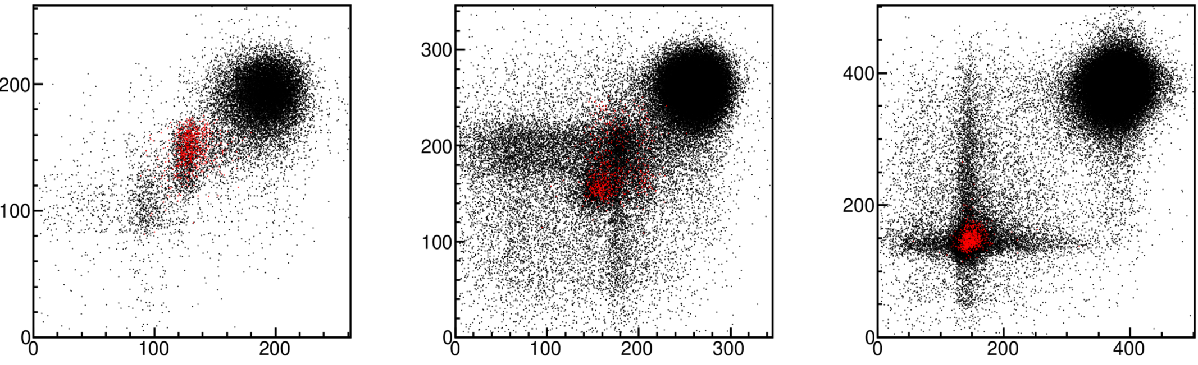


Luminosity determination (e+e- & γγ)
π, μ
e
e
μ
cosmic
π
Cosmic
e
e
π, μ
π, μ & cosmic
Cosmic and μ, π clusters begin to overlap with energy
8

Slide 9
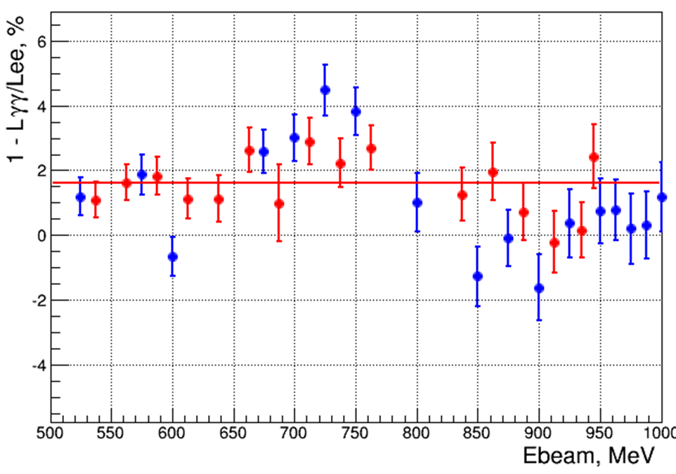
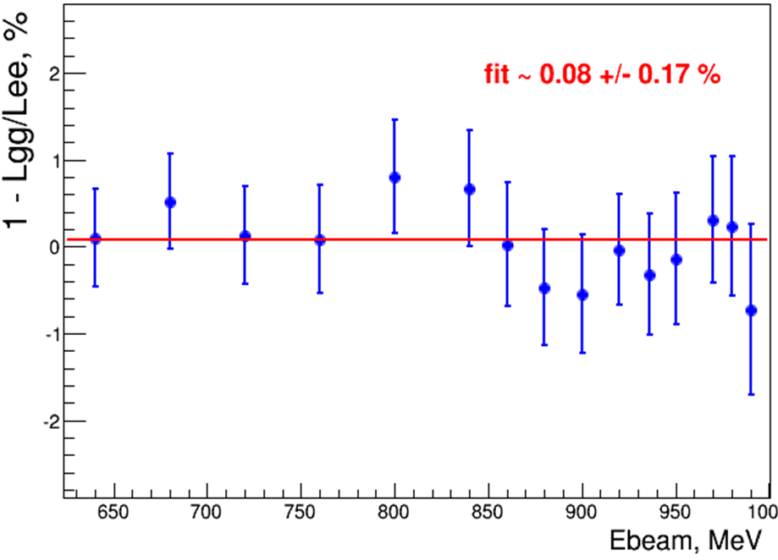
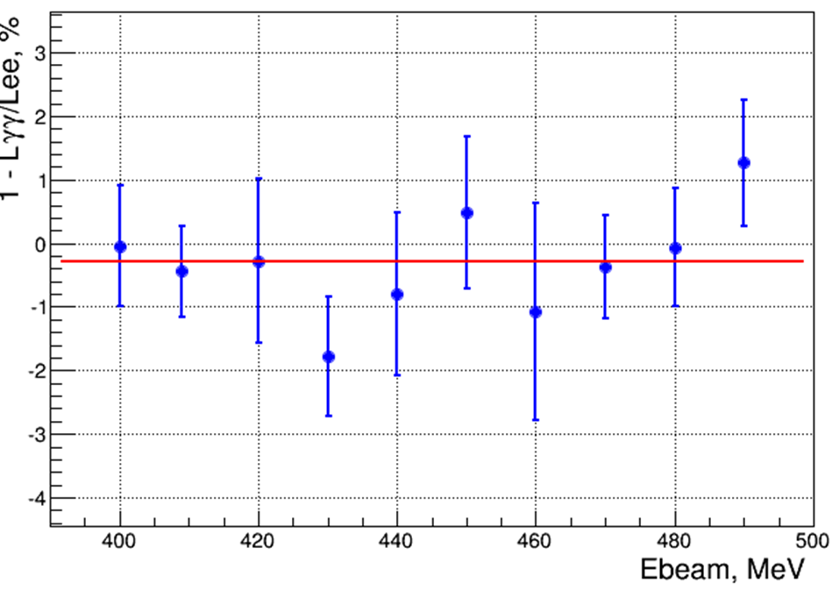
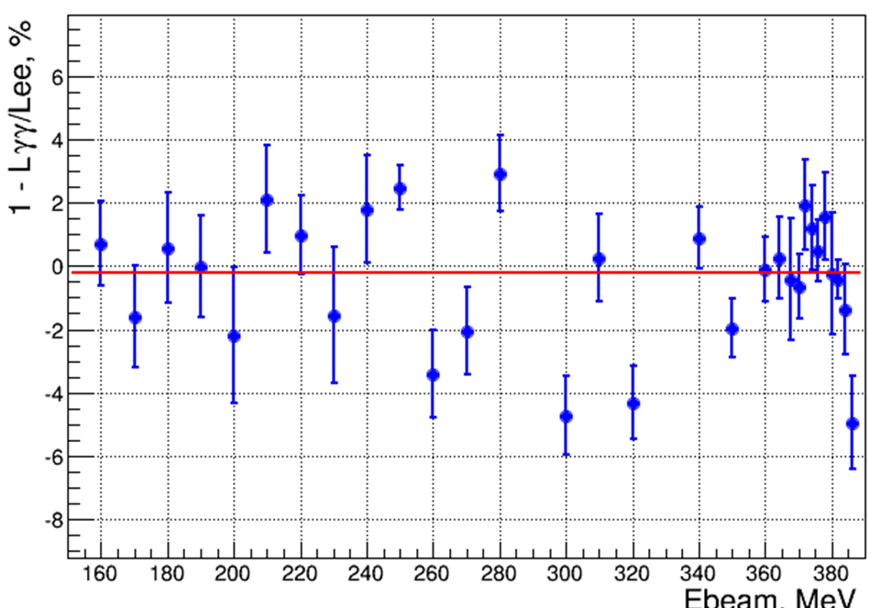
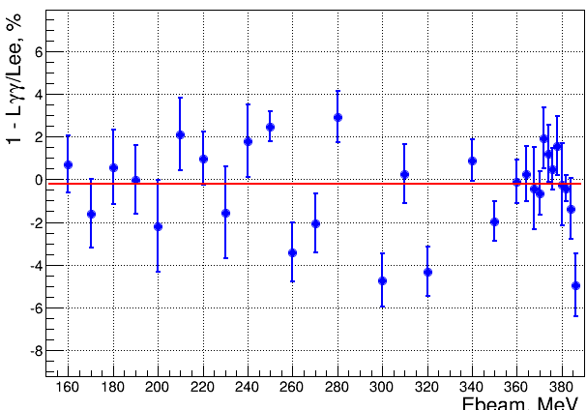
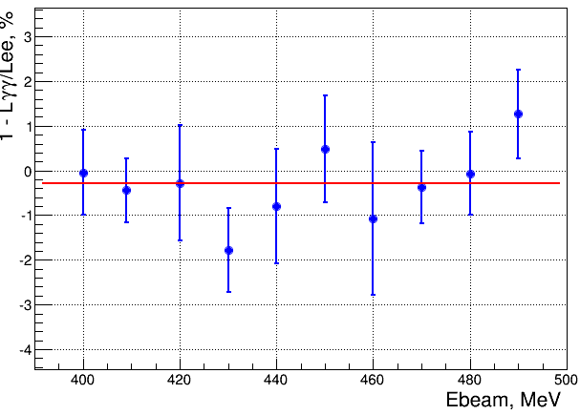
Luminosity determination
Fit: (2 ± 1)%
Fit: (0.1 ± 0.2)%
Scan up & down, 2011
Scan up, 2012
Preliminary
Fit: (-0.3 ± 0.3)%
Fit: (-0.2 ± 0.2)%
ϕ→ω scan, 2013
Low energy scan, 2013
9

Slide 10
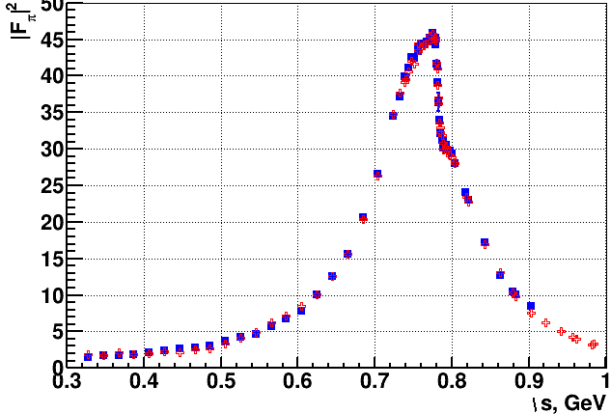
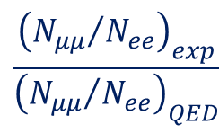
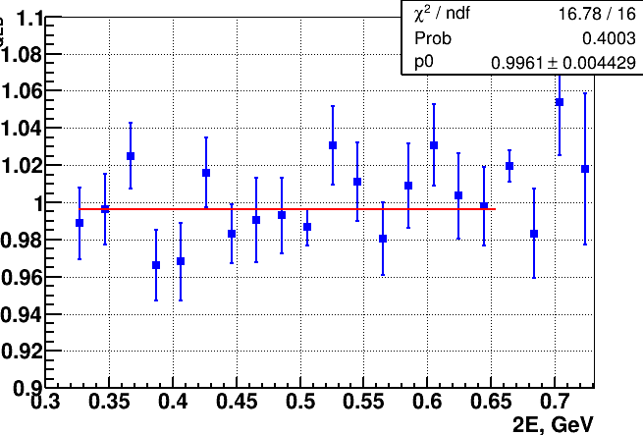
e⁺e⁻ → π⁺π⁻ preliminary
2013 data (9.4 pb⁻¹)
2013 data
2013 data
by momentum
Preliminary
PRELIMINARY
Work in progress
Fit: (-0.4 ± 0.5)%
Only statistical errors are shown
Work in progress
Work in progress
by energy deposition
by energy deposition
by energy deposition
by momentum
Analysis of this process will be presented in detail by F. Ignatov.
You are welcome
10

Slide 11
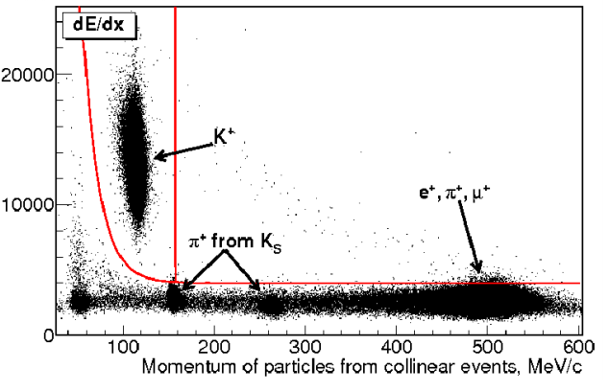
Study of the process e⁺e⁻ → K⁺K⁻
The process e+e- → K⁺K⁻ has been study at energies around ϕ meson mass. Events selection is based on information about average energy losses dE/dx in DC and the average momentum of pair tracks
In E_{cm} = 1004 – 1060 MeV:
25 energy points
Luminosity integral 5.9 pb⁻¹

Slide 12
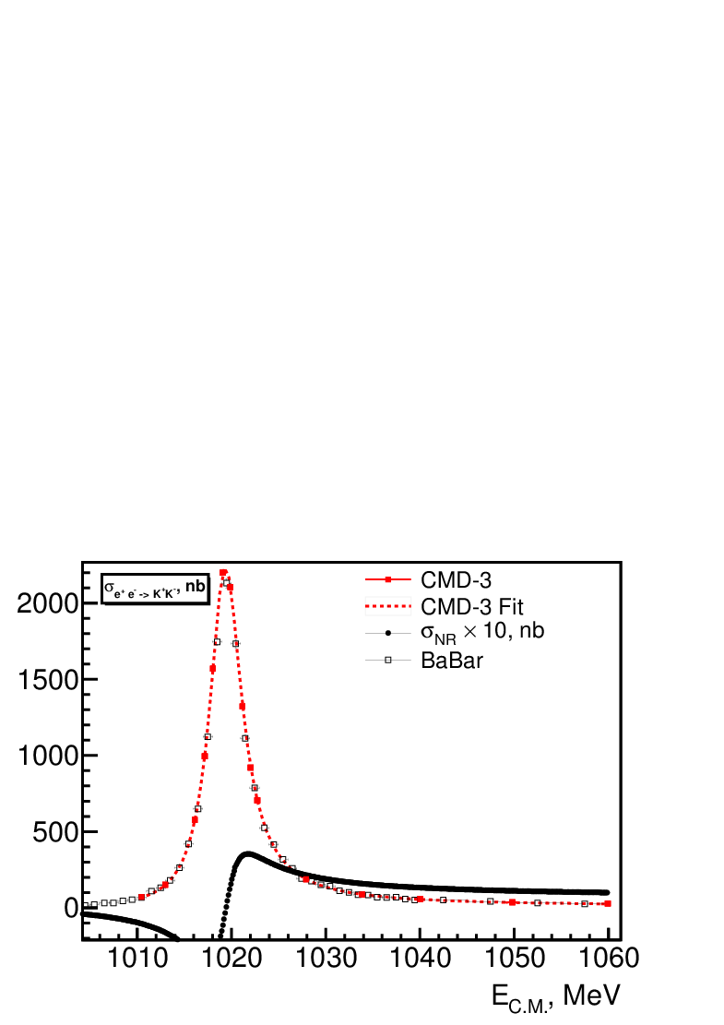
e⁺e⁻ → K⁺K⁻
Preliminary
Δσ_{nr} = 10×[σ(fit) - σ(ϕ)], nb
Interference between ϕ with
mainly ω & ρ resonances
The measured cross section of the process e+e- → K⁺K⁻ together with the results from CMD-2 and BaBar is shown near φ-meson mass energy. The systematic error is of about 2.5%
Analysis of this process will be presented in detail on poster session by E. Kozyrev. You are welcome

Slide 13
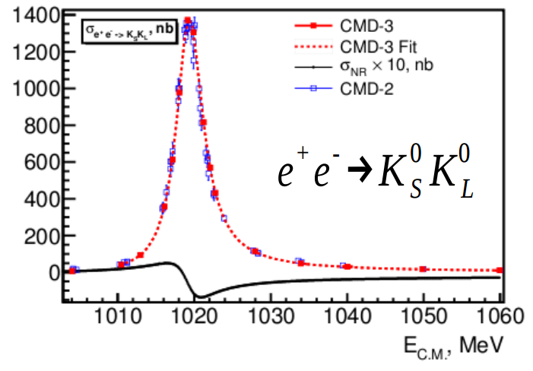
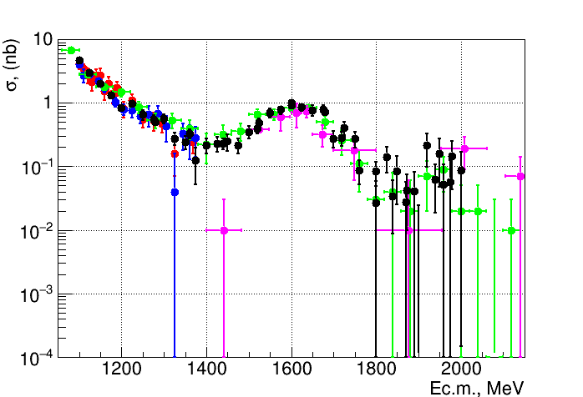
e⁺e⁻ → K_{L}K_{S}
This process is studied using decay K_{s}→π⁺π⁻
In E_{cm} = 1004 – 1060 MeV:
25 energy points
Luminosity integral 5.9 pb⁻¹
Systematic error is 2 – 3 %
Δσ_{nr} = 10×[σ(fit) - σ(ϕ)], nb
Δσ_{nr} = 10×[σ(fit) - σ(ϕ)], nb
Good agreement with all previous results
In E_{cm} = 1100 – 2000 MeV:
54 energy points
Luminosity integral 32.1 pb⁻¹
1889 events with fully
reconstructed K_{S} → π+π−
CMD-3 (Preliminary)
CMD-2
SND
BaBar
DM1

Slide 14
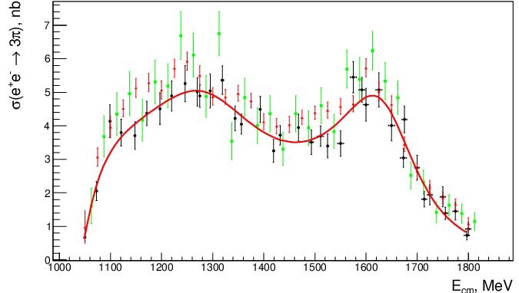
Cross section of the e⁺e⁻ → π⁺π⁻π°
Black points - CMD-3 data (run 2011 & 2012)
Green points – BaBar data
Red points – SND data
Analysis is based on integrated luminosity ∼ 23 pb-1
Cross section was measured at 38 energy points
Preliminary
Current systematic error ∼ 3%
Red fit – sum of amplitudes: ω, ϕ, ω’, ω’’
PHOTON 2015 conference Recent results from VEPP-2000
14

Slide 15
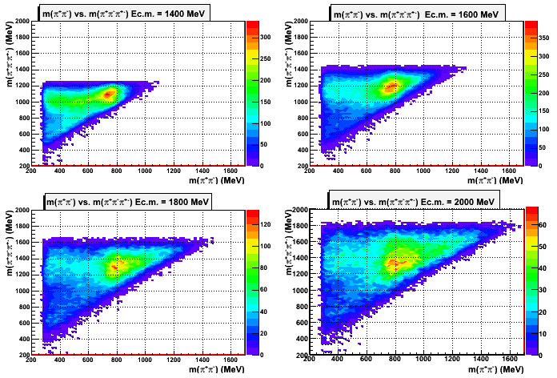
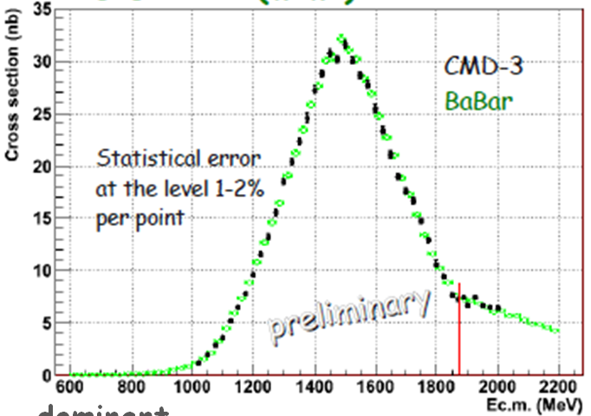
Dynamics of e⁺e⁻ → 2π⁺2π⁻ & cross section
a₁(1260)
a₁(1260)
a₁(1260)
ρ(770)
ρ(770)
ρ(770)
a₁(1260)
ρ(770)
A ρ⁰ is always present, a₁(1260)π and a₂(1320)π are significant
15

Slide 16
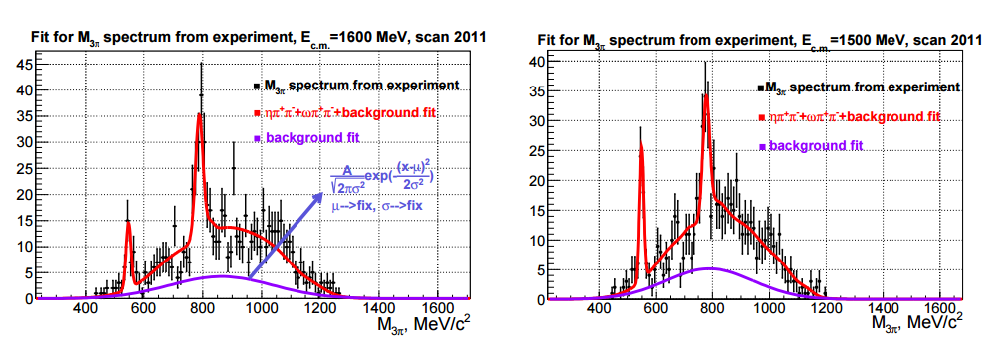
e⁺e⁻ → 5π
Study 2(π⁺π⁻)π⁰ final state in intermediate ηππ and ωππ production
e⁺e⁻ → ηπ⁺π⁻→2(π⁺π⁻)π⁰
e⁺e⁻ → ωπ⁺π⁻→2(π⁺π⁻)π⁰
Preliminary
Preliminary

Slide 17
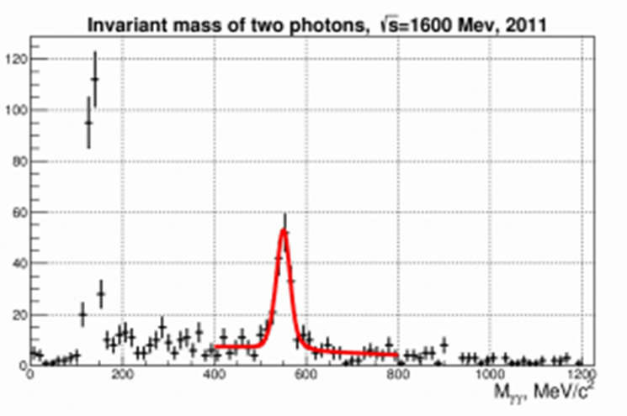
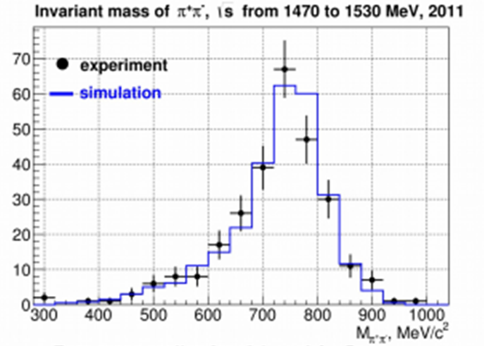
e⁺e⁻ → ηπ⁺π⁻ (η→γγ)
m(γγ)
Preliminary
m(ππ)
Cross sections are in agreement for both decay mode η→π⁺π⁻π⁰ and γγ
ηρ intermediate state dominates.
Analysis of this process will be presented on poster session in detail by A.Popov. You are welcome.

Slide 18
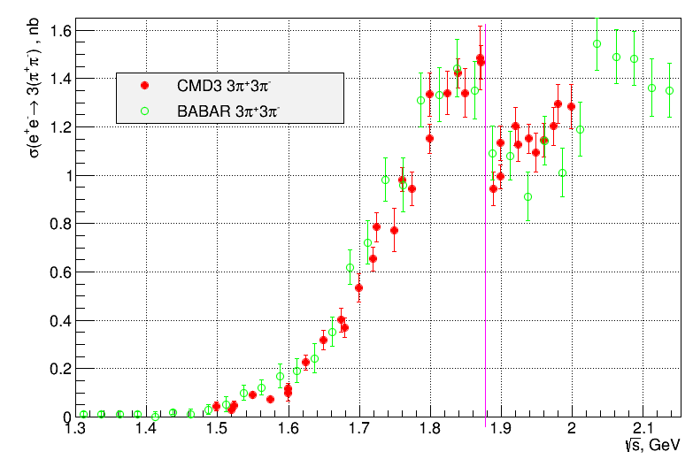
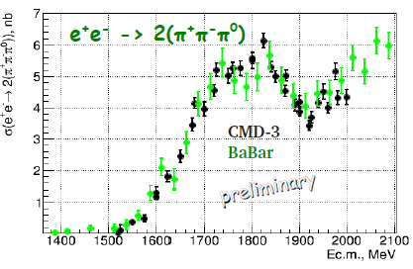
e⁺e⁻ → 6π
nn threshold
Systematic error is 6%, main source is model dependence. High statistics will help to reduce this error.
Preliminary studies of dynamics:
Main production mode: (phase space or f₀(1370));
Hint of energy dependent dynamics in 1.7-1.9 GeV energy range;
3π⁺3π⁻: The dip structure near nn threshold is confirmed; Phys.Lett. B723(2013)82
18

Slide 19
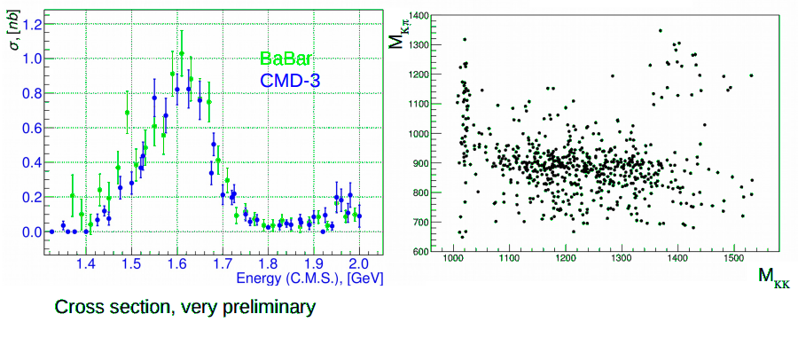
e⁺e⁻ → K⁺K⁻π°
φ(1020)
Preliminary
K*(892)
Cross section vs energy
It is consistent with BaBar
but more precise
The plot Kπ vs K+K- clearly shows
the ϕπ° and K*(892)K mechanism

Slide 20
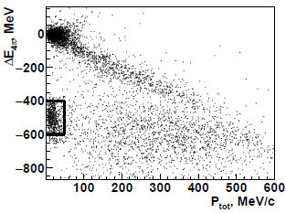
e⁺e⁻ → K⁺K⁻π⁺π⁻
Preliminary
ΔΕ=Ε_{π} + Ε_{π} + Ε_{π}+ Ε_{π} - 2E_{beam}
ΔΡ= | + + + |
CMD-3 studies uses 22 pb⁻¹ between 1.5 and 2 GeV, more than 20000 events with 3 and 4 tracks were selected for analys;
Ionisation losses in DC dE/dx provide good K/π separation;
Analysis of π⁺π⁻, K±π∓, K⁺K⁻ invariant masses shows clear signals from ρ⁰, K^{*0}(892), ϕ;
Many different mechanisms seen:K₁(1270)K→KρK, K*(892)Kπ,
K₁(1400)K → K*(892)Kπ, ϕπ⁺π⁻.
20

Slide 21
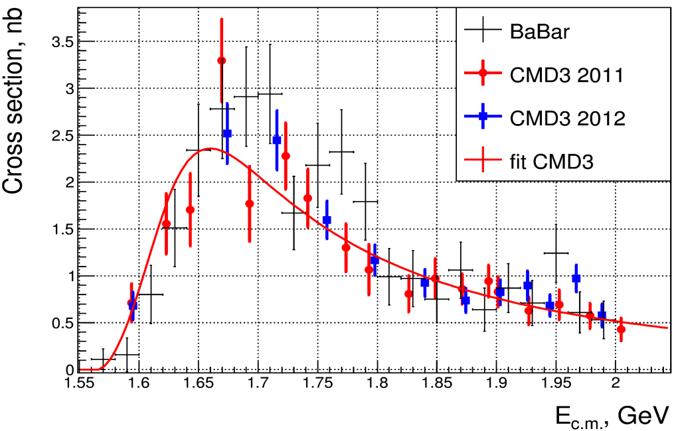
e⁺e⁻ → K⁺K⁻η
A data sample of 22 pb⁻¹ collected in
2011-2012 is used to study e⁺e⁻ → K⁺K⁻η;
XS was measured at 23 energy points
between 1.57 - 2.0 GeV;
Analysis empasizes the dominant ϕη signal,
studies of nonresonant K⁺K⁻η needed;
Background with numerous components seen;
The data sample includes 1600 events of the
signal and about 600 background events;
XS e⁺e⁻ → K⁺K⁻η
BaBar
CMD-3
Preliminary
Analysis of this process will be presented on poster session in detail
by S. Ivanov. You are welcome.
21

Slide 22
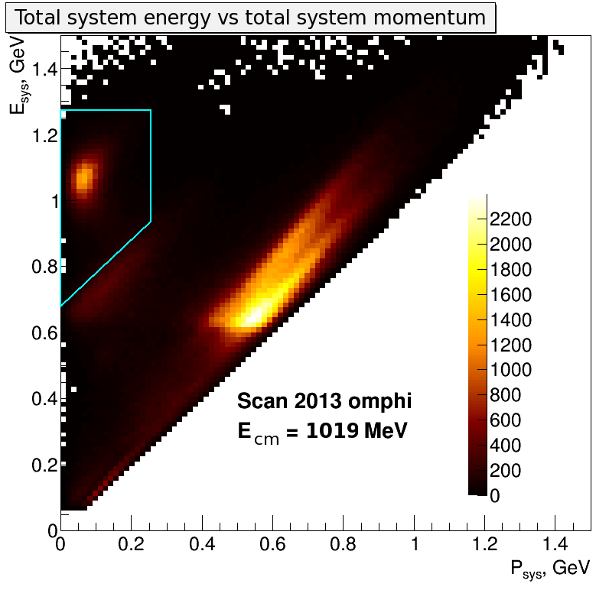
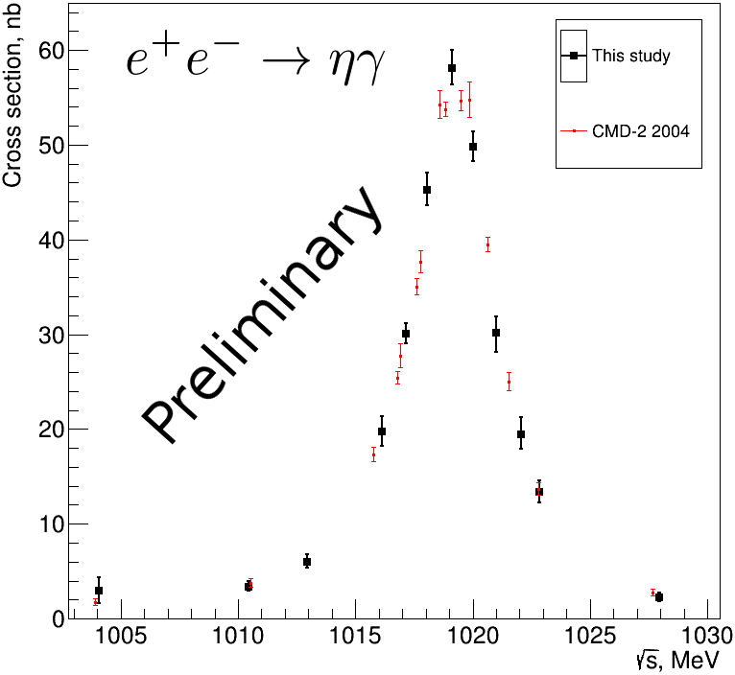
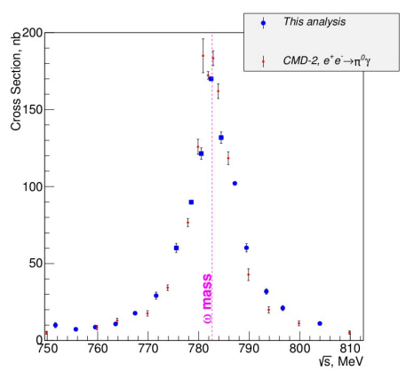
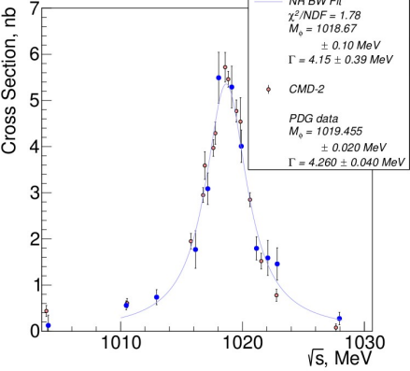
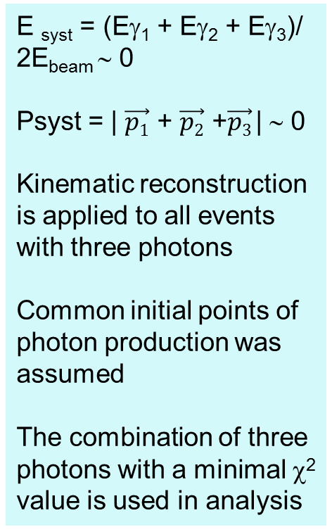
e⁺e⁻ → π⁰γ,ηγ → 3γ
Process are under study in CMS energy range 750-1030 MeV. Data collected in 2013
Main physics background is two gamma annihilation with one radiated photon
E _{syst} = (Eγ₁ + Eγ₂ + Eγ₃)/ 2E_{beam} ∼ 0
Psyst = | $\vec{p1}$ + $\vec{p2}$ +$\vec{p3}$| ∼ 0
Kinematic reconstruction is applied to all events with three photons
Common initial points of photon production was assumed
The combination of three photons with a minimal χ² value is used in analysis
1
Preliminary
Φ → ηγ
Φ → π⁰γ
ω → π⁰γ
Preliminary
Preliminary
Preliminary

Slide 23
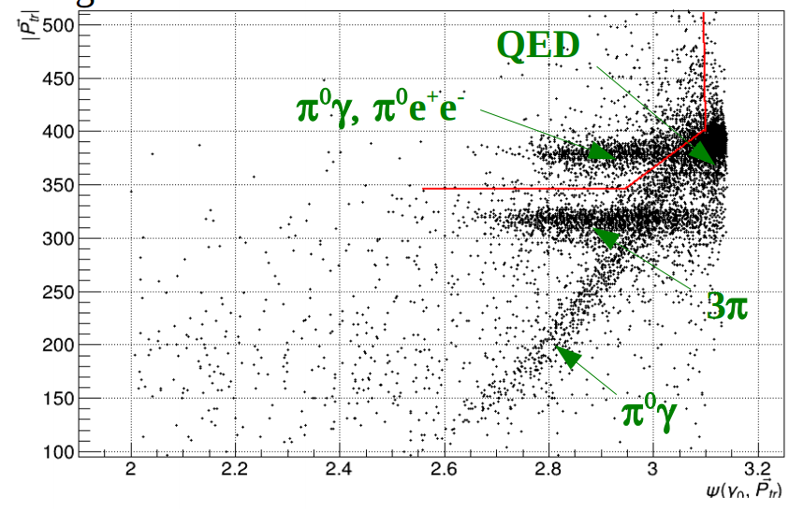
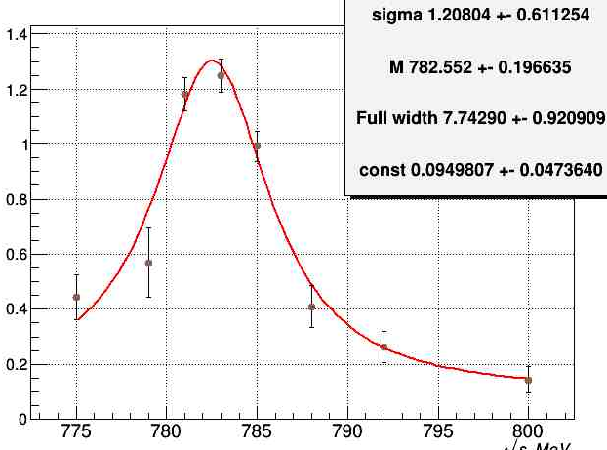
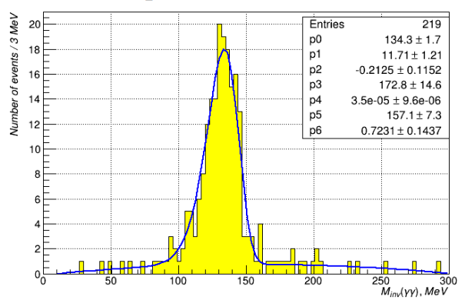
e⁺e⁻ → ω → π⁰e⁺e⁻
The total momentum of charged particles |P_{tr}| vs angle between the most energetic photon direction. Red line presents the selection criteria
|P_{tr}|
ψ(γ₀,P_{tr})
Events/3 MeV
Preliminary
m(γγ) MeV
The analysis is still in progress. Our statistics is enough to decrease statistical error twice with
respect to the previous CMD-2 result. Additionally with better detector performance we hope to reach the most precise result also for the ηee channel.

Slide 24
Conclusion and nearest perspective
VEPP-2000 collider successfully operated at √s = 2m_{π} - 2 GeV with L_{max} = 2x10³¹ cm⁻²s⁻¹ and collected about 60 pb⁻¹ per detector.
CMD-3 detector has good enough performance and monitoring of different detector subsystems.
Cross sections measured have the same or better statistical precision with respect to previous CMD-2 experiments.
CMD-3 results will provide high accuracy, compatible or better than ISR measurements, the tentative goals are 0.3% (0.5%) for π⁺π⁻ and ~3% for multibody modes.
VEPP-2000 upgrade is underway with new positron injection facility, which will increase luminosity at least by factor of 10.
We start analysis of the multihadron processes with Ks in final states: K_{S}K±π±, K*±K⁻⁺ → K_{S}π±K⁻⁺, K*±K*⁻⁺ → K_{S}π±K_{L}π⁻⁺ and so on
Various studies of transition form factors are in progress:
e⁺e⁻ →π⁰γ, ηγ, π⁰e⁺e⁻, ηe⁺e⁻.
We plan to get data with integrated luminosity of about 1-2 fb⁻¹ in 5 – 10 years, which should provide new precise results on multihadron production. We hope that stars on the sky will be favorable for us.

Slide 25
Back slides

Slide 26
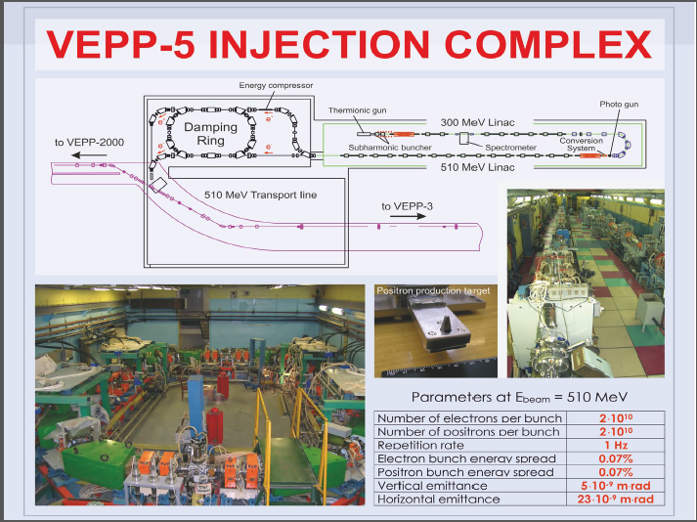
Plans and perspectives

Slide 27
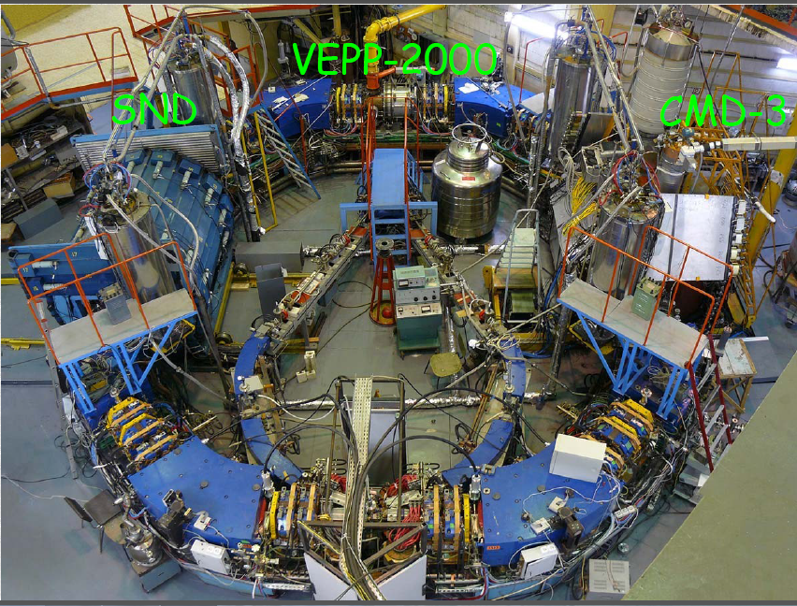
VEPP-2000 experimental area

Slide 28
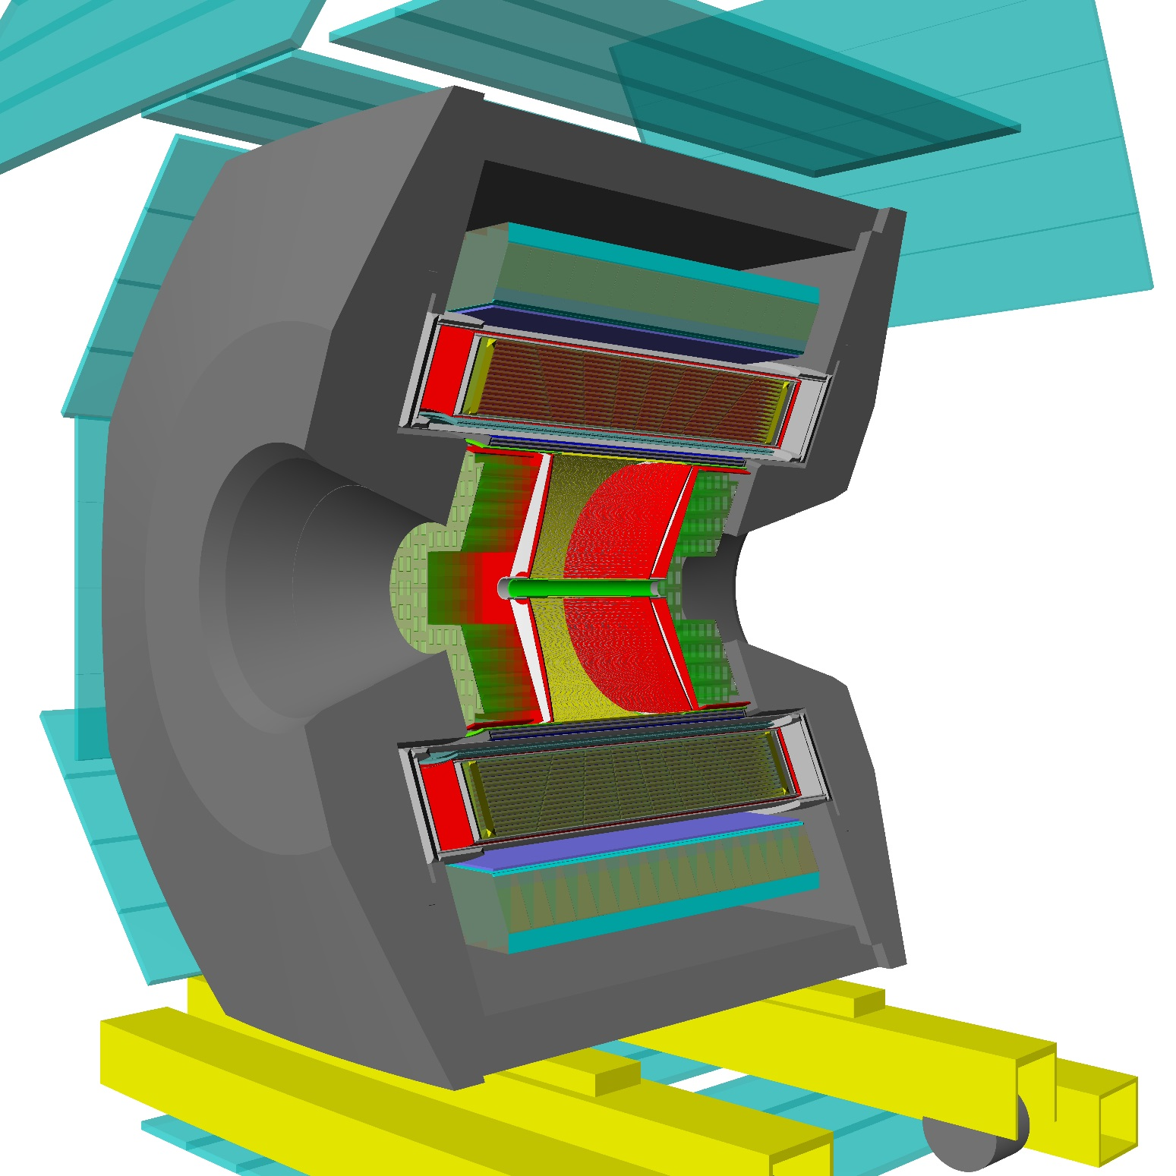
PHOTON 2015 conference Recent results from VEPP-2000
28

Slide 29



Dynamics of the process e⁺e⁻ →π⁺π⁻π⁰π⁰
a₁(1260)
ρ(770)
ρ(770)
f₀(500)
ρ(770)
ρ(770)

Slide 30


Slide 31

e⁺e⁻ → π⁺π⁻ statistics and systematics
Main sources of systematics:
e/μ/π separation – 0.2%
multiple ways to get detector response from data itself
fiducial volume – 0.1%
independent systems, which
can be used to determine fiducial volume
beam energy – 0.1%
constant monitoring with Compton backscattering
radiative corrections – 0.1%
proof from data
Many systematic studies will be rely on high statistics
Expected statistical error for 2013 data
8.3 pb⁻¹ ω-region
9.4 pb⁻¹ region below 1 GeV
( except ω)
31

Slide 32


Search for e⁺e⁻ → η'(958)
C-even resonances can be produced via
Theory: assuming real γ, Br(η→e⁺e⁻) = 3,7×10⁻¹¹. Virtuality and transition form factor can enhance it.
No events found
Special physical run was done dedicated to search eta’,
Analysis is based on integrated luminosity of about 2.69 pb⁻¹
at √s ~ M_{η'} look for e⁺e⁻ → η'(958),
CMD-3: η'→ ηπ⁺π⁻, η → 2γ
Γ(η’ → e⁺e⁻) < 0.0024 eV at 90%CL, Phys. Lett. B740 (2015) 273;
SND: η'→ ηπ⁰π⁰, η → 2γ, 3π⁰, π⁺π⁻π⁰,
Γ(η'→ e⁺e⁻) < 0.0020 eV at 90% CL, Phys. Rev. D 91, 092010;
Combine SND data with CMD-3:
Γ(η‘ → e⁺e⁻) < 0.0011 eV at 90% CL,
Br(η'→ e⁺e⁻) < 5.6×10⁻⁹ at 90% CL.
32

Slide 33
Physics program
Precision measurement of R:
R = σ(e⁺e⁻ →hadrons)/σ(e+e- →μ⁺μ⁻)
exclusive approach, up to 1% for major modes;
Study of hadronic final states: e+e- → 2h, 3h, 4h, ...
where h = p, K, π;
Study of vector mesons and their excitations:
ρ', ρ'', ω', ϕ', ...;
Comparison of cross-sections e⁺e⁻ →hadrons (I = 1) with spectral
functions of τ-decays;
Study of nucleon electromagnetic formfactors at threshold
e⁺e⁻ → pp, n ;
Measurement of the cross-sections using ISR;
Study of the higher order QED processes.
Overall, we plan to collect ∼ 1fb⁻¹
_
_
n
33

