Slide 1
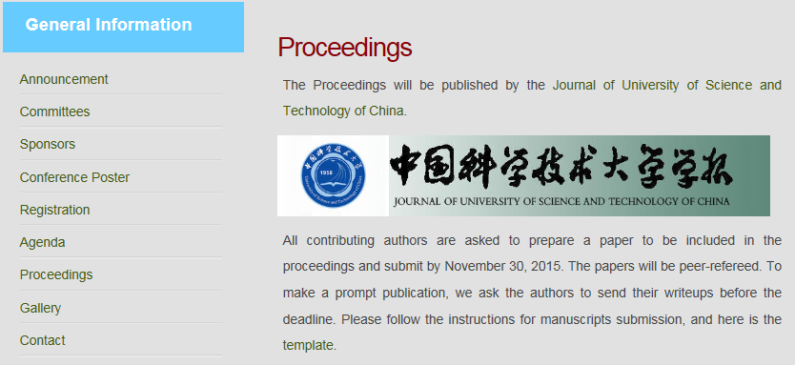
Proceedings
Will be published in paper by
the Journal of University of Science and Technology of China.
Each participant will receive a copy.
Deadline for proceedings: Nov.30, 2015.
http://pnp.ustc.edu.cn/phipsi2015/

