Slide 1
STATUS AND PROSPECTS OF E+E- COLLIDERS AT BINP
10th International Workshop on e+e- Collisions from ϕ to ψ
University of Science and Technology of China (USTC)
Hefei, Chine
September 23-26, 2015
Pavel Piminov
Budker Institute of Nuclear Physics
Novosibirsk, Russia

Slide 2
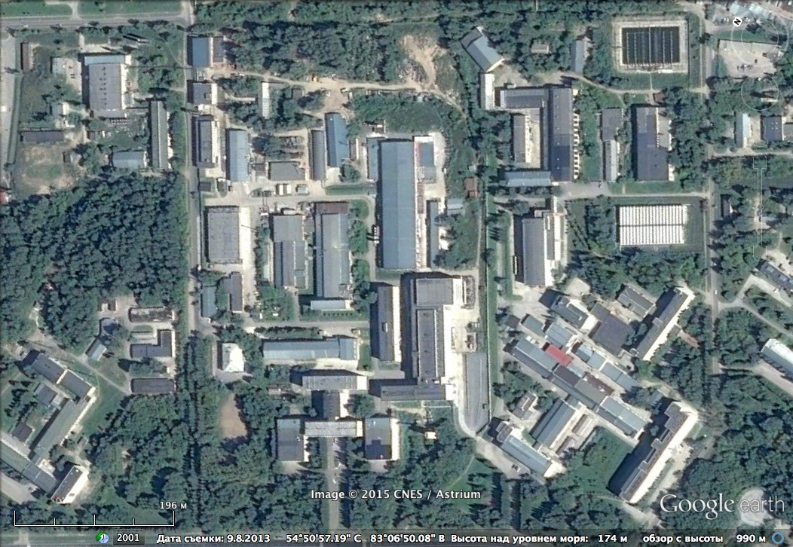
VEPP-4M
VEPP-3
Synchrotron Radiation
GOL-3 & GDT
VEPP-2000
No

Slide 3
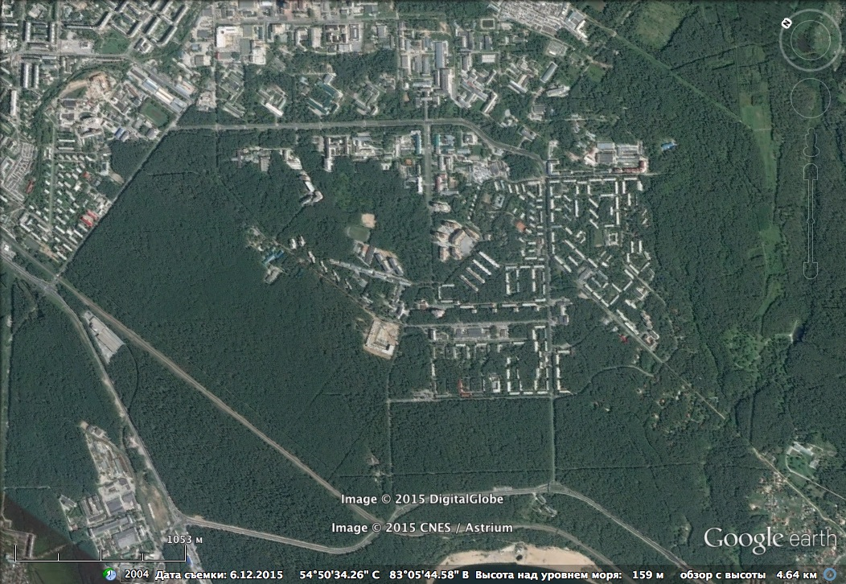
BINP MAIN SITE
ACCELERATOR MASS SPECTROMETER
FREE ELECTRON LASER
ELECTRON COOLING PRODUCTION
SUPERCONDUCTION WIGGLER PRODUCTION
MAGNETS, VACUUM SYSTEMS, RF SYSTEMS, POWER SUPPLY, DETECTORS, PLASMA COMPONENTS, INDUSTIAL ACCELERATORS, …
BINP WORKSHOP
No

Slide 4
PREVIOUS COLLIDERS
e⁻e⁻ VEP-1 (1964-1968) E=43÷160 MeV
e⁺e⁻ VEPP-2 (1965-1972) E=120÷670 MeV
e⁺e⁻ VEPP-2M (1974-2000) E=180-700 MeV
e⁺e⁻ VEPP-4 (1979-1985) E=1-5.5 GeV

Slide 5
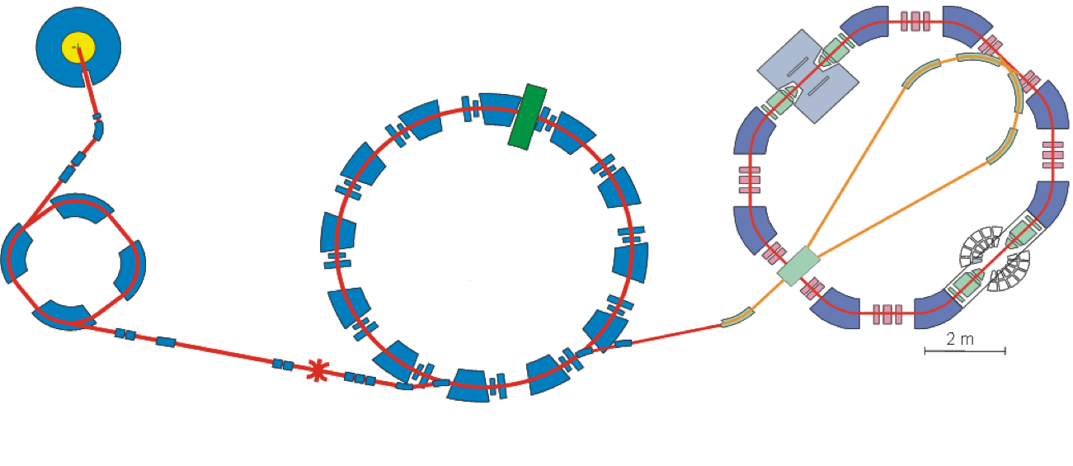
VEPP-2000
Since 2006, upgrade since 2013
E = 0.1 ÷ 1 GeV
Round Beams
Beam Energy Calibration
VEPP-2000
Linac ILU
2.5 MeV
CMD-3
Booster B-3M
250 MeV
Booster BEP
825 MeV
SND
e+ convertor

Slide 6
VEPP-2000 PARAMETERS
Energy | 0.1-1 | GeV
Circumference | 24.39 | m
Number of bunches | 1e+ x 1e-
Harmonic number | 14
Betatron tunes, h/v | 4.1/2.1
Natural chromaticity, h/v | -8.8/-5.8
Compaction factor | 0.036
Max luminosity | 1·10³² | cm⁻² s⁻¹
Bunch current | 25 | mA
Betas @ IP, h/v | 10/10 | cm
Coupling | 100%
Bunch length | 4 | cm

Slide 7
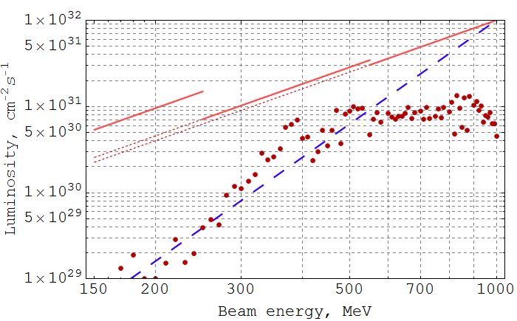
VEPP-2000 LUMINOSITY
http://indico.ihep.ac.cn/event/4464/timetable/#all.detailed
DA
Touschek
IBS
Beam-Beam
e+
L_{peak} = 2.5×10³¹cm⁻²s⁻¹ @ 900 MeV
L_{peak} = 1.2×10³¹cm⁻²s⁻¹ @ 510 MeV
Δν = 0.175 → ξ = 0.125/IP
L ~ E⁴
Ramping

Slide 8
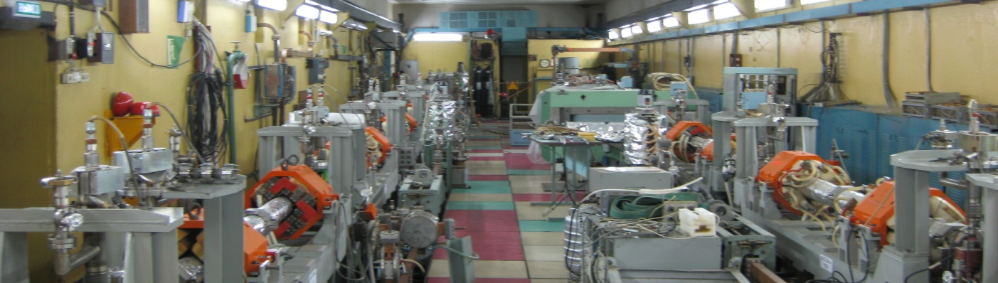
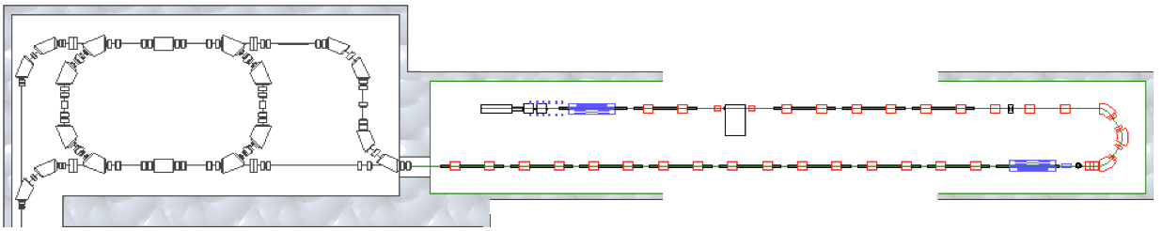
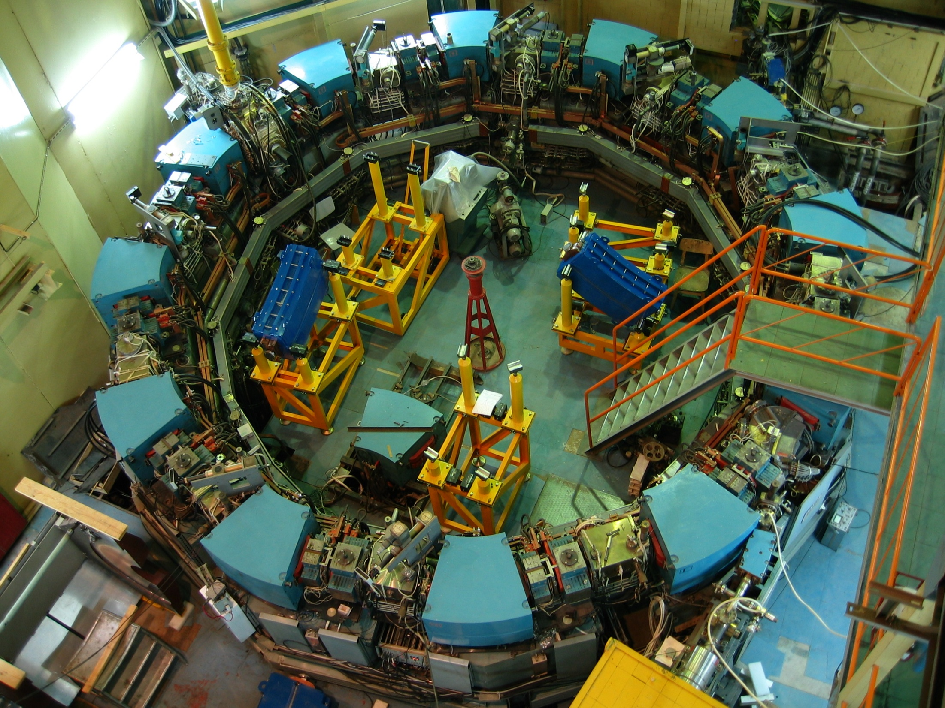
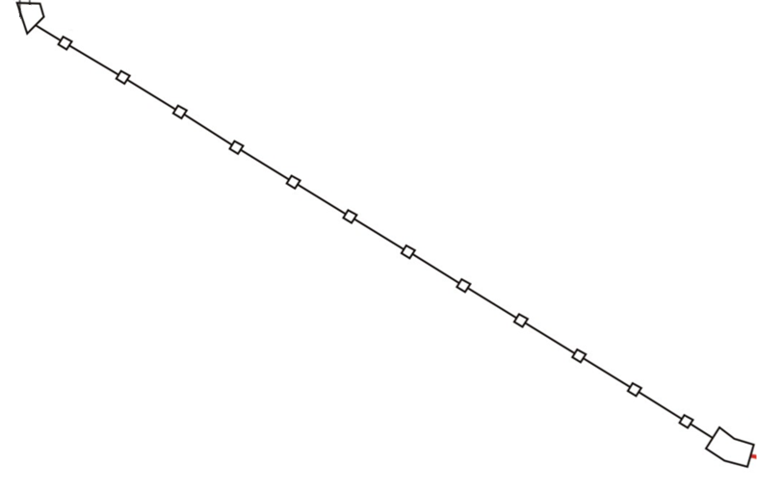
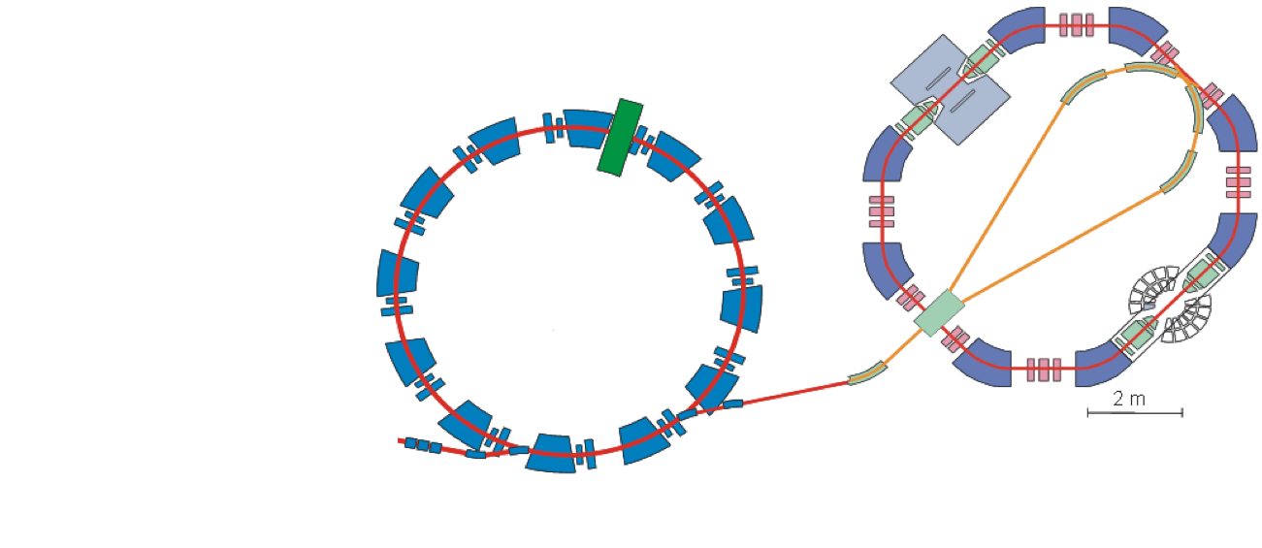
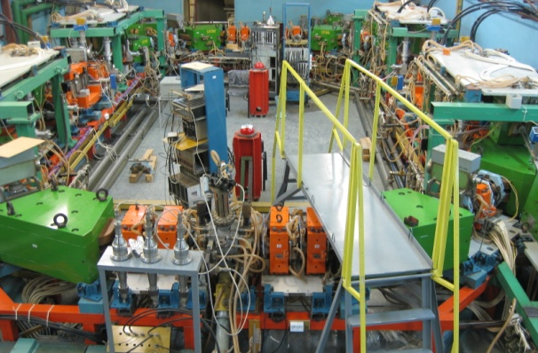
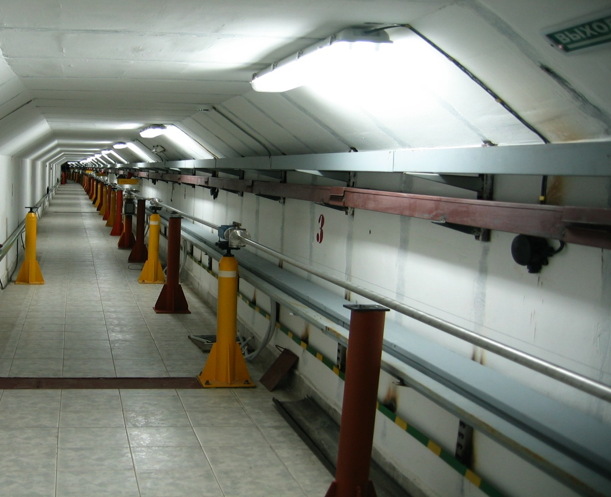
UPGRADE OF VEPP-2000
New e+e- Injector 510 MeV
e+
e- linac
Damping
Ring
e⁻ gun
e+ convertor
e-
e+ linac
VEPP-2000
New Transfer Channel
200 meters
510 MeV
CMD-3
Booster BEP
1 GeV
SND

Slide 9
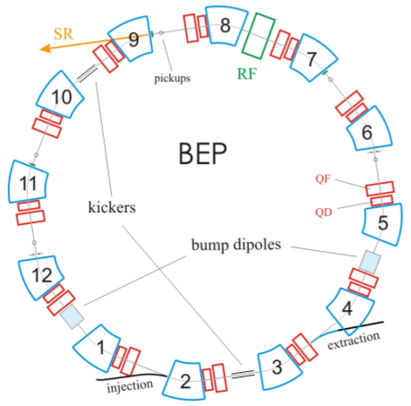
UPGRADE OF BEP BOOSTER
Energy | 0.4-1 | GeV
Revolution frequency | 13.414 | MHz
Bending radius | 128 | cm
Energy loss | 70 | keV
Emittance | 86 | nm·rad
Harmonic number | 13
Betatron tunes, h/v | 3.4/2.4
Compaction factor | 0.06
  New injection septum magnet
  New RF
  Modification 12+1 bending magnets
  New correction coils
  Modification of 24 quadrupoles
  New correction coils in F-quads
  X-corrections in D-quads
  Vacuum chamber modification
  New BUMP
  SR channel

Slide 10
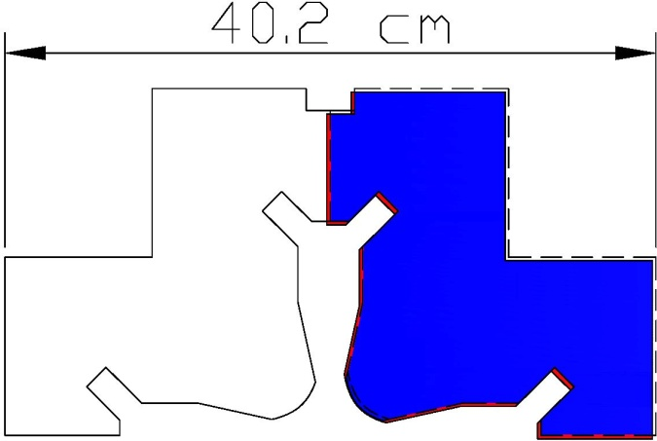
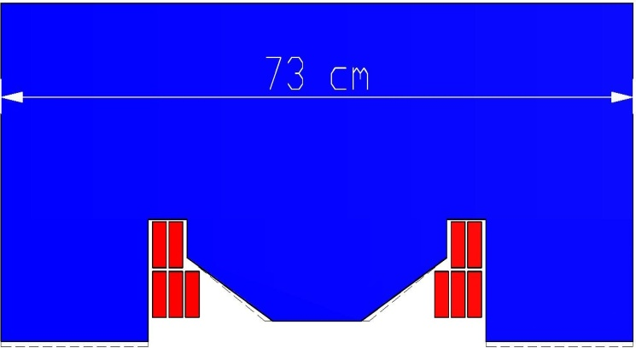
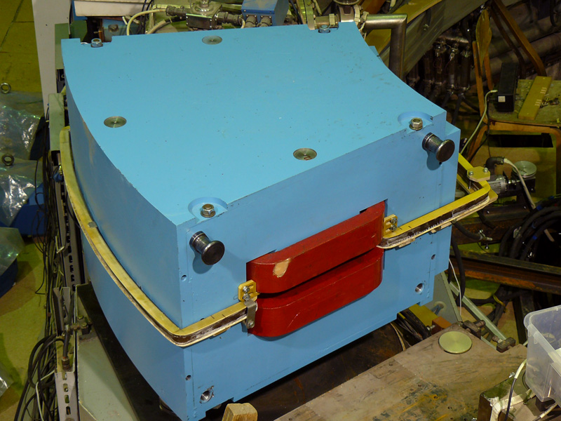
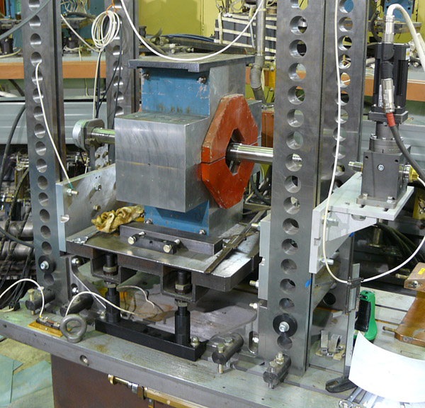
UPGRADE OF BEP BOOSTER
Bending & Quadrupole Magnets Modification
5 kGs/cm
sextupole component enhancement
Gap 40 ➝ 32 mm, 26 kGs

Slide 11
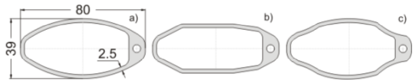
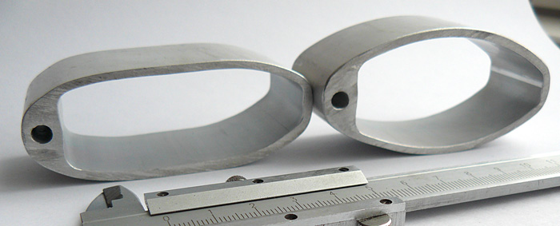
UPGRADE OF BEP BOOSTER
Vacuum Chamber Modification

Slide 12
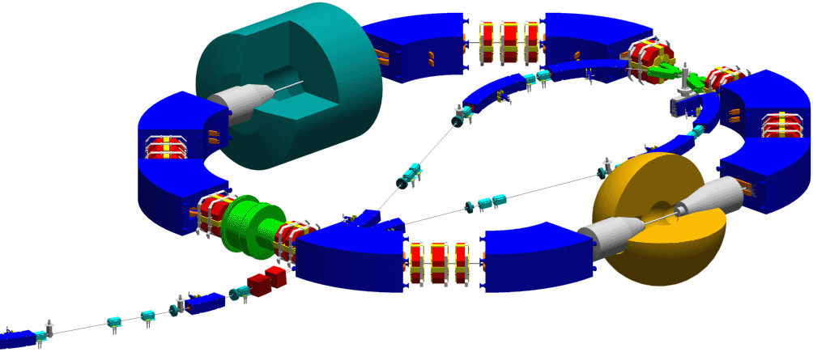
UPGRADE OF VEPP-2000
Or
Original kickers
New 26 kGs bending magnets
New additional
kickers
New scrappers

Slide 13
VEPP-4M
Deuteron

Slide 14
VEPP-4M PARAMETERS
Energy | 0.925 ÷ 4.75 (5.2)
Circumference | 366.075 |  |  |  |  | m
Number of bunches | 2e+ x 2e- (16e-)
Harmonic number | 222
Betatron tunes, h/v | 8.54/7.57
Compaction factor | 0.0168
Coupling | 0.05%
Bunch length | 5 |  |  |  |  | cm
Beam Energy | 1.5 | 1.8 | 3 | 4.7 | 5.2 | GeV
Emitance | 16 | 25 | 67 | 167 | 200 | nm·rad
Energy Spread | 2.5 | 3.0 | 4.9 | 7.8 | 8.5 | ·10⁻⁴
Beam Current | 1.6 | 3.0 | 12 | 25 | 25 | mA
Luminosity | 0.9 | 2.0 | 14 | 44 | 25 | ·10³⁰ cm⁻²·s⁻¹

Slide 15
KEDR @ VEPP-4M

Slide 16
E+E- TAGGET SYSTEM @ VEPP-4M

Slide 17
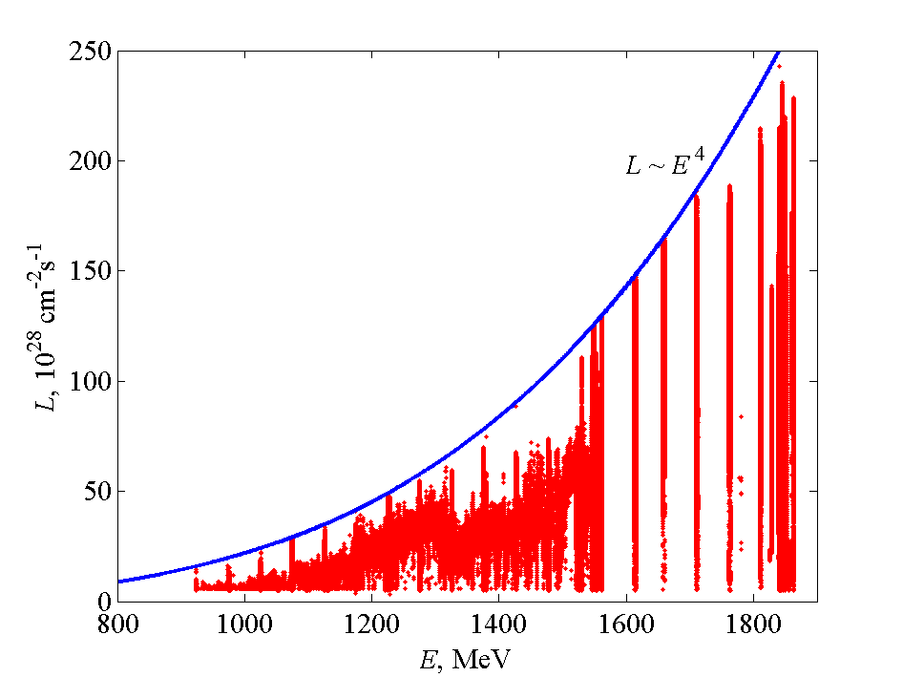
VEPP-4M LUMINOSITY

Slide 18
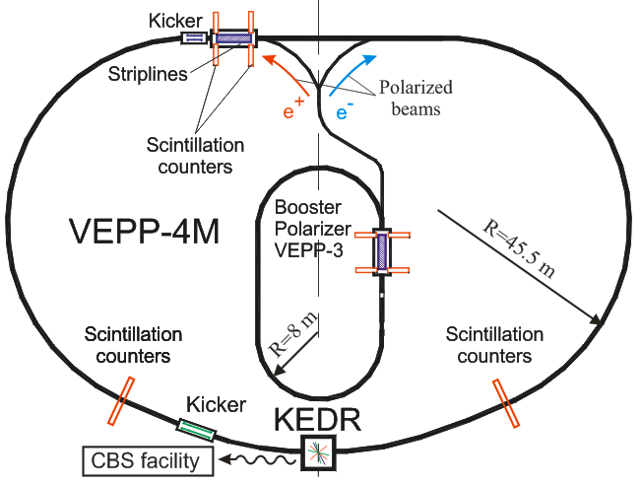
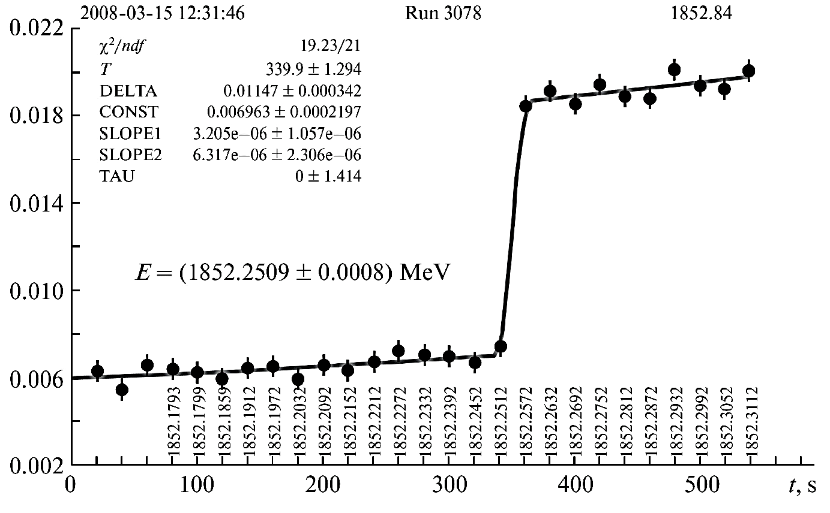
VEPP-4M RD BEAM ENERGY CALIBRATION
Accuracy ~ 10⁻⁶
Needs polarized beam
Up to 2-3 serial measurements possible with the same beam
Polarized beam obtained in ranges E = 1.5÷2 GeV and 3.8÷5 GeV

Slide 19
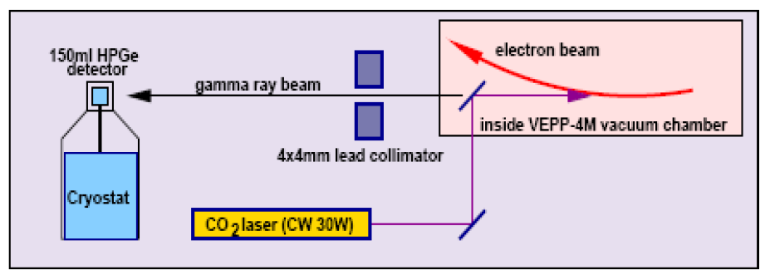
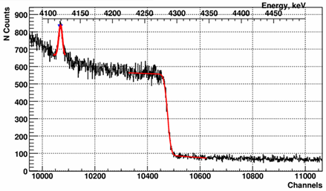
VEPP-4M CBS BEAM ENERGY CALIBRATION
Na²⁴ (1)=1368.625 keV
Na²⁴ (2)=2754.008 keV
Na²⁴ (1+2)=4122.633 keV
Accuracy ~ 5·10⁻⁵
Measurement time ~ 10 min
Beam energy spread ~10%
During statistics acquisition
E < 3.5 GeV

Slide 20
BEAM TEST FACILITY @ VEPP-4M
KEDR
Bend
Target
 | e⁻ | γ
Energy | 0.1÷3 | 0.05÷1.5 | GeV
σ_{ΔE/E} | 0.5÷1.5 | ~0.5 | %
Intensity | 10÷100 | ~1000 | Hz

Slide 21
BEAM TEST FACILITY @ VEPP-4M
FARICH Prototype

Slide 22
DEUTERON @ VEPP-3

Slide 23
VEPP-4M PLANS
2015/2016
E=1.5÷1.85 – J/Ψ, Ψ(3770), D-mesons, …
Summer 2016
New injector
RF System Upgrade
2016/2020
E=1.85÷4.75 – R-scan, γγ-physics, Λ_{c}, ϒ(1S), …
2016 (2 months) & 2017 (4 months)
Deuteron experiment γ + D ➝ p + n
➝

Slide 24
SUPER-CTAU-FACTORY

Slide 25
SUPER-CTAU-FACTORY PHYSICS
D-Dbar mixing
CP violation searches in charm decays
Rare and forbidden charm decays
Standard Model tests in  leptons decays
Searches for lepton flavor violation τ→μγ
CP/T violation searches in  leptons decays
Production of the polarized anti-nucleons @ E=1 GeV (may be with reduced luminosity)

Slide 26
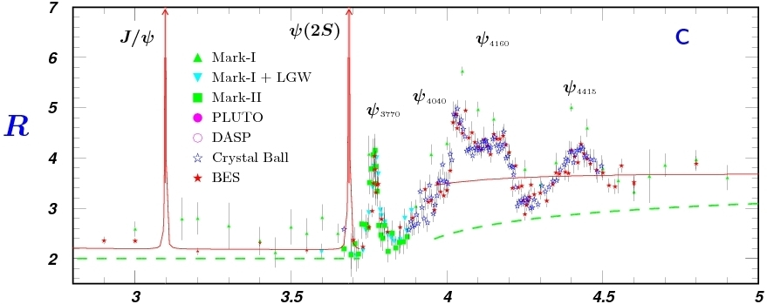
SUPER-CTAU-FACTORY PHYSICS
D_{s}
τ
D
τ⁺τ⁻

Slide 27
SUPER-CTAU-FACTORY SPECIFICATION
Beam Energy from 1.0 to 2.5 GeV
Luminosity ~ 10³⁵ at 2 GeV
Longitudinal Polarization of Electrons at IP
No Energy Asymmetry
No Energy Monochromatization
Energy Calibration with Medium Accuracy is Sufficient (Compton Backscattering)

Slide 28
SUPER-CTAU-FACTORY CONCEPT
Two Rings
Crab Waist Collisions
Small Beta Function at IP (β_{y} ~ 800 um)
5 Siberian Snakes
Superconducting Wigglers to keep the same damping and emittance in the whole energy range
High Beam Current
50 Hz Injection Rate
2.5 GeV Linac (two beams acceleration)
Electron Polarization Source

Slide 29
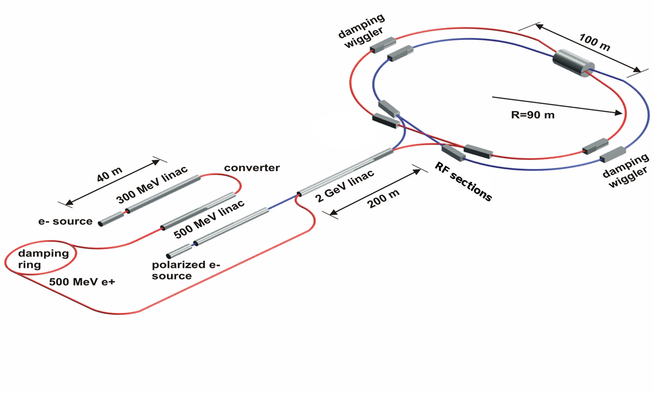
SUPER-CTAU-FACTORY LAYOUT

Slide 30
SUPER-CTAU-FACTORY LAYOUT

Slide 31
SUPER-CTAU-FACTORY DETECTOR
Universal magnetic detector:
1 – Vertex detector
2 – Drift chamber
3 – Identification system based
on FARICH
4 – Calorimeter
5 – Superconducting coil
6 – Yoke with a muon system.

Slide 32
SUPER-CTAU-FACTORY PARAMETERS
Energy | 1.0 GeV | 1.5 GeV | 2.0 GeV | 2.5 GeV
Circumference | 780 m
Emittance hor/ver | 8 nm/0.04 nm @ 0.5% coupling
Damping time hor/ver/long | 30/30/15 ms
Bunch length | 16 mm | 11 mm | 10 mm | 10 mm
Energy spread | 10.1·10⁻⁴ | 9.96·10⁻⁴ | 8.44·10⁻⁴ | 7.38·10⁻⁴
Momentum compaction | 1.00·10⁻³ | 1.06·10⁻³ | 1.06·10⁻³ | 1.06·10⁻³
RF frequency | 508 MHz
Harmonic number | 1300
Particles in bunch | 7·10¹⁰
Number of bunches | 390 (10% gap)
Bunch current | 4.4 mA
Total beam current | 1.7 A
Beam-beam parameter | 0.15 | 0.15 | 0.12 | 0.095
Luminosity | 0.63·10³⁵ | 0.95·10³⁵ | 1.00·10³⁵ | 1.00·10³⁵

Slide 33
SUPER-CTAU-FACTORY POLARIZATION
Longitudinal Polarization
1 Snake
5 snakes
3 snakes
3 Snake
1 snake
5 Snake

Slide 34
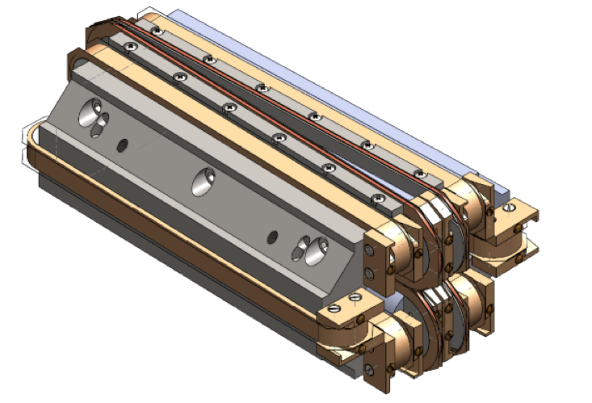
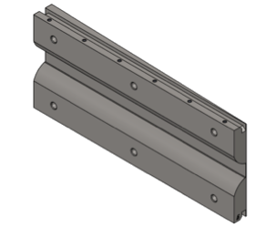
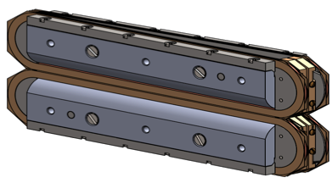
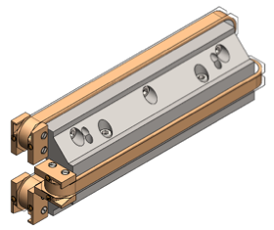
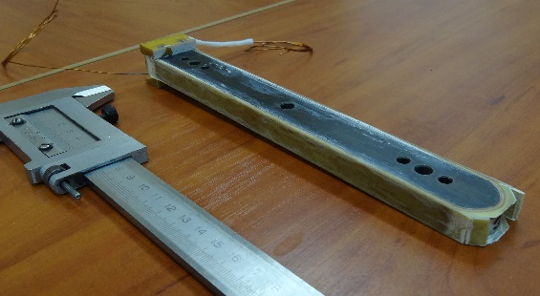
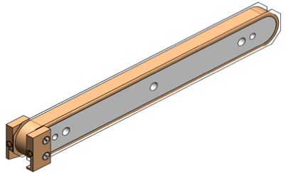
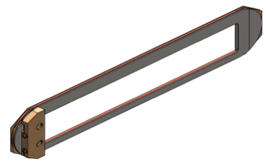
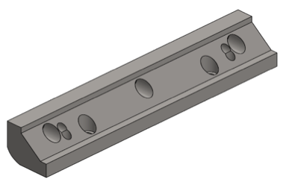
SUPER-CTAU-FACTORY QD0
Length | 200 | mm
Gradient | 10.7 | кГс/см
Aperture radius | 10 | мм
ΔB/B | 10⁻³
Current | 600 | А

Slide 35
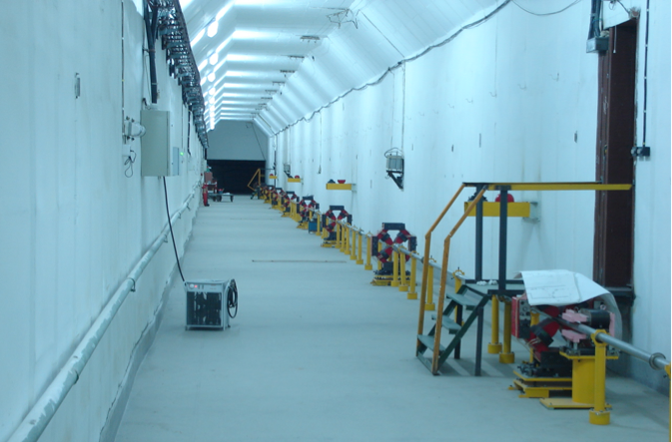
SUPER-CTAU-FACTORY

Slide 36
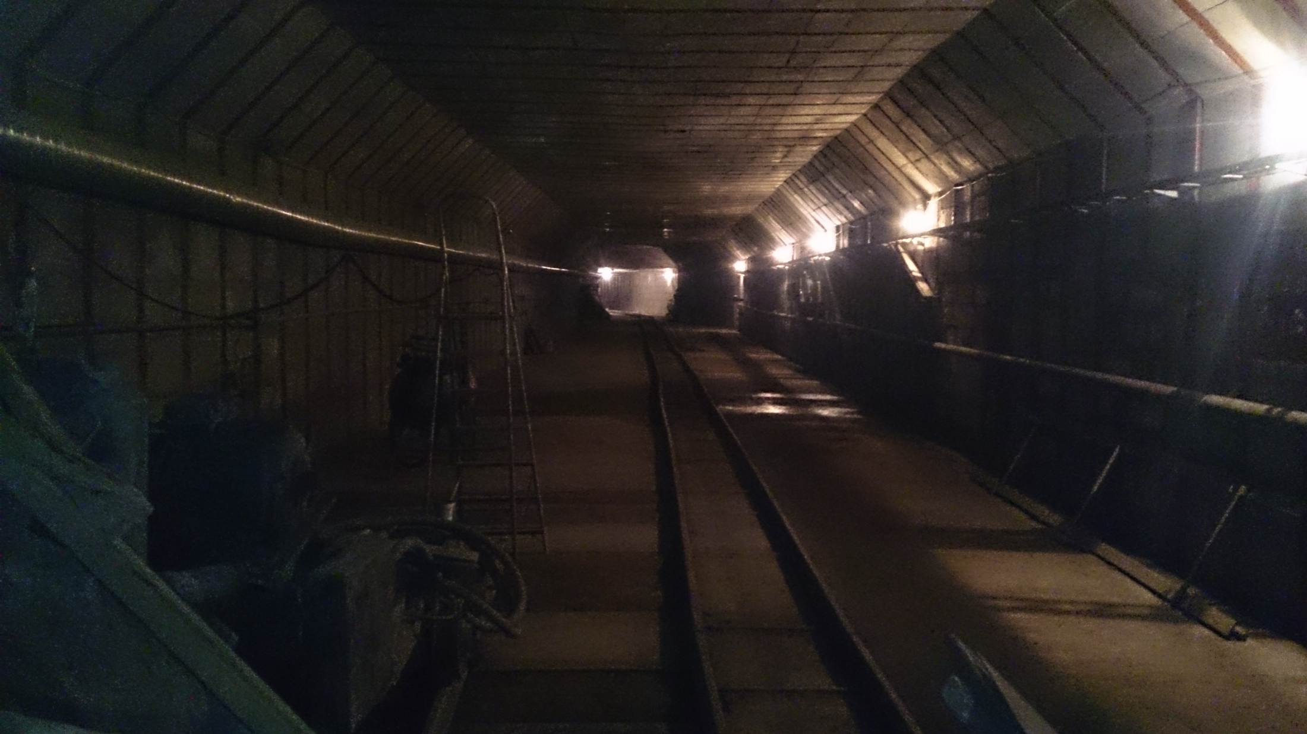
SUPER-CTAU-FACTORY

Slide 37
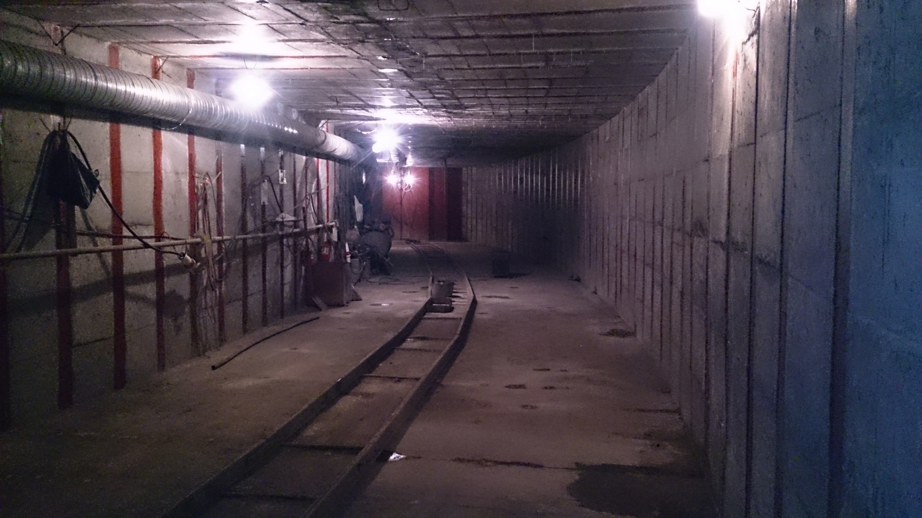
SUPER-CTAU-FACTORY

Slide 38
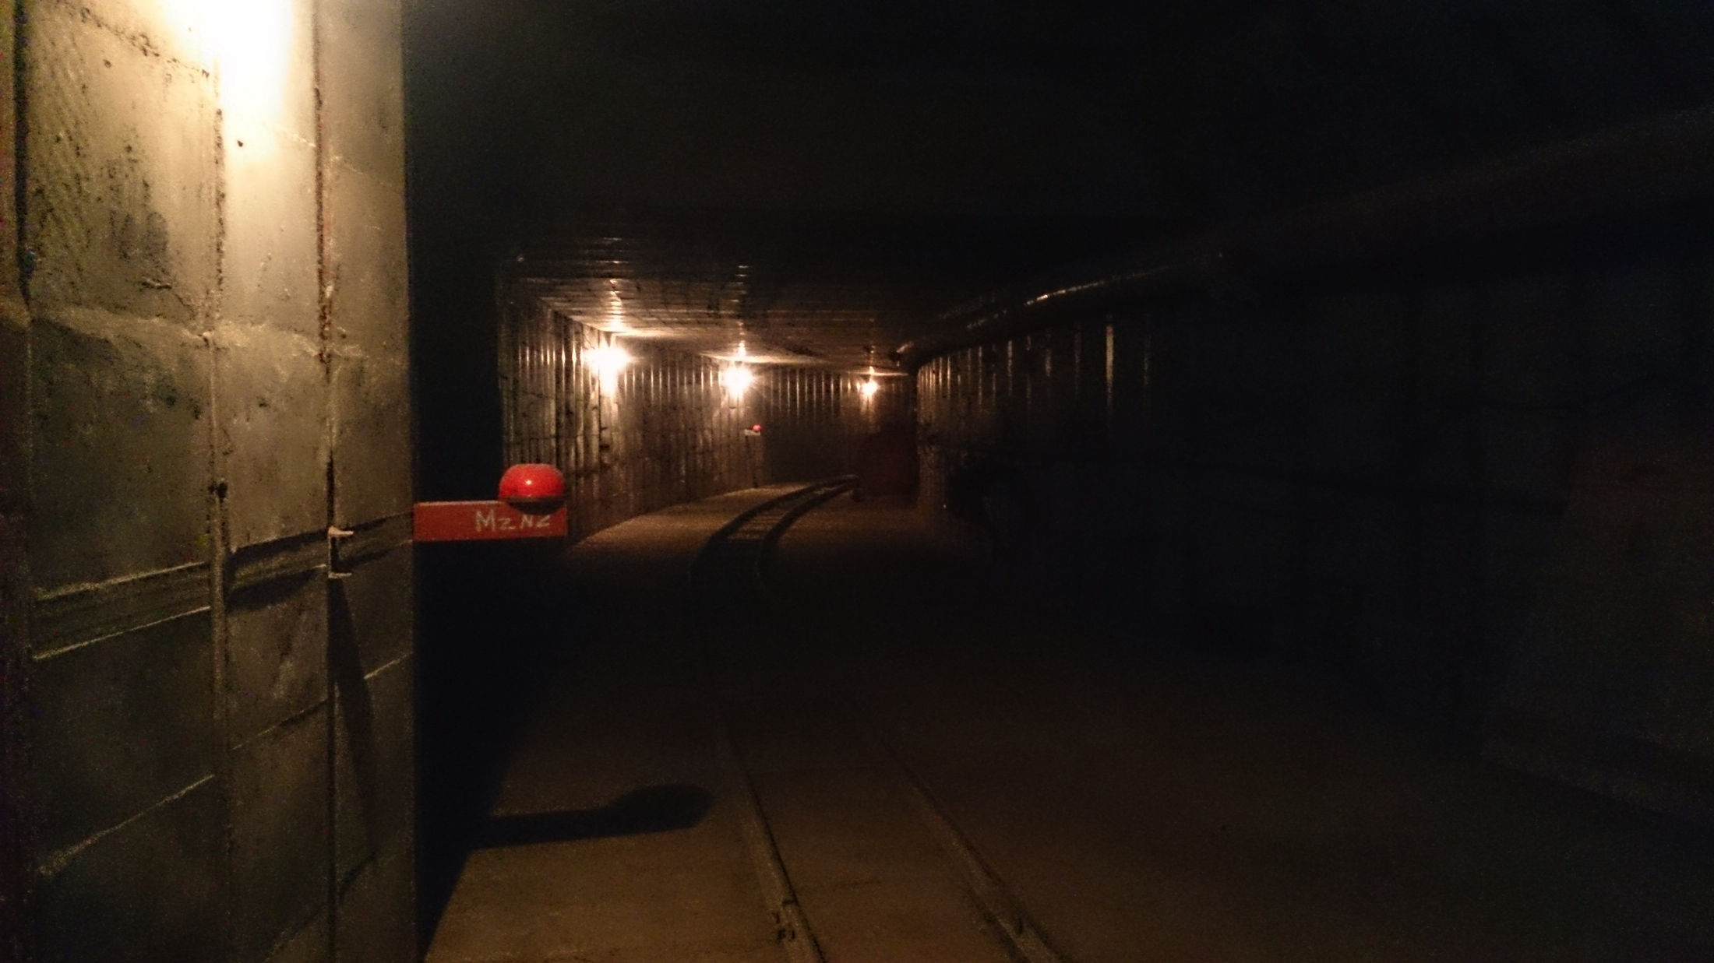
SUPER-CTAU-FACTORY

Slide 39
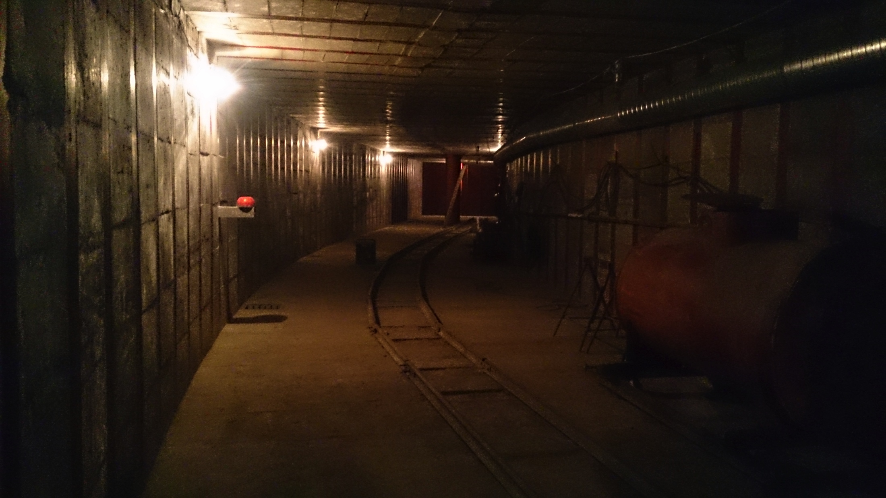
SUPER-CTAU-FACTORY

Slide 40
THANK YOU

