Slide 1
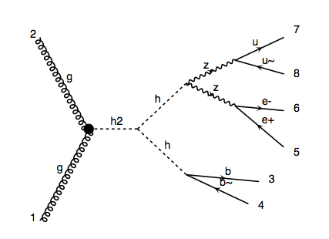
m_H=300GeV signal
pp > H > h h > Z Z b b > l l j j b b

