Slide 1
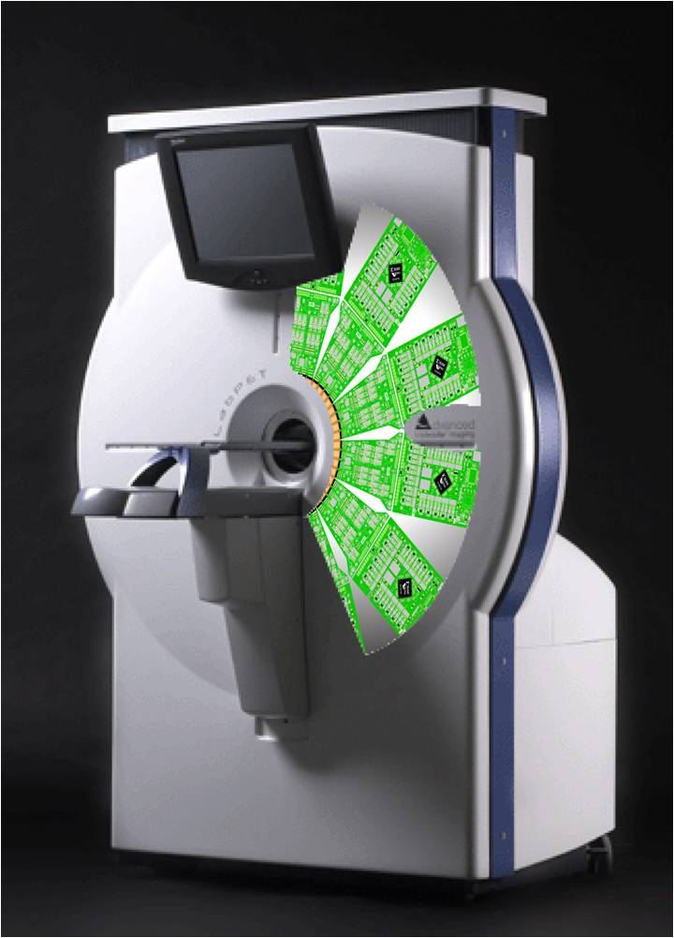
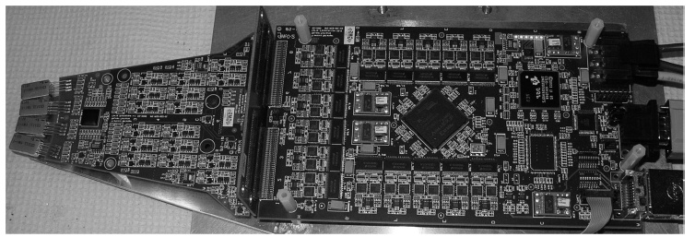
Firmware Upgrade for the Acquisition Board of the LabPET Small Animal PET Scanner (FESPP-1)
Goals :
Increase event throughput
Reduce logic consumption
No hardware modifications
M.-A. Tétrault, R. Fontaine, R. Lecomte

Slide 2
Method
Bottleneck
Dual Crystal + APD

Slide 3
Results
LGSO Trigger Level

