Slide 1
Current Status of EAST Plasma Control and Data Acquisition
Bingjia Xiao & EAST CODAC group
Institute of Plasma Physics, Chinese Academy of Sciences

Slide 2
Outline
Introduction
EAST plasma control
EAST central control and timing
  TDAP33(Friday) and CMSP-19 (Tuesday)
EAST data acquisition
EAST data and operation service
Summary

Slide 3
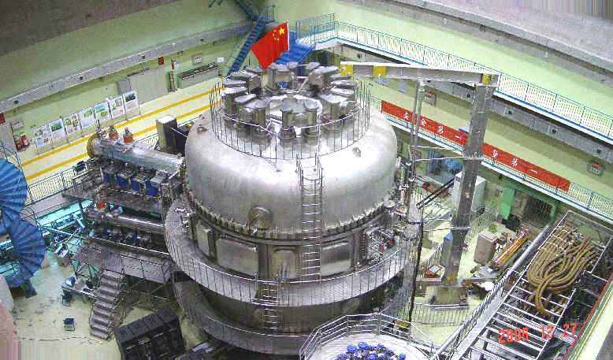
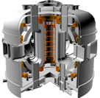
Introduction: EAST is the 1st full superconductive tokamak consists of >10 sub-systems
Vacuum
ICRF
Cryogenic
LHW
Water cooling
NBI
TF coils and PS
ECR
PF coils and PS
Fueling
Quench Protection
Technical diagnostics
Data Acquisition and service
Diagnostics
Plasma Control
Central Control, synchronization and interlock

Slide 4
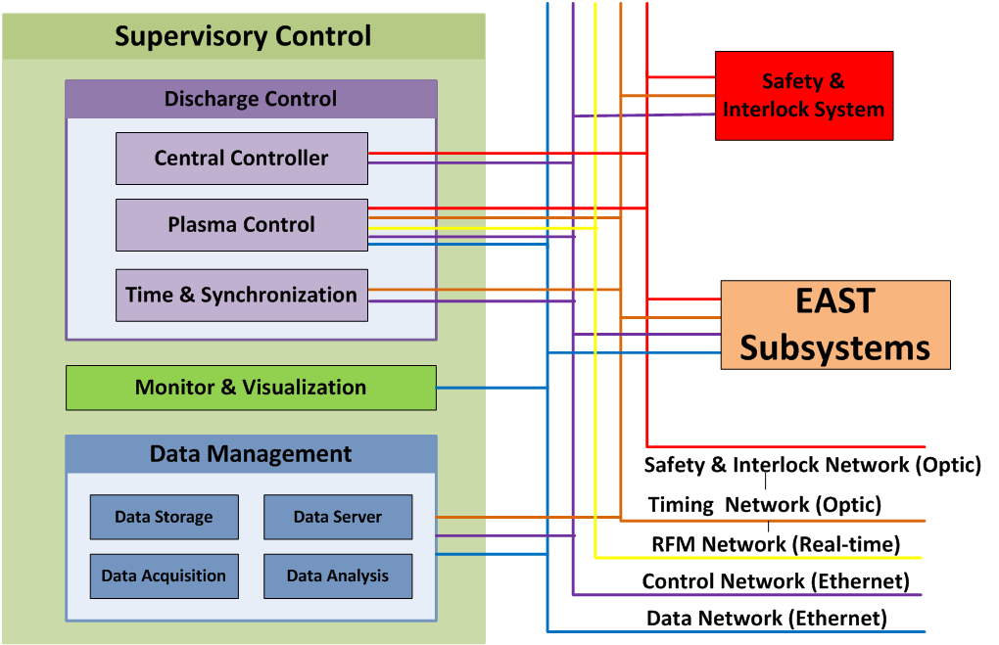
EAST CODAC

Slide 5
Outline
Introduction
EAST plasma control
EAST central control and timing
  TDAP33(Friday) and CMSP-19 (Tuesday)
EAST data acquisition
EAST data and operation service
Summary

Slide 6
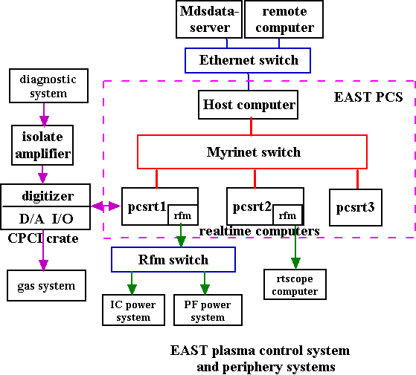
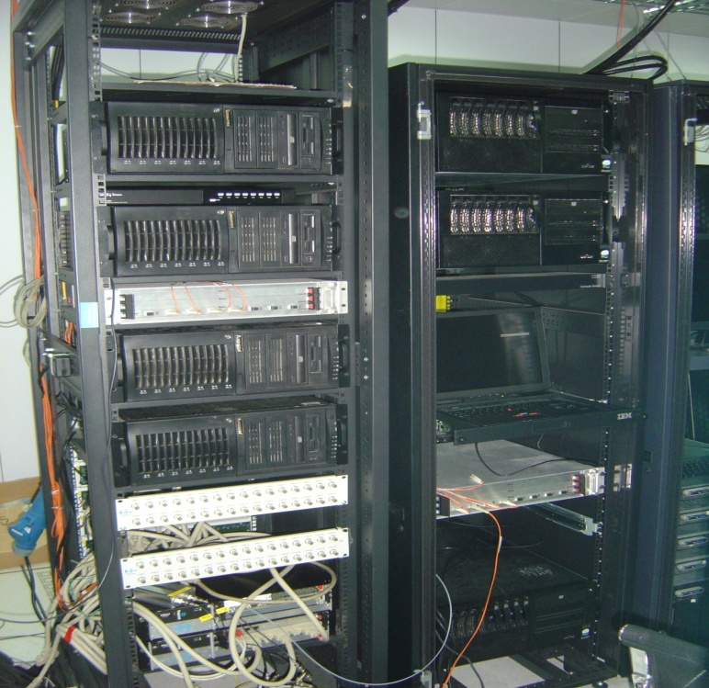
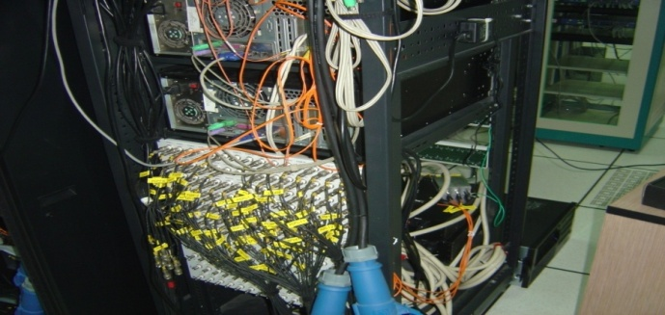
EAST Plasma Control: inherited from DIII-D
Plasma current, density, boundary, position and…stability, …

Slide 7
Plasma control algorithms
100
Ch.
PS
Gas
Valve
…
RTEFIT/
ISOFLUX
Density
RZIP
…
HCN (plasma density)

Slide 8
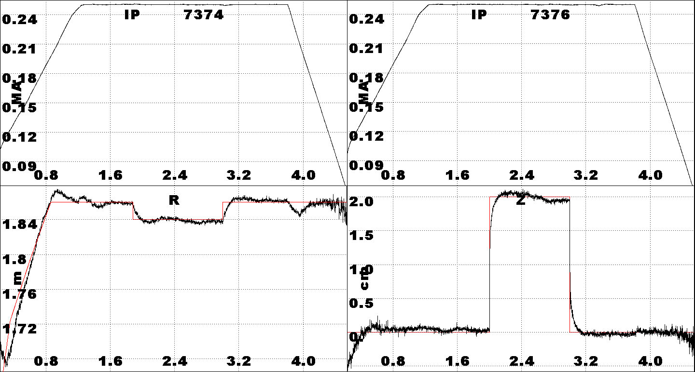
Plasma Current and Position Control
IP：<1%(1 kA), R: 0.3%(6 mm), Z: 0.6 mm
Time (s)

Slide 9
Good agreement between RT & offline EFIT

Slide 10
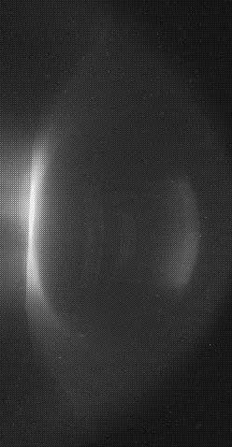
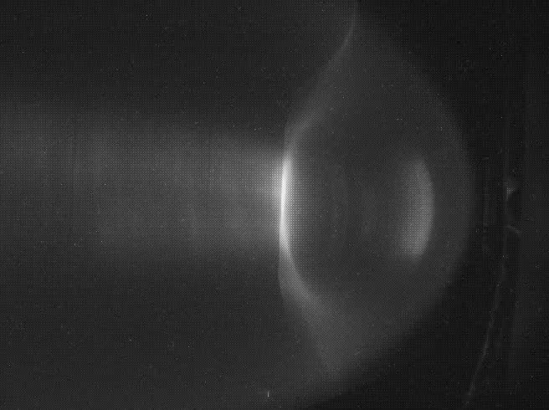
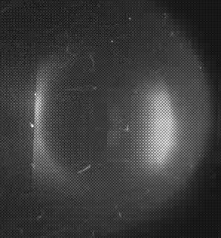
Plasma shape feedback control: #13928
HCN Chord length
540 ms 1752 ms 2040 ms

Slide 11
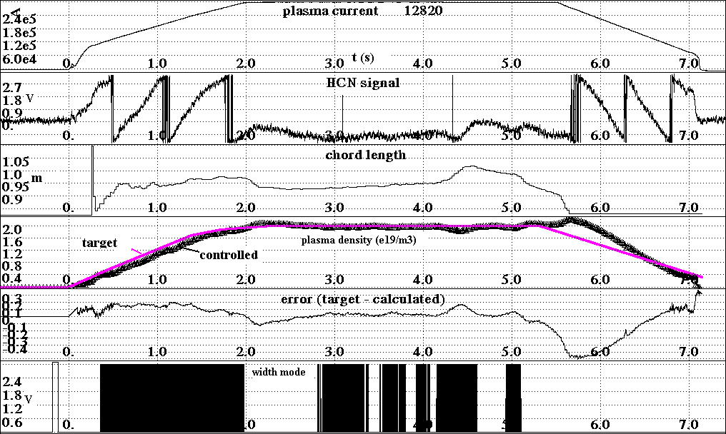
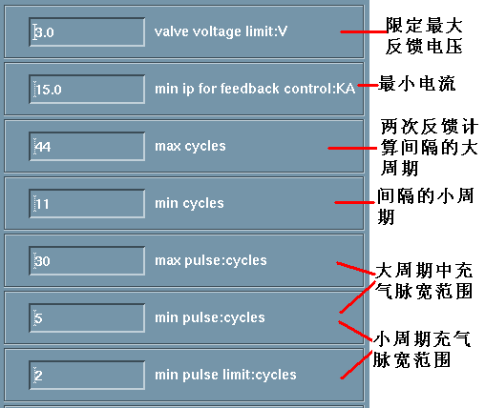
Plasma density feedback control

Slide 12
EAST data acquisition
TDAP33(Friday)
TDAP-32, A Continuous Data Acquisition System Based on cPCI for EAST Tokomak
Distributed
Heterogeneous
Remote Controllable
Extensible
Segmented data storage & service
Real-Time Operation
Features:
TDAP-13, EAST Data System for Steady-State Operation
TDAP-14, A Slice-Based Data Acquisition System for Long Duration Discharge in EAST
12

Slide 13
Outline
Introduction
EAST plasma control
EAST central control and timing
  TDAP33(Friday) and CMSP-19 (Tuesday)
EAST data acquisition
EAST data and operation service
Summary

Slide 14
Data and operation service
Mdsplus
  jScope, review+, dwscope,
  Eastviewer: flux surfaces, discharge parameters
  Rtscope
  Webscope
Local data archive
  EASTSCOPE
LOGBOOK: Logs for EAST operation
Data analysis
  EFIT, in RT (PCS)
  EFIT offline (between shot):
  ….
CMSP-27, Tuesday
CMSP-7, Tuesday

Slide 15
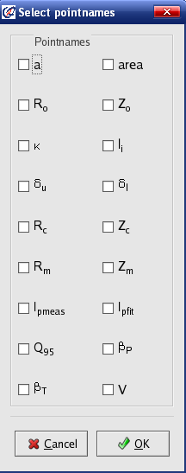
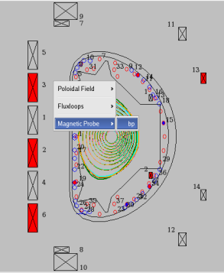
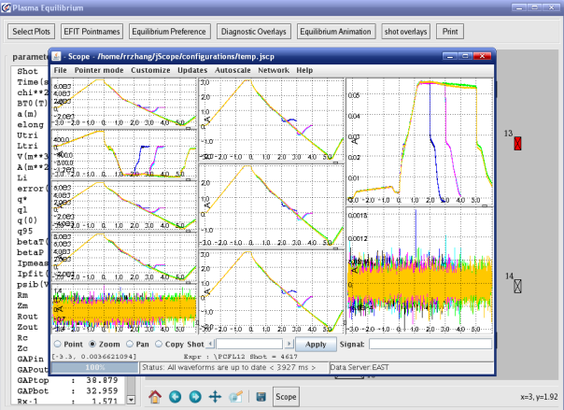
EASTVIEWER: viewing EFIT data & discharge parameters
Features: Python & Java in open source; across OS; easy extensible

Slide 16
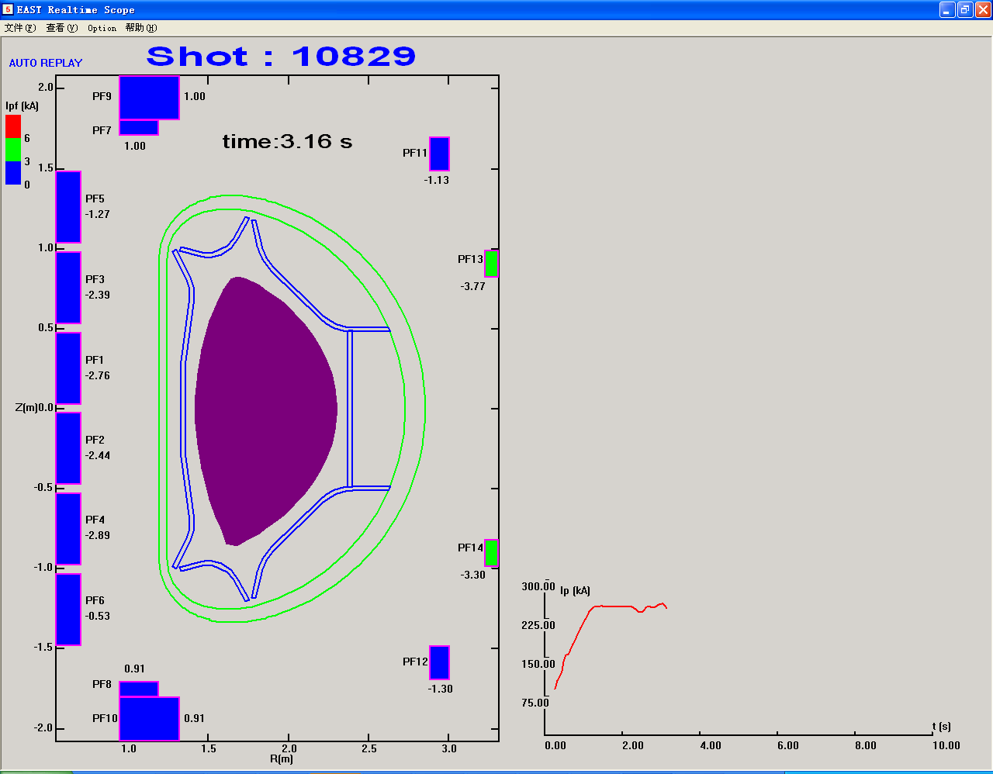
Rtscope: PCS to displaying computer by RFM

Slide 17
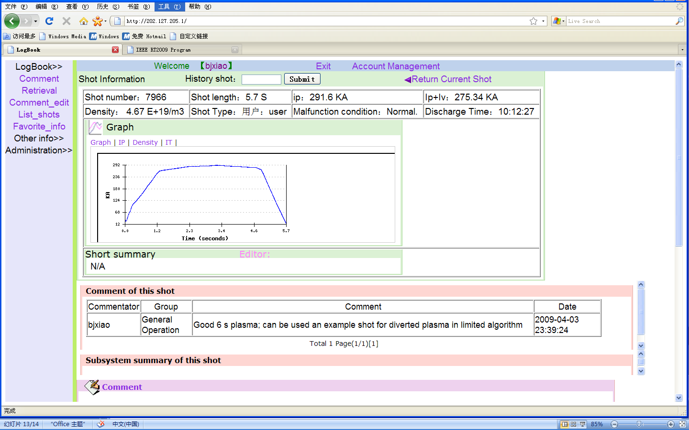
Logbook : http://202.127.205.1/

Slide 18
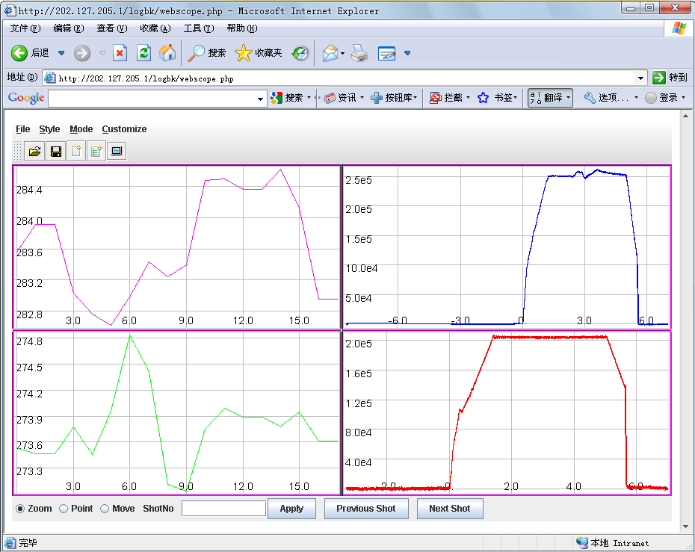
Webscope: web based pulsed data viewer http://202.127.205.1/logbk/webscope.php
Features:
Web based, Java
Configurable
Multi data server
Multi trees
Accommodate all jScope style

Slide 19
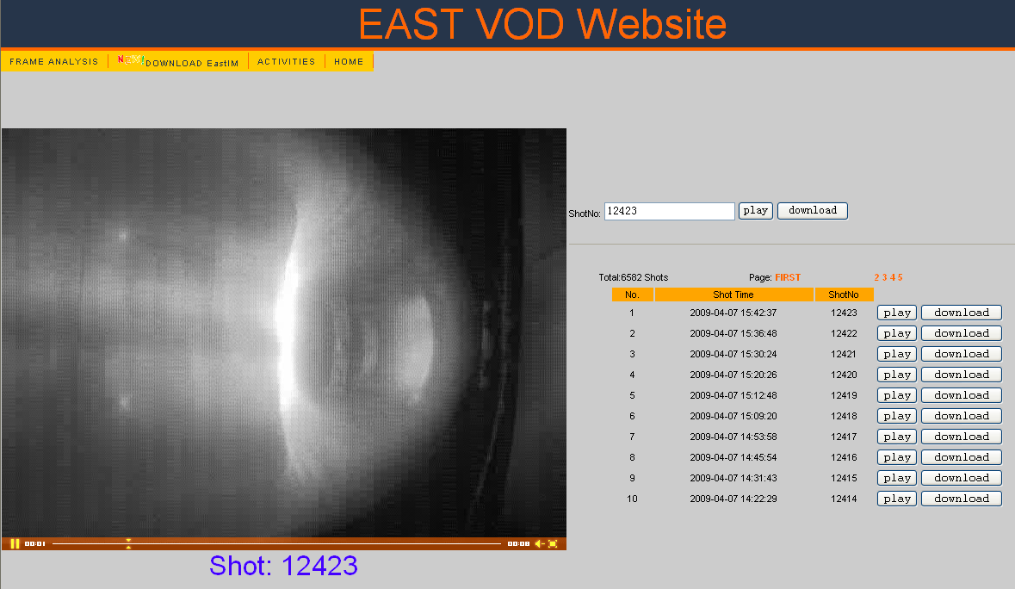
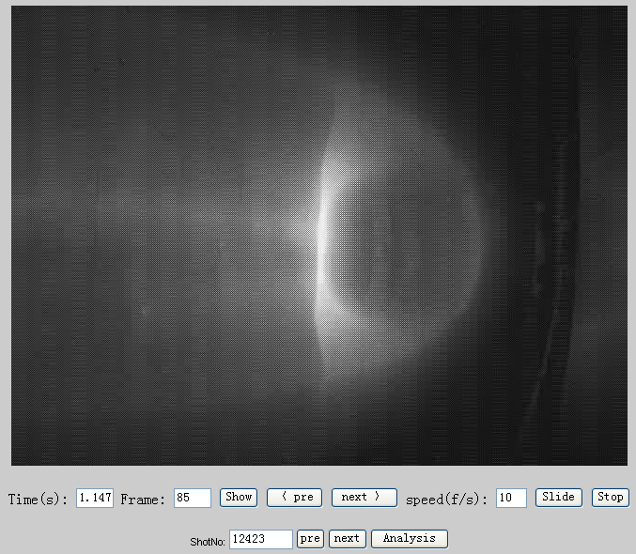
EAST VOD for plasma discharge image
Features:
Realtime acquired, compressed between shots and published on webpages in FLV format.
Video can be viewed frame by frame relevant to each discharge time.

Slide 20
Summary
EAST plasma control has realized shape feedbacked, position, density and current controls in good accuracy, using LINUX PC clusters in Myrinet and RFM network.
EAST data acquisition, storage and service, for minute scale discharge, have been provided. Real-time data access is under way.
A series of data viewing and visualization tools have been developed.

