Slide 1
Pulse Pile-up Recovery Using Model-Based Signal Processing.
Paul. A.B. Scoullar, Southern Innovation, Australia.
Prof. Rob J. Evans Department of Electrical & Electronic Engineering, The University of Melbourne, Australia
RT 2009, 15th May 2009

Slide 2
Presentation Outline
Genesis of the technology
Problem Introduction
Linear Filtering Techniques
Solution Methodology
Some Performance Results
Conclusions

Slide 3
Southern Innovation
Genesis of the technology
Technology genesis in PhD Research into Landmine Detection.
Neutron activated gamma-ray spectroscopy to detect TNT.
Large background signal and source detector cross-coupling.
Neutron Source
Gamma Ray Detectors
Explosive (TNT)

Slide 4
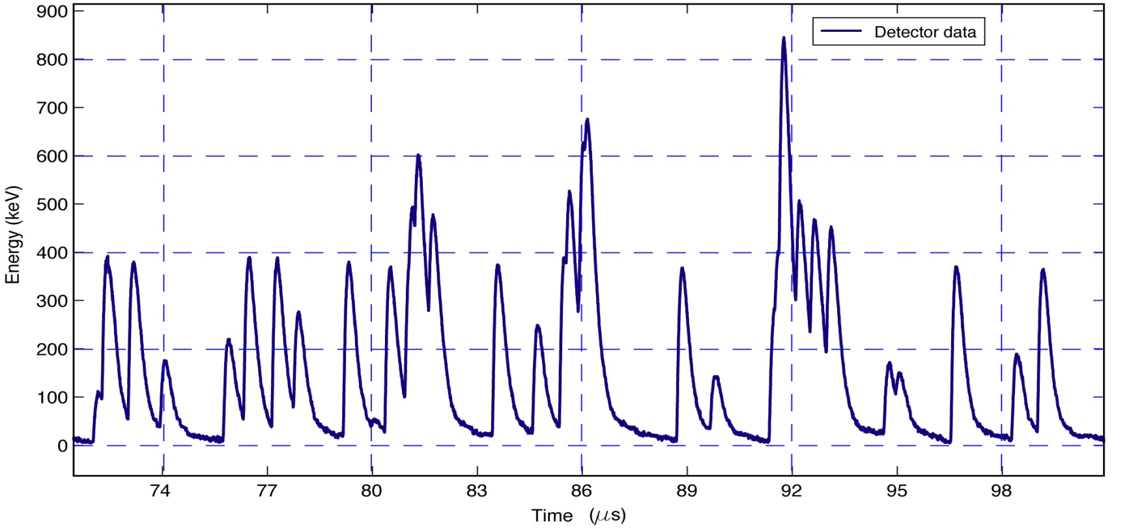
Problem Introduction
Pulse Pile-Up
A burst of radiation ‘arrives’ within the detector response time.
Reduces energy resolution, increase dead-time and extends the time required for accurate classification.
Reduce the neutron generator current and reject piled-up pulses.

Slide 5
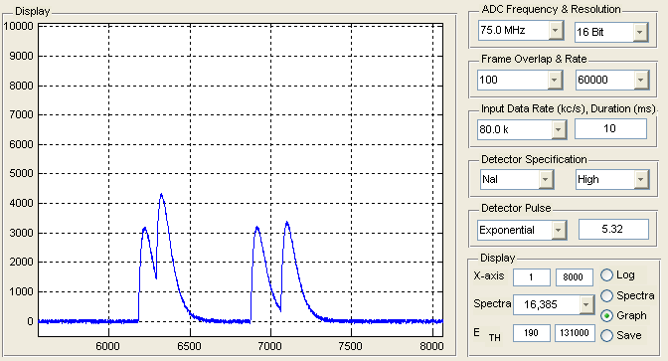
Traditional Pulse Processing
Low Count-Rates
Only clearly separated events are detected accurately.
At 100 kc/s - 40% of events are corrupted by pulse pile-up.
Valid Events
Detector Data

Slide 6
Model Based Signal Processing
Modeling the measurement process.
A black box approach to radiation detection.
To what extent can the measurement process be characterized?
If so, can we solve for the inverse of the process M⁻¹.
Determine the ‘unobservable’ input to the detection process s(t).
M
s(t)
y(t)

Slide 7
Linear Filtering Approaches
Convolution Filtering
In the frequency domain Y.
Y = S . M
Robust against noise however pulse duration is extended.
Inverse Filtering
In the frequency domain Y.
Y = M⁻¹ . S
Shortens pulse duration but amplifiers the noise power.

Slide 8
The Inverse Problem

Slide 9
Linear Filtering Approaches
Convolution Filtering
In the frequency domain Y = S . M
Robust against noise however pulse duration is extended.
Inverse Filtering
In the frequency domain Y = M⁻¹ . S
Shortens pulse duration but amplifiers the noise power.
Wiener Filtering
A trade-off between convolution and inverse filtering.
W_{f} =
M*
As the noise variance (λ) → 0 the Wiener Filter approaches Inverse filtering, as (λ) get larger the Wiener Filter approches Convolution filtering.
|M|² + λ

Slide 10
Linear Filtering Approaches
Convolution Filtering
In the frequency domain Y = S . M
Robust against noise however pulse duration is extended.
Inverse Filtering
In the frequency domain Y = M⁻¹ . S
Shortens pulse duration but amplifiers the noise power.
Wiener Filtering
A trade-off between convolution and inverse filtering.
W_{f} =
M*
As the noise variance (λ) → 0 the Wiener Filter approaches Inverse filtering, as (λ) get larger the Wiener Filter approches Convolution filtering.
|M|² + λ

Slide 11
Linear Filtering Approaches
Convolution Filtering
In the frequency domain Y = S . M
Robust against noise however pulse duration is extended
Inverse Filtering
In the frequency domain Y = M⁻¹ . S
Shortens pulse duration but amplifiers the noise power.
Wiener Filtering
A trade-off between convolution and inverse filtering.
W_{f} =
Energy
Signal
Noise
Frequency
M*
As the noise variance (λ) → 0 the Wiener Filter approaches Inverse filtering, as (λ) get larger the Wiener Filter approches Convolution filtering.
|M|² + λ

Slide 12
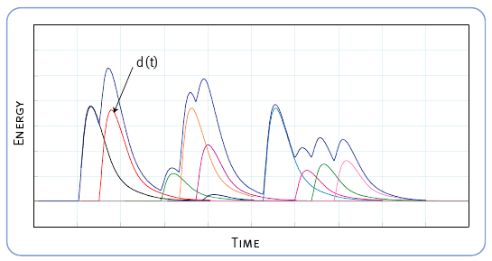
Maximum Likelihood Estimation
Continuous Time
Discrete Time
h(t)
τi

Slide 13
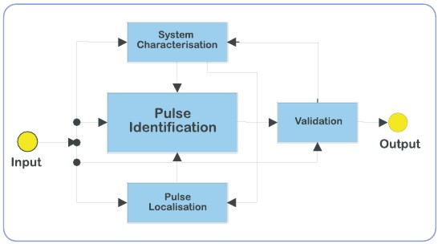
Algorithm Overview
The Pulse Pile-up Recovery Algorithm

Slide 14
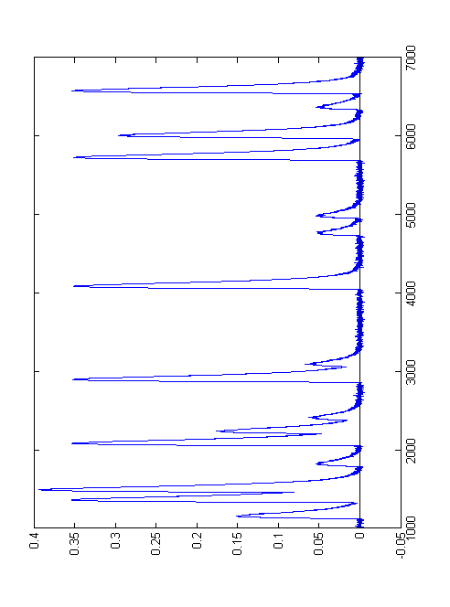
Algorithm Input.
Convolution Filtering
Currently digitising data at 75 MHz and 14 Bit accuracy.
Detector Data

Slide 15
Pulse Localisation.
Linear FIR Filtering
Accuracy dependant on the signal to noise ratio.
Low signal to noise ratio 3ns [ 4 subsample positions ].
High signal to noise ratio 660ps [up to 20 subsample positions].
Sampling faster of course would improve the achievable accuracy.
True Arrivals
Alg. Estimate

Slide 16
Pulse Identification.
Estimation of event energy
Using knowledge of expected pulse shape E[h].
Linear programming techniques to minimise the ||L2|| norm.
Optimally estimates the energy of all events in the data set.
Alg. Estimate

Slide 17
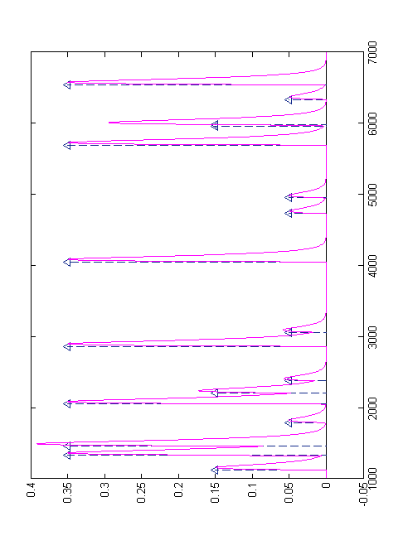
Data Validation
Reconstruct the detector data
Using our estimates of event timing, number, energy and E[h].
Reconstruct a ‘noise free’ estimate of the detector data set ŝ[n].
Est. Energy
Est. ADC Data

Slide 18
Data Validation
Examine the residuals
Compare the estimated data s[n] with actual ADC data s[n].
Where all parameters are accurately estimated var(e) ≈ var(w).
Statistical test on e[n] used to identify errors in estimation.
Est. ADC Data
Residuals

Slide 19
Pulse Pile-Up Recovery
Very high count-rates
The number, arrival time and energy pulses are estimated.
At 1,000 kc/s less than 10% of events cannot be decoded.
Valid Events
Detector Data
Residuals

Slide 20
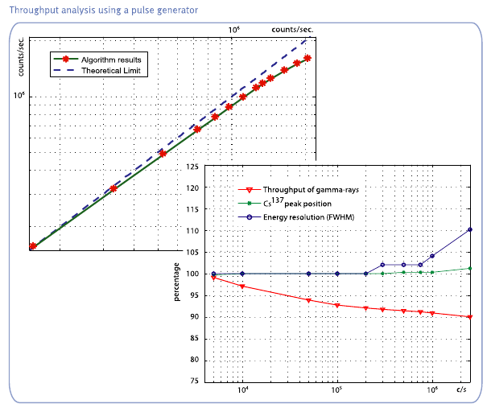
Results – Pulse Generator.

Slide 21
Experimental Data – Throughput
†
†
† D. M. Scates & J. K. Hartwell, Applied Radiation and Isotopes, vol. 63, p 465-73, May 2005

Slide 22
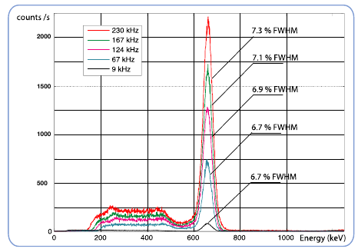
Experimental Data – Resolution.

Slide 23
Implementation – Real Time.
Hardware Implementation
Implemented in an off the shelf Xilinx development board.
Virtex-4 SX35 FPGA.
Performance Details
Data digitized at 75 MHz with 14-Bit accuracy.
Sustained performance - output count rate greater than 2,000 kc/s.
Burst performance – output count rate 3 times sustained rate.
Pulse-pair resolution of less than 50 ns.
Event timing accuracy of 3.5 ns.

Slide 24
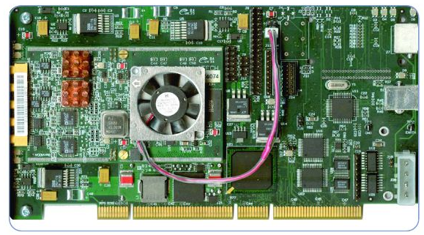
Implementation – Real Time.

Slide 25
In Summary
We have presented a model based signal processing technology for the estimation of key parameters in pulse processing including: the number; energy; and time of arrival of pulses.
Able to adapt to a range of radiation detector types.
Decodes rather than discard data corrupted by pulse pile-up.
Dramatically reduces dead-time even at low count rates.
Improves detector throughput and efficiency.
Reduces measurement time, more counts faster.

Slide 26
Questions?

