Slide 1
Overview of the CMS Trigger System
J. Varela
IST/LIP Lisbon
CMS Trigger Project Manager
16th IEEE NPSS Real Time Conference
May 10-15, 2009, Beijing, China

Slide 2
Outline
1. Architecture of the CMS Trigger system
Emphasis on the Level 1 Trigger
HLT: F. Meijers talk
2. Performance results with cosmic data
All results shown are preliminary
Only highlights
Final result will be published this autumn
3. Triggering with first LHC beams
Not much, for known reasons

Slide 3
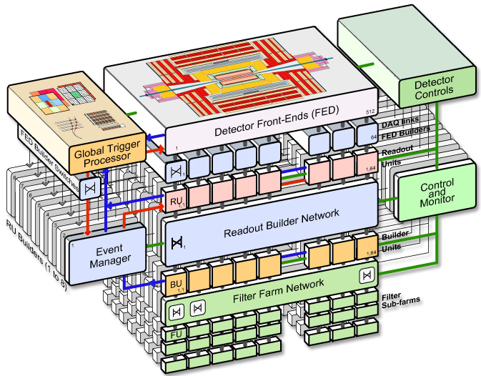
The CMS Trigger
Trigger rejection factor: 10⁷
Collision rate 1 GHz → permanent storage rate O(10²)Hz
Level 1 Trigger:
Hardwired processors
High Level Triggers:
CPU farm
Level-1 Trigger Requirements:
Output: 100 kHz
Latency: 3 μsec
HLT designed to output O(10²)Hz

Slide 4
Level-1 Trigger
Information from Calorimeters and Muon detectors
Electron/photon triggers
Jet and missing E_{T} triggers
Muon triggers
Backgrounds are huge
Sophisticated trigger algorithms
Steep efficiency functions of thresholds
Synchronous and pipelined parallel processor
Bunch crossing time = 25 ns
Time needed for decision (+its propagation) ≈ 3 μs
Large and complex system
Trigger primitives (on-detector): ~5000 electronics boards of 7 types
Regional/Global (off-detector): 45 crates, 630 boards, 32 board types
Flexibility
Large number of programmable parameters in the electronics
Most algorithms implemented in re-programmable FPGAs

Slide 5
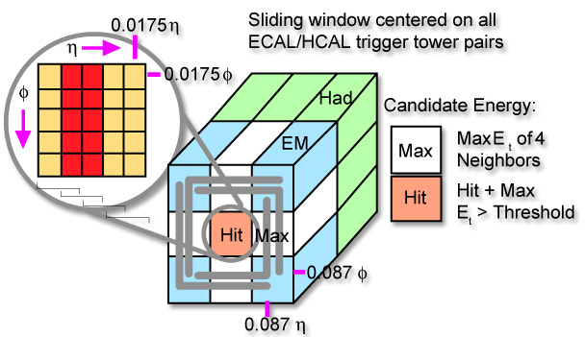
Electron & photon Trigger
Electromagnetic trigger based on 3x3 trigger towers
E
+ H/E
Trigger threshold on sum of two towers
Main issue is the rejection of huge jet background

Slide 6
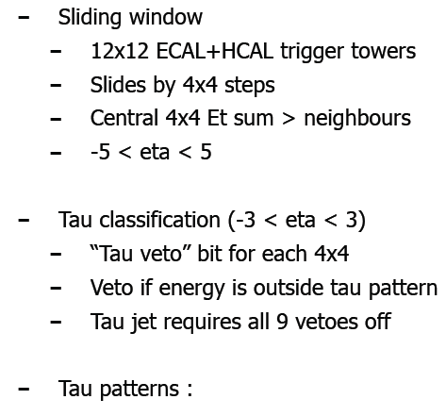
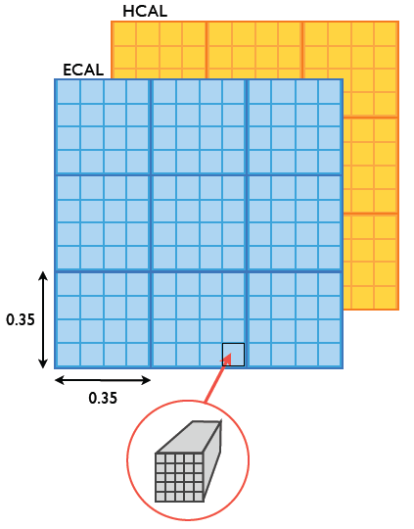
Jet and Tau Triggers
ECAL and HCAL regions

Slide 7
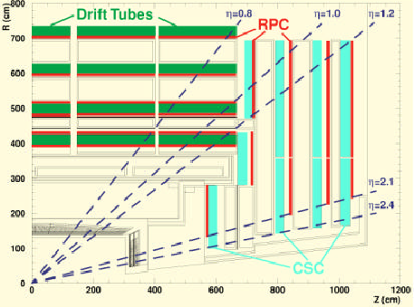
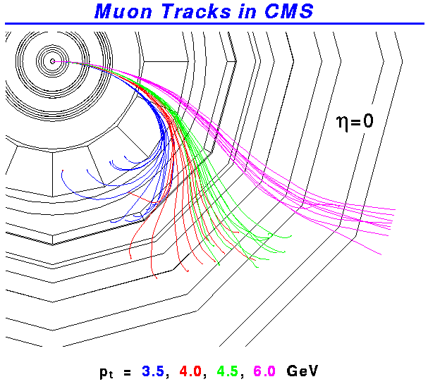
Muon Trigger Detectors
Level-1 μ-trigger info from:
Dedicated trigger detector: RPCs (Resistive plate chambers)
- Good time resolution
Muon chambers with accurate position resolution
- Drift Tubes (DT) in barrel
- Cathode Strip Chambers (CSC) in end-caps

Slide 8
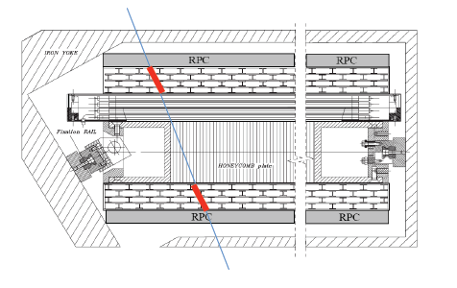
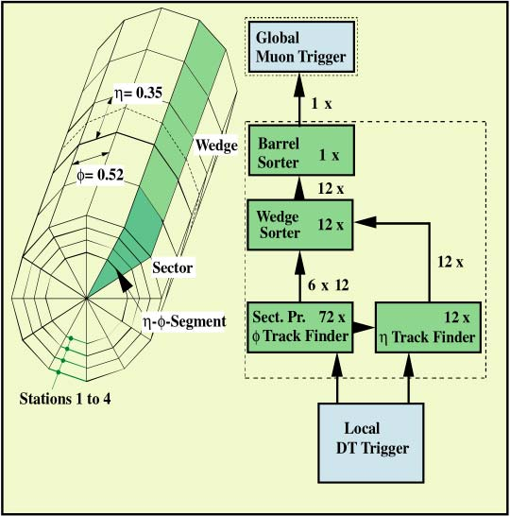
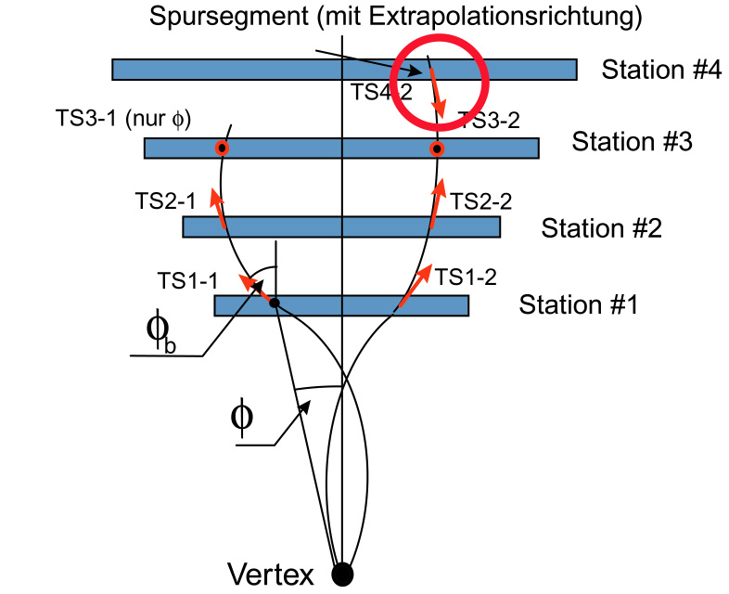
Muon Tracking Triggers
Drift Tube and CSC Triggers based on Track Segment identification followed by full Track Finder
RPC Trigger based on Patterns matching
Local Segment Finder
Phi Track Finder

Slide 9
Global Trigger Algorithms
Logic combinations of trigger objects identified by the Calorimeter Trigger and the Muon Trigger
Best 4 muons p_{T}, charge, φ, η, quality, MIP, isolation
Best 4 isolated electrons/photons E_{T}, η, φ
Best 4 non-isolated electrons/photons E_{T}, η, φ
Best 4 jets in forward regions E_{T}, η, φ
Best 4 jets in central region E_{T}, η, φ
Best 4 τ-Jets E_{T}, η, φ
Total E_{T} ΣE_{T}
Total E_{T} of all jets above threshold H_{T}
Missing E_{T} E_{T}^{missing}, φ(E_{T}^{missing})
Energy and tower count in HF rings
Thresholds (p_{T}, E_{T})
Optional topological and other conditions (geometry, isolation, charge, quality)
128 algorithms running in parallel

Slide 10
Level-1 Trigger Architecture
Calorimeter Trigger
Muon Trigger
DAQ
ECAL
Trigger Primitives
HCAL
Trigger Primitives
RPC hits
CSC hits
DT hits
Link system
Segment finder
Segment finder
Regional Calorimeter Trigger
Track finder
Pattern Comparator
Track finder
40 MHz pipeline
4+4 μ
4 μ
4 μ
MIP+ ISO bits
Global Calorimeter Trigger
Global Muon Trigger
e, J, E_{T}, H_{T}, E_{T}^{miss}
4 μ
Global Trigger
L1A
Status
TTC system
TTS system
32 partitions
Detectors Frontend

Slide 11
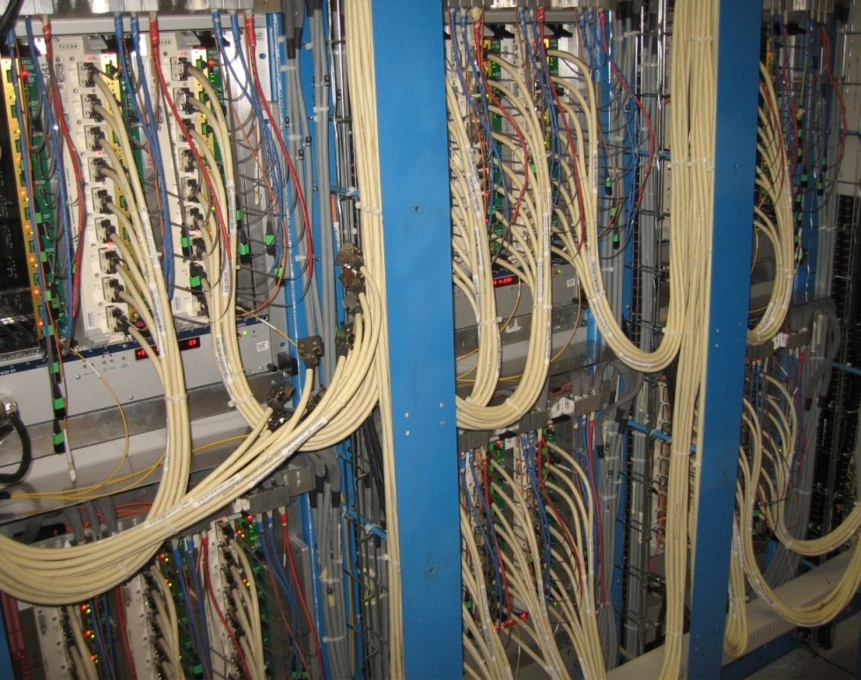
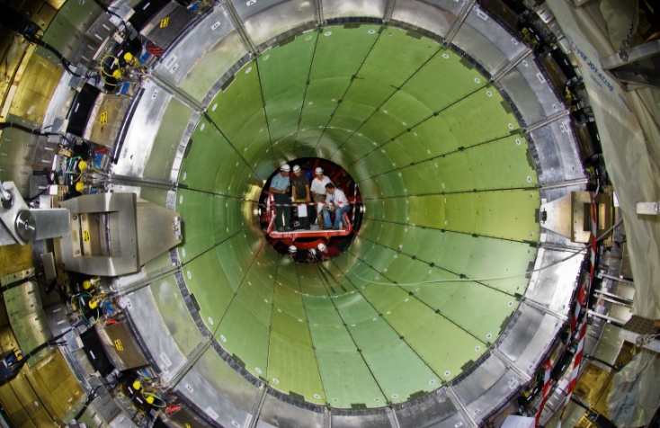
ECAL Trigger & Readout
On-detector:
Trigger energy sums
E.m. feature bit
Trigger and DAQ optical links
Off-detector:
Trigger tower primitives
Data concentration & DAQ interface
Trigger links to RCT
ECAL
Off-Detector Crates
ECAL Crystal Calorimeter
18 Crates
108 Trigger boards
54 DAQ boards
54 Control boards
3000 Gbit optical links
2500 Gbit electrical links

Slide 12
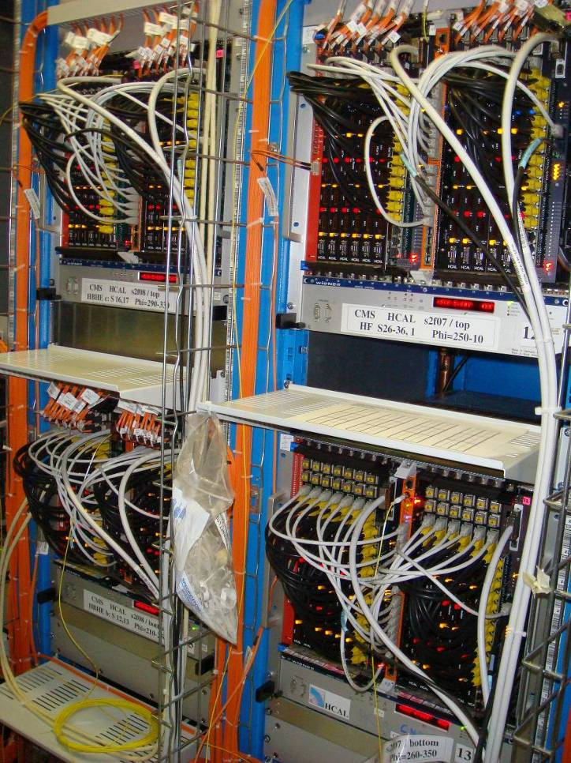
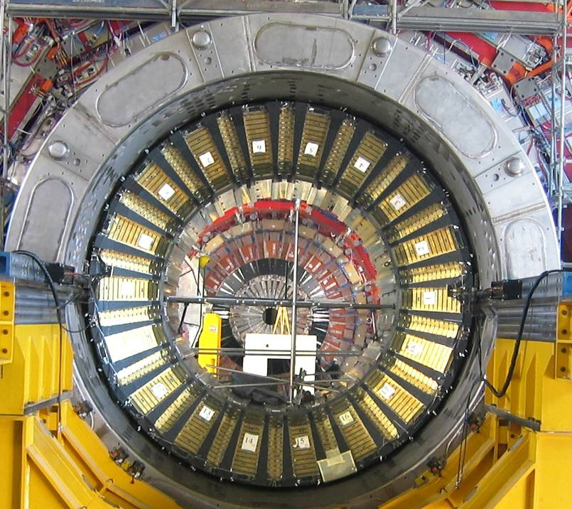
HCAL Trigger & Readout
On-detector:
Pulse digitization
Data transmissions (synchronous)links
Off-detector:
Trigger tower primitives
Data concentration & DAQ interface
Trigger links to RCT
Hadronic Calorimeter
HCAL
Off-Detector Crates

Slide 13
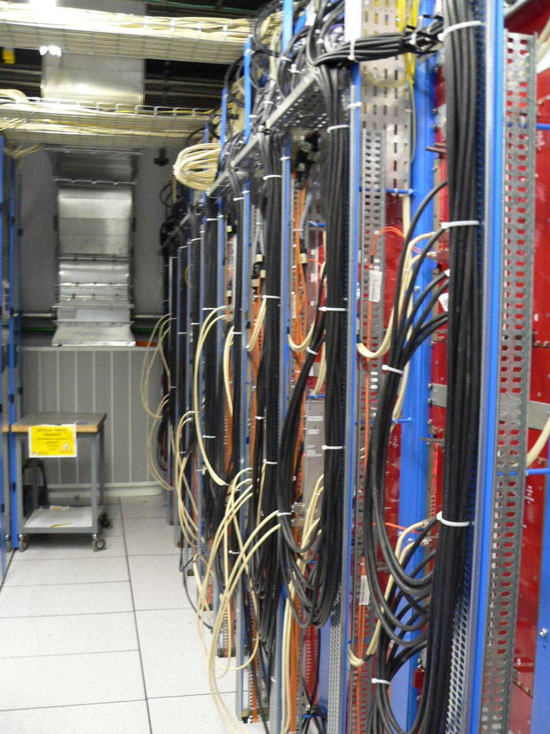
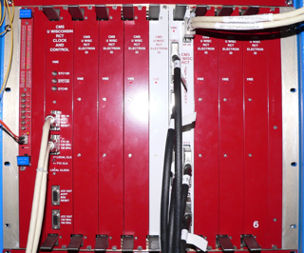
Regional Calorimeter Trigger
Receives Trigger Primitives (TPs) from 8000 ECAL/HCAL/HF towers
Finds top 4 iso and 4 non-iso e/γ candidates per crate
Computes 14 tower sums (regions) per crate
All sent to Global Calorimeter Trigger at 80 MHz on SCSI cables
18 Crates
18 Clock and Control Cards
126 Receiver Cards
126 Electron ID Cards
18 Jet Summary Cards
clock distribution crate
RCT Crate

Slide 14
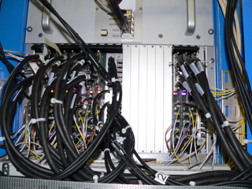
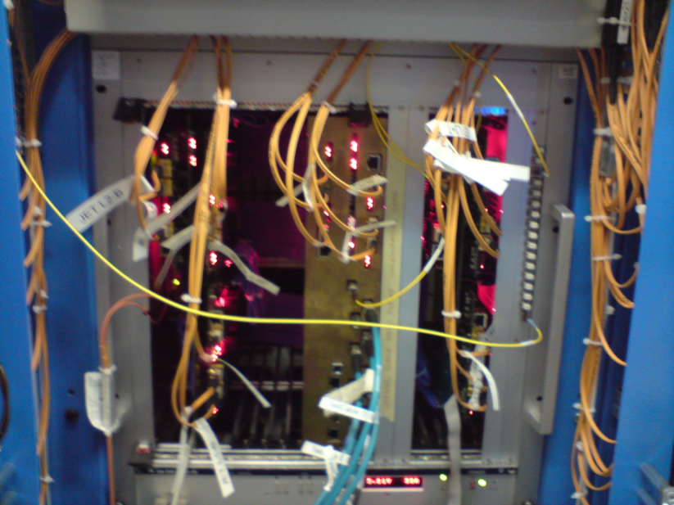
Global Calorimeter Trigger
Source Card System (6 crates)
copper to optical conversion
high speed optical links
GCT Main Crate:
Two wheel cards
One Concentrator Card
Jet finder
Electron sorter
Total and missing energy
- Forward minimum bias trigger
Source Card Crate
GCT Main Crate

Slide 15
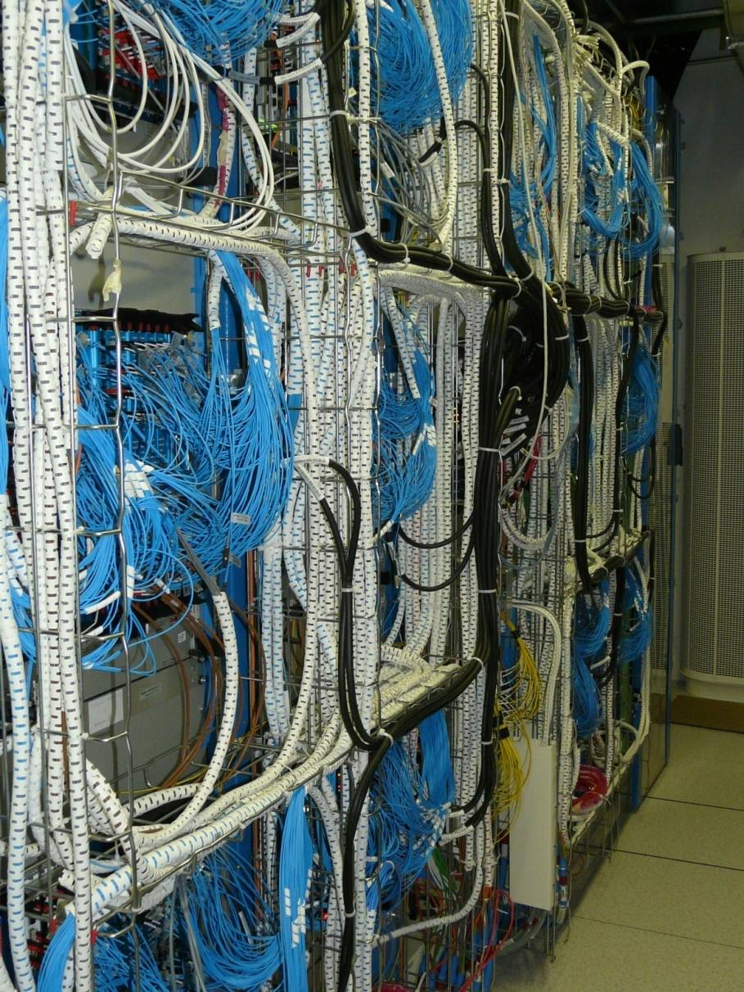
RPC Muon Trigger
RPC trigger pattern comparators
Barrel (4/6) and endcap (3/4)
12 crate PACT and one central crate
Optical fibers from Link Boards on detector periphery
Optical splitting of signals in chambers boundaries
Link Box
Trigger Crate

Slide 16
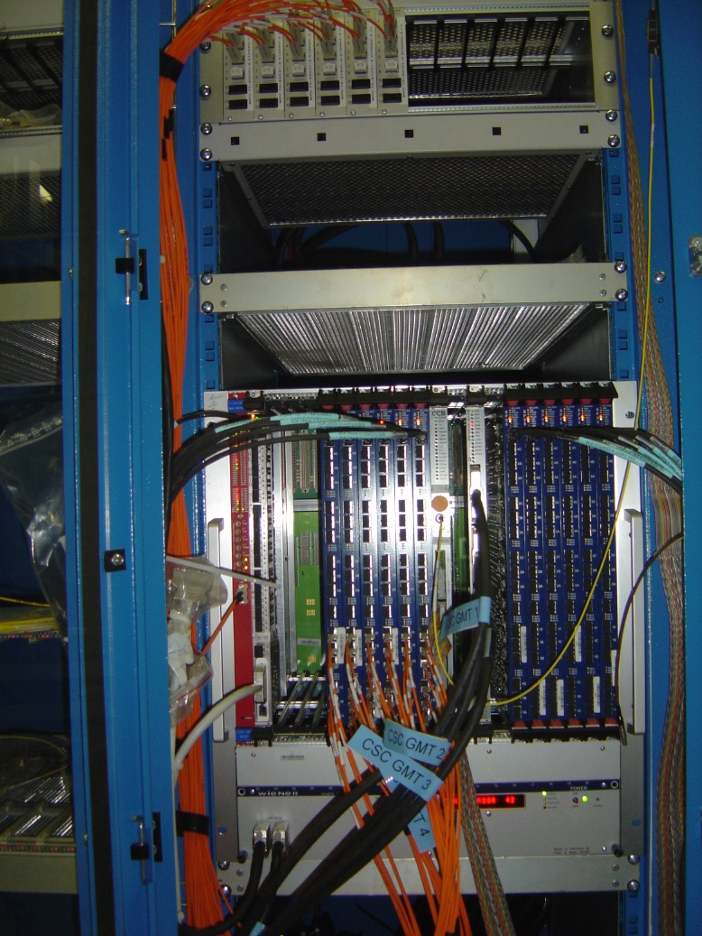
CSC Muon Track Finder
Single crate system
12 Sector Processors
Optical links from CSC Trigger Primitives in Peripheral Crates
Trigger data exchange with DT track finder in barrel-endcap transition region
Data from RPC detector to eliminate ambiguities

Slide 17
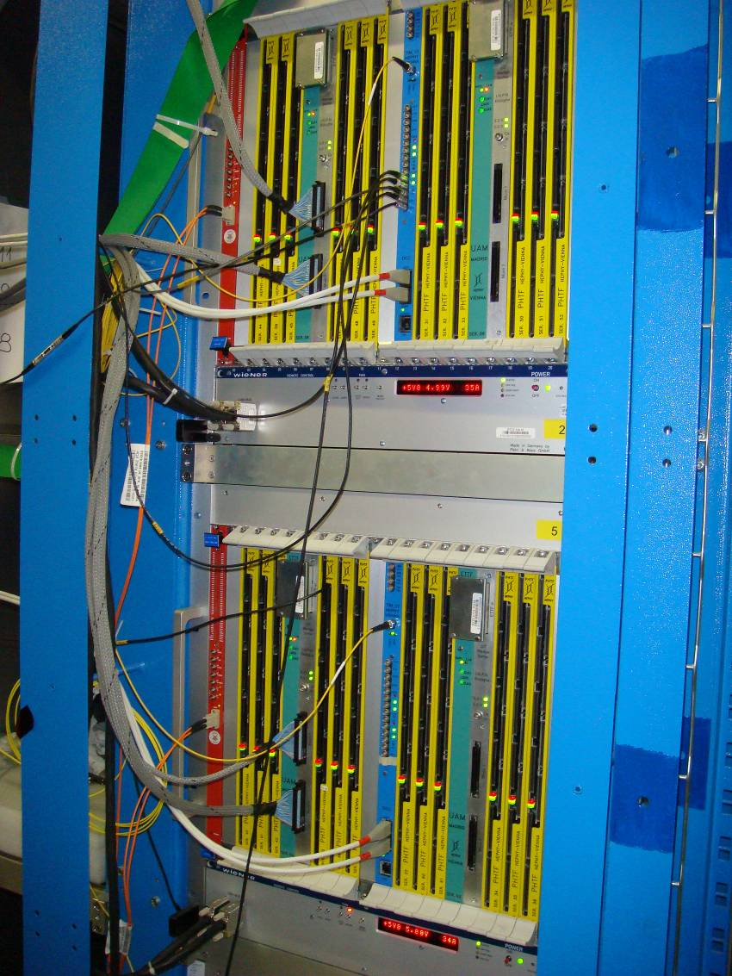
DT Muon Track Finder
6 crate system:
two detector sectors per crate
optical fibers from detector sector collector
data sharing between sectors
Track finding in phi and eta projections
Central crate:
final muon sorter (4 muons)
interface to DAQ
interface to TTC and TTS systems
DTTF Crates

Slide 18
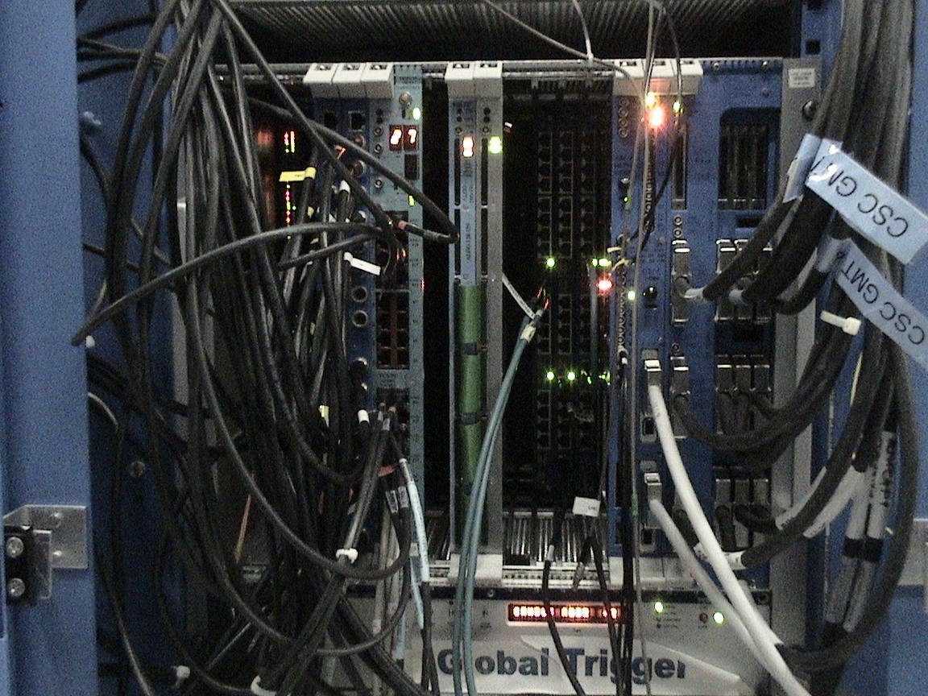
Global Trigger
Single crate system
Global Muon Trigger board: combines muon objects from the three muon systems
Global Trigger algorithms boards
L1Accept and Trigger Control signals distributed to 32 TTC partitions
Allows to operate 8 Detector
Partitions in parallel
Independent Triggers and
control signals per Partition
Global Trigger Crate

Slide 19
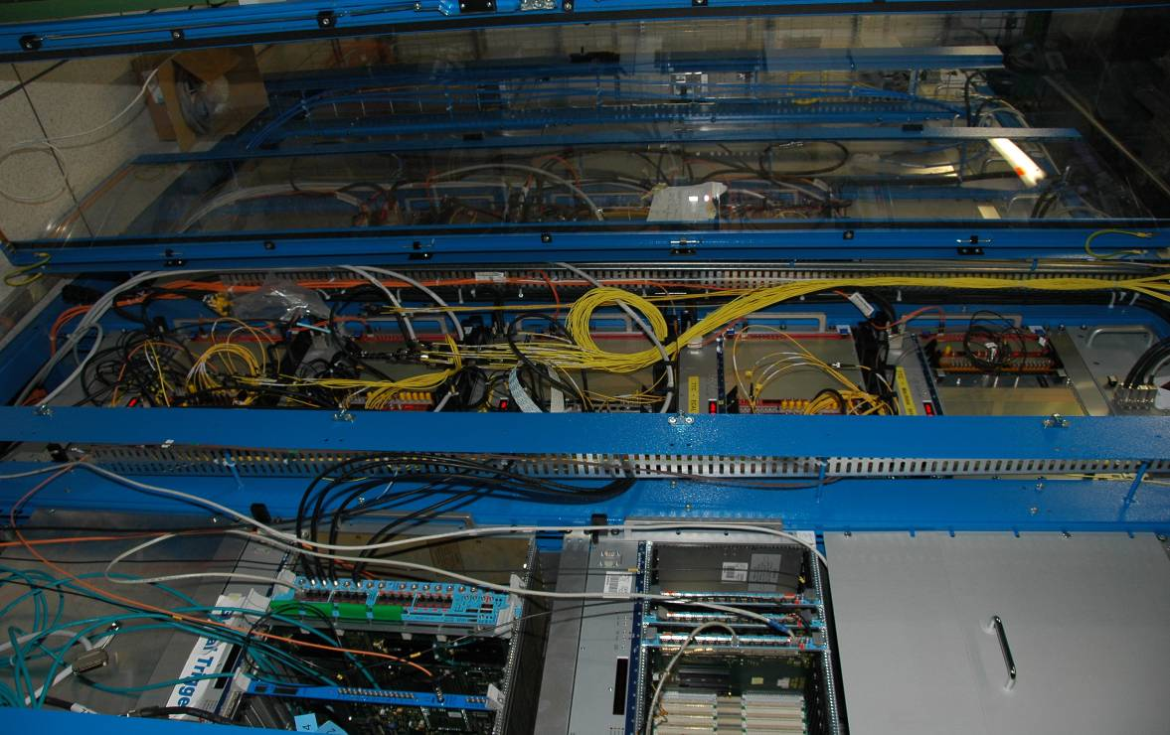
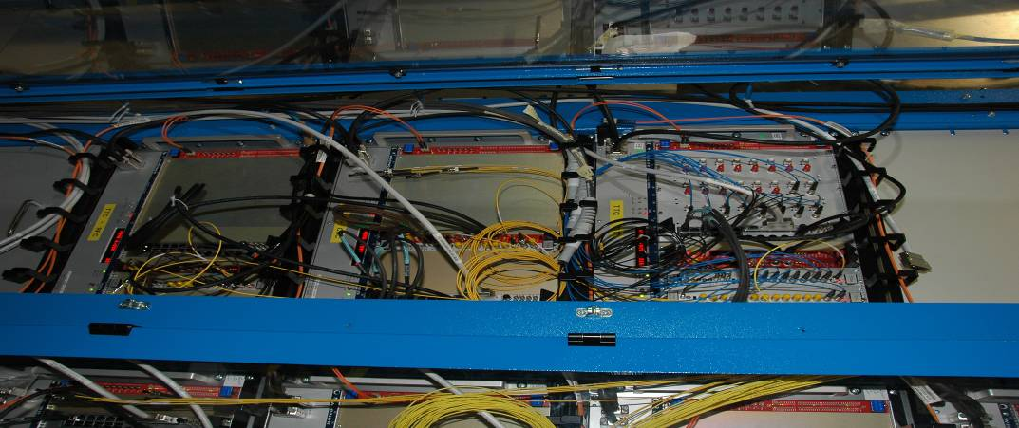
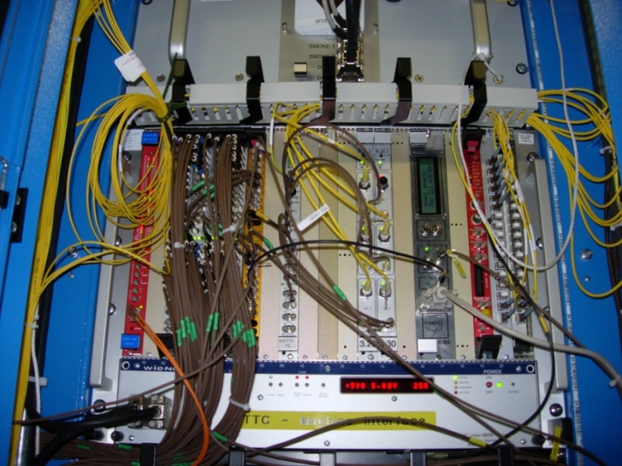
TTC System
Timing and Trigger Control
Interface to LHC machine (clock and orbit)
Optical distribution of clock, L1A and fast signals
Organized in 32 partitions
Local trigger control
TTC Machine Interface
TTC Racks
RF2TTC
Fanouts
RFRX
BST

Slide 20
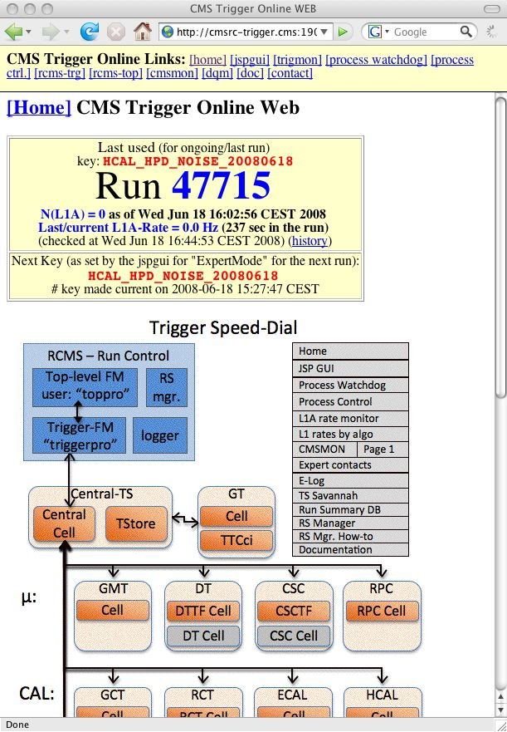
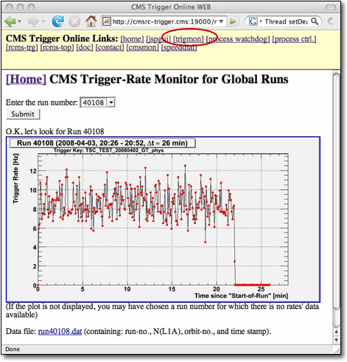
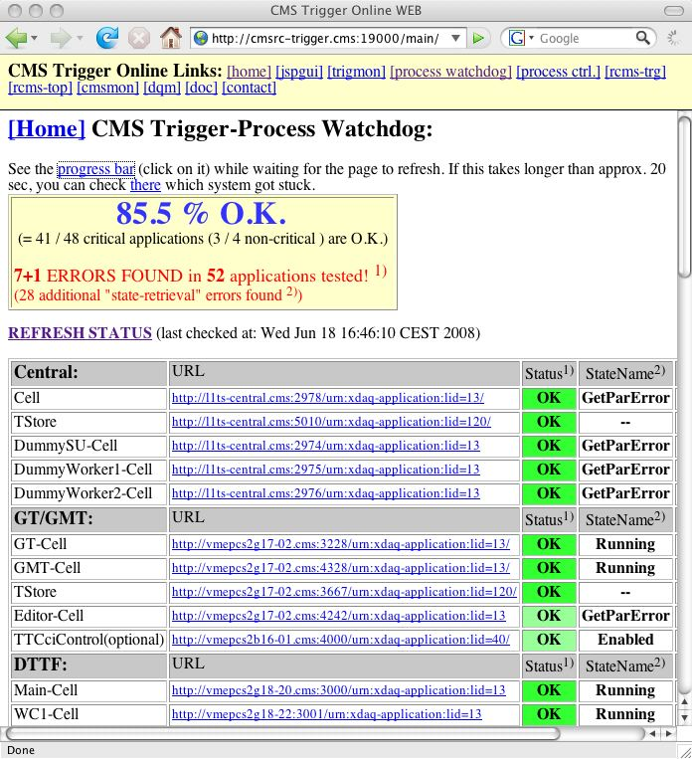
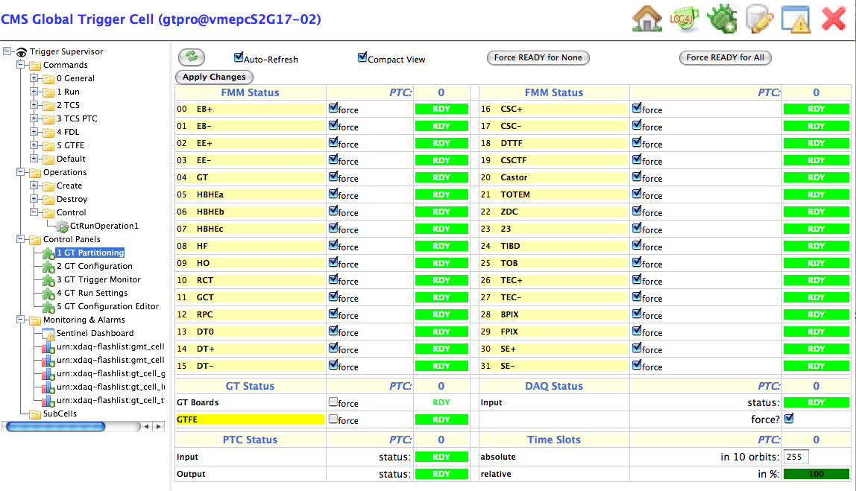
L1 Trigger Online Software
Distributed system
Based on Trigger Supervisor Framework
Monitoring tools
Web based access
Configuration databases

Slide 21
L1 Trigger Emulation
L1 Trigger emulator
● Emulates bit by bit the L1 Trigger subsystems
Implementation:
● Modular design: follow the modularity of the hardware subsystems
● Use the same input as the hardware
● Produce same output as hardware, with identical format
● Use the same configuration as the hardware
Very powerful tool for trigger monitoring

Slide 22
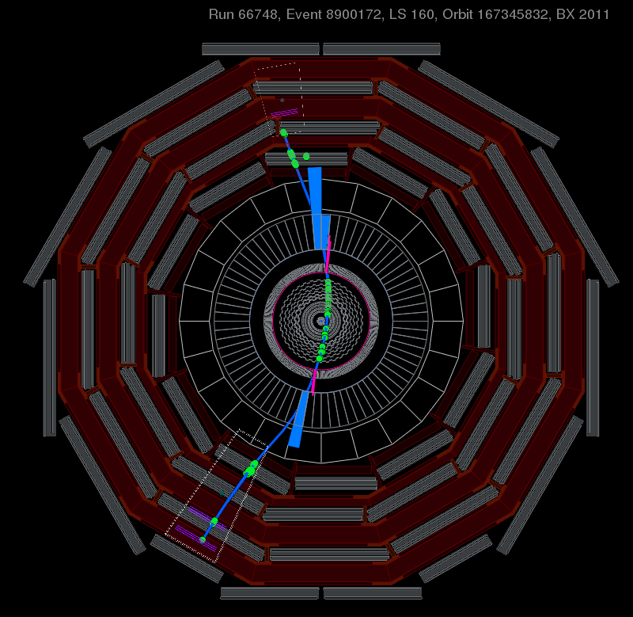
Cosmic muons in CMS
CRAFT:
Cosmic Run at Four Tesla
300 million triggers in 2008
Detectors calibration
Tracking alignment
Trigger studies:
Synchronization
Data vs emulator
Trigger vs reconstructed data
Trigger efficiencies

Slide 23
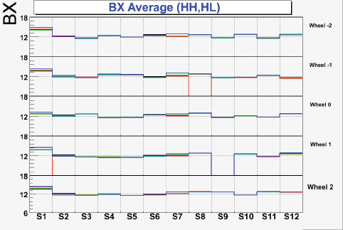
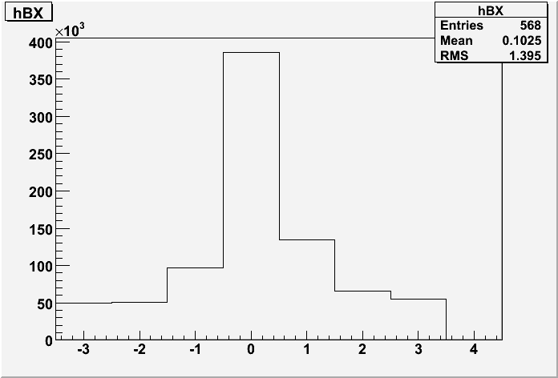
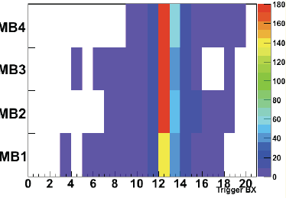
Muon trigger synchronization
Drift tube muon trigger:
Average bunch number
Cosmic muons allowed to synchronize the trigger and detector L1 readout
RPC detector
Bunch Number
Trigger Bunch Number

Slide 24
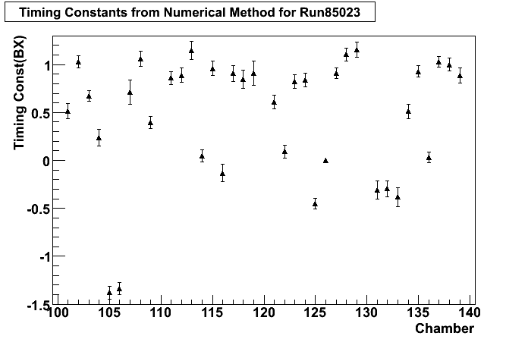
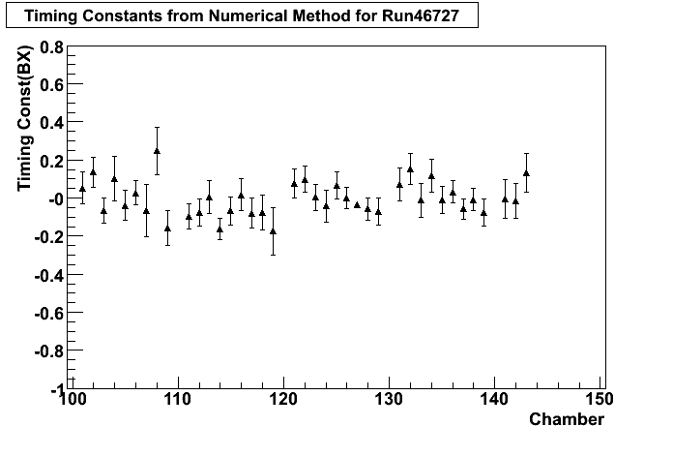
Endcap muons synchronization
Endcap detectors are less favorable for cosmic muons
Large accumulated statistics allowed to collect enough muon crossing the endcaps
A timing shift for each chamber was obtained by an analysis of the data
First measurements
After timing adjustments
⇒ Intra-CSC synchronization within ±0.1 bx

Slide 25
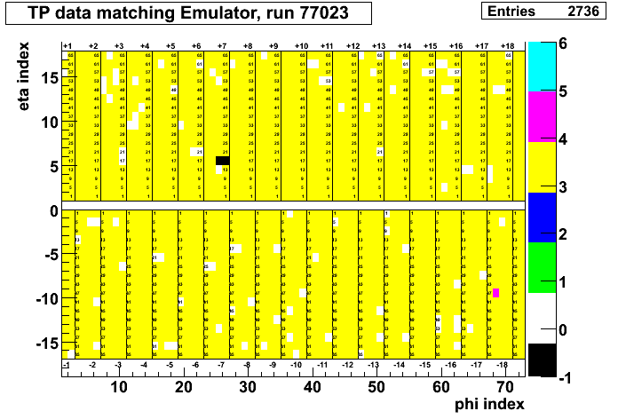
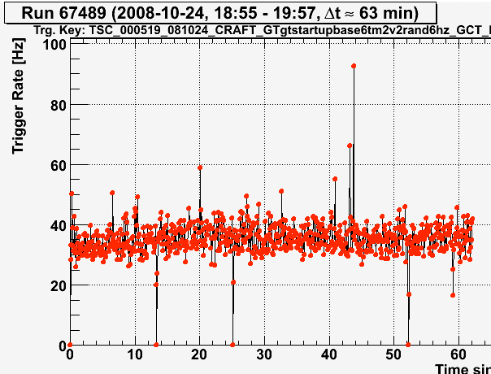
Calorimeter trigger synchronization
Using muon induced energy deposits in calorimeters
In cosmics runs:
Electron/photon trigger (threshold 1 GeV)
Jet and tau triggers
Calorimeter trigger rate ~ 200 Hz
Bunch number of ECAL
trigger tower data
eta
phi
Electromagnetic trigger rate
Time (s)

Slide 26
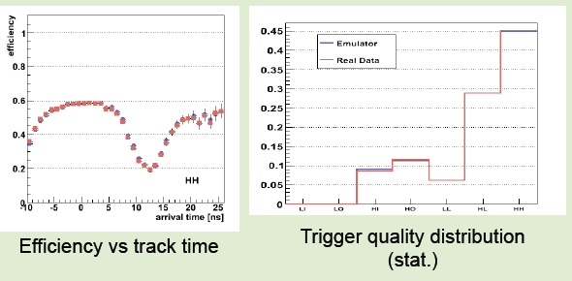
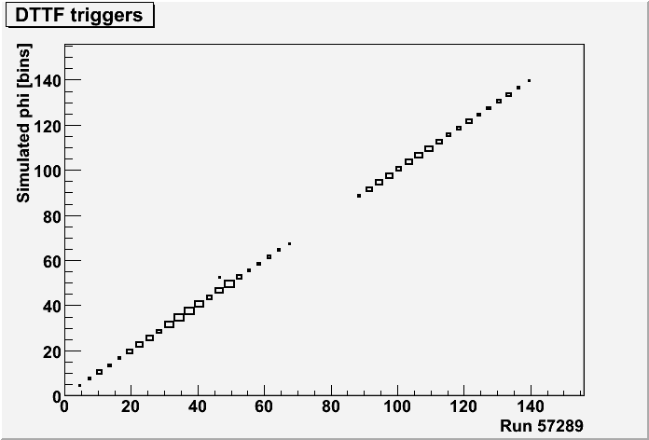
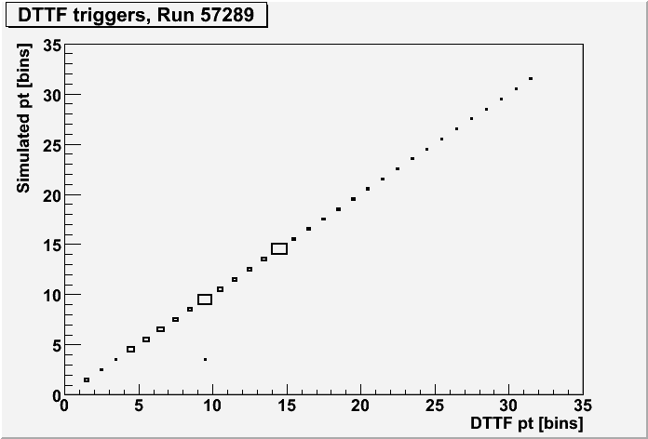
Data vs Emulator: muon trigger
Emulator (blue)
Data (red)
Drift Tube track
segments:
DT Track Finder:
DTTFmuons
Run 57289
phi
pt

Slide 27
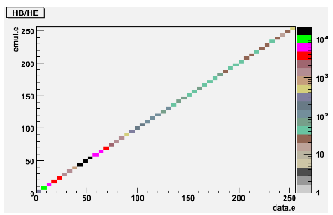
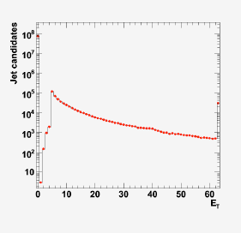
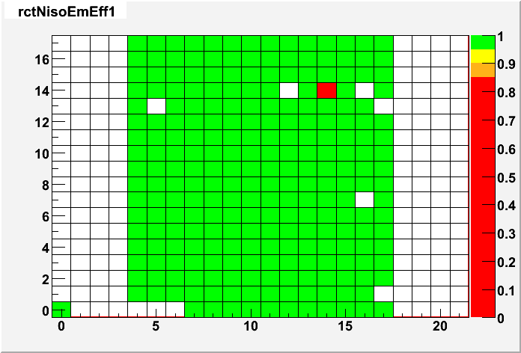
Data vs Emulator: calorimeter trigger
HCAL trigger primitives
Efficiency for data-emulator matching is close to 100%
Problems are easily spotted
phi
RCT electrons
GCT jets
- GCT Emulator (solid black line)
- GCT Data (red points)
phi
Et
eta

Slide 28
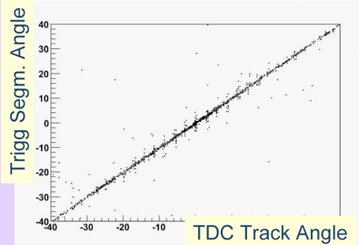
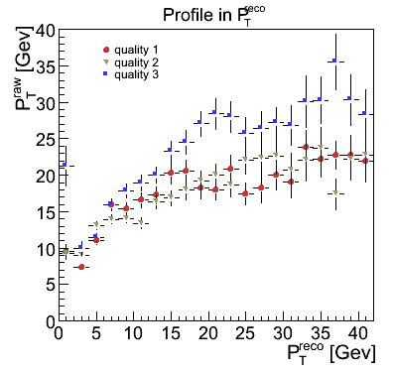
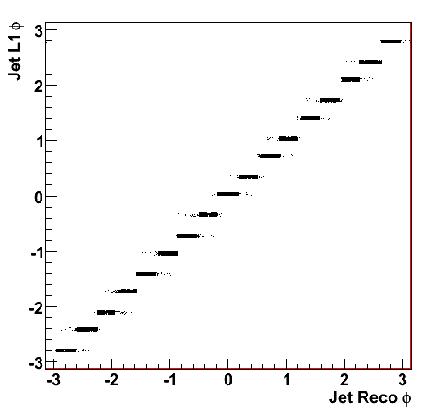
Trigger data vs reconstructed data
DT muon track segments
Trigger objects are sent (in parallel) to DAQ and are compared to objects reconstructed from detector hits
Endcap muon tracks
Trigger
Trigger
Calorimeter Jets
Reconst
Reconst

Slide 29
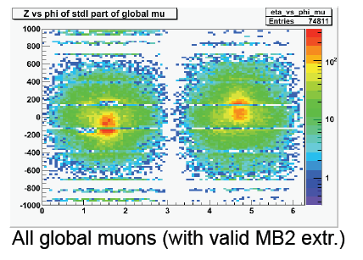
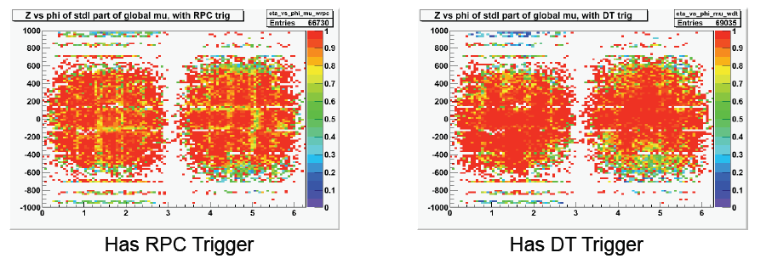
Matching DT/RPC trigger and tracks
Select reconstructed global muons (inner track associated to outer muon chamber track)
Determine efficiency of redundant RPC and DT muon triggers (barrel)
Z
phi

Slide 30
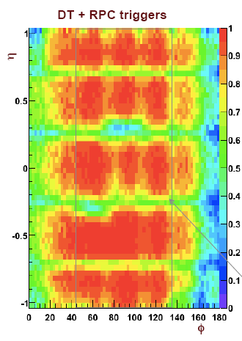
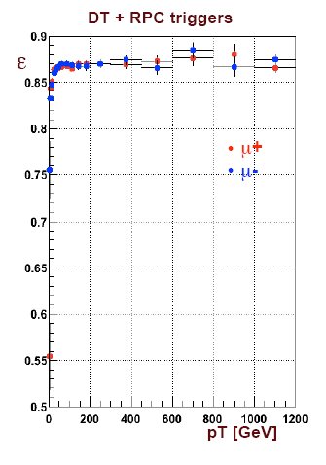
Barrel muon trigger efficiency
Tag&probe method with cosmic muon traversing CMS:
Trigger with the Bottom detectors
Measure efficiency in the Top detectors
Inefficiency is dominated by acceptance (intrinsic efficiency >95%)
fiducial

Slide 31
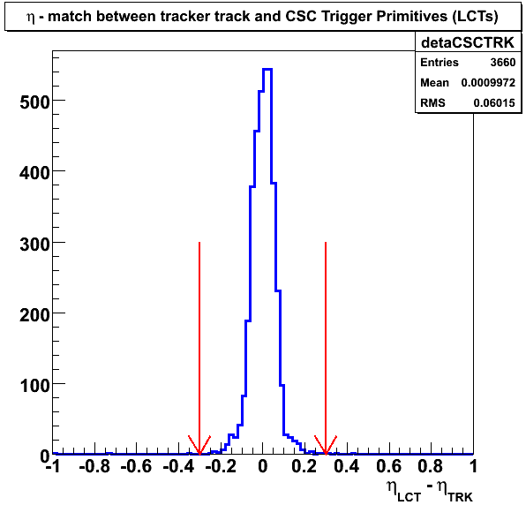
Endcap muon trigger efficiency
Select reconstructed tracks traversing the two endcaps (1.1<|η|<2.1)
Tag&probe: trigger with one endcap, measure in the other
Look for matching Trigger tracks
Matching tracker and trigger
Trigger primitives efficiency
Muon track finder efficiency
98%

Slide 32
Electron trigger efficiency
Cluster energy
Select reconstructed global muons
Search electromagnetic deposits matching the muon
Look for matching electron trigger candidates
ET

Slide 33
LHC beams dumped in collimator
Sep 7, 2008
Recorded 17 beam shots
L1 Triggers used:
BPTX+ (beam pick-up sensor)
CSC halo
HF minimum-bias trigger
Total no-beam rate ~3Hz
CSChalo,HF
HF after pulse
(filtered by trigger rules)
BPTX+
run 61642
Sun Sep 7 20:33:14 2008
Sun Sep 7 20:34:39 2008
Sun Sep 7
Sun Sep 7
Sun Sep 7 20:38:50 2008
Sun Sep 7 20:40:15 2008
Sun Sep 7 20:41:38 2008
Sun Sep 7 20:43:04 2008
Sun Sep 7 20:44:28 2008
Sun Sep 7 20:45:52 2008
Sun Sep 7 20:47:15 2008
Sun Sep 7 20:48:39 2008
Sun Sep 7 20:50:03 2008
Sun Sep 7 20:51:28 2008
Sun Sep 7 20:59:51 2008
Sun Sep 7 21:01:15 2008
13073 Sun Sep 7 21:05:27 2008
Bunch Number
List of 17 beam splash events

Slide 34
LHC beams through CMS
Sep 10, 2008
Run 62064 – BPTX+ trigger
BPTX adjusted on-the-fly to be in time
First beam passing through CMS
Triggers used:
BPTX
CSC halo
HF minimum-bias trigger
Synchronization of trigger data:
Bunch occupancy histograms with trigger data
Bx
orbit
N
ECAL trigger
Bx

Slide 35
Beams seen with muon halo trigger
Sep 11, 2008
During the period of first RF-captured beam
the rate of halo muon triggers (CSC) increased significantly
TS#1
TS#2
Average halo rate from cosmic ray backgrounds is about 2.2Hz.
TS#3
TS#4
TS#5
TS#6

Slide 36
Final Comments
The CMS trigger is now ready
Commissioning of this large system was an hard task
The performance achieved with cosmics is good
Not covered:
What did we learn?
Probably a good topic for RT2010 in Portugal

