Slide 1
Commissioning of the ATLAS High Level Trigger with Single Beam and Cosmic Rays
RT2009 Conference
Beijing (China)
12-May-2009
Cristobal Padilla (IFAE-Barcelona/CERN) on behalf of the ATLAS Collaboration
Outline:
Review of HLT architecture
Tools needed for Commissioning
Operational conditions for single-beam and cosmic rays
HLT results from single-beam and cosmic ray running
Summary

Slide 2
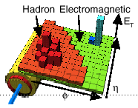
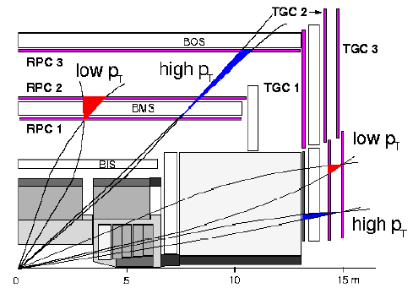
Trigger/DAQ Architecture
Trigger
Calo
MuTrCh
DAQ
Other detectors
40 MHz
40 MHz
LV
L1
D
E
T
RO
FE Pipelines
RoI
2.5 μs
Lvl1 acc = 75 kHz
75 kHz
RoI data = 1-2%
ROD
ROD
ROD
Read-Out Drivers
120 GB/s
Read-Out Links
120 GB/s
~ 10 ms
ROS
Read-Out Buffers
RoI Builder
LVL2
RoI
requests
D
A
T
A
F
L
O
W
H
L
T
ROB
ROB
ROB
L2 Supervisor
L2 N/work
L2 Proc Unit
ROIB
L2SV
Read-Out Sub-systems
L2P
L2N
~2+4 GB/s
~2 kHz
Lvl2 acc = ~2 kHz
EB
Dataflow Manager
DFM
EBN
Event Building N/work
~ sec
Event Filter
~4 GB/s
SFI
Sub-Farm Input
Event Filter
Processors
EFP
Event Builder
EFP
EFN
Event Filter N/work
EFP
EFP
EFacc = ~0.2 kHz
SFO
Sub-Farm Output
~ 200 Hz
~ 300 MB/s

Slide 3
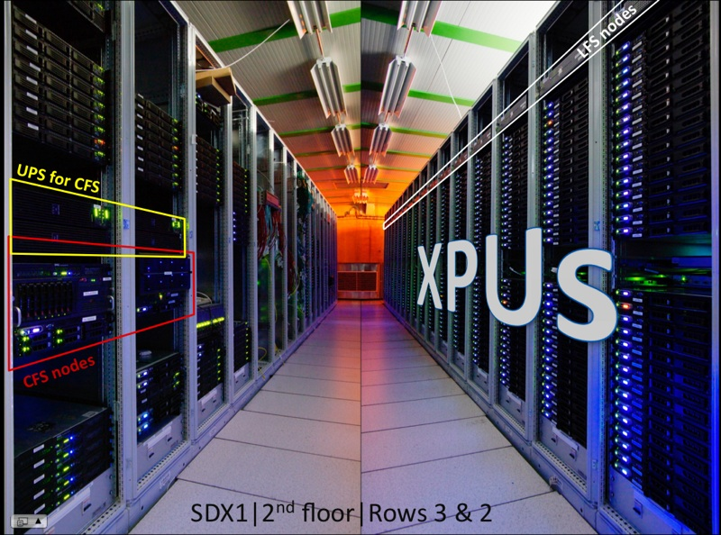
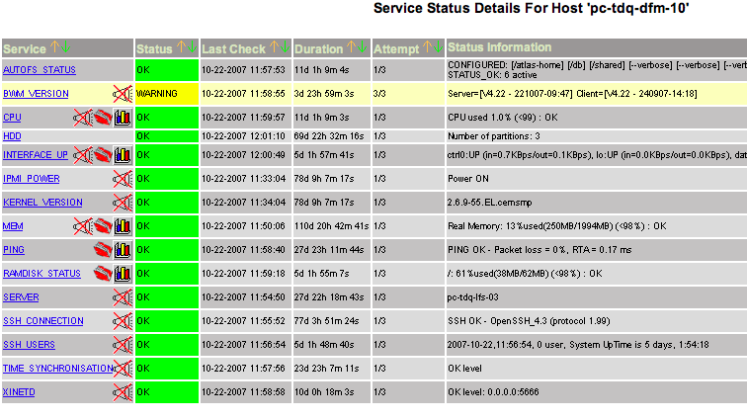
HLT Hardware Installation
Currently 824 nodes on 27 racks
8 cores/node in 2xHarpertown quad-core @2.5 GHz
2 GB memory/core
Can run L2 or EF
Example node monitored with a tool based on nagios

Slide 4
HLT Structure
EM ROI
EM ROI
The basic ingredient of the HLT is the HLT Steering which controls the flow of code execution inside the HLT processing units
Algorithms for feature extraction (FEX) and applying requirements (HYPO)
  Configurable by parameters
  Results (Features) cached by HLT steering
Sequences: FEX and HYPO algorithms producing TriggerElements (ex: L2_mu10)
Chains: Ordered list of defined numbers of TriggerElements
  Steering aborts chains as soon as given step fails (early reject)
Menu: Collection of chains (and pass-through+prescales)
  In python or xml, recorded in database
L2 Calorim.
L2 Calorim.
TrigEMCluster
Cluster?
Cluster?
L2 tracking.
TrigInDetTrakcs
Track?
Match?
EF Calorim,
EF Calorim,
CaloCluster
EF tracking
EFTrack
Track?
e/γ reconst.
e/γ reconst.
egamma
e OK?
γ OK?
FEX
HYPO
Feature

Slide 5
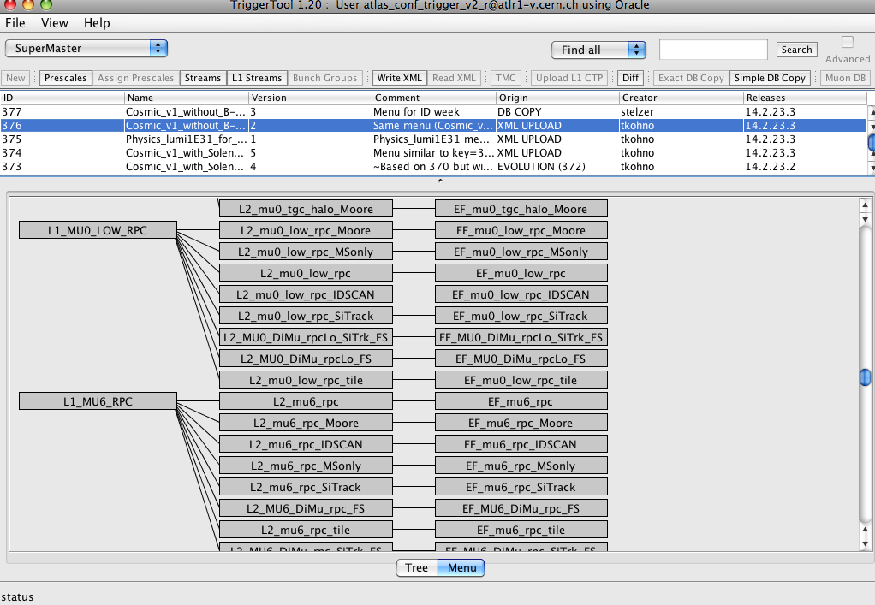
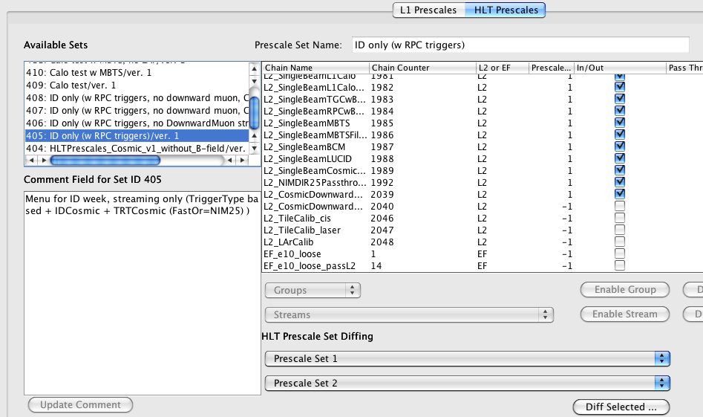
Trigger Tool
Tool for shifters, experts and offline users
  Offline user can easily check the configuration used in a run
  Trigger shifter can modify pre-scales and pass-through settings
  Expert can modify aspects of the trigger configuration

Slide 6
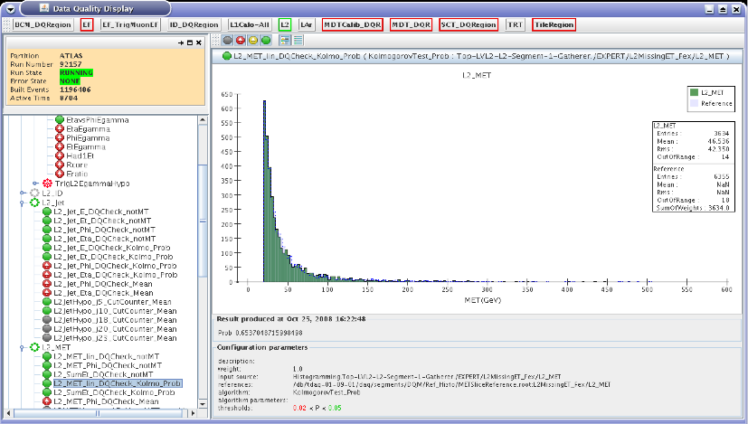
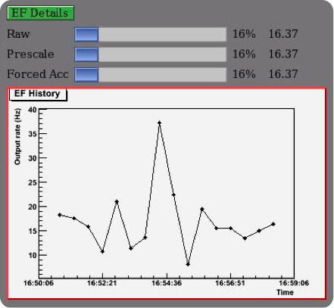
Online Monitoring
Automatic Data Quality checks
Rate Monitoring
Trigger Presenter
  Provide rate information and farm status
  Displays detailed trigger rates (and history) at any step of the HLT selections
Algorithms online monitoring and Data Quality
  Algorithms produce histograms for shifters and experts
  Statistics of all nodes is gathered and centralized
  Automatic checks are also performed and displayed

Slide 7
Offline Monitoring
Tier0: Designed to reconstruct all events (200 Hz) from ATLAS within ~24 hours (1600 cores, 2 GB /core, CERN batch workers)
  Allows review of saved trigger quantities (used extensively) and comparison with offline reconstructed objects.
CAF: (CERN Analysis Facility), constituted by 400 cores, 64 for trigger use
  Designed to rerun ~10% of collected events for calibration and commissioning
  Checks the HLT decision: run on minimum bias stream and events taken in pass through mode to compare online and offline results
  Handles the debug stream: events with HLT crashes, errors and timeouts
  Deployment of new code for HLT farm: Separate patch branch of trigger code with its own “nighlies” to be tested with real data

Slide 8
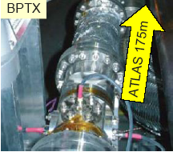
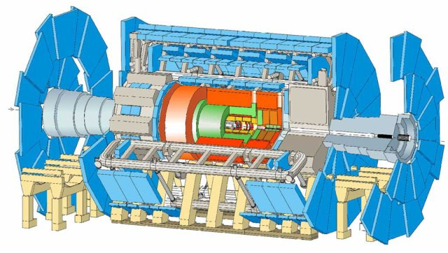
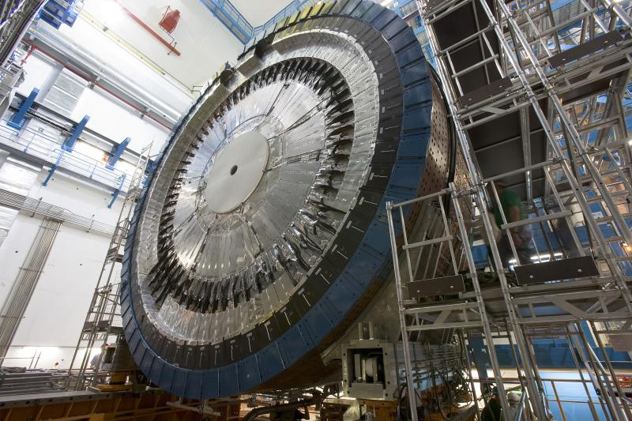
First experience with LHC beam
LHC beam
Loss monitor
Tertiary collimators, 140 m
beam splash events when closed
BPTX, 175 m
Reliability and stability main goals for the first beam
  A simple configuration based on L1 decision only
    Crucial to have the Beam Pickups (BPTX) and Minimum bias scintilators (MBTS) well timed in
  Protect detectors
    Pixel detector off
    Semi Conductor Tracker (SCT) at low bias voltage
    Muon system at reduced High Voltage
  HLT infrastructure used for tagging event and routing them to streams
    Algorithms not run except when needed for streaming tasks
Less than 1k events on which the HLT could be later run offline
  Only those that have an RoI in Calorimeter or Muon in time with BPTX or MBTS
Minbias Trigger Scintillator:
32 sectors on LAr cryostat

Slide 9
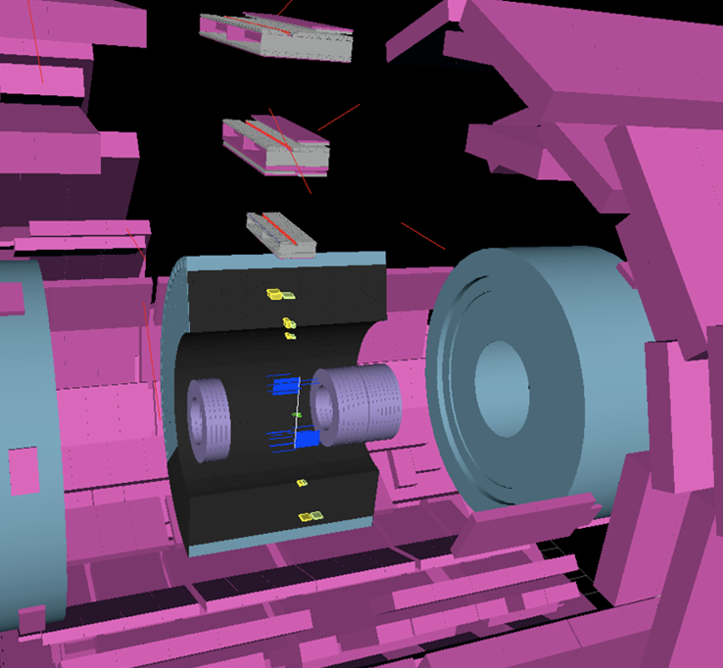
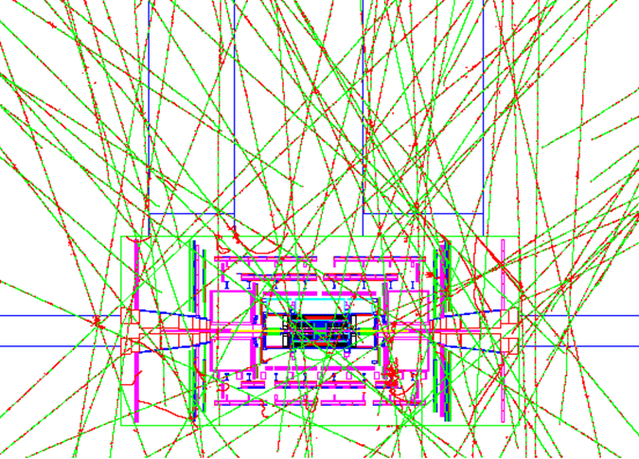
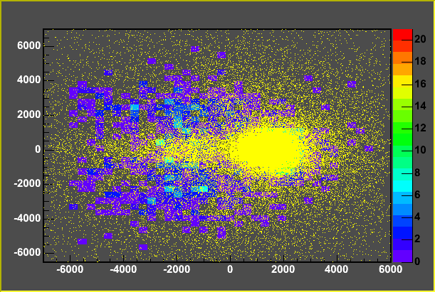
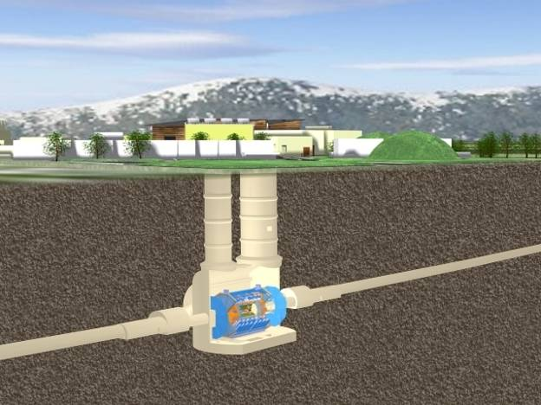
Commissioning with Cosmics
Simulated cosmics flux
in the ATLAS cavern
Real Cosmic Event
x (cm)
Muon impact points extrapolated
to surface as measured by
Muon Trigger chambers (RPC)
(Calorimeter trigger also available)
ATLAS shafts
z (cm)
Rate ~100 Hz below ground:
~ O(15 Hz) crossing Inner Detector
Notes:
Comment that particles are need for the full commissioning of the detector: first cosmics, then single beam then collisiong

Slide 10
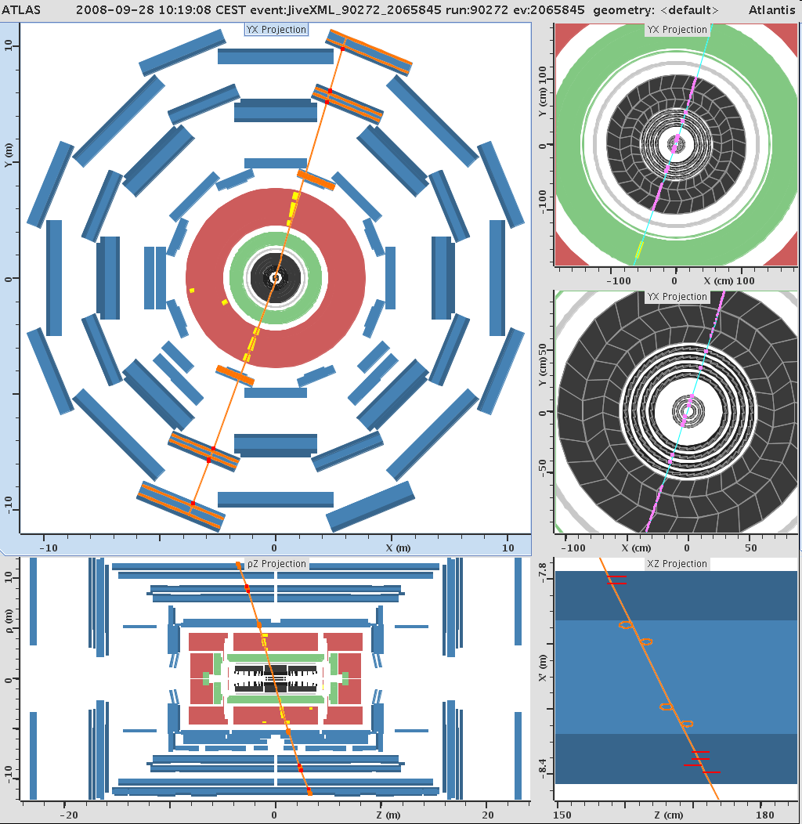
A Nice Cosmic Muon Through the whole Detector
Notes:
WE have recorded nice events like this one where the muon has crossed the whole detectos and has passed thorugh the interation point area

Slide 11
Issues on Cosmic Event Data
Confirm plane high pt
Pivot plane
Confirm plane low pt
Muon Spectrometer:
RPC trigger setup
No beam clock
  Muon trigger chambers provide timing
  Phase issues in read-out/calibration of precision muon chambers (MDT), transition radiation tracker (TRT), etc..
No beam/no IP
  Tracks distributed over d₀, z₀
  L2 dedicated algorithms for fast muon reconstruction (in MDTs) and fast tracking algorithms in inner detector assume particles pointing towards the beam line
Muons in HLT
  The r-z view could not be fully reconstructed at L2 because algorithms are designed for pointing tracks and data access request is in trigger towers pointing to the IP
  Possible to relax pointing requirements to study rejection/efficiency
  Timing issues cause percent-level loss
Tracking in HLT
  Significant modification to get tracks needed for inner-detector alignment

Slide 12
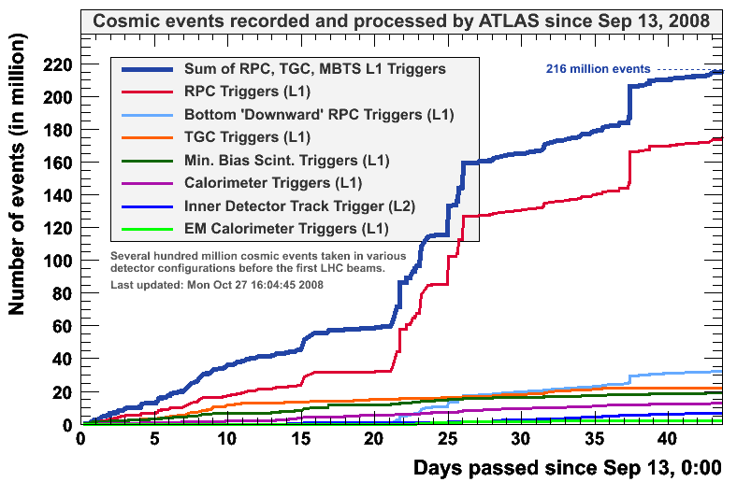
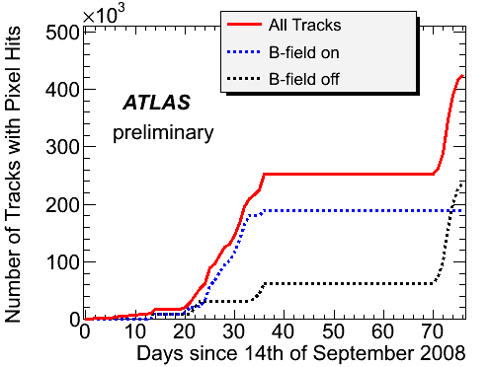
Commissioning with Cosmics
A huge amount of cosmic
ray triggers are recorded,
in total (left) as well as
giving tracks also in the
smallest-volume detector,
the Pixels (below)
Active use of the High Level Trigger system to select tracks that cross the Pixel detector and classify the events in a special stream.
Good test of the infrastructure for trigger and analysis
Notes:
Just read it

Slide 13
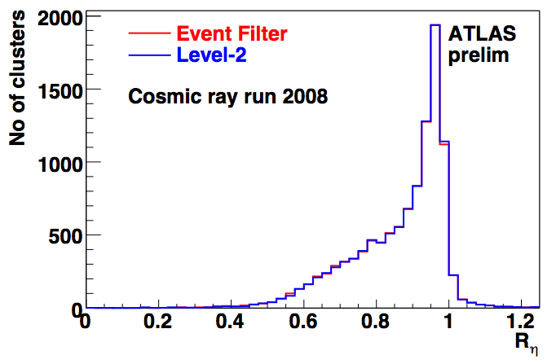
Cosmic run: use of Physics Menu
Despite low expected statics, a full physics menu run in parallel to cosmic chains.
  e/γ, jets/missing ET, τ, μ, minimum bias…
ROIs with e/γ, τ, etc. signatures not very common with cosmics, rarer to get events until the end of the chains.
A few thousand of events
Both L2 and EF algorithms exercised successfully
Example plot from eγ FEX algorithms comparing L2 and EF: Shower shape in 2nd EM sampling Rη=E(3×7)/E(7×7).

Slide 14
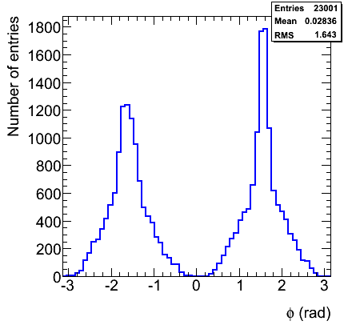
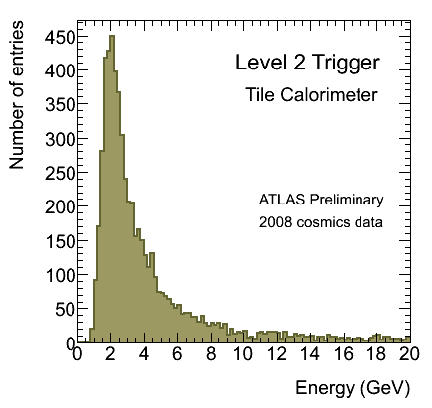
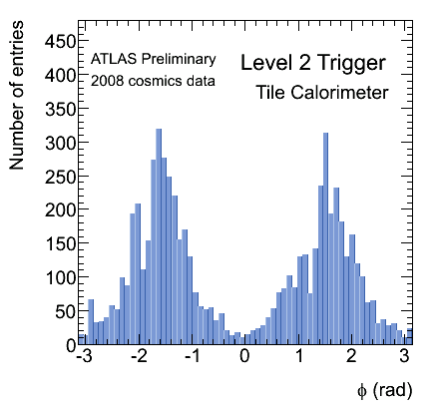
L2: calorimeter algorithm
ATLAS Preliminary
Cosmic Monte Carlo
Algorithm implemented into the calorimeter Read Out Driver (ROD) DSP and result decoded at L2
Poor efficiency (<< 1%) due to lack of ROI pointing
Back-to back distribution seen
Energy deposition agrees with that for a MIP
Run 91060
energy deposition
and ϕ distributions
of muon tracks in
Tile Calorimeter

Slide 15
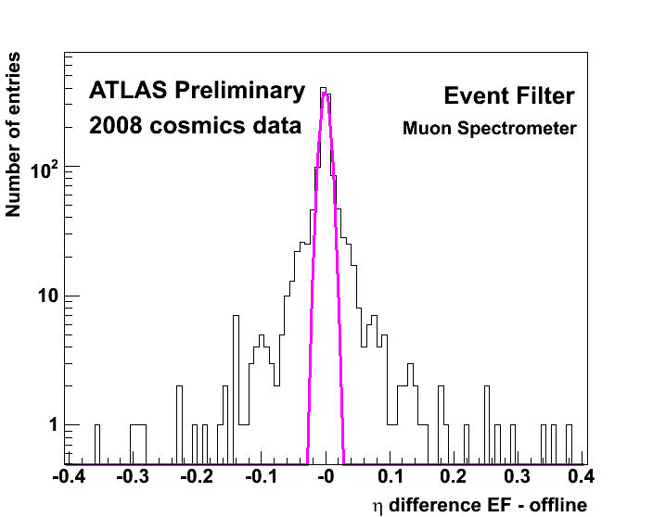
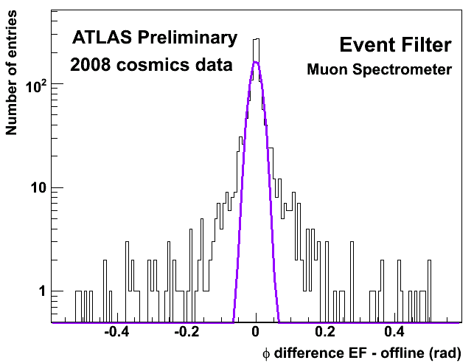
Muon Event Filter
MUON algorithm exercised on cosmic data
angular resolutions (η,ϕ): σ_{η}=0.007, σ_{ϕ}=17mrad
Solenoidal and toroidal field on
Resolutions with respect to Offline
η resolution
φ resolution
Tails in the distributions are consequences of different calibration constants and the RoI-based strategy in the EF algorirthm

Slide 16
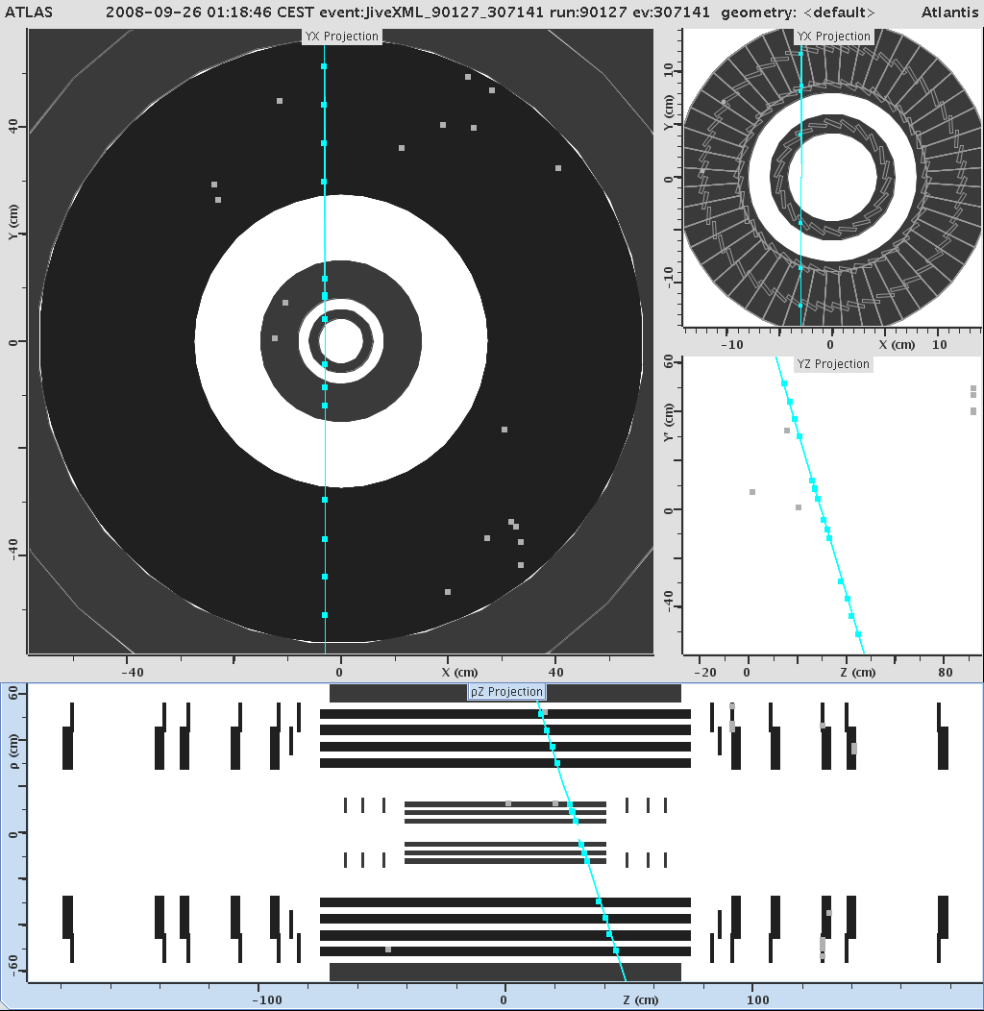
L2 ID Tracking
Three L2 tracking algorithms:
  Si Track: Combinatoric search for track seeds in innermost Si layers and their extension into tracks in outer Si layers. Si algo with TRT extension.
  IDSCAN: use histogramming techniques to find z-position of the IP and identify tracks originating from there. Si algo with TRT extension.
  TRTSegFinder: TRT-only algorithm looking for segments in the TRT.
Goal: Record as many ID tracks as possible, do not introduce biases in selection, keep rate at acceptable levels.
Secondary goal: to the extend possible, try to use machinery, setup, algorithms, etc. that are used for collisions.

Slide 17
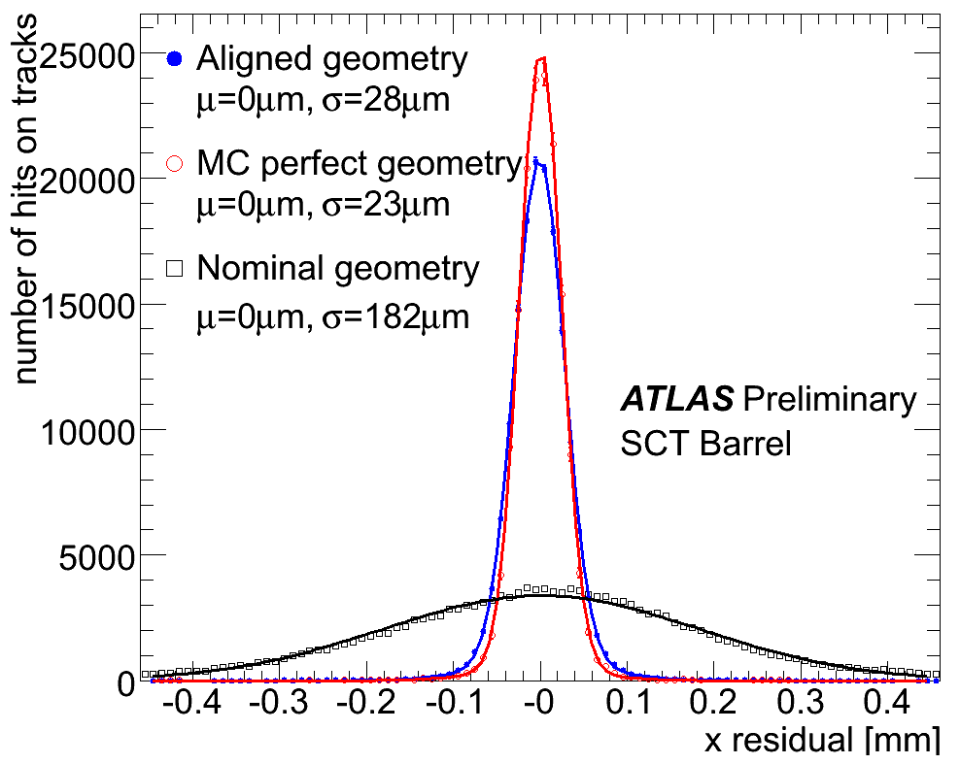
L2 ID Tracking: Performance
Trigger chain starting with all L1 accepted events and involving an OR of any L2 tracking algorithm finding tracks.
Allowed collection of a good fraction of cosmic muons passing through the inner detector, with no significant biases
Performance:
  Uniform event efficiency of >99% for “golden Si” tracks.
  Fake rates 0.01%-1%.
  Algorithms complementary.
Rerun 1 month later: HLT tracking
works out of the box, despite some
changes in the detector configuration!

Slide 18
Summary
The ATLAS HLT has been fully tested under actual data taking conditions
  Algorithms for L2 and EF
  Configuration
  Steering
  Monitoring
The HLT actively contributed to data taking
  HLT infrastructure used for streaming in single beam and cosmic ray operation
  Vital use of L2 tracking for collection of cosmic tracks to be used for Inner Detector alignment
HLT commissioning is progressing well and there is ongoing work in different areas to be ready for LHC operation
  Monitoring improvements
  Speeding up boot-up and configure transitions
  Continue measuring performance with cosmic running

Slide 19
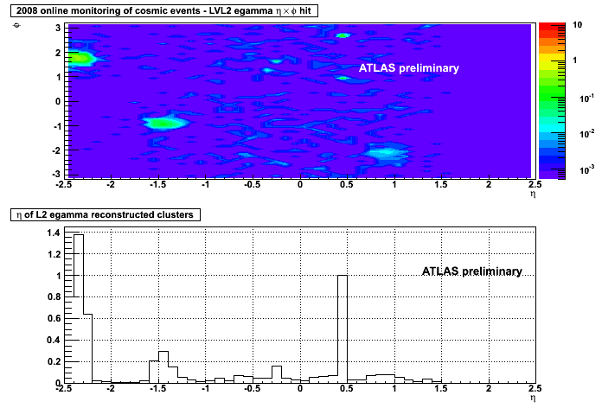
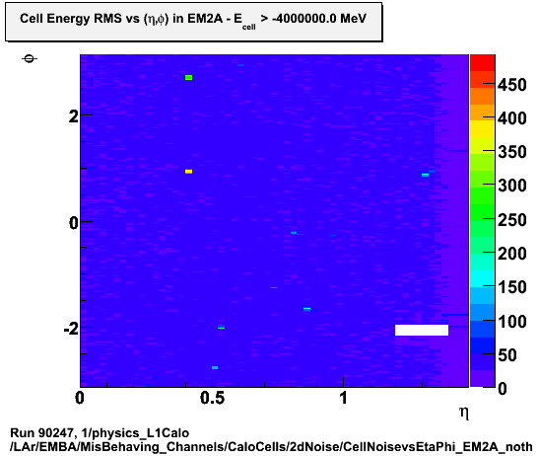
L2 Calo: HLT feedback to the Detector
Hot cells in the eta region around 0.475 are seen by the HLT monitoring and by the detector monitoring. Plots normalized wrt the counting of the bin 0.475.
Cross checking possible. Calo Trigger functional and may help identifying hot detector regions.
Hardware issues addressed during shutdown
Hardware issues addressed during shutdown
Detector Online monitoring
Hardware issues addressed during shutdown
MeV
ATLAS preliminary

