Slide 1
Collecting more data for XYZ study at BESIII
Changzheng Yuan
IHEP, Beijing
QCD & Exotics, Jinan, China
June 8-12, 2015

Slide 2
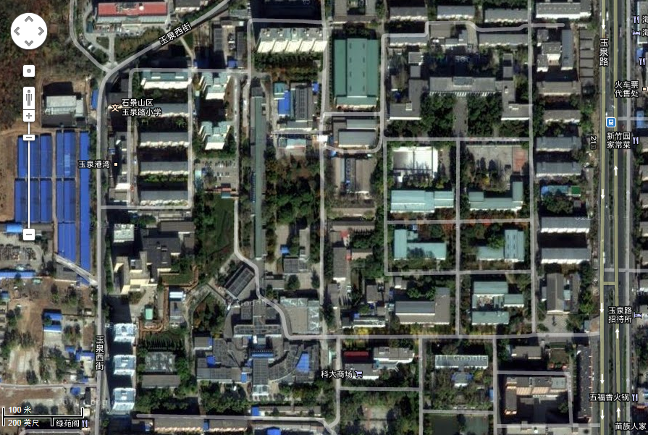
北京正负电子对撞机 （BEPC）
Satellite view of IHEP, Beijing
LINAC
My office
BEPCII
(Beijing electron-positron collider)
Founded: 1984, Ecm=2-5 GeV
1989-2005 (BEPC):
L_{peak}=1.0x10³¹ /cm²s
2008-now (BEPCII):
L_{peak}=8.5x10³²/cm²s
BESIII detector
Main entrance to IHEP
Campus of IHEP, CAS

Slide 3
BEPC II: double-ring e⁺e⁻ collider
Beam energy:
1-2.3 GeV
Luminosity:
1×10³³ cm⁻²s⁻¹
Optimum energy:
1.89 GeV
Energy spread:
5.16 ×10⁻⁴
No. of bunches:
93
Bunch length:
1.5 cm
Total current:
0.91 A
SR mode:
0.25A @ 2.5 GeV
RF
RF
Compton back-scattering for high precision beam energy measurement
BESIII is here
IP

Slide 4
BESIII detector
SC magnet, 1T
Magnet yoke
RPC
TOF, 90ps
Be beam pipe
MDC, 130 μm
0.5% at 1 GeV/c
Total weight 730 ton, ~40,000 readout chnls, Data rate: 5kHz, 50Mb/s
Ming YAO
CsI(Tl) calorimeter, 2.5% @ 1 GeV

Slide 5
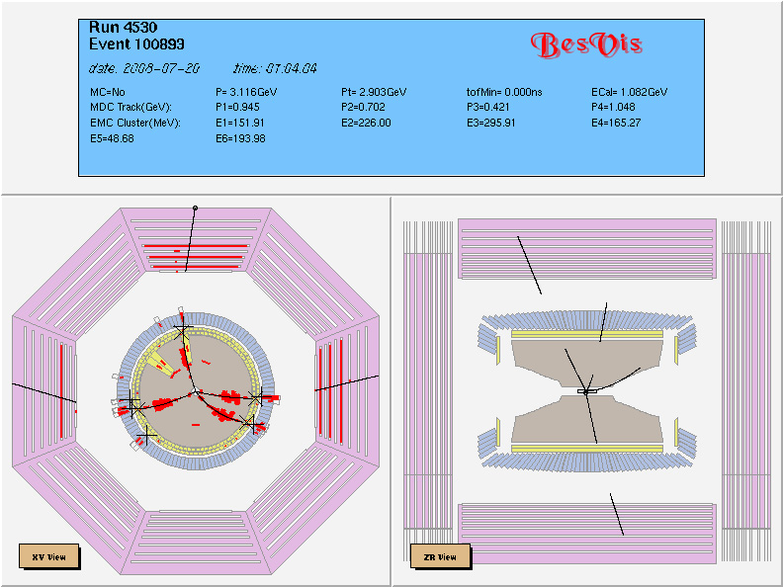
First event: July 20, 2008

Slide 6
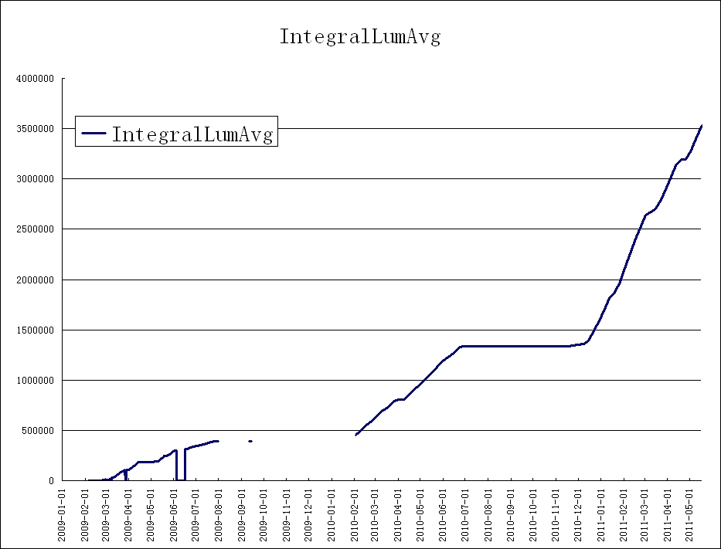
BESIII data samples
Note that luminosity is lower at J/ψ,
and machine is optimal near ψ’’ peak
2012:
ψ′ & J/ψ
[0.4B & 1.1B]
Integrated lum.: Jan. 2009– May 31 2011
about 4.0 fb⁻¹ @ different energies
Note increase in slopes!
ψ’’: 2.9 fb⁻¹
ψ′: 0.5 B
J/ψ: 1.3 B
XYZ: 5.0 fb⁻¹ [2013-14]
2011: ψ’’ &
ψ(4040)
2010: ψ’’
2009: ψ′ & J/ψ

Slide 7
What is next?
Without major upgrade, the typical lifetime of an e⁺e⁻ collider is ~ 10 years!
LEP: 11 yrs [LEP, LEPII]
SLC: 9 yrs
KEKB: 11 yrs
PEP-II: 9 yrs
CESR: 23 yrs [CLEO, CLEOII, CLEOIII]
CESR-c: 6 yrs
BEPC: 16 yrs [BES, BESII]
BEPCII: 2008 ➔ 2018 (10yrs)? 2022 (14yrs)?
What is the best data sample for BESIII in 3-7 yrs to achieve more in physics?

Slide 8
Estia Eichten @ this workshop

Slide 9
One proposal from BESIII collab. meeting in 2014
We propose a long term data taking plan at BESIII for a better understanding of the strong interaction!
Start from 4.0 GeV to Emax of BEPCII [>4.6 GeV]
with 10 MeV step
500/pb per point
Understand the XYZ, charmonia, and more!
The arguments follow …

Slide 10
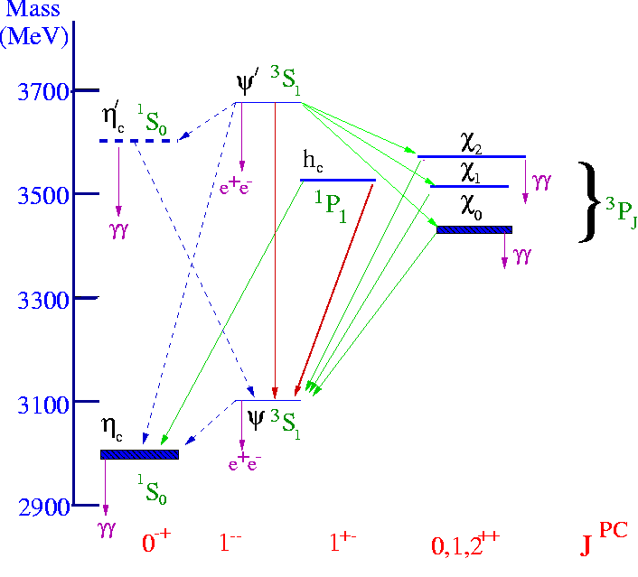
The heavy quarkonium system
At short distance
Cornell model works pretty well
V(r) = −4α_{s}/3r+kr

Slide 11
The quarkonium system
When distance becomes larger
Theory 1: screened potential
Theory 2: hybrids with excited gluons
Theory 3: tetraquark states
Theory 4: meson molecules
Theory 5: cusps
Theory 6: final state interaction
Theory 7: coupled-channel effect
Theory 8: mixing
Theory 9: mixture of all these above effects
Theories …
Need data to test and develop theory

Slide 12
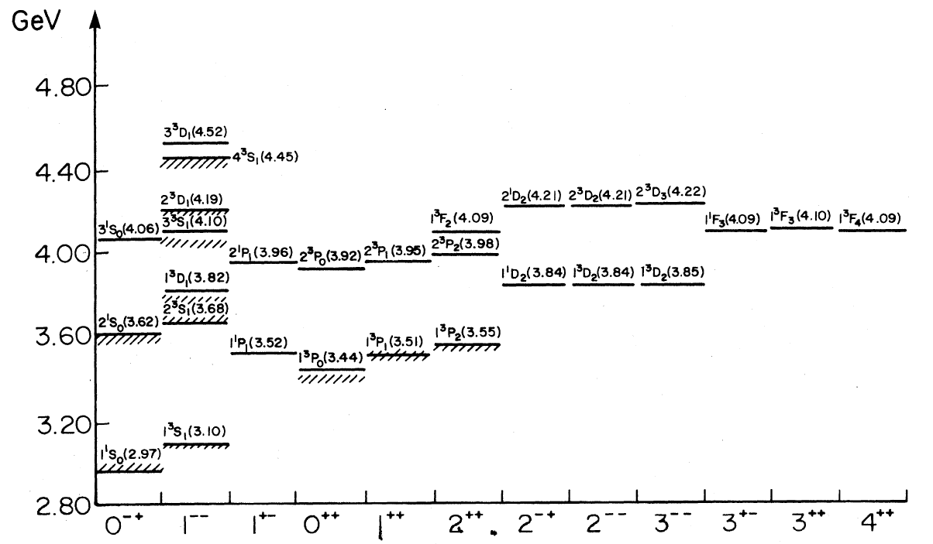
Charmonium spectroscopy after 40 years
Is Y(4660) the 5S state?
Hard to observe 3D in open charm, will hadronic transitions help?
Hybrids ~ 4.2-4.5 GeV
Tetraquarks ~ 3.9-4.7 GeV
DD*/D*D*/D*_{s}D*_{s}/DD₁ molecule
~ 3.9-4.4 GeV
Godfrey & Isgur, PRD32, 189 (1985)

Slide 13
Where are these states?
¹D₂ (2⁻⁺): mass ~ 3830 MeV should be narrow
³D₃ (3⁻⁻): ³D₂ (2⁻⁻) observed recently, ³D₃ soon?
Where are the 2P, 3P spin-triplet states?
Where are the 3S, 2P, 3P spin-singlets?
Can we identify F-wave states?
P-wave spin-triplets from S-wave E1 transition
P-wave spin-singlets from S-wave hadronic transition
¹D₂ may be produced in h_{c}(2P) E1 transition
Are there hybrids (1⁻⁻, other J^{PC})?

Slide 14
The XYZ states
What are they ?
Charmonium?
Hybrid?
Tetraquark?
Molecule?
…
Z(4430)
Z(4250)
Z(4050)
Z(4200)
Zc(3900)
Zc(4020)
?
X(3872)
XYZ(3940)
X(3915)
X(4160)
Y(4008)
Y(4140)
Y(4260)
Y(4360)
X(4350)
Y(4660)
Not all XYZ states are charmonia!

Slide 15
XYZ particles
Name | J^{PC} | Γ(MeV) | Decay modes | Experiments | interpretation
X(3872) | 1⁺⁺ | <1.2 | ππJ/ψ, γJ/ψ, DD*, … | Belle/CDF/D0/BaBar/LHCb | ‾DD* molecule?
X(3940) | 0^{?+} | ~37 | DD* (not DD, ωJ/ψ) | Belle | η_{c}’’(?)
Y(3940) | ?^{?+} | ~30 | ωJ/ψ (not DD*) | Belle/BaBar
Y(4140) | ?^{?+} | ~11 | φJ/ψ | CDF & CMS & BaBar | ccss?
X(4160) | 0^{?+} | ~140 | D*D* (not DD, DD*) | Belle | η_{c}’’(?)
Y(4008) | 1⁻⁻ | ~220 | ππJ/ψ | Belle (not Babar) | ψ(4040)?
Y(4260) | 1⁻⁻ | ~80 | ππJ/ψ | BaBar/CLEO/Belle | ccg hybrid?
X(4350) | ?^{?+} | ~13 | γγ, φJ/ψ | Belle | ccss?
Y(4360) | 1⁻⁻ | ~75 | ππψ(2S) | BaBar/Belle
Y(4660) | 1⁻⁻ | ~50 | ππψ(2S), Λ_{c}Λ_{c} (?) | Belle/BaBar
Z±(4430) | 1⁺ | ~100 | ψ(2S)π± | Belle/LHCb | 4-quark?
Z±(4050) | 1⁺ | ~80 | χ_{c1}π± | Belle (not Babar) | 4-quark?
Z±(4250) | 1⁺ | ~180 | χ_{c1}π± | Belle (not Babar) | 4-quark?
Z±(3900) | 1⁺ | ~40 | J/ψπ± | BESIII/Belle/CLEOc | 4-quark?
Z±(4020) | ?? | ~10 | h_{c}π± | BESIII | 4-quark?

Slide 16
R values/ψ states/Y states
From PDG
Information between 4.0 & 4.7 GeV is very limited!
BESIII can contribute!

Slide 17
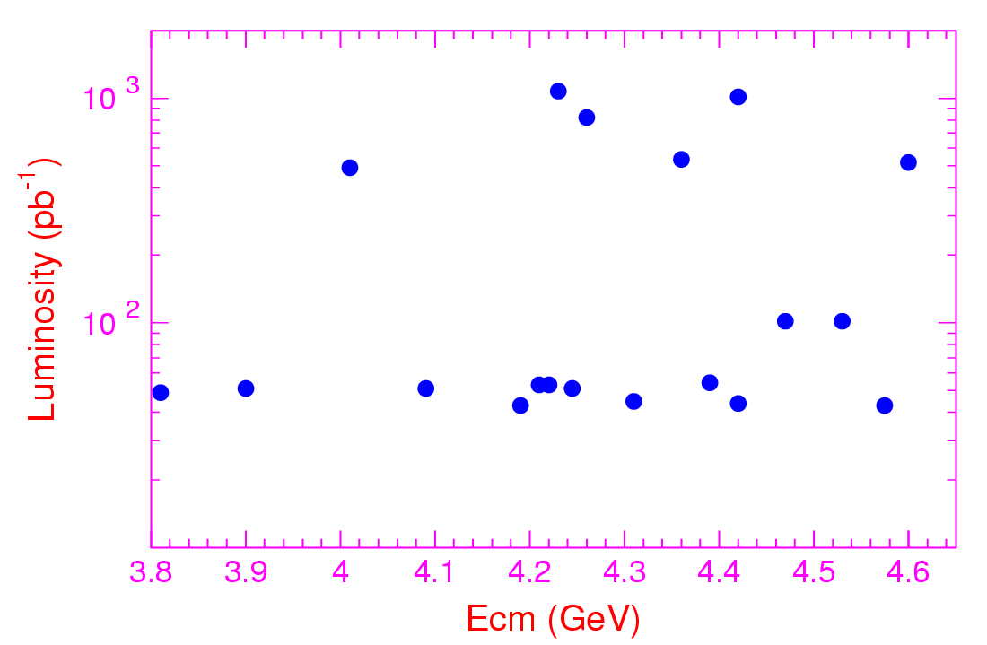
We collected 5/fb above 4 GeV
4230
4600
4420
4260
4360
4010
4470
4530
4210
4310
3810
3900
4090
4390
4220
4190
4245
4420
4575
Notes:
For the XYZ states study, from the end of 2012, BESIII has accumulated about 3.3 inverse fb data at 14 energy points. Around psi(4040), Y(4260), and Y(4360) peaks, we collected the largest data sample in the world so far for the study of its decays, and data samples with small statistics at another 10 energy points are collected for the line-shape study of these vector states.

Slide 18
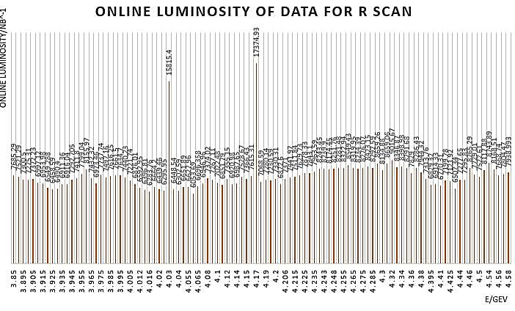
We collected 0.8/fb at >100 energy points
Notes:
For the XYZ states study, from the end of 2012, BESIII has accumulated about 3.3 inverse fb data at 14 energy points. Around psi(4040), Y(4260), and Y(4360) peaks, we collected the largest data sample in the world so far for the study of its decays, and data samples with small statistics at another 10 energy points are collected for the line-shape study of these vector states.

Slide 19
We’ve done a lot with these samples
Observation of Z_{c}(3900)→π±J/ψ, π⁰J/ψ, ‾DD*
Observation of Z_{c}(4020)→π±h_{c}, π⁰h_{c}, ‾D*D*
Observation of Z_{c}(4050)→πψ’, Y(4260)→γX(3872)
Observation of ψ(1³D₂ )=X(3823)
Observation of e⁺e⁻ → ωχ_{cJ}, φχ_{cJ}, ηh_{c}
Observation of e⁺e⁻ → ηJ/ψ, η’J/ψ, ηψ’
Observation of e⁺e⁻ →KKJ/ψ possibly from Y(4260)
Search for radiative transitions γX(4140), γη_{c}, γχ_{cJ}
Search for Z_{cs}, search for Z→light hadrons
Search for ππh_{c}(2P), ππχ_{cJ}, πππχ_{cJ}, γη_{c2}(¹D₂ ), …
Search for missing charmonium states
Charm meson production and decay; Charm baryons
ψ, Y→Light hadrons
…
XYZ+C

Slide 20
We also found more questions to answer
In the X sector
Where the X(3872) & X(3823) come from? Resonance decays or continuum production?
May other X states be produced and where?
In the Y/ψ sector
Is the Y(4260) a single resonance? Is Y(4008) a real structure?
Does the Y(4360) decay only to ππψ’? Not to ηJ/ψ ?
What is hidden behind ππh_{c}?
Correlation between charm production & charmonium transitions?
May we observe the charmonium 3³D₁ state at ~4.5 GeV?
In the Z sector
Are the Z_{c} and Z_{c}’ from resonance decays or continuum prod.?
Are there more Z_{c} states and Z_{cs} states [KJ/ψ, D*D_{s} , or DD_{s}*]?
In the C sector
Charm spectroscopy: D*, D₀, D₁, D₂, D_{s0}, D_{s1}, D_{s2}, ...
Charm decays: D_{s} and Λ_{c} samples are too small …

Slide 21
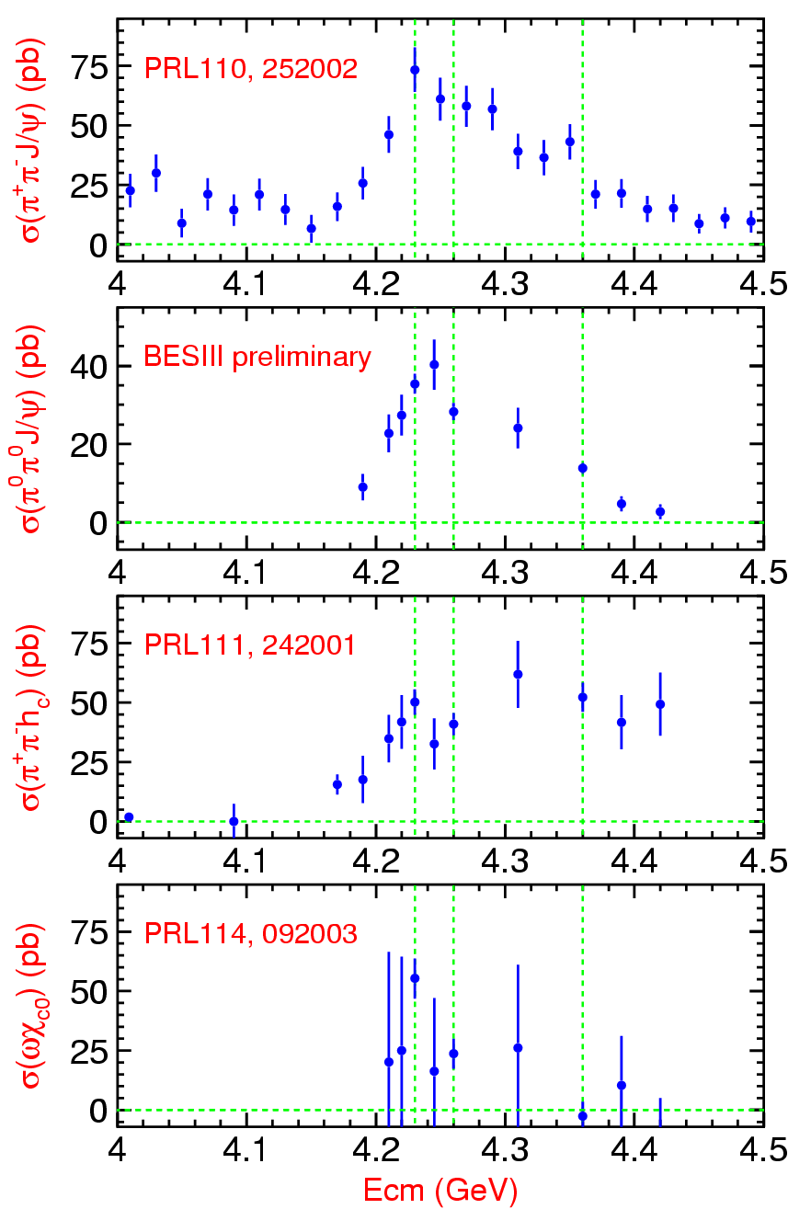
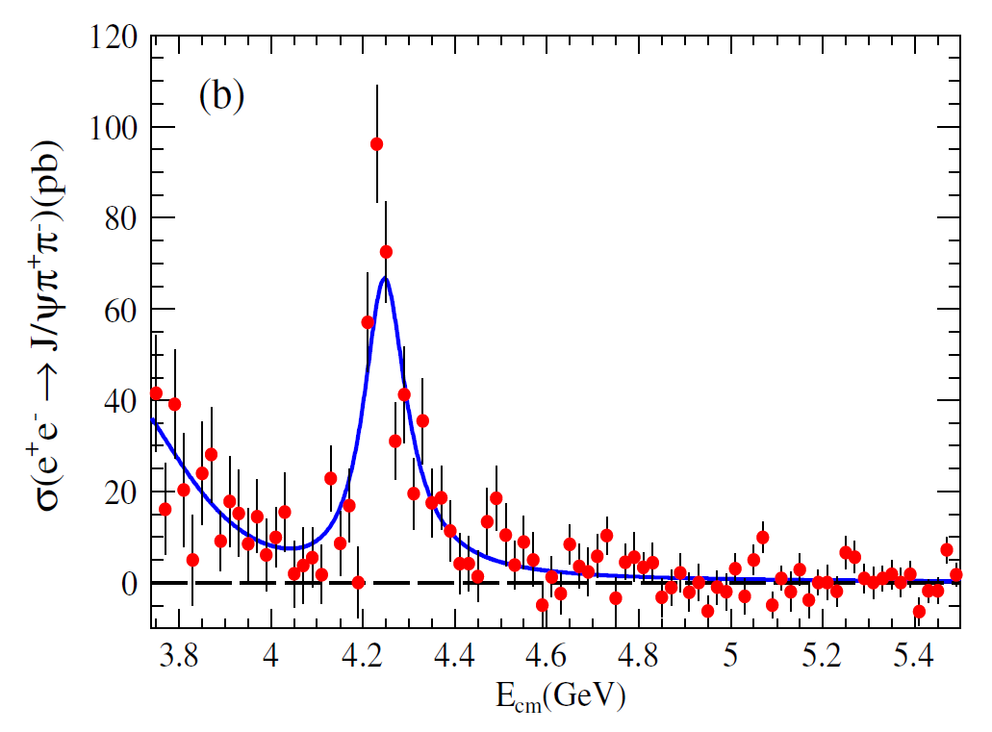
BaBar, ππJ/ψ
PRD86, 051102

Slide 22
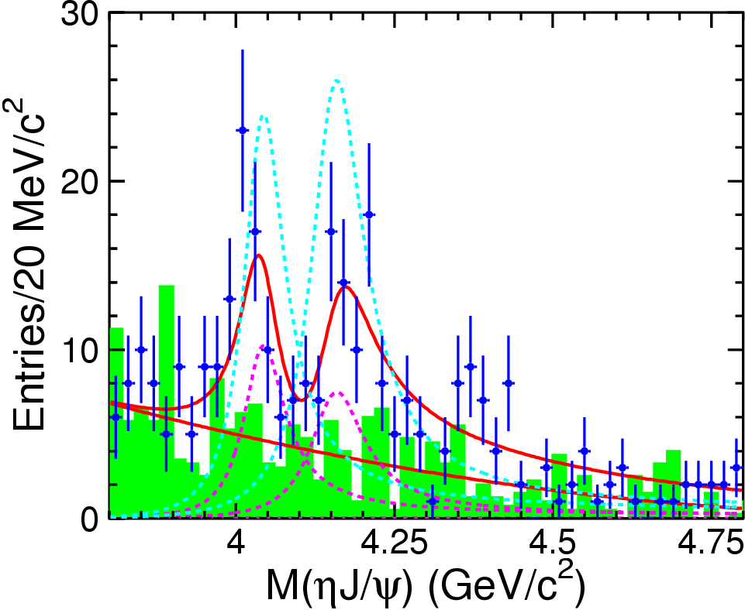
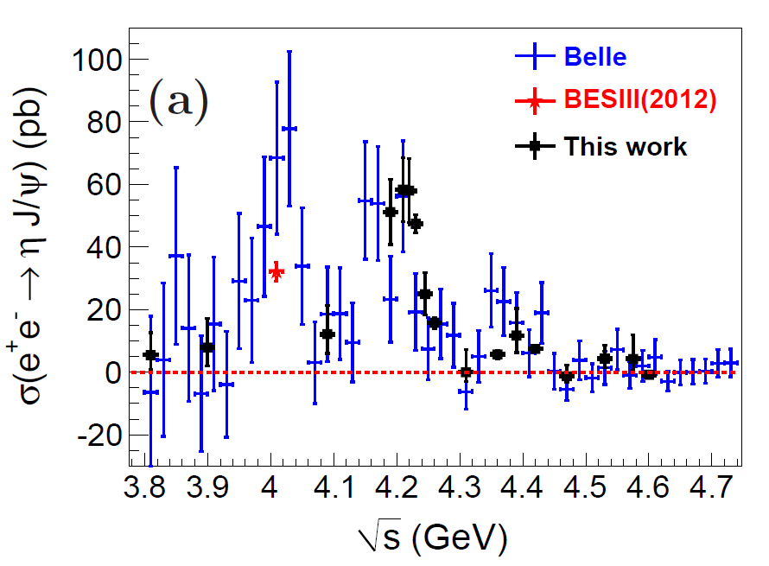
e⁺e⁻→ ηJ/ψ
BESIII:
arXiv: 1503.06644
arXiv: 1210.7550
PRD87, 051101
What is going on here?
BESIII: Can do better in the full energy range!

Slide 23
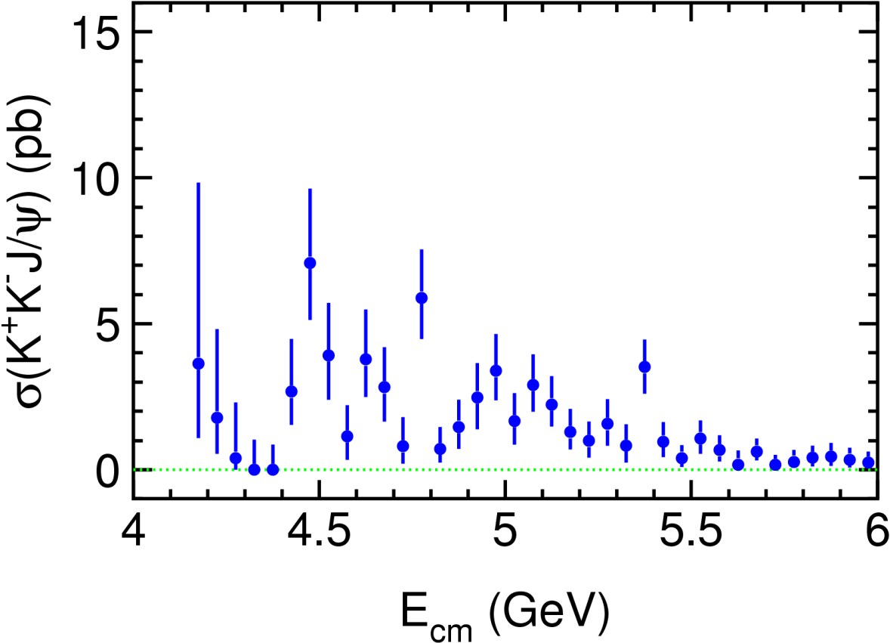
Cross sections of e⁺e⁻→ K⁺K⁻J/ψ
What’s the cross section here?
Any structure?
arXiv: 1402.6578
PRD89, 072015
BESIII: Y(4260)+ψ(4415)+?

Slide 24
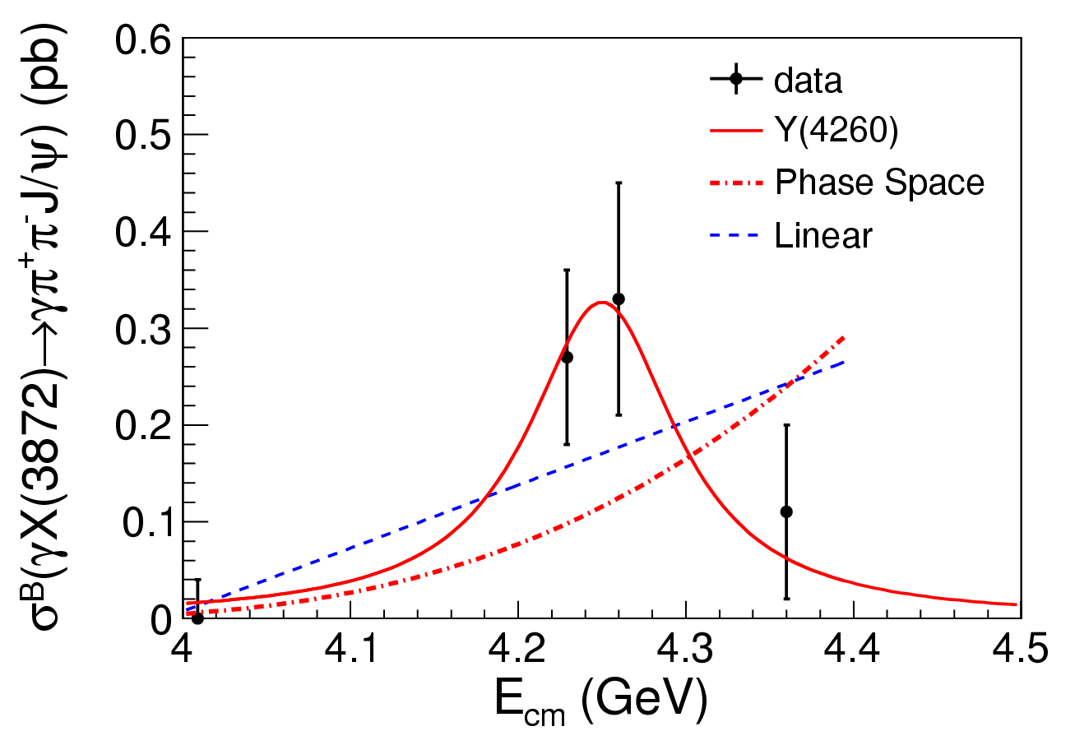
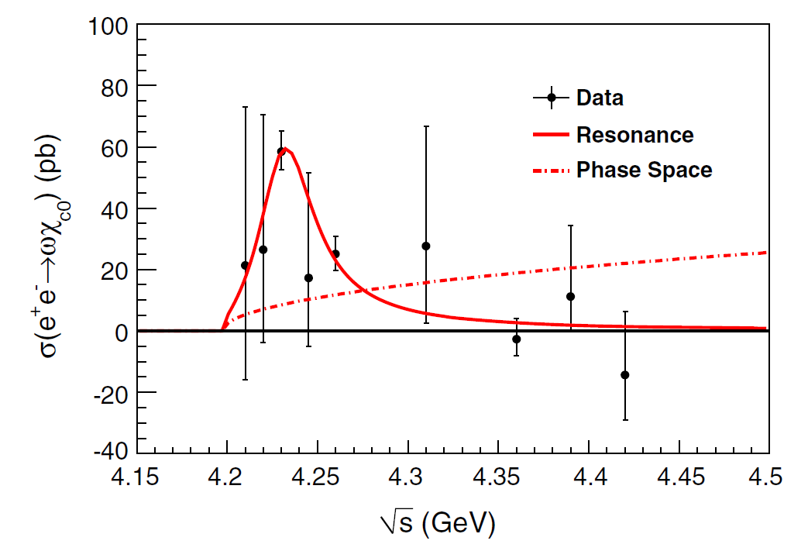
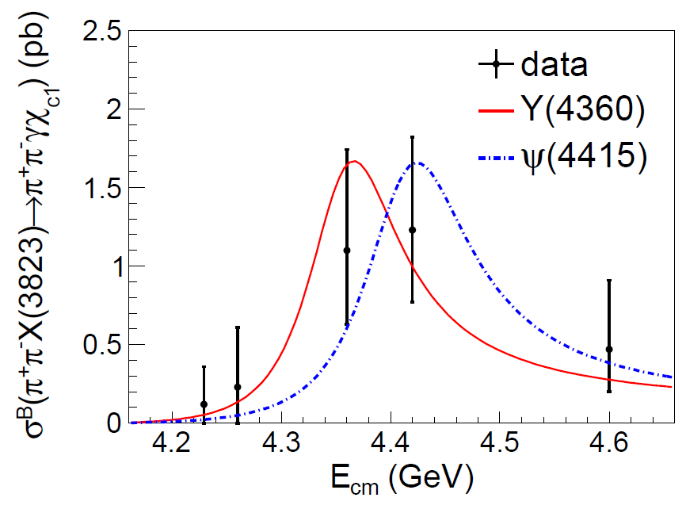
e⁺e⁻→γX(3872) & ππX(3823) & ωχ_{c0}
γX(3872)
BESIII:
PRL 112, 092001 (2014)
BESIII: arXiv: 1503.08203, PRL (in press)
BESIII:
PRL 114, 092003 (2015)
ππX(3823)
ωχ_{c0}
Notes:
Using the signal events observed, the Born cross section times the branching fraction of X(3872) decays into pipijpsi are calculated as listed in this table. For 4009 data and 4360 data, since the signals are not significant, upper limits on the production rates at 90% confidence level are set. The observation suggests that the X(3872) might be from the radiative transition of the Y(4260). Combining the cross section of electron positron goes to pi pi jpsi measured by BESIII and take the branching fraction of X(3872) decays to pi pi jpsi as 5 percent, the cross section ratio of Y(4260) decays into gamma X(3872) to Y(4260) decays into pipijpsi is about 11 percent, which is a relatively large transition ratio.

Slide 25
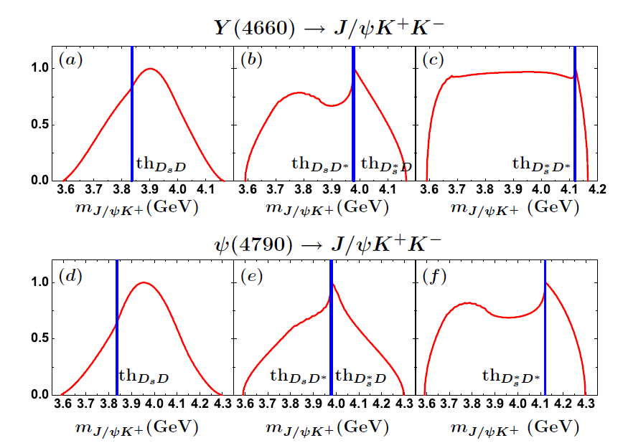
e⁺e⁻→ KZ_{cs} @ E_{cm}>4.5 GeV
Chen, Liu, Matsuki:
PRL 110, 232001 (2013)
BESIII: May we find excited Zc & Zcs?

Slide 26
We need data
To understand
The ψs
The Ys
The other XYZ particles via hadronic and radiative transitions of the ψs or/and Ys or continuum
The C-even charmonium states
More data points between 4 GeV and 4.6 [4.8] GeV
At each point, we need more luminosity

Slide 27
The Big Plan
Start from 4.0 GeV up to the maximum energy BEPCII can reach (≥ 4.6 GeV)
10 MeV step (slight adjust ~ thresholds, skip those 6 points we have already collected large samples)
500 pb⁻¹/point (from the size of the existing samples! )
Year 1: 4.0-4.1 GeV
Year 2: 4.1-4.2 GeV
Year 3: 4.2-4.3 GeV
Year 4: 4.3-4.4 GeV
Year 5: 4.4-4.5 GeV
Year 6: 4.5-4.6 GeV
Years 7, 8, ...: >4.6 GeV
~ 4.5/fb per year!
A bit conservative than BEPCII design luminosity (5/fb/yr)!
Top-up injection allows more integrated luminosity!
If “Year 1” = 2015, we finish 4.6 GeV data taking in 2021!

Slide 28
The 2015-16 plan
BESIII is going to take 3.0/fb data for Ds study at ~4.17 GeV
May we instead take 500 pb⁻¹/point at 6 or more points for XYZ study too?
This is part of the 2nd year of the big plan
Will be discussed at the collab. meeting next week

Slide 29
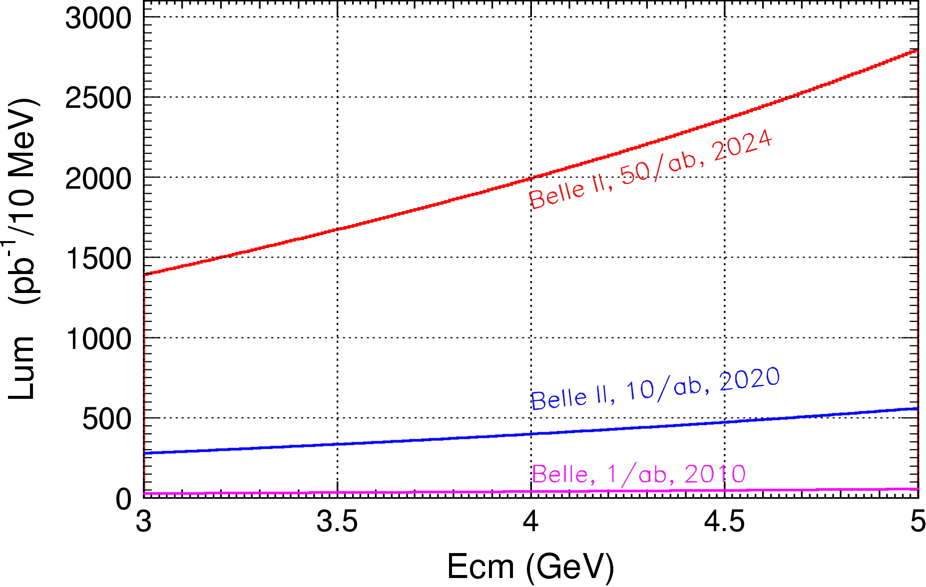
Charmonium region at Belle II
ISR produces events at all CM energies BESIII can reach
At 4.26 GeV for π⁺π⁻J/ψ
ε_{BESIII} = 46%
ε_{Belle} = 10%

Slide 30
Summary
We are proposing a long term data taking plan at BESIII for a better understanding of the strong interaction!
Start from 4.0 GeV to Emax of BEPCII
with 10 MeV step
500/pb per point
Understand the XYZ, charmonia, and more!
Please let us know if you have any new/crazy idea to use these data, or any other suggestions on the plan!

Slide 31
The end

Slide 32
Start from low energy
Accelerator optimized at low energy, gain experience step by step to run at high energy
No saturation in detector at low energy
Also important sample for Ds and D studies
Radiative correction is necessary in all cross section measurements
Radiative correction at s depends on cross sections at s’<s

Slide 33
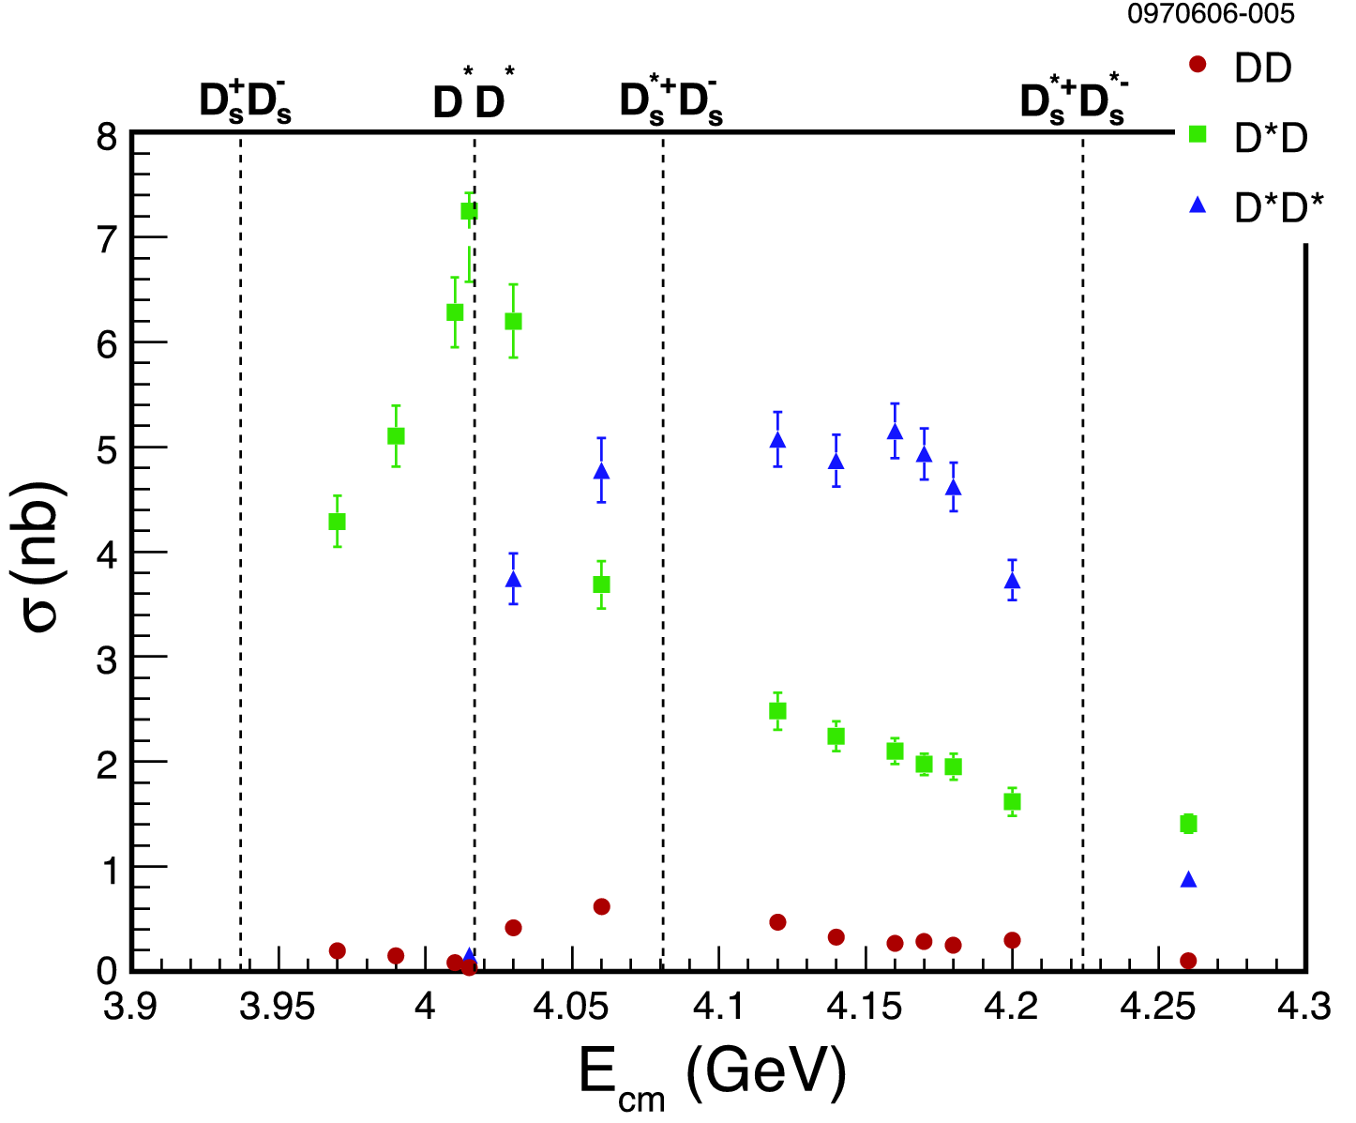
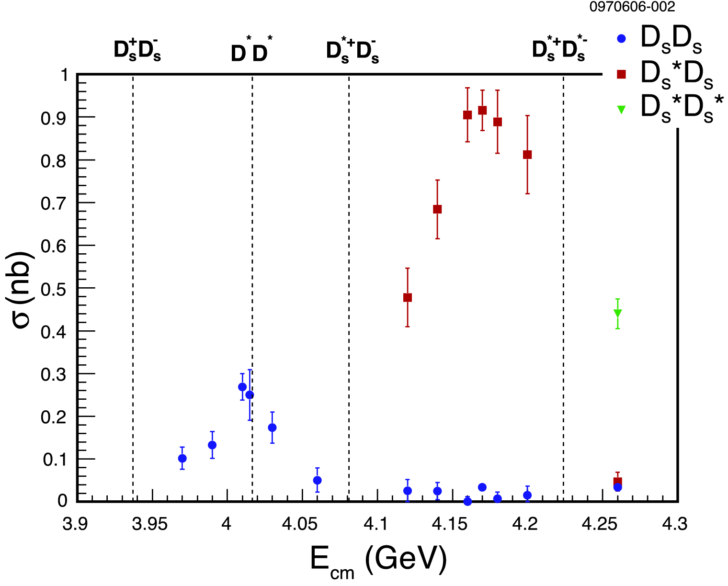
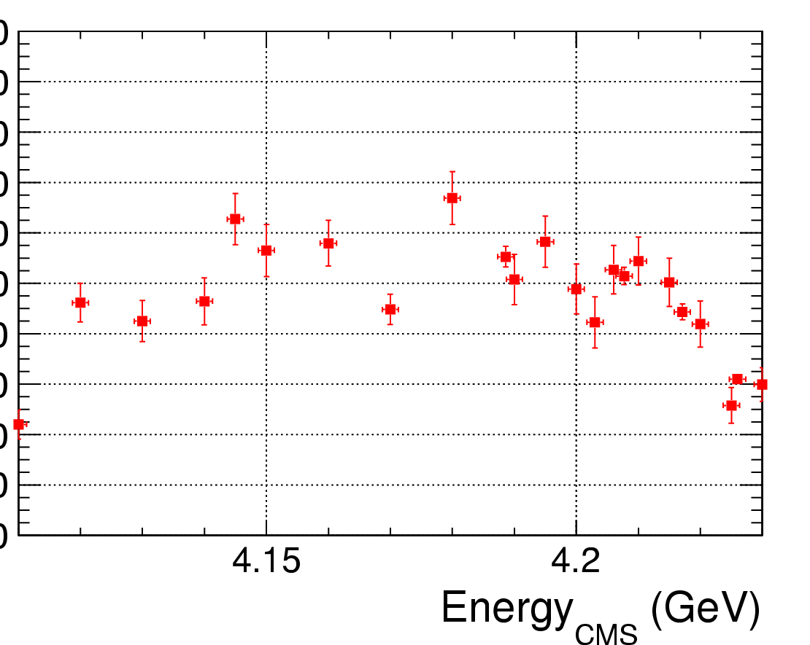
CLEO hep-ex/ 0702008

Slide 34
H_{ccg}→γη_{c} & γχ_{c0}
σ(e⁺e⁻ →H_{ccg}) ~ O(10-100) pb [???]
B(H_{ccg}→γη_{c})~2x(B(H_{ccg}→γχ_{c0}) ~ 4x10⁻⁴
[in H,‾cc in spin-singlet! LQCD by Dudek’09]
Scan e⁺e⁻→γη_{c} and γχ_{c0} for exotic structures
εB ~ 10% for γη_{c} and γχ_{c0}→γ+hadrons
Maybe a topic of next generation TauC-factory!

Slide 35
Multiple points vs. one point with large luminosity
This is equivalent to total vs. differential cross section
More information in the differential distribution
One point is good if focus on one topic
Multiple points are better for search
May affect a bit the Ds analysis

