Slide 1

Perspectives on XYZ States @
High Intensity Electron Positron Accelerator (HIEPA)
Hai-ping Peng (彭海平)
penghp@ustc.edu.cn
(On behalf HIEPA Steering Committee)
University of Science and Technology of China (USTC)
QCD Exotics, June. 07-12, Jinan China
Notes:
Good Morning everyone.
My topic is High intensity Electron Postion Acc…
Tau physics is one of most important topics in our projection.
But Since this is the first time we introduce our projects in the internationial conference,
Also, most of your are all the experts on tau physics,
So I would like to introduce you HIEPA project, rather than focus on tau physics only.
I apologize that I change the title of talk.

Slide 2
Outline
The Status of BEPCII/BESIII
What is HIEPA
Highlight Physics Program @ HIEPA
Pre-Conceptual Design
Activities
Summary

Slide 3

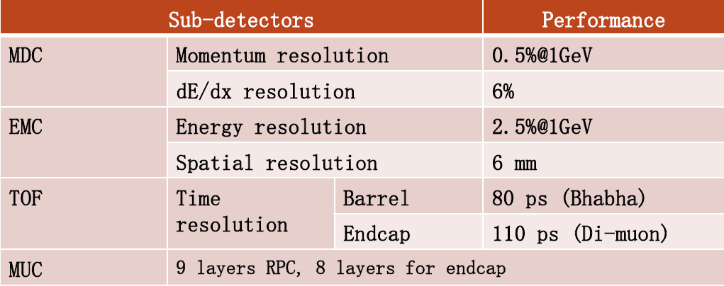
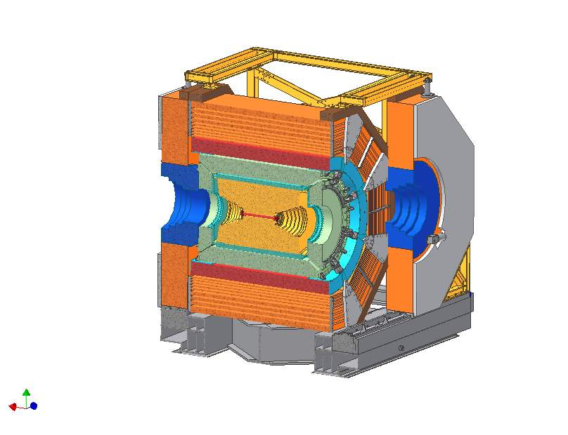
Status of BEPCII/BESIII
RF
SR
RF
Compton back-scattering for high precision beam energy measurement
Large Crossing Angle
BESIII
IP
Beam energy : 1.0-2.3 GeV
Energy spread : 5.16 ×10⁻⁴
Optimum ene. : 1.89 GeV
Luminosity : 1×10³³ cm⁻²s⁻¹
No. of bunches : 93
Bunch length : 1.5 cm
Total current : 0.91 A
SR mode : 0.25A@2.5GeV
Achieved 0.853×10³³cm⁻²s⁻¹
Unique machine running on tau-charm region in the world
Notes:
Let us begin from the BEPCII/BESIII,
As you know, BEPCII/BESIII is the only collider running in china to date.
It also is the unique machine runing on tau-charm region in the world.
The design luminorcity of BEPCII is 10^33, and now we reach 70% our design goald.

Slide 4
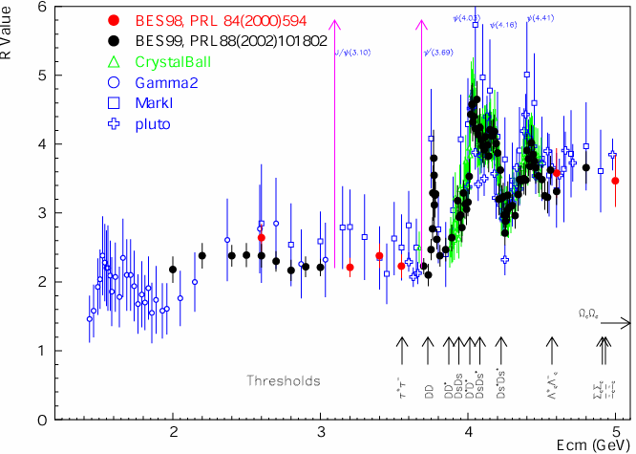
BESIII Data Taking
J/ψ 1.3x10⁹
ψ’
0.5x10⁹
4040
0.5 fb⁻¹
4420
1 fb⁻¹
4600
0.5 fb⁻¹
ψ(3770)2.9 fb⁻¹
2175
0.1 fb⁻¹
4230÷4260
1.9 fb⁻¹
4360
0.5 fb⁻¹
130 points R Scan
Ｗorld largest/unique sample from e⁺e⁻ collision : J/ψ, ψ(2S), ψ(3770), Y(4260) ..
Plan to take data around 4.17 GeV above DsDs* threshold in 2015-2016
Notes:
BESIII begin taking data from 2009,
So far, we have collected the world large jpsi, pisp, and pispp data at threshold production, We also collected total about 7fb-1 data above 4 GeV, which is unique
data in the world for typical charm physics and XYZ physics intersive study.

Slide 5
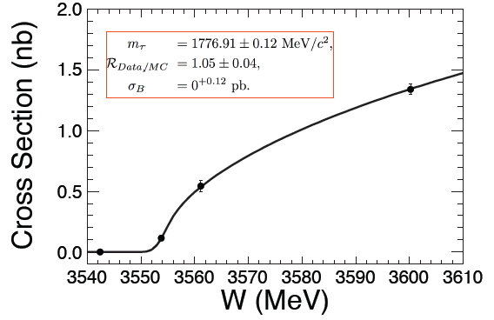
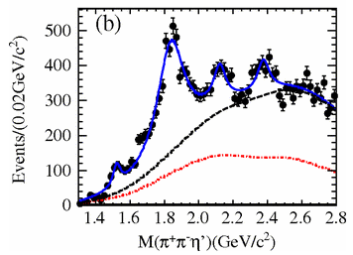
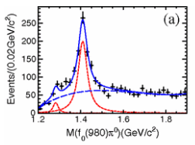
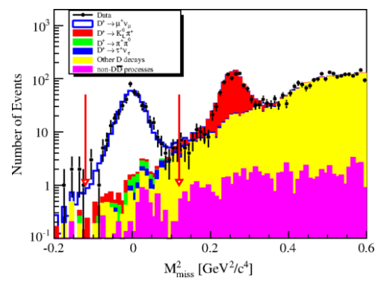
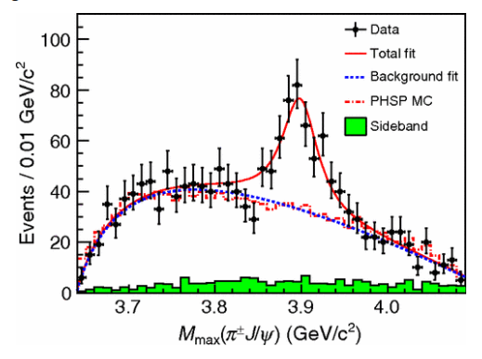
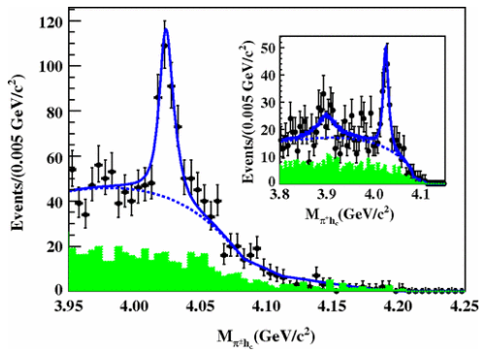
BESIII Fruitful Physics Results
X(1835)
Large Isospin Violation
η(1405)→f₀(980)π⁰
X(2120)
X(2370)
Best Precision of tau mass in single experiment
Z_{c}(3900)
Z_{c}(4020)
Most precise measurement for D leptonic decay
BESIII have ∼100 publication http://bes3.ihep.ac.cn/pub/physics.htm
Notes:
Using this data, BESIII have got excellent physics results,
like the best precision of Tau mass measurement in single experiment,
The interesting results on the light hadron physics, such as discovery new state of X(1835) and large ISO spin violation process eta(1405)->f0(980)pi0
Most precise measurement for D leptonic-semi-leptonic decay,
And exciting XYZ results such as discovery of Zc(3900) and Zc(4020)
To day, BESIII have more than 100 publications.

Slide 6
What Project Are We Proposing?
Advantage and Shortage of BEPCII/BESIII
Threshold production
Clean Signal, low background
High efficiency and resolution
……….
Small Ecms range : 2-4.6 GeV
In-sufficient luminosity : 10³³ cm⁻² s⁻¹
BEPCII/BESIII will end her mission around 2022
Led by the High Energy Physics Association of China, we are exploring possible future collider project post BEPCII/BESIII
High Intensity Electron Positron Accelerator (HIEPA)
Notes:
BEPCII/BESIII will end her mission around 2020,
Led by the high energy Physics association of China, we are exploring possible
Future collider proejct post BEPCII and BESIII
High intensity Electron Positron accelerator (HIEPA) is one of the options.
HIEPA facility can be serviced as a collider machine,
Which provide peak lumin…..
The energy range from 2-7Gev, polarization available on one beam
And the symmertic machine with low currents and crabbed saist solution for the interation….
It also can

Slide 7
What is HIEPA
High Intensity Electron Positron Accelerator (HIEPA)
Collider machine
Providing peak luminosity ∼ 1×10³⁵ cm⁻²s⁻¹ at 4 GeV for physics
Energy range E_{cm} = 2−7GeV
Symmetric machine with polarization available on one beam
Being a 3rd/4th generation SRF (synchrotron radiation facility).

Slide 8
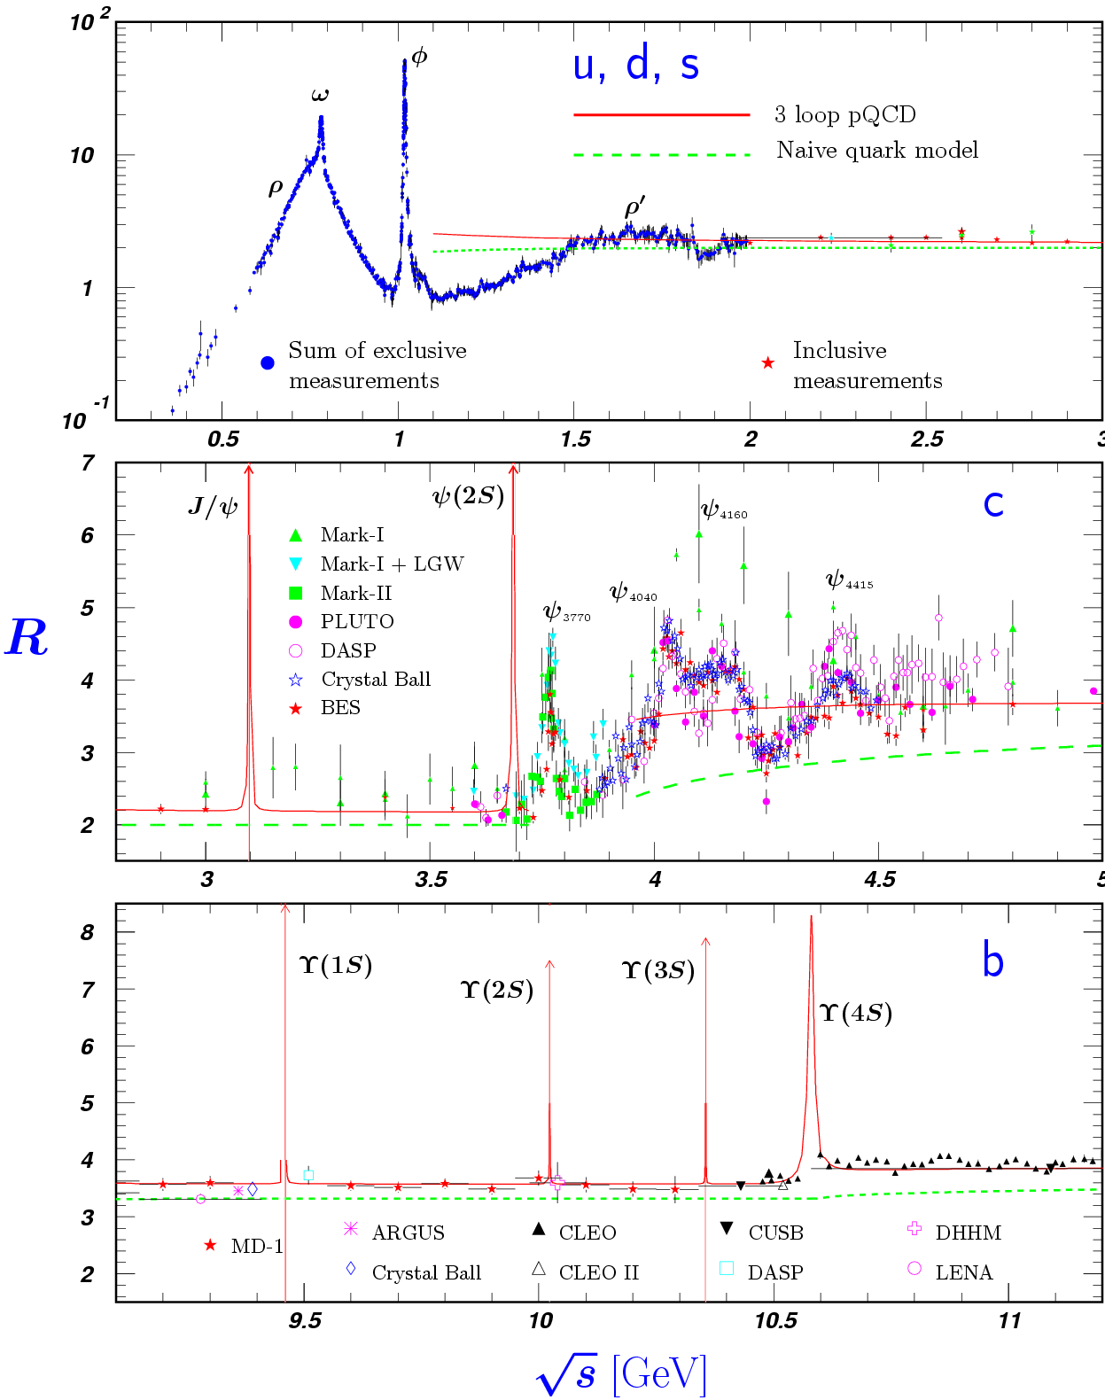
Features of the τ-c Energy Region
Why Physics on τ-c energy region
τ⁺τ⁻
D_{s}D_{s}
Λ_{c}Λ_{c}
Rich of resonances, charmonium and charmed mesons.
Threshold characteristics (pairs of τ, D, D_{s}, charmed baryons…).
Transition between smooth and resonances, perturbative and non-perturbative QCD.
Mass location of the exotic hadrons, gluonic matter and hybrid.
Notes:
Now the naïve question is why we propose the machine on tau-charm energy region.
As we know, the tau-charm energy region have several advanced features.
The region have very rich of resonances, such as charmonium and charmed mesons.
It have threshold characteristics, which can provide a clean enviroment for physics
Also, It is well know that the region is serviced as a transition between soomth and resonances, pertubative and monpertubvative QCD
Also, mass of the extotic hadron, gluonic and hybird are expected in this region

Slide 9
Physics at τ-c Energy Region
R=s(e⁺e⁻→hadron)/
s(e⁺e⁻→m⁺m⁻)
Hadron form factors
Y(2175) resonance
Mutltiquark states with s quark, Zs
MLLA/LPHD and QCD sum rule predictions
Light hadron spectroscopy
Gluonic and exotic states
Process of LFV and CPV
Rare and forbidden decays
Physics with τ lepton
XYZ particles
Physics with D : f_{D} & f_{Ds}
D₀-D₀ mixing
Charm baryons, τ lepton
New physics
R scan
Precision Δα_{QED}, a_{μ}, charm quark mass extraction.
Hadron form factor(nucleon, Λ, p).
Notes:
Rich physics topic are expected in the tau-charm energy region.
For example, in 2-3GeV, it is ideal region to study the hadron form factors,
Study the properties of Y(2175) and search for the mulitquaks states with s quark,
It also can be used to test QC sum rule predictions.
In the charmonium energy region, which can collect very very last data samples, and
It can be used to study the light hadron spectroscopy And gluonic and exotis states.
It also can be used to search for the LFV process, CPV process and rare and forbidden decays preocss.
Of course tau physics can be one of landmark in this region.
Above the 4GeV region, It is ideal place to study XYZ particle, Physics with D meason
And D-D0 mixing charm bayrons.
Of course, the R scane in the whole energy region will definenalyy improve the presision
Of delta Alpha QDQ, charm quark mass extraction. Estpcaiilly in the range from 5-7 GeV,
There are very rare experiment data to day.
The data can also be use for the hadron from factor study.

Slide 10
Data Samples / Year
10³⁵cm⁻²s⁻¹ × 86400s × 180days × 90% = 1.4ab⁻¹
 | CLEO-C |  | BES-III/ year 10³³cm⁻²s⁻¹(10fb⁻¹) | τ-charm/year 10³⁵cm⁻²s⁻¹ (1ab⁻¹)
J/ψ | − | − | 10×10⁹ | 10×10¹¹
ψ(2S) | 54 pb⁻¹ | 27×10⁶ | 3×10⁹ | 3×10¹¹
ψ(3770) | 818 pb⁻¹ | 5×10⁶ D-pair | 3×10⁷ | 3×10⁹
4.17 GeV | 586 pb⁻¹ | 7×10⁵ D_{s}-pair | 2×10⁶ | 3×10⁹
τ⁺τ⁻ (4.25) |  | 4×10⁶ | 3×10⁷ | 3×10⁹
Selected Highlight physics topic
Hadron Spectroscopy (charmonium)
Tau Physics
Nucleon/hadron electromagnetic form factor
…..
10¹⁰ charm @ (4S)
10¹⁰ τ pairs @ (4S)
BELLE-II/Super KEKB
10³⁶cm⁻²s⁻¹(10ab⁻¹)
Notes:
With assumed 10^35 luminrocity, it is estimated to get the 1.4ab-1 data per year
Taking into account really running days and data taking efficiency.
It is expected to collected 10^9 D meson pair and Tau lepton pairs.
These data is about 1/3 of BELLE-II data/per year which is expected to run with luminosity at 10^36

Slide 11
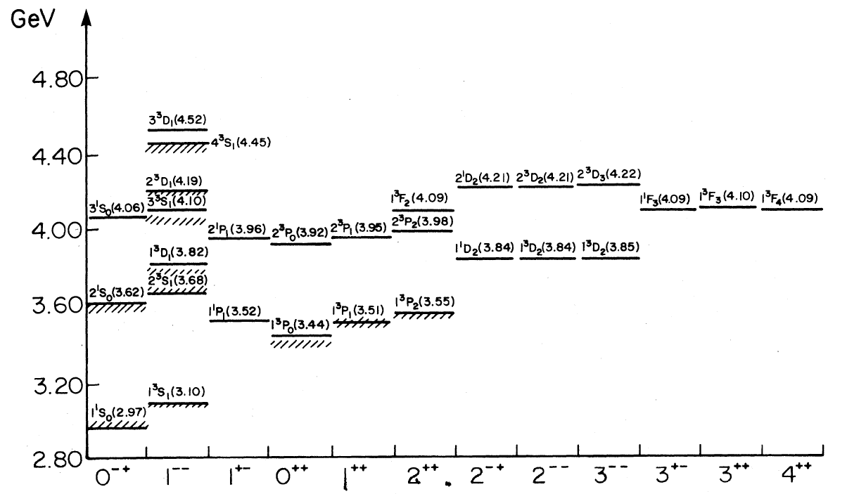
Charmonium (like) Spectroscopy
Key question : Is there any exotic hadron exist
D wave , narrow
P wave Spin-triplet
S/P Wave Spin-Singlets
F Wave
HH
HH
HH
HH
h
h
A better understanding on charmonium spectrum may help to understand natures of QCD
Help to search for the exotic states
Godfrey & Isgur, PRD 32, 189 (1985)
States below charm threshold are all well observed
A lot of missing states above the threshold
Many missing states above charm threshold
Notes:
This plots show the expected charmonium spectronscopy prodicted by QM,
To date, in experiment, states below charm trheshold are all observed well,
But above the charm threshold, there are still some missing states have not be observed yet
Also, in the last decay, a lot of new XYZ states are observed, which is not a obviously conventional charmonium states.
The nature is these new observetion is unclear.
A better understaing on charmonium spectron may help to understand their natures.

Slide 12
Charmonium (like) Spectroscopy
Very Rich Physics Programs
Tetraquarks ~ 3.9-4.7 GeV
DD*/D*D*/D*_{s}D*_{s}/DD₁ molecule ~ 3.9-4.4 GeV
Hybrids ~ 4.2-4.5 GeV
Godfrey & Isgur, PRD 32, 189 (1985)
Excellent to test QCD !

Slide 13
Charmonium (like) Spectroscopy
Is Y(4660) the 5S state?
X(3872)
X(3940)
X(4160)
X(4350)
Y(3940)
Y(4008)
Y(4260)
Y(4360)
Y(4660)
Z(3900)
Z(4020)
Z(4050)
Z(4200)
Z(4250)
Z(4430)
What are they?
Charmonium?
Hybrid?
Tetraquark?
Molecule?
Non-resonance?
Godfrey & Isgur, PRD 32, 189 (1985)
?
Not all XYZ states are charmonia!
Need more production and decay observation experimentally!
Notes:
This plots show the expected charmonium spectronscopy prodicted by QM,
To date, in experiment, states below charm trheshold are all observed well,
But above the charm threshold, there are still some missing states have not be observed yet
Also, in the last decay, a lot of new XYZ states are observed, which is not a obviously conventional charmonium states.
The nature is these new observetion is unclear.
A better understaing on charmonium spectron may help to understand their natures.

Slide 14
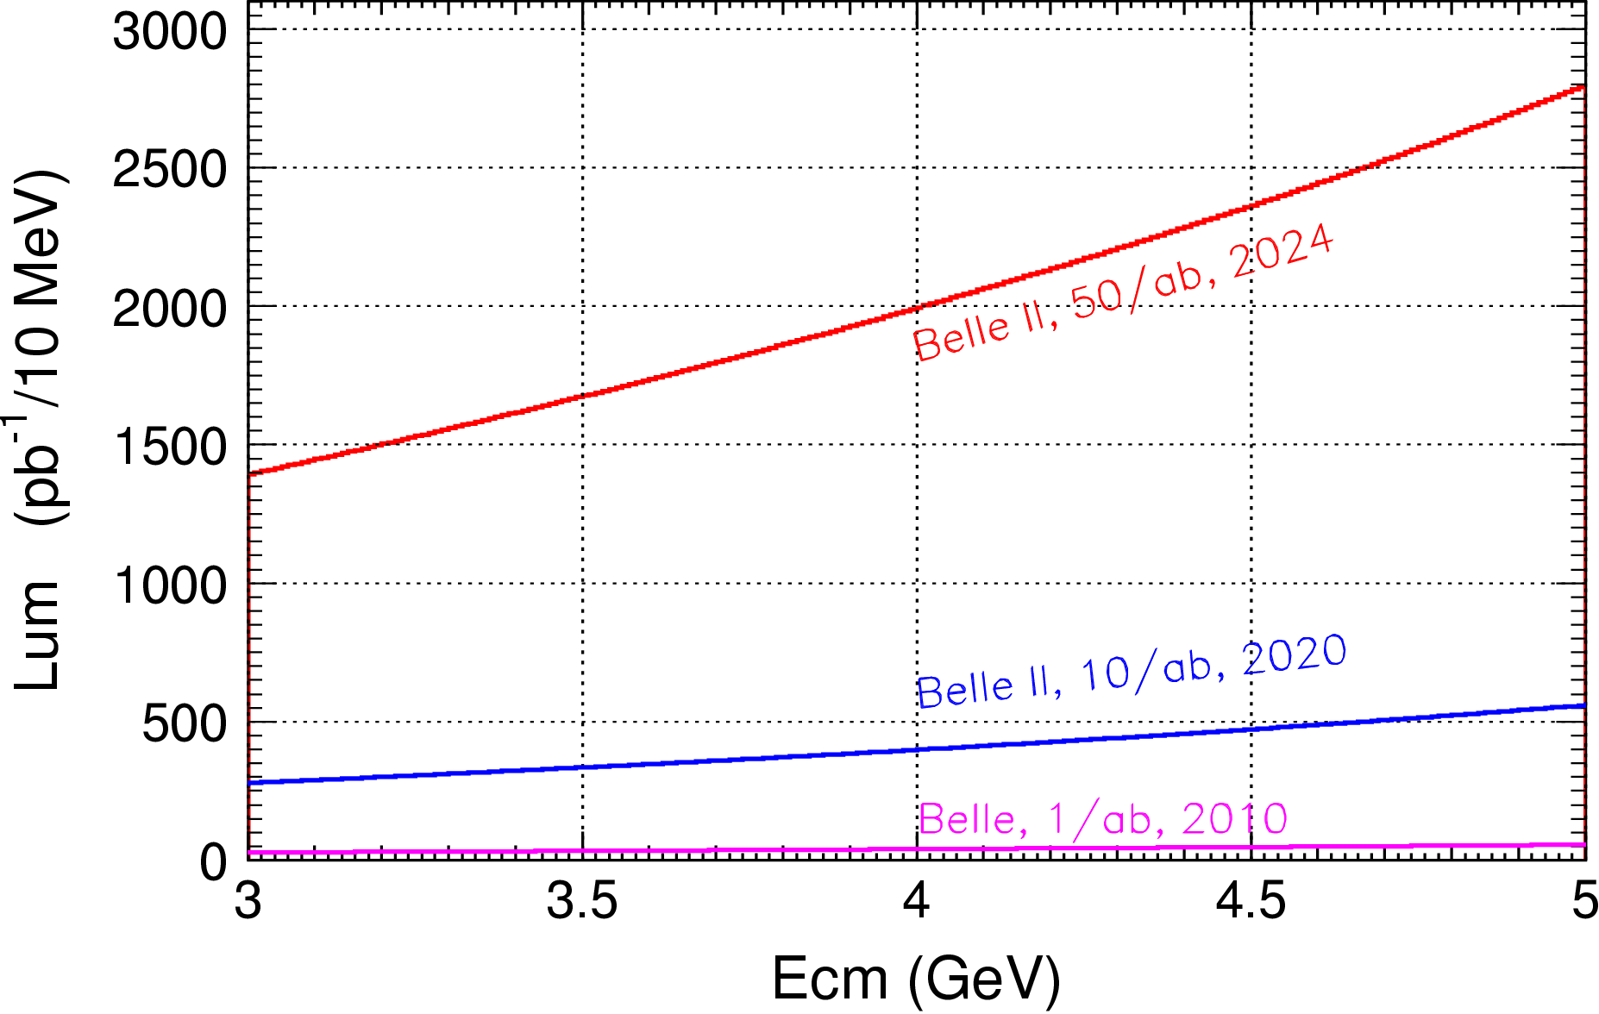
Competition from Belle II?
Integrated luminosity
0.4ab⁻¹ from Belle II 2024
1.0ab⁻¹ from HIEPA/year
@ 4.26 GeV for π⁺π⁻J/ψ
ε_{BESIII} = 46%, ε_{Belle} = 10%
τ−c factory have incomparable superiority to explore Charmonium(like) states

Slide 15
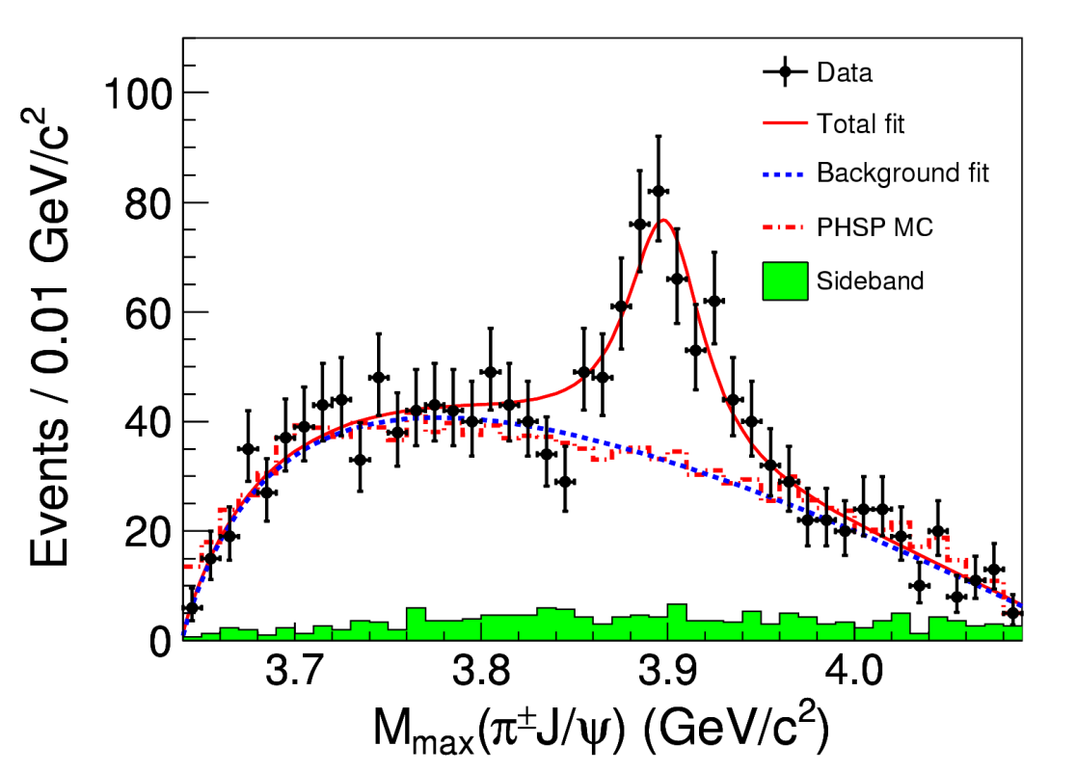
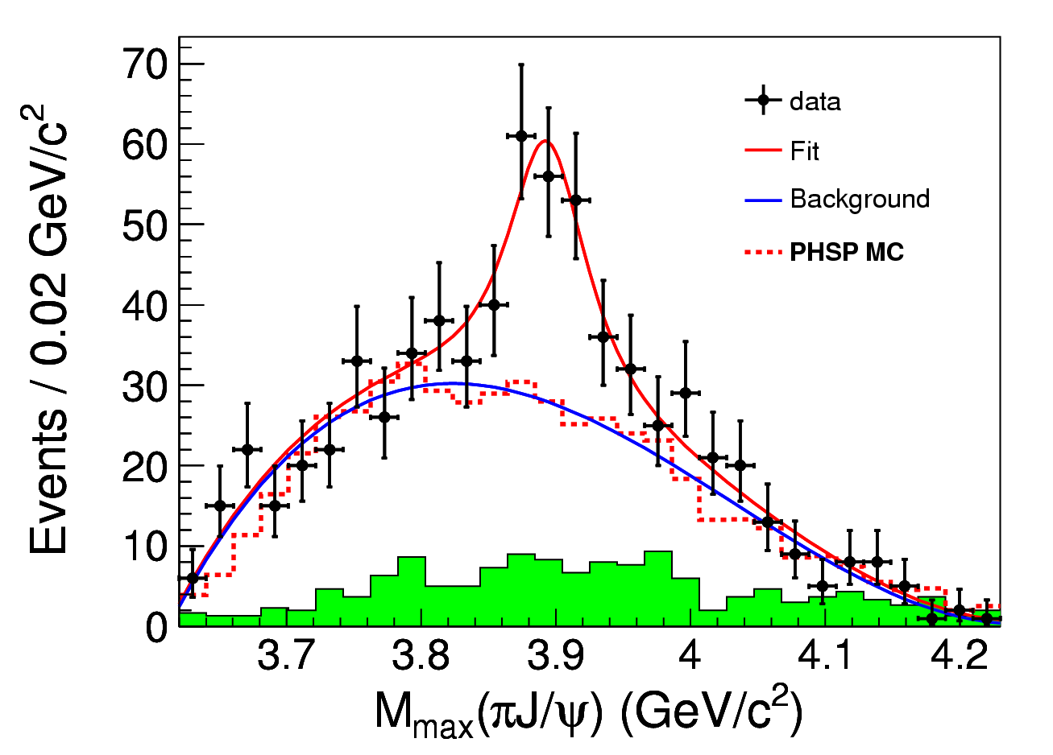


Observation of Z_{c}(3900)
BESIII at 4.260 GeV: PRL110, 252001
0.525 fb⁻¹ in one month running time
Belle with ISR: PRL110, 252002
967 fb⁻¹ in 10 years running time
>5.2σ
>8σ

Slide 16
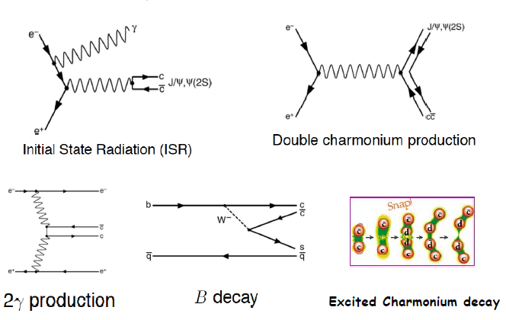
Production Mechanism @ B Factory

Slide 17
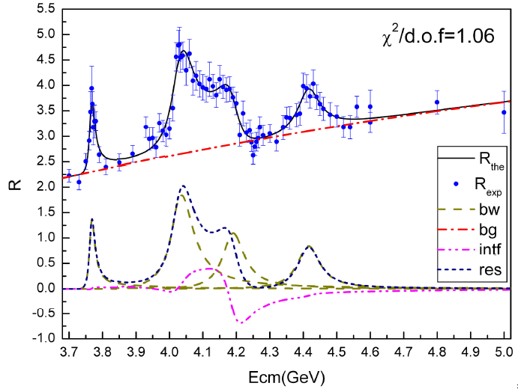
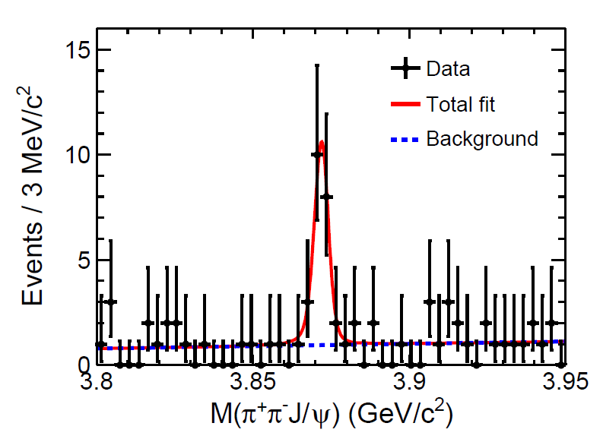
Production Mechanism @ τ-c Factory
ψ/Y/Hybrid(ccg) (1⁻⁻) produced directly in the e⁺e⁻ collision
To determine the resonance parameters for the excited ψ or Y state
Precisely measure the x-sec of inclusive/exclusive final states at different Ecms
Charge parity c=+1 states produced via radiative transition from vector ψ/Y
The decay rate ψ(nS/nD)→γX(3872), X(3940)…
χ_{cJ}(2P)、χ_{cJ}(3P)、η_{c}(3S)、 η_{c}(4S)、 …
  B(ψ(3S)→γχ’_{cJ}) = (7, 3, 1) x 10⁻⁴ for J=2,1,0
  [Rev. Mod. Phys. 80, 1161 (2008) ]
Search for new states from hadronic transition
To search for Zc, Zcs, hc(2P) ….
PLB 660, 315 (2008)
PRL 112, 092001 (2014)
σ(Y(4260) →γX(3872))∼6pb
Complementary to B factory

Slide 18
Search for 1⁻⁻ Hybrid
B(H_{ccg}→γη_{c}) ~ 2x(B(H_{ccg}→γχ_{c0}) ~ 4x10⁻⁴
[in H,‾cc in spin-singlet! LQCD by Dudek’09]
σ(e⁺e⁻→H_{ccg}) ~ O(10-100) pb [???]
Scan e+e⁻→γη_{c} and γχ_{c0} for exotic structures
εB ~ 10% for γη_{c} and γχ_{c0}→γ+hadrons
L_{peak}=10³⁵/cm²/s, 1 year running = 10⁶pb⁻¹=1 ab⁻¹
At 100 energy points above‾DD threshold
N^{obs}(γη_{c})=O(4~40)/point/year at peak
N^{obs}(γχ_{c0})=O(2~20)/point/year at peak

Slide 19
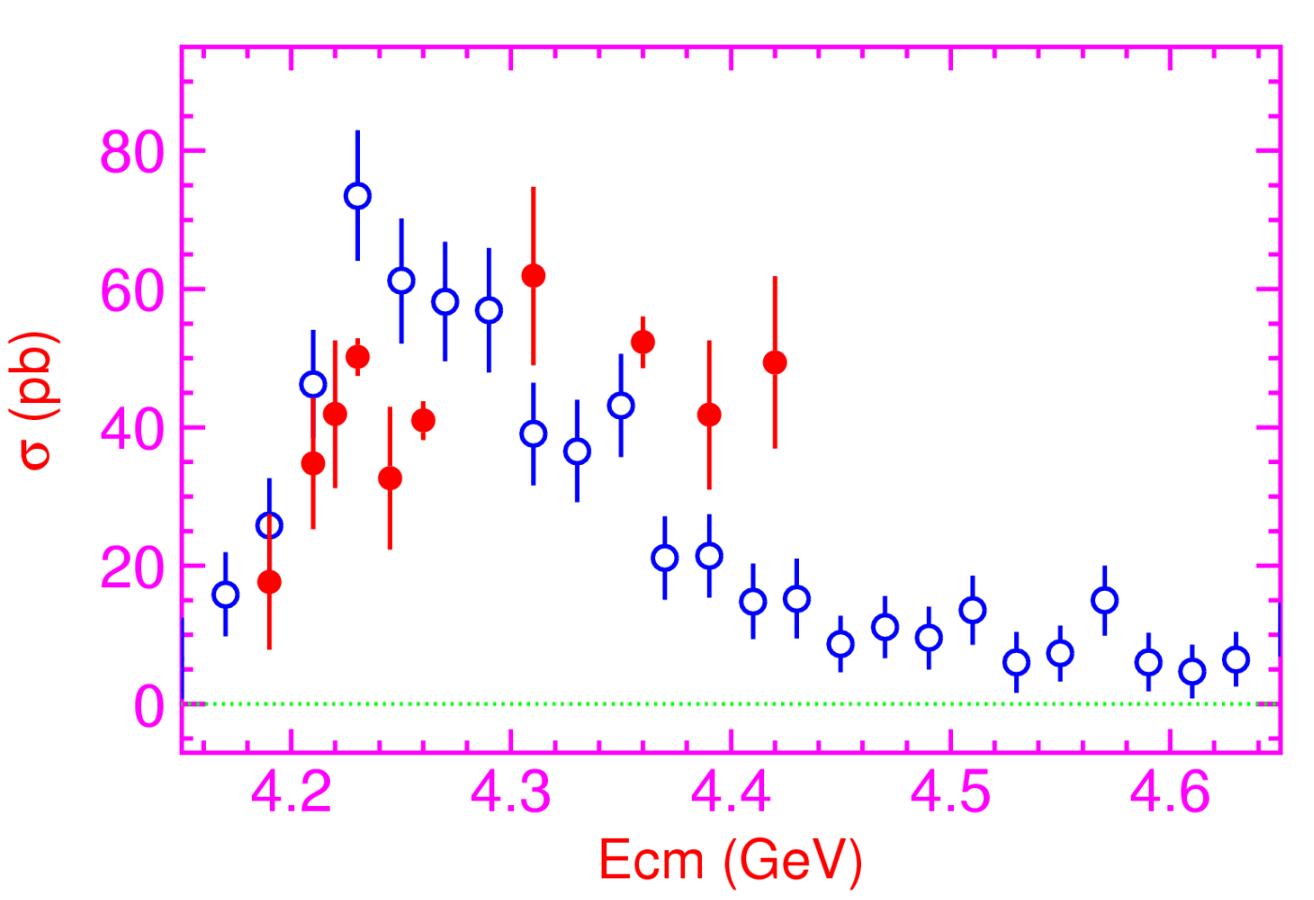
Exclusive Line shape Measurement
L_{peak}=10³⁵/cm²/s, 1 year running = 10⁶pb⁻¹ = 1 ab⁻¹
At 100 energy points above‾DD threshold
Precisely measure the x-sec for exclusive final states
π π h_{c}(1P)
π π J/ψ

Slide 20
Explore the Nature of Z_{c}
σ(e+e⁻→ππ(π)+charmonium) ~ O(10) pb
Look for states in π+charmonium
εB ~ 2.7% for ππh_{c}→ππγη_{c}
εB ~ 5.0% for ππJ/ψ
εB ~ 2.0% for ππχ_{c}→ππγJ/ψ
εB ~ 1.0% for ππψ′→ππππJ/ψ
L _{peak}=10³⁵/cm²/s, 1 year running = 10⁶ pb⁻¹=1 ab⁻¹
N^{obs}=O(10⁵)/year; sufficient for PWA or Argand plot analysis

Slide 21
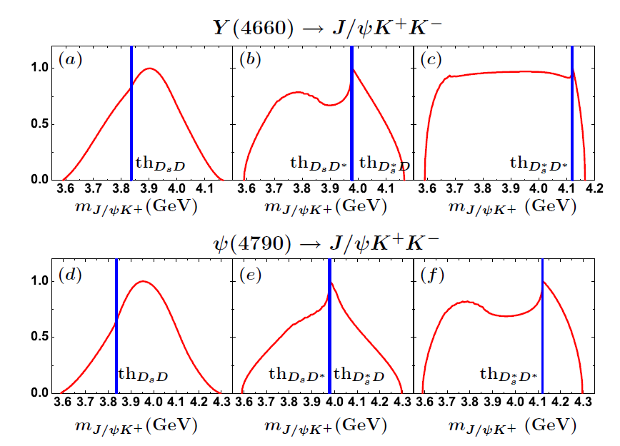
Search for Z_{cs} @ E_{cms}>4.5 GeV
Liu X. arXiv: 1303.6842
search for Excited Z_{c} and Z_{cs} particle

Slide 22
Search for η_{c2}(1¹D₂)
B(h_{c}(2P) →γη_{c2}) ∼ 3×10⁻⁴ [E1 trans., Barnes′ 05]
B(η_{c2}→γh_{c}) ∼ (44−54)% [E1 trans., Fan′ 09]
B(h_{c}→γη_{c}) ∼ 54% [E1 trans., BESIII′10]
σ(e⁺e⁻→π⁺π⁻h_{c}(2P)) ∼ 20 pb @ Ecm = ?? GeV
εB(η_{c}→hadrons) ∼ 1.5% at BESIII
N^{obs}=2×10⁻⁵×L (L is int. lumi. in pb⁻¹)
L _{peak} = 10³⁵cm⁻¹s⁻¹, 1 year running = 10⁶pb⁻¹ = 1ab⁻¹
N^{obs}=20 events /year,
Background is expected to be low for narrow h_{c} and η_{c}
Notes:
In Following, I introduce some very simple estimation for the searching for these missing states.
First Example is to search for the D wave singlet,
This D wave siglet states is expected produce and decay by the E1 transition of
P wave singlet,
If we asumment the production cross section of excited P wave singlet is 20pb
And the our experience from BESIII on the efficiency to tage etac hadron decay
mode is 1.5%,
We expected we can got the 20events/per years
The background is very low due to the narraow width of hc and etac
Another example is to search for the exicited stand of chi_cj,
Which is expected to produce by the E1 transition from the psip particle,
We expected we can get the 10-100 events per year.
The same, the background is very low due to the narraw with psip and psi.

Slide 23
Search for χ_{c1}(2³P₁)
B(ψ →γχ′_{c1}) ∼ 3×10⁻⁴ [E1 trans., Barnes′ 05]
B(χ′_{c1}→γψ′) ∼ 1 ×10⁻³ [E1 trans., Barnes′ 05]
B(χ′_{c1}→γJ/ψ) ∼ 1 ×10⁻⁴ [E1 trans., Barnes′ 05]
σ(e⁺e⁻→ψ(nS)/ψ(mD)) ∼ (3-7) nb @ for n>1, m>1
εB ∼ (1−5)% at BESIII
N^{obs} = (1−10)×10⁻⁵×L (L is int. lumi. in pb⁻¹)
L _{peak} = 10³⁵cm⁻¹s⁻¹, 1 year running = 10⁶pb⁻¹ = 1ab⁻¹
N^{obs} = (10−100) events /year,
Background is low for narrow ψ′ and J/ ψ
Notes:
In Following, I introduce some very simple estimation for the searching for these missing states.
First Example is to search for the D wave singlet,
This D wave siglet states is expected produce and decay by the E1 transition of
P wave singlet,
If we asumment the production cross section of excited P wave singlet is 20pb
And the our experience from BESIII on the efficiency to tage etac hadron decay
mode is 1.5%,
We expected we can got the 20events/per years
The background is very low due to the narraow width of hc and etac
Another example is to search for the exicited stand of chi_cj,
Which is expected to produce by the E1 transition from the psip particle,
We expected we can get the 10-100 events per year.
The same, the background is very low due to the narraw with psip and psi.

Slide 24
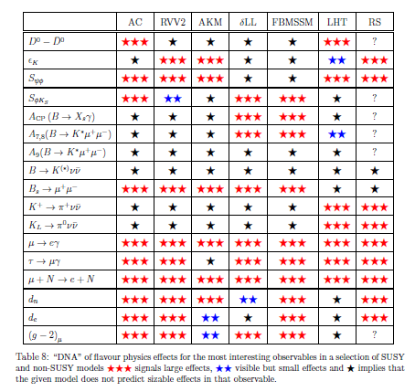
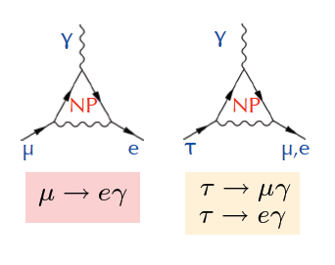
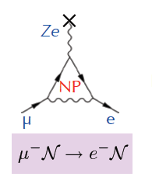
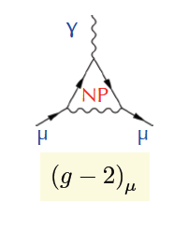
cLFV Decay τ→ℓγ
No evidence of new physics been found at high energy frontier.
important and complementary to search for new physics in the precision frontier.
μ/τ anomalous decays
μ → e
conversion
Anomalous
magnetic moment
In τ-charm factory, τ→μγ decay is a golden mode to search for NP
W. Altmannshofer et al. arXiv : 0909.1333
Notes:
Now we move the new physics,
As we know, the discovery of Higgs complete the list of the partilce in SM.
But there some still a lots questions can not be explain the the SM framework.
To date, there are not any evidence of new physics at high energy frontiers,
So it is important and complementart to directly search for new physics in the presision frontier.
This table is DNA for the new physics search in flavor physics,
and charge letpon Falvor violavation decay is found to be a promising process to find the new physics
And discribmate the different models and contraint theirs parameters.

Slide 25
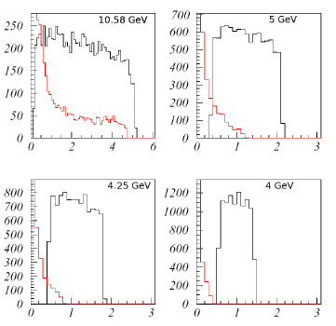
STCF .VS. BF : τ→μγ ｂａｃｋｇｒｏｕｎｄ
Background e⁺e⁻→τ⁺τ⁻γ
Dominant BKG @ B Factory
Dominant source at Υ(4S) : e⁺e⁻ → τ⁺τ⁻γ
Does not contribute below √s ≈ 4m_{τ}/√3 ≈ 4.1 GeV.
Dominant BKG @ STCF
τ decays : [arXiv:1206.1909]
direct (τ⁺→π⁺π⁰ν_{τ}) and combinatorial
QED processes :
e⁺e⁻ → μ⁺μ⁻γγ, e⁺e⁻ → e⁺e⁻ μ⁺μ⁻γ
Continuum hadron production e⁺e⁻ → qq
ψ(2S) and D-meson decays
Polarized beam may further suppress background and increase the sensitivity for the new physics significantly
Notes:
The advance of this analysis in the Tau-charm region is that background e+e→gammga tautau is not contribute any more which is the dominant background in the B factory.
In tau-charm region, the background is expected to be tau directroly decay like tau->pi,
QED process, continuum hadron production, psi(2p) and D men

Slide 26
Expected Br(τ→μγ) upper limit
E(GeV) | σ(nb) | L(ab⁻¹) | N_{ττ}(10¹⁰)
3.686 | 5.0 | 1.5 | 0.75
3.77 | 2.9 | 3.5 | 1.03
4.17 | 3.6 | 2.0 | 0.71
Total |  | 7.0 | 2.49
Fast simulation for NP sensitivity and detector optimization is going on
Important process to process the detector optimaztion
 | σ_{E}/E=1.5% | σ_{E}/E=2.5%
Signal (Br=10⁻⁹) | 17 | 15
Muon background | 7 | 11
Pion background | 83 | 271
Expected 90% CL upper limit for Br | 1.1×10⁻⁹ | 3.0×10⁻⁹
Expected 90% CL upper limit for Br with pion suppression by a factor of 30 | 3.3×10⁻¹⁰ | 5.1×10⁻¹⁰
Supper-B Expected limit : 3x10⁻⁹@75ab⁻¹ (7×10¹⁰ τ-pairs)
Notes:
The study from Vlaimir show with 7ab-1 data, super tau-charm can get
The comparable or better upple limit than that of Supper-B expections.
We are prosssing the correspond fast simulation for NP sensitivity and to
Optimization the detector perfromance.

Slide 27
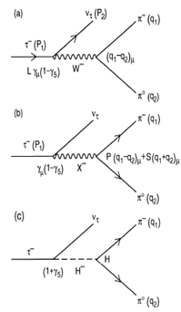


CP Violation in τ Decay
No CPV in τ decay is expected in SM
The discovery of CPV in tau sector would be a clean signature of NP
One of the most promising CPV channels is τ⁻→K_{S}π⁻ν
SM CP asymmetry from K_{S}-K_{L} mixing is expected to be : [Bigi & Sanda, PLB 625, 2005, Grossman &Nir JHEP 1204 (2012) 002]
BaBar measurement [PRD 85, 031102]
Belle measurement [PRL 107, 131801]
Charge Higgs, new Scalar,
W_{L}-W_{R} Mixings, LeptonQuarks?
A_{cp} = (1.8±2.1± 1.4) ×10^{-3 @} W ∼ [0.89-1.11] GeV
Notes:
Now, we move to the CPV in tau decay.
To day, CP violation is observed in B,D and Ksystem
But no ovserved in the lepton sector,
The discovery of CPV in tau decay is a clean signture of NP.
The most promising CPV channels is tau-Ks pi v,
The SM predicted the CVP at 10-3 level duo to the Ks-Kl mixing,
But Belle and Babar did not observed any evindence for it CPV

Slide 28

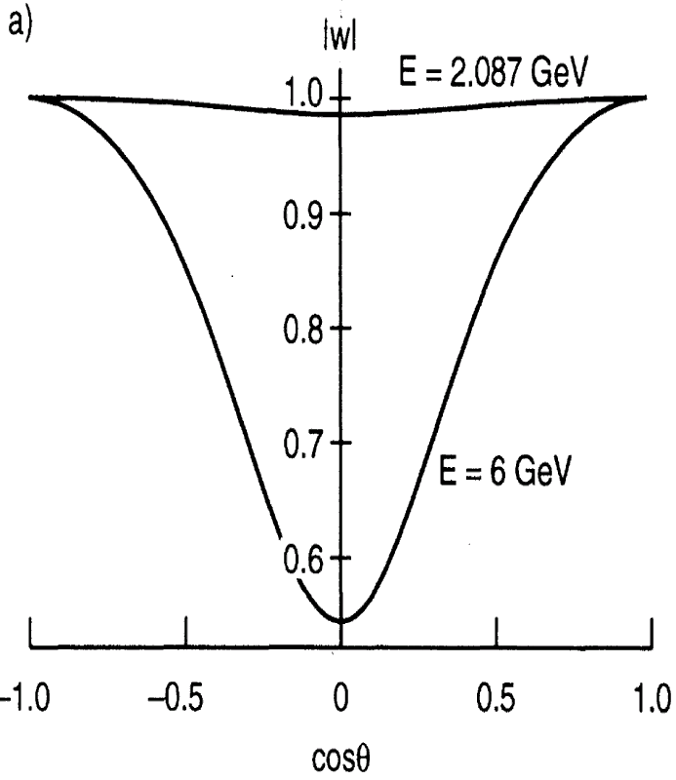

τ CPV in Angle Distribution
Need new measurement on the angular CPV asymmetry
Use T-odd rotationally invariant products : e.g.
in τ⁺ and τ⁻ decays to >=2 hadrons such as :
τ⁻→π⁻π⁰ν_{τ} /k⁻π⁰ν_{τ} , τ⁻→π⁻π⁺π⁻ν_{τ} /K⁻π⁺π⁻ν_{τ} ,
Need
polarized beam
tau-charm
“Figure Of Merits” -- Y. S. TSAI
BESIII @ 4.25 (10³³cm⁻²s⁻¹) FOM=1
HIEPA @ 4.25 (10³⁵cm⁻²s⁻¹) FOM=100
Super B @ (10³⁶cm⁻²s⁻¹ ) FOM=65
B factory
Y. S. Tsai, PRD 51.3172
Notes:
So we need a new measurement on the angular CPV asymmerty.
Like use T-od ratationally invariant products.
The kind of analysis can be performed in the tau decay into final state with more than 2 hadron.
But the polarized beam is necessary.
As we know, the polarization of electron beam can be transver to the produce
Tau,
In tau-charm region, all the produce tau is expected to the 100% poralaztion
While in the super factor, the proporazation is expected to be about 50% with
Tau cos\thet is 0.
A important variable “Figure Of Merits” proposed by the Y.S TSAI which take
into accouting luminorcist, polarization and total cross section,
to quantitative evaluate the feature of different experiment on CPV study
And HIEPA is found to be with the best quilaty.
Evaluate the characters of

Slide 29


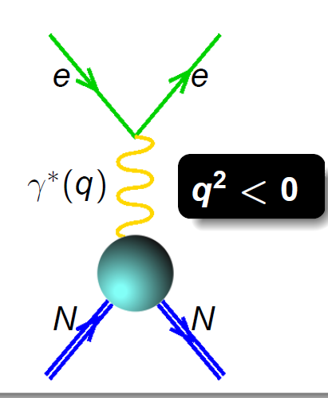
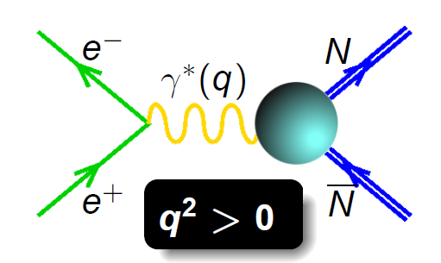
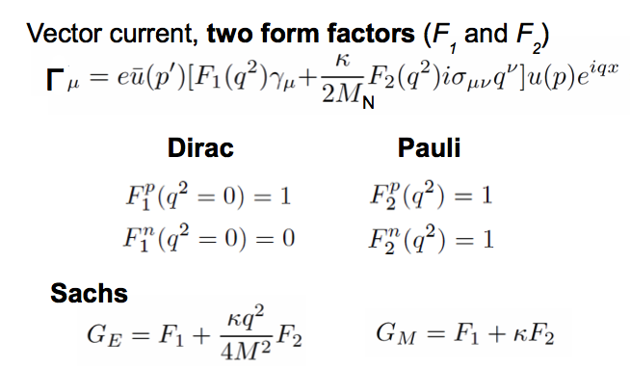

Nucleon Electromagnetic Form Factors (NEFFs)
Spatial distributions of electric charge and current inside the nucleon
, Λ Λ
Space-like:
FF real
Time-like:
FF complex
Complete picture of the nucleon structure requires both space-like and time-like FF measurements!
Cristina Morales
Notes:
Now we move to the Nuclearon Electromagnetic Form factor topic.
The nucleon (proton and neutron) electromagnetic form factors describe the spatial distributions of electric charge and current inside the nucleon and thus are intimately related to its internal structure; these form factors are among the most basic observables of the nucleon.
There two kind of FF measurement, Space-like FF, which can be measured in the scatter process, while the Time like FF, can be measure in the annihilate in the ee and ppbar process.
An complete picture of the nucleon structrure requires both space-like and time-like FF measurement.

Slide 30

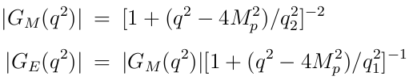

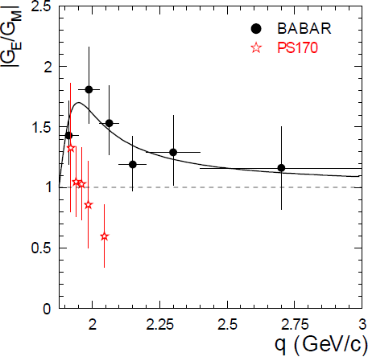
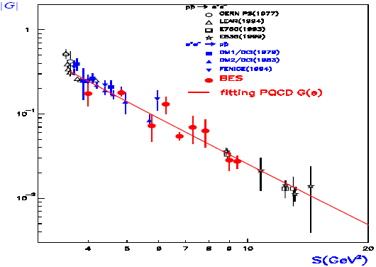

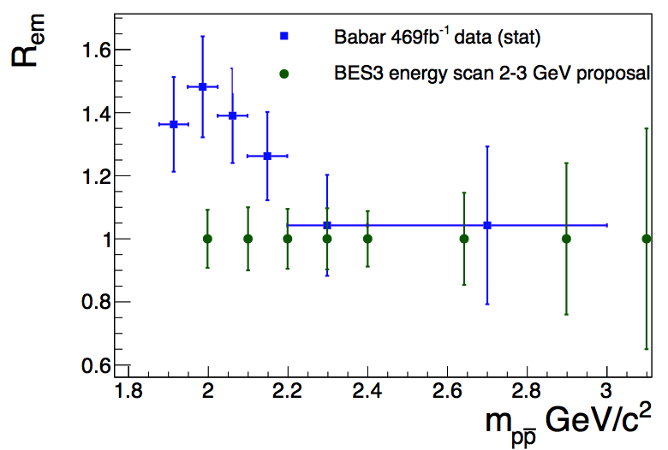
Proton FF : Time-Like
Assume G_{M}=G_{E}
Only 2 measurements,
but results are contradict
10-24% precision from B factory
QCD predict
BES3 0.4fb⁻¹, ∼10% Precision
δ|R_{EM}|/|R_{EM}| ∼ 9% - 35%
δ|G_{M}|/|G_{M}| ∼ 3% - 9%
δ|G_{E}|/|G_{E}| ∼ 9% - 35%
first time extraction without any assumption.
Notes:
However, for the time like proton FF, to day, the experiment statistics are still limit,
It always assume the Gm=Ge in most of experiment, only two results from babar and PSI
To extract the ratio of Ge to Gm, but the results are contradict, and the uncertainty of
Ratio from the B factory is 10-24%.
In BESIII, the uncertainty of the ratio is expected to be round 10% with 0.4pb-1 data,
And it can be first time to extract the Gm and Ge without assumption.

Slide 31
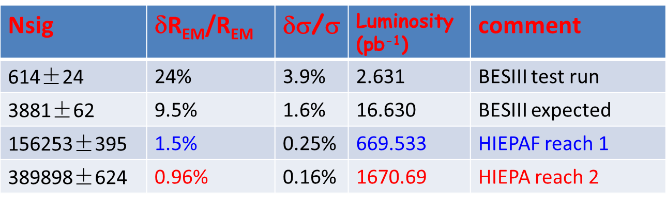
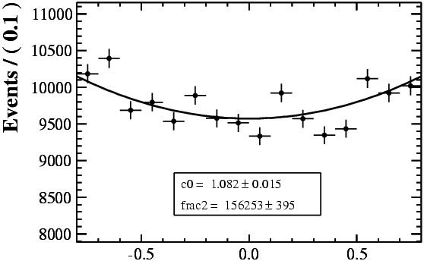
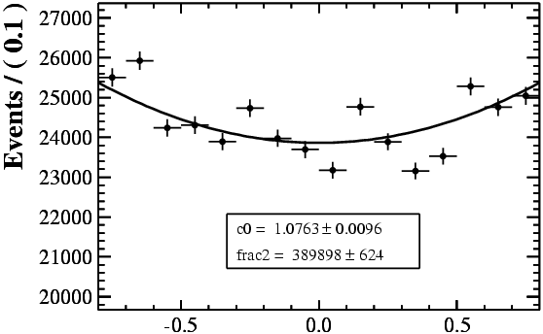
Proton FF (√s=2.23GeV) @ τ-c Factory
1 day
2 days
HIEPA reach 1
HIEPA reach 2
Notes:
So, for the Ratio of GE and Gm, the uncertainty of BESIII test run is about 24%,
While is expected 10% in BESIII final results,
while in HIEPA, the uncertiant is expected to be 1.5% or 1% with 1 or 2 days date
taking respectively.

Slide 32
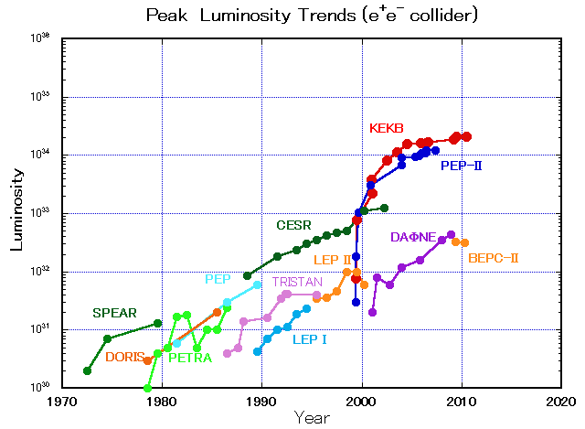

Pre-Conceptual Design
SKEKB
HIEPA
BEPC-II
BEPC
2025
Notes:
To have a super tau-charm factory, one of biggest challenge is high luminosity.
This plot shown the evolution of luminosity for the e+e- collider at different energy.
The desiged luminosity of BEPCII/BESIII is at 10^33,
The curver show the evolution BEPC luminosity, we expected to read the design goal very soon.
To readch a luminosity at 10^35 at 2025 for the HIEPA, it is reasonable compare to the SKEKB , but is bigg challenge.

Slide 33
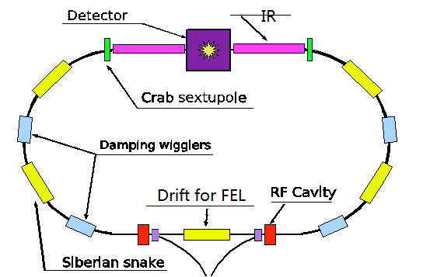
Pre-Conceptual Design -Machine
Symmetric machine with low currents and crabbed waist solution for the interaction region
Polarization available on one beam : Sibelian Snake
Notes:
To have a supper tau-charm factory, we have a very prelimnary ceonceptual design
For the Machine.
The lattice of machine are show in this plot.
To reach a high luminocity, it is designed to be a s……..
And the Sibelain snake solution for the one polarized beam.

Slide 34
Pre-Conceptual Design -Machine
Beam Parameters
Optimal Energy | 2 GeV
Beam Energy | 2-7 GeV
Bean Current (A) | 2
Luminosity (cm⁻²s⁻¹) | 10³⁵
Emittance (nm.rad) | 0.1
光源亮度 | 10¹⁷~10²¹ Ph./(s mm² mrad² 0.1%BW)
辐射类型 | 弯铁辐射、插入元件辐射
寿命 | Top-up
Circumference (m) | 648
RF Frequency (MH) | 500
Harmonic Number | 1080
聚焦结构类型 | 7BA，组合型
周期数 | 24
直线节长度 | 5m×12，9m×10，81m×2 （其中一个为对撞区）
Notes:
The very preliminary parameter for the accelerator are list in this table

Slide 35
Requirement To the Detector
Efficient event triggering, exclusive state reconstruction and tagging
high efficiency and resolutions for charged and neutral particles
Low noise and High radiation hardening and rate
Best possible solid angle coverage
High tracking/PID eff. for charge tracks : [0.05, 2.0] GeV
Good mom. resolution for charged particles: [0.05, 2.0] GeV
Good eff. and ene. resolution for electron/γ : [0.02,2.5] GeV
Good vertex detection: 50 mm
Notes:
Now move the the detector,
To efficiently trigger events, and reconstruction and tag the exclusive state. A general
Requirement on the detector is high efficiency and resolustion for both charged and enutrla particle.
This require our sub-system of detector

Slide 36
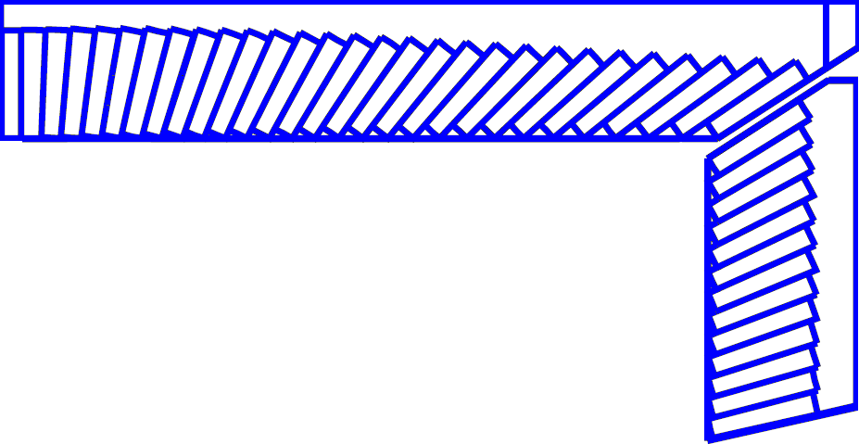
Pre-Conceptual Design - Detector
245 cm
MUD
μ/π suppression power >10/30
York/Muon
185 cm
EMC
Energy range: 0.02-2.5 GeV
At 1 GeV σ_{E} (%)
Barrel(Cs(I): 2
Endcap (Cs): 4
Superconducting magnet
(0.7-1 T)
York/Muon
135 cm
EMC
105 cm
PID
π/K (and K/p) 3-4σ separation up to 2GeV/c
PID-barrel
85 cm
20°
PID-endcap
MDC (Low mass )
σ_{xy}=130 mm
dE/dx<7%, σ_{p}/p =0.5% at 1 GeV
MDC
15 cm
PXD/SSD
PXD
Material budget ~0.15%X₀/layer
σ_{xy}=50 mm
10 cm
3~6 cm
IP
120 cm
140 cm
190 cm
240 cm
300 cm
Notes:
We also have very preliminary conception design for the Detector, a very BESIII like symetry
Detectors is proposed.

Slide 37
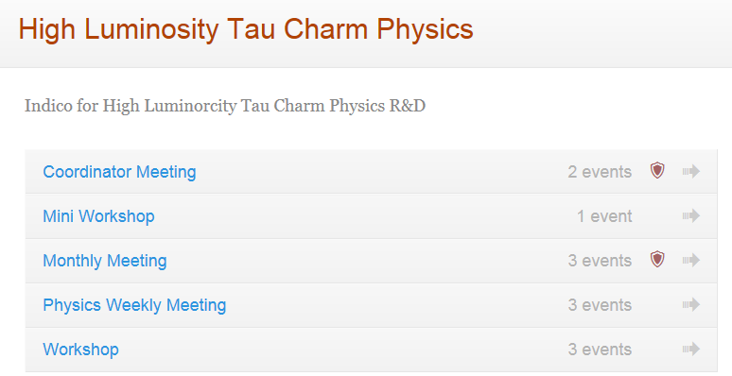
Activities
http://wcm.ustc.edu.cn/pub/CICPI2011/futureplans/

Slide 38
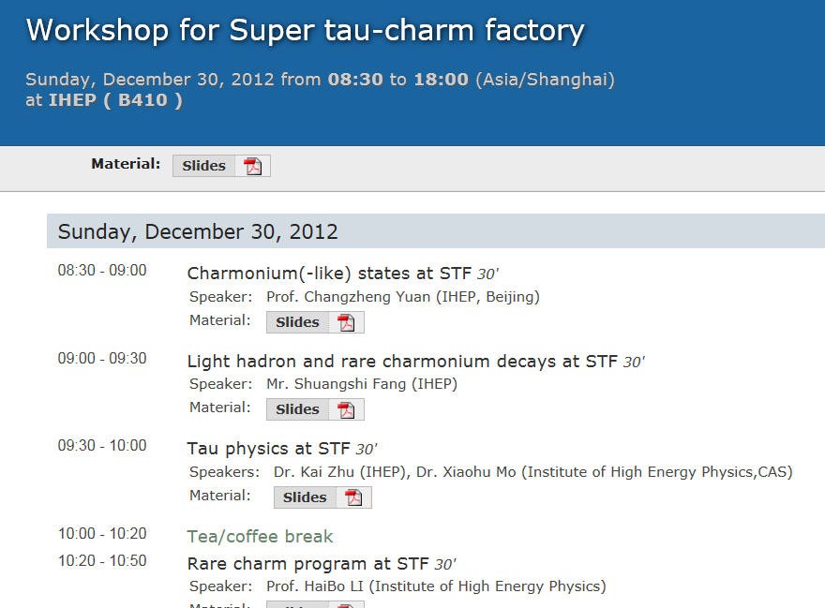
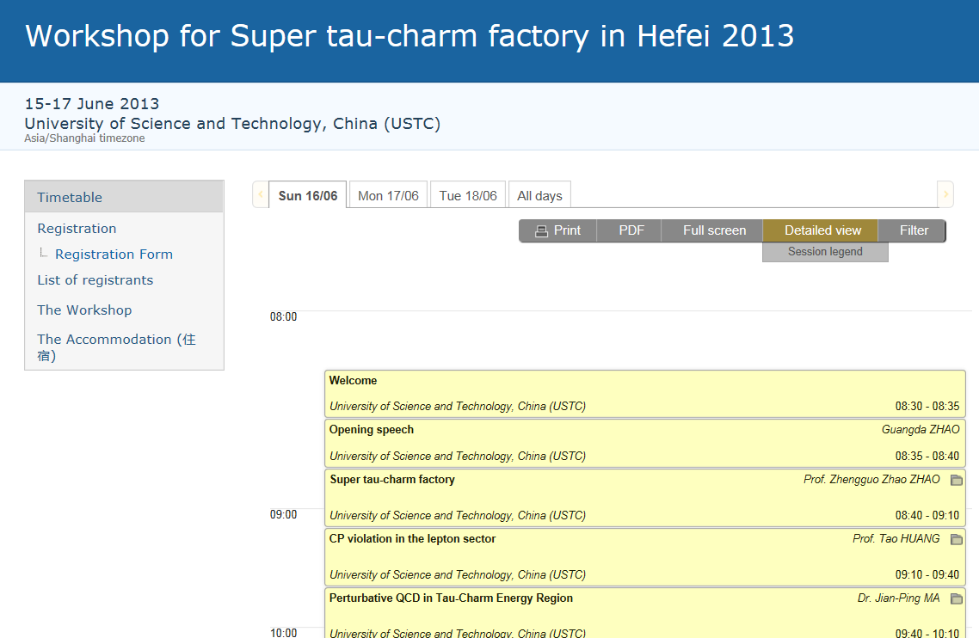
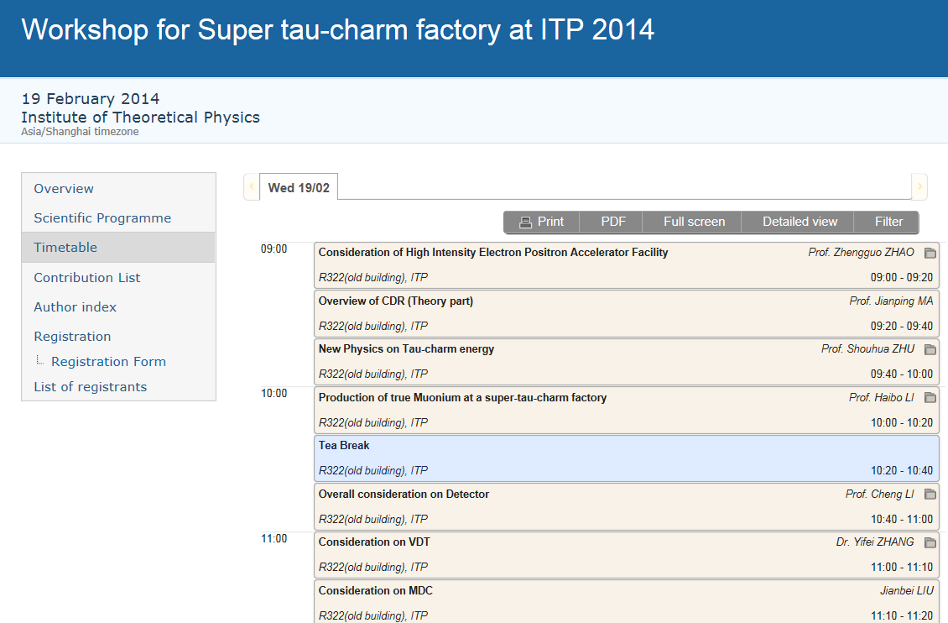
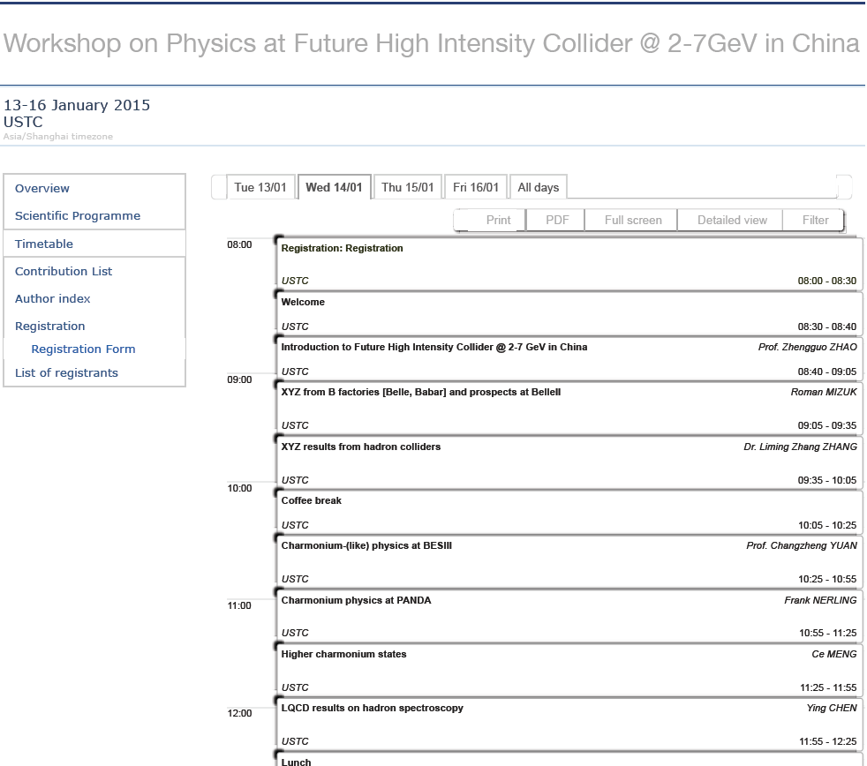
Workshop for HIEPA

Slide 39

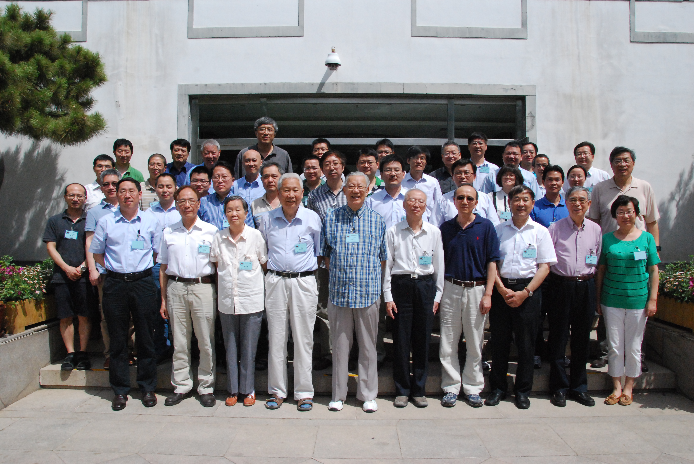
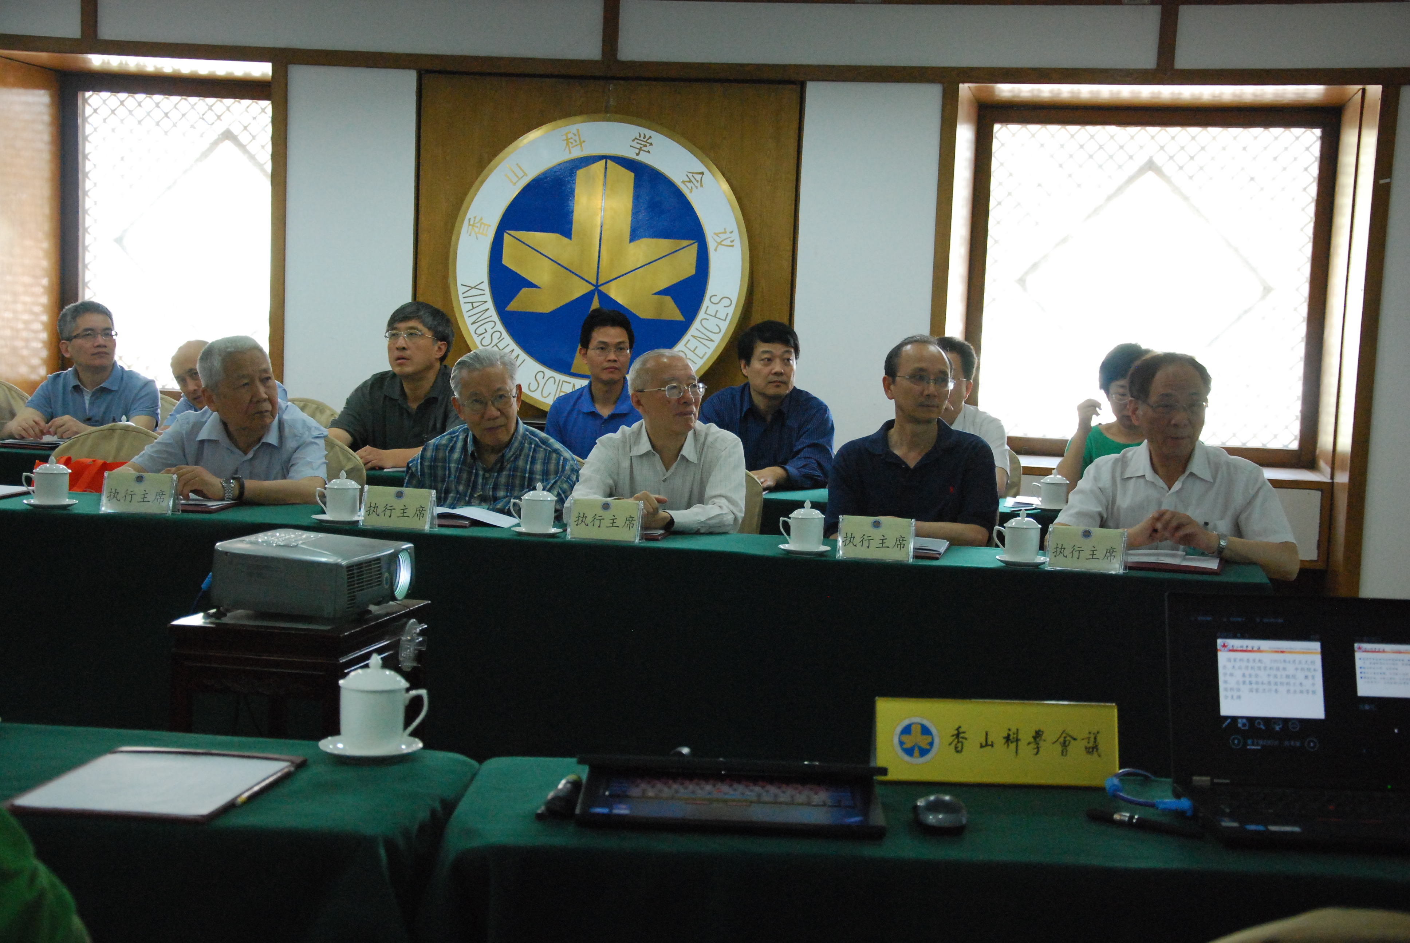
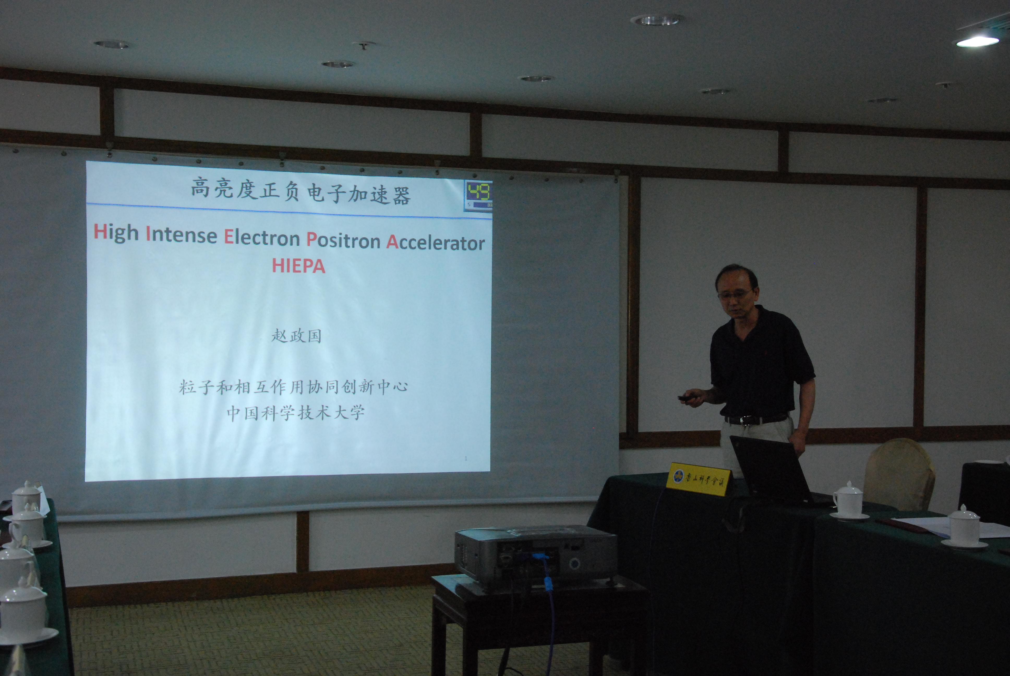
XiangShan-Science Conference
XiangShang-Science Conference, June 3-4, 2015, ∼40 scientists and official joint,
Very important conference for Large Scale/Key Project in China

Slide 40

Summary
HIEPA is one of the possible options for HEP in China.
Rich of physics program with charm quark and tau lepton, have interesting physics relating to key science questions
New/Key technologies and method with challenges
Reasonable scale and cost.
China has the team and experts that has been leading this field for decades
Interdisciplinary mode (STCF + SRF)
Tend to have a CDR this winter
Your ideas, suggestions and inputs are very important for us
incomparable superiority for Charmonium (like)
Welcome to join the effort

Slide 41
Production mechanism
ψ/Y particles are directly produced :
Measure the production cross section precisely,
Extract the excited ψ or Y states resonance parameters via fitting data.
Study states with C=+1 via radiative transition :
B(ψ(3S)→γχ′_{cJ}) = (7,3,1)×10⁻⁴ for J=2, 1, 0 [E. Eichten et al. Rev. Mod. Phys. 80, 1161 (2008)]
ψ(nS/nD)→γXYZ [X(3872) ,Y(4140) et al.], no theoretical prediction on transition rate,
BESIII : σ(Y(4260) →γX(3872))∼6pb [PRL 112, 092001 (2013)]
Search for states in ψ/Y particles hadron decay :
Y(4260)→πZ_{c}(3900), ψ→πh_{c}(1P/2P) …..
Topics at HIEPA
Where are the missing states above the charm threshold
¹D₂(2⁻⁺) : M∼3830MeV, narrow, may be produced in h_{c}(2P) E1 transition
P-wave spin-triplets from S-wave E1 transition
P-wave spin-singlets from S-wave hadron transition
Can we identify F-wave states?
Can we find the Z_{cs}?
Are there hybrids (1⁻⁻, others J^{PC})
Notes:
In tau-charm energy machine, psi and Y can directly produced with running the machine at a given energy.
And the state with C=1 can be studied via radiative transition.
And hardron decay fro psi or Y states can be used to search for states, like zc(3900)
The interesting charmonium topic in HIEPA is to seraching for the missing particle
Above the charm thredhold, like D wave singlet state and Pwave excited state.
To identify F-wave states and search for Zcs, also to looking for the hybirds states predicted by QCD.

Slide 42
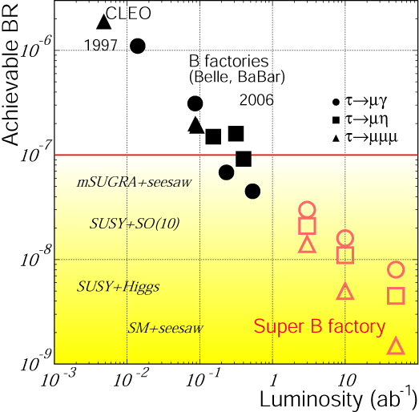
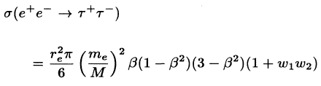
cLFV Decay τ→μγ @ B Factory
From A. Bondar, Charm2010
Current limit : ~ 4×10⁻⁸ (5×10⁸ τ-pairs)
BABAR : 516fb⁻¹ [PRL, 104, 021802]
BELLE : 545fb⁻¹
At (4S) :
ISR background e+e-→τ⁺τ⁻γ
Upper Limit ∝ 1/√L
Expected limit : 3x10⁻⁹@75ab⁻¹ (7×10¹⁰ τ-pairs)
Belle-II Factory with L=10³⁶cm⁻²s⁻¹
10¹⁰ tau pairs per year (x-sec=1nb)
HIEPAF with L=10³⁵cm⁻²s⁻¹
10⁸ tau pairs per year at threshold (x-sec=0.1nb)
3.5×10⁹ tau pairs/year at 4.25GeV (x-sec = 3.5nb)
Super-B 75 ab⁻¹
7×10¹⁰ τ-pairs
What can HIEPA have with 3x10⁹ ττ pairs / year?
Notes:
Tua->gamma mu have been detail studying for many years in B facotry.
This plot show the update limint as function of luminosity for the different experiment.
The current update limit is about 4x10-8 from both BABAR and BELLE,
It is clear see that the upper limit is proportional to 1/sqrt(L)
The strudy from Supper B show the expected UL is 3x10-9 with 75ab-1 data.
At HIEPA, we expected to collected 3x109 tau pair per year
It is interesting to know what the expected UL can be acieved in hiepa.

Slide 43
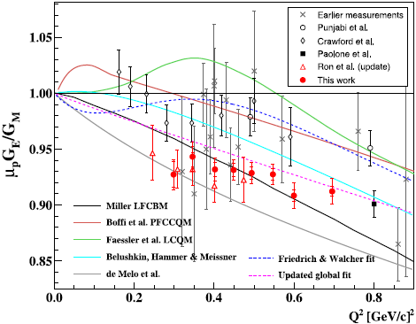

Proton FF : Space-Like
Many measurements of the proton form factors in the space-like region.
At Jlab, the proton factor ratio was measured precisely with an uncertainty of ~1%, based on which the proton electronic and magnetic radii could be extracted.
JLab
JLab
Notes:
Many measurement of proton form factor in the space-like region have performed,
And at JLAB, THE PROTON FACTOR RATIO was measurement precisely with an uncertianty of 1%,
Base on which the proton electronic and magnetic radii could be extracted.

Slide 44





Tracking System
Low mass
Notes:
The tracking system is consistem with a low mass main draft chamber together
with a silicon detectors and cylindrical GEM,
The silicon detectors can take reference as star heavy flavor tracker or Belle2 pixel detector
And CGEN can talk a reference of KLOE inner tracker which have been installed.

Slide 45



Tracking System
Notes:
A fast simulation of two option with MDC plus the star hevery flavor tracker or BELLEII pixel deter
Show the similar perfromce for the two options, and the results can be invprove sinificant at
High mass region with the inner deter, but not big change in the low mementum region.
And the tracker efficiency can be improved with the inner detector.

Slide 46
PID Detector
Key Features of PID System
Enable π/K (and K/p) 3-4σ separation up to 2GeV/c
Suitable for high luminosity run – fast detector
Radiation hard, especially in the endcap region
Compact – reduce costs of the outer detectors
Modest material budget - <0.5X₀
Low Momentum PID
Specific energy loss (dE/dx) in MDC can be used for low momentum PID
Better dE/dx resolution for longer track length
BESIII MDC (~6%, track length ~0.7m)
clean π/K/p ID for p<0.8/1.1 GeV/c
High Momentum PID
TOF can not identify π/K to p=2GeV/c
Cherenkov detector is necessary
Two catalogs
  Threshold Cherenkov – simple to build
  Imaging Cherenkov: RICH (large momentum range)/ DIRC / TOP (most compact)

Slide 47




PID Detector
Baseline Design
PID by RICH at 0.8<p<2GeV/c, no TOF
Proximity RICH, similar to ALICE HMPID design, but with PHENIX HBD (CsI coated GEM) readout
n~1.3 (liquid C₆F₁₄), UV detection
Already proven
Immune to B field → same structure at both the endcap and the barrel
Alternative Design
No TOF, PID by RICH only
Similar to BELLE-II ARICH design, Aerogel + Position Sensitive Photon Detector
n~1.13 (Below threshold for proton at p<2GeV/c)
Already proven at the BELLE-II endcap, how about the barrel part?
Need R&D
ALICE HMPID
PHENIX HBD

Slide 48



Electromagnetic Calorimeter
EMC Requirements
Good energy resolution
Good position/angular resolution
Good timing resolution if possible
Challenging
Radiation damage
  Decrease light yield
  A function of run time
High photon background rate
  Produce pile-up
  Degrade energy and angular resolution
Babar, NIM A479 (2002) 1
Behavior of the light emitted by a crystal
due the radiative Bhabha photons
0.75 krad
1.2 krad

Slide 49

Crystal

Slide 50


BSO Test
Measured with XP2262
9 crystals from SICCAS, 2x2x20 cm³
Caltech

Slide 51




SiPM Test
Hamamatsu S10362-33-050C, 3x3 mm²
BGO

Slide 52
Electromagnetic Calorimeter
BSO Crystal
Pros:
Relative fast
Radiation hard
Emission spectrum peak at 480 nm
Small X0 (60% CsI) → more compact
Small Moliere Radius (60% CsI) → finer segmentation
Low raw material cost (~PWO and 50% BGO, much less than LYSO)
Cons:
LY smaller than CsI(Tl) and LYSO (however, ~ PWOII at -25 ⁰C)
Dose rate dependent LY, fast recovery time → LY Calibration system needed
Not mature (large size available, mass production not proven)
PhotoSensors
PIN Photodiode
Mature
Large noise/signal
Large Area APD
Relatively Mature
Large noise/signal
Vacuum photopentode
New, under developing
Low noise, low gain (~10-100)
Sensitive to magnetic field
Multi-Pixel Photon Counter (MPPC/SiPM)
New, under developing
High gain (~10⁶), low ENE, simplify elec.
Insensitive to magnetic field
Good timing resolution

Slide 53





Muon Detector

Slide 54
Physics @ HIEPA
Precise test of SM
R Scan, Hadron form factor (nucleon, Λ, π), Δα_{QED}, a_{u}
tau lepton decays, lepton universality test
CKM matrix, Decay constants (f_{D}/f_{Ds}), form factors
Neutral D mixing and strong phase
hadron physics
meson, baryon, hyperon spectroscopy
threshold effects
Glueball: direct test of QCD at low energy
Multiquark, exotics, hybrids…..
Charmonium(-like) spectroscopy
Charmed baryon decays
New physics(tiny/forbidden in SM)
Rare charmonium decays ： LFV, LNV, BNV…
Rare charm decay : FCNC, LFV, LNV, invisible
Rare tau decay : FCNC, LFV, LNV
Rare light meson decay : η/η′/ω/φ
Exotic phyics
Light dark matter :
light Higgs boson(a₀), U boson
New interactions
CP Violation
Unexpected large CPV in tau or charm: tiny in SM
CP violation in baryon/hyperon/charm baryon

Slide 55



Nucleons FF
提高中子形状因子的测量精度在实验和理论方面都具有重要意义！
意大利曾计划对DAΦNE/FINUDA做重大专门改进来测量核子形状因子

Slide 56

BESIII Data Taking
Began taking data from 2009
10×10⁹ proposed
3×10⁹ proposed
10 fb⁻¹ proposed
2-3GeV R Scan + Y(2175) 0.5fb⁻¹ unique data
Plan to take data around 4.17 GeV for the DsDs* study next run
Notes:
BESIII begin taking data from 2009,
So far, we have collected the world large jpsi, pisp, and pispp data at threshold production, We also collected total about 7fb-1 data above 4 GeV, which is unique
data in the work for typical charm physics and XYZ physics intersive study.

Slide 57
HIEPA
Collaborative Innovation Center
for Particle Physics and Interaction
University of Science and Technology of China
Institute of High Energy Physics, CAS
Institute of Theoretical Physics, CAS
Tsinghua University
University of Chinese Academy of Sciences
Shangdong University
Shanghai Jiaotong University
Peking University
Nanjing University
Nankai University
Wuhan University
Hua Zhong Normal University

