Slide 1
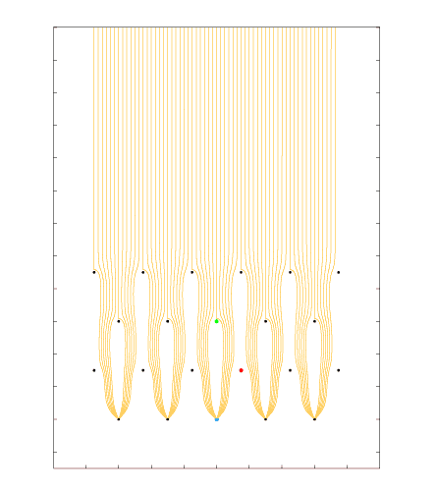
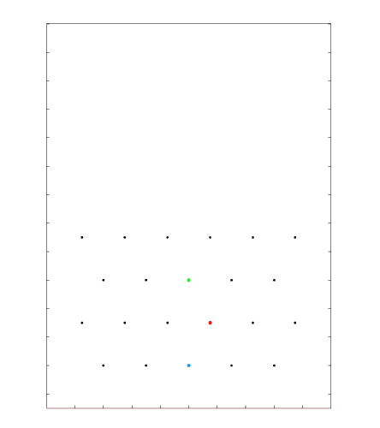
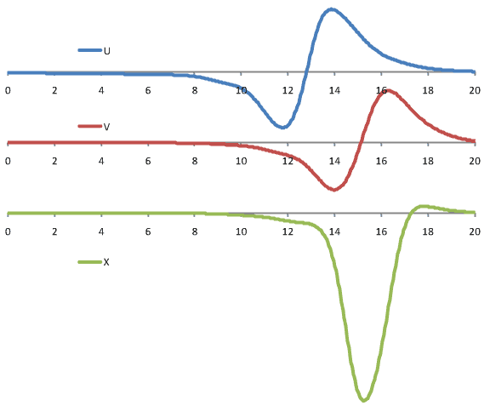
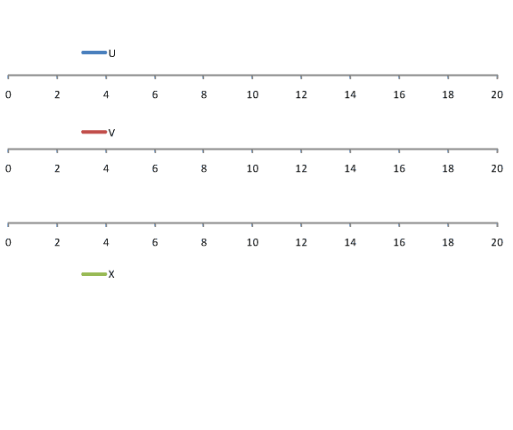
Signal Formation: Induced Signals from a Track Segment
Grid
U
V
[µs]
X
DUNE style wire arrangement: 3 instrumented wire planes + 1 grid plane
Raw current waveforms convolved with a 0.5µs gaussian (~1/2 drift length) to mimic diffusion

Slide 2
Performance as ASIC is submerged in LN₂

