Slide 1
Probing Supersymmetry via Z-decay
Jin Min Yang
ITP, Beijing
CEPC-Physics Workshop
IHEP 2015.8.11

Slide 2
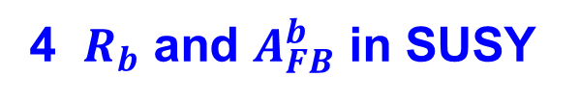
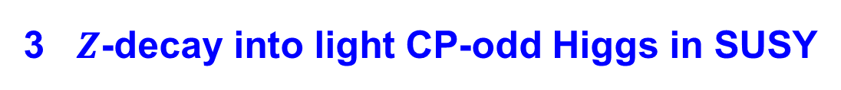
Outline
1 Introduction
2 Lepton flavor violating $Z$-decay in SUSY
3 $Z$-decay into light CP-odd Higgs in SUSY
4 $R_{b}$ and $A_{FB}^{b}$ in SUSY
5 Conclusion

Slide 3


1 Introduction
LEP-I:
$${2.4×10}^{31} cm^{2}s^{−1}$$
At Z-pole the SM agrees with experiments perfectly !
Super Z-factory:
${10}^{34}–{10}^{35}$ $cm^{2}s^{−1}$

Slide 4
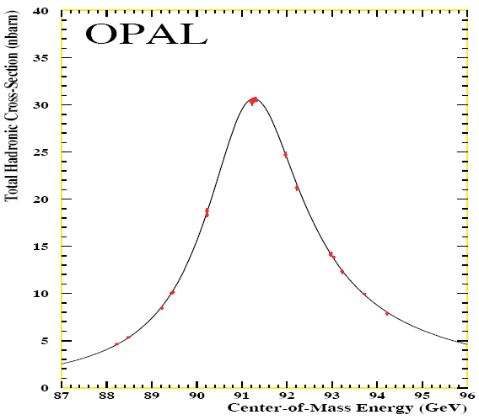

Slide 6





Use super $Z$-factory to constrain/probe new physics
$$b$$
$$Z$$
$$\overline{b}$$

Slide 7
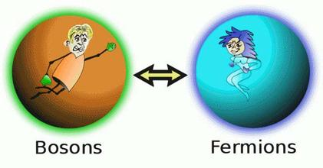

2 Lepton flavor violating $Z$-decay in SUSY
SUSY

Slide 8
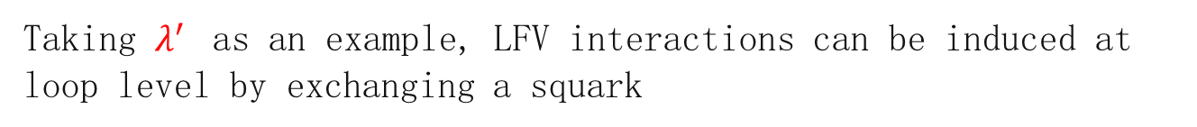
2.1 LFV Z-decay in SUSY without R-parity
Cao, Wu, Yang
NPB 829(2010)370
In MSSM the R-violating interactions:
Taking $λ^{′}$ as an example, LFV interactions can be induced at loop level by exchanging a squark

Slide 9



bound
bound
bound
bound
bound
$2σ$sensitivity
bound
$2σ$sensitivity
$2σ$sensitivity

Slide 10
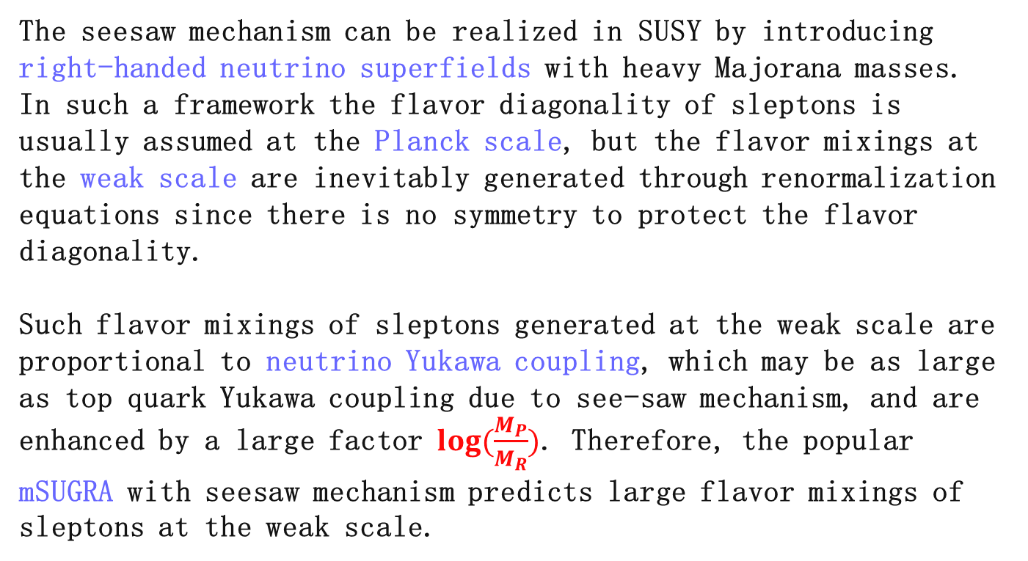
2.2 LFV Z-decay in SUSY seesaw model
Cao, Xiong, Yang
EPJC 32(2004)245
The seesaw mechanism can be realized in SUSY by introducing right-handed neutrino superfields with heavy Majorana masses.
In such a framework the flavor diagonality of sleptons is usually assumed at the Planck scale, but the flavor mixings at the weak scale are inevitably generated through renormalization equations since there is no symmetry to protect the flavor diagonality.
Such flavor mixings of sleptons generated at the weak scale are proportional to neutrino Yukawa coupling, which may be as large as top quark Yukawa coupling due to see-saw mechanism, and are
enhanced by a large factor $log(\frac{M_{P}}{M_{R}})$. Therefore, the popular
mSUGRA with seesaw mechanism predicts large flavor mixings of sleptons at the weak scale.

Slide 11
Both charged sleptons and left-handed sneutrinos have mixings in flavor space
These flavor-changing couplings will contribute to the LFV Z-decays

Slide 12
observable at GigaZ
too small !

Slide 13

3 $Z$-decay into light CP-odd Higgs in SUSY
Cao, Heng, Yang
JHEP 11(2010)110
Some new physics models predict a light CP-odd scalar $a$

Slide 15
GigaZ

Slide 16
GigaZ

Slide 17
GigaZ

Slide 18
GigaZ

Slide 19
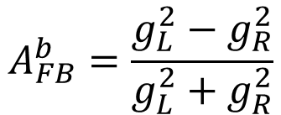

4 $R_{b}$ and $A_{FB}^{b}$ in SUSY
Cao, Su, Yang, Zhang
work in progress
$$A_{FB}^{b}=\frac{g_{L}^{2}−g_{R}^{2}}{g_{L}^{2}+g_{R}^{2}}$$

Slide 20
Chargino -- stop
right-handed stop
left-handed stop

Slide 21
Neutralino -- sbottom

Slide 22
Charged Higgs – top

Slide 23
Neutral Higgs - bottom

Slide 24
gluino – sbottom

Slide 25
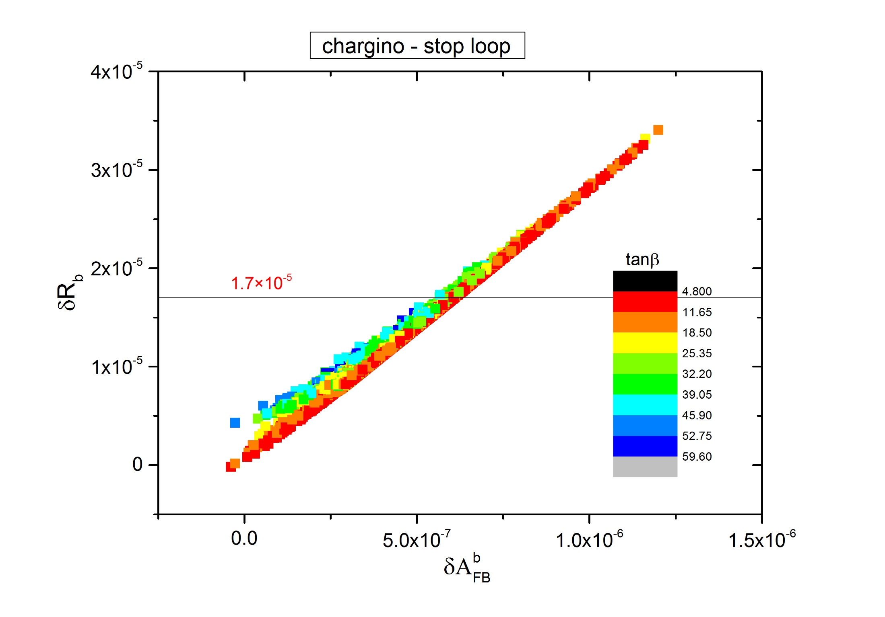

Slide 26
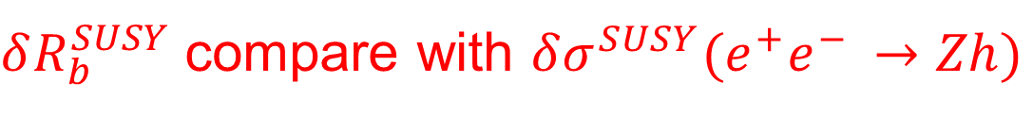


$δR_{b}^{SUSY}$compare with $δσ^{SUSY}(e^{+}e^{− }→Zh)$
$$δR_{b}^{SUSY}$$
$$δσ^{SUSY}(e^{+}e^{− }→Zh)$$

Slide 27
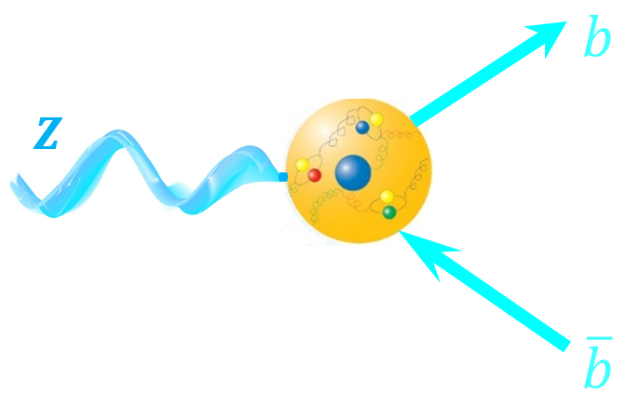


5 Conclusion
We can use super $Z$-factory
to constrain/probe SUSY
LFV $Z$-decays
$Z$-decays to CP-odd Higgs
$R_{b}$
via

Slide 28
Thanks ！

