Slide 1
CEPC Accelerator
Q. Qin for the accelerator team
IHEP
August 10, 2015

Slide 2
Outline
Introduction
Accelerator physics
Technical system design
From CEPC to SppC
Conclusion

Slide 3
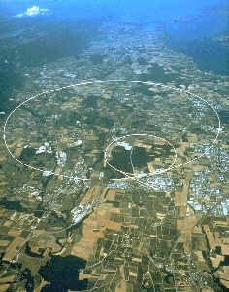
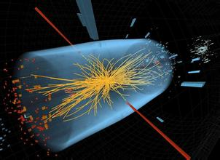

1. Introduction
Motivations
  Higgs Boson was discovered three years ago, with a lower energy than expected
  Circular collider seems more mature and promising
  More high energy physics hide in a possible pp collider converted by electron machine

Slide 4
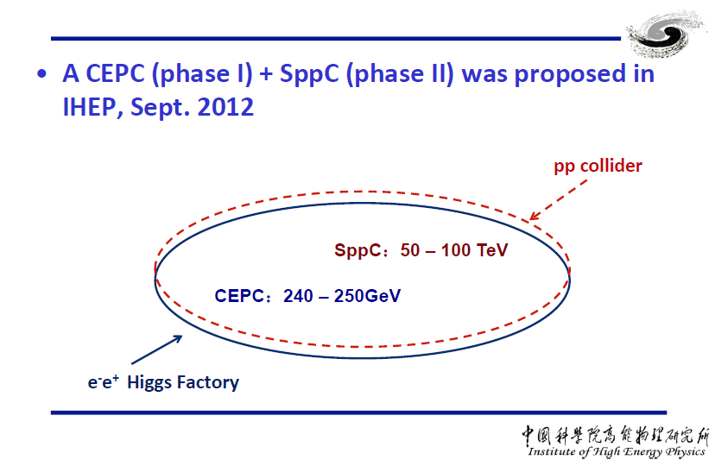
What is CEPC+SppC ?

Slide 5
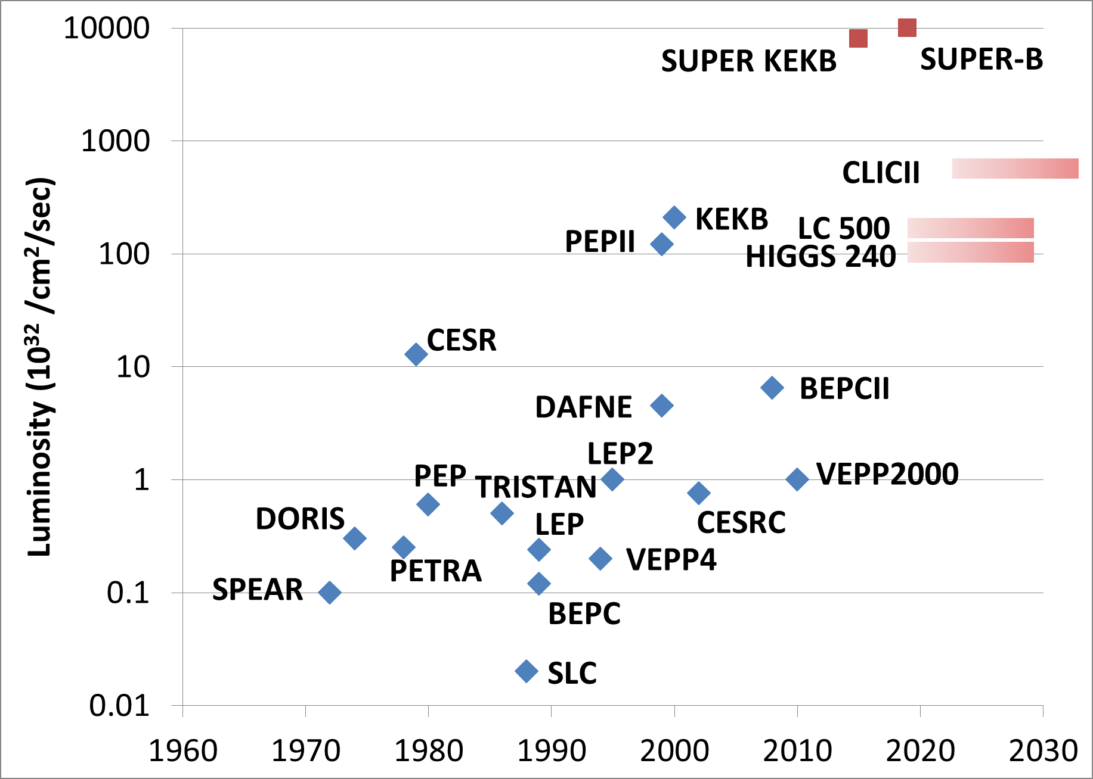
Livingston Chart on Luminosity
CEPC

Slide 6
Accelerator outline
Schematic layout
Linac + booster
as injectors
CEPC:
E_{b}=120GeV
  Limited by
  beamstrahlung & SR
  (~125GeV)
Cross-section = 200 fb
e+
e-
LTB
CEPC (50km-100km)
Boostr(50Km-100km)
SppC 50-100Km)
Alain Blondal et al

Slide 7
Circumference
  Determined by SppC beam energy
  Assume Ecm = at least 70TeV for new physics (p-p)
Beam power
  50 MW/beam,synchrotron radiation (50⁺ MW w/FFS)
Luminosity
  ≥1×10³⁴cm⁻²s⁻¹/IP
Ecm (TeV) | B (T) | C (km)
70 | 12 | ~80
70 | 20 | ~50

Slide 8
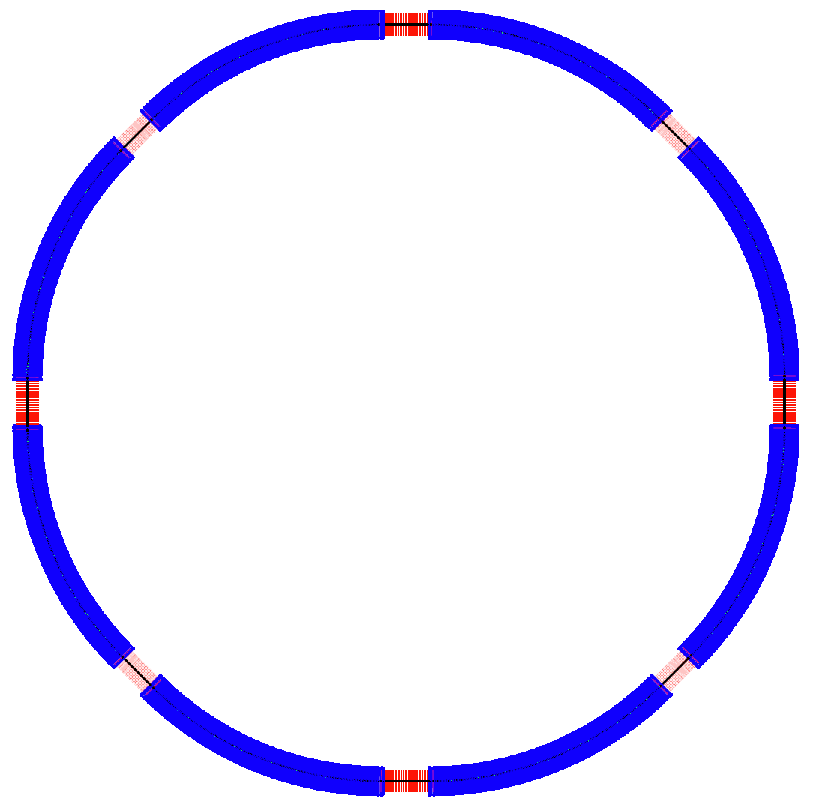
General info of CEPC
CEPC is a Circular Electron Positron Collider to study the Higgs boson
Critical parameters:
  Beam energy: 120GeV
  Circumference: ~54 km
  SR power: 51.7 MW/beam
  8*arcs
  2*IPs
  8 RF cavity sections
  Filling factor of the ring: ~70%
Length of the straight sections are compatible with SppC requirement
½ RF
½ RF
P.S.
IP1
RF
RF
D = 17.3 km
RF
IP4
IP2
RF
C = 54.374 km
RF
IP3
P
RF
½ RF
½ RF

Slide 9
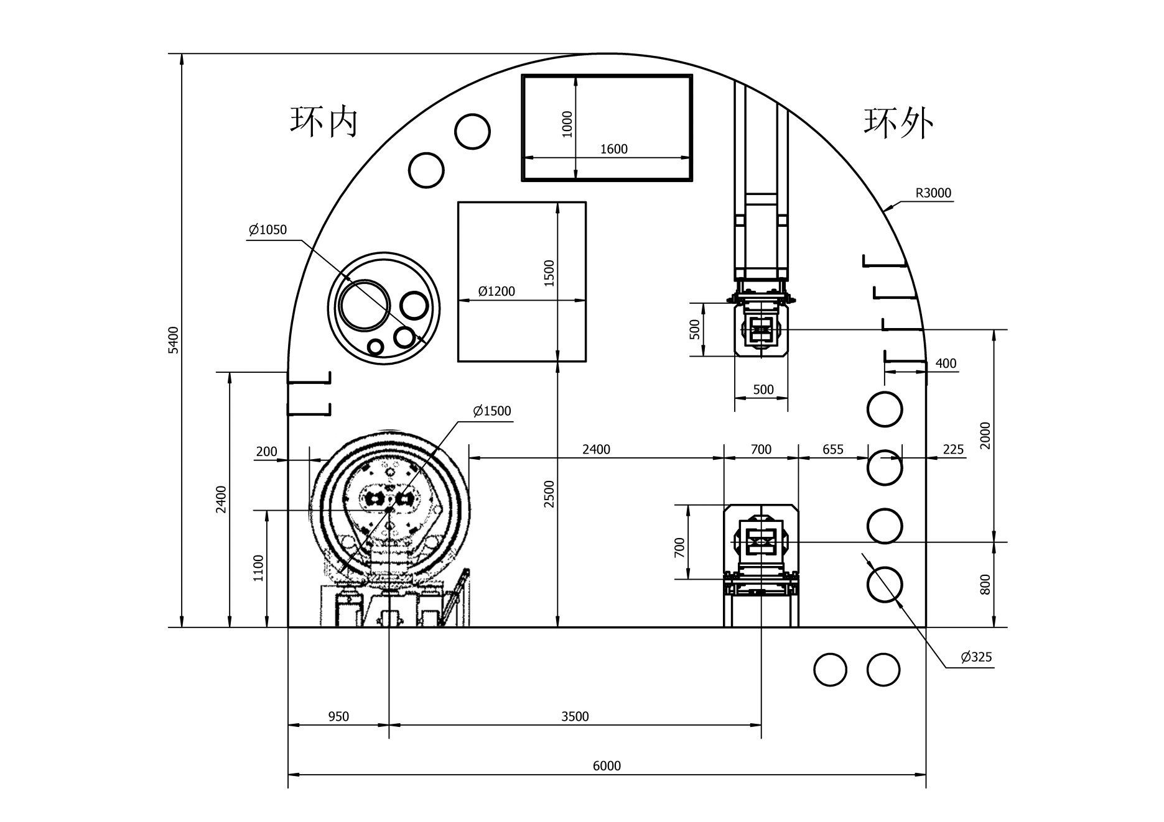
Tunnel Cross Section – SPPC + CEPC Magnets
Drill/Blast Method
6 m

Slide 10
CEPC main parameter
Parameter | Unit | Value | Parameter | Unit | Value
Beam energy [E] | GeV | 120 | Circumference [C] | m | 54752
Number of IP[N_{IP}] |  | 2 | SR loss/turn [U₀] | GeV | 3.11
Bunch number/beam[n_{B}] |  | 50 | Bunch population [Ne] |  | 3.79E+11
SR power/beam [P] | MW | 51.7 | Beam current [I] | mA | 16.6
Bending radius [ρ] | m | 6094 | momentum compaction factor [α_{p}] |  | 3.36E-05
Revolution period [T₀] | s | 1.83E-04 | Revolution frequency [f₀] | Hz | 5475.46
Emittance (x/y) | nm | 6.12/0.018 | β_{IP}(x/y) | mm | 800/1.2
Transverse size (x/y) | mm | 69.97/0.15 | ξ_{x,y}/IP |  | 0.118/0.083
Beam length SR [σ_{s.SR}] | mm | 2.14 | Beam length total [σ_{s.tot}] | mm | 2.65
Lifetime due to Beamstrahlung (simulation) | min | 47 | lifetime due to radiative Bhabha scattering [τ_{L}] | min | 52
RF voltage [V_{rf}] | GV | 6.87 | RF frequency [f_{rf}] | MHz | 650
Harmonic number [h] |  | 118800 | Synchrotron oscillation tune [ν_{s}] |  | 0.18
Energy acceptance RF [h] | % | 5.99 | Damping partition number [Je] |  | 2
Energy spread SR [σ_{δ.SR}] | % | 0.132 | Energy spread BS [σ_{δ,.BS}] | % | 0.119
Energy spread total [σ_{δ, tot}] | % | 0.163 | n_{γ} |  | 0.23
Transverse damping time [n_{x}] | turns | 78 | Longitudinal damping time [n_{e}] | turns | 39
Hourglass factor | F_{h} | 0.658 | Luminosity /IP[L] | cm⁻²s⁻¹ | 2.04E+34

Slide 11
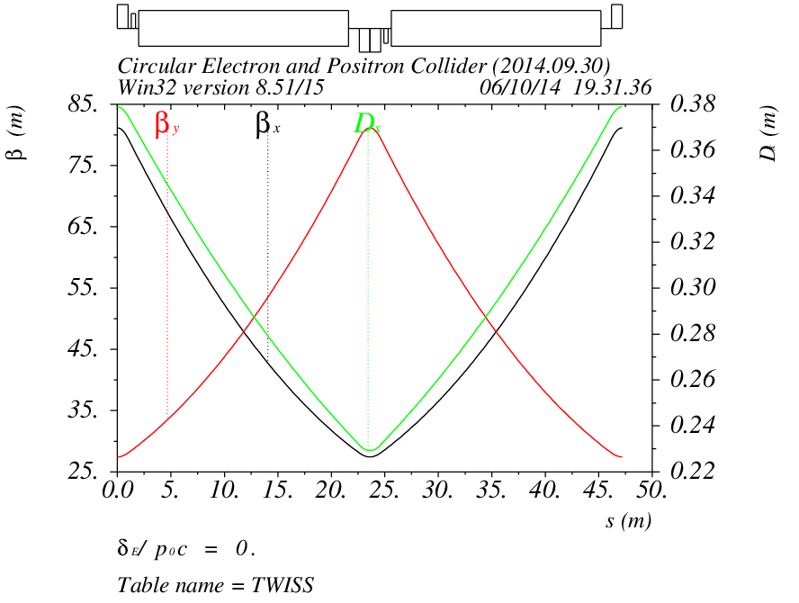
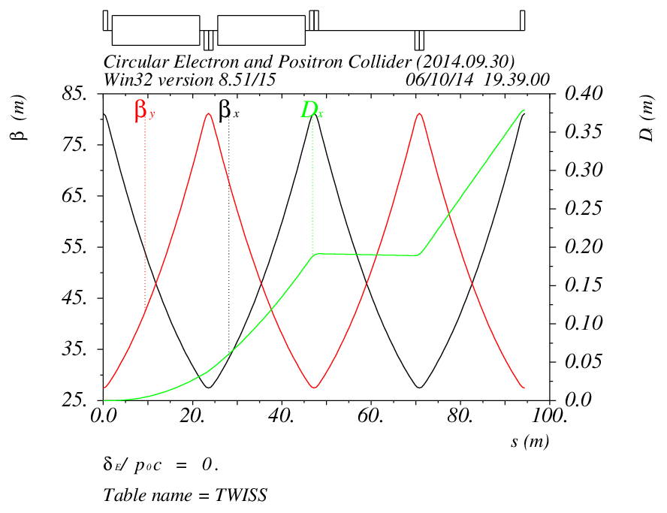
Accelerator physics
Lattice of arc sections
Length of FODO cell: 47.2m
Phase advance of FODO cells: 60/60 degrees
Dispersion suppressor on each side of every arc
Length: 94.4m

Slide 12
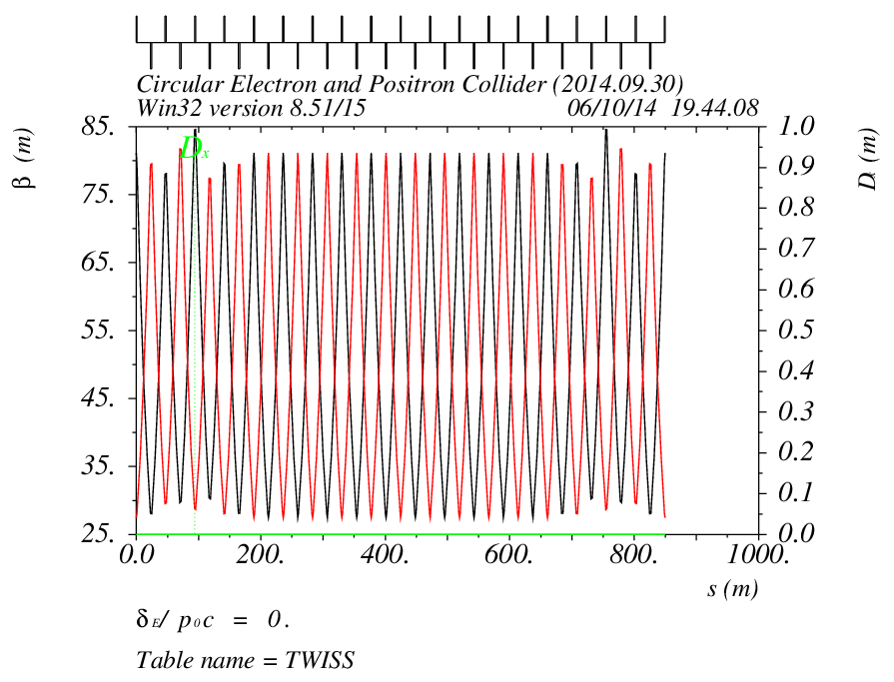
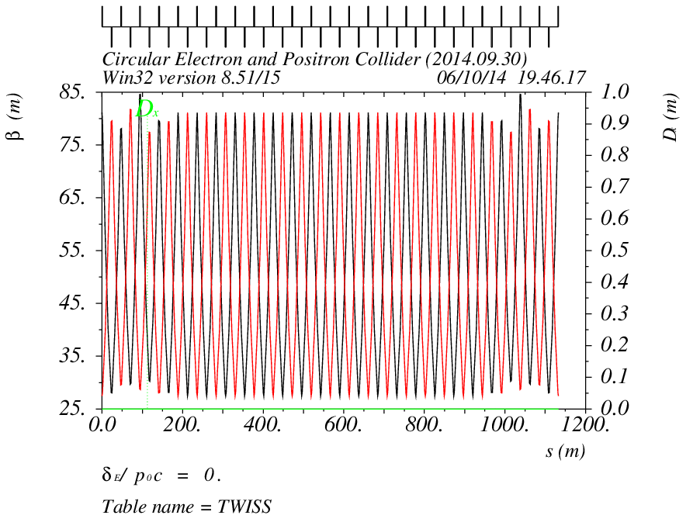
Lattice of straight sections
Short straight: 18 FODO cells
Length: 849.6m
Long straight: 24 FODO cells
Length: 1132.8m

Slide 13
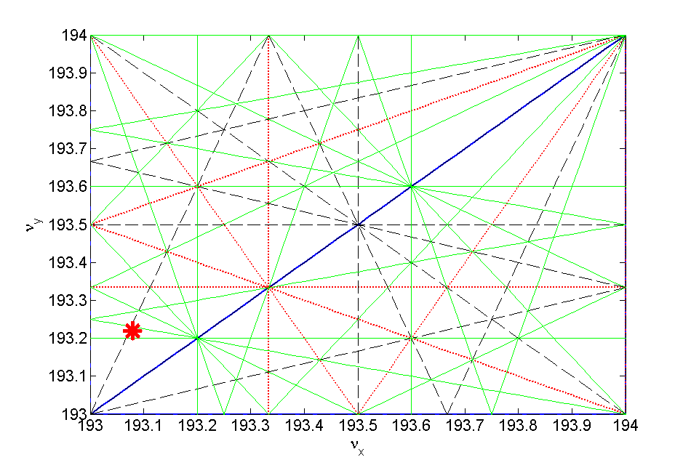
Working point
The working points are chosen as 193.08/193.22 in horizontal and vertical
Optimization is done with beam-beam simulations, to have a high luminosity

Slide 14
Detailed Luminonisty/Beam Sizes evaluation were performed (Courtesy K. Ohmi, D. Shatilov and Y. Zhang)
Beam beam simulations

Slide 15
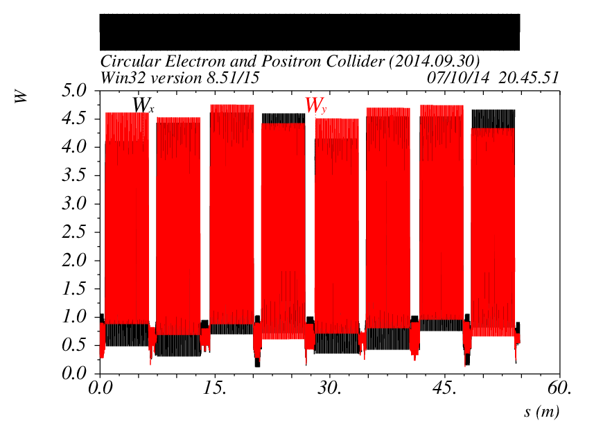
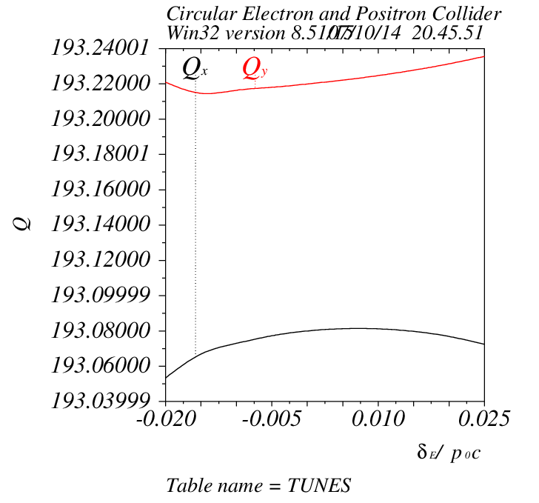
Chromatic correction
Two families of sextupoles: one family for horizontal, one family for vertical plane
One sextupole next to each quadrupole in the arc section
The W function for the ring is only a few
The chromaticity in both planes has been corrected to a positive value

Slide 16
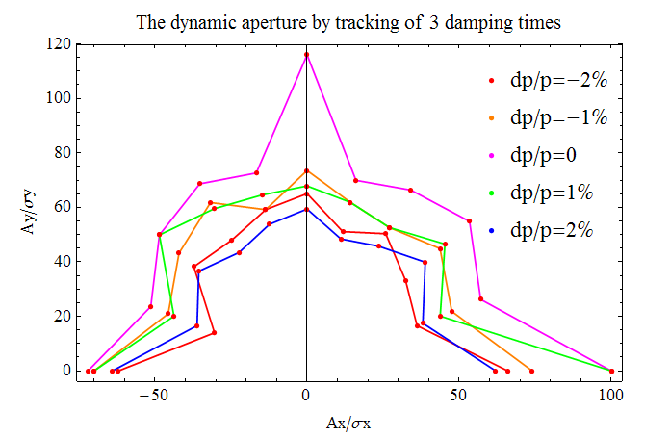
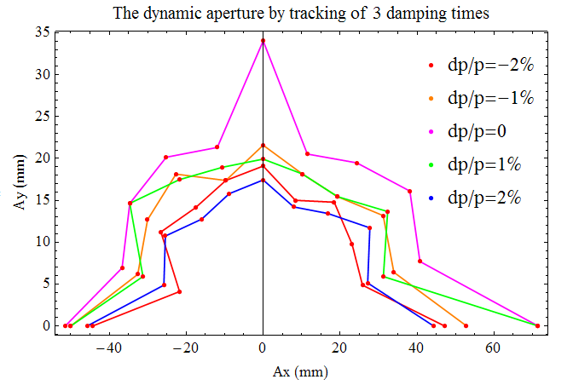
Dynamic aperture
240 turns is tracked for dynamic aperture
Full coupling is assumed for vertical plane
The dynamic aperture is: ~ 60σ_{x}/60σ_{y} or 40mm/16mm in x and y for ±2% momentum spread

Slide 17
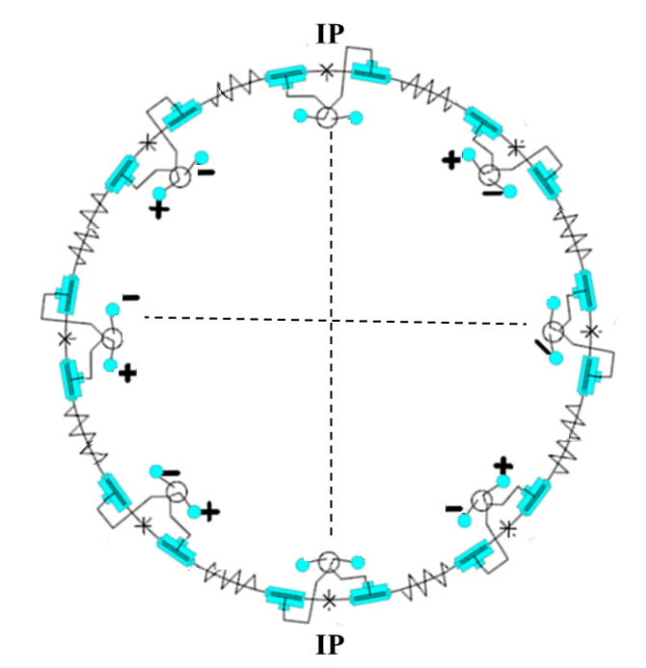
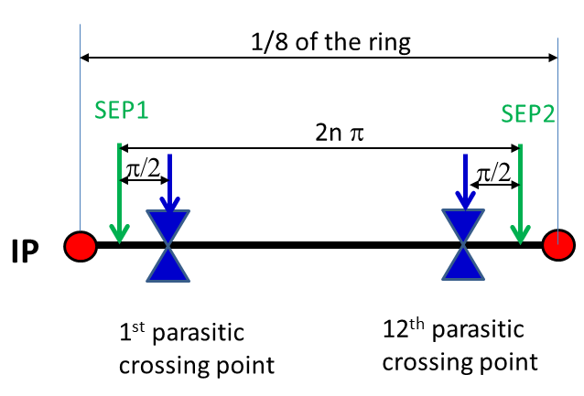
Pretzel scheme
Horizontal separation is adopted to avoid big coupling
No orbit in RF section to avoid beam instability and HOM in the cavity
One pair of electrostatic separators for each arc

Slide 18
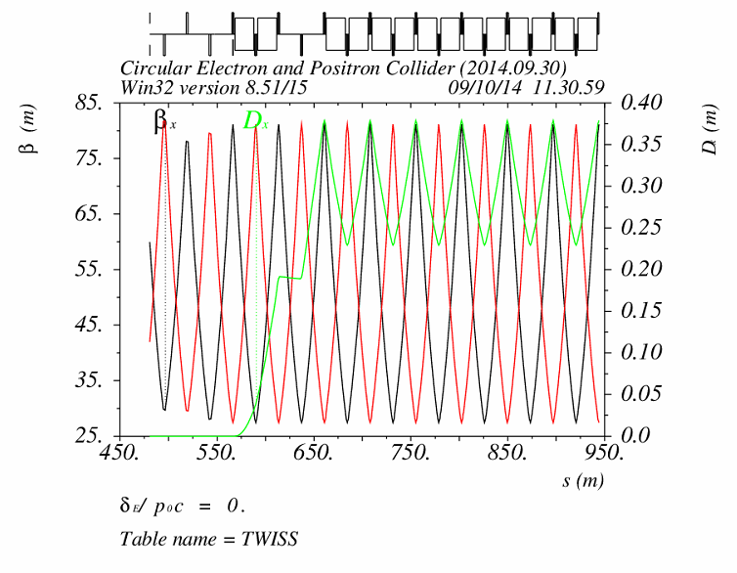
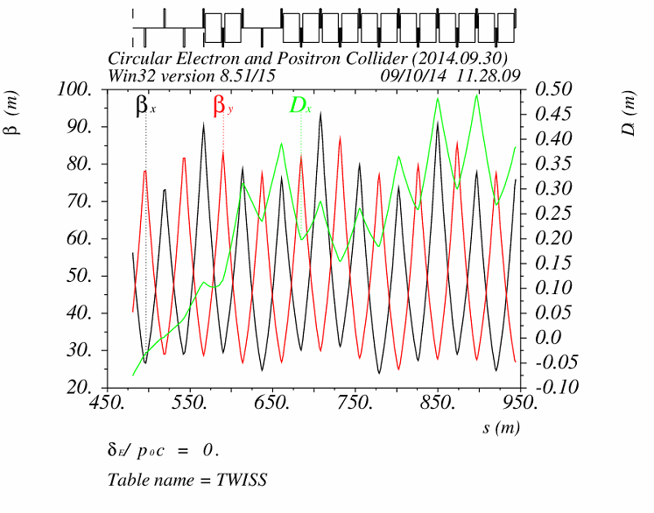
Effects of pretzel orbit
Pretzel orbit has effects on:
  Beta functions, tune
  Dispersion function, emittance
  Chromaticity, dynamic aperture
Sextupoles
on
w/o pretzel orbit
w/ pretzel orbit

Slide 19
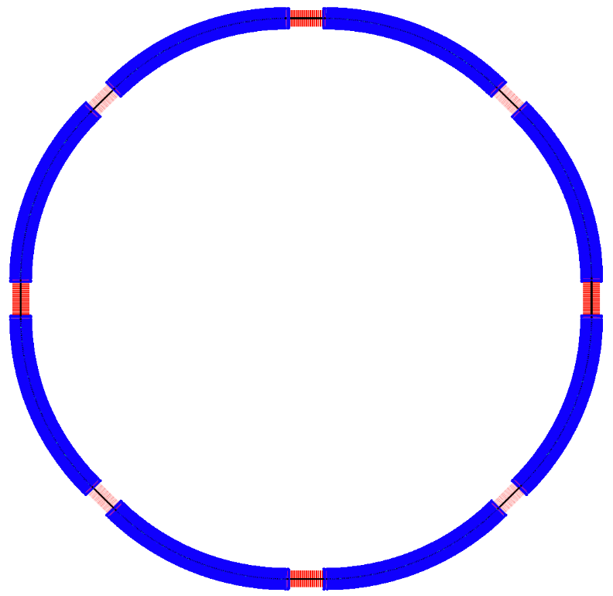
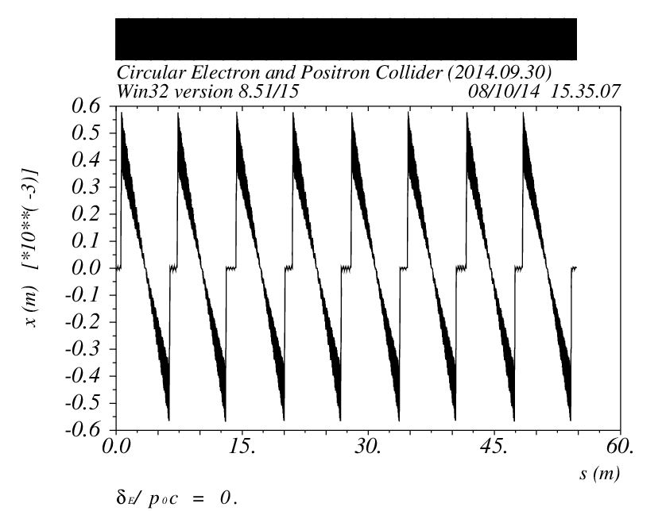
Sawtooth orbit
The energy sawtooth phenomenon has been raised and studied by K. Oide in HF2012
The total synchrotron radiation energy loss in CEPC ring is 3GeV
The beam will have 0.3% energy difference between the entrance and exit of each arc
The maximum orbit distortion is ~0.6 mm
½ RF
½ RF
P.S.
IP1
RF
RF
D = 17.3 km
RF
IP4
IP2
RF
C = 54.374 km
RF
IP3
RF
½ RF
½ RF

Slide 20
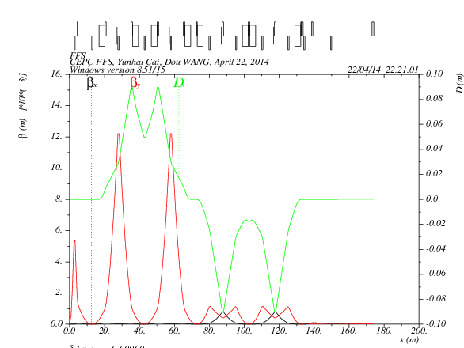
Final Focus System
DX=DPX=0
αx=αy=0
betax=84m
betaY=28m
betaX*=0.8m
betaY*=0.0012m
L*=2.5m
On momentum
Total length: 170 m
Off momentum:
±2%, ±1%
DA optimization w/o pretzel orbit is still under way.

Slide 21
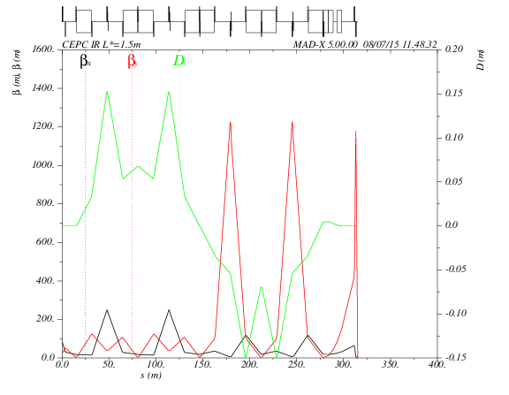
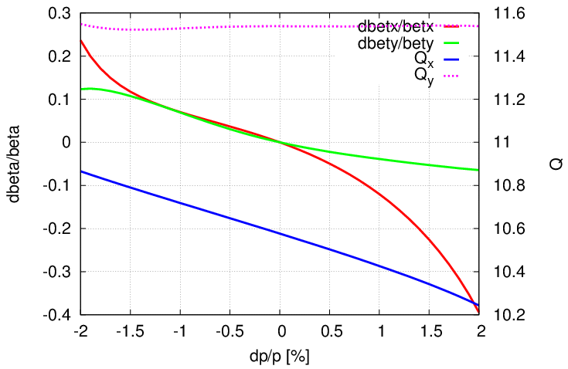
Update of CEPC FFS (FFS_3.0mm_v2_Jul_2015_tmp)
Add additional sextupoles
Vertical tune was corrected to be very flat within the energy acceptance (±2%)
DA with whole ring need to be checked
FT | CCS | MT | Natural chromaticity (incl. FODO) | Primary nonlinear corerction | High order correction | Dynamic aperture with FFS only | Dynamic aperture with whole ring | To be done
2 quads βy*=3.0mm L*=1.5m d=0.5m R=16mm Btip=4.7T | Ltot=264m βymax=1200m ΔU/U=3.3% Δβ/β=-2.5% | 2 quads | ξx=-28.6/4 ξy=-306.3/4 | reduce ξ contribution from CCS, 1st order ξ, 2nd order geo. aberr. | High order ξ (tune phase+additional sext.), 3rd order geo. aberr. from finite length sext. |  | TBD | an ARC with optimised dQ/dJ

Slide 22
Bypass design
A bypass is needed to avoid the proton detectors at IP2 and IP4.
Take out twelve FODOs from the section "ARC" and put them into bypass.
In the bypass, we use the same magnets (including bends, quadrupole, sextupole) with the main ring.
The deviation is 43.78 m.
The red line represent the bypass we have designed and the black one represents the version without bypass.

Slide 23
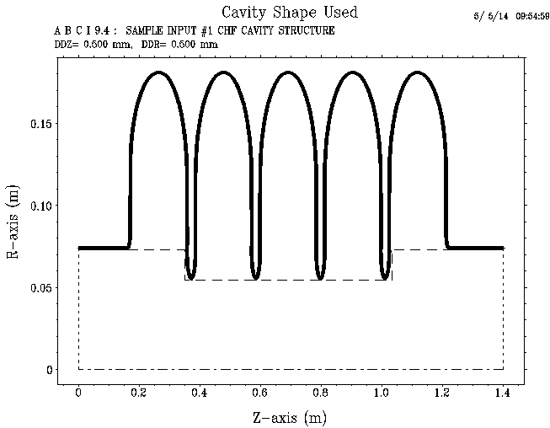
Impedance budget
Resistive wall impedance is calculated with analytical formulas
Impedance of the RF cavities is calculated with ABCI
Object | Contributions
 | R [kΩ] | L [nH] | k_{loss} [V/pC] | |Z///n|_{eff} [Ω]
Resistive wall (Al) | 16.8 | 214.4 | 552.1 | 0.0075
RF cavities (N=378) | 40.1 | -- | 1313.6 | ---
Total | 56.9 | 214.4 | 1865.7 | 0.0075

Slide 24
Multi-bunch effects
Transverse resistive wall instability
with ω_{pn} = 2πf_{rev} × (pn_{b} + n + ν_{x,y})
The growth rate for the most dangerous instability mode is 36 s⁻¹ (τ = 28 ms) in the vertical plane with mode number of μ = 21.
The growth time is higher than the transverse radiation damping time.
The resistive wall instability is not supposed to happen in the main ring!
Growth rate vs. mode number in the vertical plane

Slide 25
Beam ion instability
Ion trapping
  With uniform filling pattern, the ions with a relative molecular mass larger than A_{x,y} will be trapped.
Fast beam ion instability
  With uniform filling, the growth time considering ion oscillation frequency spread is 11ms, which is lower than the damping time.
  Fast beam ion instability could occur with uniform filling.
  The ions will not be trapped by the beam.

Slide 26
Beam lifetimes caused by different
sources in CEPC
  Radiation Bhabha lifetime
  Simulated by BBBREM
  Beam-gas lifetime
  Touschek lifetime
Courtesy of N. Wang

Slide 27
3. Technical system design
All technical systems are touched.
  Magnet, power supply, vacuum, beam instrumentation, control, mechanics & survey, radiation shielding, RF, power source, cryogenics, injection, etc.
Preliminary design for all technical system is under way.
Superconducting RF, power source are two key and important systems (expensive & power-consuming).
Efforts from IHEP are given to these key systems.

Slide 28
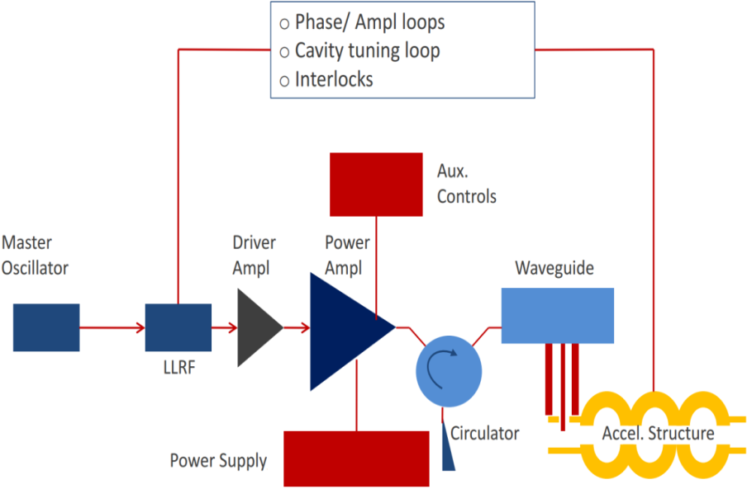
Power source design
Collider ring
Booster ring
Source options @1.3GHz/20kW level
  Klystrons become costly per W at low power and lowest cost verisons only ~ 40 % efficient;
  IOTs have higher efficiency (~ 60 %) but higher cost;
  Solid State Amplifiers (SSAs) cost competitive but currently have low efficiency (35%) - however, high availability (modular), and cost likely to decrease and efficiency increase (expect > 40 % soon).
The RF power delivered by the klystron will be fed into the cavity via a WR1500 waveguide as well as a circulator.
So Booster source option is Solid State Amplifier (SSA)
Courtesy Z. Zhou

Slide 29
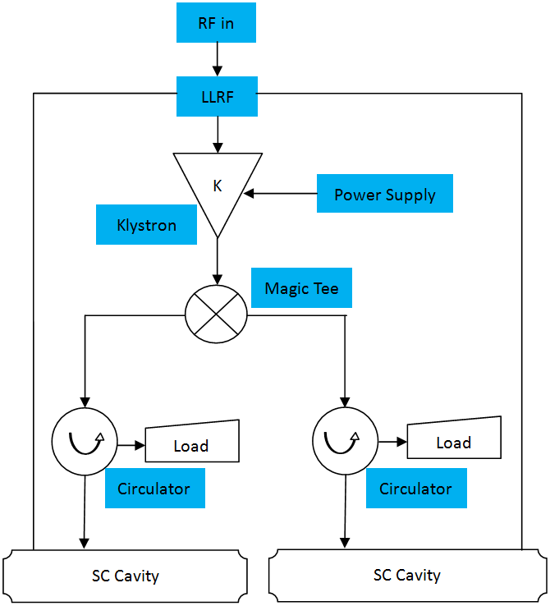
Power source for main ring
Device | Type | No.
Klystron | 800kW CW | 192
PSM | 90kV/18A | 192
Circulator & load | 400kW CW | 384
LLRF |  | 192
Waveguide | WR1500 | 384
Klystron Parameter | Value
Freq. (MHz) | 650
Bandwidth(MHz) | ±0.5
Output power (kW) | 800
Beam voltage (kV) | 90
Beam current (A) | 18
Efficiency (%) | 65
Gain (dB) | 40
PSM Parameter | Value
High voltage (kV) | 90
Current (A) | 18
Voltage stability (%) | < 2
Efficiency (%) | >90
Turn-off time (us) | <5
Stored energy (J) | <15
Circulator Parameter | Value
Freq. (MHz) | 650
Bandwidth(MHz) | ±2
Foward power (kW) | 400
Reflection power(kW) | 400
Insert loss(dB) | < 0.1
Isolation(dB) | > 26

Slide 30
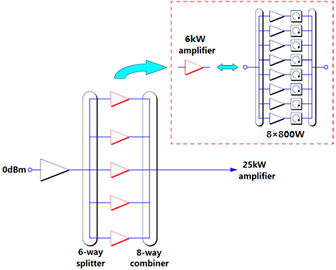
Power source for booster
Parameters mode | Value
Operation frequency | 1300MHz±0.5MHz
Cavity Type | 9-cell
Cavity number | 256
RF input power (kW) | 20/cavity
25 kW Solid state amplifier
Parameter | Value
Frequency (MHz) | 1300±5
Power (kW) | 25
Gain (dB) | 67
Efficiency | 50%@25 kW

Slide 31
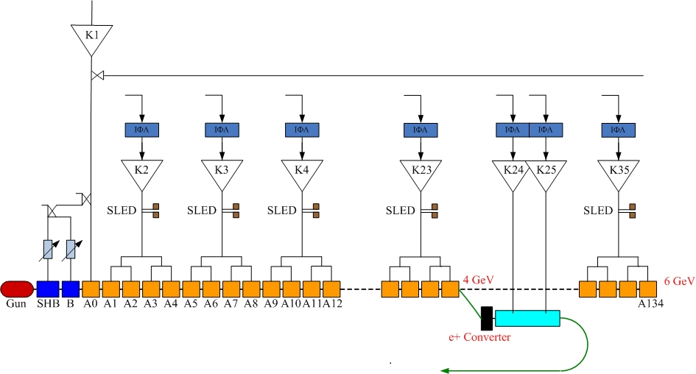
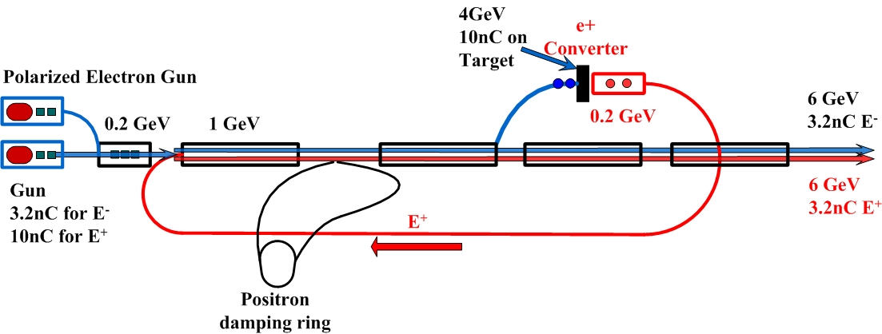
Power source for LINAC
LINAC RF system (35 sets)
Parameter | Unit | Value
e⁻ beam energy | GeV | 6
e⁺ beam energy | GeV | 6
Repetition rate | Hz | 50
e⁻ bunch population |  | 2×10¹⁰
e⁺ bunch population |  | 2×10¹⁰
Klystron output power | MW | 80
Modulator peak power | MW | 200

Slide 32
80MW Klystron
200MW Modulator
Parameters | Value
Frequency (MHz) | 2856
Output power (MW) | 80
Efficiency (%) | 42
Gain (dB) | 53
Pulse length (us) | 4
Pulse rate (pps) | 50
Beam voltage (kV) | 400
Beam current (A) | 488
Drive power (W) | 350
Parameters | Value
Peak output power (MW) | 200
Average output power (kW) | 80
PFN charging voltage (kV) | 50
PFN impedance (Ω) | 2.85
Pulse width (us) | ＞4 μs (flat top)
Pulse flatness (%) | ±0.15
Pulse rate (pps) | 50
Pulse transformer turns ratio | 1:17
Up to now ---
The design of overall parameters of klystron is finished.
The design of beam optics of electron gun is finished.
Resonate cavity parameter design and simulation are under way.

Slide 33
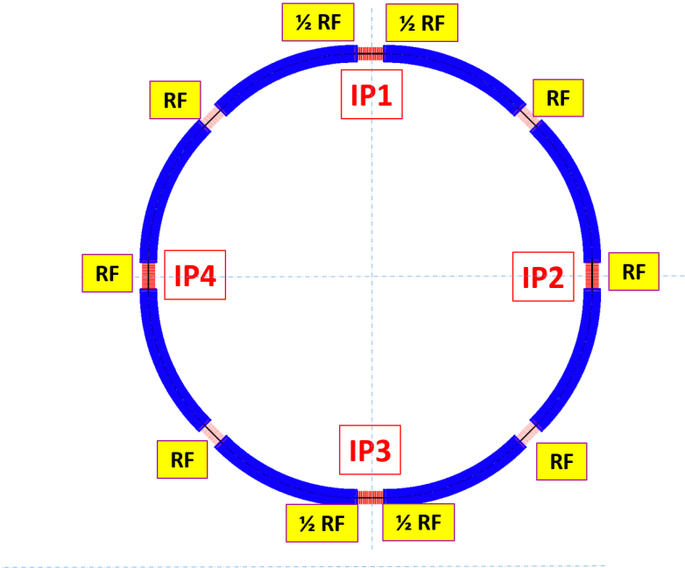
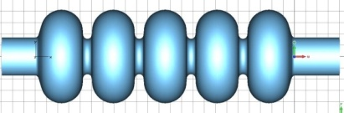
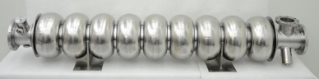
Superconducting RF system
 | Collider | Booster
Modules / section | 12 | 4
Module length (m) | 10 | 12
Cavities / module | 4 | 8
Cavities / section | 48 | 32
Total modules | 96 | 32
Total cavities | 384 | 256
Collider: 650 MHz cavity
Booster: 1.3 GHz cavity
Total cavities: 640
Total modules: 128
Total RF length: 1.4 km
Total RF voltage: 12 GeV
Beam power: 104.5 MW
HOM power: 2 MW
Courtesy J.Y. Zhai & Y. Sun

Slide 34
Baseline Parameters and Challenges
Parameters | CEPC-Collider | CEPC-Booster | LEP2
Cavity Type | 650 MHz 5-cell Nitrogen-doped Nb | 1.3 GHz 9-cell Nitrogen-doped Nb | 352 MHz 4-cell Nb/Cu sputtered
V_{cav} / V_{RF} | 17.9 MV / 6.87 GeV | 20 MV / 5.12 GeV | 12 MV / 3.46 GeV
E_{acc} (MV/m) | 15.5 | 19.3 | 6 ~ 7.5
Q₀ | 4E10 @ 2K | 2E10 @ 2K | 3.2E+9 @ 4.2K
Cryomodule number | 96 (4 cav. / module) | 32 (8 cav. / module) | 72 (4 cav. / module)
RF coupler power / cav. (kW) | 280 c.w. | 20 | 125
RF source number | 192 (800 kW / 2 cav.) | 256 (25 kW / cav.) | 36 (1.2 MW / 8 cav.)
HOM power / cav. (kW) | 3.5 | 0.005 | 0.3
HOM damper | coaxial/waveguide@2K + ferrite @ RT | coupler @ 2K + ceramic @ 80K | coaxial coupler

Slide 35
Preliminary Cavity Design
Parameter | Unit | Main Ring | Booster
Cavity frequency | MHz | 650 | 1300
Number of cells | - | 5 | 9
Cavity effective length | m | 1.154 | 1.038
Cavity iris diameter | mm | 156 | 70
Beam tube diameter | mm | 170 | 78
Cell-to-cell coupling | - | 3 % | 1.87 %
R/Q | Ω | 514 | 1036
Geometry factor | Ω | 268 | 270
E_{peak}/E_{acc} | - | 2.4 | 2
B_{peak}/E_{acc} | mT/(MV/m) | 4.23 | 4.26
Cavity longitudinal loss factor* k_{∥ HOM} | V/pC | 1.8 | 3.34
Cavity transverse loss factor* k⊥ | V/pC/m | 2.4 | 35.3
Acceptance gradient | MV/m | 20 | 23
Acceptance Q₀ at acceptance gradient | - | 4E10 | 2E10
* main ring bunch length 2.65 mm, booster bunch length 2.66 mm

Slide 36
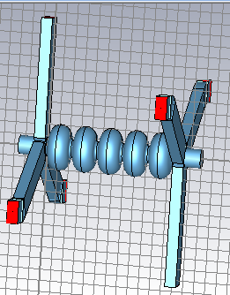
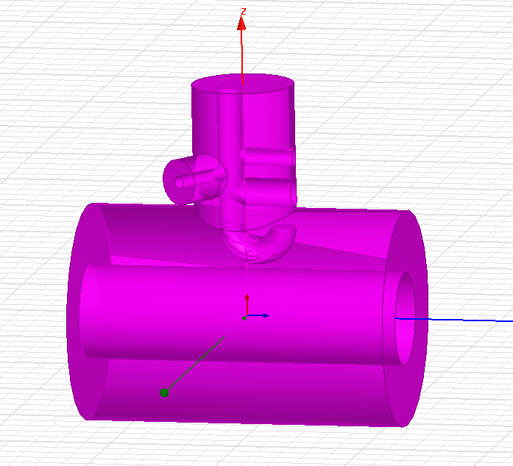
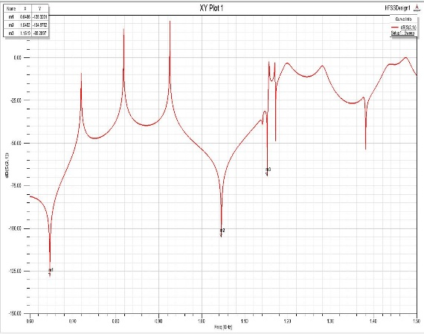
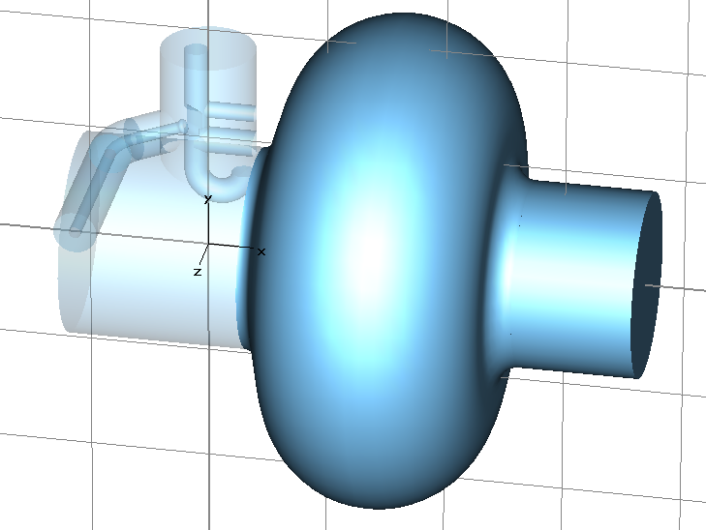
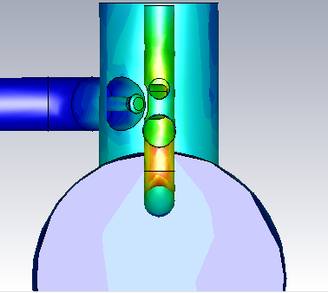
HOM and SOM Damping
Need effective damping of the 3.5 kW HOM power per cavity with coaxial coupler or waveguide. Design and simulation ongoing.
Waveguide HOM coupler
Monopole modes impedance
Dipole modes impedance
Coaxial HOM coupler

Slide 37
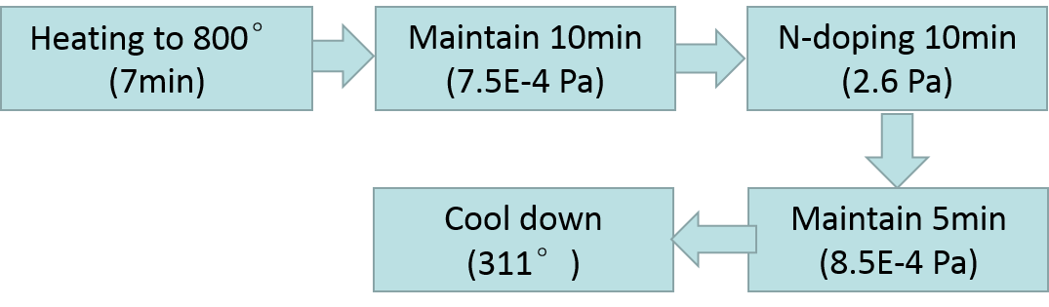
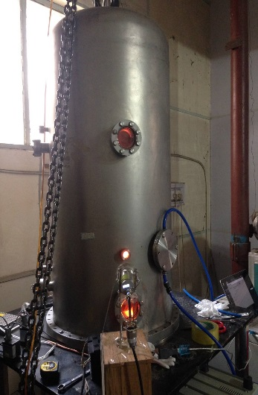
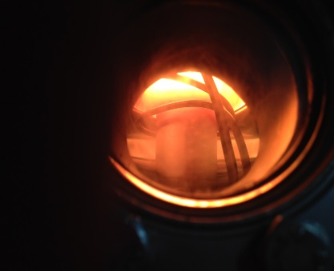
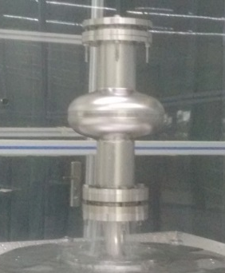
Nitrogen-Doping for High Q₀ Cavity
Collaborate with Pekin University
1.3 GHz single cell fine grain cavity tested
N-doped with vacuum induction furnace
Chemical polishing (BCP) , plasma cleaning
PKU
PKU

Slide 38
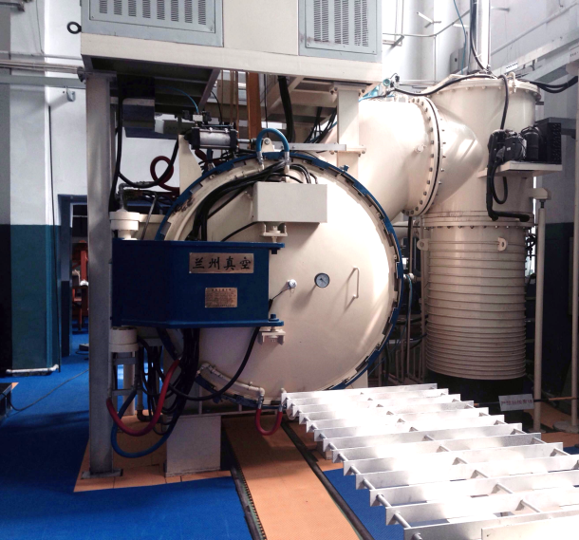
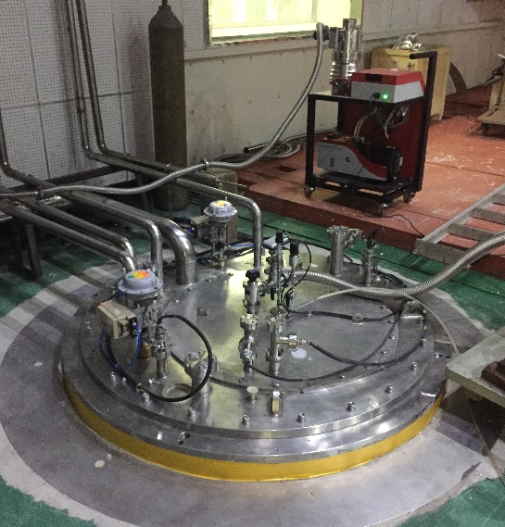
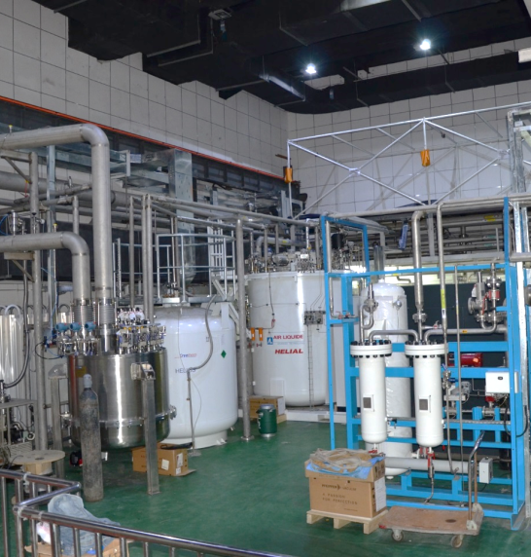
Nitrogen-Doping for High Q₀ Cavity
Six 1.3 GHz (low loss and TESLA shape, fine grain and large grain) and four 650 MHz single cell cavities and three 1.3 GHz 9-cell cavities to be studied
IHEP vacuum resistance furnace also to be used for N-doping
New vertical test Dewar with closed loop helium recycle in commissioning
800mm ID

Slide 39
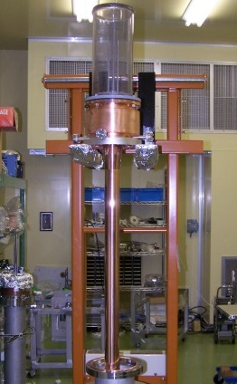
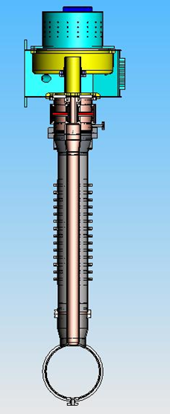
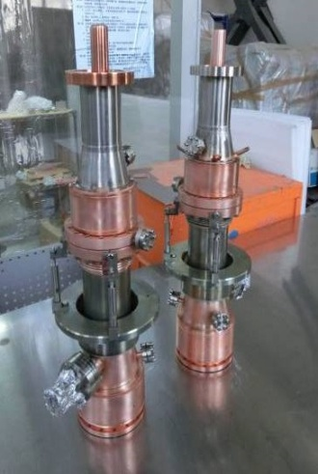
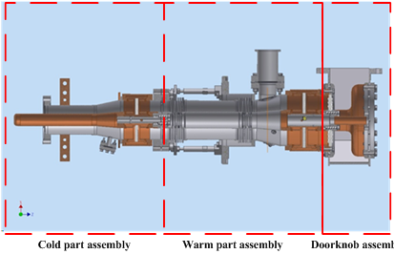
Power Coupler and Related R&D
Main ring 650 MHz 300 kW c.w. coupler:
high power handling capacity, high yield and reliability
two windows for vacuum safety and cavity clean assembly
small heat load and effective cooling
simple structure for cost saving
KEKB (380 kW) / BEPCII (120 kW) type as baseline
China ADS 650 MHz 150 kW c.w. coupler in R&D
Booster 1.3 GHz 4 kW (average) coupler:
Similar to XFEL / ILC
ILC-type (two-window fixed-coupling) developed by IHEP tested to 6 kW average (800 kW pulsed with DF 0.75 %)
ERL 1.3 GHz coupler with variable coupling in R&D

Slide 40
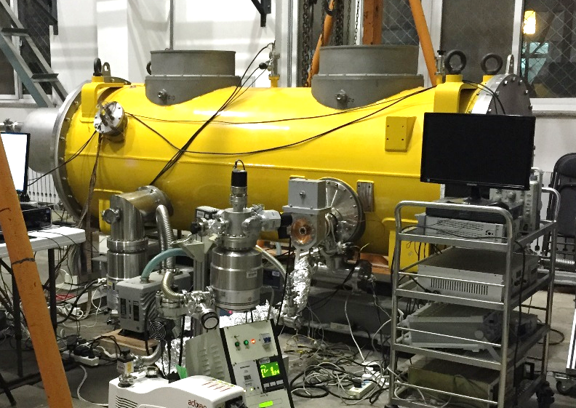
1.3 GHz Module Integration and Test
  To prevent Q₀ degradation during CEPC cavity operation, we should study the clean room assembly, module integration, magnetic hygiene and flux expulsion technology.
  IHEP 1.3 GHz short cryomodule (IHEP-ILC-TC1) integration and liquid nitrogen test completed. Perform horizontal test and develop methods and procedures to keep cavity Q₀ from vertical test to horizontal test.
1.3 GHz 5MW pulsed klystron delivered. Plan to make high power test of the cavity at 2K with the cryogenic system soon.
BEPCII spare cavity and ADS spoke cavity module integration and operation provide experience and team training.
Cavity industrialization and more R&D work planned.

Slide 41

Linac and Booster design
FODO cell
ARC
Courtesy C. Zhang & X.H. Cui

Slide 42




Beam injection scheme
Courtesy X.H. Cui

Slide 43

Injection linac
Beam energy:
E_{linac} = 6 GeV
Energy Spread:
σ_{E}<1×10⁻³；
Bunch population:
N_{bunch, booster}=(5%× N_{bunch,collider})/0.9=2×10¹⁰
Bunch structure:
f_{rep}= 50-100Hz, D_{t}=0.7 ns,
Emittance:
Depending on aperture selection of the booster. A=Y²/b_{max}. Y=16mm, b_{max}=130m, A～2 mm•mrad, e～0.05A～0.1 mm•mrad
Courtesy X. Li

Slide 44

Electron Source
Unpolarized Conventional Electron Source
High Voltage = 150 kV
Beam Radius ~ 3.0mm (at gun anode, beam current is 6.0A)
Courtesy X. Li
BEPCII Electron Gun

Slide 45


Positron Source
Unpolarized Positron Source
Conventional Positron Source
Courtesy X. Li
For BEPCII
Electron beam at Target 240MeV, 8A
Positron beam 80mA
For CEPC
Electron energy at Target 600MeV
Positron beam
BEPCII Positron Source

Slide 46








Other technical systems

Slide 47
4. From CEPC to SppC
Use the same CEPC tunnel to build SPPC, exploring new physics beyond SM
Maximize the beam energy to 70-100 TeV range by using 20 T SC magnets
Keep the e-/e+ rings when adding the SPPC
Possible collision: pp, e-/e+, ep, pA, eA, AA
Build a new injector chain for SppC (proton and ions)
Independent physics programs for the accelerators of the injector chain

Slide 48

General layout
SPPC rings:
8 arcs (5.9 km) and long straight sections (850m*4+1038.4m*4)
2 IPs for pp (perhaps one at IR6 for e-p in the future)
2 IRs for e+e- detectors (pp: injection, RF)
2 IRs for collimation
2 IRs for RF and beam abortion
Courtesy of J.Y. Tang

Slide 49
SppC main parameters (very preliminary)
Parameter | Value | Unit
Circumference | 54.36 | km
Beam energy | 35.3 | TeV
Dipole field | 20 | T
Injection energy | 2.1 | TeV
Number of IPs | 2 (4)
Peak luminosity per IP | 1.2E+35 | cm⁻²s⁻¹
Beta function at collision | 0.75 | m
Circulating beam current | 1.0 | A
Max beam-beam tune shift per IP | 0.006
Bunch separation | 25 | ns
Proton population/bunch | 2.0E+11
SR heat load @arc dipole (per aperture) | 56.9 | W/m
Courtesy J.Y. Tang

Slide 50


Technical challenges and R&D plan
High field magnets: SC dipoles of 20 T are the key issue both in technical challenges and machine cost
  Both technical challenges and cost: 2/3 ring circumference
  Nb₃Sn (15T) +HTS (5T) or pure HTS
  Twin-aperture: save space and cost
  Common coils or Cosine-theta type
  Open mid-plane structure to solve SR problem?
  SC quads: less number but also difficult

Slide 51
High field accelerator magnets for SppC
SppC needs thousands of high field dipoles and quadrupoles installed along a tunnel 50 km in circumference
Aperture diameter of the main dipole / quadrupole: 40~50 mm
Field strength of the main dipole: 20 Tesla
Field quality: 10⁻⁴ at the 2/3 aperture radius
Outer diameter of the magnet: 900 mm
Outer diameter of the cryostat: 1500 mm (in a 6-m diameter tunnel)
Total magnetic length of the 20-T main dipole: ~ 33 km in a 50-km circumference

Slide 52




R&D plan of the 20-T magnet technology
(2015-2020)
High field magnet design study: coil configuration, field quality, stress management;…
Cos-theta dipole
Common coil dipole
Block type dipole
Canted cos-theta dipole
Courtesy Q.J. Xu

Slide 53
20-T magnet working group in China
NIN (Northwest Institute for Non-ferrous Metal Research) & WST (Western Superconducting Tech. Co.)
NIN: Advanced Bi-2212 R&D. Significant progress in past several years.
WST: Qualified Nb₃Sn supplier for ITER. High J_{c} Nb₃Sn R&D.
Shanghai JiaoTong U.& SST (Shanghai Superconductor Tech. Co.)
YBCO R&D and production. Significant progress in past several years.
Tsinghua U. & Innost (Innova Superconductor Tech. Co.)
10+ years R&D and production of Bi-2223. Modification of production lines for Bi-2212 is under discussion.
CHMFL (High Magnetic Field Laboratory of the Chinese Academy of Sciences)
Nb₃Sn CICC conductor & high field solenoids; advanced insulation materials;…
IHEP (Institute of High Energy Physics, Chinese Academy of Sciences)
Accelerator Center Magnet Group：30+ years R&D and production of conventional accelerator magnets.
Superconducting Magnet Engineering Center：10+ years R&D and production of superconducting solenoids for particle detectors and industries.
And……
More collaborations are needed!

Slide 54
Conclusion
The CEPC accelerator design is now under study at IHEP, China;
Many progresses have been made in both accelerator physics and technical systems design;
Pre-CDR for CEPC-and SppC is completed, and has been reviewed by the international review committee by the end of lunar year 2014 (February 2015);
A lot of work on AP and technology systems need to be done to optimize the design, towards CDR;
A long way to go to SppC from CEPC , and the R&D on some key technologies is necessary.

Slide 55
Thank you !

