Slide 1
Monte-Carlo event generation for CEPC
Xin Mo (IHEP)
Aug. 18, 2015

Slide 2
MC is the reference
MC contains all the physics inputs
MC is the guiding star
Measurement always makes ratios

Slide 3
Outline
Introduction of the generator
Whizard 1.95 & 2.2.x
Sample production
Signal
Background
An DIY example

Slide 4
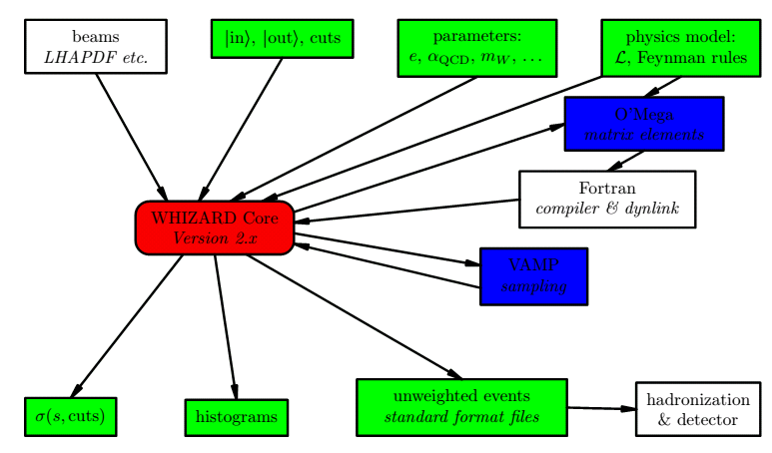
Components of generator
PYTHIA 6.4

Slide 5
Event simulation
Unshowered
or Unhadronized
Whizard
Showered
& Hadronized
Pythia

Slide 6
Mass production
Signal
Backgrounds
2 fermions
4 fermions

Slide 7
Sample information
Signal:
/afs/ihep.ac.cn/users/m/moxin/cefs/data/stdhep/ signal/Higgs
SM backgrounds:
/afs/ihep.ac.cn/users/m/moxin/cefs/data/stdhep/background
Sample information:
Luminosity: 5050fb⁻¹ Polarization: unpolarized
ISR: on Beamstrahlung: off

Slide 8
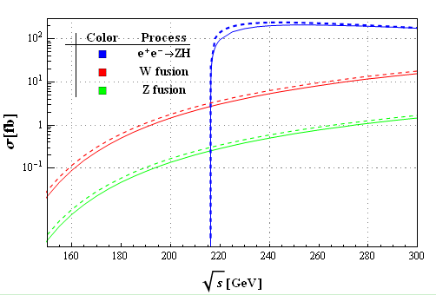
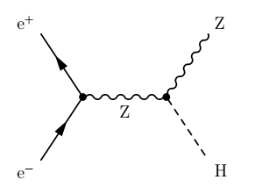
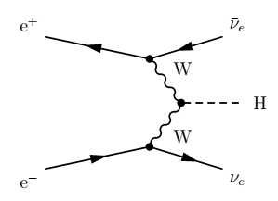
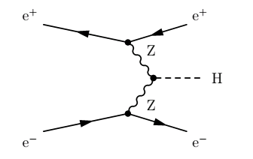
Signal
Higgs-strahlung
Vector boson fusion

Slide 9
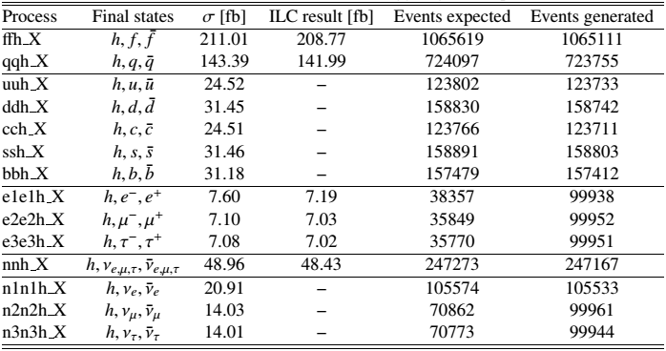
Signal

Slide 10
Signal
Naming schedule:
Beam polarization
Process name, X means inclusive decay
The lower limit of number of events is set to 100000

Slide 11
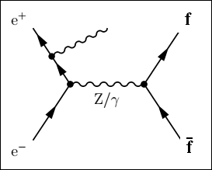
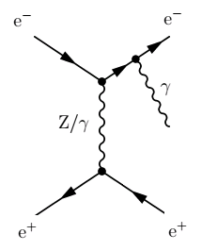
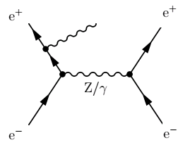
2-fermions background
Final state with two fermions
Generic s-channel production
Radiative Bhabha
e⁺e⁻→ γe⁺e⁻

Slide 12
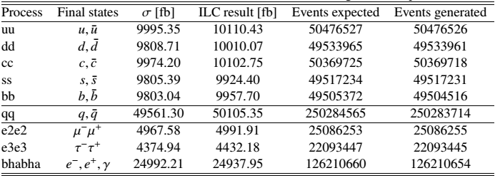
2-fermions background

Slide 13
Classification of 4 fermions
WW type
Single W type
＋
＋
ZZ type
Single Z type
＋
＋

Slide 14
Classification of 4 fermions
WW type
Mixing type
ZZ type
Single W type
Single mixing type
Single Z type

Slide 15
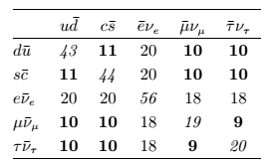
W type

Slide 16
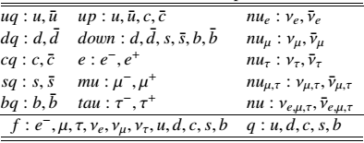
Alias for particles

Slide 17
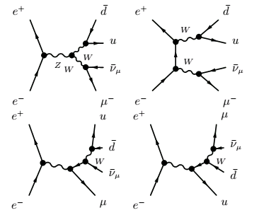
Basic topological structure(WW)

Slide 18
Topological structure(SW)
Additional topology of single W type with respect to WW type

Slide 19
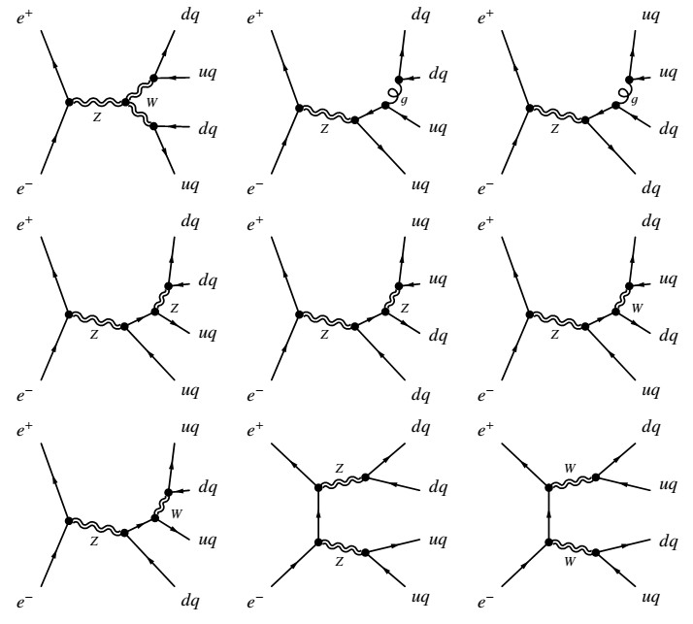
Topological structure(ZZorWW)

Slide 20
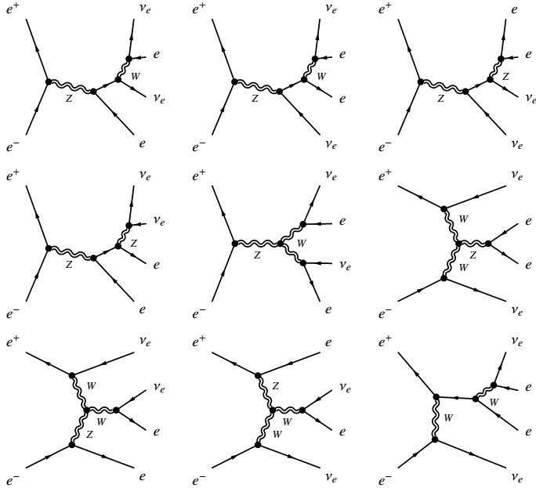
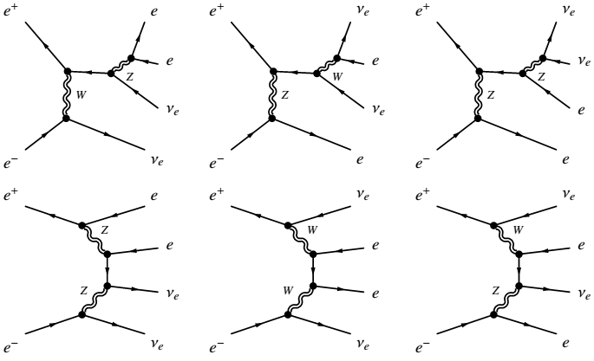
Topological structure(SZorSW)

Slide 21
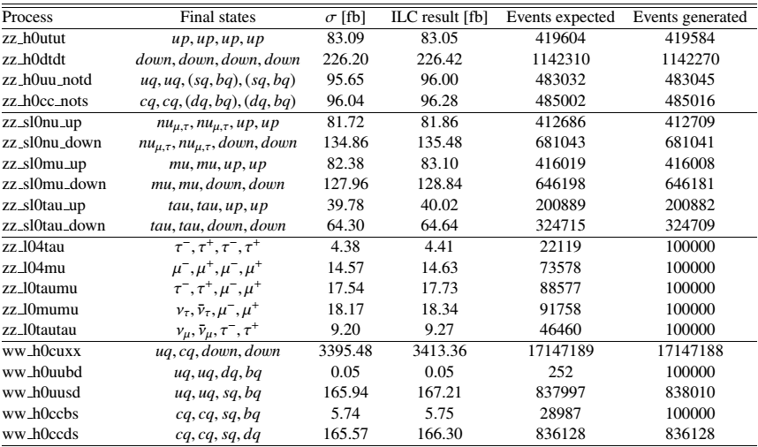
4-fermions Part

Slide 22
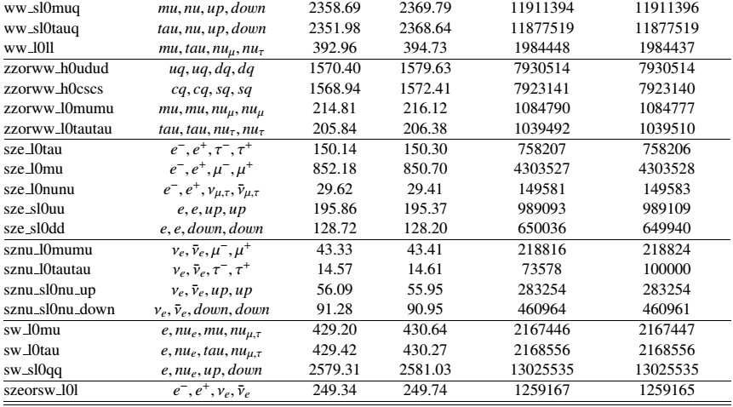
4-fermions Part

Slide 23
4-fermionsPart
Naming schedule:
Beam polarization
h-hadronic
l-leptonic
sl-semi leptonic
The lower limit of number of events is set to 100000

Slide 24
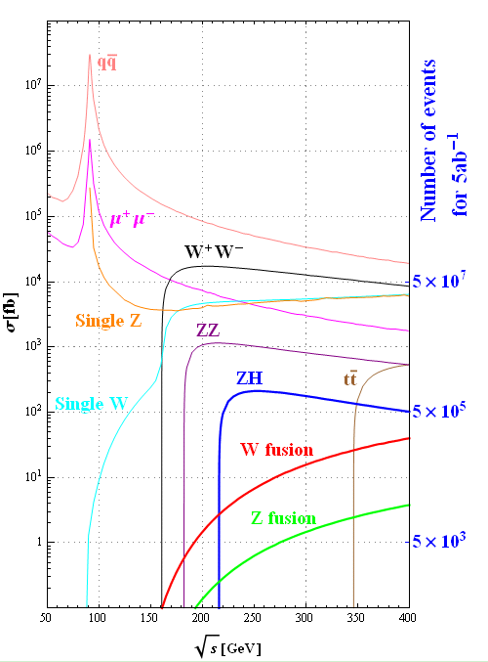
Summary table
Cross sections [fb]
 | 240GeV | 250GeV
qq | 54662 | 50216
μ⁺μ⁻ | 4685 | 4405
single Z | 4538 | 4734
single W | 5086 | 5144
W⁺W⁻ | 16004 | 15484
ZZ | 1079 | 1033
ZH | 203 | 212
W fusion | 5.36 | 6.72
Z fusion | 0.50 | 0.63

Slide 25
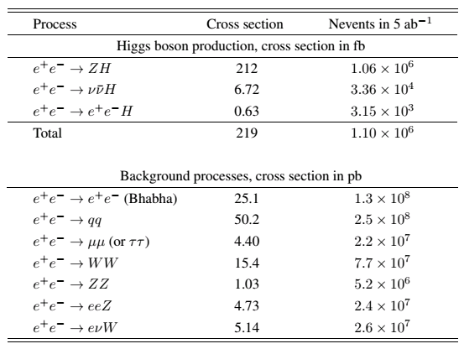
Number of events

Slide 26
How to DIY
Source the script at
/afs/ihep.ac.cn/users/m/moxin/setup/whizard2.2.7_slc6-setup.sh
An example file
/afs/ihep.ac.cn/users/m/moxin/scratch/temp/example/e2e2h.sin
Copy the example file to anywhere you have privilege, and run command “whizard e2e2h.sin”
Hope you could have fun!

Slide 27
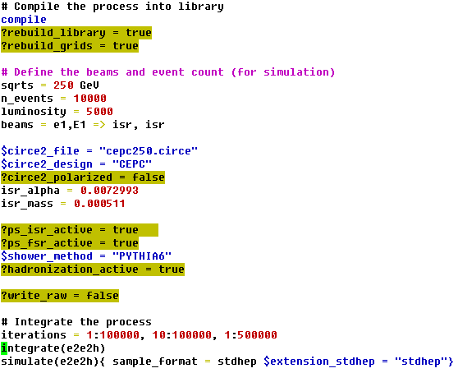
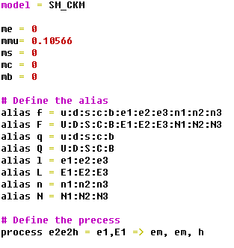
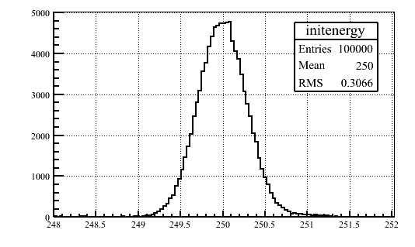
Interpretation
Claim of model
Configurations
Beam setup, default CEPC setting
Particle alias
Hadronization & fragmentation
Process definition
Integration & simulation

Slide 28
Some plans for future
An generic n→1 interface
lhef
hepevt
hepmc stdhep
madgraph
……
Validation for benchmark samples
More details on this issue can be found at
CEPC docdb: CEPC Document 34-v2
Arxiv: arXiv:1505.01008
My Email address: moxin@ihep.ac.cn
Office: Main building room B229

Slide 29
Thanks
Thanks for attention!

Slide 30
Backup
Backup

Slide 31
Topological structure(ZZ)

