Slide 1
Browsing into data: Jets, Tau, MET, etc
Gang Li
li.gang@mail.ihep.ac.cn

Slide 2
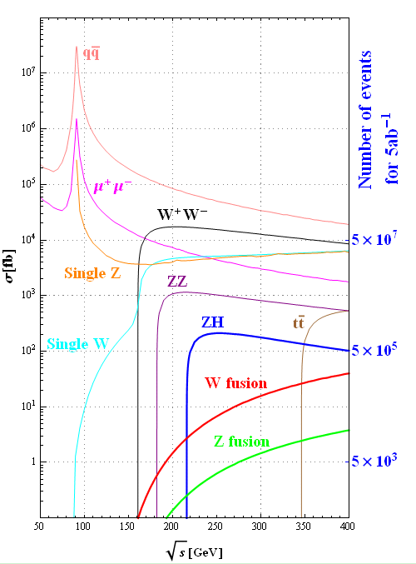
Summary table
Cross sections [fb]
 | 240GeV | 250GeV
qq | 54662 | 50216
μ⁺μ⁻ | 4685 | 4405
single Z | 4538 | 4734
single W | 5086 | 5144
W⁺W⁻ | 16004 | 15484
ZZ | 1079 | 1033
ZH | 203 | 212
W fusion | 5.36 | 6.72
Z fusion | 0.50 | 0.63

Slide 3
Two types physics objects used in analysis
  Single PFO: e/μ/γ …
  Composed objects: quarks and gluon jet, and τ
    The four-momentum, flavor, electrical charge
Now we move on and investigate composed objects

Slide 4
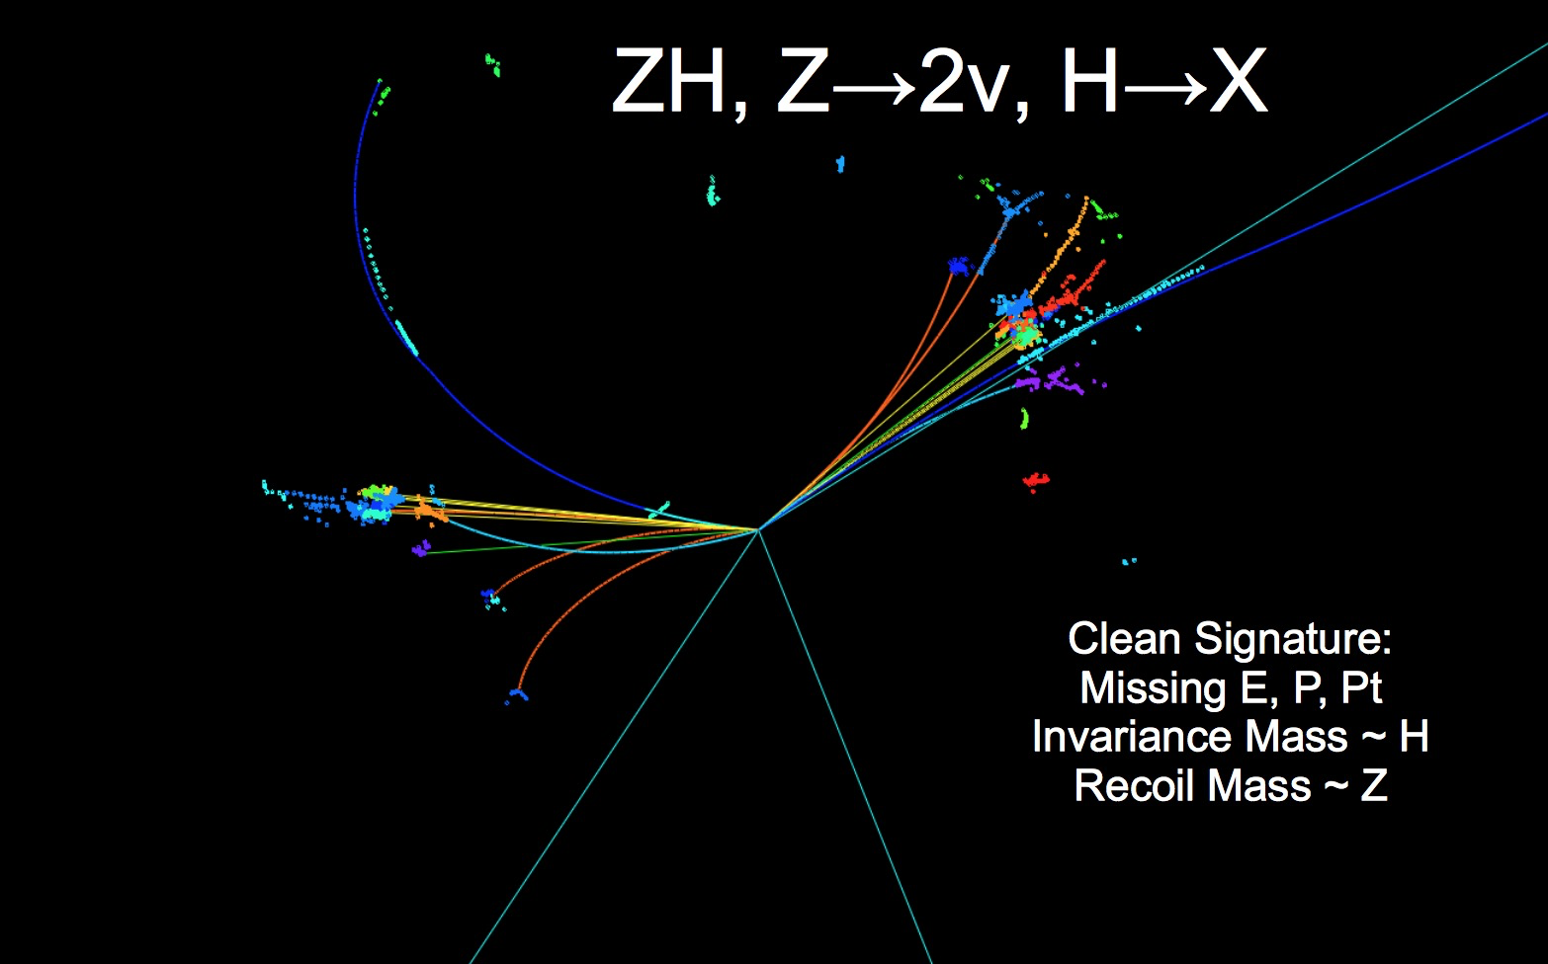

Slide 5
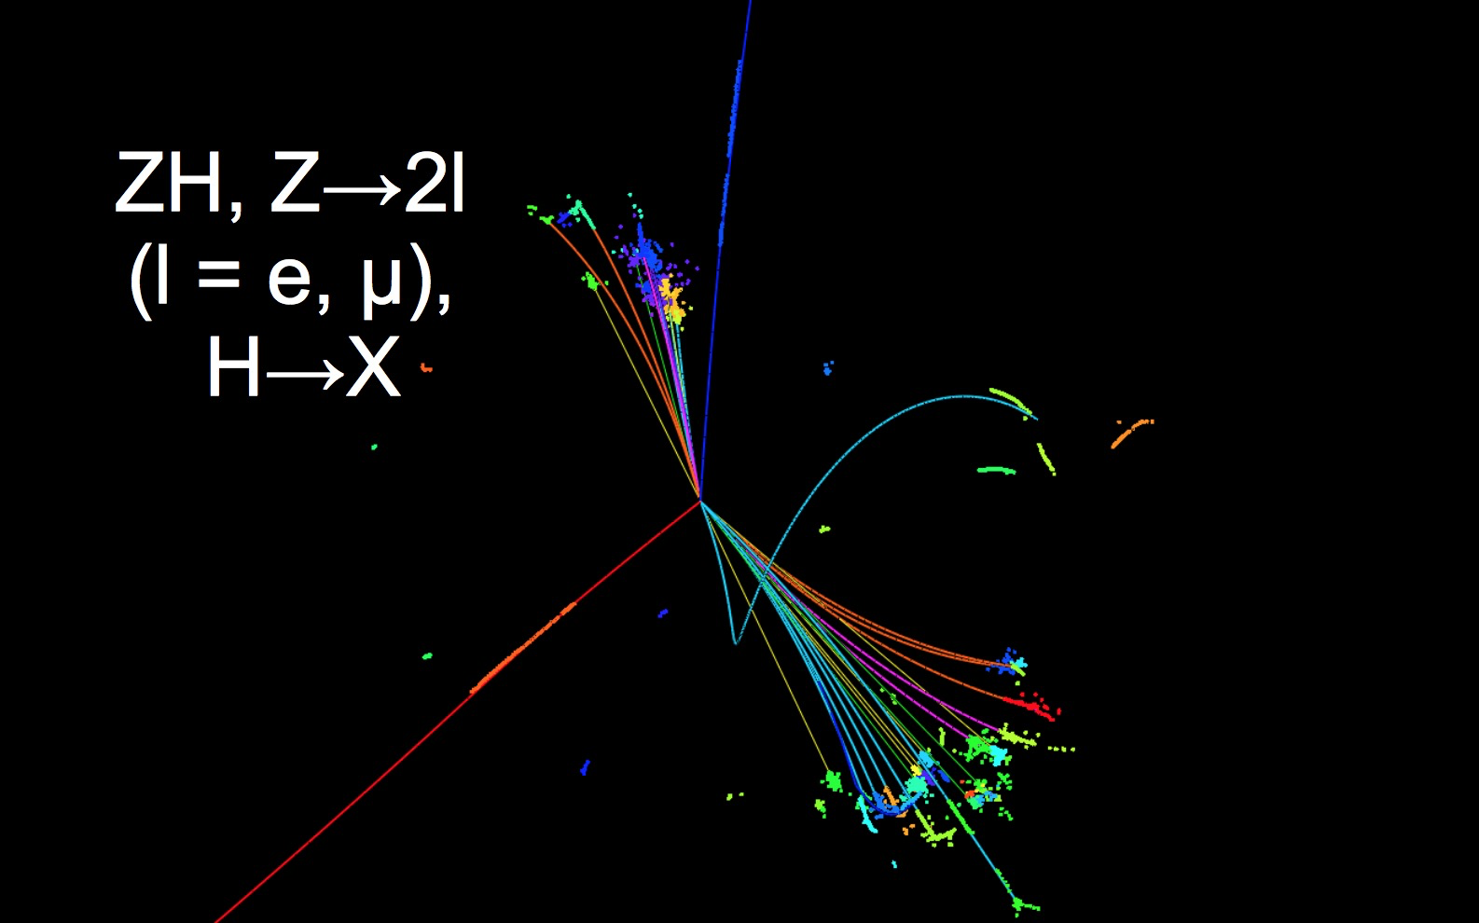

Slide 6
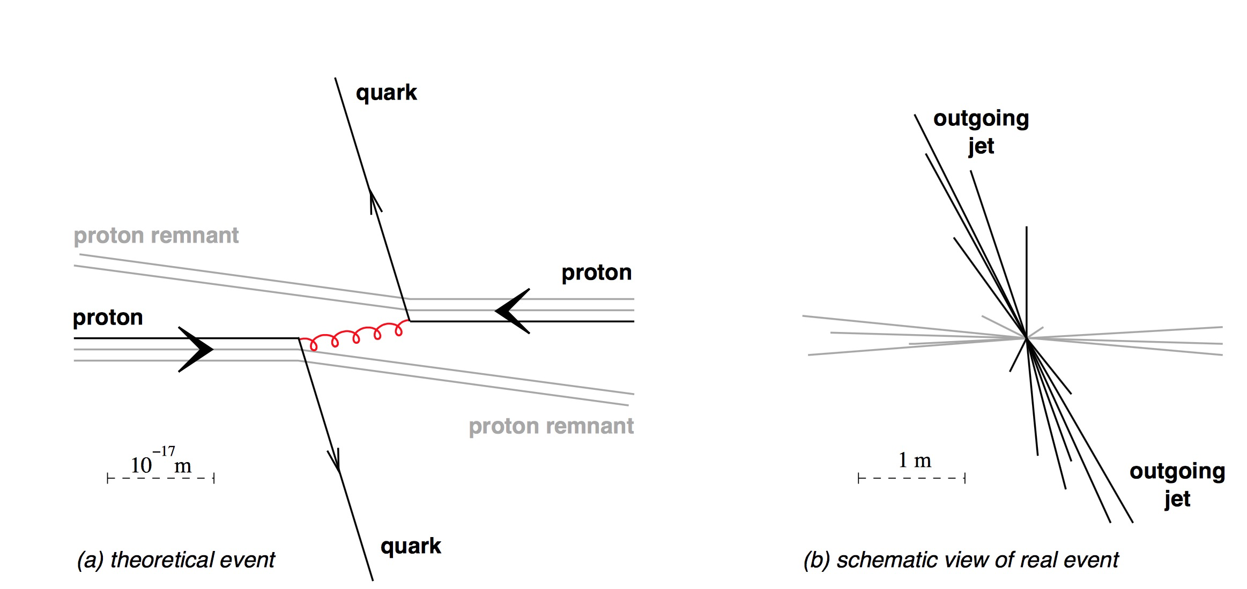
Jets from partons to real objects

Slide 7
The configuration of Jet-clustering is different from hadron collider
  Exclusive jets: force the PFOs into fixed number of jets
  Some special objects should be removed from FPO collection before jet-clustering, such as electrons, muons, …

Slide 8
On LCFI+
Standalone package on vertexfinder, Jet-clustering, and flavor identification
Based on MVA method
Potentially adopt the latest development in the industrial
General introduction as user level

Slide 9
Direction of LCFIPlus development
LCFIVertex
The first realistic flavor tagging in ILC
Incorporating modern flavor tagging techniques
to obtain reasonable performance
No other algorithms to be compared…
Mainly tuned with Z-pole qqbar samples
LCFIPlus
LCFIPlus
the second version
improvement
Clear target: Higgs self-coupling to ~30%
high demand for performance
Focused on >=4 jet environments
Including jet clustering (performance driver for 6-jets)
Trying many ideas for performance improvement
feedback
ZHH analysis
LCFIPlus is more performance-driven,
mainly concentrated on many-jet processes

Slide 10
Data/process flow
All in “lcfiplus” namespace
EventStore
singleton for data pool
vector<Track *>
vector<Neutral *>
vector<MCParticle *>
vector<Vertex *>
vector<Jet *>
any other types
LCIO
LCIOStorer
Automatic type identification
(Allow one name with multiple types)
Automatic creation/deletion
(using ROOT class dictionary)
Automatic conversion from
LCIO to lcfiplus classes
(using hook in EventStore)
Conversion to LCIO
is manually invoked by
LcfiplusProcessor
Algorithm
configuration
PrimaryVertex
BuildUpVertex
JetClustering
JetVertexRefiner
FlavorTag
MakeNtuple
LcfiplusProcessor
TrainMVA
ReadMVA etc.
Marlin processor
Process Marlin parameters
to be passed to Algorithm
LCIO I/O configuration
Parameters class used
for type-safe configuration
Internal algorithms
Independent
Marlin

Slide 11
LCIO input/output (LCIOStorer)
LCFIPlus
LCIO
LCIO -> LCFIPlus
PFO/MCP conversion
at SetEvent()
(called by processor)
Vertex/Jet conversion
automatically at request of
lcfiplus collection
MCParticle
MCParticle
MCColorSinglet
RecoMC
ParticlesLink
Track
PandoraPFOs
Neutral
LCFIPlus -> LCIO
Vertex
Done manually
(automatic option available
but not used in
LcfiplusProcessor)
Cannot “update” existing
LCIO collection –
known issue in PID
Jet – vertex connection is
in LCRelation Jet_rel
Vertex
Vertex_RP
Jet
PID “yth”
“lcfiplus”
Jet
Jet_rel
Jet_vtx
Jet_vtx_RP

Slide 12
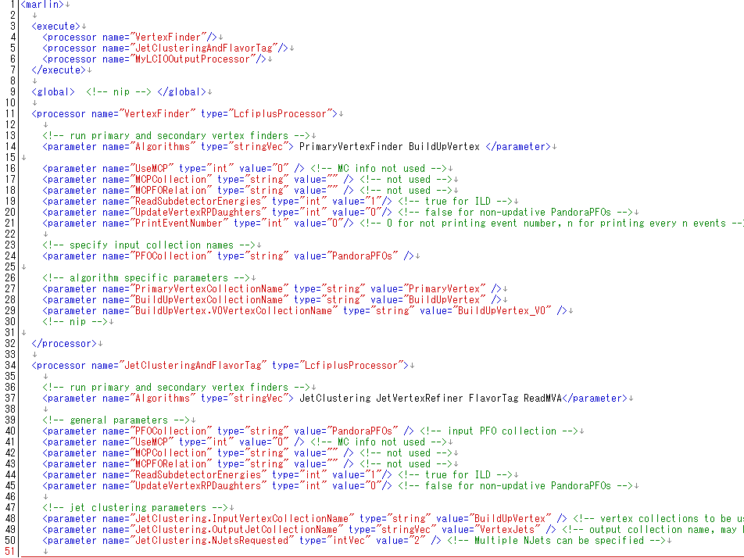
LcfiplusProcessor and parameters
Multiple LcfiplusProcessor possible now
Note: EventStore is singleton, so collection
is converted only at first processor
using the collection
List algorithms
General parameters:
see next slide for detail
See steer/README for samples
Output collections
converted to LCIO at
the end of this proc.
Altorithm specific
parameters
Input PFO collection can be different
General parameters are
treated by LcfiplusProcessor
Others sent to Algorithms

Slide 13
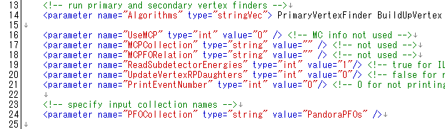
LcfiplusProcessor: global params
To use edep in subdetectors for jet-muon
detection: assume ILD so specify 0 for SiD
List algorithms
UseMCP = 0: do not
convert MCParticle
These two are
global: do specify
the same for
all LcfiplusProcessor
Modify “StartVertex” in PFO collection or not
1 for mass production, 0 for user analysis
Print current event number every n events
Good for debug
Input PFO collection: can be different in each LcfiplusProcessor

Slide 14
Algorithm (1) vertex finders
VertexFitterSimple
  Original vertex fitter with Minuit2 in ROOT
  Do not refit tracks
  Slow – may need to improve
PrimaryVertexFinder
  TearDown method with VertexFitterSimple
  Use beam vertex (fixed parameters now)
BuildUpVertex
  Secondary vertex finder with VertexFitterSimple
  Tuned for JetClustering (many cuts included)
  Recent improvement in V0 rejection

Slide 15
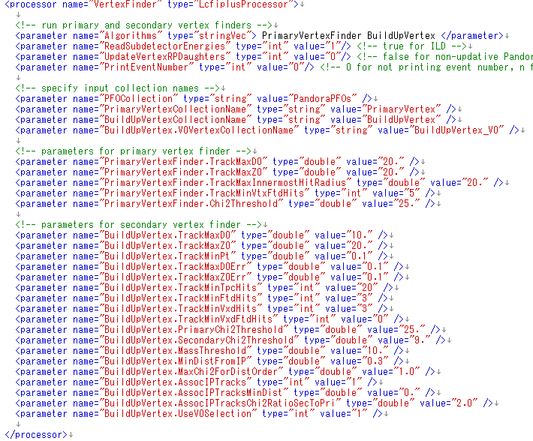
Vertex finder steering file
steer/vertex.xml
V0 collection is used
in later algorithms
Parameters are
highly tuned: please
contact us if you need
to modify them

Slide 16
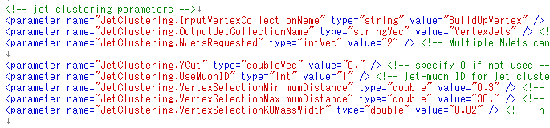
Algorithm(2) JetClustering
Jet clustering with vertex information (see next slide)
Using jet muons as vertex with UseMuonID = 1
  Using edep in muon detector: only for ILD…
Plane Durham is possible by specifying “0” for InputVertexCollectionName (do not specify “”) & UseMuonID=0
Multiple output collections can be done such as NJetsRequested = 8 6 4, (must be descending order), OutputJetCollectionName = Jets8 Jets6 Jets4
Add ParticleID yth with y23, y34,…, y910 parameters for ycuts
  Issue: yn(n+1) is obtained only if NJetRequested <= n is done

Slide 17
Vertex-Jet Finding Overview
1. Difficult to separate two b-jets which are close. Ordinary kt algorithm tends to merge them.
arXiv:1110.5785
sec. vtx.
2. To overcome this, find secondary vertices first, and use them as seeds for jet finding.
pri. vtx.
3. This results in an increased chance of correct jet separation.
This effect is particularly pronounced for final states with many b jets, e.g. Zhh
17

Slide 18
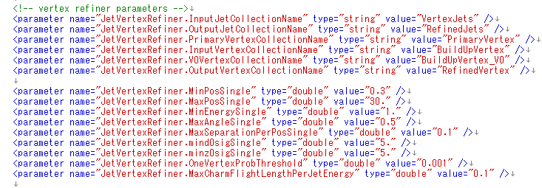
Algorithm(3) JetVertexRefiner
Consists of two algorithms
  SingleTrackVertexFinder & VertexCombiner
SingleTrackVertexFinder: reconstruct single-track vertices using existing vertex directions (see next slide)
VertexCombiner: combine vertices into two at most
aiming at combining multi+single vertices which are from same b or c – tuned for b/c separation
Jet & vertex collection are specified separately, so this
can be used after other jet clustering method (Durham etc.)
Parameters are
highly tuned

Slide 19
Single Track Selection
Normal vertex finder needs > 2 tracks
-> loose many vertices
Single track vertex can
be found by using
other vertex direction
Improves b-tagging performance
track
Vertex-IP
line
θ
D
Secondary vertex
Single track vertex
(nearest point)
IP

Slide 20
Algorithm(4) flavor tagging
Based on TMVA Boosted Decision Trees
  MLP neural net under development
  Four categories: #vtx = 0, 1, 1+singletrack, 2
Algorithms
  FlavorTag: obtain input variables
  MakeNtuple: making ROOT ntuple for training
  TrainMVA: training MVA with b/c/s ntuples
  ReadMVA: obtain BTag/CTag variables with weight file
Procedure
  FlavorTag + MakeNtuple for each training sample
  TrainMVA with all ntuples (output: weight file)
  FlavorTag + ReadMVA with the weight file

Slide 21
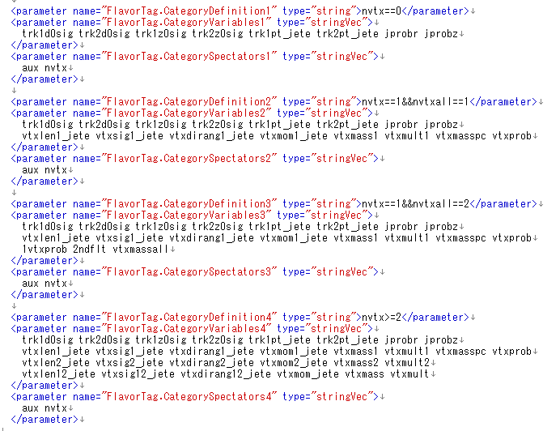
Algorithm(4) input variables

Slide 22
LcfiplusProcessor and parameters
Multiple LcfiplusProcessor possible now
Note: EventStore is singleton, so collection
is converted only at first processor
using the collection
List algorithms
General parameters:
see next slide for detail
See steer/README for samples
Output collections
converted to LCIO at
the end of this proc.
Altorithm specific
parameters
Input PFO collection can be different
General parameters are
treated by LcfiplusProcessor
Others sent to Algorithms
Known issue: JetVertexRefiner & ReadMVA cannot
be separated since we need to modify jet collection

Slide 23
Example

Slide 24
General information
LCFI+ v00-05-02 used in vo1-17-05
Z pole samples Z→bbbar, ccbar, and light quark pairs of 1M each
Input PFOs: Arbor

Slide 25
Step by step: samples
Generator samples: Z→ QQbar:
    /besfs/groups/higgs/data/Fast_Simulation/wo_beamstruhlung/background/Z-pole
    Sqrt(s)=91.18GeV
    with ISR
Simulation and reconstruction (CEPC_v1)
  /besfs/groups/higgs/data/SimReco/wo_BS/FlavorTag/CEPC_v1_zqq
    SimData
    RecData_ArborDHCAL_5_ILD

Slide 26
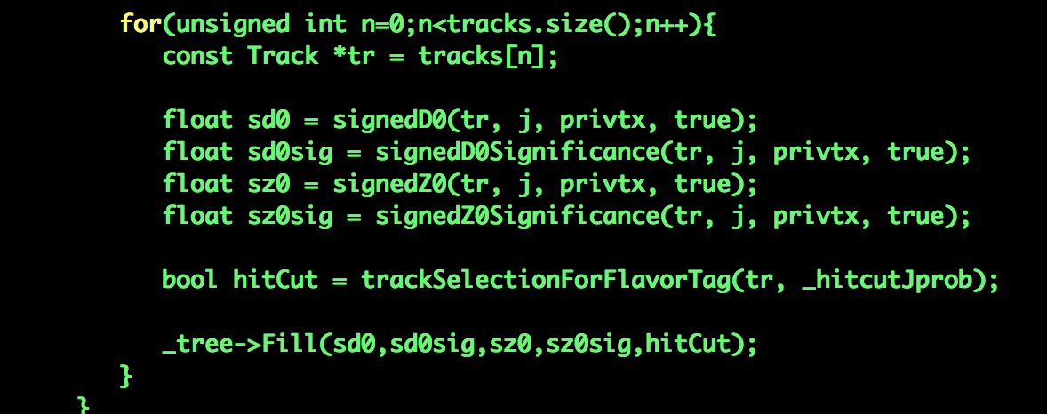
TrackNtuple: prior-prob
Based on MC samples, All tracks in jets are used
Details at
  /home/bes/lig/higgs/higgs/analysis/LCFIplus/FT_Arbor_cepc_v1/TrackNtuple

Slide 27
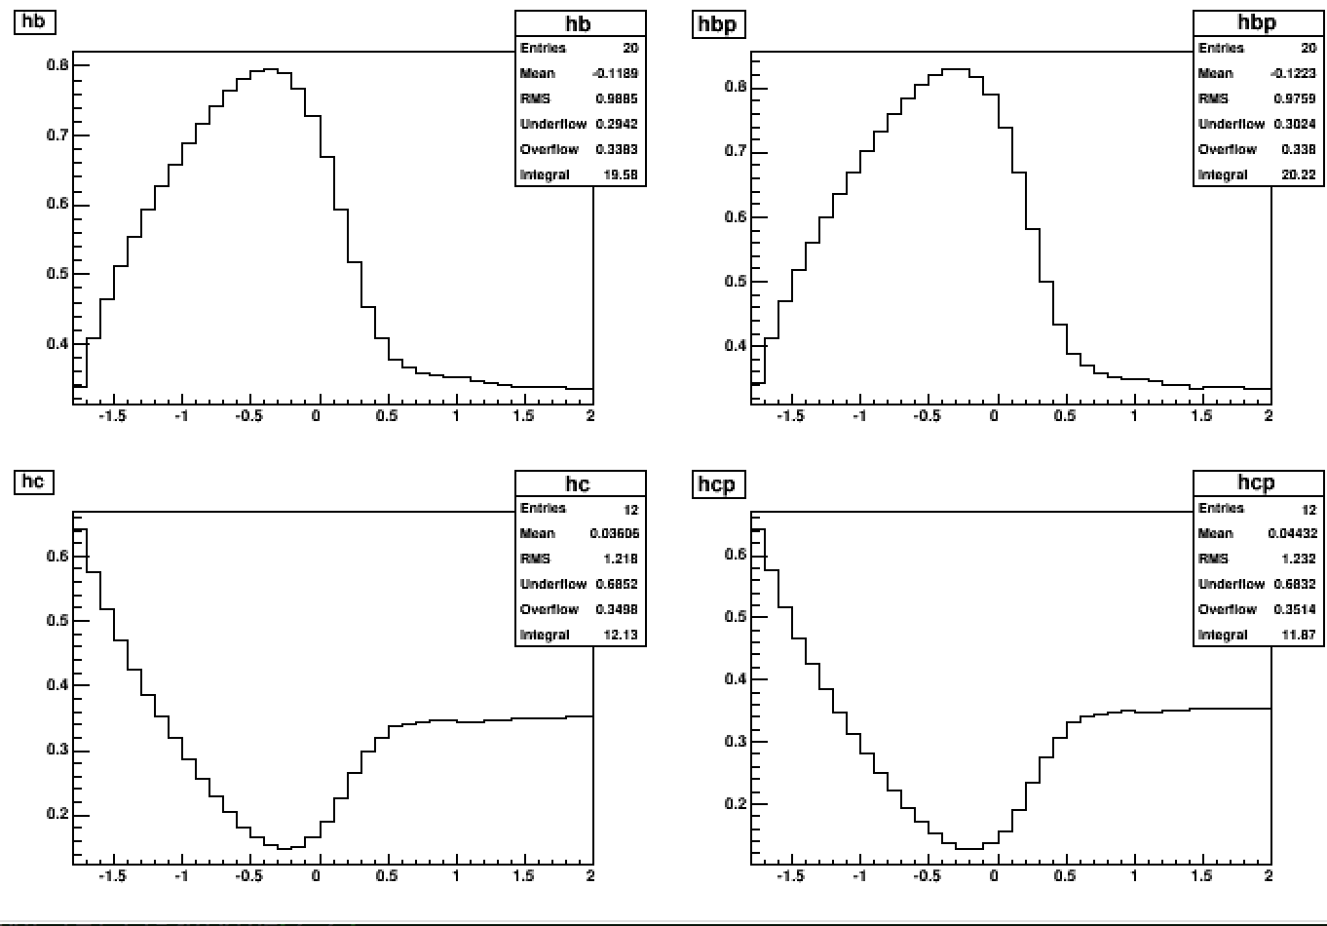

Slide 28
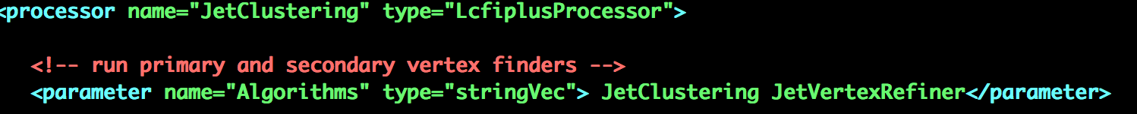
Step by step: Fill Ntuple
Based on PFOs, the variables for MVA calculated and some prior distribution generated
Three processors used:
VertexFinder(if not called),
JetClustering
MakeNtupe
Variable chose first time here

Slide 29
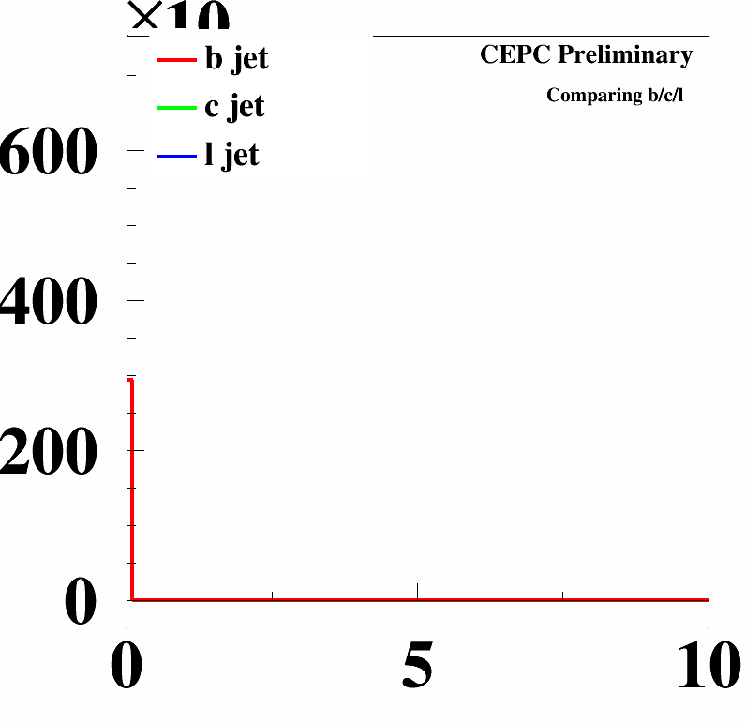
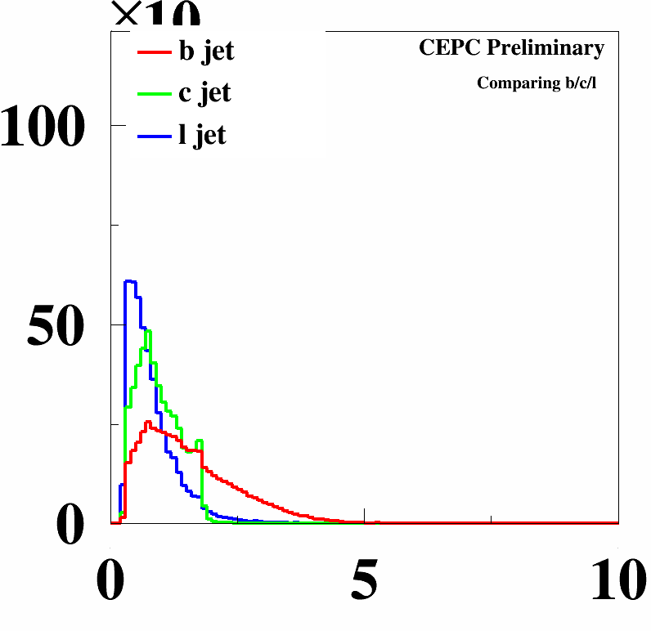
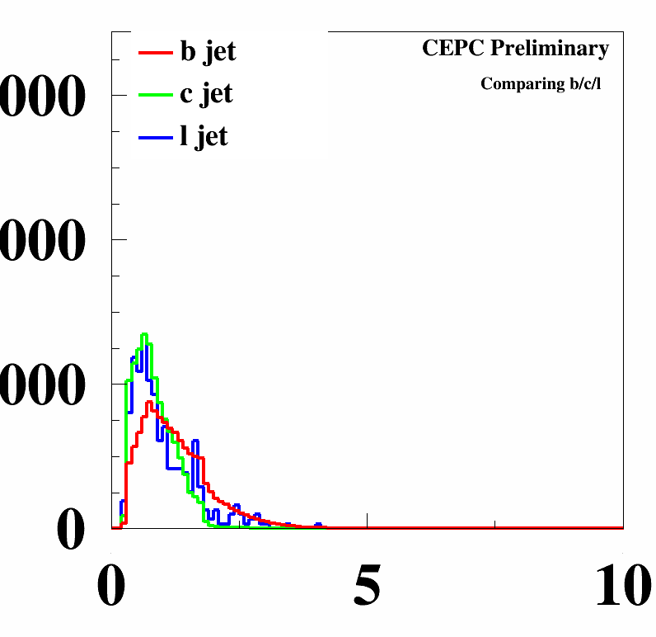
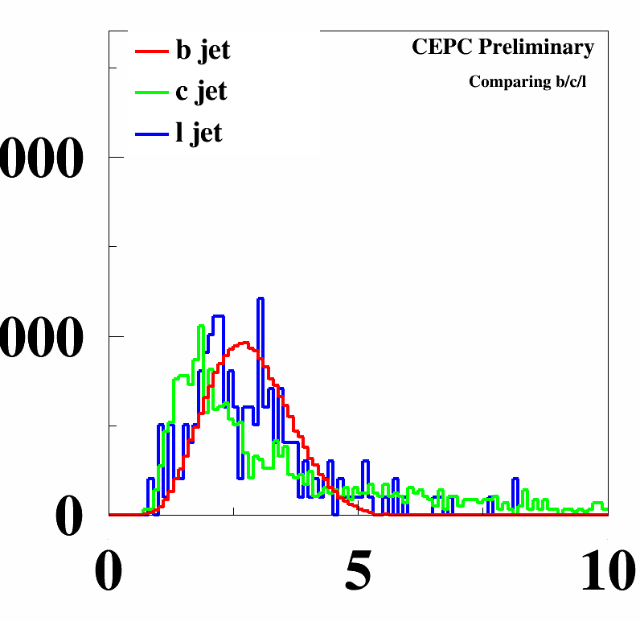
vtxmass

Slide 30
Ntrks in jets

Slide 31
Nvtx

Slide 32
Nvtxall

Slide 33
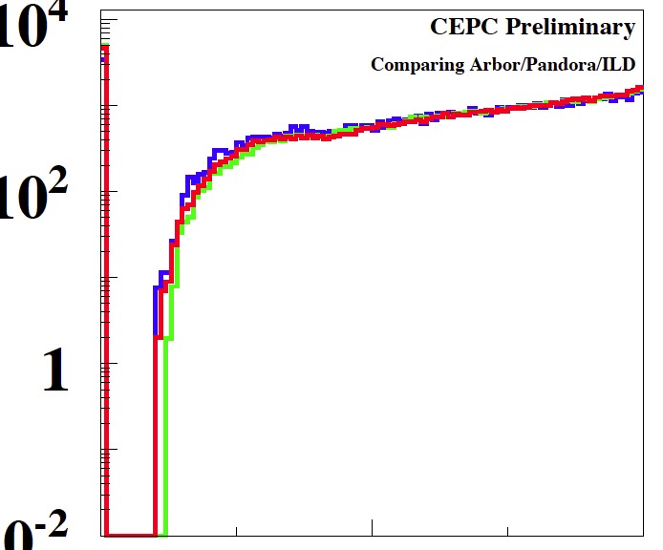
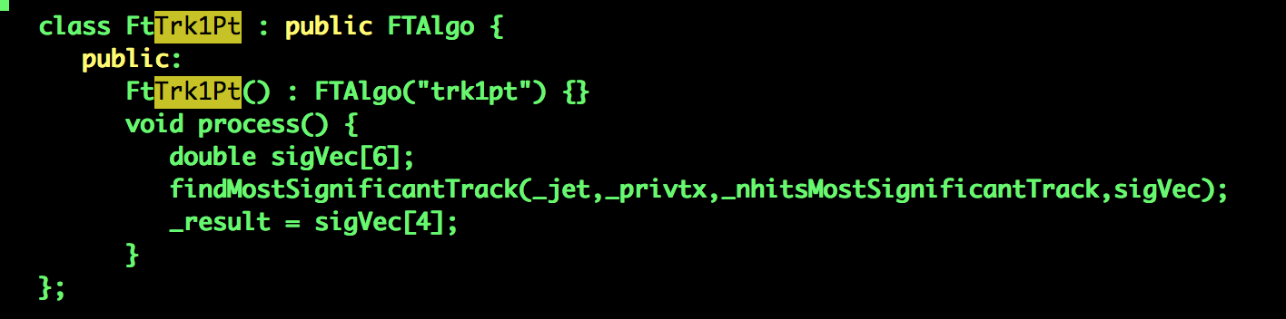
qq:trk1pt

Slide 34
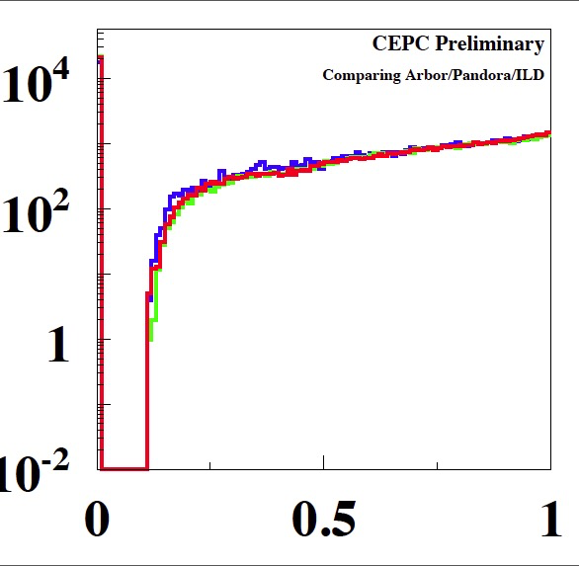
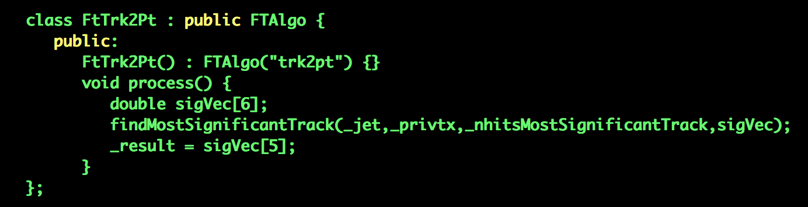
qq:trk2pt

Slide 35
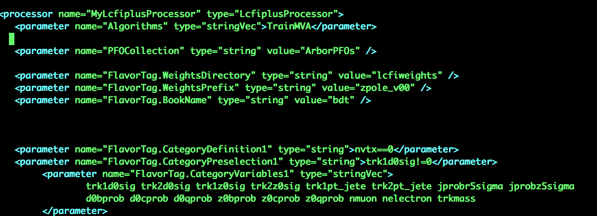
Step by step: training
Train the MVA algorithm based on (subset) of the variables in the ntuples

Slide 36
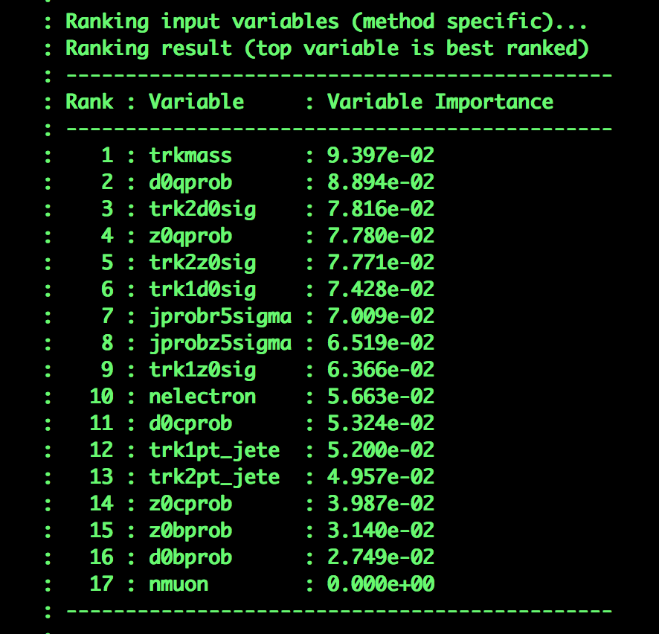
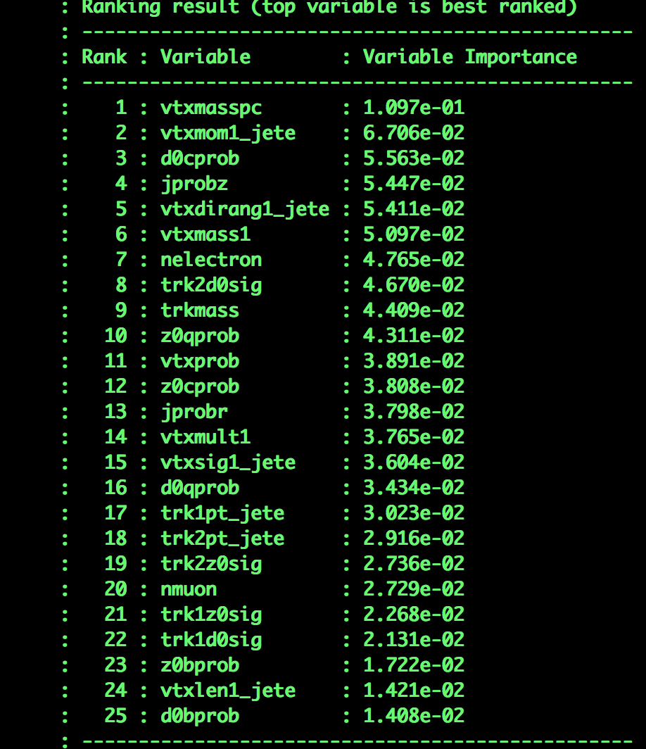
Information in log file

Slide 37
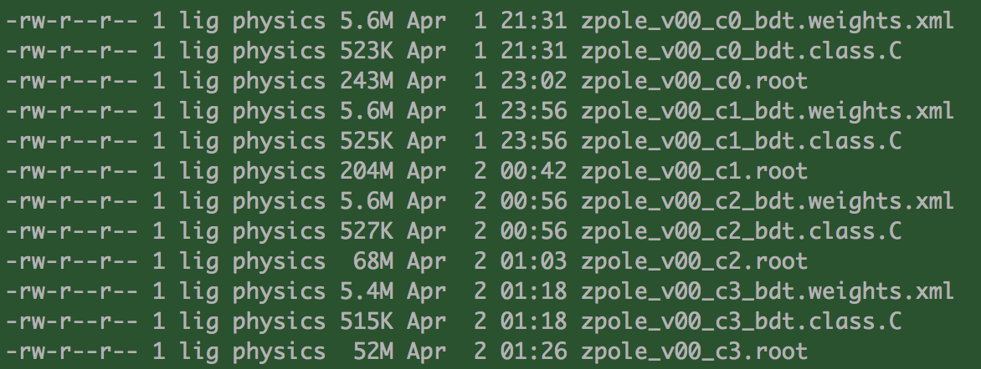
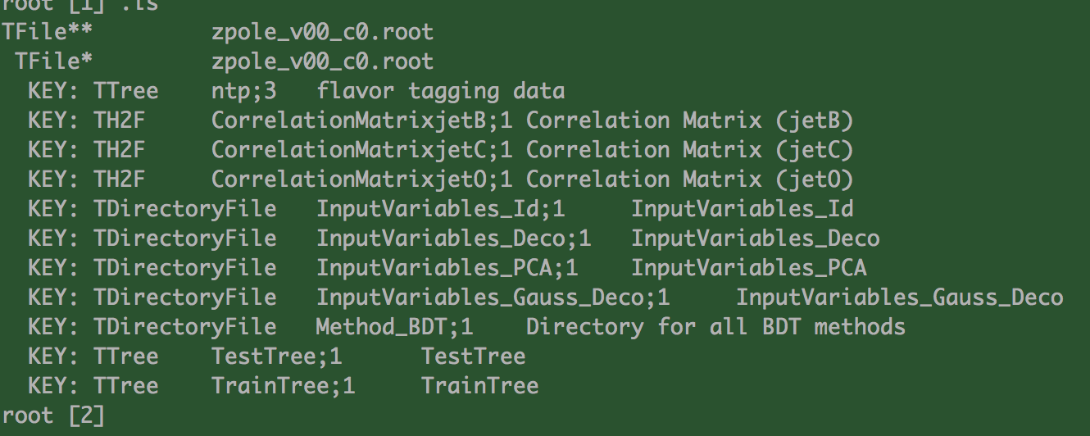

Slide 38
Step by step:
Check the performance and apply in analysis
Nvtx=0
Nvtx=1
Nvtx>1

Slide 39
Outputs
Arbor vs. ILD DBD

Slide 40
Btag

Slide 41
Ctag

Slide 42
Excersise

