Slide 1

Muon g-2 Experiment at Fermilab
State of the Experiment
James Mott, Boston University
for the Muon g-2 Collaboration
Tau2016, Beijing, China
20th September 2016

Slide 2
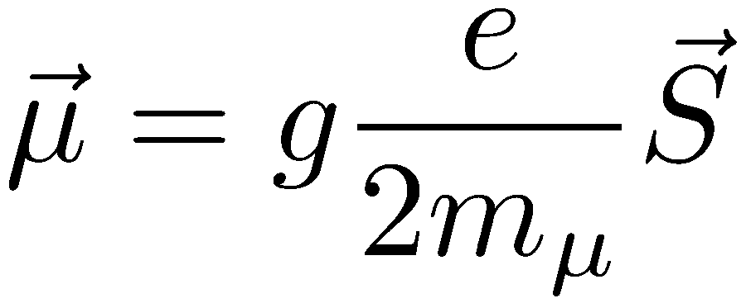
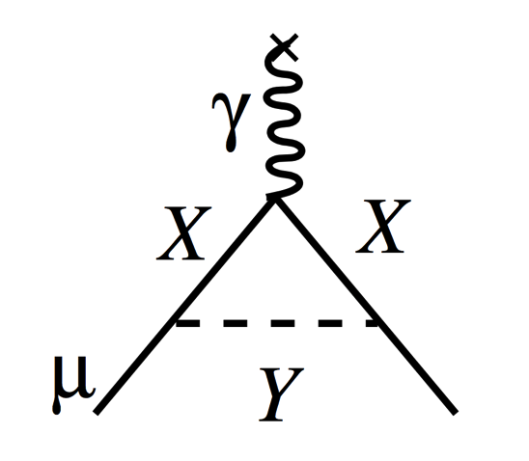
Muon Magnetic Moment
The muon has an intrinsic magnetic moment that is coupled to its spin by the gyromagnetic ratio g:
Interactions between the muon and virtual loops alter this number – X & Y could be SM or new physics:

Slide 3
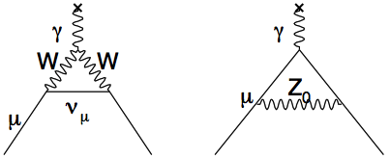

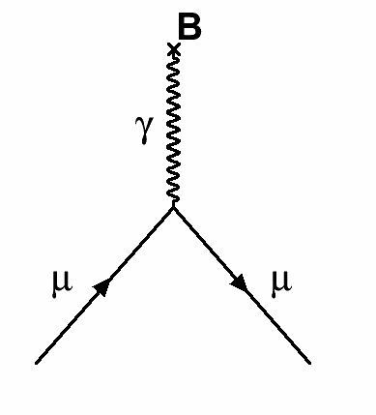

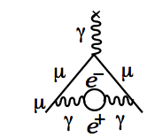
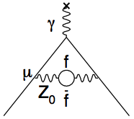
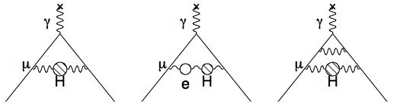
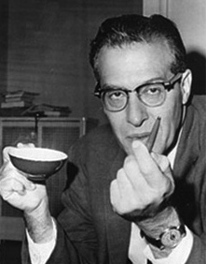
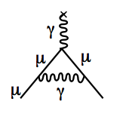
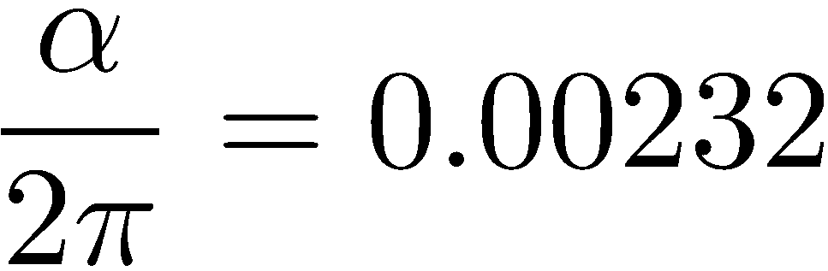
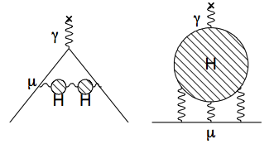
Standard Model Components of g_{μ}
Dirac
Charged,
spin ½ particle
12672 diagrams
Electroweak
Up to 10th Order QED
Kinoshita
Hadronic
Schwinger
Dominant uncertainty in calculation
1st Order QED

Slide 4
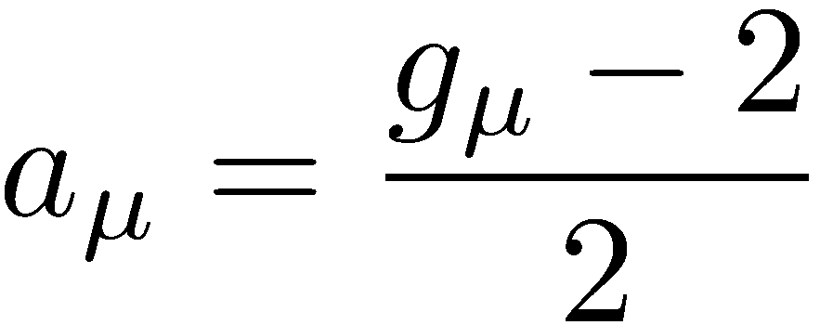
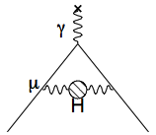
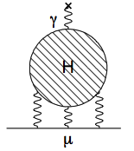
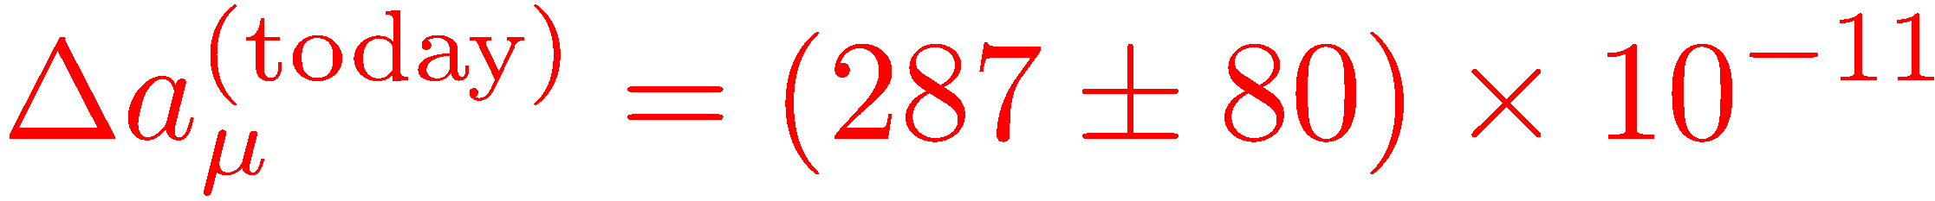
a_{μ}: Experiment vs Standard Model
g_{μ} normally denoted by anomalous piece a_{μ}:
Contribution | Value (x 10⁻¹¹)
QED (γ + l) | 116 584 718.951 ± 0.08
Hadronic VP (lo)* | 6 923 ± 42
Hadronic VP (ho)** | -98.4 ± 0.7
Hadronic LBL§ | 105 ± 26
ElectroWeak | 153.6 ± 1.0
Total SM | 116 591 802 ± 42_{H-LO} ± 26_{H-LBL} ± 2_{other} (± 49_{tot})
Significant work on-going
“Glasgow Consensus”
E821 Result (Data-taking from 1998 – 2001):
Exp - Theory:
(3.6σ)
*Davier et al, Eur. Phys. J. C(2011) 71:1515; **Hagiwara et al, J. Phys. G38, 085003 (2011); §Prades et al, Lepton Moments (2010)

Slide 5
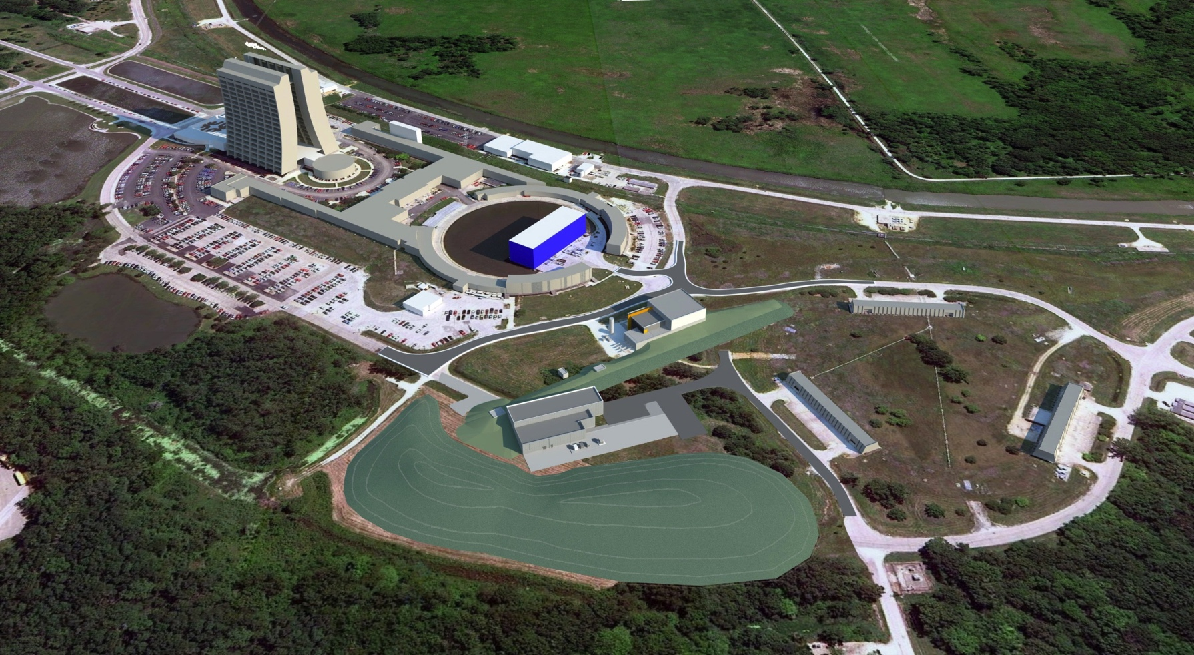
Fermilab Muon Campus Vision, c. 2012
Convert Tevatron anti-proton source to produce muon beams for experiments such as Muon g-2 and Mu2e
Muon g-2
Delivery Ring
Mu2e
Artist’s Impression of Muon Campus
5

Slide 6
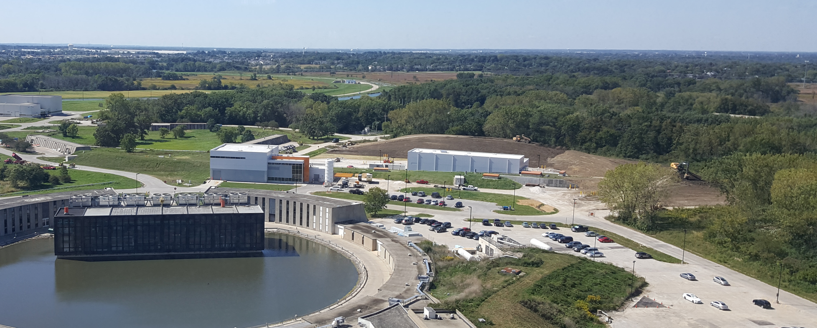
Fermilab Muon Campus Reality, Today
Delivery Ring
Mu2e
Muon g-2
Photograph from Wilson Hall
Muon g-2 hall complete, storage ring installed & operational
Mu2e civil construction complete & building outfitting underway
Conversion of accelerator complex to muon source nearing completion
6

Slide 7
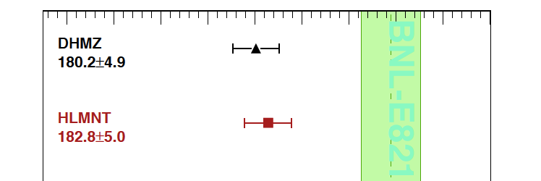
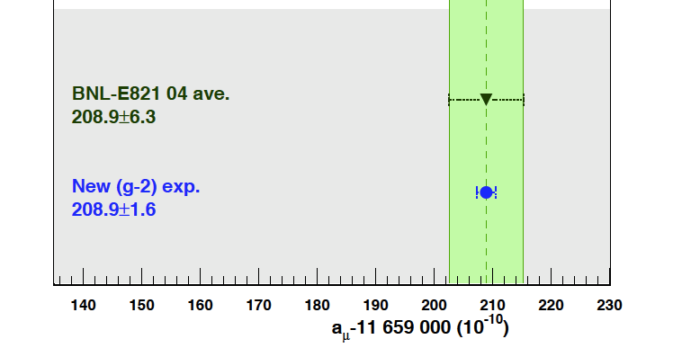
Muon g-2: Overall Goal
Reduce experimental error on a_{μ} by factor 4 & resolve the long-standing E821 g-2 discrepancy
  Requires 21 x statistics & reduction of key systematics with 4 major steps:
  Transport storage ring to Fermilab
  New experimental hall for ring
  Modify accelerator to provide a high-purity, intense beam of muons
  Upgrade injection, field, detector, electronics & DAQ systems for higher rates and lower systematics
✔
✔
3.3 – 3.6 σ
http://arxiv.org/pdf/1311.2198v1.pdf
75% Done
BNL Result
80% Done
Fermilab Goal
7

Slide 8
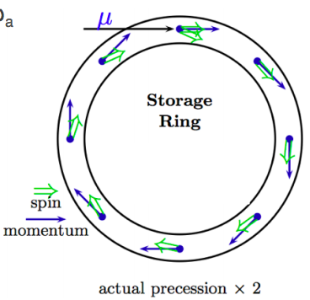
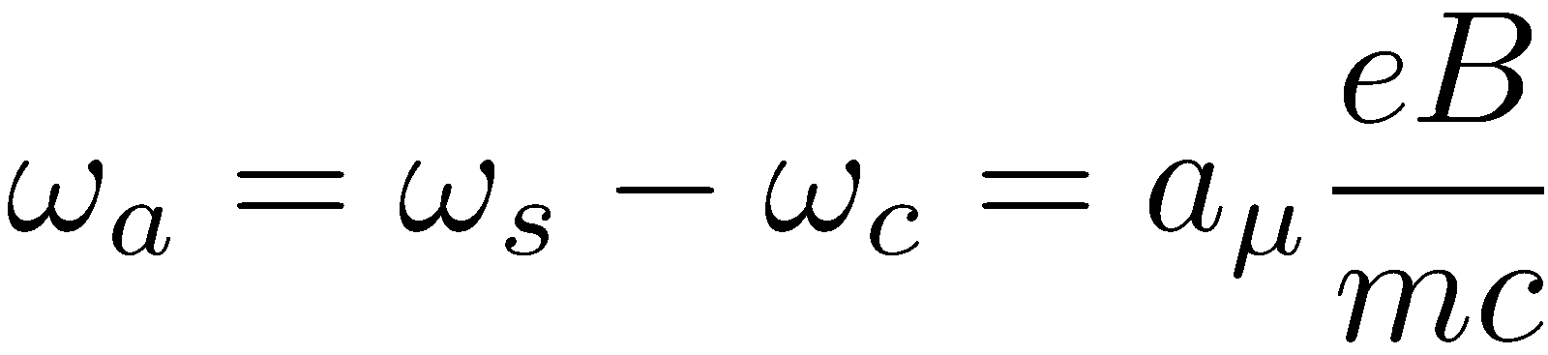
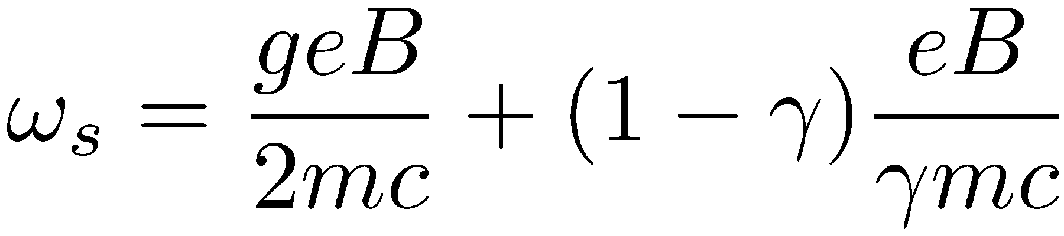
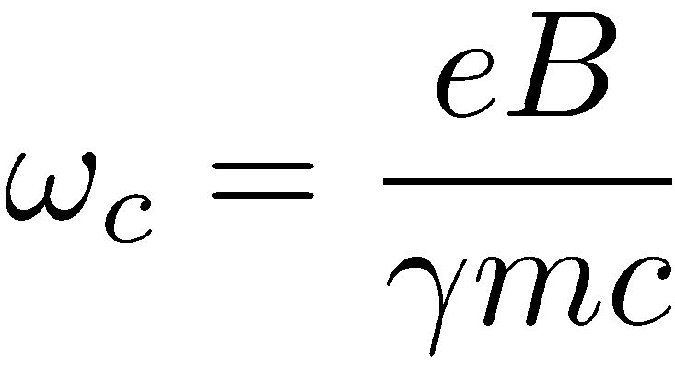
Muon g-2: Experimental Principle
Store longitudinally polarised muons in a dipole field
Measure two quantities to extract a_{μ}:
  magnetic field averaged over muon distribution, B
  anomalous precession frequency, ω_{a}
Spin precession freq.
Cyclotron freq.
Larmor precession
Thomas precession

Slide 9
Muon g-2: Muon Production
Proton bunch
Target
120 ns wide bunch of 8 GeV protons from Booster & Recycler
Fired at pion production target which is the same as that used for Tevatron Run II anti-proton production (Inconel (Ni-Cr))

Slide 10
Muon g-2: Muon Production
Proton bunch
Pions
3.11 GeV/c
Target
Outgoing pions focused by a lithium lens and then momentum-selected, centred on 3.11 GeV
The pions are then collected and sent towards the delivery ring

Slide 11
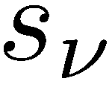
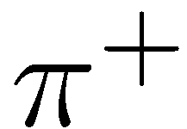
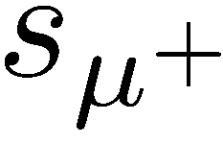
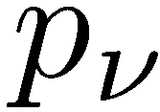
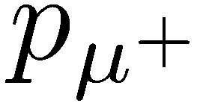

Muon g-2: Muon Production
Proton bunch
Pions
3.11 GeV/c
Target
In the delivery ring, pions decay into negative helicity μ⁺
Create a ~90% polarised beam by selecting highest energy μ⁺
Momentum of selected μ⁺ centred on 3.09 GeV (γ = 29.3) to reduce E-field effects:
0 for γ = 29.3

Slide 12
Muon g-2: Storing Muons
Proton bunch
Pions
Inflector
B = 1.45 T
3.11 GeV/c
Target
Storage ring: 14 m diameter toroidal C-magnet with 1.45 T field
Inflector magnet nullifies the storage ring field for incoming muons
Storage
ring
R=711.2cm
d=9cm

Slide 13
Muon g-2: Storing Muons
Proton bunch
Pions
Inflector
B = 1.45 T
3.11 GeV/c
Target
Storage ring: 14 m diameter toroidal C-magnet with 1.45 T field
Inflector magnet nullifies the storage ring field for incoming muons
Muons that pass through the inflector are off central orbit
Injection orbit

Slide 14
Muon g-2: Storing Muons
Proton bunch
Pions
Inflector
B = 1.45 T
3.11 GeV/c
Target
Storage ring: 14 m diameter toroidal C-magnet with 1.45 T field
Inflector magnet nullifies the storage ring field for incoming muons
Muons that pass through the inflector are off central orbit
Kicker magnets move the orbit to the centre of the storage ring
Injection orbit
Central orbit
Kicker
magnets
R
R

Slide 15
Muon g-2: Storing Muons
Proton bunch
Pions
Inflector
B = 1.45 T
3.11 GeV/c
Target
Storage ring: 14 m diameter toroidal C-magnet with 1.45 T field
Inflector magnet nullifies the storage ring field for incoming muons
Muons that pass through the inflector are off central orbit
Kicker magnets move the orbit to the centre of the storage ring
Muons focussed vertically with electrostatic quadrupoles
Electric Quadrupoles

Slide 16
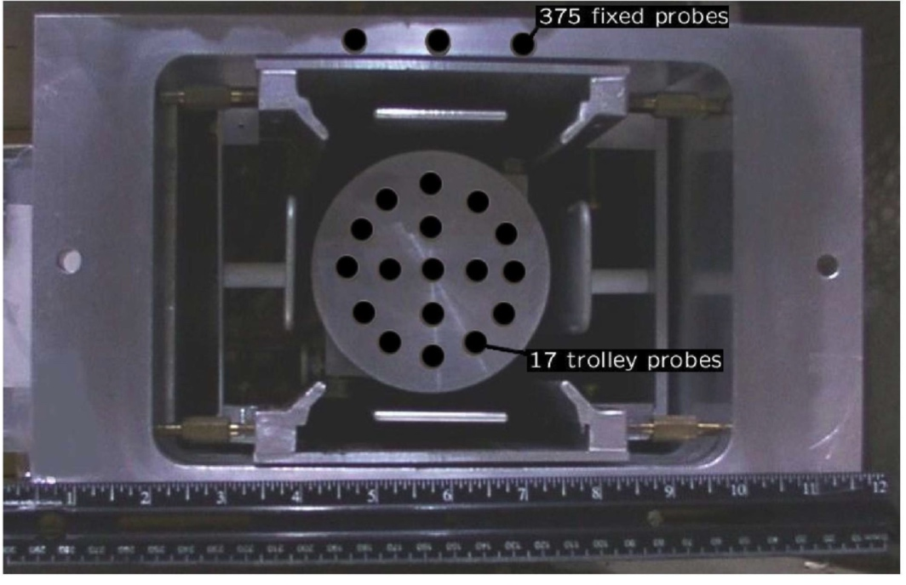
Measuring the Magnetic Field
Regularly map field inside vacuum chamber with NMR probe trolley
Monitor field during data-taking with fixed probes and interpolate
NMR trolley in vacuum chamber
BNL E821 result averaged around azimuth was good to 1 – 2 ppm
We’re shimming finer to improve this
BNL Field

Slide 17
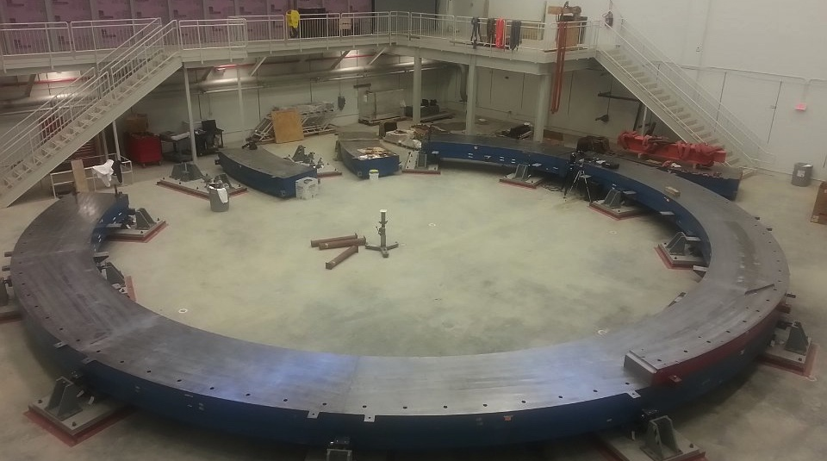
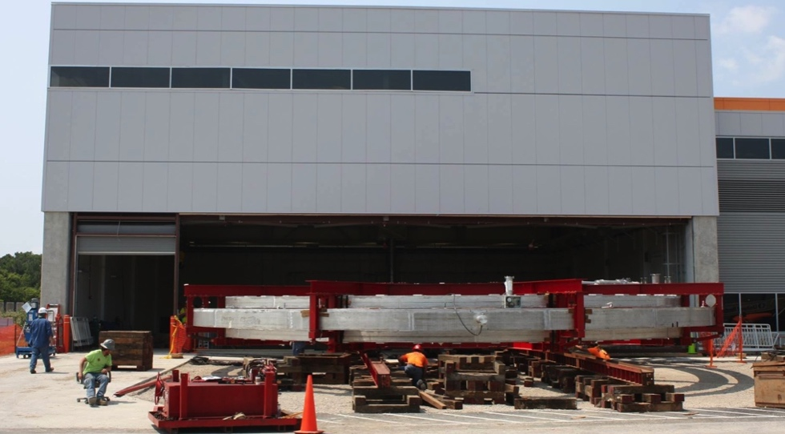
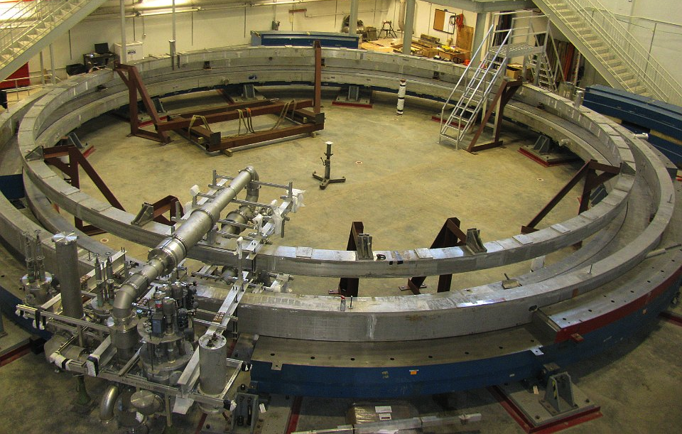
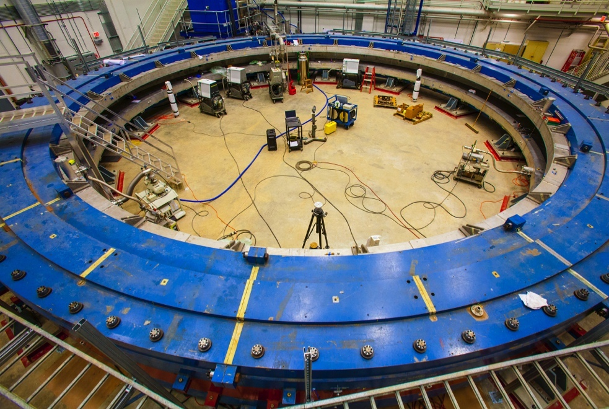
Magnet Reassembly at Fermilab
Bottom yoke pieces
Bringing in super-conducting coils
SC coils installed
Top yoke pieces
17

Slide 18
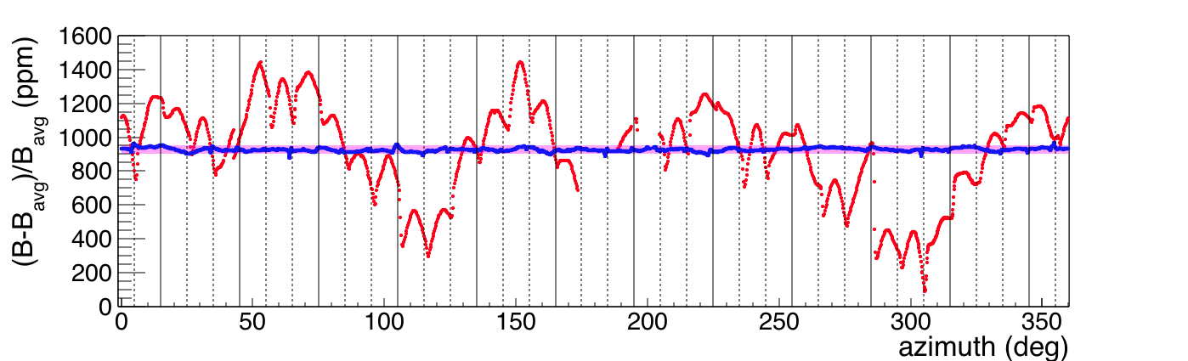
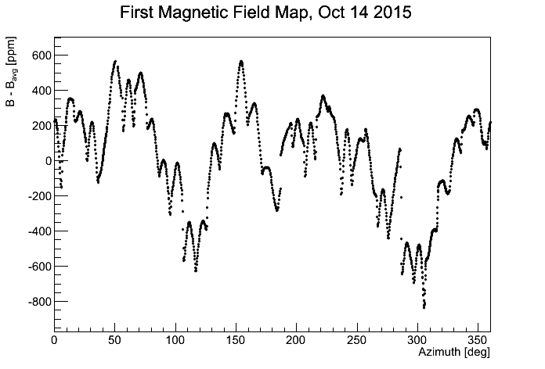
First Magnetic Field Measurement
Magnet achieved full power September 2015 with peak-peak variation of 1400 ppm:
We care about the field weighted by muon distribution
For 70 ppb uncertainty, we need a uniform field to relax constraints on measuring the muon distribution
The goal is 50 ppm after first round of rough shimming
Dipole Field Oct 2015
1400 ppm
50 ppm
Goal

Slide 19
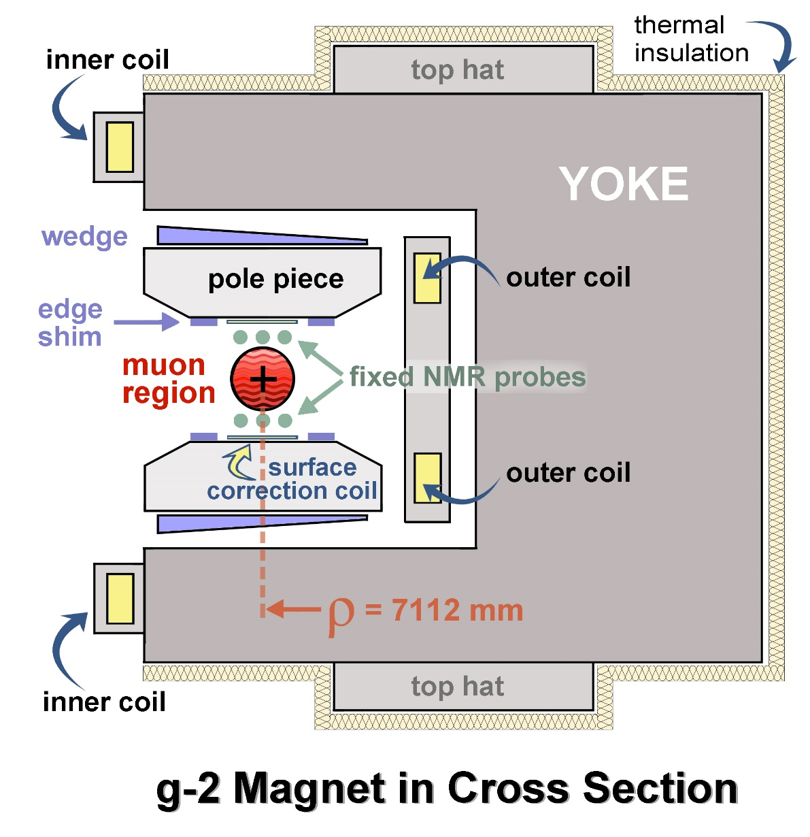
Magnetic Design & Shimming Tools
C-shaped design with 1.45 T dipole field between poles

Slide 20
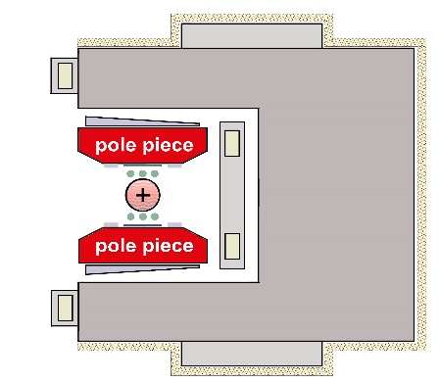
Magnetic Design & Shimming Tools
C-shaped design with 1.45 T dipole field between poles
Many “knobs” for calibration:
  72 Poles
    Shaping & homogeneity

Slide 21
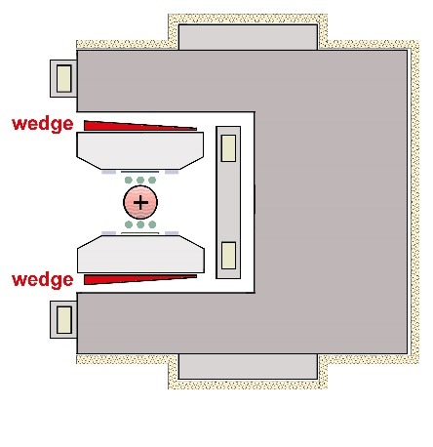
Magnetic Design & Shimming Tools
C-shaped design with 1.45 T dipole field between poles
Many “knobs” for calibration:
  72 Poles
    Shaping & homogeneity
  864 Wedges
    Quadrupole asymmetry

Slide 22
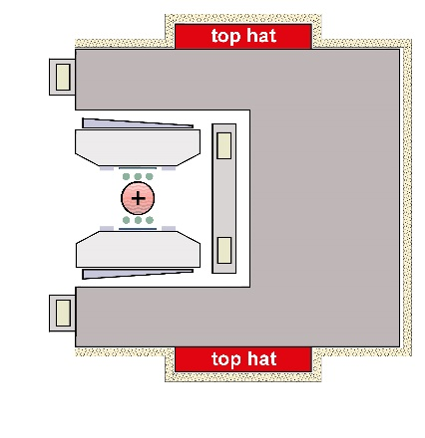
Magnetic Design & Shimming Tools
C-shaped design with 1.45 T dipole field between poles
Many “knobs” for calibration:
  72 Poles
    Shaping & homogeneity
  864 Wedges
    Quadrupole asymmetry
  48 Iron Top Hats
    Change effective μ

Slide 23
Magnetic Design & Shimming Tools
C-shaped design with 1.45 T dipole field between poles
Many “knobs” for calibration:
  72 Poles
    Shaping & homogeneity
  864 Wedges
    Quadrupole asymmetry
  48 Iron Top Hats
    Change effective μ
  144 Edge Shims
    Quad/sextapole asymmetry
  8000 Surface Iron Foils
    Local changes of effective μ
  100 Active Surface Coils
    Control current to add ring-wide average field moments
Edge shims & surface coils/foils

Slide 24
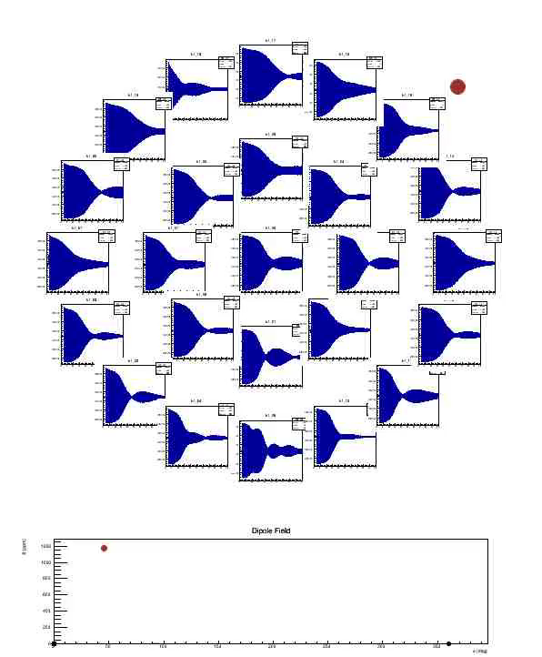
Shimming & Field Measurements
Early stages of shimming:
Field in storage volume is measured using pulsed proton NMR
Shimming trolley contains array of probes that map whole storage volume
Extracted frequency gives 10 ppB single shot measurement precision

Slide 25
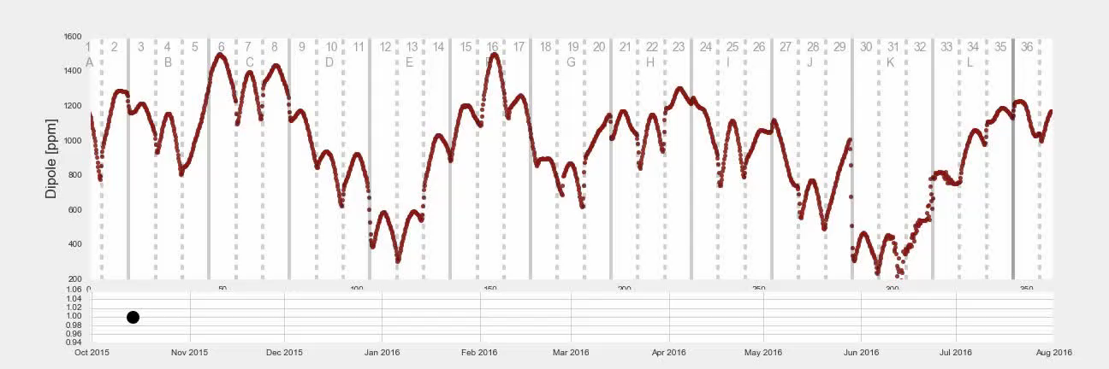
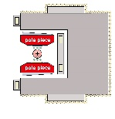
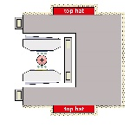
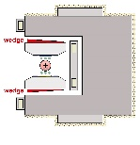
Shimming in Action
Progress towards a uniform field from Oct ‘15 to July ’16:
+
Poles
Top hats & wedges
Surface foils
25

Slide 26
Rough Shimming Result
August 2016: completed addition of surface foils & achieved 50 ppm goal for rough shimming:
Now installing vacuum chambers & detector systems
Goal
50
ppm
Oct 2015 → Aug 2016
~1400
ppm
 | RMS (ppm) | p-p (ppm)
FNAL (Rough shimmed) | 10 | 75
BNL (Typical scan) | 30 | 230
26

Slide 27
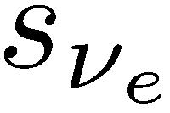
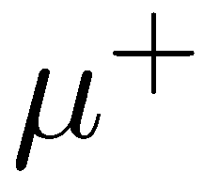
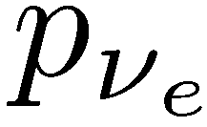
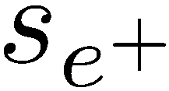
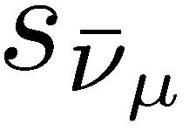
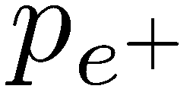

Measuring the precession frequency, ω_{a}
We measure ω_{a} using 24 electromagnetic calorimeters placed around the storage ring
The highest energy positrons are correlated with the muon spin in our polarised sample
Calorimeters
As the μ⁺ spin precesses towards and away from the calorimeters the number of high energy e⁺ is modulated by ω_{a}

Slide 28


Extracting ω_{a} from the calorimeter data
Arrival-time spectrum from previous experiment (E821):
0 – 100 μs
100 – 200 μs
200 – 300 μs
300 – 400 μs
400 – 500 μs
500 – 600 μs
600 – 700 μs
Time % 100 μs

Slide 29




Calorimeter Design
24 calorimeters: each is array of 6 x 9 PbF₂ crystals - 2.5 x 2.5 cm² x 14 cm (15X₀)
Readout by SiPMs to 800 MHz WFDs (1296 channels)
28 channel prototype tested at SLAC

Slide 30




Calorimeter Performance
Energy Resolution
Timing Resolution
σ_{E}/E ~ 2.8% @ 2 GeV
σ_{t} ~ 25 ps
Electron pile-up
Position from Energy Deposit
Temporal separation at 5 ns
See NIM A 783 (2015), pp 12–21 for details

Slide 31

Measuring the Muon Distribution
We need to measure the muon distribution to calculate:
  Average magnetic field
  Pitch correction (vertical betatron motion)
  E-field correction (not all muons at magic mom)
  We do this with three trackers around the ring
A non-destructive measurement with a resolution of 1 mm.
Trackers
Reconstructed decay position

Slide 32


Tracker Design
Each tracker has 8 modules that sit in front of calorimeter
Top down view of ring section
Each module has 128 straws in four layers
Reconstructed test beam data
Single straw resolution ~ 180 μm

Slide 33
Muon g-2: Current Schedule
Construction (Project & Muon Campus):
MC-1 (GPP)
g-2 Cryo Plant (AIP)
Ring Assembly
Ring cold & ready for operations
Shim Field
Prep Vacuum Chambers/Install
Construct/Install Sub-systems
Experiment ready for operations
Accelerator Modifications
Accelerator ready for operations
Operations (Laboratory):
Ring Cold
Detector/DAQ Commission
Beam
Tune-up
Full Running Intensity
Physics Production Running
Analysis (Collaboration):
Analysis Tools Development
Mock Data
1-2 x BNL statistics
1st Results
~5-10 x BNL
2nd Results
21 x BNL
Final Results

Slide 34
Take-home messages
The Muon g-2 experiment will reduce error by a factor of 4 compared to the previous Muon g-2 (BNL E821)
The storage ring magnet has been operational for a year and our rough shimming targets have been achieved
Beamline commissioning begins in April 2017, with real data collection starting Autumn 2017
We anticipate a result with the same precision as E821 by mid-2018
We expect to report three results with 100%, 50% and 25% of the E821 uncertainty

Slide 35
Extra Slides

Slide 36

Improvements over E821
Increase statistics: x 21
Reduce systematics: x 2 (ω_{p}) and x 3 (ω_{a})
Goal: 140 ppb
Expected Improvement
7.5 σ if same central values
Key: More muons per fill & more fills per hour
Key: Finer shimming of magnet and refined monitoring
Key: Modern detectors/electronics/DAQ/calibration

Slide 37

Systematic Errors on ω_{a} (ppb)
Detector Team
Ring Team
Detector Team

Slide 38

Systematic Errors on ω_{p} (ppb)
Brookhaven E821
FNAL

Slide 39

Absolute calibration of the field
39

Slide 40




State-of-the-art Laser-based calibration system
Front Panel Prisms
10⁻⁴ / h demonstrated

