Slide 1
Experimental Neutrino Physics:
Review and Summary
Jonathan Link
Center for Neutrino Physics, Virginia Tech

Slide 2
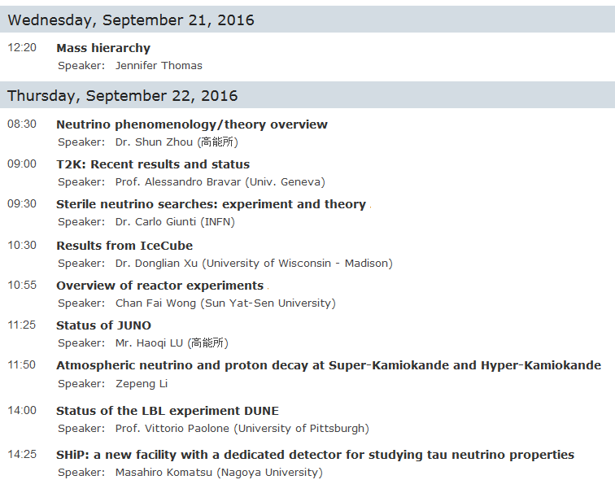
Neutrino Talks at This Conferece

Slide 3
A Brief History of Neutrinos
2012: Daya Bay Reactor Experiment measures the last unknown neutrino mixing angle, θ₁₃.
2002: SNO solves solar neutrino puzzle.
2013: T2K observes ν_{μ}→ν_{e}
1998: The Super-K experiment discovers neutrino oscillations, proving that neutrino have mass.
2000: DONuT Experiment at Fermilab discovers the third neutrino (ν_{τ})
1993: LSND observed hint of short-baseline oscillations leading to speculation on the existence of sterile neutrinos.
1987: Kamiokande observes neutrinos observed from Supernova 87A.
1968: Ray Davis observes neutrinos from the Sun.
1962: Lederman, Schwartz and Steinberger discover that there are at least two types of neutrino.
1956: Reines and Cowan discover the neutrino at the Savannah River Nuclear Reactor.
1934: Enrico Fermi Develops a theory of β-decay based on the neutrino.
time
1930: Wolfgang Pauli proposes the neutrino to preserve energy conservation in β-decay.

Slide 4
Open Questions in Neutrino Physics
Types of Neutrino Experiments
Neutrino mass hierarchy
Neutrino mass hierarchy
Neutrino Oscillations
Neutrinoless Double Beta Decay
Direct Mass Measurements
Neutrino Telescopes
Cross Sections
Neutrino mass hierarchy: normal or inverted?
Is there CP violation in neutrino mixing?
Are neutrinos their own antiparticle? (Dirac vs. Majorana)
How many neutrinos are there? (Sterile neutrinos?)
What is the absolute neutrino mass scale?
Astrophysical neutrinos?
CP violation
Dirac vs. Majorana
Sterile neutrinos
Absolute neutrino mass
Absolute neutrino mass
Astrophysical neutrinos

Slide 5
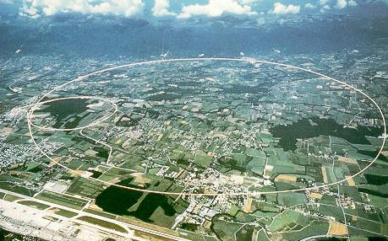
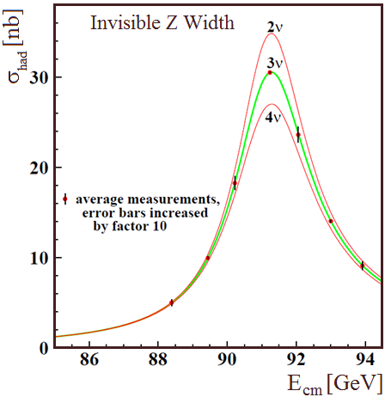
But Let’s Start With What We Already Know
There are three neutrino flavors:
ν_{e}
ν_{μ}
ν_{e}
ν_{μ}
ν_{τ}
ν_{τ}
LEP tells us that there are exactly three that couple to the Z boson
The LEP Ring
Phys. Rept. 427, 257 (2006)

Slide 6
Neutrinos Have Mass and They Mix
Neutrino mixing is governed by the PMNS mixing matrix which relates the mass eigenstates to the flavor eigenstates:
Flavor Eigenstates
Mass Eigenstates
PMNS Mixing Matrix
In the simplest approximation, the probability that a neutrino, which started out as a ν_{α}, is detected as a ν_{β} is given by:
where
* This two neutrino approximation gives a serviceable representation of the data that we have so far, but going forward it will no longer be a sufficient.
*
Notes:
Greatest Moment in Canadian Physics since Rutherford discovered transmutation of the elements (or was that chemistry)

Slide 7
The Neutrino Mixing Matrix
The PMNS mixing matrix is constructed as the product of three independent rotations (a unitary matrix with three mixing angles and one phase)
Atmospheric
Reactor
Solar
Such that:
The three mixing angles have all been measured,
but the CP violating phase, δ, is still unknown.

Slide 8
The Neutrino Mass Scale and Hierarchies
In addition to the four mixing matrix parameters, there are two independent $∆m^{2}$ scales ($∆m_{21}^{2}$ and $∆m_{32}^{2}$)
m₃
m₂
m₁
Or
m₂
m₁
m₃
Normal Hierarchy
Inverted Hierarchy
In the Inverted Hierarchy both $∆m_{31}^{2}$ and $∆m_{32}^{2}$ are negative.

Slide 9
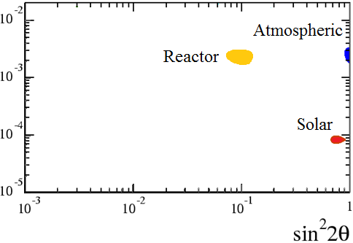
Neutrino Oscillation Data
Long-baseline ν_{μ}→ν_{e} (Nova and T2K) requires the full 3 ν
framework.
Seen by Super-K, confirmed by K2K, Minos, T2K and NOvA (θ₂₃ and $∆m_{μμ}^{2}$)
ν_{μ}→ν_{x}
ν_{e}→ν_{x}
First observed by Daya Bay, confirmed by RENO, and Double Chooz (θ₁₃ and $∆m_{ee}^{2}$)
First observed by Ray Davis. Nailed down by Super-K, SNO and KamLAND. Dominated by mixing of mass states 1 and 2 (θ₁₂ and $∆m_{21}^{2}$)
ν_{e}→ν_{x}
The data for the three neutrino mixing model is nearly complete and extraordinarily self-consistent.
Specifically, $∆m_{ee}^{2}$ and $∆m_{μμ}^{2}$, which are different linear combinations of $∆m_{31}^{2}$ and $∆m_{32}^{2}$, agree to within $∆m_{21}^{2}$.

Slide 10
Neutrino Oscillation Data
Long-baseline ν_{μ}→ν_{e} (Nova and T2K) requires the full 3 ν
framework.
Seen by Super-K, confirmed by K2K, Minos, T2K and NOvA (θ₂₃ and $∆m_{μμ}^{2}$)
ν_{μ}→ν_{x}
ν_{e}→ν_{x}
First observed by Daya Bay, confirmed by RENO, and Double Chooz (θ₁₃ and $∆m_{ee}^{2}$)
First observed by Ray Davis. Nailed down by Super-K, SNO and KamLAND. Dominated by mixing of mass states 1 and 2 (θ₁₂ and $∆m_{21}^{2}$)
ν_{e}→ν_{x}
The data for the three neutrino mixing model is nearly complete and extraordinarily self-consistent.
Specifically, $∆m_{ee}^{2}$ and $∆m_{μμ}^{2}$, which are different linear combinations of $∆m_{31}^{2}$ and $∆m_{32}^{2}$, did not have to agree to within $∆m_{21}^{2}$.

Slide 11
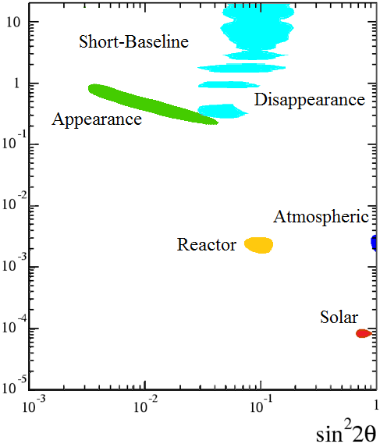
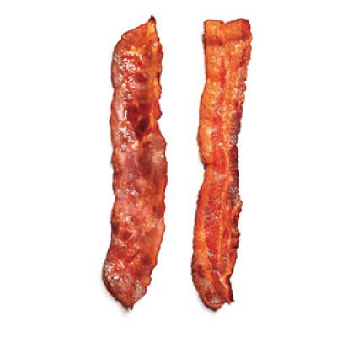
ν_{e}→ν_{x}
Neutrino Oscillation Data
ν_{μ}→ν_{e}
and Then Some…
Long-baseline ν_{μ}→ν_{e} (Nova and T2K) requires the full 3 ν
framework.
Short-Baseline anomalies observed by Reactors, Gallium Source Experiments, T2K LSND and MiniBooNE (θ_{x4} and $∆m_{4x}^{2}$)
Seen by Super-K, confirmed by K2K, Minos, T2K and NOvA (θ₂₃ and $∆m_{μμ}^{2}$)
ν_{μ}→ν_{x}
ν_{e}→ν_{x}
ν_{s}
ν_{s}
First observed by Daya Bay, confirmed by RENO, and Double Chooz (θ₁₃ and $∆m_{ee}^{2}$)
First observed by Ray Davis. Nailed down by Super-K, SNO and KamLAND. Dominated by mixing of mass states 1 and 2 (θ₁₂ and $∆m_{21}^{2}$)
ν_{e}→ν_{x}
Sterile Neutrino
(Bacon Flavor)
confirmed
The data for the three neutrino mixing model is nearly complete and extraordinarily self-consistent.
Specifically, $∆m_{ee}^{2}$ and $∆m_{μμ}^{2}$, which are different linear combinations of $∆m_{31}^{2}$ and $∆m_{32}^{2}$, did not have to agree to within $∆m_{21}^{2}$.

Slide 12
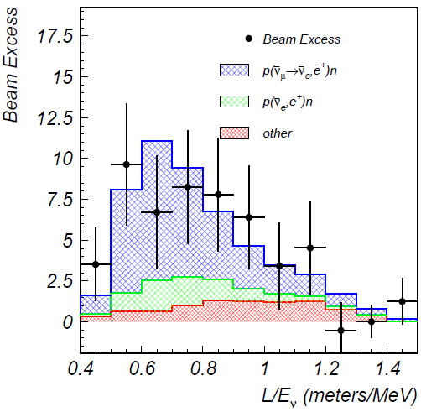
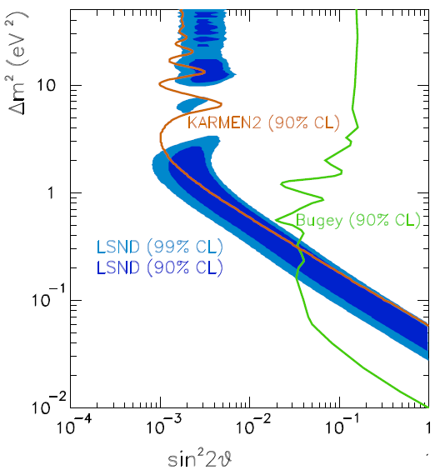
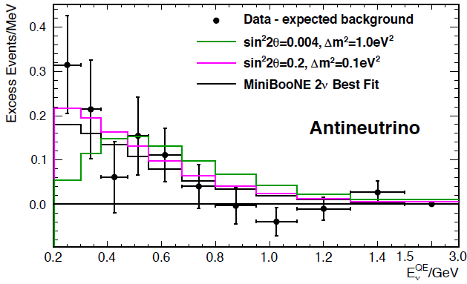
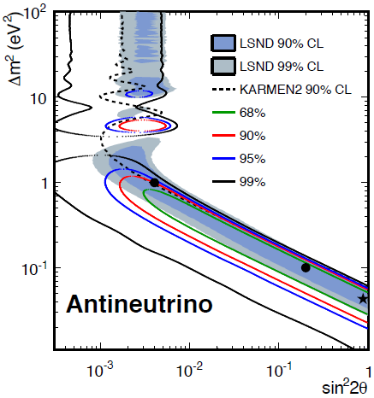
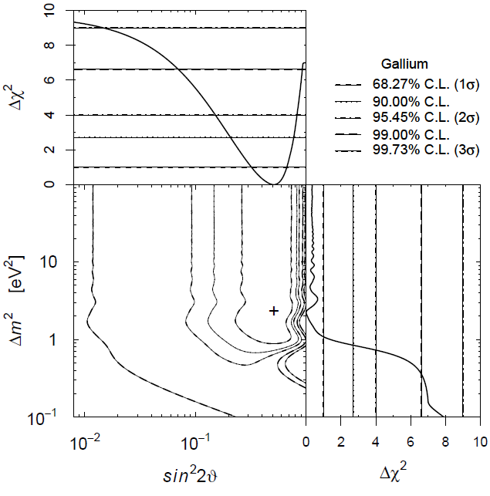
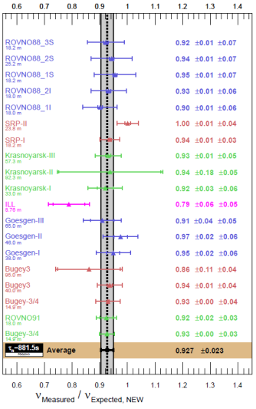
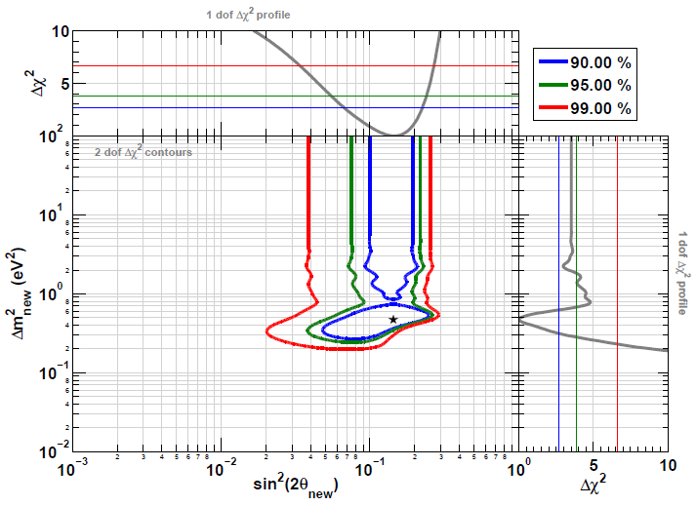
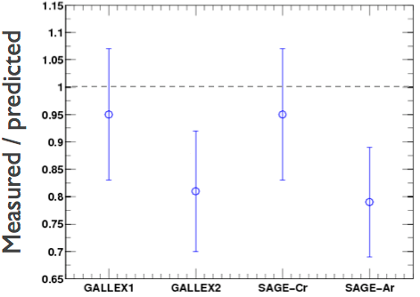
The Evidence for Sterile Neutrinos
LSND (${\overline{ν}}_{μ}→{\overline{ν}}_{e}$)
MiniBooNE (${\overline{ν}}_{μ}→{\overline{ν}}_{e}$)
Event Excess:
32.2 ± 9.4 ± 2.3
Event Excess: 78.4 ± 28.5
Aguilar-Arevalo et al., Phys.Rev.D64, 112007 (2001)
Aguilar-Arevalo et al., Phys.Rev.Lett. 110, 161801 (2013)
Gallium Anomaly ($ν_{e} Disappearance$)
Reactor Anomaly (${\overline{ν}}_{e}$ Disappearance)
Giunti and Laveder, Phys.Rev.C83, 065504(2011)
Mention et al., Phys.Rev.D83 073006 (2011)

Slide 13
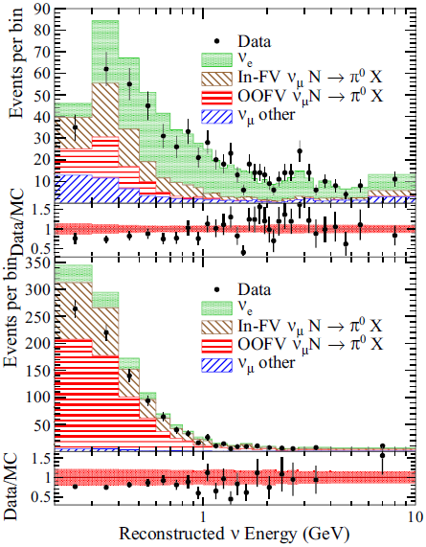
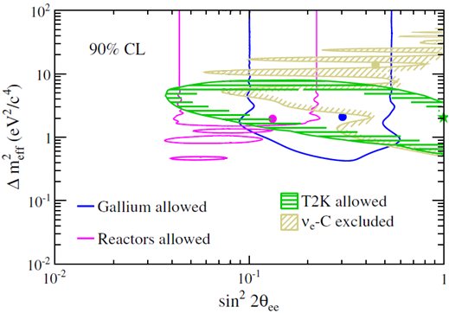
T2K Near Detector ν_{e} Disappearance
Although the T2K beam is predominantly a ν_{μ} beam, the small ν_{e} component can be used in the near detector for a ν_{e} disappearance search.
ν_{e} Selection
Phys.Rev. D91, 051102(R) (2015)
Control

Slide 14
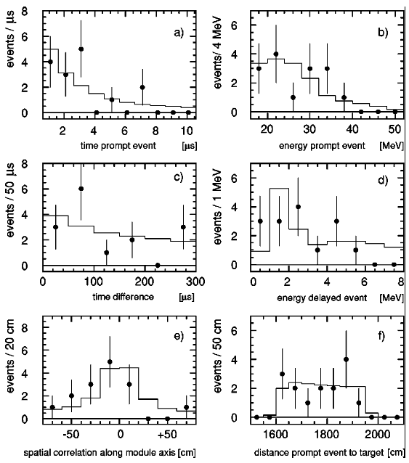
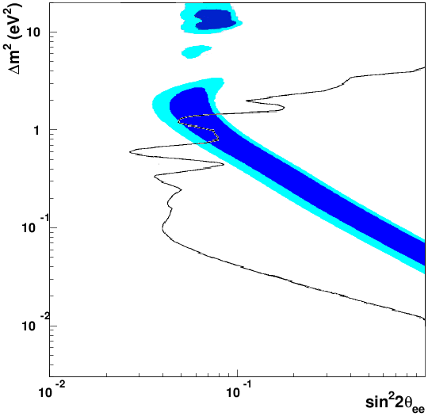
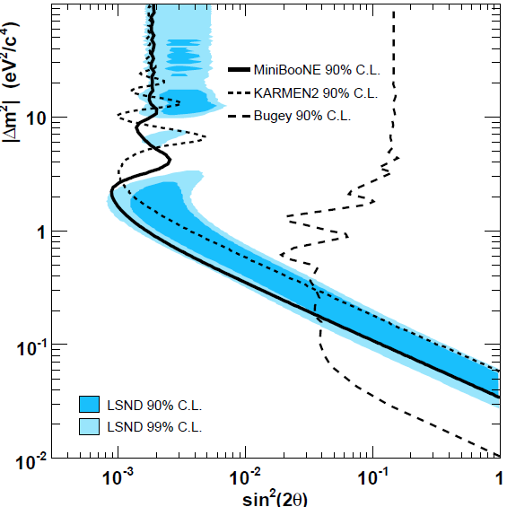
Evidence Against the ~1 eV² Sterile Neutrino
KARMEN (${\overline{ν}}_{μ}→{\overline{ν}}_{e}$)
Bugey Reactor (${\overline{ν}}_{e}$ Disappearance)
KARMEN (90% CL)
Effective
${\overline{ν}}_{μ}→{\overline{ν}}_{e}$ under
certain assumptions
No ${\overline{ν}}_{e}$ Excess
Armbruster et al., Phys.Rev.D65 112001 (2002)
Achkar et al., Nucl.Phys.B434, 503 (1995)
MiniBooNE (ν_{μ} → ν_{e} Appearance)
ν_{μ} Disappearance
(where is it?)
For $ν_{μ}→ν_{e}$ to happen there must be both $ν_{e}$ and $ν_{μ}$ disappearance
Phys.Rev.Lett. 98, 231801 (2007)

Slide 15
Relating Appearance and Disappearance Probabilities
With a single sterile neutrino we get a 4×4 PMNS mixing matrix and 3 independent Δm²s.
m₄
U_{e4}²
U_{μ4}²
U_{τ4}²
U_{s4}²
+ + + = 1 (PMNS Unitarty)
The appearance probability (ν_{μ} →ν_{e} ):
Sterile
Δm₄₃²
P_{μe} =
sin²2θ
sin²(1.27Δm₄₃²L/E)
4U_{e4}² U_{μ4}²
The ν_{e} disappearance probability:
m₃
P_{ee} = P_{es} + P_{eμ} + P_{eτ}
P_{ee} ≈ P_{es}
= 4U_{e4}² U_{s4}² sin²(1.27Δm₄₃²L/E)
Atmospheric
The ν_{μ} disappearance probability:
Δm₃₂²
m₂
Solar
P_{μμ} ≈ 4U_{μ4}² U_{s4}² sin²(1.27Δm₄₃²L/E)
m₁
Δm₂₁²
Notes:
Because P(mu, e) depends on both U(e,4) and U(mu,4), you can have nu_e disappearance without nu_e appearance, but you can’t have nu_e appearance without nu_mu disappearance.

Slide 16
Appearance vs. Disappearance
Since any 4th mass state is predominantly sterile (U_{s4} ≈1),
$$P_{μe}≈\frac{1}{4}P_{ee}×P_{μμ}$$
P_{μe} depends on both U_{e4} and U_{μ4}, so you can have ν_{e} disappearance without ν_{e} appearance, but you can’t have ν_{e} appearance without ν_{μ} disappearance.
The absence of ν_{μ} disappearance is a huge problem for the LSND and MiniBooNE signals, while the ν_{e} disappearance anomalies are consistent with all existing data.
If disappearances are small, appearance must be very small.
ν_{e} Disappearance ν_{μ}→ν_{e} Appearance ν_{μ} Disappearance
Kopp et al. JHEP 1305, 050 (2013)
Thus disappearance is the more compelling search target.

Slide 17
$ν_{e}$ and ${\overline{ν}}_{e}$ Disappearance Experiments
Reactor Experiments:
Short baselines (5 to 20 m)
High backgrounds requires new detector technologies
Significant (and costly) shielding may be required
The source is free and renewable
There are many proposed and active projects around the world
Radioactive Source Experiments:
Even shorter baselines (1 to 5 m)
Typically leverages detectors built for other applications
Very low backgrounds are required and available
There are a few ideas and one approved experiment

Slide 18
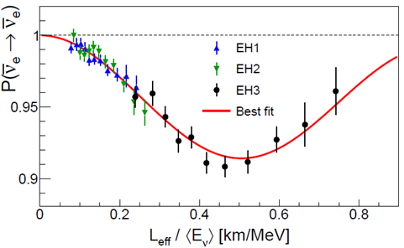
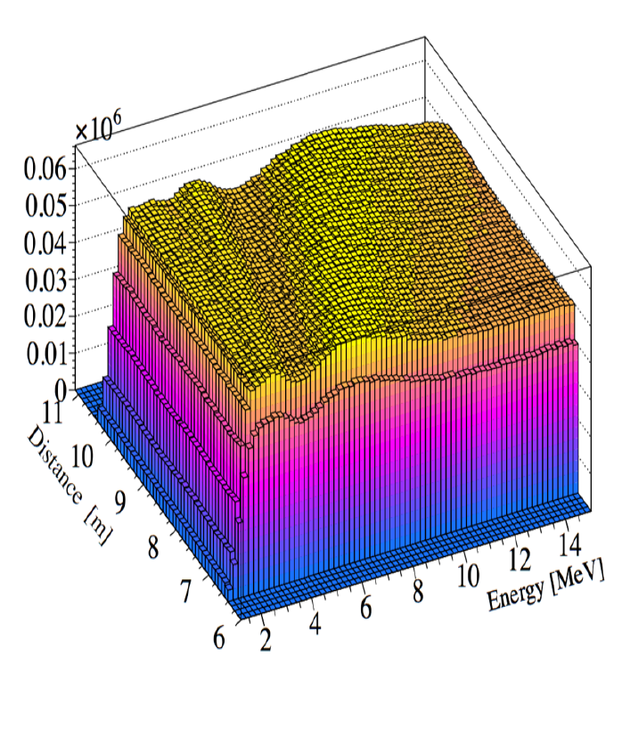
Requirement for Disappearance Experiments
“It don’t mean a thing if it ain’t got that swing”
–American jazz great Duke Ellington
Definition:
oscillometry, n., The observation and measurement of oscillations.
In disappearance experiments the existence of sterile neutrinos can only be convincingly established through oscillometry.
Daya Bay, Phys.Rev.Lett. 115,111802 (2015)
Possible oscillations in a short-baseline reactor experiment

Slide 19
$ν_{e}$ and ${\overline{ν}}_{e}$ Disappearance Experiments
Reactor Experiments:
Short baselines (5 to 20 m)
High backgrounds requires new detector technologies
Significant (and costly) shielding may be required
The source is free and renewable
There are many proposed and active projects around the world
Radioactive Source Experiments:
Even shorter baselines (1 to 5 m)
Typically leverages detectors built for other applications
Very low backgrounds are required and available
There are a few ideas and one approved experiment
Source decays away and is expensive to replace

Slide 20
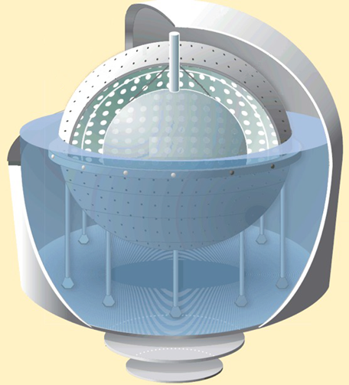
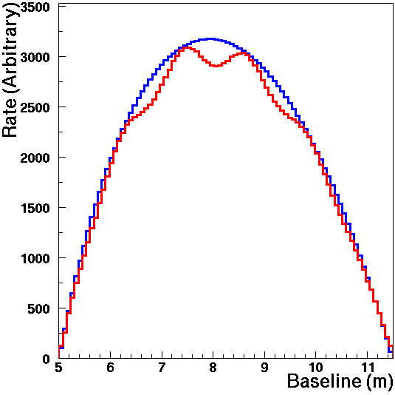
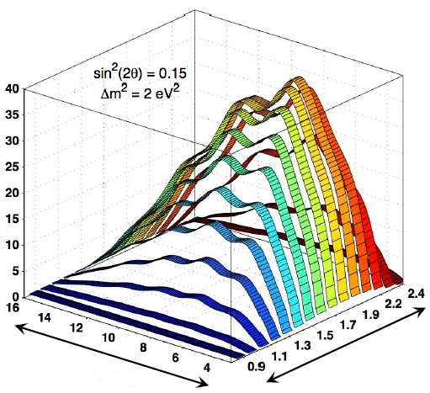
Source Experiment: SOX
Combines the Borexino detector with a ¹⁴⁴Ce ${\overline{ν}}_{e}$ source and/or a ⁵¹Cr $ν_{e}$ source.
At the typical sterile Δm², multiple oscillation wavelengths may be observed inside the detector.
JHEP 1308, 038 (2013)
⁵¹Cr Source
¹⁴⁴Ce Source
sin²2θ_{ee} = 0.12 Δm² = 1.5 eV²
8.25 m
L_{rec}(m)
E_{vis/rec}(MeV)
Source

Slide 21
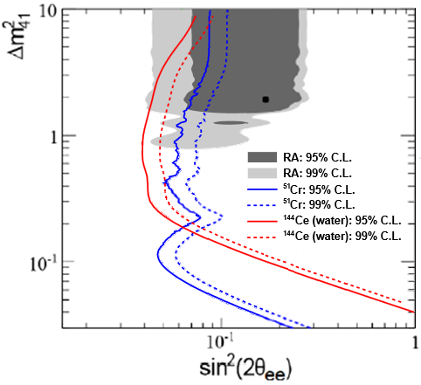
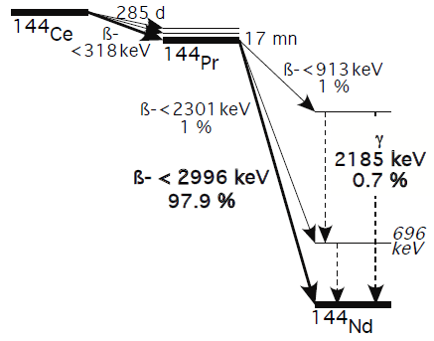
Source Experiment: SOX
Combines the Borexino detector with a ¹⁴⁴Ce ${\overline{ν}}_{e}$ source and/or a ⁵¹Cr $ν_{e}$ source.
At the typical sterile Δm², multiple oscillation wavelengths may be observed inside the detector.
¹⁴⁴Ce ${\overline{ν}}_{e}$ neutrinos have a β spectrum with a 3 MeV endpoint and are observed by inverse beta decay.
JHEP 1308, 038 (2013)
¹⁴⁴Ce-¹⁴⁴Pr Decay
8.25 m
Source

Slide 22
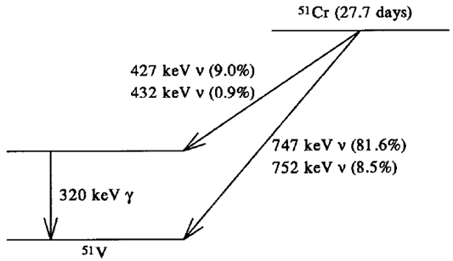
Source Experiment: SOX
Combines the Borexino detector with a ¹⁴⁴Ce ${\overline{ν}}_{e}$ source and/or a ⁵¹Cr $ν_{e}$ source.
At the typical sterile Δm², multiple oscillation wavelengths may be observed inside the detector.
¹⁴⁴Ce ${\overline{ν}}_{e}$ neutrinos have a β spectrum with a 3 MeV endpoint and are observed by inverse beta decay.
Mono-energetic ⁵¹Cr $ν_{e}$ oscillate as a pure function of L, and are detected by electron elastic scattering.
JHEP 1308, 038 (2013)
⁵¹Cr Decay
8.25 m
Source

Slide 23
Keys to a Short-Baseline Reactor Experiment
Sensitivity to the higher Δm² range (2 eV² and above) requires a compact reactor core and good energy resolution.
Detectors must be located on the surface, where random coincidence backgrounds are the most significant challenge.
Random coincident backgrounds can be reduced by:
Reducing background rates (shielding)
Improving signal pattern recognition,
(high purity and high efficiency neutron tag), and
Tightening temporal and spatial coincidence criteria

Slide 24
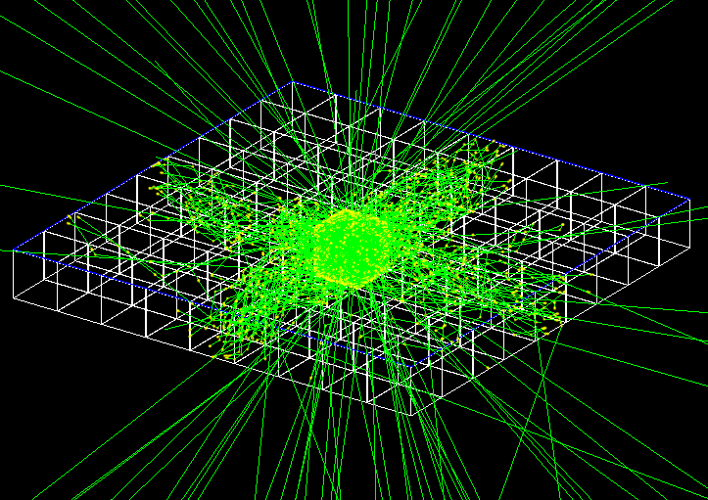
The CHANDLER* Reactor Detector
* Carbon Hydrogen Anti-Neutrino Detector with a Lithium Enhanced Raghavan-optical-lattice
$${\overline{ν}}_{e}$$
Neutron
Capture
Positron (e⁺)
e⁺
Detected Light
p
n
⁴He
Wavelength Shifting Plastic Scintillator
⁶Li
³H
Time
10 ns
~50 μs
200 ns
⁶LiF:ZnS(Ag) Sheet for neutron detection
Cubes are arrayed
in a lattice, with thin
neutron detection sheets
between each cube plane
The light is transported by total-internal-reflection
62 mm Cubes
Photon Ray Tracing in GEANT4

Slide 25
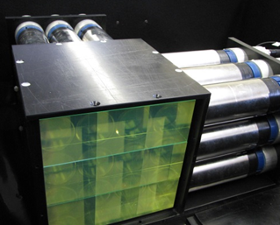
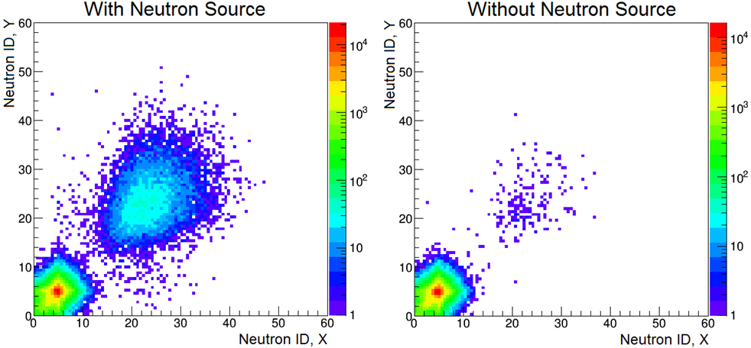
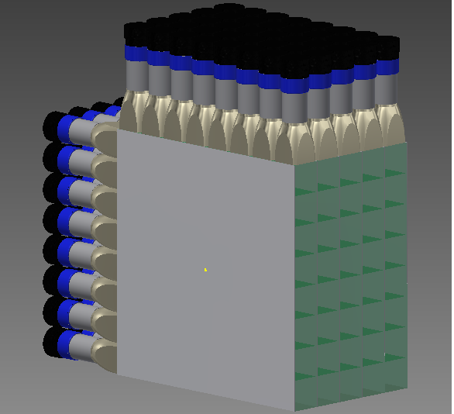
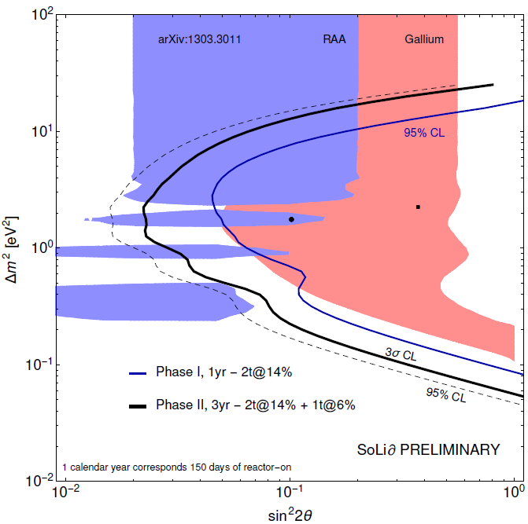
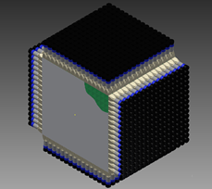
The CHANDLER Program
MicroCHANDLER is a 3×3×3 prototype which we are using to test our full electronics chain, develop the data acquisition system, study neutron capture identification and measure background rates.
MiniCHANDLER is an systems test (8×8×5) which is currently under construction, and will be deployed at a commercial nuclear power plant.
Full CHANDLER, a ton-scale detector with 16×16×16 cubes, could help to resolve the reactor anomaly when installed at a compact research reactor such as the BR2 reactor in Belgium.

Slide 26
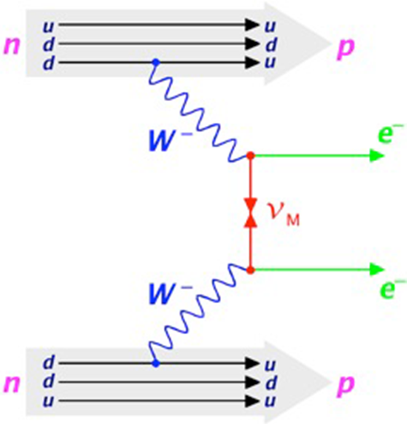
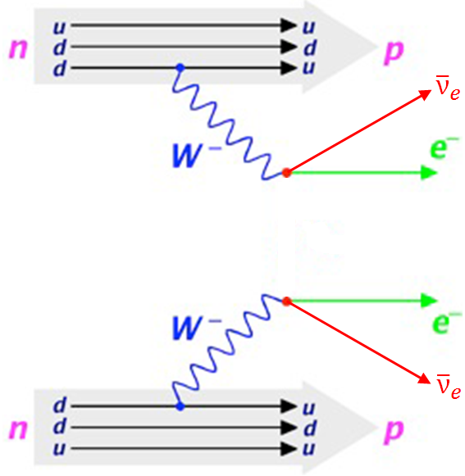
Neutrinoless Double Beta Decay
Requires the neutrino to be its own antiparticle
(i.e. a Majorana particle with $ν_{eL}={\overline{ν}}_{eR}$)
This helicity suppressed process is only possible if neutrinos have mass and it is a strong function of that mass.
Probes the effective mass of the electron neutrino:
The decay rate is a function of both the effective mass and nuclear matrix element:
2ν Double Beta Decay
0ν Double Beta Decay
$\left\langle m_{ββ} \right\rangle =\sum_{i}{U_{ei}^{2}}m_{i}$
$λ=G_{0ν}(Q,Z){\left|M^{0ν}\right|}^{2}{\left|\left\langle m_{ββ} \right\rangle \right|}^{2}$

Slide 27
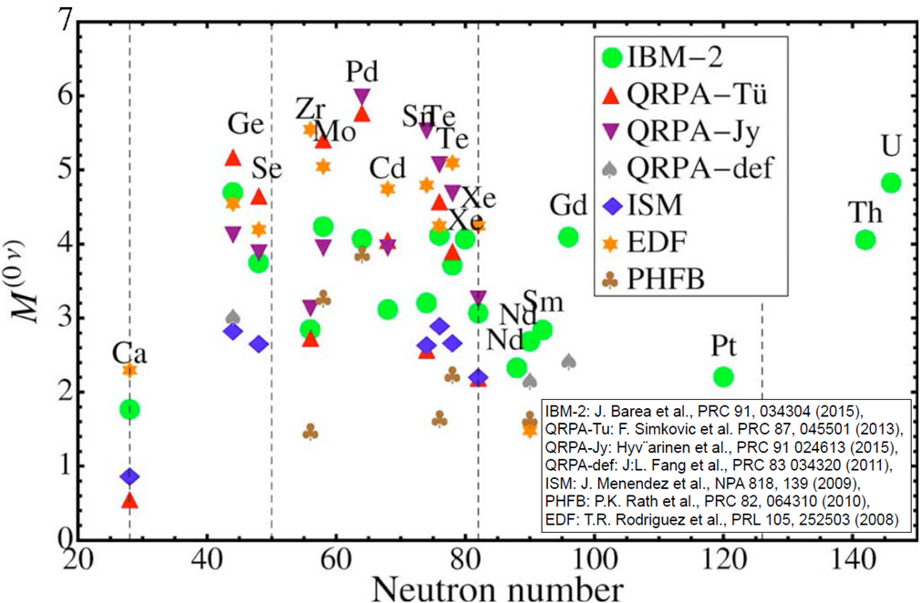
Nuclear Matrix Elements Calculations
There is a large uncertainty in the calculation of the nuclear matrix element.

Slide 28
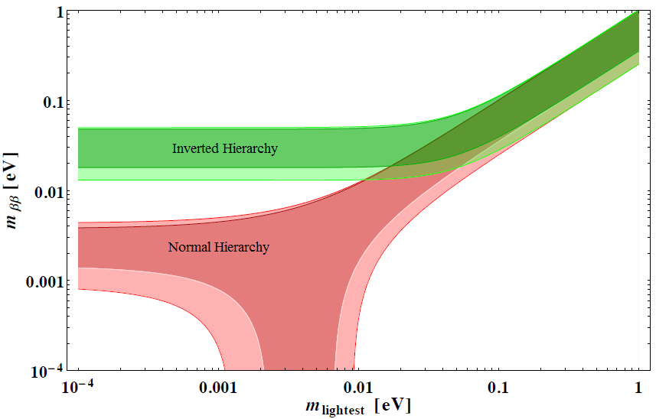
Sensitivity as a Function of Neutrino Mass
If the lightest neutrino mass is just below current limits we may see 0ν2β in the next few years.
If the mass hierarchy is inverted, the currently conceived experimental program will eventually tell us if neutrinos are Majorana of Dirac.
But if the hierarchy is normal…
$\left\langle m_{ββ} \right\rangle =\sum_{i}{U_{ei}^{2}}m_{e}$
Quasi-degenerate
Possibility of permanent ignorance
Phys.Rev. D78, 033010 (2008)
Majorana Phases

Slide 29
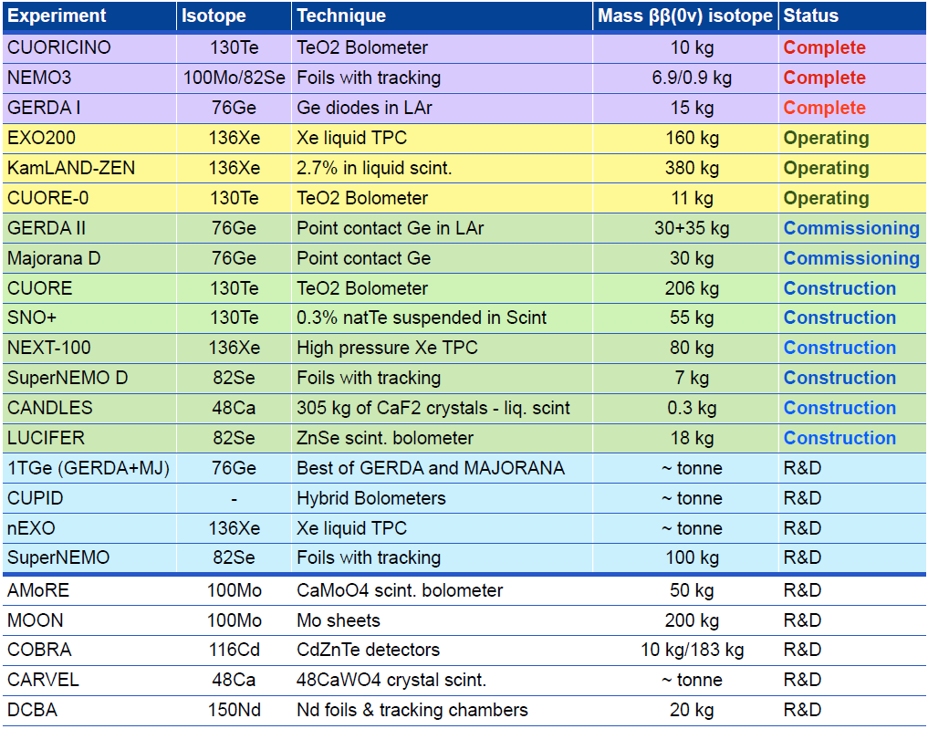
Neutrinoless Double Beta Decay Experiments

Slide 30
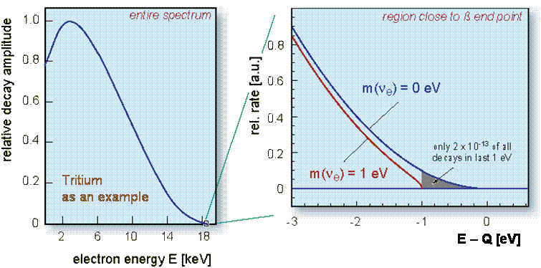
Direct Mass Measurements
Precision measurement of the beta-decay endpoint would show modifications due to non-zero effective neutrino mass.
The current state-of-the-art uses a massive magnetic spectrometer and filter which selects only the electrons closest to the endpoint.

Slide 31
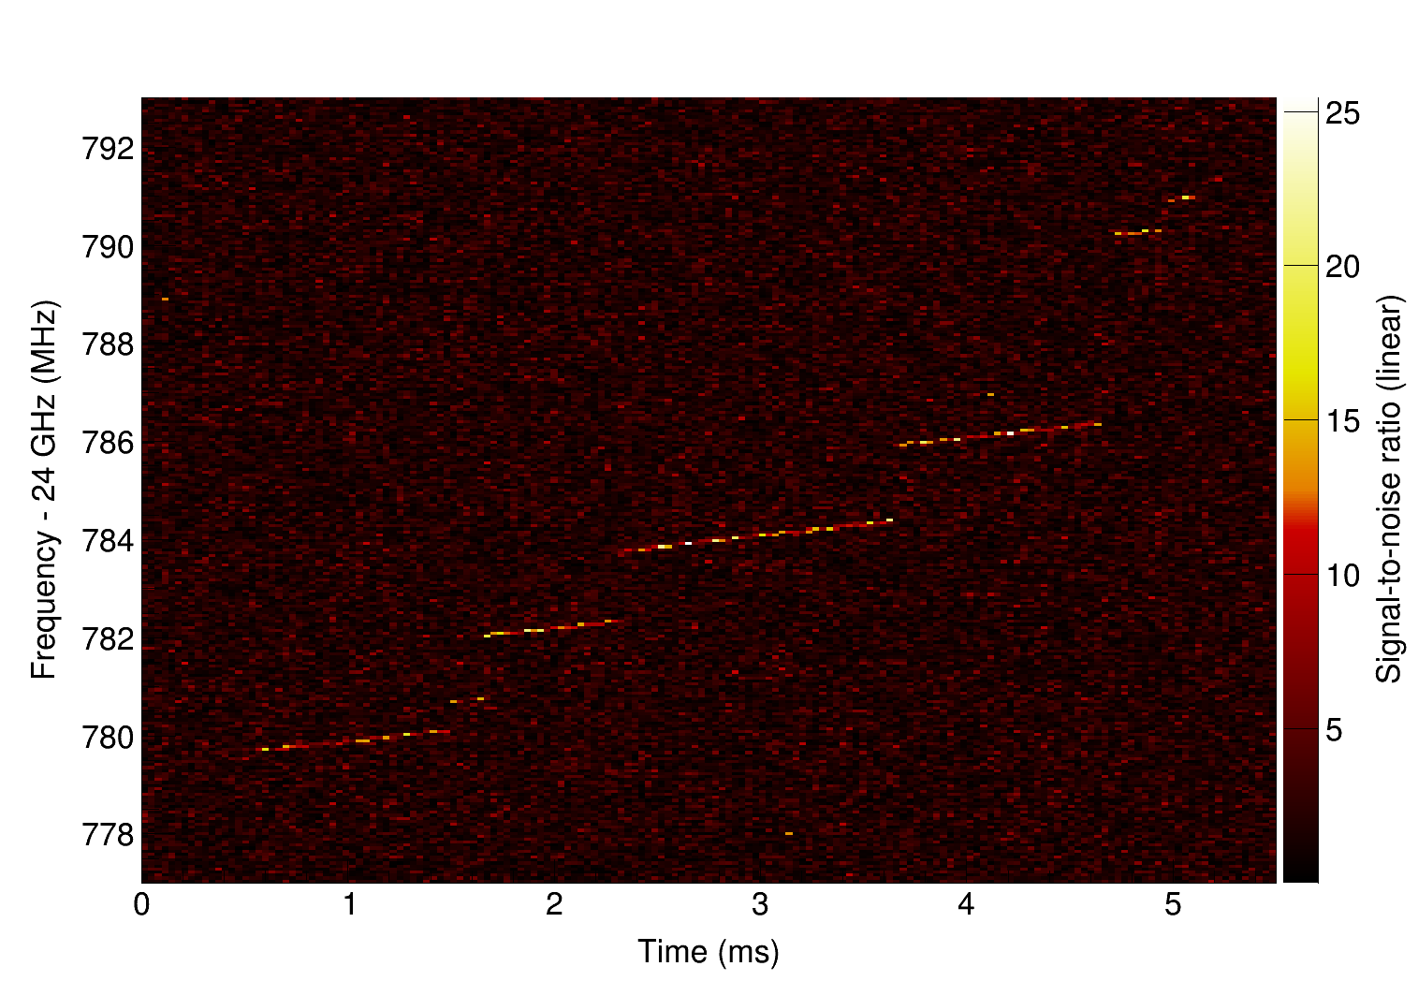
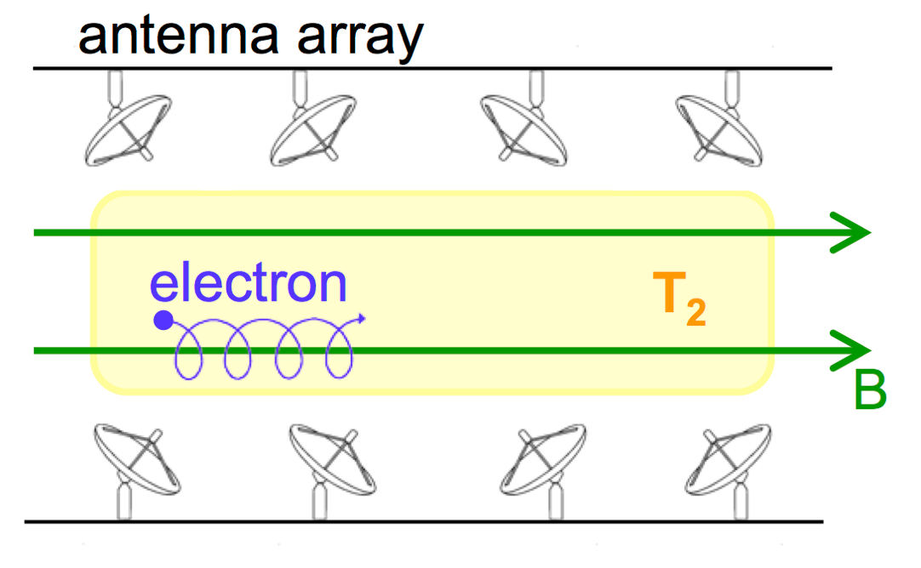
Direct Mass Measurements
The Project 8 concept is to measure the frequency of the cyclotron radiation from individual beta decay electrons
The observed frequency shows continuous energy loss from radiation and jumps in energy from scattering. The initial energy of the beta can be read off from the earliest time.

Slide 32
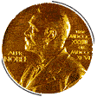
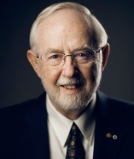
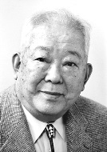
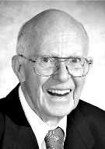
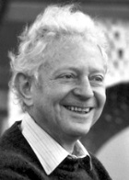
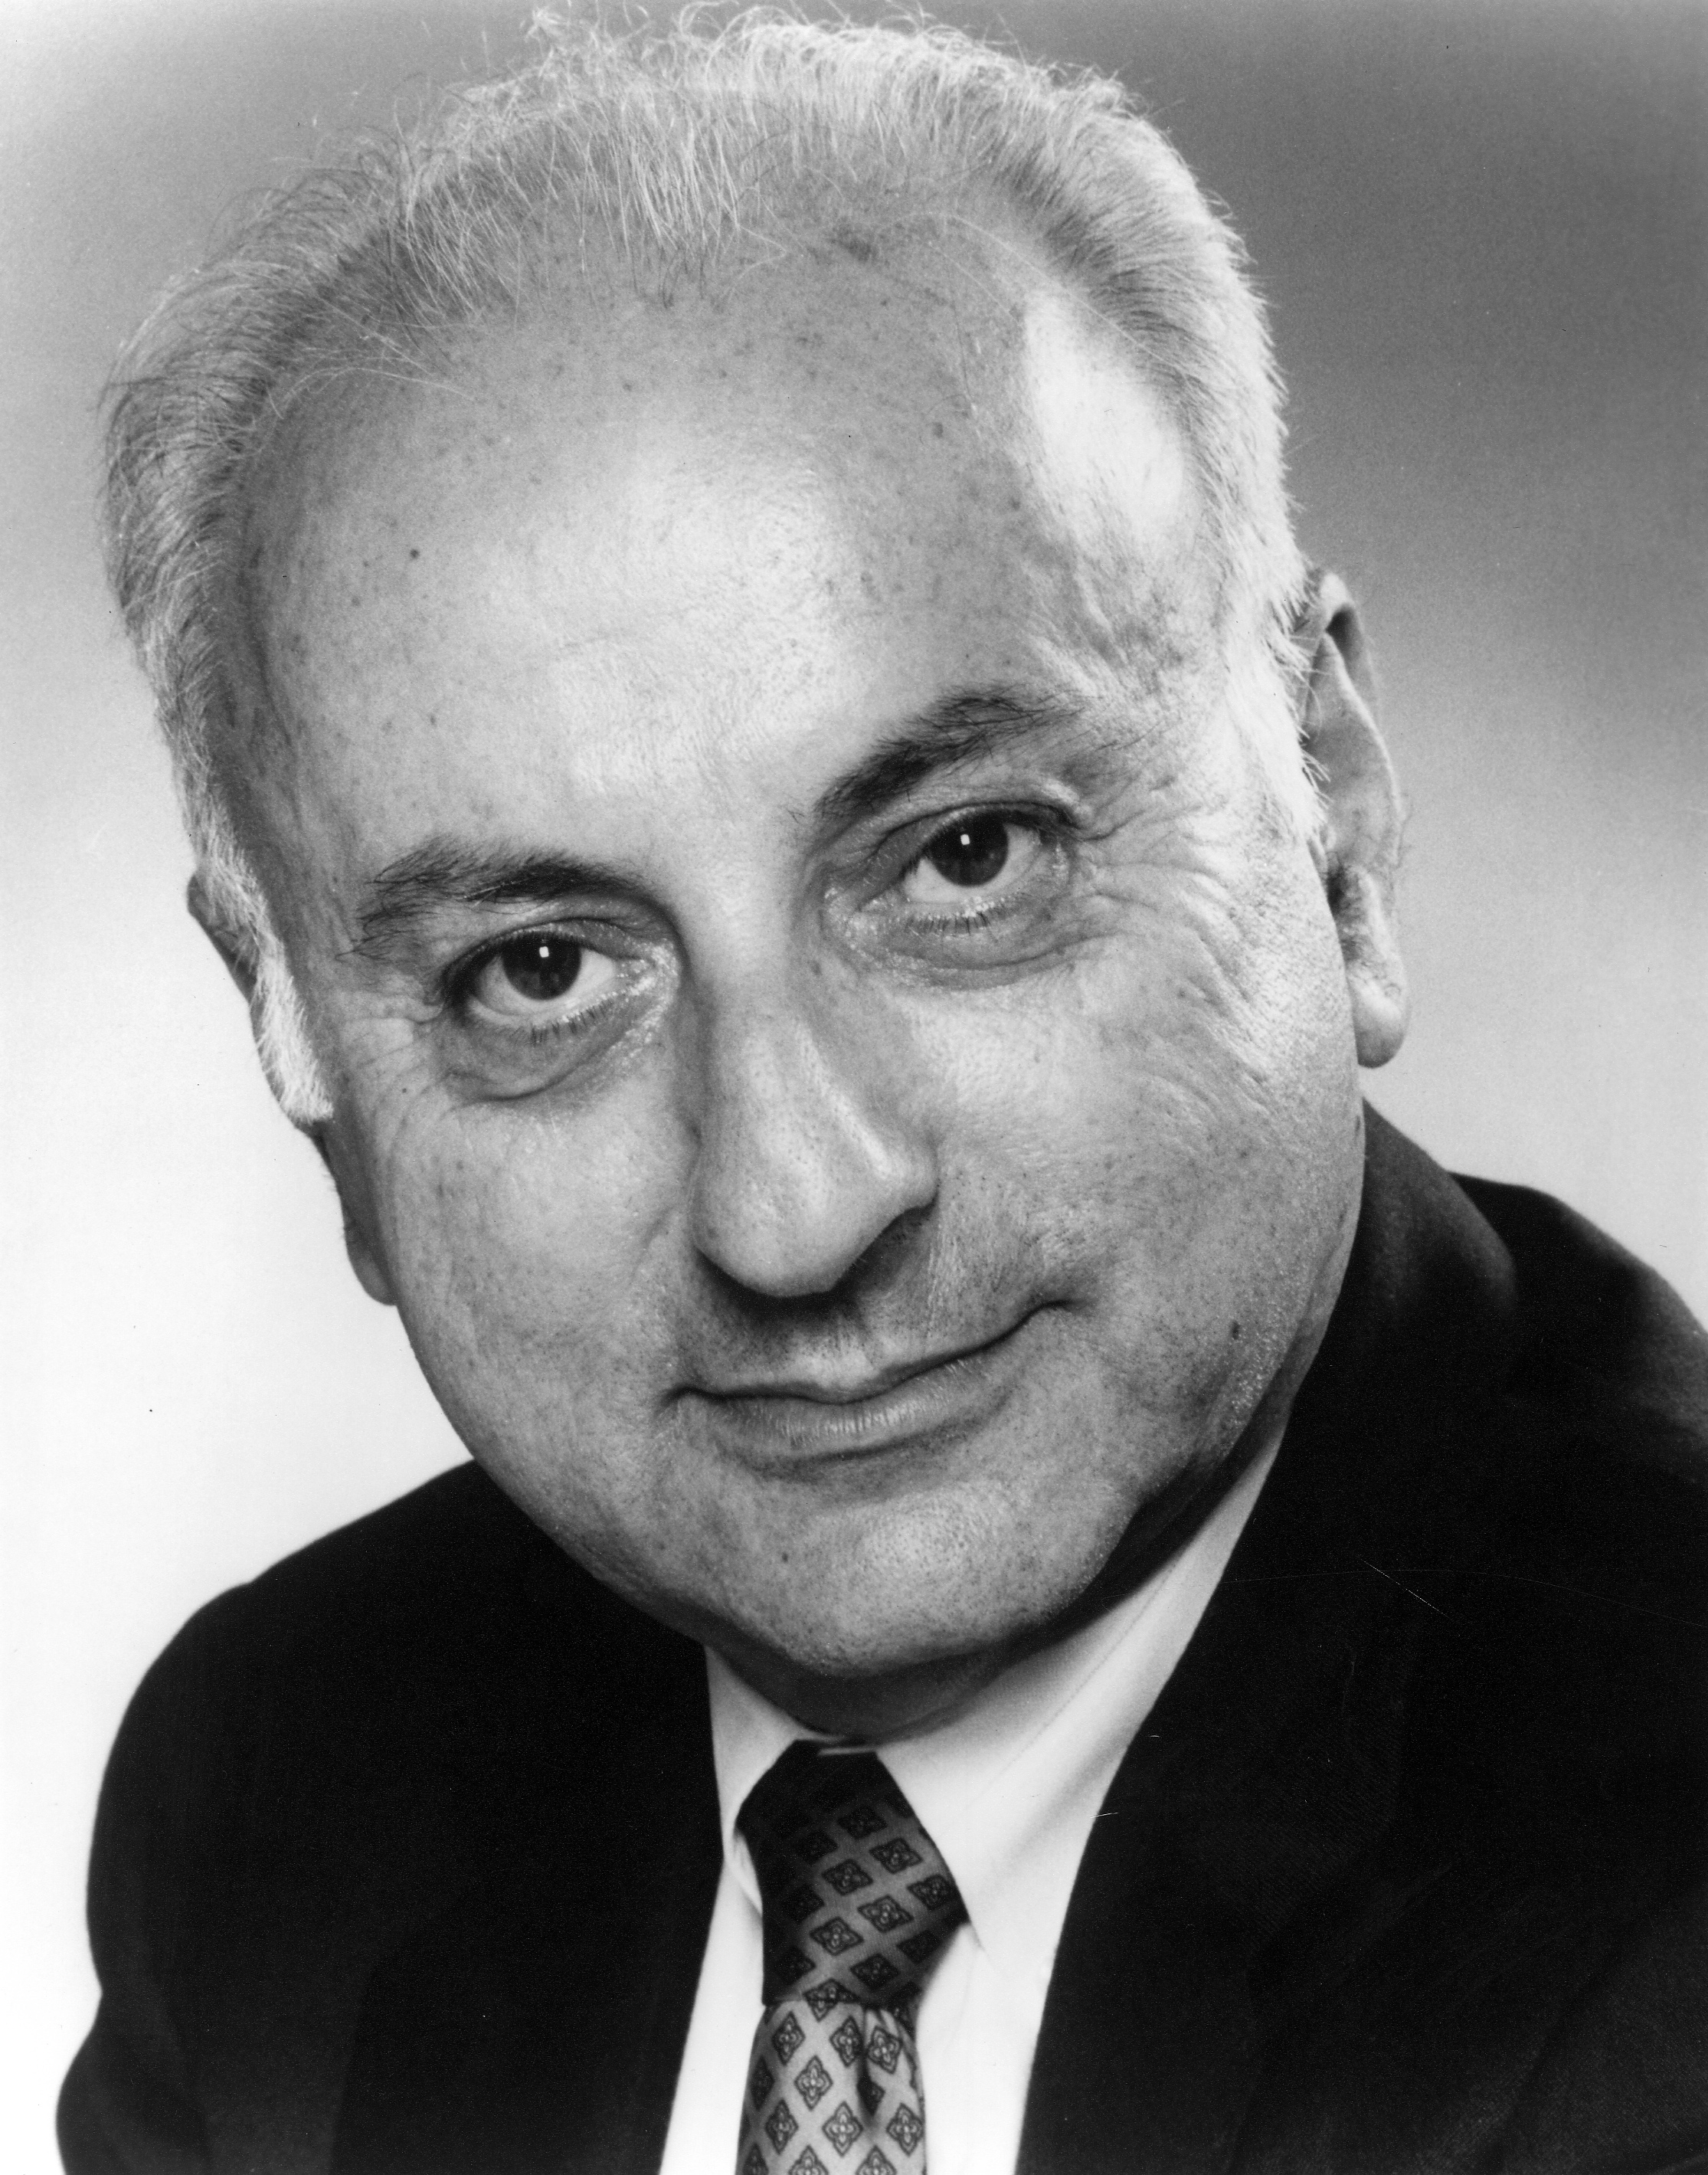
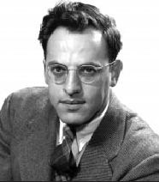
A Brief History of Neutrinos
2012: Daya Bay Reactor Experiment measures the last unknown neutrino mixing angle, θ₁₃.
2002: SNO solves solar neutrino puzzle.
2015
2013: T2K observes ν_{μ}→ν_{e}
McDonald
1998: The Super-K experiment discovers neutrino oscillations, proving that neutrino have mass.
2000: DONuT Experiment at Fermilab discovers the third neutrino (ν_{τ})
2015
Kajita
1993: LSND observed hint of short-baseline oscillations leading to speculation on the existence of sterile neutrinos.
1987: Kamiokande observes neutrinos observed from Supernova 87A.
Koshiba
2002
1968: Ray Davis observes neutrinos from the Sun.
1962: Lederman, Schwartz and Steinberger discover that there are at least two types of neutrino.
Ray Davis
Lederman
Schwartz
Steinberger
1988
1956: Reines and Cowan discover the neutrino at the Savannah River Nuclear Reactor.
2002
Fred Reines
1995
1934: Enrico Fermi Develops a theory of β-decay based on the neutrino.
time
1930: Wolfgang Pauli proposes the neutrino to preserve energy conservation in β-decay.

Slide 33
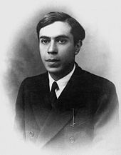
Where’s the Next Nobel Prize Coming From?
Sterile Neutrinos
Direct Mass Measurement
Neutrinoless Double Beta Decay
Extreme Neutrino Astronomy
Cosmic Neutrino Background (CνB)

Slide 36
The Nuances of ν_{μ}→ν_{e} Appearance
Recall, the ν_{e} Disappearance Probability:
P(ν_{e} → ν_{e} ) $=$ sin²2θ₁₃ sin²($∆m_{ee}^{2}$ L/4E)
Appearance Probability (in vacuum):
P(ν_{μ} → ν_{e} ) $≅$ sin²θ₂₃ sin²2θ₁₃sin²($∆m_{μμ}^{2}$ L/4E)
$+$ cos²θ₂₃ sin²2θ₁₂sin²($∆m_{21}^{2}$ L/4E)
$∓$ J sin δ sin($∆m_{μμ}^{2}$ L/4E)
$+$ J cos δ cos($∆m_{μμ}^{2}$ L/4E)
with J $=$ cosθ₂₃ sin2θ₁₂ sin2θ₁₃ sin2θ₂₃ $×$sin($∆m_{μμ}^{2}$ L/4E) sin($∆m_{21}^{2}$ L/4E)
Atmospheric
Solar
CP Violating
Interference Terms

Slide 37
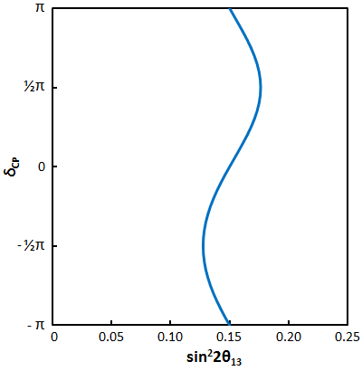
Impact of CP Phase on the Parameters
With a measured appearance rate in a long-baseline experiment, the value of sin²2θ₁₃ is dependent on the CP phase, δ…
±15%

Slide 38
The Nuances of ν_{μ}→ν_{e} Appearance
Recall, the ν_{e} Disappearance Probability:
P(ν_{e} → ν_{e} ) $=$ sin²2θ₁₃ sin²($∆m_{ee}^{2}$ L/4E)
Appearance Probability (in vacuum):
P(ν_{μ} → ν_{e} ) $=$ sin²θ₂₃ sin²2θ₁₃sin²($∆m_{μμ}^{2}$ L/4E)
$+$ cos²θ₂₃ sin²2θ₁₂sin²($∆m_{21}^{2}$ L/4E)
$∓$ J sin δ sin($∆m_{μμ}^{2}$ L/4E)
$+$ J cos δ cos($∆m_{μμ}^{2}$ L/4E)
with J $=$ cosθ₂₃ sin2θ₁₂ sin2θ₁₃ sin2θ₂₃ $×$sin($∆m_{μμ}^{2}$ L/4E) sin($∆m_{21}^{2}$ L/4E)
Atmospheric
Solar
$$ν$$
$$\overline{ν}$$
CP Violating
Interference Terms

Slide 39
Impact of CP Phase on the Parameters
With a measured appearance rate in a long-baseline experiment, the value of sin²2θ₁₃ is dependent on the CP phase, δ…
$$\overline{ν}$$
$$ν$$
$$\overline{ν}$$
$$\overline{ν}$$

Slide 40
Impact of CP Phase on the Parameters
With a measured appearance rate in a long-baseline experiment, the value of sin²2θ₁₃ is dependent on the CP phase, δ…
$$ν$$
Reactor Measurement of sin²2θ₁₃

Slide 41
The Nuances of ν_{μ}→ν_{e} Appearance
Recall, the ν_{e} Disappearance Probability:
P(ν_{e} → ν_{e} ) $=$ sin²2θ₁₃ sin²($∆m_{ee}^{2}$ L/4E)
Appearance Probability (in vacuum):
P(ν_{μ} → ν_{e} ) $=$ sin²θ₂₃ sin²2θ₁₃sin²($∆m_{μμ}^{2}$ L/4E)
$+$ cos²θ₂₃ sin²2θ₁₂sin²($∆m_{21}^{2}$ L/4E)
$∓$ J sin δ sin($∆m_{μμ}^{2}$ L/4E)
$+$ J cos δ cos($∆m_{μμ}^{2}$ L/4E)
with J $=$ cosθ₂₃ sin2θ₁₂ sin2θ₁₃ sin2θ₂₃ $×$sin($∆m_{μμ}^{2}$ L/4E) sin($∆m_{21}^{2}$ L/4E)
The ν_{μ} Disappearance Probability:
P(ν_{μ} → ν_{μ} ) $=$ sin²2θ₂₃ sin²($∆m_{μμ}^{2}$ L/4E)
Atmospheric
Solar
$$ν$$
$$\overline{ν}$$
CP Violating
Interference Terms

Slide 42
The θ₂₃ Octant
When sin²2θ₂₃ is near maximal, a small uncertainty in sin²2θ₂₃ translate into a larger uncertainty in sin²θ₂₃.
1
sin²2θ₂₃
σ
sin²2θ₂₃
sin² function
σ
sin²θ₂₃
sin²θ₂₃
σ_{2θ}
σ_{θ}
0
θ
45º
θ
2θ
90º
2θ

Slide 43
Impact of the θ₂₃ Octant
With a measured appearance rate in a long-baseline experiment, the value of sin²2θ₁₃ is dependent on δ and the octant of θ₂₃…
Reactor Measurement of sin²2θ₁₃

Slide 44
Matter Effects and Mass Hierarchy
The forward scattering of neutrinos on electrons in matter adds to the effective mass of the neutrino and therefore impacts the oscillation.
With the electron densities in the Earth, these effects are larger for higher energy neutrinos over longer baselines.
JHEP 0110, 001 (2001)
Inverted
Normal

Slide 45
Direct Measurements of the Mass Hierarchy
With a precision reactor experiment, the difference between $∆m_{31}^{2}$ and $∆m_{32}^{2}$ can be directly measured.
Phys.Rev. D 78, 071302(R) (2008)
Fourier Power Spectrum
Reactor Neutrino IBD Spectrum
Inverted
Normal
With
Oscillations
at 50 km baseline
See JUNO talk by Yueken Heng

Slide 46
ν_{e} Appearance & Fermilab Short-Baseline
 | Baseline | Mass
SBND | 110 m | 112 t
MicroBooNE | 470 m | 89 t
ICARUS | 600 m | 476 t
The anticipated program has liquid argon TPCs at there three baselines in the Booster Neutrino Beam.
The program may be able to discover or rule out ν_{μ} →ν_{e} appearance, but it will say nothing about disappearance.
10

