Slide 1
Status of CEPC-SPPC
Yifang Wang
Institute of High Energy Physics, Beijing
UCAS, July 24, 2016

Slide 2
Outline
Science
Accelerator Design
Detector Design
Site selection and Civil design
Funding requests and R&D Lists
Organization
Summary

Slide 3
Science

Slide 4
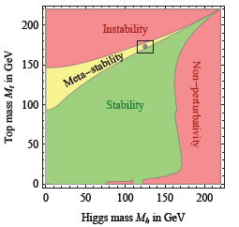
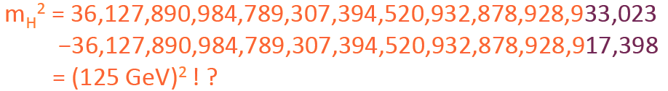
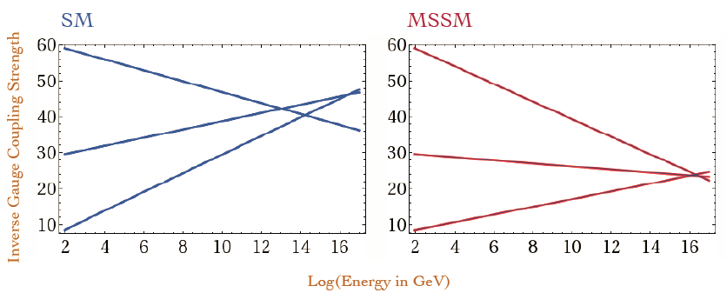
SM is not the End after the Higgs
From neutrinos to top quark, masses differs by a factor 10¹³ (Hierarchy)
Fine tuning of Higgs mass(naturalness)
Masses of Higgs and top quark are in the meta-stable region
Unification at a high energy ?
Dark matter particles ?
No CP in the SM to explain
Matter-antimatter asymmetry
Most of the issues related to Higgs

Slide 5
A Key Step: Higgs Factory
Thanks to the low mass Higgs, it is possible to build a Circular Higgs Factory(CEPC), followed by a proton collider(SppC) in the same tunnel
Looking for Hints (from Higgs) ➔ direct searches
e+
IP1
e-
LTB
High Energy Booster(7.2Km)
Medium Energy Booster(4.5Km)
e+ e- Linac
(240m)
BTC
BTC
Low Energy Booster(0.4Km)
Proton Linac
(100m)
IP4
IP3
Booster(50Km)
CEPC Collider Ring(50Km)
IP2
SppC Collider Ring(50Km)

Slide 6
Science of CEPC-SPPC
Electron-positron collider(90, 250 GeV)
  Higgs Factory（10⁶ Higgs）:
    Precision study of Higgs(m_{H}, J^{PC}, couplings)，Similar & complementary to ILC
    Looking for hints of new physics
  Z & W factory（10¹⁰ Z⁰）:
    precision test of SM
    Rare decays ?
  Flavor factory: b, c, τ and QCD studies
Proton-proton collider(~100 TeV)
  Directly search for new physics beyond SM
  Precision test of SM
    e.g., h³ & h⁴ couplings
Precision measurement + searches:
Complementary with each other !

Slide 7


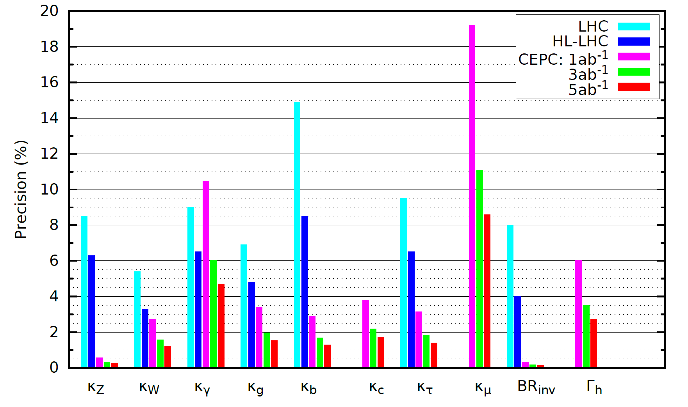
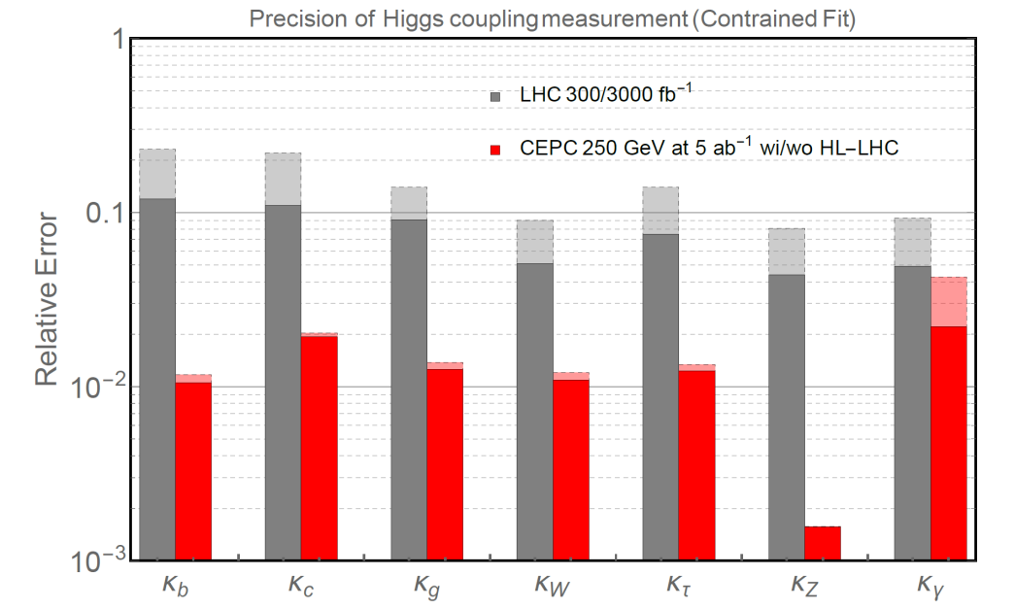
Precision Higgs Physics by CEPC
% precision ➔ M ~ 1 TeV
to new physics ➔ ~ × 10 over LHC
CEPC preCDR Volume 1 (p.9)

Slide 8
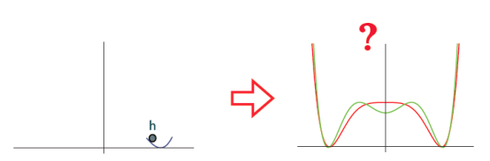
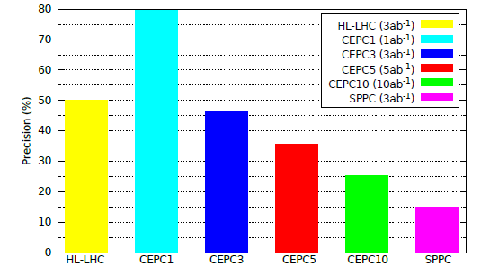
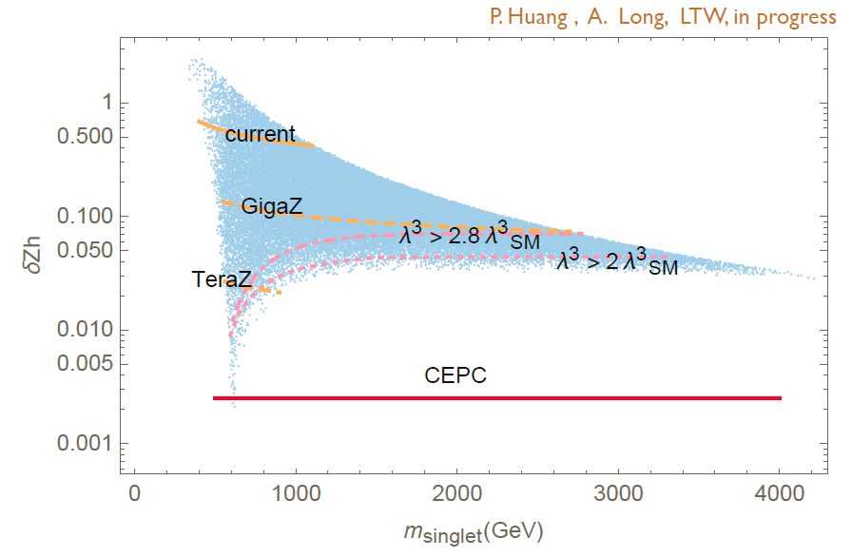
Nature of EW Phase Transition ?
1st or 2nd order ➔ Huge implications
  O(1) deviations in h³ coupling
  O(1%) shift in h-Z coupling
CEPC can determine it:
  h³ coupling at CEPC： 20-30%
  h-Z coupling at CEPC： < 0.2%
M. McCullough, PRD 90(2014)015001

Slide 9
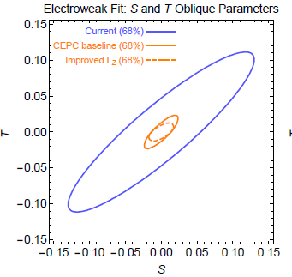
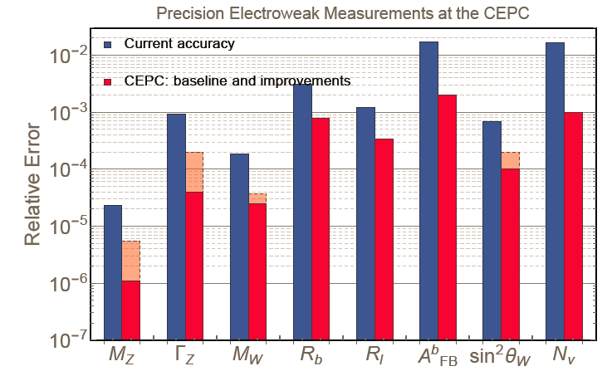
Improvement in Electroweak Precision
CEPC preCDR Volume 1 (p.10)

Slide 10
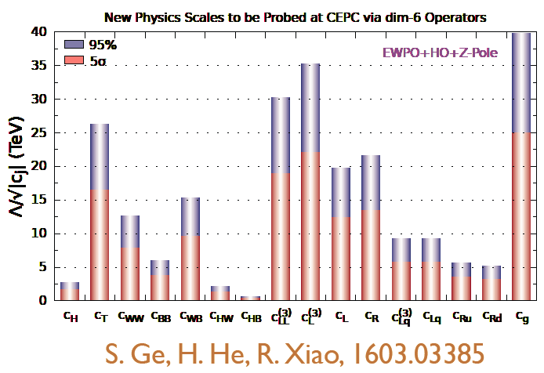
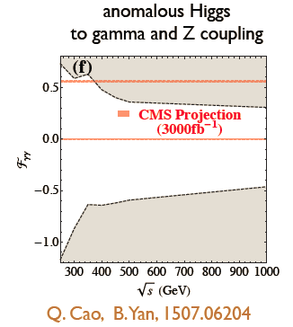
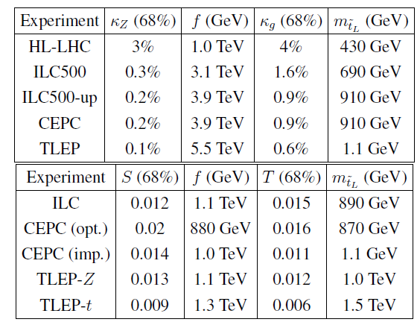
Probing New Physics(I)
Into the Multi-TeV regime

Slide 11
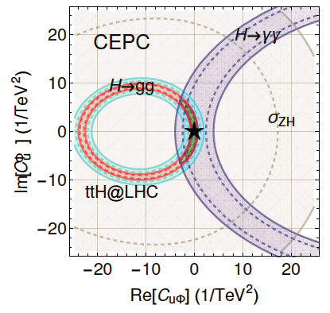
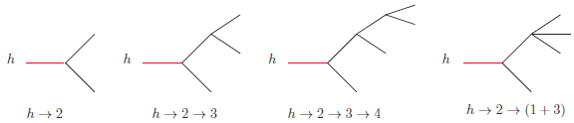

Probing New Physics(II)
A likely window to new physics through top and Higgs
  Both are special
  Important for the vacuum stability & EWSB
Higgs couplings to the dark sector through BR_{inv}

Slide 12
Time Window
CPEC
  Pre-study, R&D and preparation work
    Pre-study: 2013-15
      Pre-CDR for R&D funding request
    R&D: 2016-2020
    Engineering Design: 2015-2020
  Construction: 2021-2027
  Data taking: 2028-2035
SppC
  Pre-study, R&D and preparation work
    Pre-study: 2013-2020
    R&D: 2020-2030
    Engineering Design: 2030-2035
  Construction: 2035-2042
  Data taking: 2042 -

Slide 13
Accelerator Design
  J. Gao, talk given at PASCOS and XIIth Rencontres du Vietnam, Quy Nhon, Vietnam, July 10-16, 2016

Slide 14
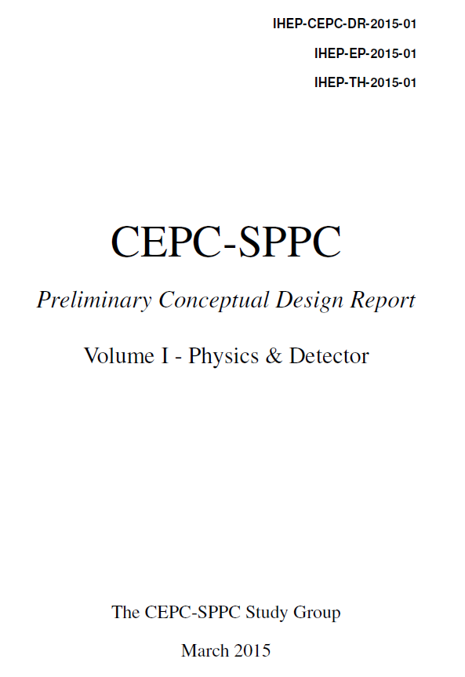
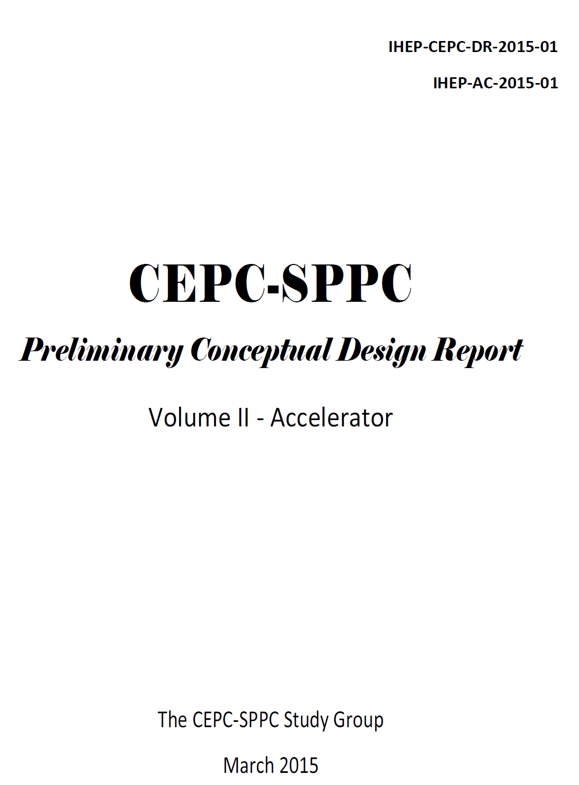
Can be downloaded from
http://cepc.ihep.ac.cn/preCDR/volume.html
403 pages, 480 authors
328 pages, 300 authors

Slide 15
CEPC Accelerator
Energy Ramp
10 ->120GeV
6~10 GeV
Electron
Linac
Booster
Positron
3 machines in one tunnel
  CEPC & booster
  SppC
Main choice of CEPC:
  One ring machine
  Head-on collision
Collision ring
45/120 GeV

Slide 16
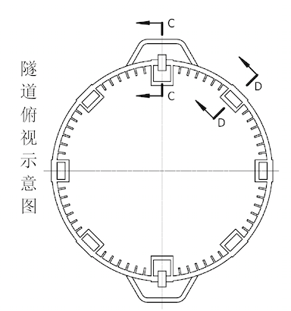
Compatibility: The Key Issue
CEPC Injector
SPPC injector
Beam pipe detour for detectors
  CEPC booster avoid storage ring
  CEPC avoid SPPC detectors
  SPPC avoid CEPC detectors
SR beamlines
Predict what SPPC needs
  Collimators
  Straight sections
  Tunnel dimensions
  Access tunnel
  ….
To be fully understood in the next 5 years

Slide 17
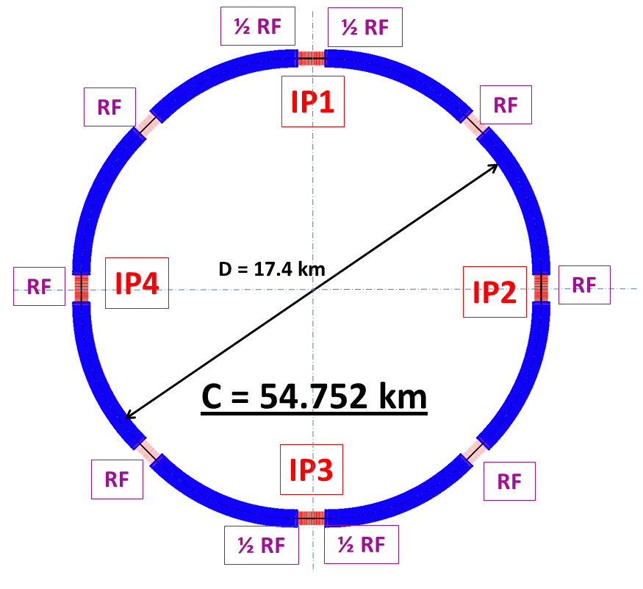
CEPC Design
Critical parameters:
  SR power: 51.7 MW/beam
  8*arcs, 2*IPs
  8 RF cavity sections (distributed)
  RF Frequency: 650 MHz
  Filling factor of the ring: ~70%
Parameter | Unit | Value | Parameter | Unit | Value
Beam energy [E] | GeV | 120 | Circumference [C] | m | 54752
Number of IP[N_{IP}] |  | 2 | SR loss/turn [U₀] | GeV | 3.11
Bunch number/beam[n_{B}] |  | 50 | Energy acceptance RF [h] | % | 5.99
SR power/beam [P] | MW | 51.7 | Beam current [I] | mA | 16.6
emittance (x/y) | nm | 6.12/0.018 | β_{IP}(x/y) | mm | 800/1.2
Transverse size (x/y) | μm | 69.97/0.15 | Luminosity /IP[L] | cm⁻²s⁻¹ | 2.04E+34

Slide 18
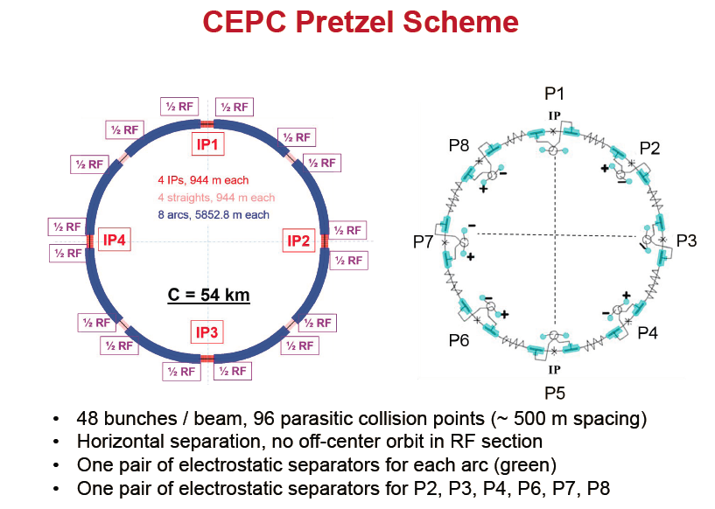

Slide 19
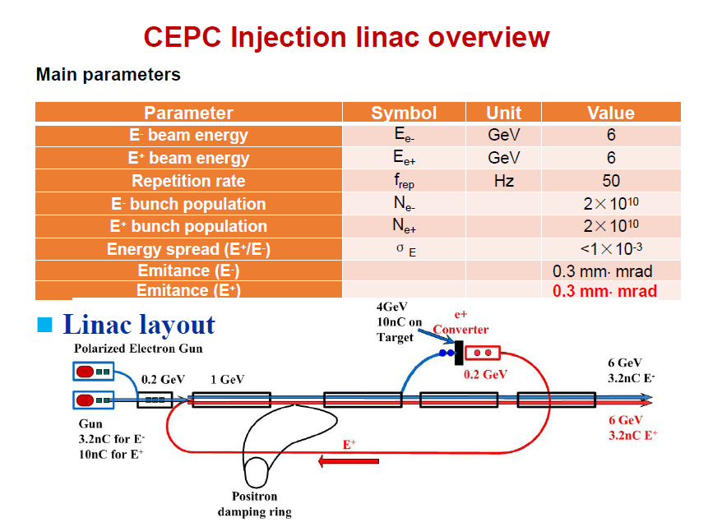

Slide 20
Main Problems left in Pre-CDR
Pretzel scheme is difficult to design and operate, with little flexibility and stability
Too high AC power consumption (~ 500 MW)
Very low luminosity for Z
Booster with very too low magnetic field (30 Gauss for 6GeV injection in a background field of 3 Gauss, say in the BEPCII tunnel) and too small dynamic aperture
Very small Dynamic Aperture at 2% energy spread with beam-beam effects and magnetic errors
Goal of CEPC CDR: a "design" working on paper

Slide 21
New Idea: Partial Double Ring
1/2RF
1/2RF
Crossing Angle: 30 mrad
1/2RF
1/2RF
IP1_ee
1/2RF
1/2RF
3Km
1/2RF
Advantage(first 3 problems):
Avoid pretzel orbit
Cost less than whole double-ring
More bunches for high luminosity Z, W
High luminosity with crab waist
1/2RF
1/2RF
1/2RF
1/2RF
1/2RF
1/2RF
IP3_ee
1/2RF
1/2RF
1/2RF

Slide 22
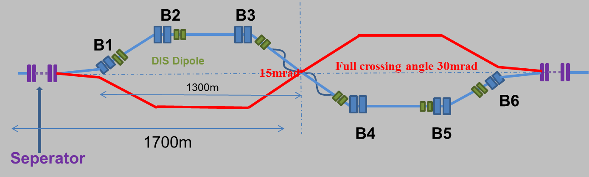
Partial Double Ring Lattice
FFS orbit

Slide 23
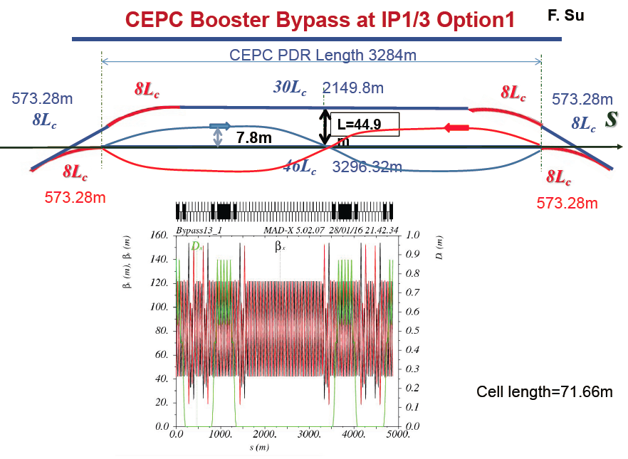

Slide 24
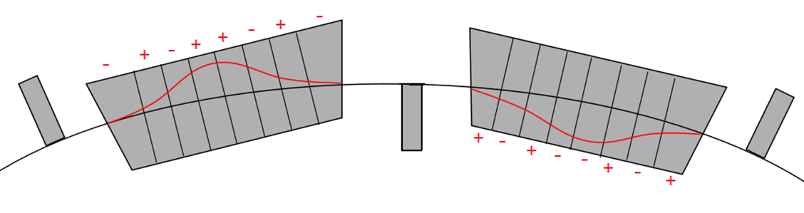
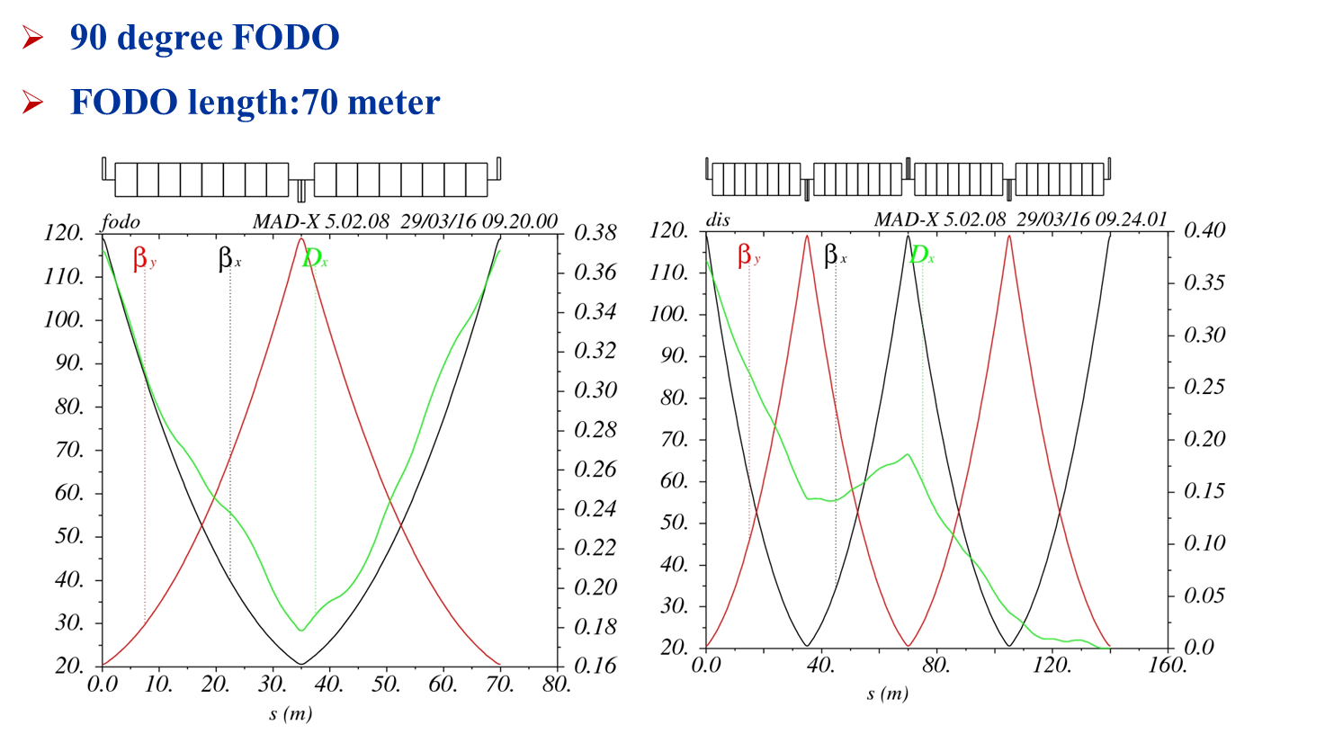
CEPC Booster Design
1) Normal Low field Bend Scheme
2) Wiggling Bend Scheme
Solution to the 4th problem

Slide 25
Parameters of Partial Double Ring
 | Pre-CDR | H-high lumi. |  | H-low power |  | Z
Number of IPs | 2 | 2 |  | 2 |  | 2
Energy (GeV) | 120 | 120 |  | 120 |  | 45.5
Circumference (km) | 54 | 54 |  | 54 |  | 54
SR loss/turn (GeV) | 3.1 | 2.96 |  | 2.96 |  | 0.062
Half crossing angle (mrad) | 0 | 14.5 | 15 | 11.5 | 15 | 15
Bunch number | 50 | 50 | 67 | 40 | 44 | 1100
Beam current (mA) | 16.6 | 16.9 | 16.9 | 10.1 | 10.5 | 45.4
SR power /beam (MW) | 51.7 | 50 | 50 | 30 | 31.2 | 2.8
Energy spread (%) | 0.13 | 0.13 | 0.13 | 0.13 | 0.13 | 0.05
Energy acceptance (%) | 2 | 2 | 2 | 2 | 2
Life time due to beamstrahlung (minute) | 47 | 53 | 36 | 41 | 32
F (hour glass) | 0.68 | 0.73 | 0.82 | 0.69 | 0.81 | 0.95
L_{max}/IP (10³⁴cm⁻²s⁻¹) | 2.04 | 2.97 | 2.96 | 2.03 | 2.01 | 3.61

Slide 26
SRF Parameters for PDR
 | H_Pre-CDR | H_PDR | Z_PDR
Beam energy (GeV) | 120 | 120 | 45.5
Luminosity L (cm⁻²s⁻¹) | 2E34 | 2.9E34 | 3.6E34
SR power per beam (MW) | 50 | 50 | 2.8
SR loss / turn U₀ (GeV) | 3.11 | 2.96 | 0.062
Bunch charge q (nC) | 60.74 | 45.41 | 7.37
Beam current I (mA) | 2 x 16.62 | 285 (pulse) | 760 (pulse)
Bunch train length (μs) | 180.1 (rev. time) | 10.7 | 10.7
No. of bunches per train | 48 | 67 | 1100
Bunch space in train (ns) | / | 160 | 9.7
Cavity voltage V_{c} (MV) | 17.9 | 9.4 | 3.8
RF power per cavity | 263 kW | 260 kW (aver.) 2.2 MW (pulse) | 175 kW (aver.) 1.5 MW (pulse)
Fundamental mode (FM) Q_{L} | 2.28E6 | 7.87E4 | 4.63E4
Cavity filling time (μs) | 1117 | 39 | 23
HOM power per cavity (kW) | 3.6 | 2.2 | 1
Main ring RF system: 5-cell 650 MHZ, Q₀ > 4.0E10@2K
Booster RF system: 5-cell 1.3GHZ, Q₀ > 2.0E10@2K

Slide 27
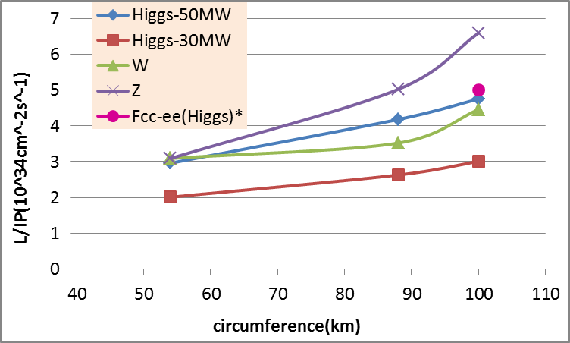
Partial Double Ring Luminosity
* Fabiola Gianotti, Future Circular ColliderDesign Study, ICFA meeting, J-PARC, 25-2-2016.

Slide 28
Key Remaining Issue
Beam physics: Dynamic aperture
Arc sextupole: 2 groups
Crab sextupoles - off
After chromaticity correction
DA (on-momentum): 27σ_{x} × 57σ_{y}
DA (±0.5%): 2σ_{x} × 2σ_{y}

Slide 29
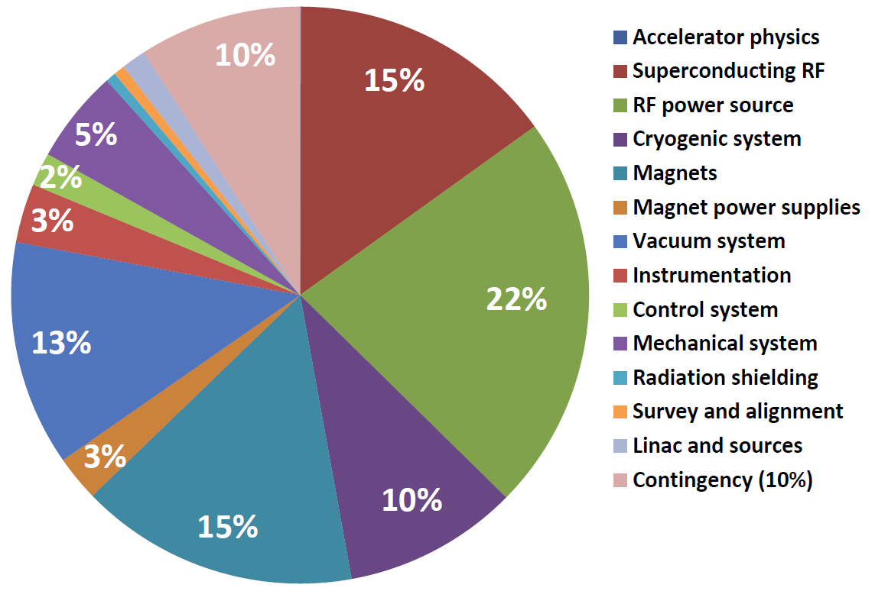
Technical Systems and their Relative Cost
10%
4%
26%
2.4%
10%
2%
12%
19%
12%
R&D needed
W. Chou
29

Slide 30
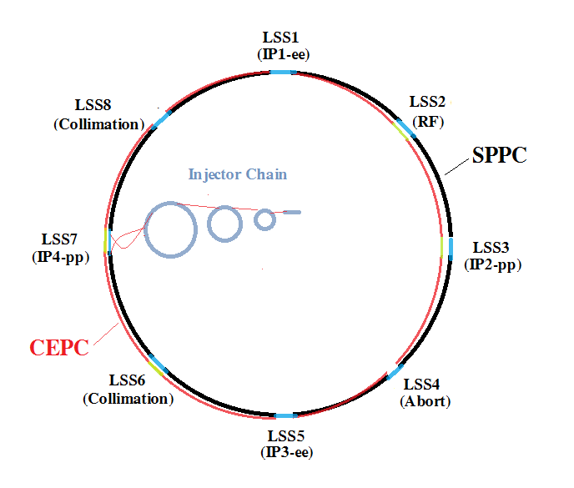
SppC General design
Parameter | Value
Circumference | 54.36 km
Beam energy | 35.3 TeV
Dipole field | 20 T
Injection energy | 2.1 TeV
Number of IPs | 2 (4)
Peak luminosity per IP | 1.2E+35 cm⁻²s⁻¹
Beta function at collision | 0.75 m
Circulating beam current | 1.0 A
Max beam-beam tune shift per IP | 0.006
Bunch separation | 25 ns
Bunch population | 2.0E+11
SR heat load @arc dipole (per aperture) | 56.9 W/m
8 arcs (5.9 km) and long straight sections (850m*4+1038.4m*4)

Slide 31
Detector Design
Y.N. Gao, talk given at “IAS conference on HEP”, Hong Kong, Jan.18-21, 2016

Slide 32
Detector Baseline Design in PreCDR
Tasks for a baseline design
- a detector concept could work for CEPC
- at the same time explore the physics potentials
ILC detectors, especially ILD as a reference
- state of the art detector, maximize the potential of
the (rather expensive) machine
- (hopefully) less technology challenges than ILD
- take advantages from world-wide studies
- sharing future critical R&D with ILC community

Slide 33
Performance requirements of ILC detectors
Vertexing
  ~1/5 r_{beampipe},~1/30 pixel size (wrt LHC)
Tracking
  ~1/6 material, ~1/10 resolution (wrt LHC)
Jet energy (Higgs self-coupling, W/Z separation)
  ~1/2 resolution (wrt LHC)
✔ CEPC
or better
✔ CEPC
less demanding
at CEPC

Slide 34
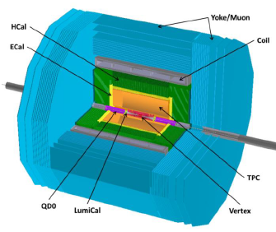
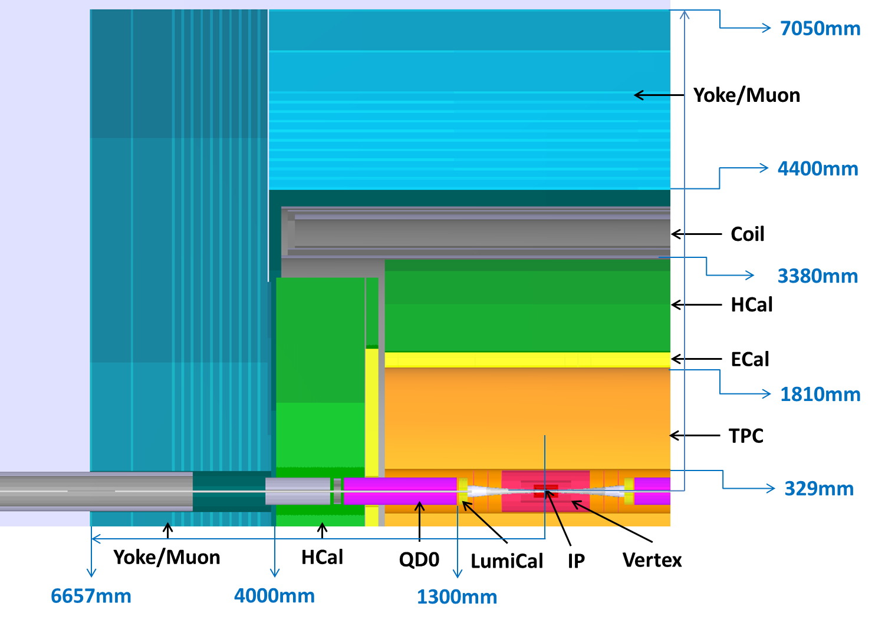
Key differences from ILC
- No push-and-pull → Less Yoke
- Shorter L*=1.5m → Challenges for MDI
- Power pulsing not possible → less power consumption
+ active cooling
(http://cepc.ihep.ac.cn/preCDR/volume.html)

Slide 35
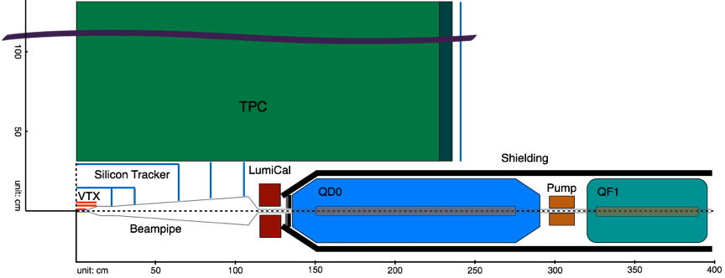
Interaction region layout
Short focal length of L* = 1.5 m (cf. ~3.5m at ILC)
Final focusing magnets inside the detector →→ constraints on the detector design + QD0/QF1 design
- No. of FTD’s reduced to 5 ( cf. 7 for ILD )
- redesign of offline/online luminosity instrumentation
- design of QD0/QF1

Slide 36
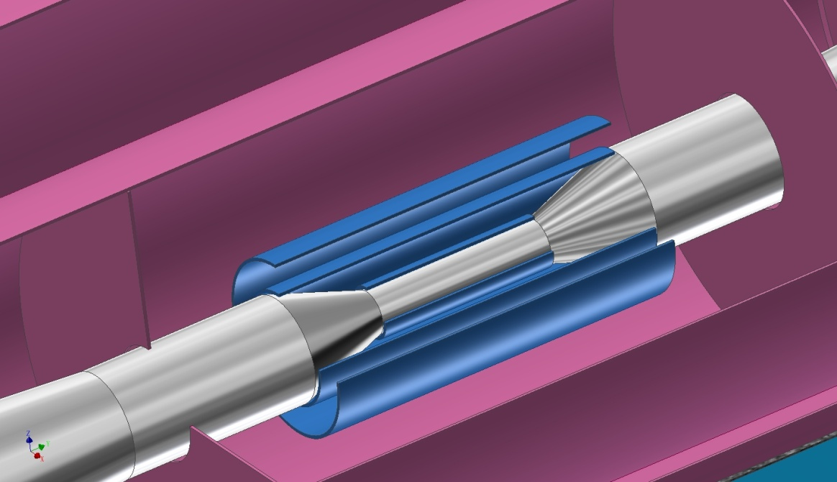
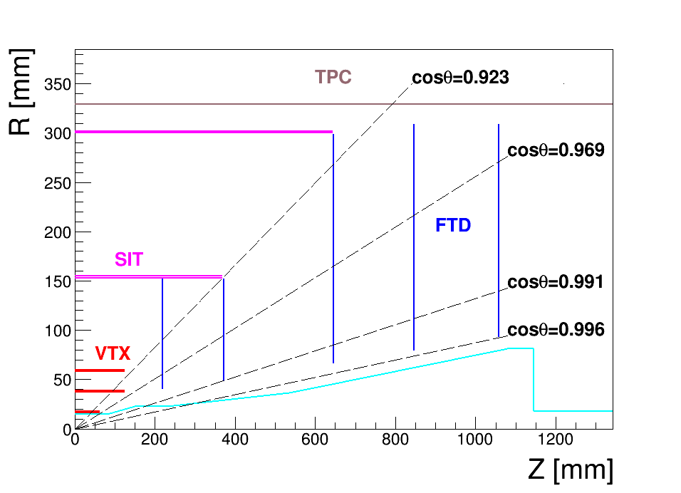
Vertex Detector and Silicon Trackers
Vertex detector：
3 cylindrical and concentric double-layers of pixels
Silicon Internal Tracker (SIT)
2 inner layers Si strip detectors
Forward Tracking Detector (FTD)
5 disks (2 with pixels and 3 with Si strip sensor) on each side
Silicon External Tracker (SET)
1 outer layer Si strip detector
End-cap Tracking Detector (ETD)
1 end-cap Si strip detector on each side

Slide 37
Technology options
Pixel sensor: power consumption < 50mW/cm² , if only air cooling used (CLIC study)
readout time ≤ 20μs
HR-CMOS sensor with a novel readout structure ─ALPIDE for ALICE ITS Upgrade
  relatively mature technology
  <50mW/cm² expected
  Capable of readout every ~4μs
SOI sensor with similar readout structure
  Fully depleted HR substrate, potential of 15μm pixel size design
  Full CMOS circuit
DEPFET: possible application for inner most vertex layer
  small material budget, low power consumption in sensitive area
Silicon micro strip sensor: p⁺-on-n technology
pixelated strip sensors based on CMOS technologies

Slide 38
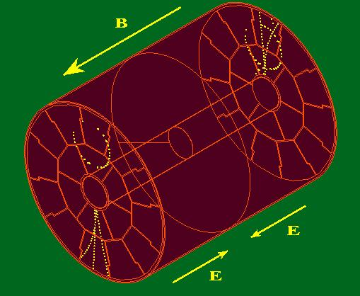
TPC Design

Slide 39
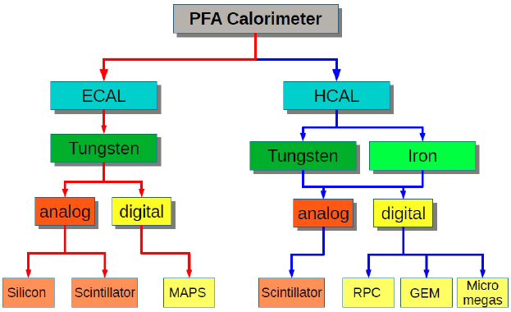

Calorimeter
Concept of Particle Flow Algorithm
-> calorimeters with very fine granularity
The calorimetry system at CEPC should be allowed to consider:
- easier (less challenging) options
- cost effective
- active cooling
Absorber :
Readout:
Active:

Slide 40
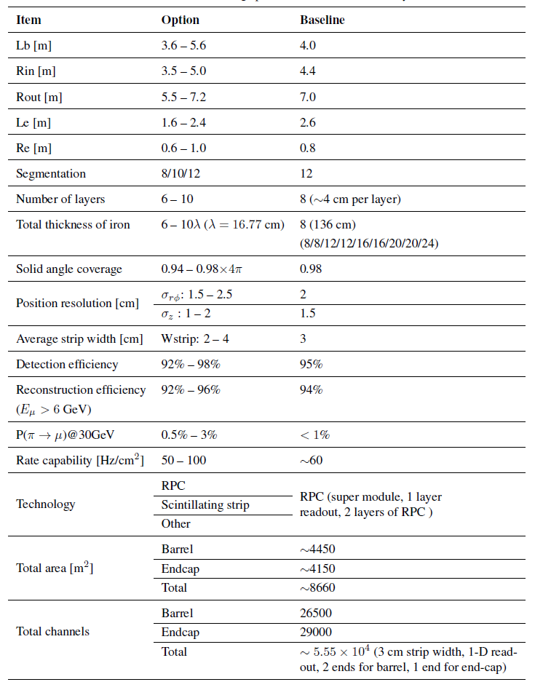
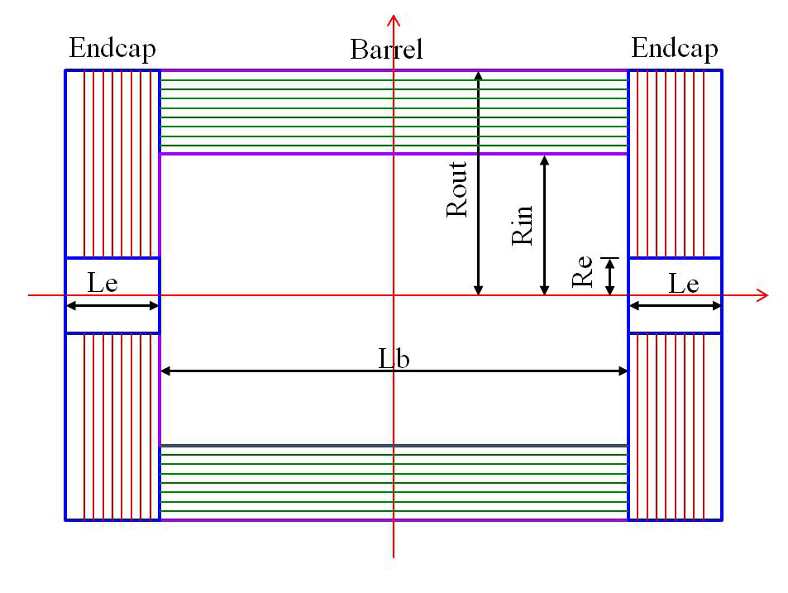
MUON System
Outside of the HCAL
- a cylindrical barrel + two endcaps
- Solid angle coverage 0.98 x 4π
Options
- RPC (bakelite RPC / glass RPC)
- Scintillator strip (WLS+SiPM)

Slide 41
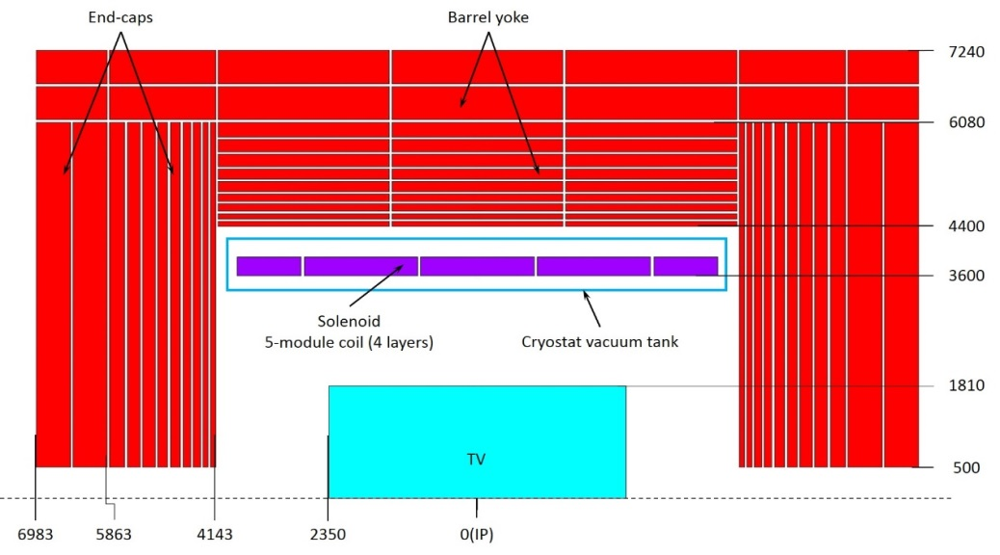
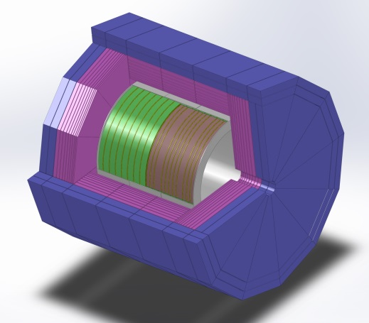
Magnet
A new design for baseline detector at CEPC
Cryostat inner radius(mm) | 3400 | Barrel yoke outer radius(mm) | 7240
Cryostat outer radius(mm) | 4250 | Yoke overall length(mm) | 13966
Cryostat length(mm) | 8050 | Barrel weight(t) | 5775
Cold mass weight(t) | 165 | End cap weight(t) | 6425
Barrel yoke inner radius(mm) | 4400 | Total yoke weight(t) | 12200

Slide 42
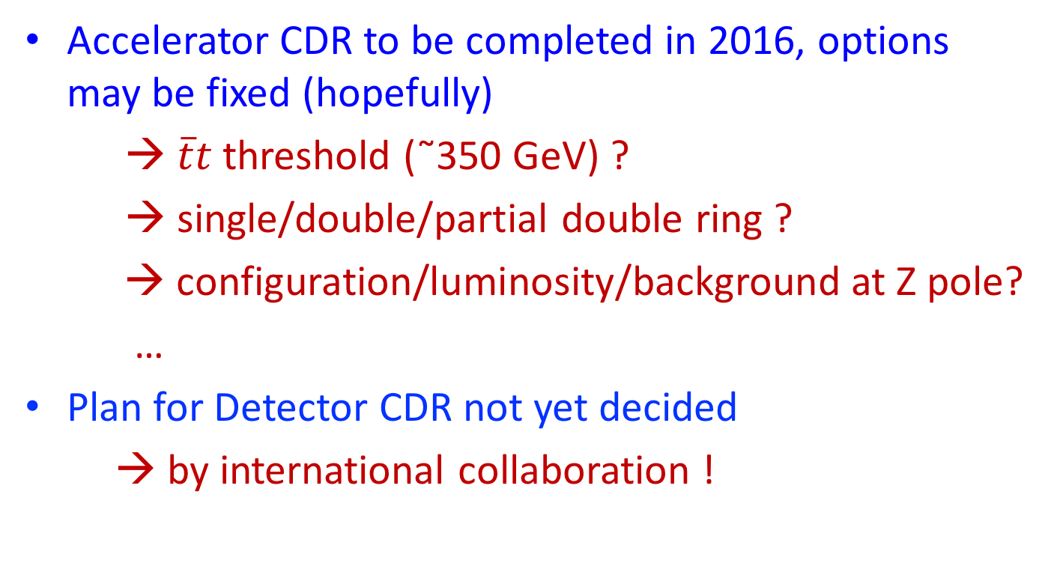
From PreCDR to CDR
Accelerator CDR to be completed in 2016, options may be fixed (hopefully)
→ $\overline{t}t$threshold (˜350 GeV) ?
→ single/double/partial double ring ?
→ configuration/luminosity/background at Z pole?
…
Plan for Detector CDR not yet decided
→ by international collaboration !

Slide 43
Tasks for CDR studies
Optimization based on the CEPC design (Acc. CDR)
Study items not covered in PreCDR
Explore new ideas/technologies
→ 2+ detector concepts for CEPC CDR
Critical R&D’s

Slide 44
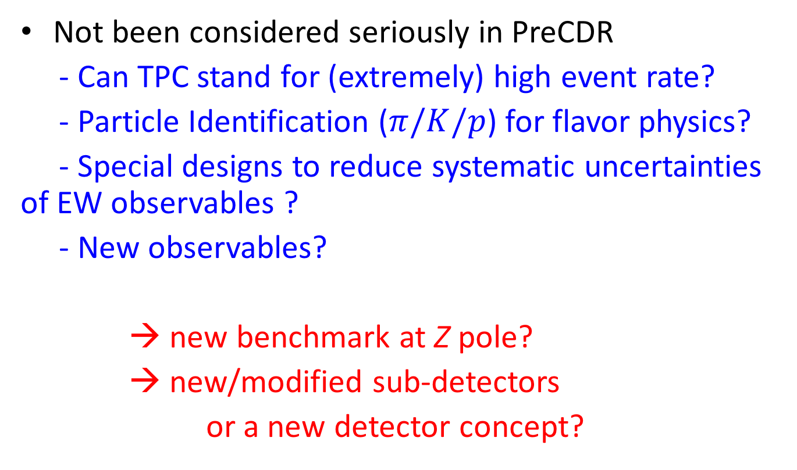
Task 0: Physics at Z-pole
Not been considered seriously in PreCDR
- Can TPC stand for (extremely) high event rate?
- Particle Identification ($π/K/p$) for flavor physics?
- Special designs to reduce systematic uncertainties of EW observables ?
- New observables?
→ new benchmark at Z pole?
→ new/modified sub-detectors
or a new detector concept?

Slide 45
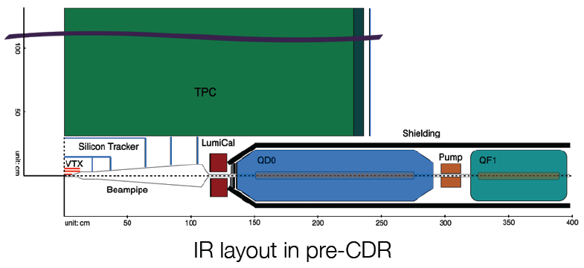
Task 1: MDI
Related to the accelerator design
- single/ (partial) double ring – crossing angle?
- L*=1.5m is good enough?
- beam & background
- QD0 & QD1
Detector design
- Luminosity monitor
- VTX and FTD’s
- inner radius of TPC
- uniformity of B-field in tracking area
- ….

Slide 46
Task 2: VTX
Critical R&D’s for the baseline design
”fit 1 GigaPixel in a Diet Coke can & keep it cool!”
-- Massimo Caccia
New ideas
→ detailed R&D plan
milestones?
joint efforts with other projects, ATLAS upgrade?

Slide 47
Task 3: Main Tracker
Challenges for TPC
- ion feedback – can TPC stands for Z pole
- detector alignment
- …
With TPC (ILD)
or full silicon tracker (SiD)
or hybrid
Large area silicon detector (even with the TPC option)
Other ideas?

Slide 48
Critical R&D with LCTPC
LCTPC Collaboration has identified some critical R&D’s
Field distortion near boundaries
  Insulator surface facing drift volume should be removed; Avoid charge up effects in GEM detector
  Electric field distortion near module boundaries should be shaped away
High B-field performance
  Is Neff at B=3.5T the same as at B=1T?
  Is electron attachment by CF4 in amplification region negligible?
  Tracking in non-uniform B-field: ExB and deviation from helix
Positive ions and Gate
  Develop ion gate: transparency, distortion, ion leak
  Is primary positive ion effect really negligible? (effects of heavy micro-curlers?)
  Establish distortion correction method
Resolution near endcaps
  Hodoscope effect?
  Angular effect? (primary ionization statistics)
Neutron BG
  Is gas mixture with a hydrocarbon molecule such as iso-C4H10 OK?
P/T control of gas volume
  2P CO₂ cooling of the whole gas volume?
From K. Fujii

Slide 49
Task 4: Refine the requirements for calorimeters
Jet energy resolution is less demanding for CEPC
Power pulsing is not possible at CEPC
→ new performance requirement to be defined
→ large cell, less channels
new design, new technologies?
active cooling?
→ plan & milestones?

Slide 50
More questions/tasks
Superconducting magnet
Readout electronics for all sub-detectors?
Software, computing?
Need a muon detector?
…

Slide 51
Near future plan
1st funding request to Ministry of Science and Technology of China approved, to support a few most critical R&D activities:
- design and optimization
- LumiCAL
- a sensor design for the vertex detector
- Ion feedback effects of TPC
- cooling for ECAL/HCAL
- …
Ready to welcome international collaborations

Slide 52
Site Selection and Civil Construction

Slide 53
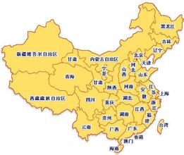

Site selections (a few main candidates)
1)
2)
1) Qinhuangdao
2) Shanxi Province
3) Near Shenzhen and Hongkong
3)

Slide 54
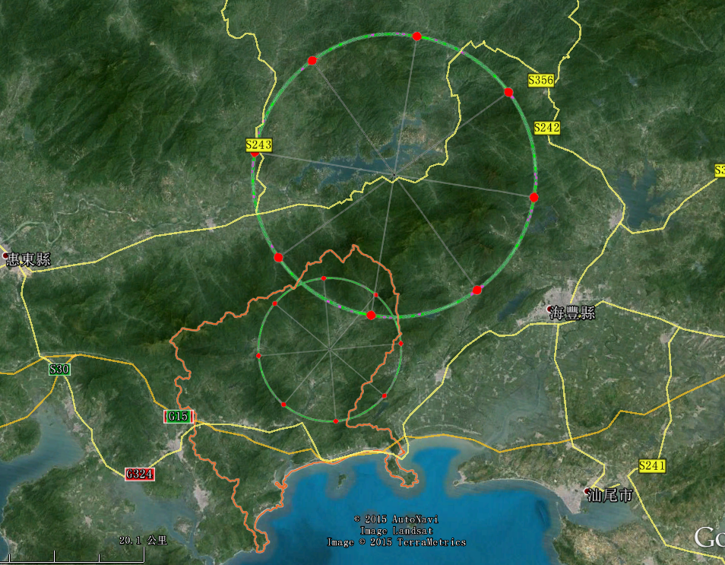
Site Selection
Continue to work on site selection
Previously investigated: 300 km north-east of Beijing
A new possibility close to Hong Kong, invited by the local government

Slide 55
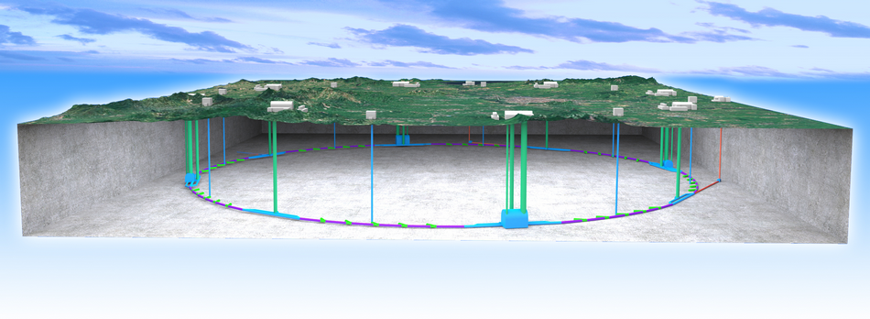
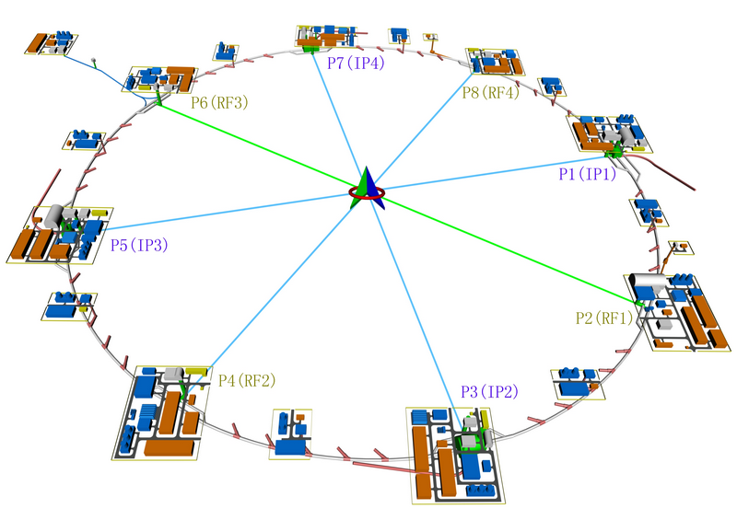
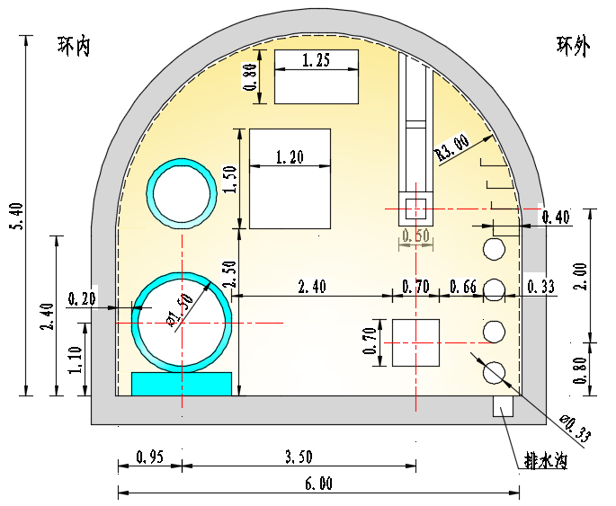
Civil Construction
Surface buildings

Slide 56
Total Cost Breakout
10%
26%
63%

Slide 57
Funding Requests and R&D List

Slide 58
Current Status and the Plan
Pre-CDR completed
  No show-stoppers
  Technical challenges identified ➔ R&D issues
  Preliminary cost estimate
Working towards CDR
  A working machine on paper
  Ready to be reviewed by government at any moment
R&D issues identified and funding request underway
  Seed money from IHEP: 12 M RMB/3 years
  MOST: 35 M/5 yr approved, ~40 M to be asked next year
  NCDR: ~0.8 B RMB/5 yr, failed in a voting process
  CAS & CNSF: under discussion, hopefully ~ 50M/y

Slide 59
Key R&D Issues
Accelerator & Detector design
Site selection, civil design
Key technology development
  High Q₀ SRF cavities and high efficiency thermal power removing SRF accelerating unit
  High efficiency RF power sources(Klystron, solid state, …)
  High power Cryogenic system
  Beam monitor and diagnostice
  Silicon detectors
  High field SC magnets

Slide 60
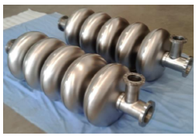
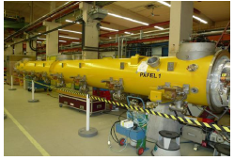
SRF System: three key issues
Extremely high Q₀ cavities
  New technology: N-doping to improve Q₀ by a factor ~ 4
Efficient thermal power extraction
  SR power
  HOM power
Mass production
Largest SRF system next to ILC
Technically challenge
Used by all future acclerators
Key factors for the cost

Slide 61
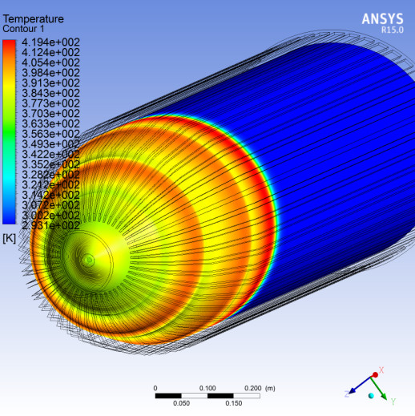
RF power source: Efficiency
Key parameters of NEW klystron design
Parameters mode | Now | Future
Centre frequency (MHz) | 650+/-0.5 | 650+/-0.5
Output power (kW) | 800 | 800
Beam voltage (kV) | 80 | 70
Beam current (A) | 16 | 15
Efficiency (%) | 65 | 80
Gun assembly
Key factors for the cost and the power consumption
Used by radar, radio and television broadcasting, …
Collector design

Slide 62
Organization

Slide 63
Current organization for pre-CDR
To get the community support
To get everybody involved
To get things going
Collaboration Board
Chair: Yuanning Gao
Steering Committee
Chair: Yifang Wang
Project Director
Xinchou Lou
Qing Qin
Theory Group
Accelerator Group
Detector Group

Slide 64

International Collaboration
A new international organization for CEPC will be organized after (at least some) funding is available
  A new format: not ITER, CERN, ILC, …
An international advisory board is formed to discuss in particular this issue, together with others
Many MOU and meeting minutes signed with collaborating institutions/organizations:
  UChicago, BNL, SLAC, BINP,
  Oxford, INFN, …
  More will be signed
Seeking international
coordination

Slide 65
ICFA Statements
ICFA meeting of Feb. 2014 at DESY, Hambourg, stated:
ICFA meeting of July 2014 in Spain, stated:
ICFA supports studies of energy frontier circular colliders and encourages global coordination
… ICFA continues to encourage international studies of circular colliders, with an ultimate goal of proton-proton collisions at energies much higher than those of the LHC.

Slide 66


Slide 67
Summary
CEPC is the first Chinese effort for a Science project at such a scale ➔ Challenges every where.
Tremendous progresses up to now, but a long way to go
Given the importance of Higgs, we hope that at least one of them, FCC-ee, ILC, or CEPC, can be realized.
We fully support a global effort, even if it is not built in China

