Slide 1

CEPC Partial Double Ring Lattice &
SPPC Lattice Design
Feng Su Jie Gao Dou Wang Yiwei Wang
Jingyu Tang Tianjian Bian Sha Bai
Huiping Geng Yuan Zhang Yuanyuan Guo
Yuemei Peng Ye Zou
The first IHEP-BINP CEPC Accelerator Collaboration Workshop
Jan 12-13, 2016
Notes:
Good afernoon everyone. My report is
CEPC Partial Double Ring Lattice Design & SPPC Lattice Design

Slide 2
Outline
CEPC Partial Double Ring Lattice
SPPC Lattice

Slide 3
CEPC Partial Double Ring Lattice

Slide 4
CEPC Partial Double Ring Layout
1/2RF
1/2RF
IP1_ee
RF
RF
3.2Km
1/2RF
1/2RF
Bypass
about 42m
IP4_pp
IP2_pp
Bypass
about 42m
1/2RF
1/2RF
IP1_ee/IP3_ee, 3.2Km
IP2_pp/IP4_pp, 1132.8m
4 Short Straights, 141.6m
4 Medium Straights, 566.4m
4 Long Straights, 849.6m
2 Short ARC, 24*FODO, 1132.8m
4 Medium ARC, 112*FODO, 5286.4m
4 Long ARC, 124*FODO, 5852.8m
C=59044m
RF
RF
IP3_ee
1/2RF
1/2RF
SU Feng
2016.1.4
Notes:
This is the CEPC Partial double ring Layout. Which was showed many times.
IP1 and IP3 is for ee collider. We choose partial double ring scheme here. The length is about 3200m, the full crossing angle is 26mrad.(milliradian)
IP2 and IP4 is for pp collider. For CEPC, We need a bypass lattice to turn around the pp detectors. It’s about 42m .

Slide 5
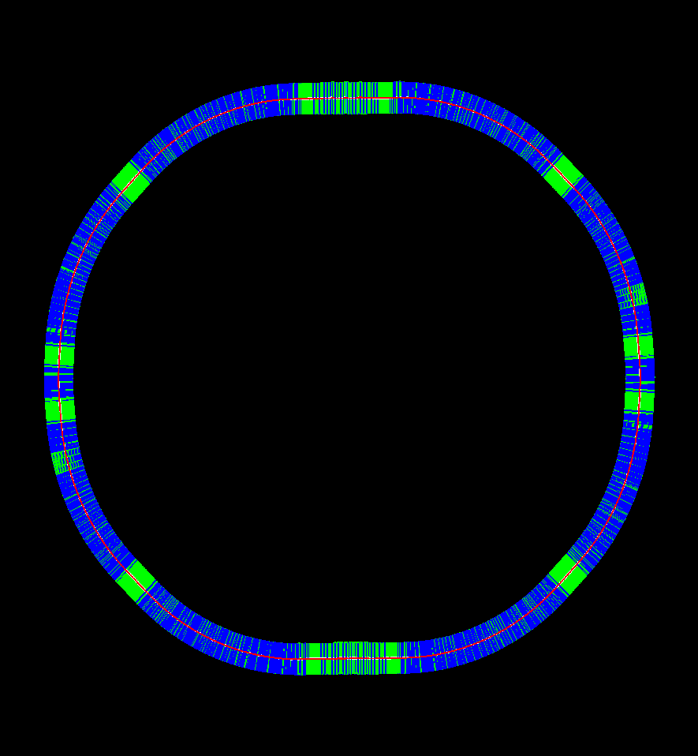
CEPC Partial Double Ring Layout
CEPC Partial Double Ring
By MADX and PTC
Blue: Bend
Green: Straight Section
Bypass
C=59044m
Bypass
SU Feng
2016.1.4
CEPC Partial Double Ring
Notes:
It’s not clear to see the distance in bypass part and PDR.

Slide 6
CEPC Partial Double Ring Layout
12
62.5urad
4.5m
0.75mrad in total
B2
B3
B1
614.4m
479.1m
54m
307.2m
Full crossing angle 26mrad
13mrad
7.852m
IP
B6
Septum Dipole
Septum Dipole
Separator
1642m
B4
B5
Version 1.0
sufeng
2015.12.20
For CEPC 120GeV beam:
Max. deflection per separator is 66μrad.
Using Septum Dipole after separator to acquire 13 mrad
Notes:
Deflection angle of each seperator is 62.5 micro radian. Antisymmetry of this part

Slide 7
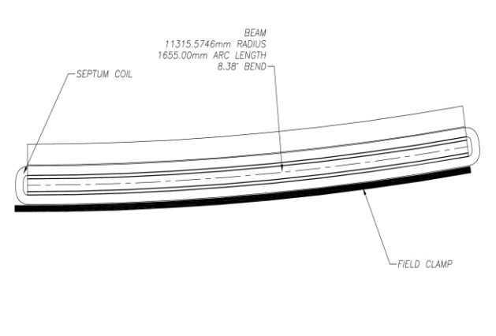
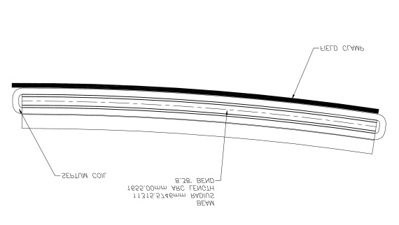
Separator with Thin Septum Magnet
Sigmax=697.8um 20sigma=14mm
20mm
Beam
dump
Septum Magnet：L=3m
（4.25mrad）thicknes=3-5mm
rho=705.822m B=0.56T
Separator： 62.5 urad
12 个
0.75 mrad
Notes:
Beam size is 700 micrometer。 just in case 以防万一

Slide 8
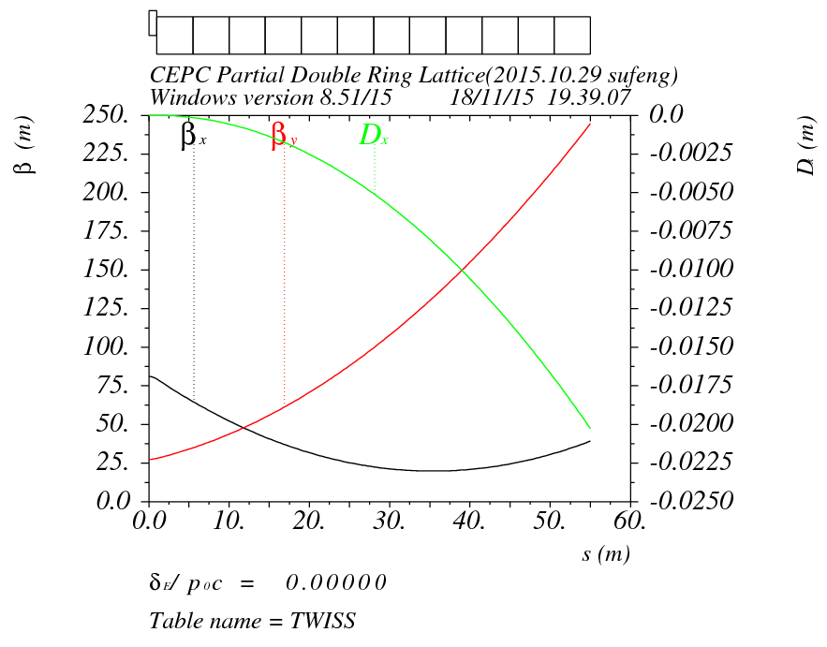
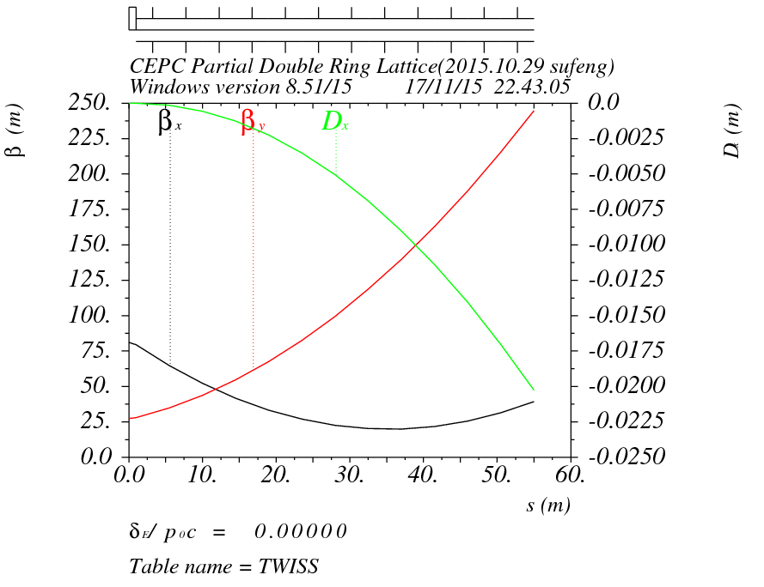
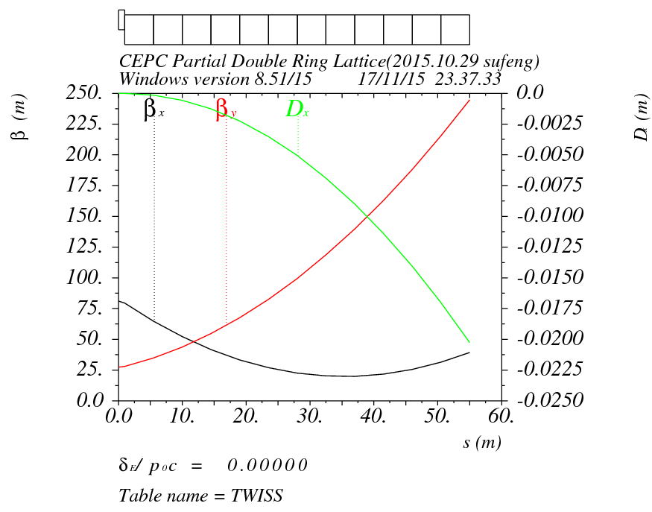
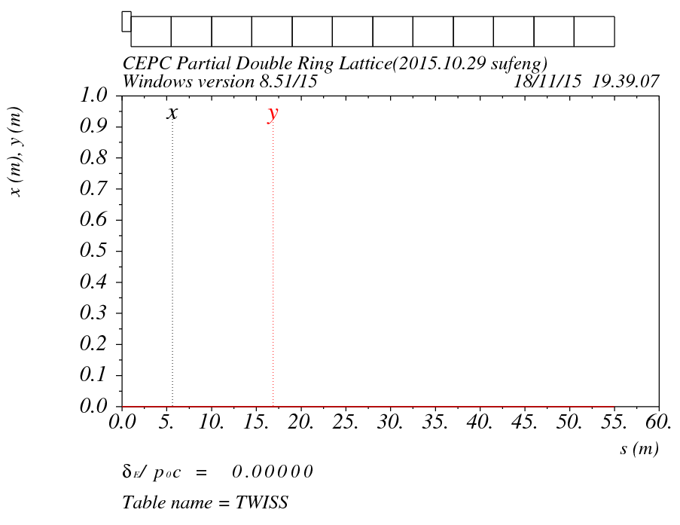
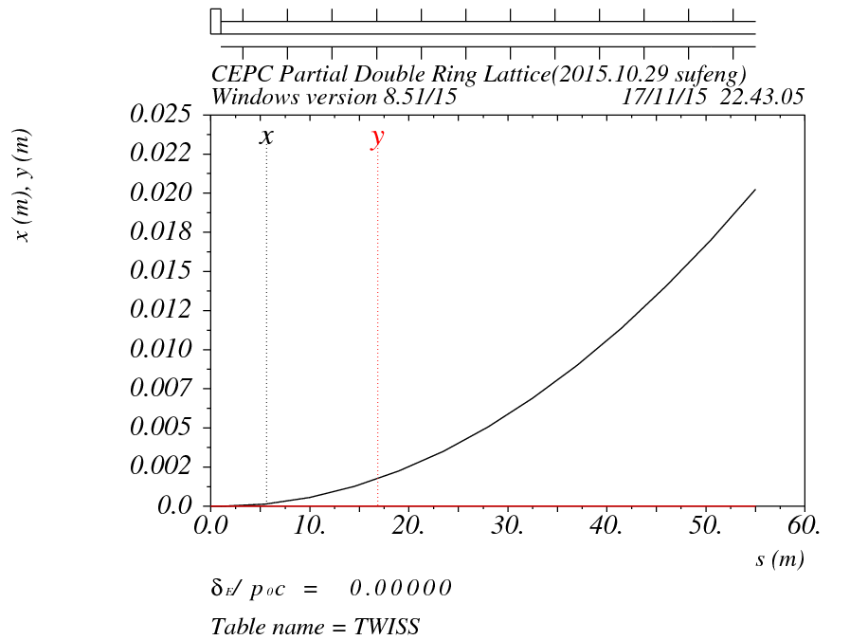
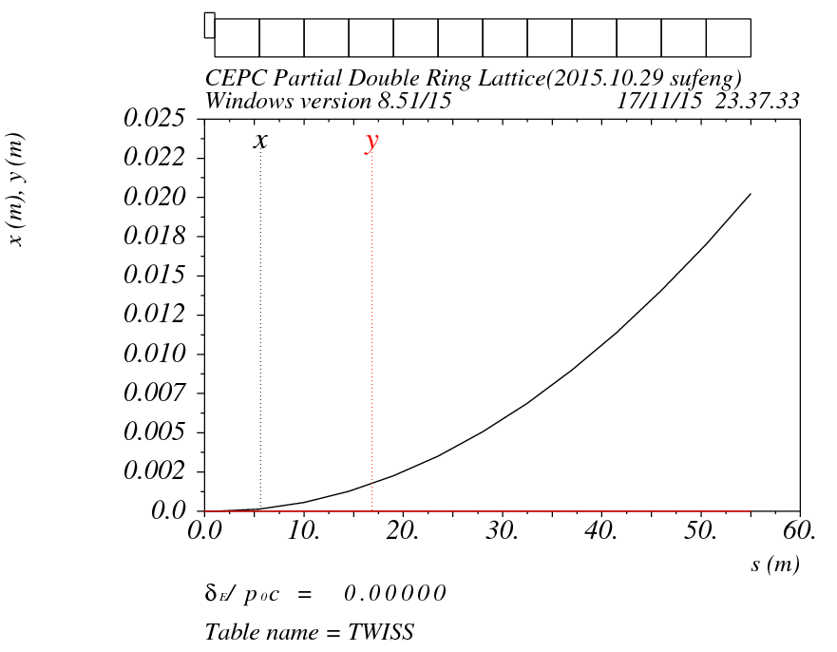
Orbit difference between dipole separator kicker
Dipole
Seperator
Kicker
X=20.25mm
X=20.25mm
X=20.25mm

Slide 9
So we use Dipole instesd Seperator in lattice now

Slide 10
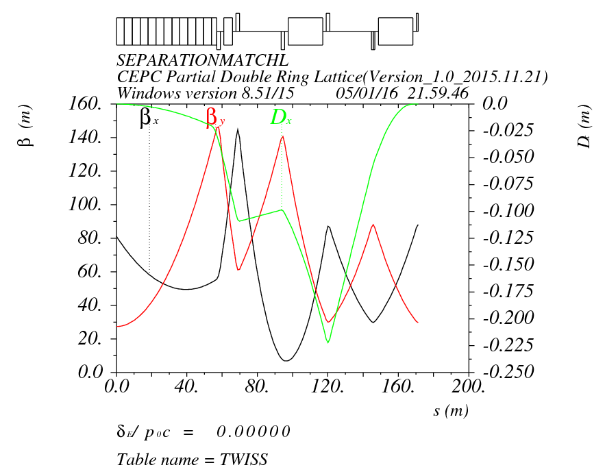
SEPARATIONMATCHL
Beta<150m

Slide 11
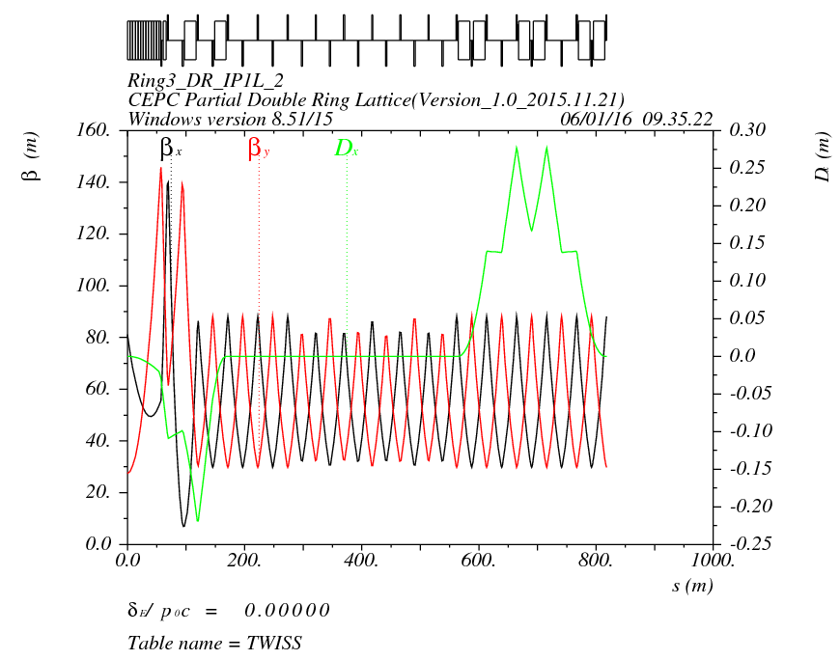
RING3_DR_IP1_2

Slide 12
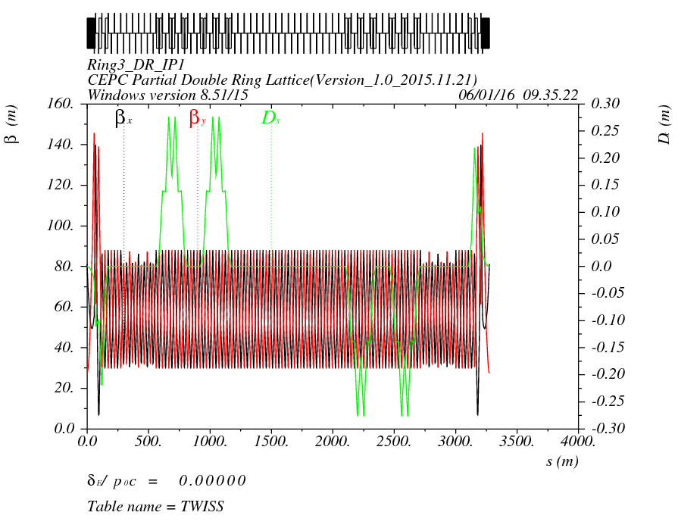
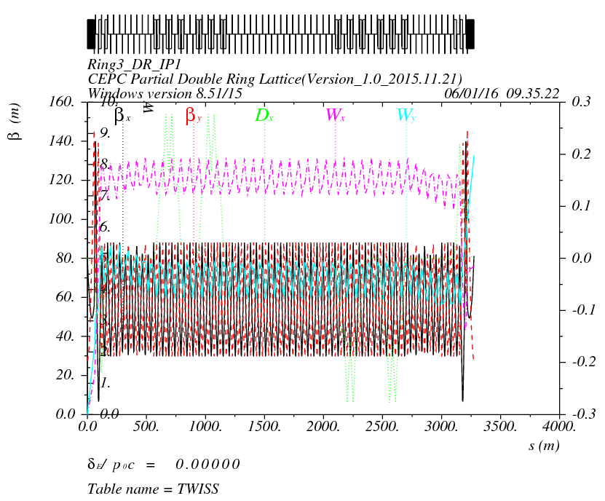
Orbit (RING3_DR_IP1) Version 1.0 without FFS

Slide 13
Dipole Strength Version 1.0 without FFS
 | Angle(mrad) | L(m) | Rho(m) | Brho(E0/c)(T/m) | B(T) | Ek(KeV) | KeV/m
B0 | 3.232 | 19.6 | 6064.36 | 400 | 0.06596 | 631.625 | 32.226
BSepL | -0.0625 | 4.5 | -72000 | 400 | -0.00556 | 53.2 | 11.822
BSeptumL | -4.25 | 3 | -705.822 | 400 | -0.56667 | 5426.4 | 1808.8
BMatch1L | -0.469 | 4.9 | -10447.8 | 400 | -0.03829 | 366.624 | 74.821
BMatch2L | -3.171 | 19.6 | -6181.02 | 400 | -0.06471 | 619.704 | 31.618
BMatch3L | -4.36 | 19.6 | -4495.41 | 400 | -0.08898 | 852.069 | 43.473
B2 | 2.167 | 19.6 | 9044.76 | 400 | 0.04422 | 423.494 | 21.607
B3 | 2.167 | 19.6 | 9044.76 | 400 | 0.04422 | 423.494 | 21.607
B4 | -2.167 | 19.6 | -9044.76 | 400 | -0.04422 | 423.494 | 21.607
B5 | -2.167 | 19.6 | -9044.76 | 400 | -0.04422 | 423.494 | 21.607
BMatch3R | 4.36 | 19.6 | 4495.41 | 400 | 0.08898 | 852.069 | 43.473
BMatch2R | 3.171 | 19.6 | 6181.02 | 400 | 0.06471 | 619.704 | 31.618
BMatch1R | 0.469 | 4.9 | 10447.8 | 400 | 0.03829 | 366.624 | 74.821
BSeptumR | 4.25 | 3 | 705.822 | 400 | 0.56667 | 5426.4 | 1808.8
BSepR | 0.0625 | 4.5 | 72000 | 400 | 0.00556 | 53.2 | 11.822

Slide 14
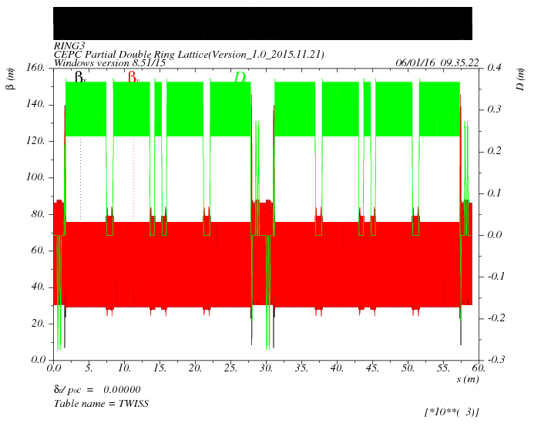
Survey & Dynamic Aperture
（Version 1.0 –without FFS）
0: 20σx 700σy
0.01：16σx 500σy
0.02：10σx 170σy
Bypass part at IP2/4

Slide 15
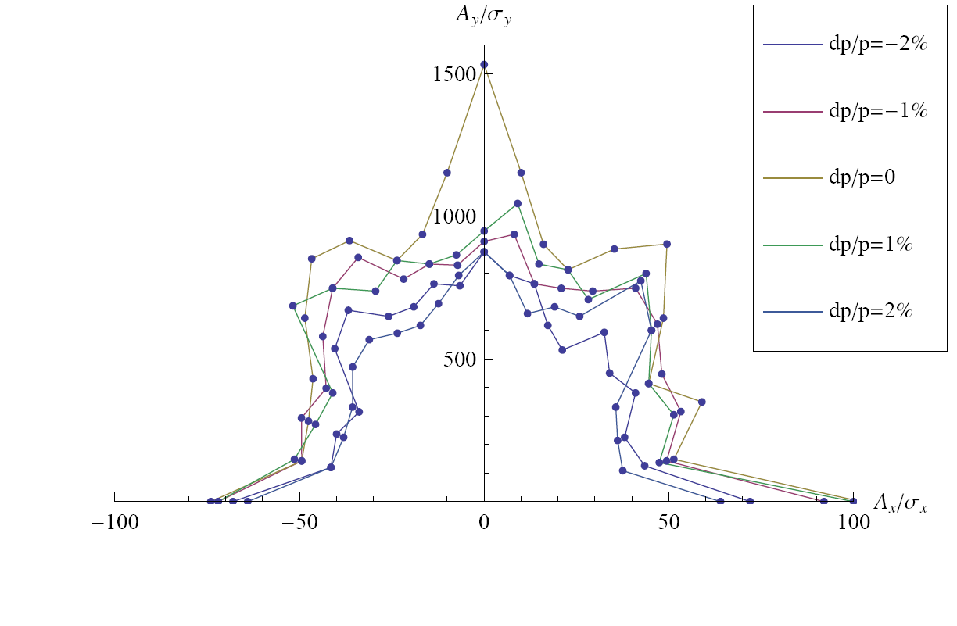
Dynamic Aperture Comparation
0: 20σx 700σy
0.01：16σx 500σy
0.02：10σx 170σy
0: 50σx 1500σy
0.01：50σx 900σy
0.02：40σx 800σy
CEPC Partial Double Ring Lattice
(Version1.0-20160104)
CEPC Main Ring Lattice (without pretzel)
(September 30, 2014 Geng Huiping)

Slide 16
CEPC-Single
CEPC-Single-Bypass
CEPC-PDR-Bypass
CEPC-PDR-Bypass-PDRnPi
Notes:
integer multiple of pi.

Slide 17
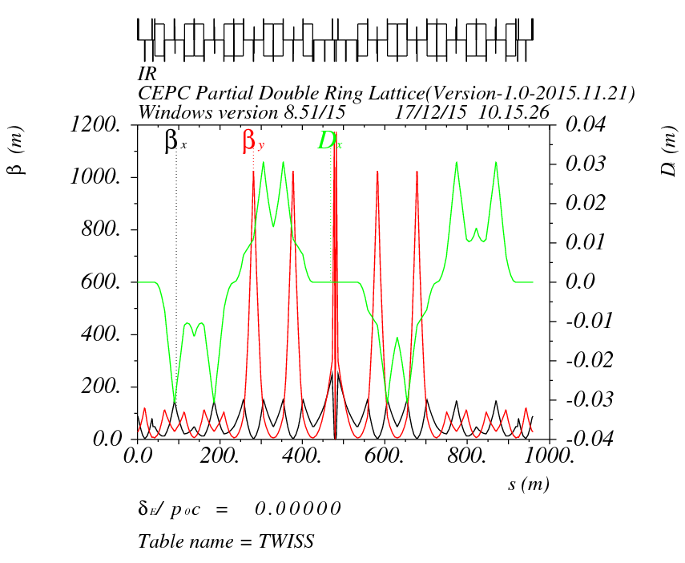
FFS Part
Crab sextupoles
IP
-I
Y:2.5Pi X:2Pi
K2=-126.77
Wangdou-20151216

Slide 18
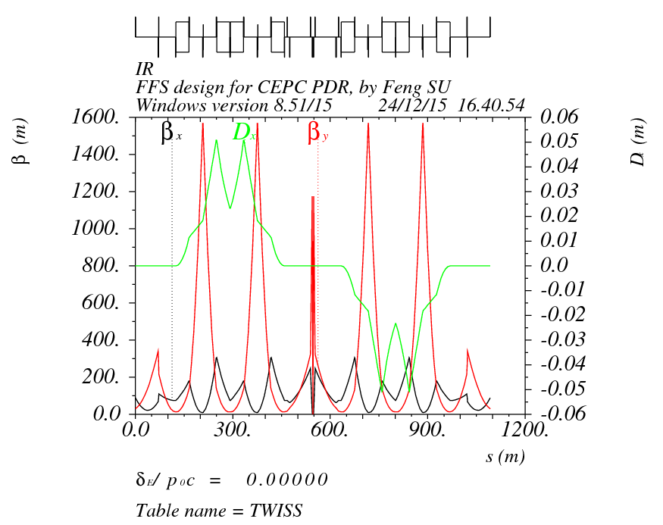
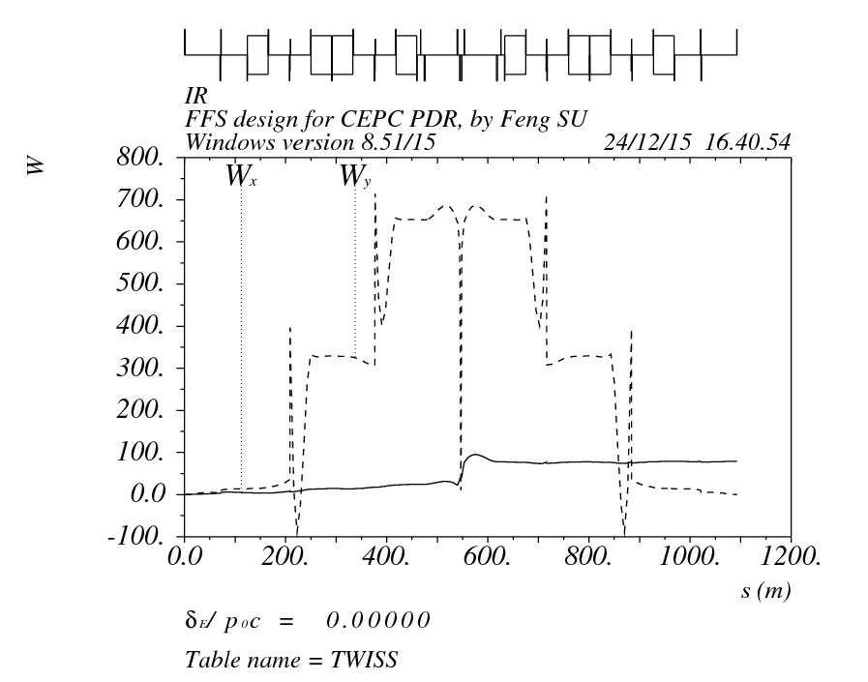
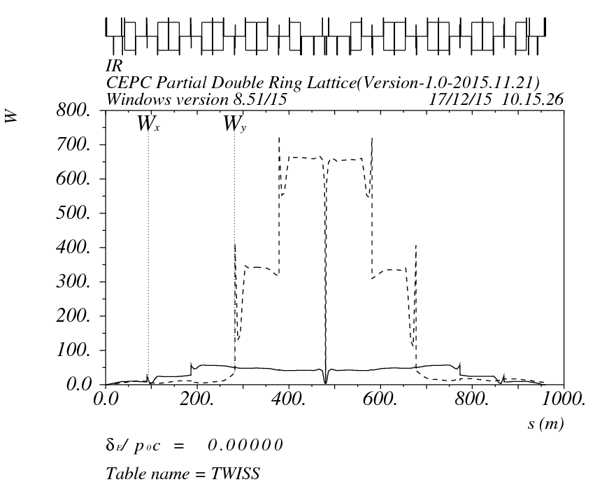
Sufeng-20151224
Wangdou-20151216
K2=-48.57
K2=-126.77

Slide 19
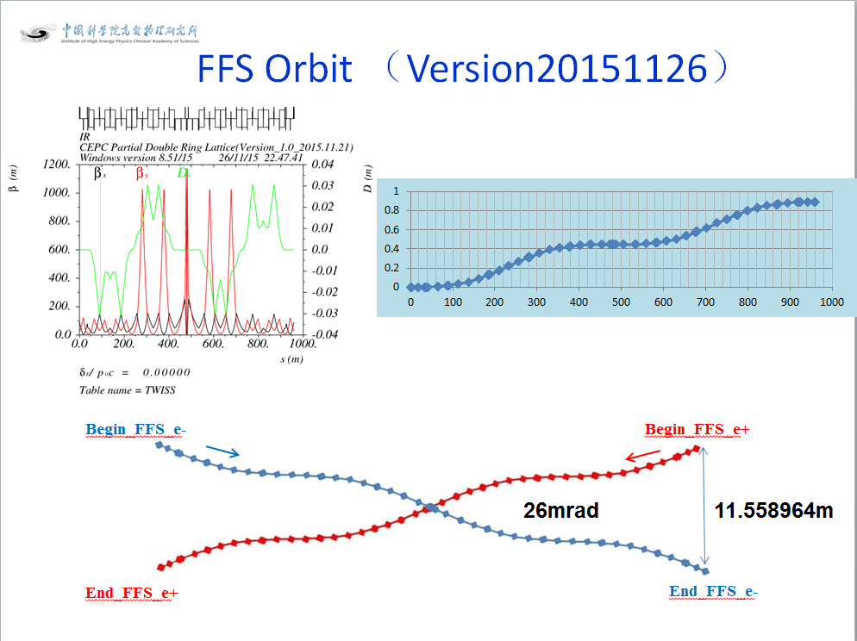
Orbit of FFS Part
Notes:
Focus on the two plane correction scheme. Following.

Slide 20
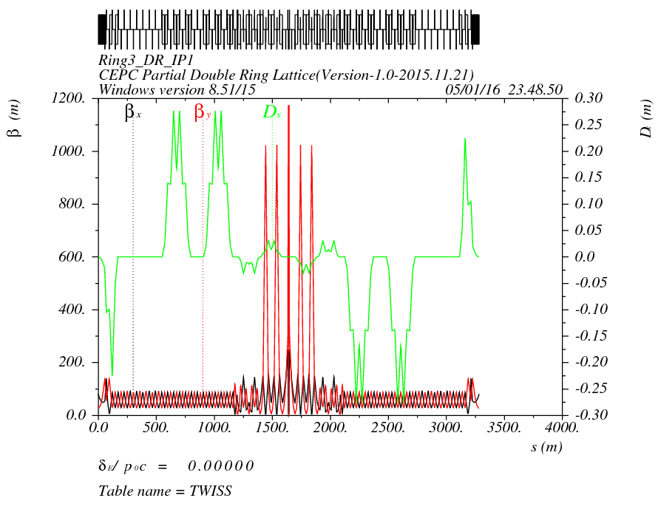
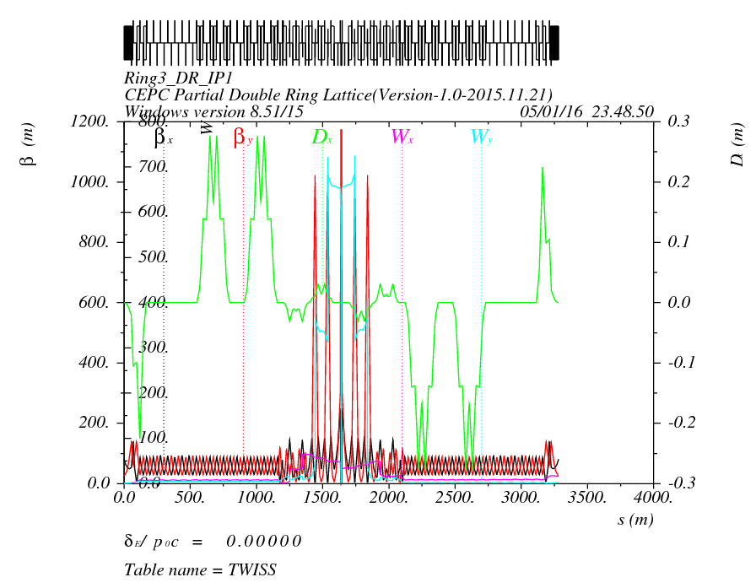
Orbit (RING3_DR_IP1) Version 1.0 + FFS(20151126)

Slide 21
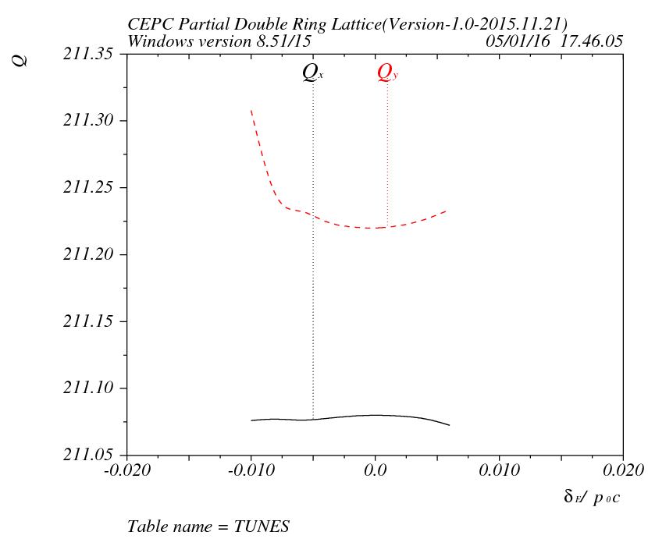
Tune/DA with FFS
0: 13σx 55σy
0.01：0
0.02：0
For details：
Energy spread between
-0.8628% and 0.719% has DA, out is 0.
Notes:
The vertical tune may cross the oscillation line.

Slide 22
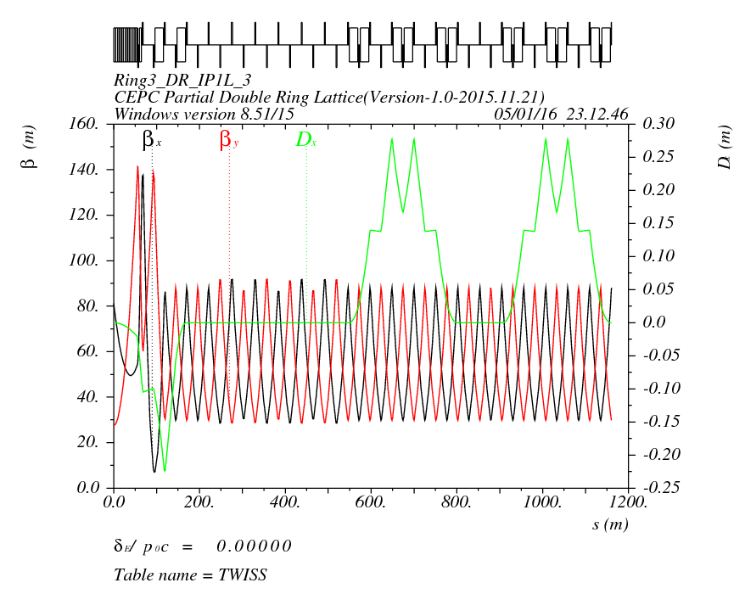
Optimize
1、We tried to add sextupoles here, but not help for DA. Because it’s not easy to match the phase advance between them.
2、Try to add some Sextupoles to correct high order chormaticity here.

Slide 23
DA Comparation
CEPC-PDR-Bypass
CEPC-PDR-Bypass-Sex

Slide 24
Summary for part 1
The first version of CEPC Partial Double Ring Lattice was designed (Version 1.0). The whole length of CEPC PDR is 3281.27m, full crossing angle is 26mrad, maximum distance between two ring is 14.913m.
The Dynamic Aperture need to be optimized. Now the DA of CEPC with PDR and Bypass(at IP2/4) and without FFS is better than before, but the DA with FFS is not good enough.
We may add more sextupoles in PDR to correct the high order chromaticity , or use more group of sextupoles in ARC to optimize the DA.
The linear lattice of PDR may also be optimized.

Slide 25
2. SPPC Lattice

Slide 26
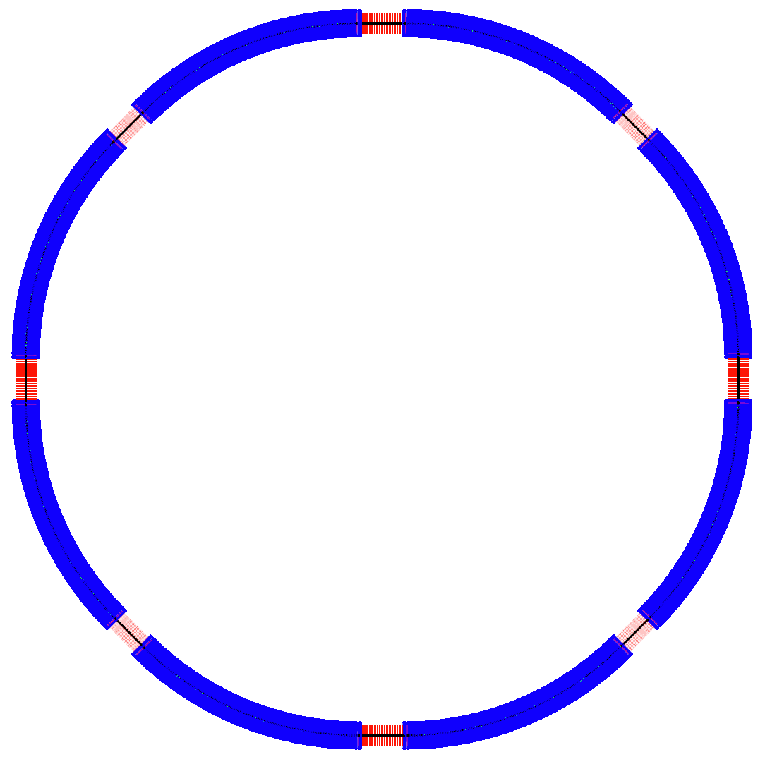
ARC81
ARC12
SPPC Layout
（Su Feng, Jul. 10, 2015）
LSS1_ee
P.S.
arccell1
arccell2
P.S.
LSS8_extr
LSS2_inj
ARC78
ARC23
arccell2
arccell1
LSS7_pp
LSS3_pp
C = 55.025 km
arccell1
arccell2
ARC67
ARC34
LSS1/5 : 1083m
LSS2/4/6/8 : 938.6m
LSS3/7 : 1070.89m
ARC 5920.4m
LSS6_coll
LSS4_coll
P.S.
arccell2
arccell1
P.S.
LSS5_ee
ARC56
ARC45

Slide 27
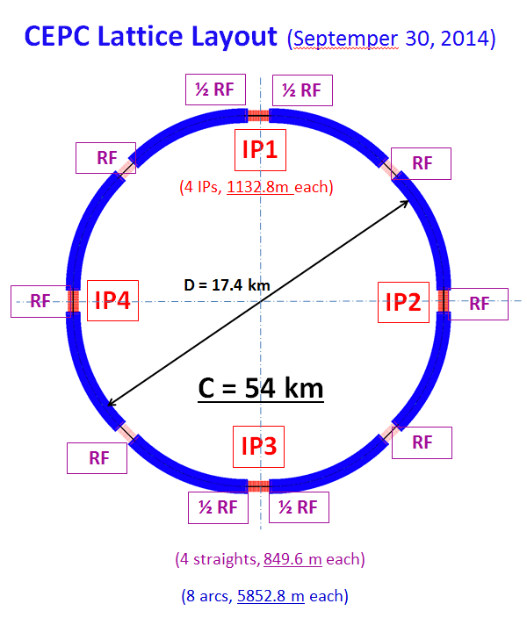
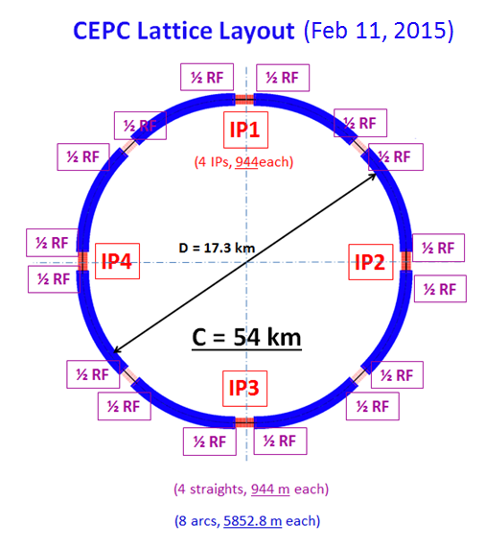
Layout of two CEPC lattices
Huiping Geng
Notes:
The circumference and the length of the Straight Section is a little different from thae CEPC layout.
This are the two version lattice layout by Hiping Geng. Wo hope the length of each the closely the better.
We should make it the nearly the better. We can change and adjustment them in the future.

Slide 28
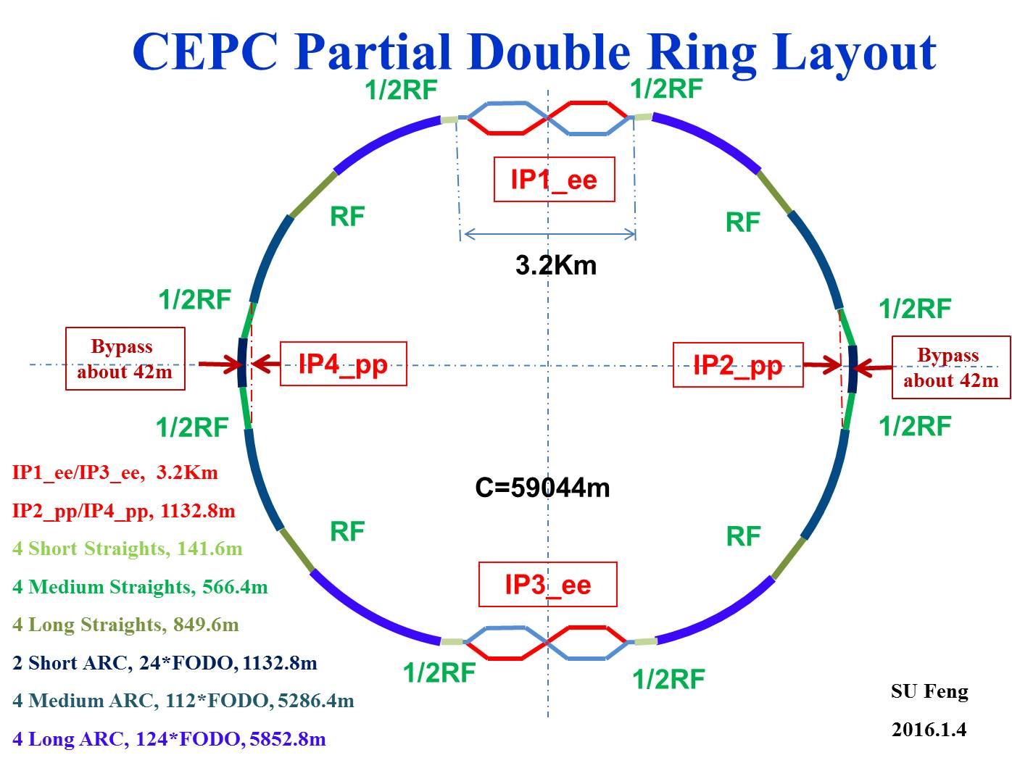
Consideration of CEPC New Layout with PDR

Slide 29
SPPC Layout
（Su Feng Jan. 10, 2016）
ARC81
ARC12
LSS1_coll
P.S.
arccell1
arccell2
P.S.
LSS8_extr
LSS2_inj
ARC78
ARC23
arccell2
arccell1
LSS7_pp
LSS3_pp
C = 58.983 km
arccell1
arccell2
ARC67
ARC34
LSS1/5_coll ：3.2Km
LSS2/4/6/8：788.31m
LSS3/7_pp: 973.83m
ARC: 5963.2m
LSS6_RF
LSS4_RF
P.S.
arccell2
arccell1
P.S.
LSS5_coll
ARC56
ARC45
Notes:
8段弧区，90度相移4个FODO Cell可消色散，若每个Cell 8块Dipole，则nB需是256的倍数。
This is the layout of SPPC, we rename the straight section as Long Straight Section 1 /2 and … . Configuration maybe change in the future.

Slide 30
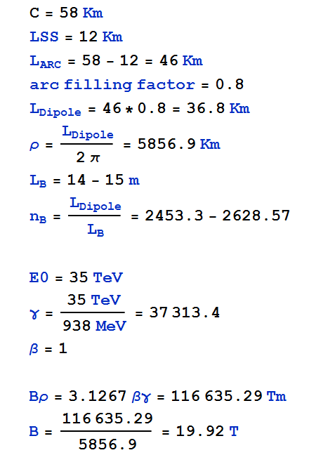
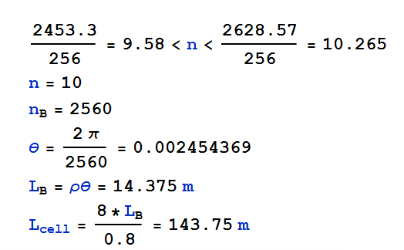
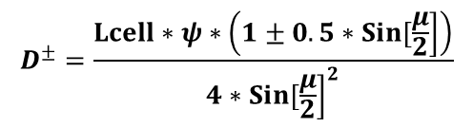
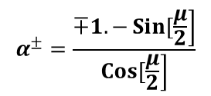
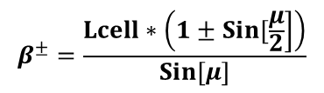
Parameter Estimate for ARC CELL
High Field Dipole in Pre-CDR ：20T，15m
$$β^{±}=\frac{Lcell∗\left(1±\left.Sin[\frac{μ}{2}\right]\right)}{\left.Sin[μ\right]}$$
$$α^{±}=\frac{∓1.−\left.Sin[\frac{μ}{2}\right]}{\left.Cos[\frac{μ}{2}\right]}$$
$$D^{±}=\frac{Lcell∗ψ∗\left(1±0.5∗\left.Sin[\frac{μ}{2}\right]\right)}{4∗{\left.Sin[\frac{μ}{2}\right]}^{2}}$$
Notes:
8段弧区，90度相移4个FODO Cell可消色散，若每个Cell 8块Dipole，则nB需是256的倍数。

Slide 31
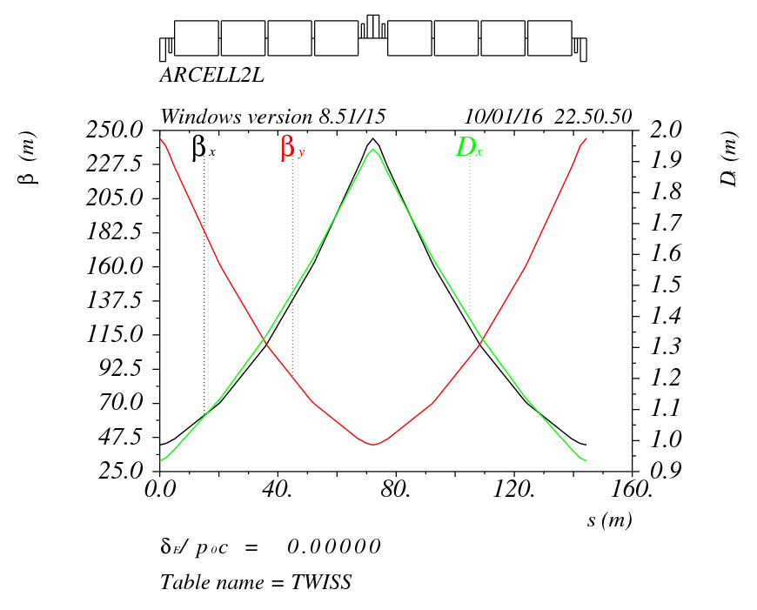
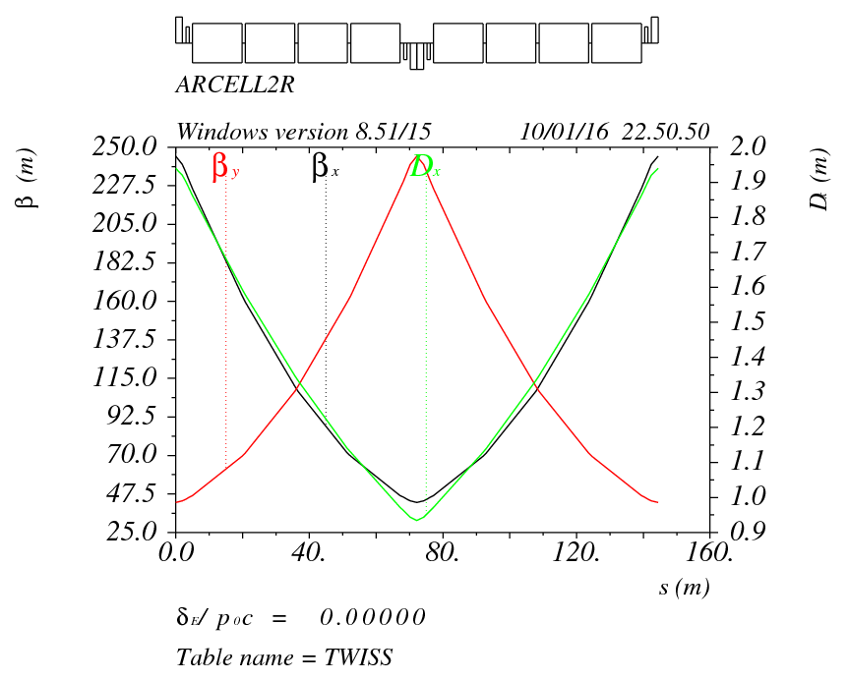
FODO CELL in ARC
arccell1
L=144.4m
arccell2
Betax: 244.878/42.57
Betay: 42.569/244.869
Notes:
This is the arc cell, we use FODO in the ARC. This is a half deficuous quadrupole,then the sextupole, 4 dipoles, and sextupole, and fucus quadrupole. The length is 144.4m. The maximum and minmun beta function is about 244 and 42.57. as from the different side of the low beta pp IP, the sign of the quadrupoles are opposite. Fucus become defocus, and defocus become focus.

Slide 32



ARC CELL
 | LQ | DQS | LS | DSB | LB | DBB
SPPC | 4m | 1m | 0.5m | 1m | 14.8m | 1m
FCC-hh | 6.3137m | 1m | 0.5m | 2.184m | 14.3m | 1.36m
Betax: 244.878/42.57
Betay: 42.569/244.869
($ε_{n}$=4.1um)
B max [T] | G max [T/m] | k1 | k2
19.61 | 582.156 | 4.9899E-3 | 0
$$ε=\frac{ε_{n}}{γ}$$
E (Collision：35TeV)
(Injection：2.1TeV)
$ε$(Collision：1.099*10^-10m=0.1099nm)
（ Injection： 1.83*10^-9m=1.83nm）
σ（Collision：1.66*10^-4m=166um）
（ Injection： 6.76*10^-4m=676um）
R=20*σInj=13.52mm
D=27.04
Pre-CDR：
Dipole: L=15m B=20T
Quadrupole:
D = 45 mm B_{pole}=16 T
G=711.1T/m K1=6.097*10^-3
Notes:
This is the parameter of ARC FODO. The according K1 is about 5 times 10 to minus 3. the according parameter from SPPC Pre-CDR by the magnets people, the length of dipole is zbout 15m, and the field is about 20T. The aperture of quadrupole is about 45mm,and the pole-tip field is B_{pole} = 16 T. the graduate is according about 711T/m. K1=6.097*10^-3.acquire.

Slide 33
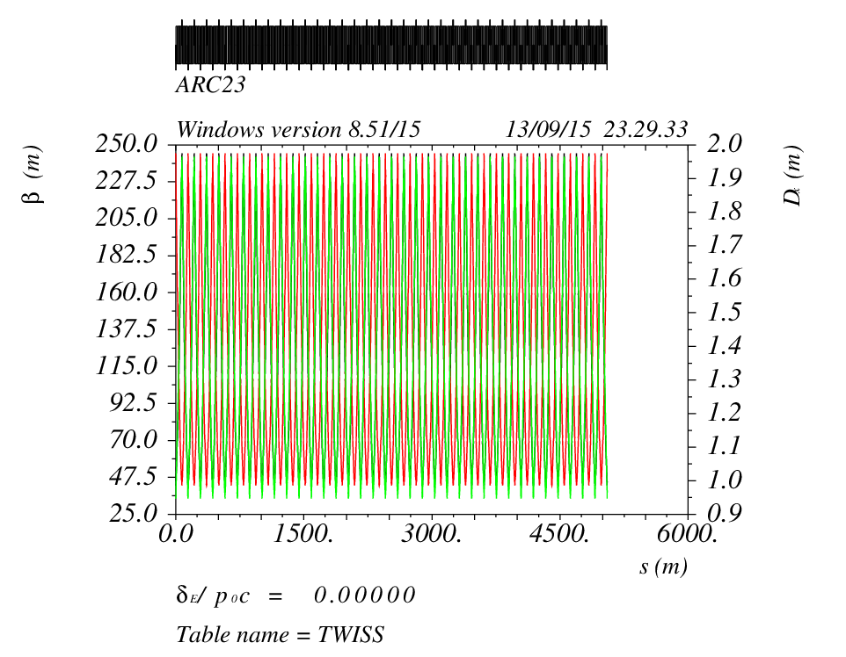
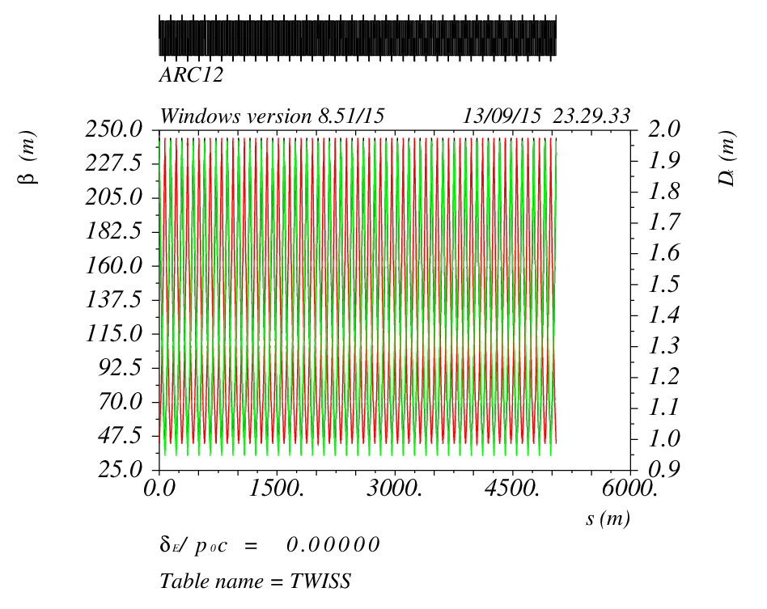
ARC （ARCDSPL,36 CELL, ARCDSPR）
ARC23
ARC45
ARC67
ARC81
ARC12
ARC34
ARC56
ARC78
L=5963.2m
Notes:
This is the arc part, each has 35 fodo cells. And the length is 5054m. As from the left and right side of the low-beta-pp IR, the quadrupoles are opposite sign ,they are devided into two family.4 arc like this ,and 4 like this.

Slide 34
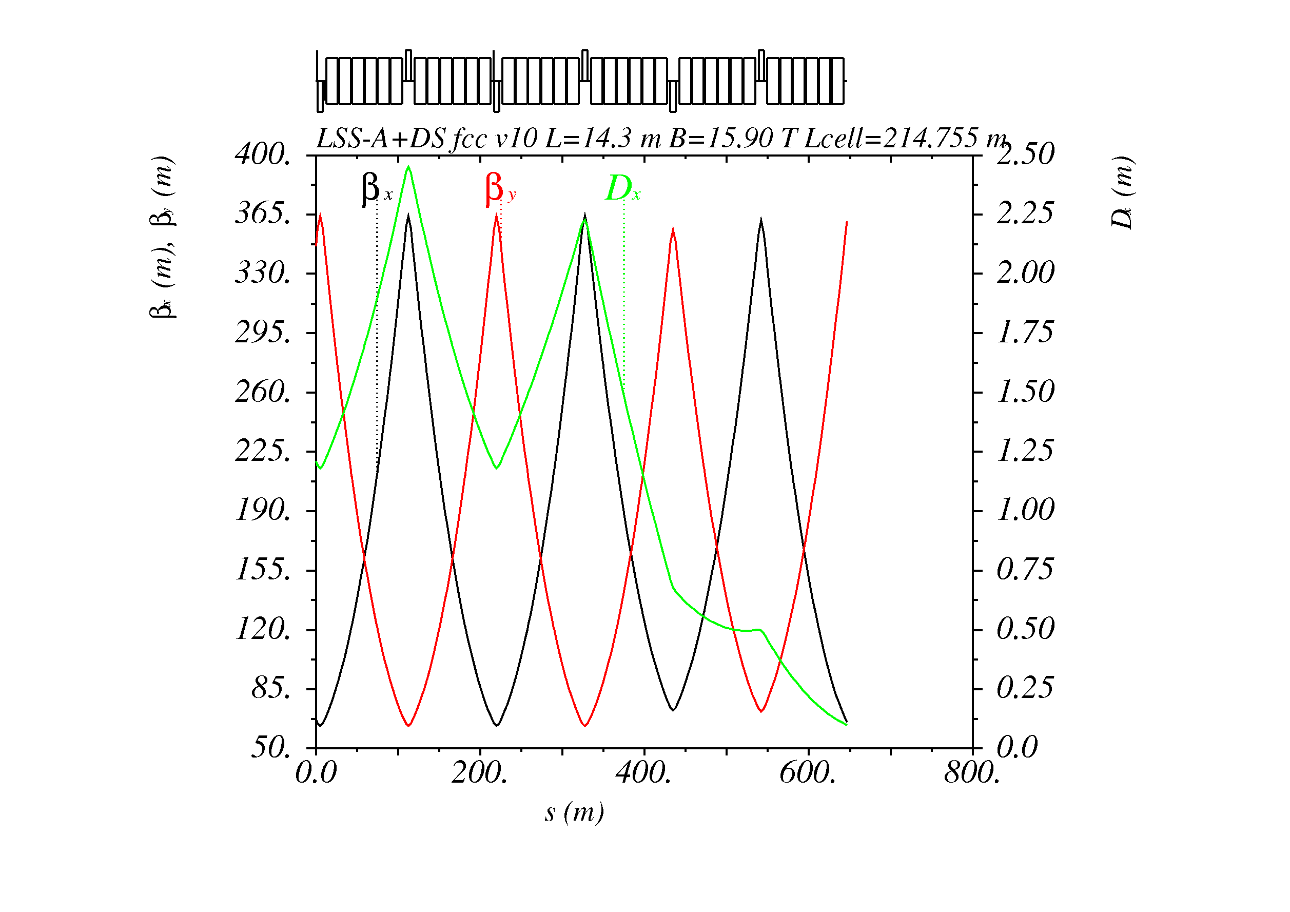
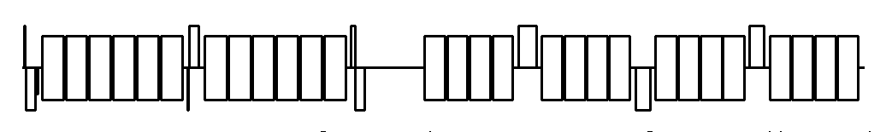
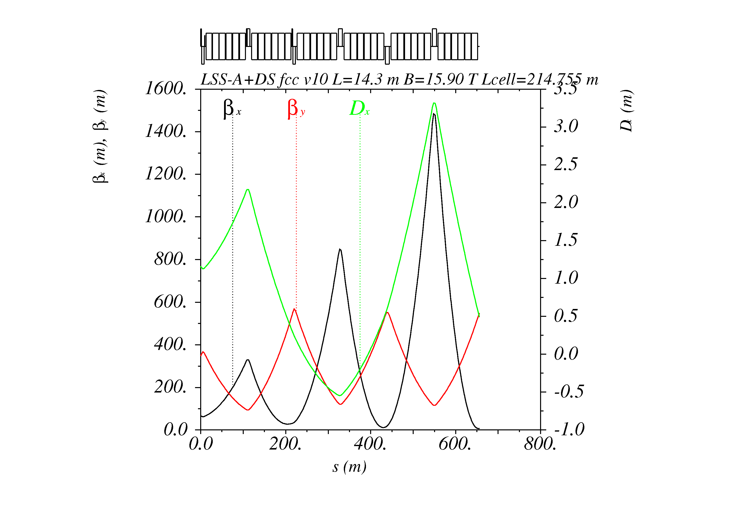
Dispersion Suppressor (DS) types
ARC
→ IP
Half Bend (half weak dipoles)
(1)
433.2m
14.3 m
8.33T
13.5 m
7.74T
(2)
LHC-like
(3)
Full Bend
Longer DS but less cells in the Arcs

Slide 35
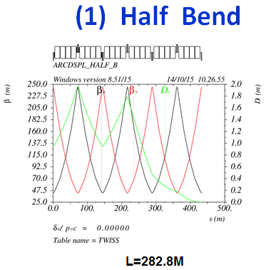
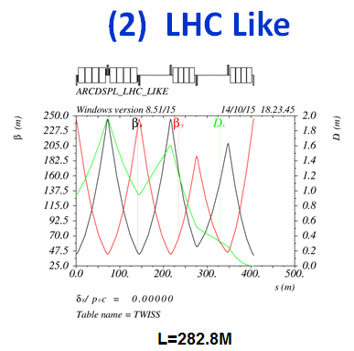
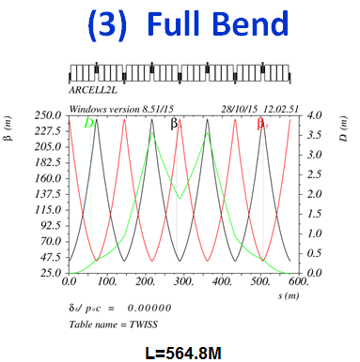
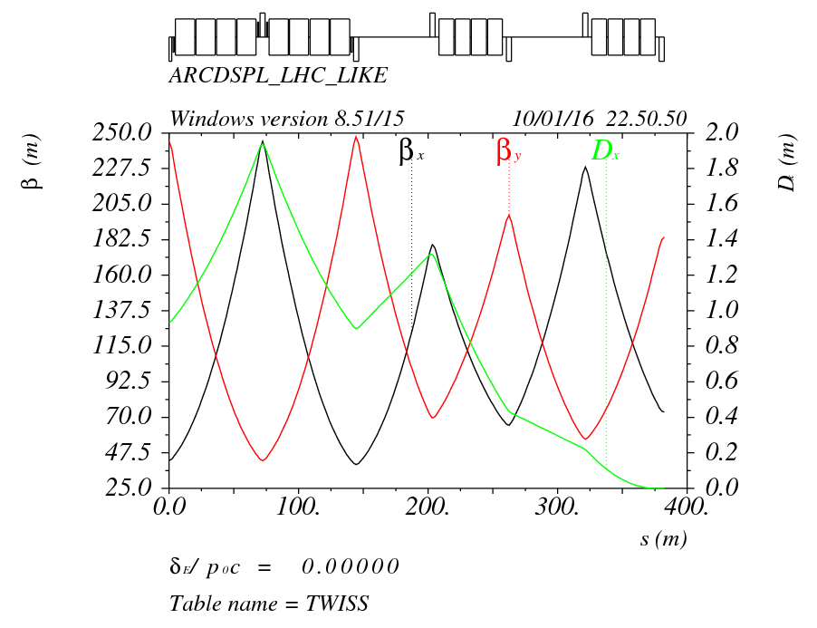
L=288.8m
L=288.8m
L=288.8m
 | BDSP1L | BDSP2L | BDSP1R | BDSP2R | B0
(1) | 9.93 | 9.93 | 9.93 | 9.93 | 19.86 | (T)
(2) | 18.93 | 18.93 | 18.93 | 18.93 | 19.86 | (T)
(3) | 19.86 | 19.86 | 19.86 | 19.86 | 19.86 | (T)

Slide 36
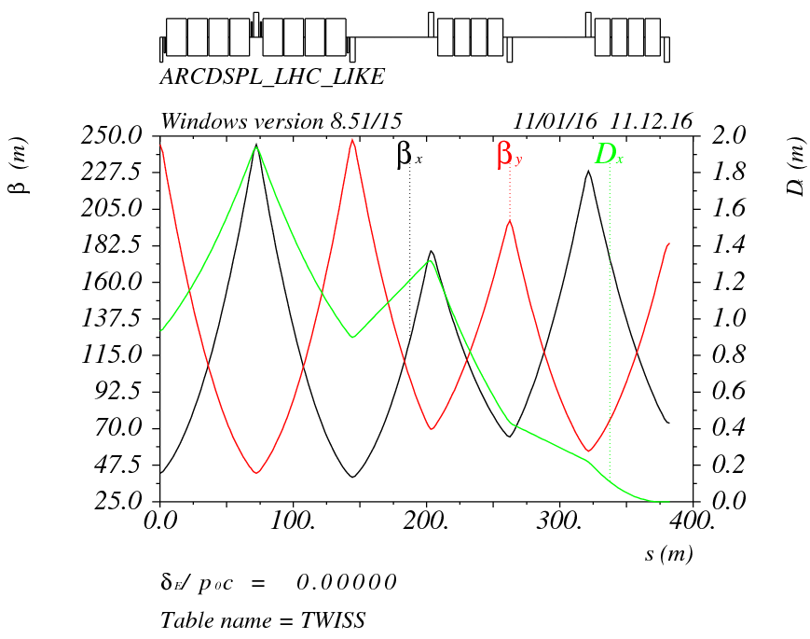
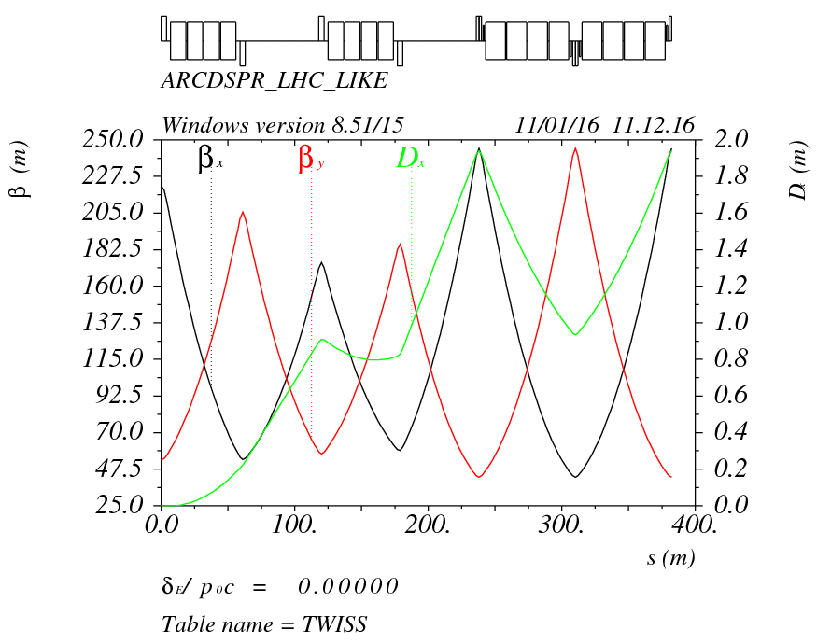
Dispersion Suppressor (DS)
BDSP1L
BDSP2L
BDSP2R
BDSP1R
382.4m
 | BDSP1L | BDSP2L | BDSP1R | BDSP2R | B0
B | 18.93 | 18.93 | 18.93 | 18.93 | 19.86 | T
L | 11.5 | 11.5 | 11.5 | 11.5 | 14.8 | m

Slide 37
Long Straight Section
SPPC Layout
（Su Feng Jan. 10, 2016）
ARC81
ARC12
LSS1_coll
P.S.
arccell1
arccell2
P.S.
LSS8_extr
LSS2_inj
ARC78
ARC23
arccell2
arccell1
LSS7_pp
LSS3_pp
C = 58.983 km
arccell1
arccell2
ARC67
ARC34
LSS1/5_coll ：3.2Km
LSS2/4/6/8：788.31m
LSS3/7_pp: 973.83m
ARC: 5963.2m
LSS6_RF
LSS4_RF
P.S.
arccell2
arccell1
P.S.
LSS5_coll
ARC56
ARC45
Notes:
This part is the long straight section design. It’s the LSS1_ee LSS2_inj…

Slide 38
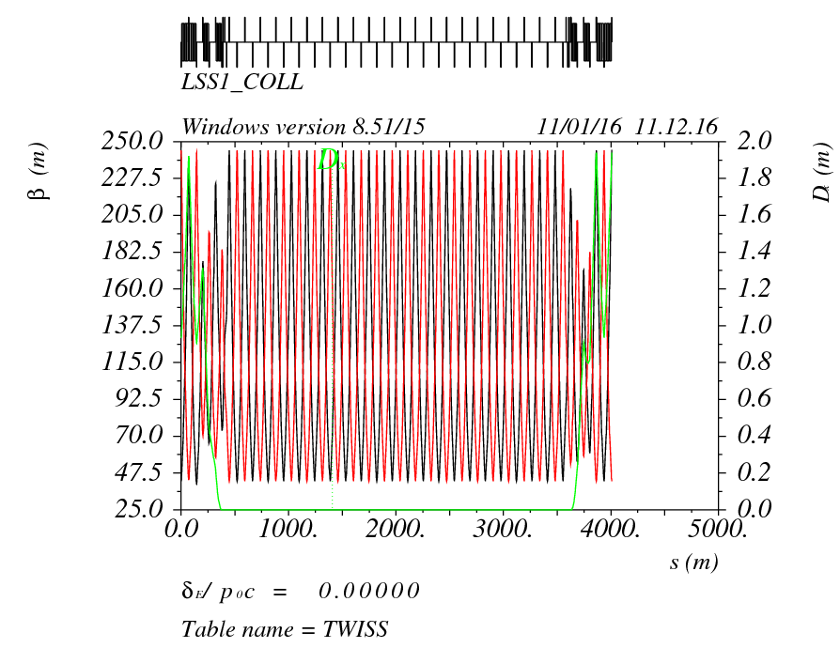
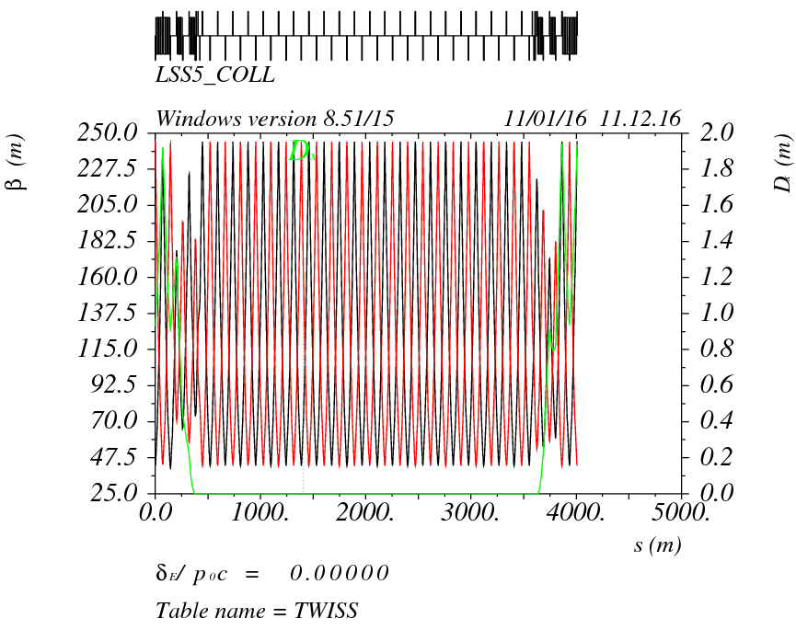
LSS1/5_coll
L=3243.106m
ARCDSPL, ARC_to_STR, 21.5*STRCELL, STR_to_ARC, ARCDSPR
382.4m, 71.719m, 3104.6m, 66.789m, 382.4m
Notes:
Now we just use the simple fodo cell, missing all the dipole to instead. The quadrupole is the same with fodo cell. We will investaga the need and requirement of each Long straight section to redesgin and rematch to satisfy the requirement.

Slide 39


LSS2_inj/LSS8_extr
L=788.306m
-ARCDSPR, ARC_to_STR, 4.5*STRCELL, STR_to_ARC, -ARCDSPL
382.4m, 71.719m, 649.8m, 66.787m, 382.4m

Slide 40


LSS4/6_rf
L=788.306m
-ARCDSPR, ARC_to_STR, 4.5*STRCELL, STR_to_ARC, -ARCDSPL
382.4m, 71.719m, 649.8m, 66.787m, 382.4m

Slide 41


LSS3_pp/LSS7_pp
L=973.829m
ARCDSPL, ARC_to_STR, 21.5*STRCELL, STR_to_ARC, ARCDSPR
382.4m, 71.719m, 973.829m, 66.789m, 382.4m
Notes:
The key point for my work is the low beta pp IR design. LSS3_pp LSS7_pp…

Slide 42
Q Strength
 | K1(m^-2) | G（T/M） | L(M) | βmax
K1.QT.1R | 4.9751e-03 | 580.428 | 6 | 3543.69
K1.QT.A2R | -5.2595e-03 | -613.668 | 9 | 9601.686
K1.QT.B2R | -5.2595e-03 | -613.668 | 9 | 9601.686
K1.QT.3R | 5.3434e-03 | 623.369 | 8 | 9731.53
K1.QM.4R | -2.2804E-04 | -266.04 | 4 | 3798.29
K1.QM.5R | 8.8592E-04 | 103.36 | 4 | 1506.53
K1.QM.6R | -1.2144E-03 | -141.68 | 4 | 587.87
K1.QM.7R | 1.0640E-04 | 124.133 | 4 | 531.25
K1.QM.8R | -4.2431E-03 | -495.028 | 4 | 162.20
K1.QT.1L | -4.9751e-03 | -580.428 | 6 | 3543.69
K1.QT.A2L | 5.2595e-03 | 613.668 | 9 | 9601.686
K1.QT.B2L | 5.2595e-03 | 613.668 | 9 | 9601.686
K1.QT.3L | -5.3434e-03 | -623.369 | 8 | 9731.53
K1.QM.4L | 2.2804E-04 | 266.04 | 4 | 3798.29
K1.QM.5L | -8.8592E-04 | -103.36 | 4 | 1506.53
K1.QM.6L | 1.2144E-03 | 141.68 | 4 | 587.87
K1.QM.7L | -1.0640E-04 | -124.133 | 4 | 531.25
K1.QM.8L | 4.2431E-03 | 495.028 | 4 | 162.20
Pre-CDR：
IR:
D = 60 mm B_{pole} = 20 T
G=666.7T/m K1=5.716*10^-3
R=30mm
20mm=20σ
σ=1mm
β=σ^2/ε=10.03km
Matching section:
D = 60 mm B_{pole} = 16 T
G=533.3T/m K1=4.572*10^-3

Slide 43

Separation Dipole
L=1070.8m
β*=0.75m
RMS bunch length=7.55cm
Normalize emittance= 4.0μrad
Momentum compaction factor=1.4*10^-4
……
Full crossing angle=146μrad

Slide 44

Separation Dipole

Slide 45
Summary for part 2
The first version of SPPC Lattice was designed (Version 1.0). The whole length and layout is according to CEPC lattice layout. full crossing angle is 146urad.
Crossing angle and Separation Dipole need to be studied and installation.
LSS3_pp low-β pp optics need to be studied and optimization.
The Dynamic Aperture need to be studied: MADX or Sixtrack.

Slide 46
Acknowledge
Gang Xu, Qing Qin, Yuan Zhang, Yuemei Peng, Qingjin Xu, Yukai Cui, Xiaohao Cui, Zhe Duan, Yudong Liu, ……
Thanks for your kind help and beneficial discussion!

Slide 47
Reference
[1] CEPC-SPPC Preliminary Conceptual Design Report, The CEPC-SPPC Study Group, IHEP-CEPC-DR-2015-01.
[2] J. Gao, IHEP-AC-Note-2013-012.
[3]Xiao Ming et al, CEPC_bunch_train _ 2015-8-28
[4]Oridy, FCC-ee_150917
[5] P. Raimondi, Status on SuperB effort, La Thuile, March 11, 2006
[6]W. Kalbreier, et al, “Layout, design and construction of the electrostatic separation system of the LEP e+e- collider”, CERN, Geneva, Switzerland.
[7] R. Martin, et al, “Status of the FCC-ee interaction region design”, HF2014 Workshop, Beijing, China, 9-12 October, 2014

Slide 48
Thank You !

