Slide 1
DA issues in high performance e+e- colliders
A.Bogomyagkov, E.Levichev, P.Piminov
Budker Institute of Nuclear Physics
Novosibirsk, RUSSIA

Slide 2
Outline
Introduction (DA limiting factors and requirements)
DA in the arcs
Comparison of nonlinear sources of FF
Simulation results, radiation influence
Conclusion

Slide 3
Disclame
Transverse dynamic aperture bound by a collider lattice is mainly considered in the talk.
High order chromatic effects and nonlinear (dynamic) bandwidth are covered in the report by Anton Bogomyagkov.

Slide 4
High performance e+e- colliders
Head-on collider with low IP beta (~1 mm)
(preCDR CEPC)
Nanobeam collider
(Super KEKB)
CW collider
(CW CEPC by J Gao, FCC-ee, SuperB/Italy, SuperCT/BINP)

Slide 5
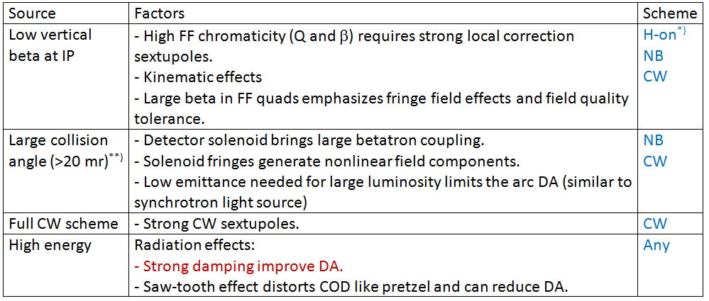
DA limiting factors
^{*)} Large dispersion is required for local chromaticity correction in the low-beta head-on collision as well as in the CW scheme. For this reason the IR design for both schemes is almost same. But the beam separation in the arcs (pretzel) for the head-on scheme can destroy the symmetry and reduce the DA.
^{**)} Single aperture first quad is undesirable for large collision angle due to the strong fringe sextupole.

Slide 6
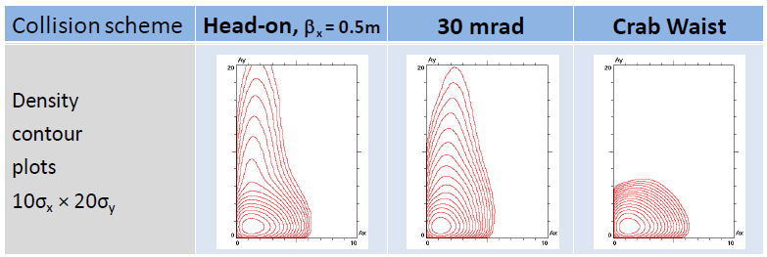

DA requirements
Beam lifetime due to bb effects.
Recommendation from simulations by D.Shatilov:
DA ≈ 10σ_{x} x 50σ_{y}
(incl.errors, misalignments,etc.)
Vertical beam tail growth example due to bb effects in FCC-ee at 120 GeV (D. Shatilov)
Effective injection (conventional type, on-energy, off-axis)
M. Aiba et al. FCCee review at CERN, 14.10.2015
Ax ≈ 13 mm N ≈ 16σ_{x}
J. Seeman. FCC week, Washington DC, March 25, 2015
Ax ≈ 16 mm N ≈ 15σ_{x}
K. Oide. FCC-ee Optics Meeting, CERN, 11 Sep. 2015
N ≈ 14.6σ_{x} @175 GeV N ≈ 30σ_{x} @45.6 GeV (@2.5σ_{e})
Required DA ≈ 20σ_{x} x 50σ_{y}

Slide 7
DA study and optimization
The lattice is too complex to optimize DA at once. We split it in sections and study/optimize step-by step:
Arcs,
FF & IR without Crab Sextupoles,
Arcs + FF & IR without Crab Sextupoles,
Arcs + FF & IR with Crab Sextupoles,
Radiation effects,
Solenoid fields, etc.
Two sections connection gives, as a rule, the DA less than the individual ones. Maximization of the individual DA is necessary at every step.

Slide 8
Low emittance FODO cell DA (I)
Emittance decreases with focusing increase but for too strong focusing emittance grows up again.
DA generally decreases with focusing increase. Strong sextupole resonances form gaps in the DA profile.
βx = 80 m
βy = 30 m
Ax>80σ
Ax>60σ

Slide 9
Low emittance FODO cell DA (II)
Rough estimations for harmonic Hamiltonian representation (1D for simplicity)
FODO with FCC-ee parameters, thin lense approximation, two sextupoles for the chromaticity compensation. The horizontal harmonic strength is estimated as
Where L is the cell half-length and θ is the cell half-bend. The DA (distance to the fixed point) in the vicinity of the resonance ν = m/n is
Being normilized to the beam size it gives
For FCC-ee parameters (θ = 2 mrad, L = 20 m, ρ = 10 km, ε_{x} = 1 nm, β_{x} = 80 m) the estimations give overestimated but still reasonabe values
Separation scheme (pretzel) destroys the FODO symmetery, increase number of resonances and can reduce the DA.

Slide 10
Interaction region DA
Due to the low vertical beta (~ 1 mm) at IP the paraxial approximation is not longer valid and the next (octupole-like) terms should be involved.
Due to the low vertical beta at IP chromatic effects are severe and require strong sextupoles for compensation. In spite the sextupoles are usually arranged in the “ – I pairs”, the high order effects reduce the DA.
Due to the high (~few km) betas in the first FF quadrupoles, the fringe field nonlinearities as well as the field errors are emphasized.

Slide 11
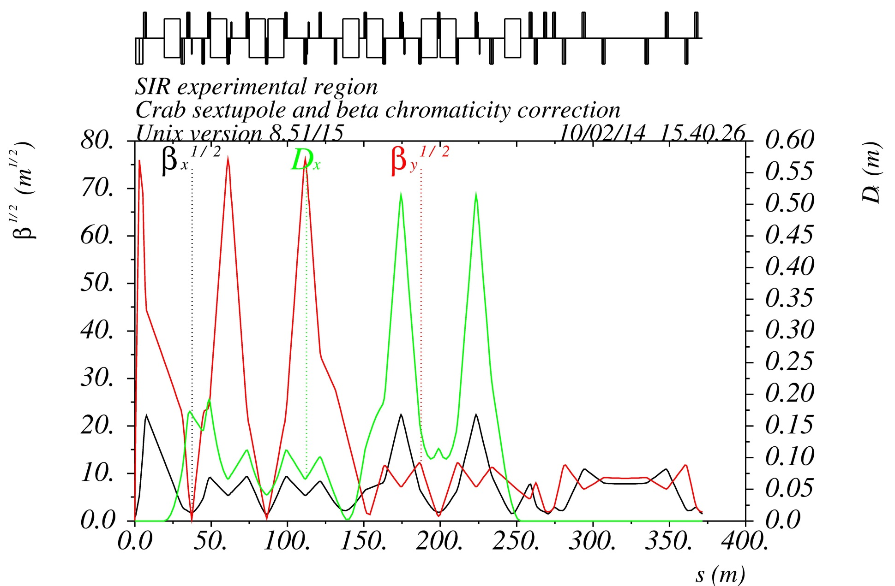
Optics blocks example
Y1
Y2
X1
X2
CRAB
First quad fringes: large strength and beta
Old version, for example only
IP: Kinematic terms: extremely low IP beta
-I
-I
Chromatic section:
strong sextupoles, large beta
FFT
YXCCS
CRAB

Slide 12
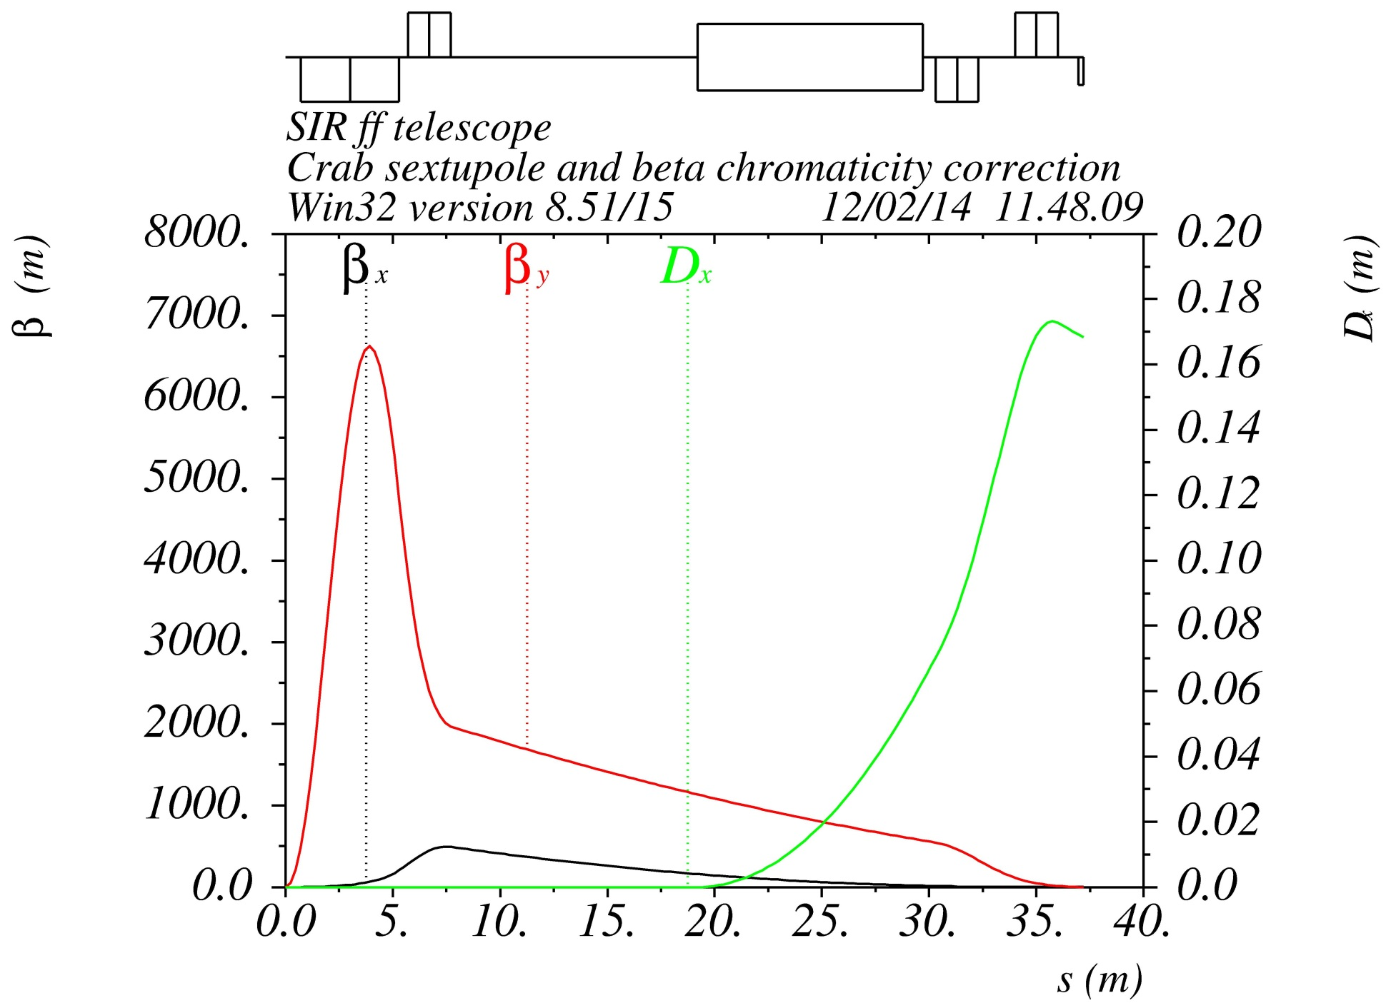
Final focus example
L*(D0)
QD0
Old version, for example only
D0=2 m
Q0: L=3.6 m, G=90 T/m @ 175 GeV
D1=0.4 m
Q1: L=2 m, G=84 T/m @ 175 GeV
IP

Slide 13
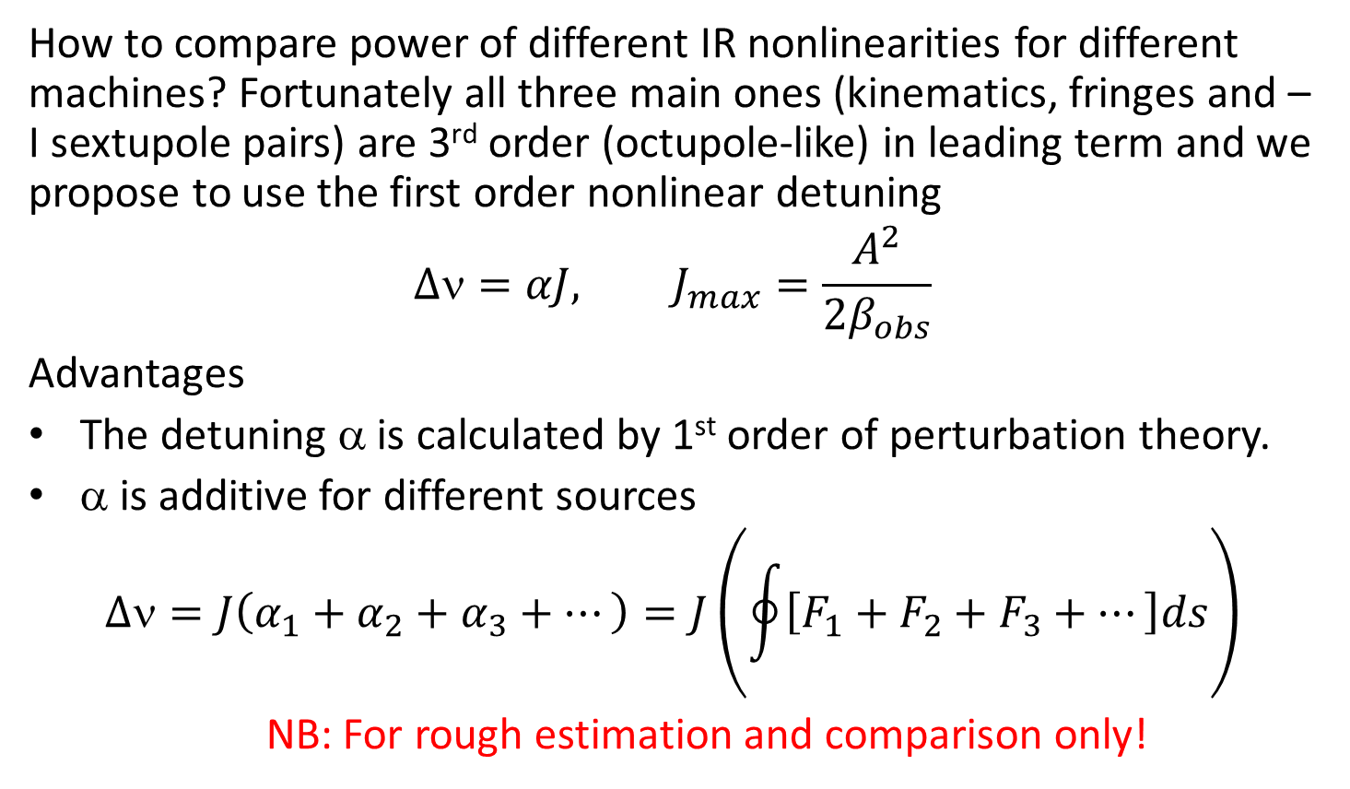
IR nonlinearities figure of merit
How to compare power of different IR nonlinearities for different machines? Fortunately all three main ones (kinematics, fringes and – I sextupole pairs) are 3rd order (octupole-like) in leading term and we propose to use the first order nonlinear detuning
$$∆ν=αJ, J_{max}=\frac{A^{2}}{2β_{obs}}$$
Advantages
The detuning α is calculated by 1st order of perturbation theory.
α is additive for different sources
$$∆ν=J\left(α_{1}+α_{2}+α_{3}+⋯\right)=J\left(\oint{\left[F_{1}+F_{2}+F_{3}+⋯\right]ds}\right)$$
NB: For rough estimation and comparison only!

Slide 14
Final quad QD0 and chromaticity
Defining the QD0 (thin lense) focusing requirements as α_{o} = –α_{I} one can find
The beta and its derivative in the end of L* are given by
FF vertical chromaticity(half of FF):
QD0 natural chromaticity
Correction by sextupoles
Note: For FF μ’ corresponds to the chromatic function excitation introduced by B.Montague (LEP Note 165, 1979)

Slide 15
Kinematics
For the extremely low β* and large transverse momentum the first order correction of non-paraxiality is given by
The main contribution comes from the IP and the first drift:
where 2L is the distance between 2 QD0 quads around the IP.

Slide 16
QD0 Fringe Fields
Quadrupole fringe field nonlinearity is defined by
and the vertical detuning coefficient is given by
Or, with above assumptions (k₁₀ is the central strength):
E.Levichev, P.Piminov, arXiv: 0903.3028
A.V.Bogomyagkov et al. IPAC13, WEPEA049, 2615

Slide 17
Chromatic sextupoles
Vertical chromatic sextupole pair separated by –I transformer gives the following coordinate transformation in the first order^{*)}
Pair of sextupoles
Octupole
By analogy to the octupole and using the expression for the FF chromaticity we found for the vertical detuning (2 pairs)
^{*)} A.Bogomyagkov, S.Glykhov, E.Levichev, P.Piminov http://arxiv.org/abs/0909.4872

Slide 18
Discussion
Kinematic effect increases with L* increase and β* decrease.
Fringe field effect increases fast with L* increase and β* decrease. It is sensitive to the QD0 central gradient k₁₀.
Sextupole pair effect increases with L* increase and β* decrease. Short sextupole and large dispersion are desirable.
In spite the estimations are very rough, they seem reasonable and are confirmed by tracking simulation.

Slide 19
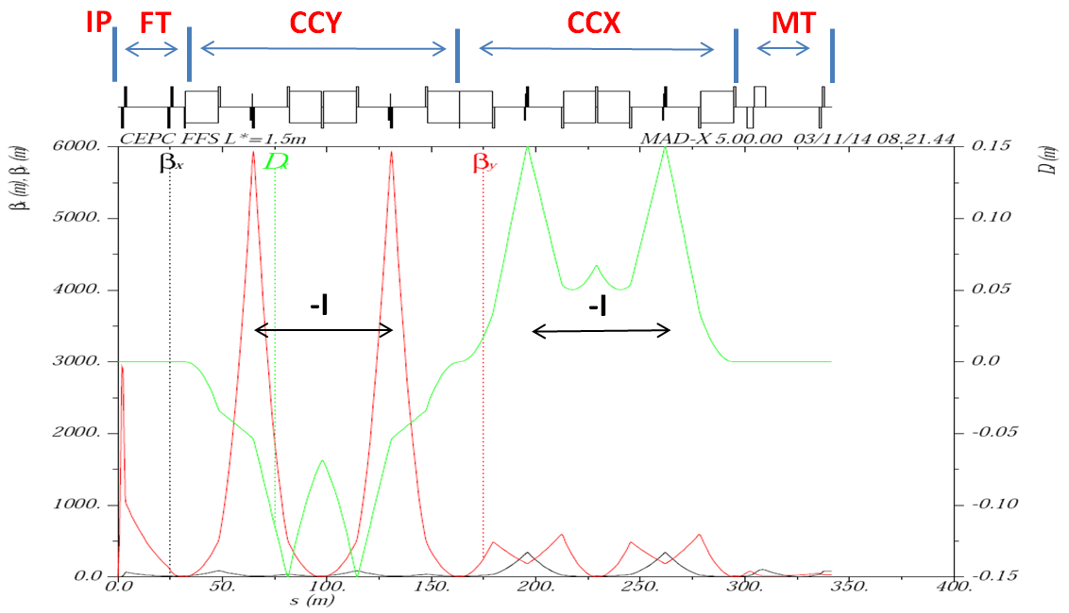
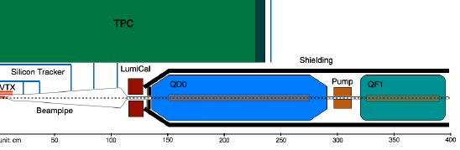
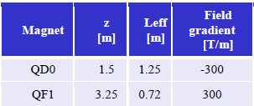
CEPC parameters
CEPC-SppC PreCDR, March 2015.
L* = 1.5 m, β_{y}* = 1.2 mm, β_{yFFmax} ≈ 3 km, β_{CCY} ≈ 6 km, η_{CCY} ≈ 5 cm

Slide 20
V.detuning for different lattices
 | LEP³⁾ CERN | Super C-Tau¹⁾ Novosibirsk | SuperKEKB²⁾ Japan | FCC-ee/AB 2015⁴⁾ | CEPC^{*)} IHEP
10³ β*(m) | 10 | 0.8 | 0.26 | 1 | 1.2
L*(m) | 3.5 | 0.6 | 0.76 | 2 | 1.5
-ξ* | 700 | 1500 | 5600 | 4000 | 2500
-K₁(m⁻²) | 0.11 | 12.8 | 5.1 | 0.15 | 0.75
L_{QD0}(m) | 2 | 0.2 | 0.32 | 3.6 | 1.25
β_{SY} (m) |  | 180 | 2000 | 3700 | ≈6000
η_{SY} (cm) |  | 13 | 46 | 15 | ≈5
10⁻⁶ α^{f} (m⁻¹) | 0.015 | 0.34 | 2.6 | 0.1 | 0.14
10⁻⁶ α^{k} (m⁻¹) | 0.008 | 0.11 | 1.3 | 0.24 | 0.12
10⁻⁶ α^{sp} (m⁻¹) | NA | 0.53 | 0.52 | 3.5 | 12
¹⁾ SuperC-Tau CDR, Novosibirsk, 2009.
²⁾ K.Oide, FCC Kick-off Meeting, Geneva, 14 Feb 2014
³⁾ T.M.Taylor, PAC 1985
⁴⁾ A.Bogomyagkov, FCC-ee asymmetric design, BINP, Dec 2015.
⁵⁾ CEPC-SPPC PreCDR, v.II, March 2015.
^{*)} I have no precise data, many guesses.

Slide 21
Comparison with simulation
 | Kin | Fringe | Sextupole pair
Simulation
α_{xx} (cm⁻¹) | 0.6 | 11 | -23
α_{xy} =α_{yx} (cm⁻¹) | 3.8 | 153 | -712
α_{yy} (cm⁻¹) | 755 | 1137 | -1.8×10⁵
Estimation
α_{yy} (cm⁻¹) | 844 | 430 | -0.2×10⁵
Simulation considers all quads fringes (included those strong in the Y chromatic section) and realistic beta behavior

Slide 22
Theoretical conclusions
FODO cell DA corresponding to low emittance is not very large compare to the required one. Careful phase advance selection is needed. Other approaches such as – I sextupole pairs arrangement or sextupole multi-families solution is possible (but more complex).
Major part of the vertical nonlinearity for the extra-low beta IP comes from chromatic sextupoles due to the finite length effect. The finite length effect in the –I sextupole pair can be improved by additional (low-strength) sextupole correctors.
Third order aberrations including the fringe field and kinematics can be mitigated by a set of octupole magnets located in proper beta and phase.

Slide 23
Simulation
Scenario:
We use the following tracking codes: MAD8 and Acceleraticum¹⁾ (BINP home made).
The tunes are fixed at (0.53, 0.57) to get large luminosity.
Dynamic aperture and other nonlinear characteristics are defined from tracking for different sources to found their power ranking.
We try to compensate (mitigate) every source locally by optimizing the phase advance, insertion of additional sextupoles and octupoles.
We collect all the ring sections together and optimize 6D DA globally (damping, tapering, errors, BB effects, etc. can be included at this stage).
¹⁾ D.Einfeld, Comparison of lattice codes, 2nd NL Beam Dynamics Workshop, Diamond Light Source, 2009

Slide 24
Recent example
FCC-ee DA optimization (November 2015)
Acceleraticum
SY5 OY1 SY1 SY2 SY4 SY3 OY2 … → SD (arcs)
SX6 SX5 OX1 SX1 SX2 SX4 SX3 OX2 … → SF
Set of nonlinear magnets in use.

Slide 25
Nonlinear magnets legend
SY5, SX6, SX5 – increase of the noninear (dynamic) bandwidth
SY1, SY3 – main vertical section for the FF chromaticity compensation. Arranged in the – I pair.
SY2, SY4 – sextupole corrector to compensate the finit length effect of SY1 and SY3. Also arranged in the – I pair.
SX1, SX3 – main horizontal section for the FF chromaticity compensation. Arranged in the – I pair.
SX2, SX4 – sextupole corrector to compensate the finit length effect of SX1 and SX3. Also arranged in the – I pair.
OY1, OY2, OX1, OX2 – octupole correctors to mitigate the kinematic and FF fringes effects
SD, SF – vertical and horizontal sextupoles in the arcs.

Slide 26
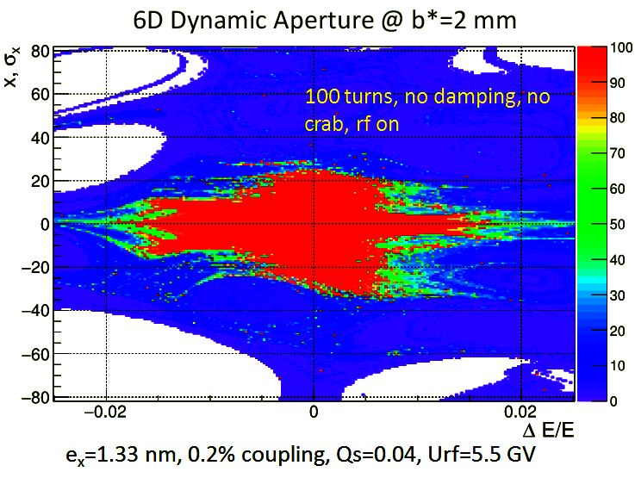
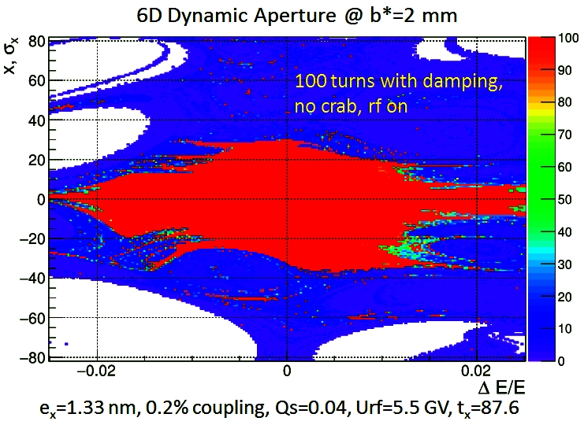
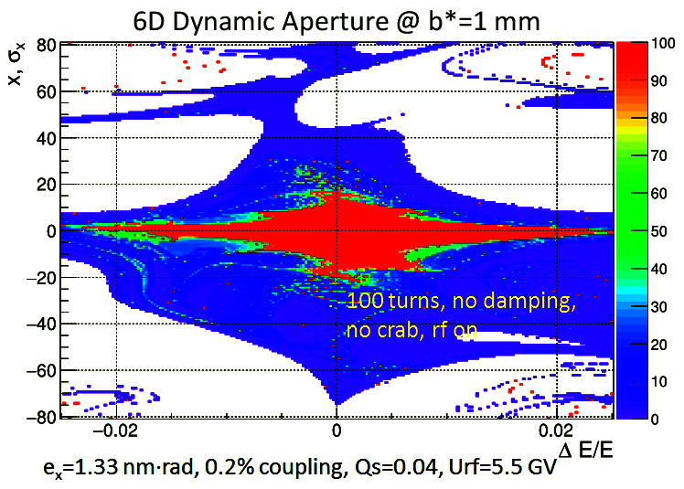
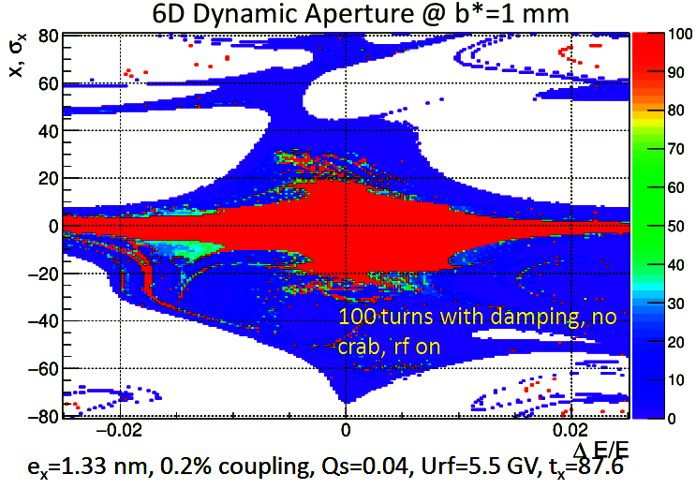
DA with/without damping

Slide 27
Conclusion
For high performance e+e- factories DA limitation is a challenging problem.
Main limiting factors are: vertical sextupole chromatic section in IR, FF quads fringes, arc sextupoles.
Local + global compensation can schemes provide reasonable DA.
Damping at high energy is an important factor increasing the DA.
Remaining problems: interference of CW sextupoles with other IR nonlinearities reduces the DA; proper (distributed) radiation in the arcs; quads radiation contribution (“damping DA”); magnet tapering; detector solenoid (and other MDI elements) effects; machine errors and misalignments; BB effects.

