Slide 1
CEPC Interaction Region design and Dynamic Aperture Optimization
Yiwei Wang, Yuan Zhang, Dou Wang, Huiping Geng,
Xiaohao Cui, Sha Bai, Tianjian Bian, Feng Su, Jie Gao
Institute of High Energy Physics (IHEP, Beijing)
The first IHEP-BINP CEPC Accelerator Collaboration Workshop
IHEP, 12-13 January 2016

Slide 2
Outline
Lattice design of the interaction region
Optimization of the interaction region nonlinearity
Summary

Slide 3
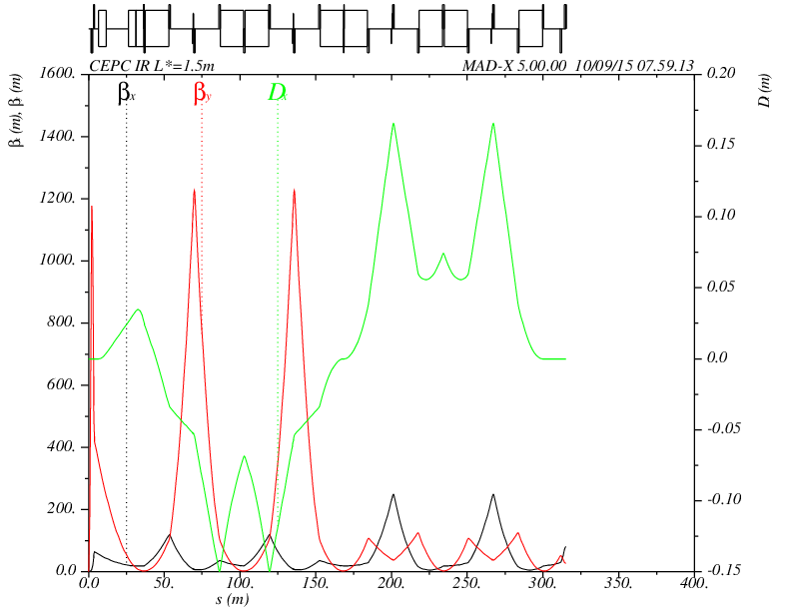
Lattice of interaction region
IR lattice design with local chromaticity correction with
βx*=0.8m, βy*=3mm, εx=6.12nm, κ=0.3%, L*=1.5m, 2IPs
latest lattice for head-on collision: FFS_3.0mm_v3.0_Nov_2015
IP
FT
CCY
CCX
MT
L*= 1.5m
βy*= 3mm
GQD0= -300T/m
GQF1= 300T/m
-I
-I

Slide 4
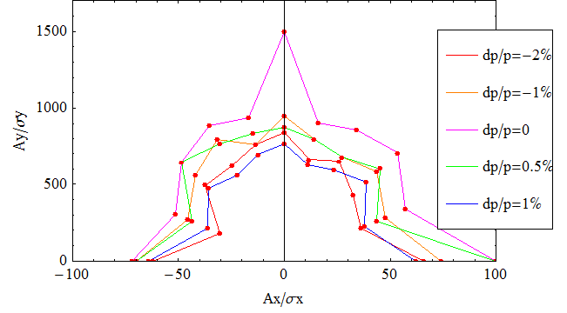
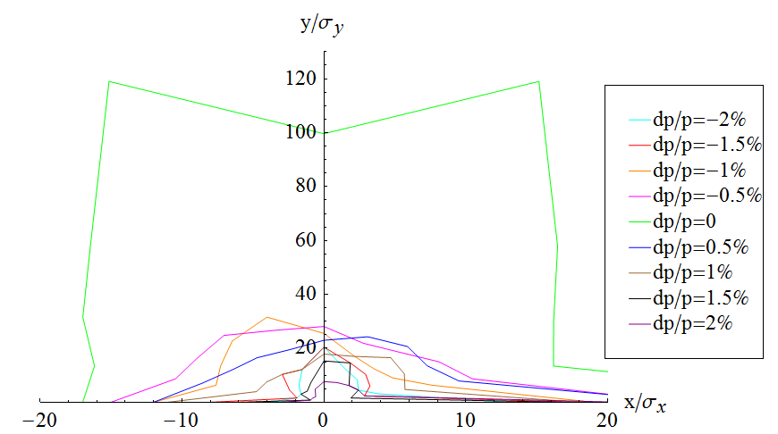
Lattice of interaction region
Dynamic aperture of whole ring is limited by the strong nonlinearity of IR due to small βy*
An example: DA with only ARC vs. DA with ARC + preliminary IR
Optimization of the dynamic aperture
Local correction: optimization of IR nonlinearity
Global correction: with help of ARC (see Yuan Zhang’s talk)
W/ ARC (20140930 by Huiping Geng)
W/ ARC+IR (FFS_3.0mm_v0_Feb_2015 Yiwei Wang)
±2% (1.5σx , 13.5σy)
without radiation damping, error of the magnets, synchrotron motion included
Tracking with 3 times of damping time, Coupling factor κ=0.003 for emitty

Slide 5
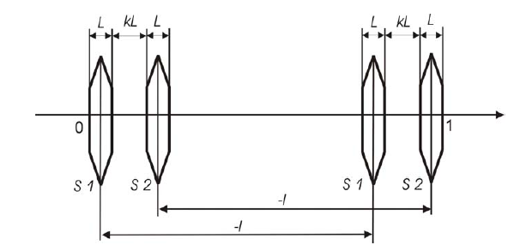
Finite length effect of sextupoles
Add additional sextupoles next to the main one*
Compensate the finite length effect (Lsext=0.3m)
k=1, S1/S2=-0.1
*A.Bogomyagkov et al.
http://arxiv.org/abs/0909.4872

Slide 6
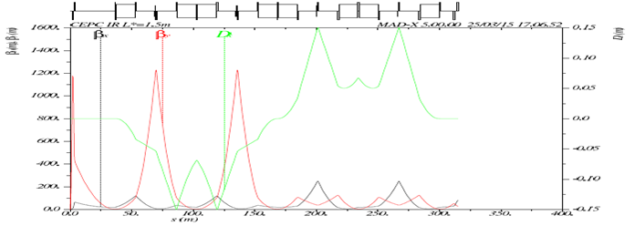
High order chromaticity
remove 2 quads in FT#
tune phase of sextupoles#
FFS_3.0mm_v1.0_Mar_2015
# Yunhai Cai, private communication.
K. Oide, SLAC-PUB-4806, Nov 1988.
additional sext at 1st image point*
*K. Oide, SLAC-PUB-4806, Nov 1988.
R. Brinkmann, DESY M-90-14, Nov 1990.
FFS_3.0mm_v2.2_Sep_2015

Slide 7
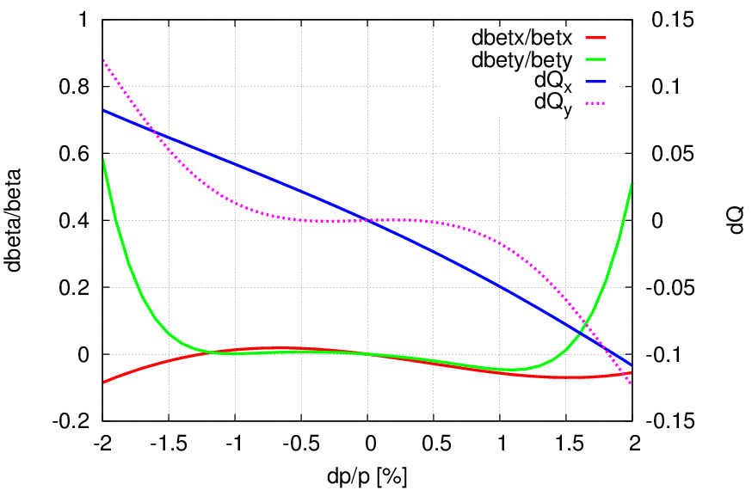
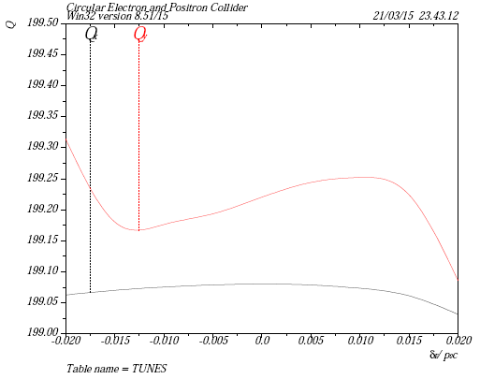
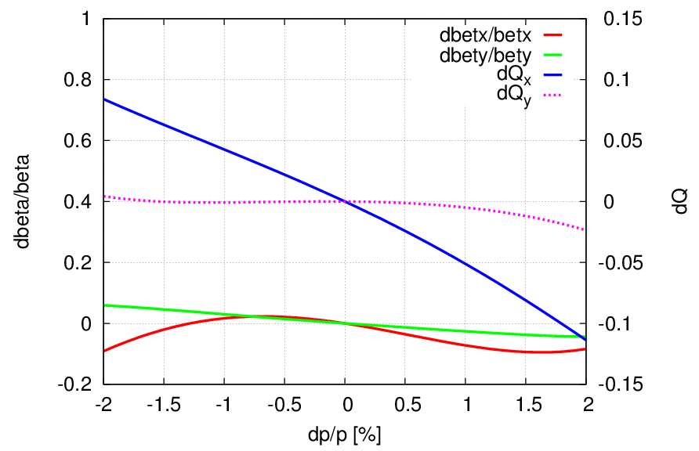
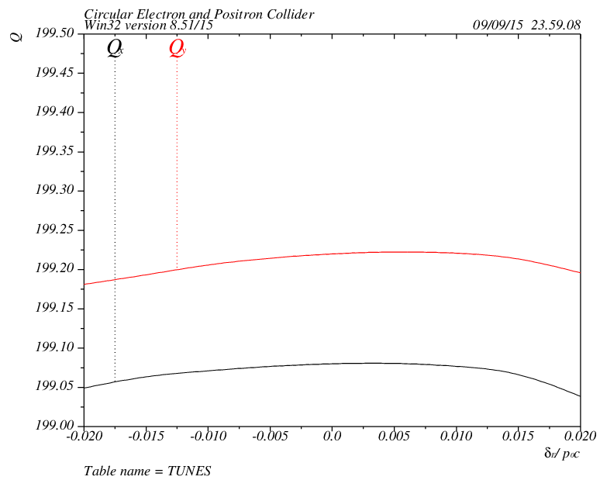
High order chromaticity (cont.)
Tune shift due to energy deviation
v1.0
v2.2
IR only, from IP to the entrance of FFS
IR + ARC, periodic solution

Slide 8
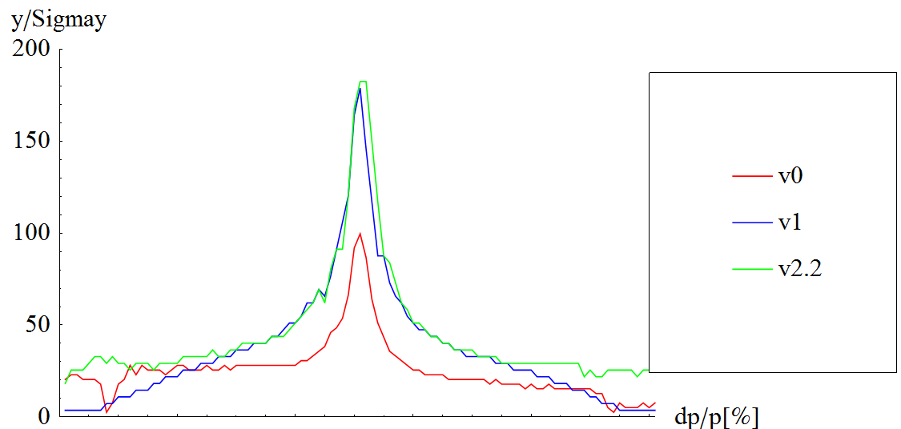
High order chromaticity (cont.)
Vertical dynamic aperture vs. dp/p
From v1.0 -> v2.2: DA increased significantly for large off-momentum 20σy for ±2% (green line)
W/O error of the magnets
Synchrotron motion included
Tracking with 3 times of damping time
Coupling factor κ=0.003 for εy
x0=0.001σx
-2
-1
0
1
2

Slide 9
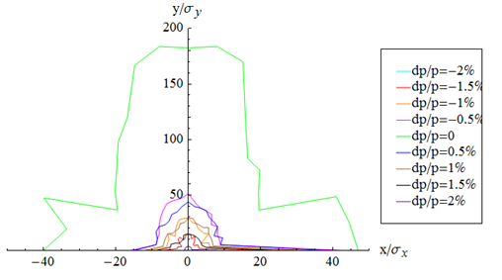
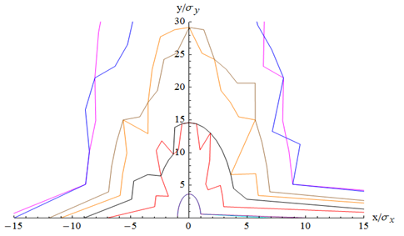
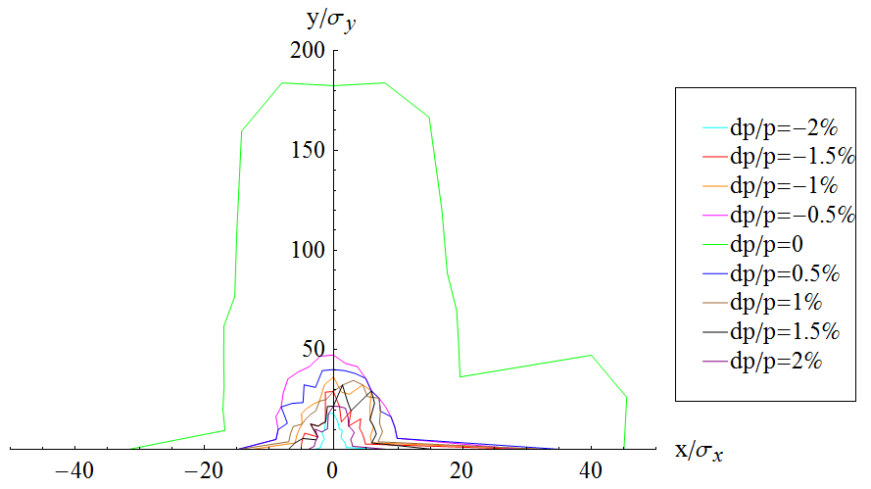
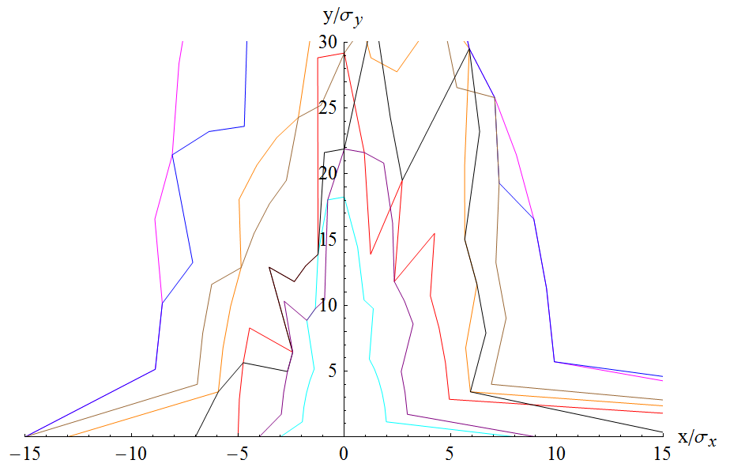
High order chromaticity (cont.)
Dynamic aperture for both planes
v2.2: on momentum (20σx, 180 σy), off momentum ±2% (2.5σx , 20σy)
v1.0
v2.2

Slide 10
-I break down and high order dispersion
Many additional sextupoles in IR
Idea from linear collider final focus*
Six more sextupoles (3,4,5,8,9,10) to correct break down of –I transformation
Three more sextupoles (2,6,7) help to correct the second order dispersion and so on
*R. Brinkmann, DESY M-90-14, Nov 1990.
IP
FT
CCY
CCX
MT
L*=1.5m
βy*=3mm
1
2
3
4
5
6
7
8
9
10
-I
-I
FFS_3.0mm_v3.0_Nov_2015

Slide 11
-I break down and high order dispersion (cont.)
In practice, dynamic aperture is optimized directly with the additional sextupoles in IR
W/O error of the magnets
Synchrotron motion included
Tracking with ~1 times of damping time
Coupling factor κ=0.003 for εy
Downhill simplex algorithm used*
19 points of dp/p from -2% to 2%
Optimize with initial phases (phasex, phasey)=(0,0),(pi/2, pi/2), (0, pi/2), (pi/2, 0)
*K. Oide, private communication

Slide 12
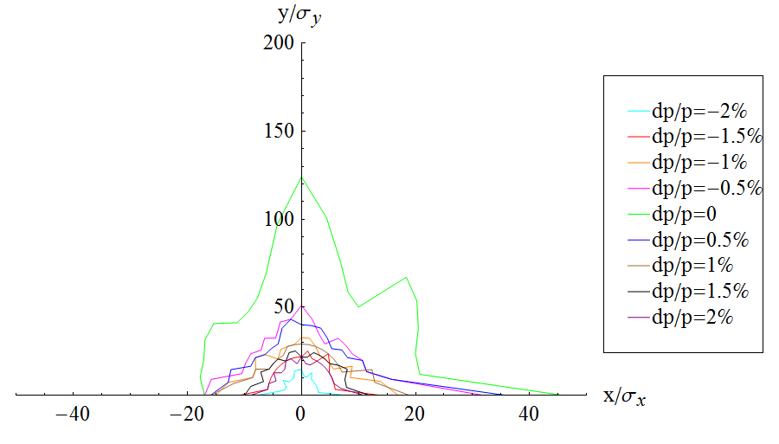
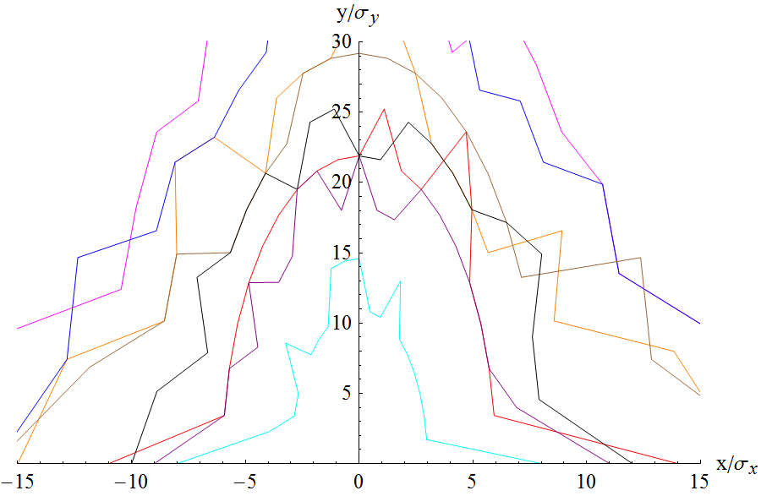
-I break down and high order dispersion (cont.)
FFS_3.0mm_v3.0_Nov_2015
L*=1.5m
βy*=3mm
1
2
3
4
5
6
7
8
9
10
-I
-I
+(2,3,4,5) sextupoles

Slide 13
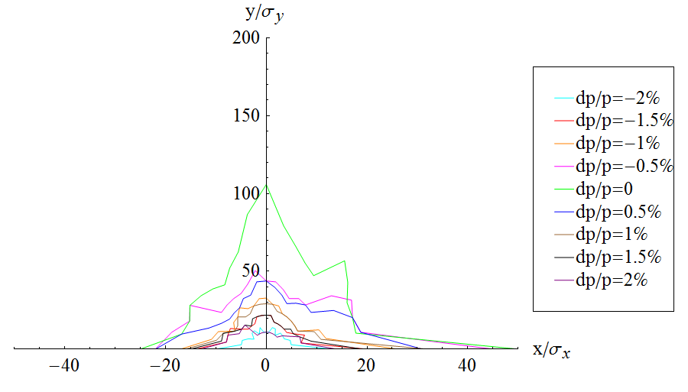
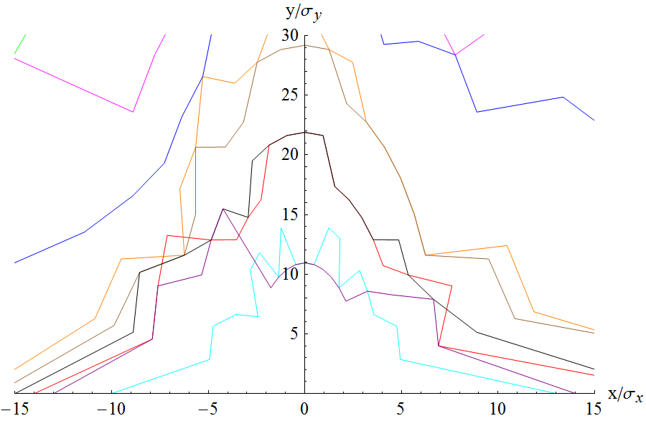
-I break down and high order dispersion (cont.)
FFS_3.0mm_v3.0_Nov_2015
L*=1.5m
βy*=3mm
1
2
3
4
5
6
7
8
9
10
-I
-I
+(2,3,4,5,6,7) sextupoles

Slide 14
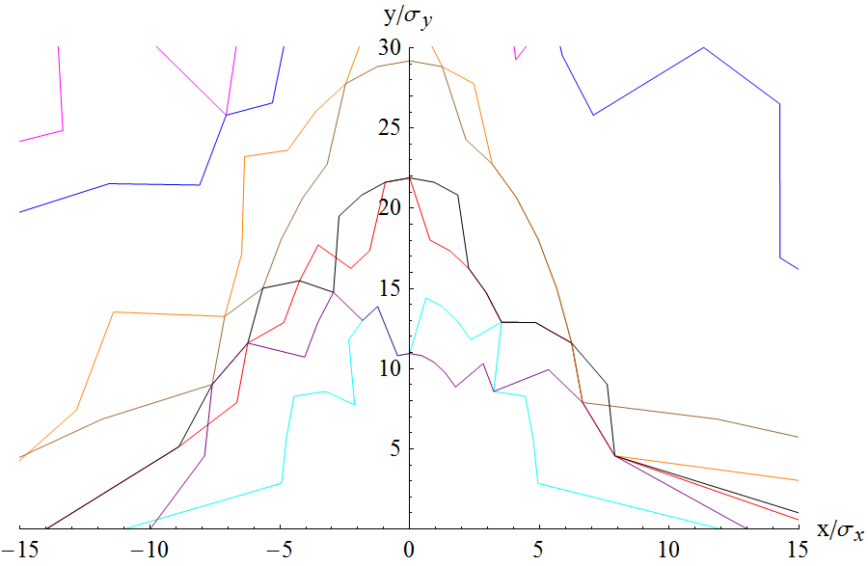
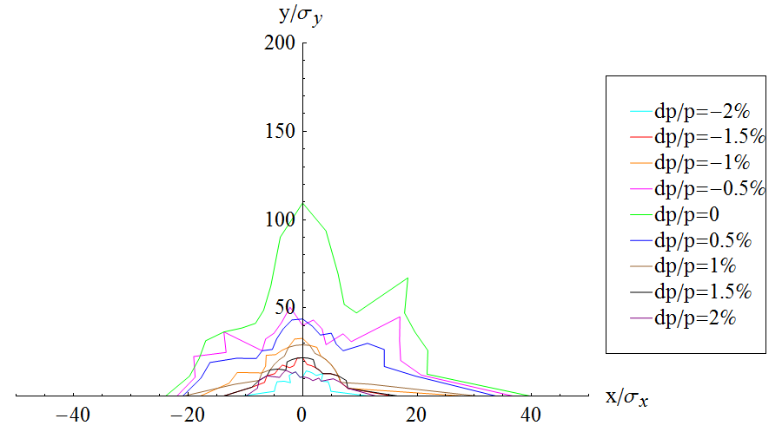
-I break down and high order dispersion (cont.)
FFS_3.0mm_v3.0_Nov_2015
L*=1.5m
βy*=3mm
1
2
3
4
5
6
7
8
9
10
-I
-I
+(2,3,4,5,6,7,8,9,10) sextupoles

Slide 15
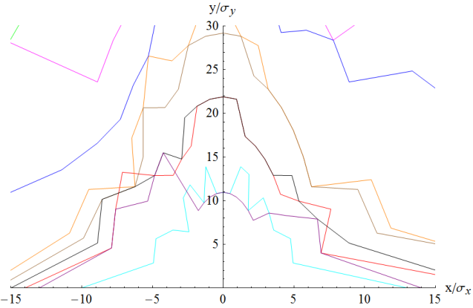
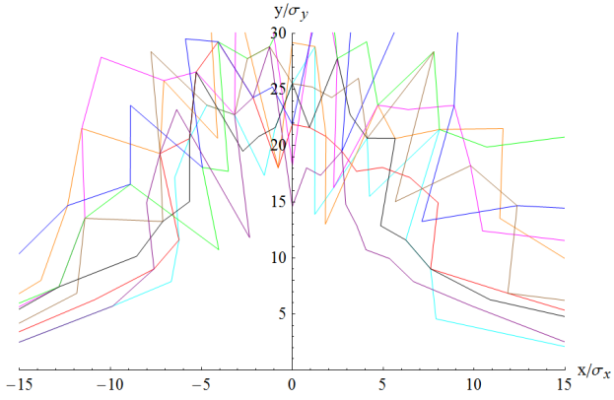
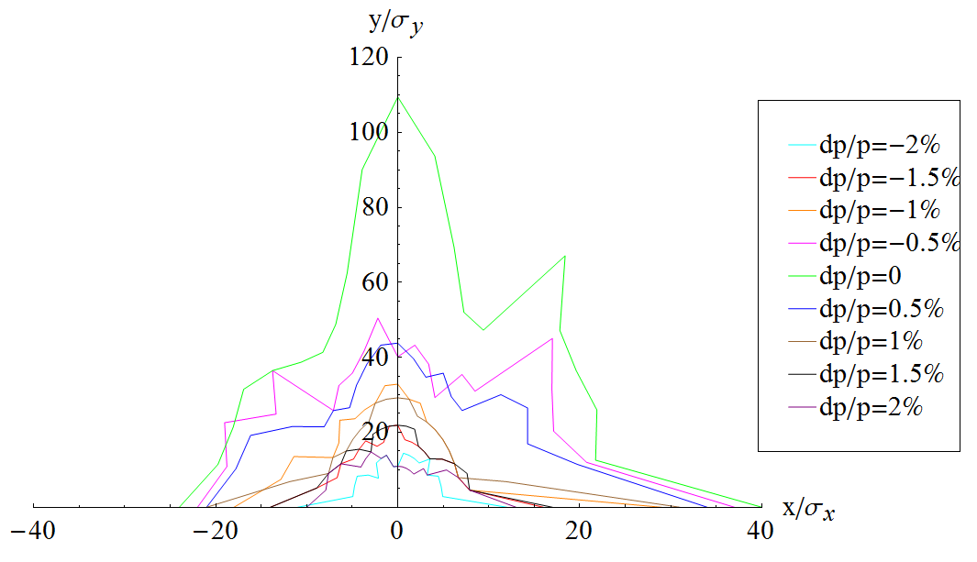
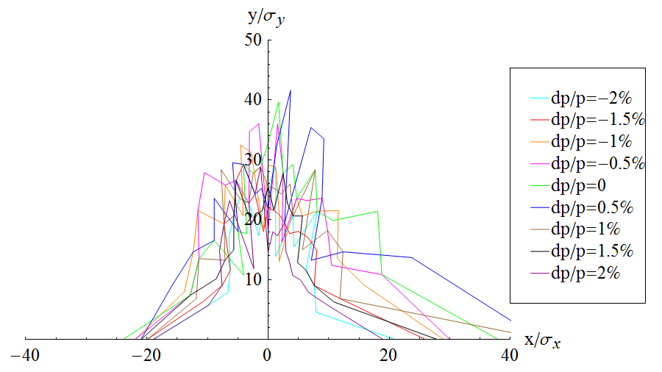
Radiation damping
Dynamic aperture is optimized directly with the additional sextupoles in IR
W/O error of the magnets
Synchrotron motion and radiation damping included
Tracking with 1 times of damping time
Coupling factor κ=0.003 for εy
W/O damping: ~6.5 σx × 10σy for ±2%
W/ damping: ~9 σx × 20σy

Slide 16
Acknowledge
Yunhai Cai, Demin Zhou, Katsunobu Oide, Kazuhito Ohmi, Yingshun Zhu, Ming Xiao, Gang Xu, Qing Qin, Yoshihiro Funakoshi, Yukiyoshi Ohnishi, Hiroshi Sugimoto
Thanks for their kind help and beneficial discussions!

Slide 17
Summary
To optimize the dynamic aperture of CEPC main ring
Local correction within IR have been tried
DA incresed significantly, though some prospects needed to be check.
Combine of local and global correction is under going
Multi-object optimization is necessary to get a better solution and quick convergence.

Slide 18
Thank you for your attention!

