Slide 1




CEPC partial double ring scheme and crab-waist parameters
Dou Wang, Jie Gao, Feng Su, Ming Xiao, Yuan Zhang, Jiyuan Zhai, Yiwei Wang, Bai Sha, Huiping Geng, Tianjian Bian, Xiaohao Cui, Yuanyuan Guo
1st IHEP-BINP CEPC Accelerator Collaboration Workshop, Jan 12-13, 2016 . IHEP

Slide 2
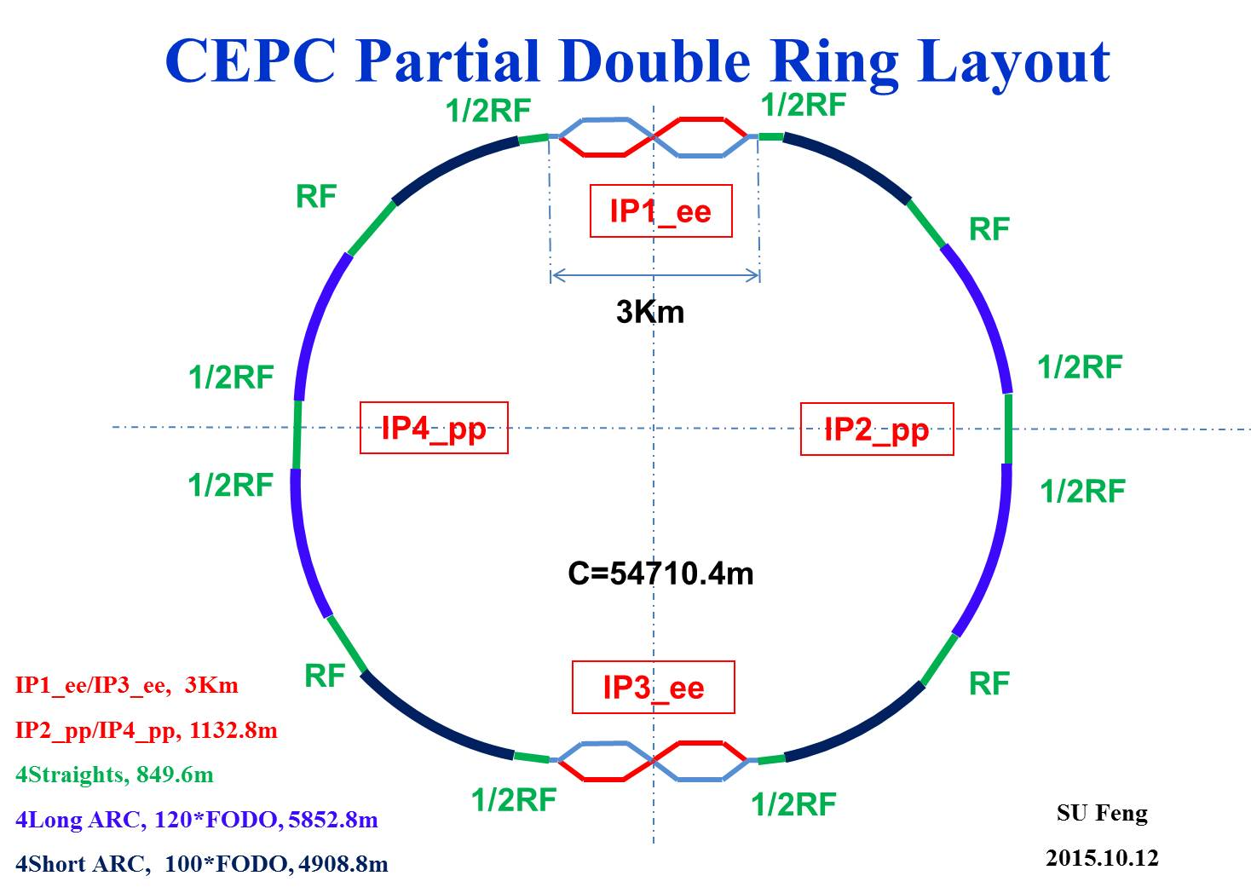
Advantage:
Avoid pretzel orbit
Accommodate more bunches at Z/W energy
Reduce AC power with crab waist collision
bypass (pp)
bypass (pp)

Slide 3
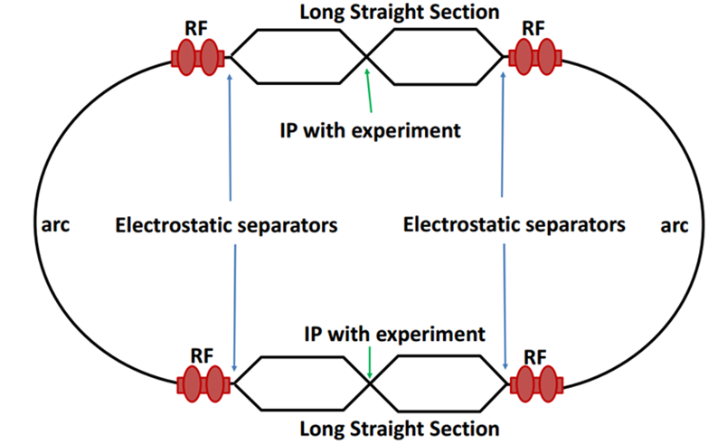
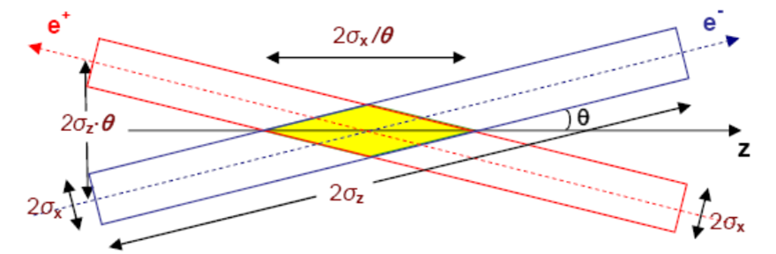
Machine constraints / given parameters
Energy E₀
Circumference C₀
N_{IP}
Beam power P₀
β_{y}*
Emittance coupling factor κ_{ε}
Bending radius ρ
Piwinski angle Φ
ξy enhancement by crab waist F_{l} ~1.5
Energy acceptance (DA)
Phase advance per cell (FODO)

Slide 4
Constraints for parameter choice
Limit of Beam-beam tune shift
F_{l}: ξy enhancement by crab waist
Beam lifetime due to beamstrahlung
BS life time: 30 min
V.I. Telnov
Beamstrahlung energy spread
A=δ₀/δ_{BS} (A≥3)
HOM power per cavity
*J. Gao, emittance growth and beam lifetime limitations due to beam-beam effects in e+e- storage rings, Nucl. Instr. and methods A533（2004）p. 270-274.

Slide 5
Parameter choice – step 1
Beam-beam limit:
F_{l}: ξy enhancement by crab waist, ~ 1.5.

Slide 6
Parameter choice – step 2

Slide 7
Parameter choice – step 3
BS life time: 30 min
ξy:
μ-- phase advance/cell, ϕ-- bending angle/cell.
Estimate :

Slide 8
Parameter choice – step 4

Slide 9
Parameter choice – step 5
Effective bunch length: overlap area of colliding bunches
Hour glass effect:

Slide 10
Parameter choice – step 6
V_{rf} , φ_{s}
Energy acceptance from RF:

Slide 11
Parameter choice – step 7
Beam lifetime due to radiative Bhabha scattering
Beam lifetime due to Beamstrahlung
HOM power per cavity
HOM loss factor:
*V.I. Telnov, "Issues with current designs for e+e- and gammagamma colliders“, PoS Photon2013 (2013) 070. https://inspirehep.net/record/1298149/files/Photon%202013_070.pdf

Slide 12
Primary parameter for CEPC double ring
 | Pre-CDR | H-high lumi. |  | H-low power |  | Z
Number of IPs | 2 | 2 |  | 2 |  | 2
Energy (GeV) | 120 | 120 |  | 120 |  | 45.5
Circumference (km) | 54 | 54 |  | 54 |  | 54
SR loss/turn (GeV) | 3.1 | 2.96 |  | 2.96 |  | 0.062
Half crossing angle (mrad) | 0 | 14.5 | 8.9 | 11.5 | 8.7 | 16.5
Piwinski angle | 0 | 2 | 3.1 | 2 | 2 | 2.6
N_{e}/bunch (10¹¹) | 3.79 | 3.79 | 1.32 | 2.81 | 2.0 | 0.37
Bunch number | 50 | 50 | 144 | 40 | 57 | 1100
Beam current (mA) | 16.6 | 16.9 | 16.9 | 10.1 | 10.1 | 36.2
SR power /beam (MW) | 51.7 | 50 | 50 | 30 | 30 | 2.2
Bending radius (km) | 6.1 | 6.2 | 6.2 | 6.2 | 6.2 | 6.1
Momentum compaction (10⁻⁵) | 3.4 | 3.0 | 2.3 | 2.6 | 2.5 | 5.4
β_{IP} x/y (m) | 0.8/0.0012 | 0.306/0.0012 | 0.058/0.0016 | 0.22/0.001 | 0.115/0.001 | 0.3/0.001
Emittance x/y (nm) | 6.12/0.018 | 3.34/0.01 | 2.32/0.0058 | 2.67/0.008 | 2.56/0.0078 | 1.18/0.0069
Transverse σ_{IP} (um) | 69.97/0.15 | 32/0.11 | 11.6/0.097 | 24.3/0.09 | 17.6/0.088 | 18.8/0.083
ξ_{x}/IP | 0.118 | 0.04 | 0.01 | 0.04 | 0.028 | 0.02
ξ_{y}/IP | 0.083 | 0.11 | 0.11 | 0.11 | 0.11 | 0.042
V_{RF} (GV) | 6.87 | 3.7 | 3.6 | 3.6 | 3.7 | 0.28
f _{RF} (MHz) | 650 | 650 | 650 | 650 | 650 | 650
Nature σ_{z} (mm) | 2.14 | 3.3 | 3.0 | 3.2 | 3.0 | 3.0
Total σ_{z} (mm) | 2.65 | 4.4 | 4.0 | 4.2 | 4.0 | 3.0
HOM power/cavity (kw) | 3.6 | 3.3 | 1.0 | 1.5 | 0.95 | 0.73
Energy spread (%) | 0.13 | 0.13 | 0.13 | 0.13 | 0.13 | 0.05
Energy acceptance (%) | 2 | 2 | 2 | 2 | 2
Energy acceptance by RF (%) | 6 | 2.2 | 2.2 | 2.2 | 2.4 | 2.0
n_{γ} | 0.23 | 0.49 | 0.46 | 0.47 | 0.46 | 0.08
Life time due to beamstrahlung_cal (minute) | 47 | 53 | 32 | 41 | 32
F (hour glass) | 0.68 | 0.73 | 0.89 | 0.69 | 0.7 | 0.83
L_{max}/IP (10³⁴cm⁻²s⁻¹) | 2.04 | 2.97 | 2.75 | 2.03 | 2.07 | 1.25

Slide 13
CEPC single ring parameter
 | H |  | Z
 | Pre-CDR | Low-HOM
Number of IPs | 2 | 2 | 2
Energy (GeV) | 120 | 120 | 45.5
Circumference (km) | 54 | 54 | 54
SR loss/turn (GeV) | 3.1 | 3.1 | 0.062
N_{e}/bunch (10¹¹) | 3.79 | 1.0 | 0.13
Bunch number | 50 | 187 | 4800
Beam current (mA) | 16.6 | 16.6 | 55.5
SR power /beam (MW) | 51.7 | 50 | 3.45
Bending radius (km) | 6.1 | 6.1 | 6.1
Momentum compaction (10⁻⁵) | 3.4 | 3.4 | 3.4
β_{IP} x/y (m) | 0.8/0.0012 | 0.06/0.001 | 0.4/0.0012
Emittance x/y (nm) | 6.12/0.018 | 6.13/0.018 | 0.9/0.018
Transverse σ_{IP} (um) | 69.97/0.15 | 19.2/0.13 | 18.9/0.15
ξ_{x}/IP | 0.118 | 0.031 | 0.072
ξ_{y}/IP | 0.083 | 0.074 | 0.028
V_{RF} (GV) | 6.87 | 6.87 | 0.68
f _{RF} (MHz) | 650 | 650 | 650
Nature σ_{z} (mm) | 2.14 | 2.13 | 1.5
Total σ_{z} (mm) | 2.65 | 2.4 | 1.5
HOM power/cavity (kw) | 3.6 | 1.0 | 0.55
Energy spread (%) | 0.13 | 0.13 | 0.05
Energy acceptance (%) | 2 | 1.5
Energy acceptance by RF (%) | 6 | 6.1 | 4.5
n_{γ} | 0.23 | 0.21 | 0.028
Life time due to beamstrahlung_cal (minute) | 47 | 46
F (hour glass) | 0.68 | 0.66 | 0.82
L_{max}/IP (10³⁴cm⁻²s⁻¹) | 2.04 | 2.1 | 1.04

Slide 14
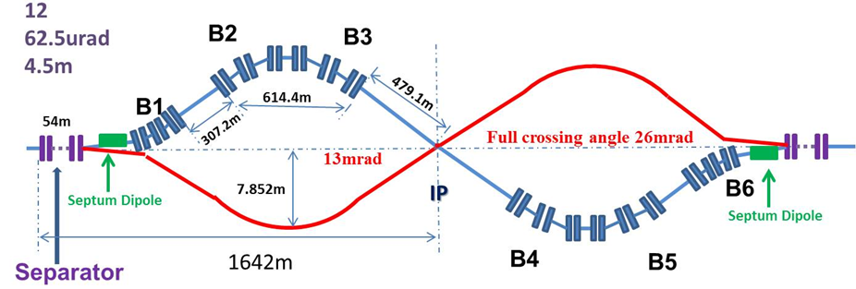
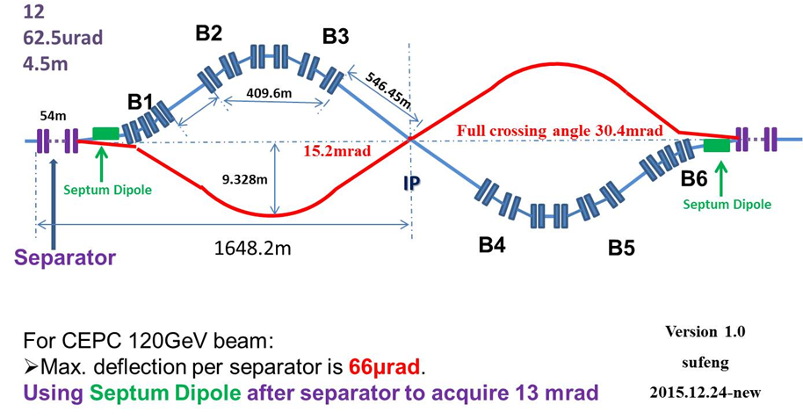
CEPC Partial Double Ring Lattice

Slide 15
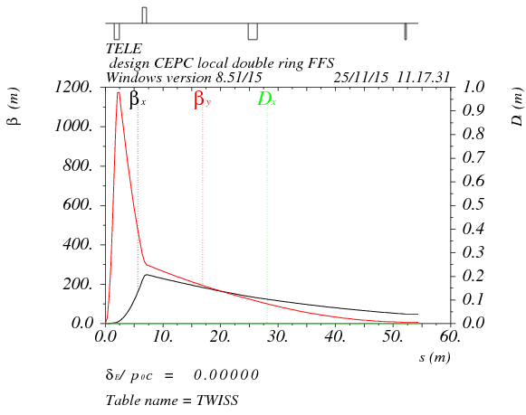
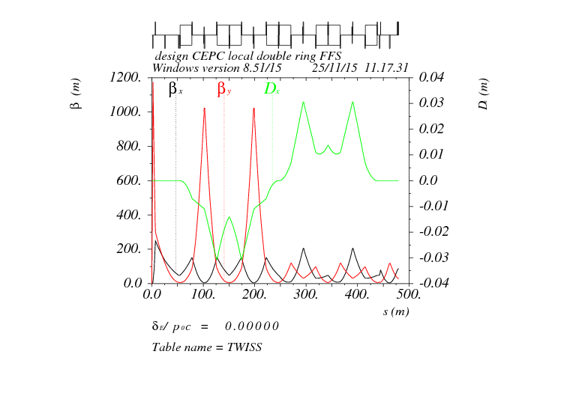
Double ring FFS design with crab sextupoles
Betax=0.8m
Betay=0.003m
Crab sextupole
IP
Critical energy: Ec=100 keV
Dipole strength: B=0.01 T
L*=1.5m
L(QD0)=0.91m, G(QD0)=-300T/m
L(QF1)=0.74m, G(QF1)=106T/m
L₀=4m
As Oide said, the second FFS sextupoles of the CCS-Y section can work as the crab sextupoles, if their strengths and phases to the IP are properly chosen.

Slide 16
Crab sextupole strength
Δϕ_{x}=2π, Δϕ_{y}=2.5π
The crab sextupole should be placed on both sides of the IP in phase with the IP in the horizontal plane and at π/2 in the vertical one.

Slide 17
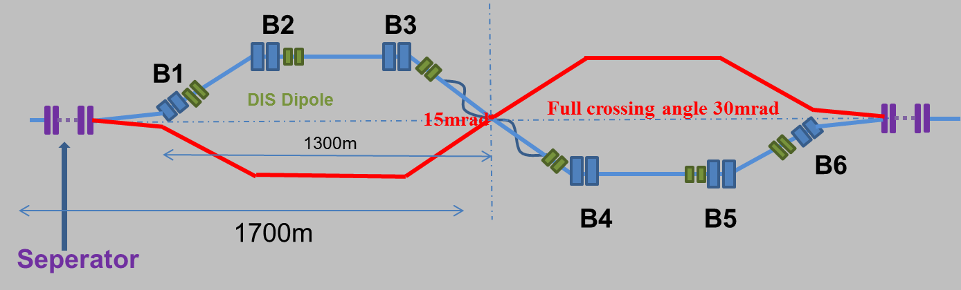
Combine with partial double ring lattice
FFS orbit

Slide 18
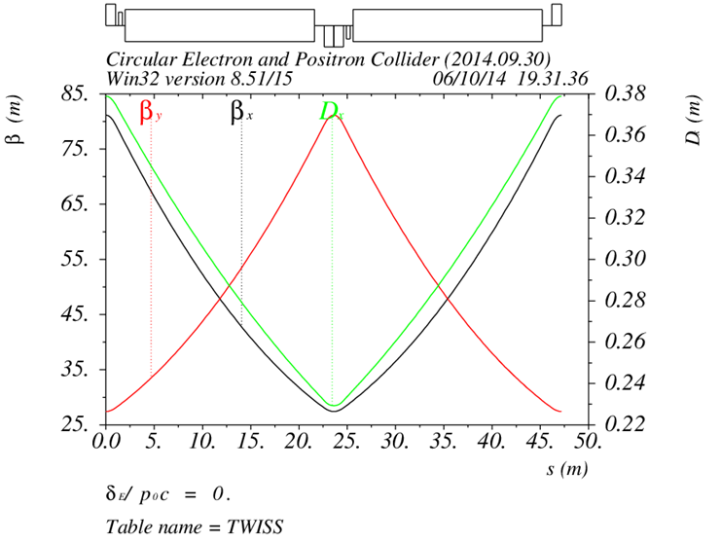
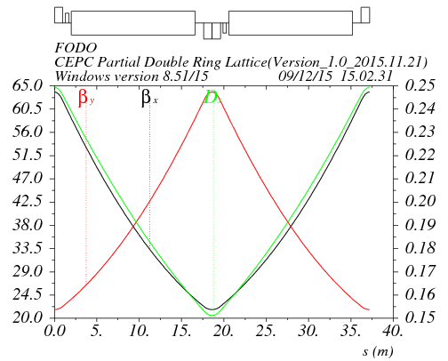
Arc redesign-lower emittance
Length of FODO cell: 47.2m
Phase advance of FODO cells: 60/60 degrees
Emittance: 7.9nm, αp=5.38E-5
Bunch length: 2.3mm
Length of FODO cell: 37.5m
Phase advance of FODO cells: 60/60 degrees
Emittance: 4.3nm , αp=2.25E-5
Bunch length: 3.3mm

Slide 19
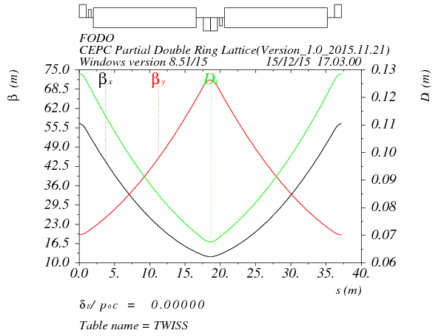
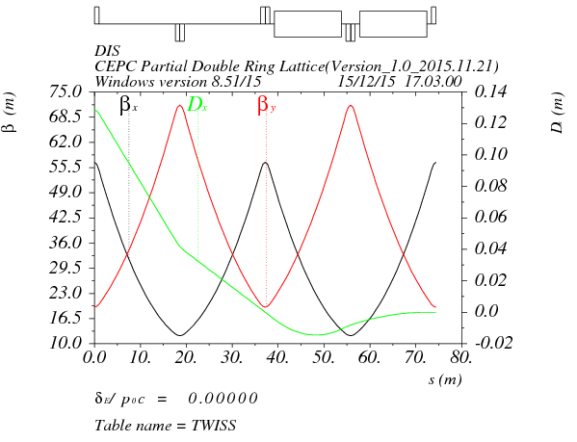
Arc redesign-ultra low emittance
Length of FODO cell: 37.5m
Phase advance of FODO cells: 90/60 degrees
Emittance: 2.3nm, αp=1.07E-5
Bunch length: 3.3mm
Dispersion supressor:
Angle(BDIS1)=3.583724E-03
Angle(BDIS2)=-8.598108E-04
Angle(B0)=2.723923E-03
BDIS1
BDIS2
B0
B0

Slide 20
summary
A consistent calculation method for CEPC parameter choice with carb waist scheme has been created.
Based on partial double ring scheme, we can get higher luminosity (+50%) keeping Pre-CDR beam power or to reduce the beam power (30 MW) keeping same luminosity.
Based on partial double ring scheme, we get a set of Z parameter with 1.25*10³⁴cm⁻²s⁻¹ luminosity using 1100 bunches.
CEPC single ring scheme is neither easy to reduce cavity HOM power for Higgs nor to accommodate more bunches for Z.
FFS with crab sextupoles and lower emittance arc has been designed. DA optimization is undergoing.

Slide 21
Thanks！

