Slide 1
Dynamic Aperture Optimization in CEPC
ZHANG Yuan, WANG Yiwei, GENG Huiping, WANG Dou
zhangy@ihep.ac.cn
Jan 12th, 2016

Slide 2
Outline
Introduction
Optimization by Dynamics “Analysis”
Optimization by Algorithm
Summary

Slide 3
Introduction
The ring is closed by Huiping, Dou and Yiwei, including the IR
The linear chromaticity is corrected to 0
The task is to optimize the sextupole(multipole) strength to enlarge the dynamic aperture
MADX and SAD is used

Slide 4
Chromaticity

Slide 5
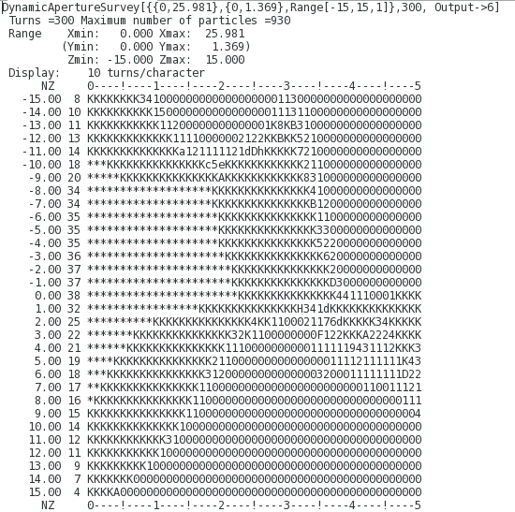
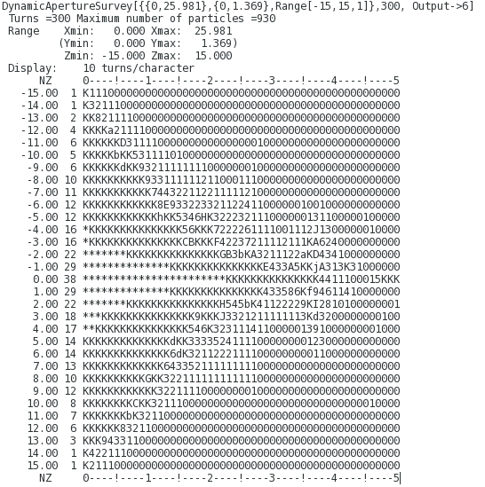
SAD: DAPWIDTH=15, NORFSW vs RFSW

Slide 6
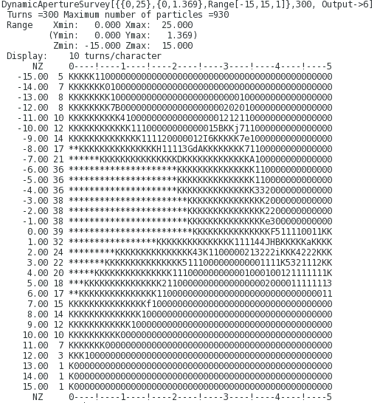
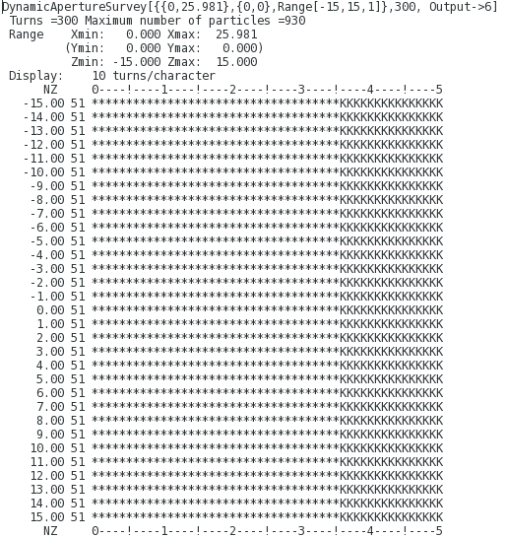
SAD: DAPWIDTH=15, NORFSW(0.3% vs 0)

Slide 7

It tells us,
Since the DA for negative momentum deviation is better than positive, we may tune the nonlinear parameters for $δp>0$ referencing to that for $δp<0$
The X-Y coupling resonance is very important for DA.

Slide 8

The GNFU@IP for $δ_{p}$=-0.006/+0.006
"GNFC" 3 0 0 0 -5.149963789e-12
"GNFS" 3 0 0 0 -0.02306695348
"GNFA" 3 0 0 0 0.02306695348
"GNFC" 2 1 0 0 -2.466987725e-11
"GNFS" 2 1 0 0 -0.4348156416
"GNFA" 2 1 0 0 0.4348156416
"GNFC" 1 0 2 0 3.922195901e-11
"GNFS" 1 0 2 0 -75.85348672
"GNFA" 1 0 2 0 75.85348672
"GNFC" 1 0 1 1 -6.941291986e-11
"GNFS" 1 0 1 1 64.25366995
"GNFA" 1 0 1 1 64.25366995
"GNFC" 1 0 0 2 7.865708085e-12
"GNFS" 1 0 0 2 2.038894417
"GNFA" 1 0 0 2 2.038894417
"GNFC" 3 0 0 0 4.007127963e-12
"GNFS" 3 0 0 0 0.9498285205
"GNFA" 3 0 0 0 0.9498285205
"GNFC" 2 1 0 0 -1.301625474e-12
"GNFS" 2 1 0 0 0.6736062092
"GNFA" 2 1 0 0 0.6736062092
"GNFC" 1 0 2 0 -3.754507816e-11
"GNFS" 1 0 2 0 74.49193338
"GNFA" 1 0 2 0 74.49193338
"GNFC" 1 0 1 1 1.465636501e-10
"GNFS" 1 0 1 1 -79.49210913
"GNFA" 1 0 1 1 79.49210913
"GNFC" 1 0 0 2 -7.226930165e-11
"GNFS" 1 0 0 2 14.32651633
"GNFA" 1 0 0 2 14.32651633

Slide 9
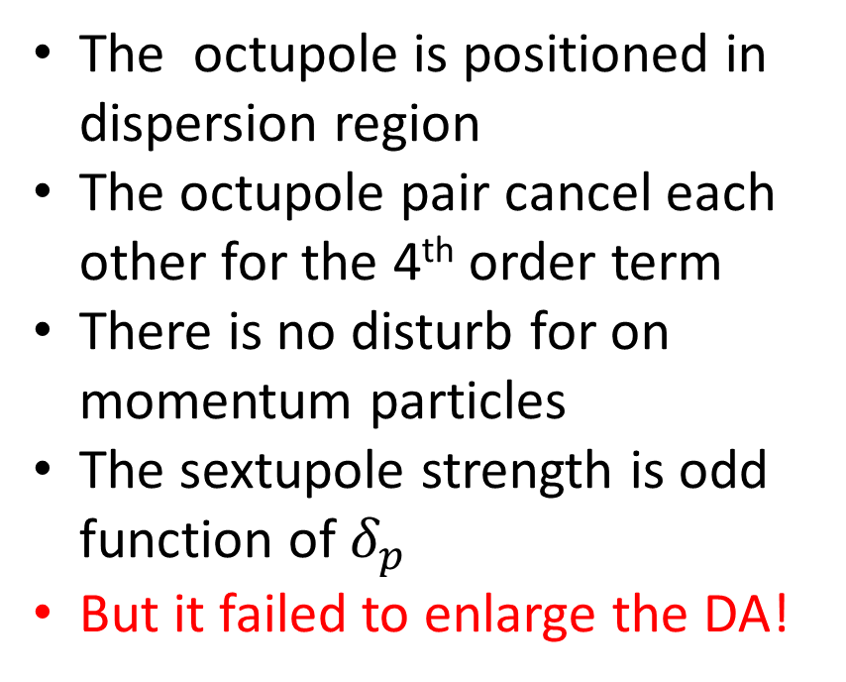

Specific Octupole Pattern to tune GNFU(3) behavior
The octupole is positioned in dispersion region
The octupole pair cancel each other for the 4th order term
There is no disturb for on momentum particles
The sextupole strength is odd function of $δ_{p}$
But it failed to enlarge the DA!
+OCT
-OCT
$$π$$

Slide 10
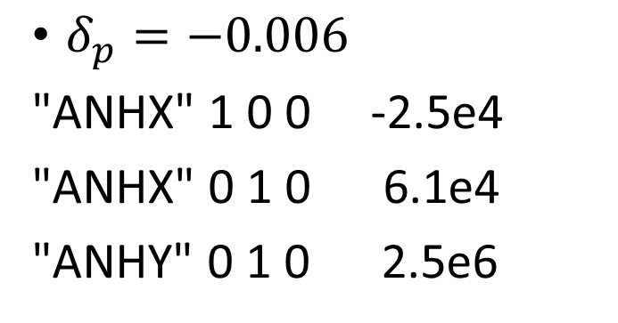
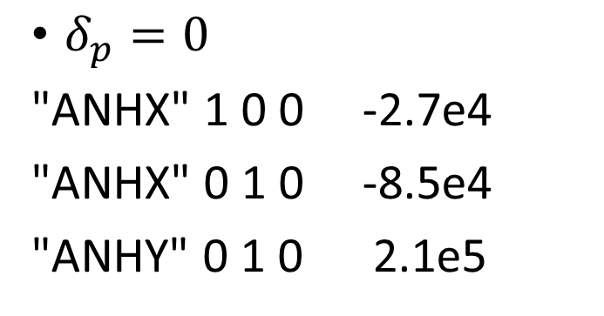
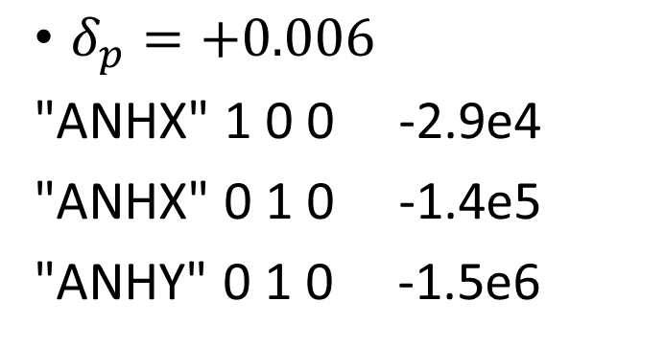
The Detuning term
$δ_{p}=0$
"ANHX" 1 0 0 -2.7e4
"ANHX" 0 1 0 -8.5e4
"ANHY" 0 1 0 2.1e5
$δ_{p}=−0.006$
"ANHX" 1 0 0 -2.5e4
"ANHX" 0 1 0 6.1e4
"ANHY" 0 1 0 2.5e6
$δ_{p}=+0.006$
"ANHX" 1 0 0 -2.9e4
"ANHX" 0 1 0 -1.4e5
"ANHY" 0 1 0 -1.5e6
ANHX100/ANHX010 mainly comes from the arc
ANHY010 mainly comes from IR

Slide 11
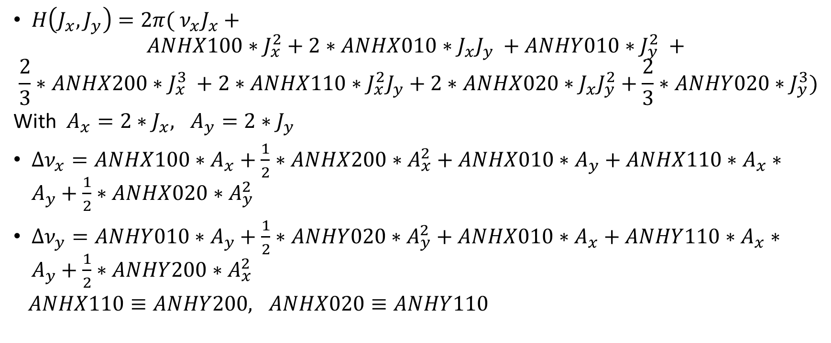
MADX tune shift calculation
$H\left(J_{x}, J_{y}\right)=2π( ν_{x}J_{x}+$
$$ANHX100∗J_{x}^{2}+2∗ANHX010∗J_{x}J_{y} +ANHY010∗J_{y}^{2} +$$
$$\frac{2}{3}∗ANHX200∗J_{x}^{3} +2∗ANHX110∗J_{x}^{2}J_{y}+2∗ANHX020∗J_{x}J_{y}^{2}+\frac{2}{3}∗ANHY020∗J_{y}^{3})$$
With $A_{x}=2∗J_{x}, A_{y}=2∗J_{y}$
$Δν_{x}=ANHX100∗A_{x}+\frac{1}{2}∗ANHX200∗A_{x}^{2}+ANHX010∗A_{y}+ANHX110∗A_{x}∗A_{y}+\frac{1}{2}∗ANHX020∗A_{y}^{2}$
$Δν_{y}=ANHY010∗A_{y}+\frac{1}{2}∗ANHY020∗A_{y}^{2}+ANHX010∗A_{x}+ANHY110∗A_{x}∗A_{y}+\frac{1}{2}∗ANHY200∗A_{x}^{2}$
$ANHX110≡ANHY200, ANHX020≡ANHY110$

Slide 12

Tune shift vs amplitude (on-momentum)
19$σ$

Slide 13


Tune shift vs amplitude (-2$σ_{p}$)
1$8σ$

Slide 14


Tune shift vs amplitude (+2$σ_{p}$)
1$2σ$

Slide 15
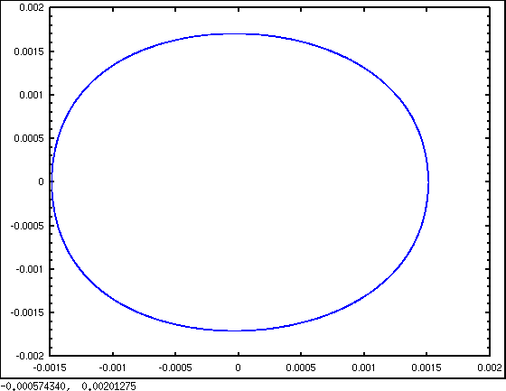
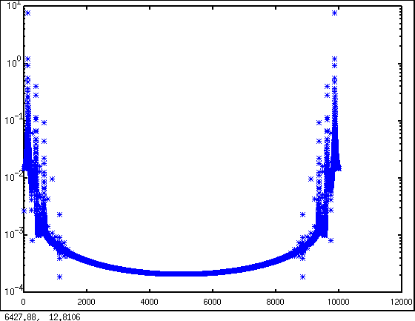
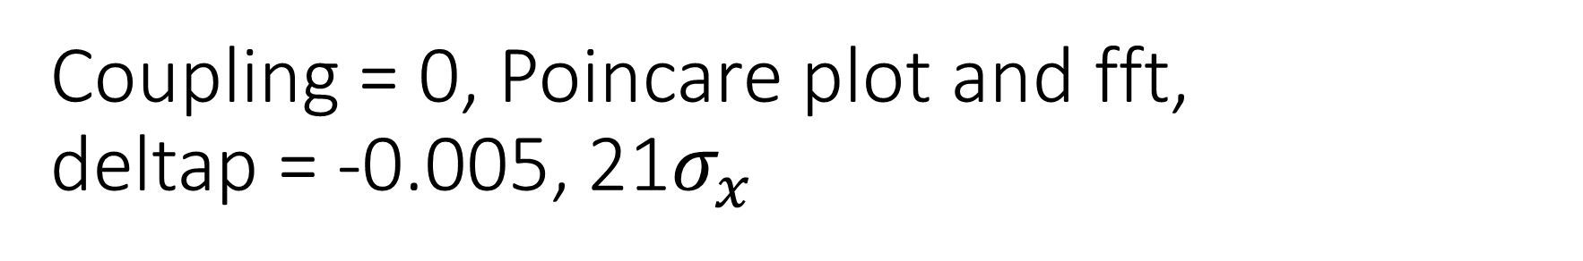
Coupling = 0, Poincare plot and fft, deltap = -0.005, 21$σ_{x}$

Slide 16
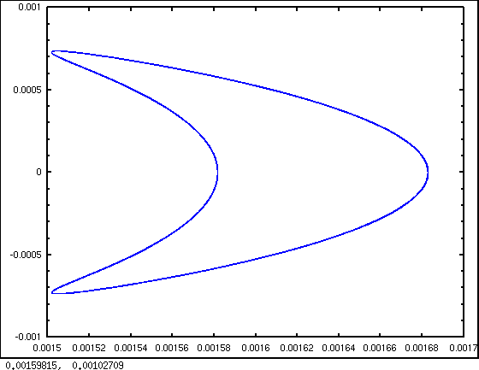
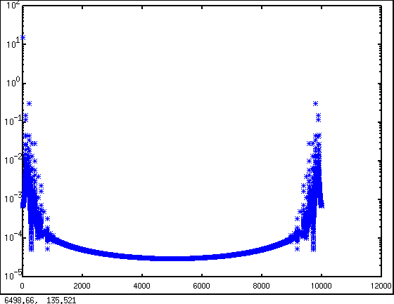
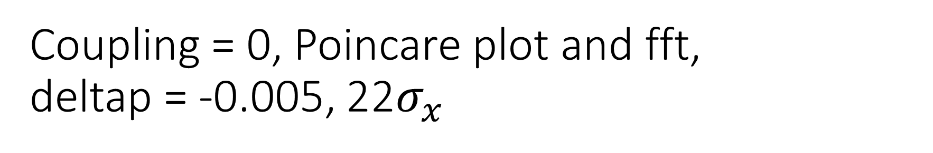
Coupling = 0, Poincare plot and fft, deltap = -0.005, 22$σ_{x}$

Slide 17
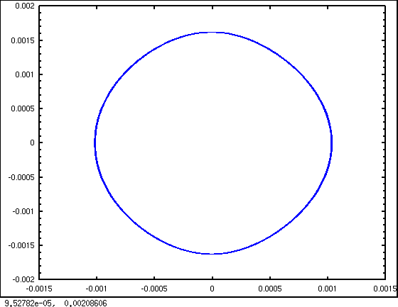
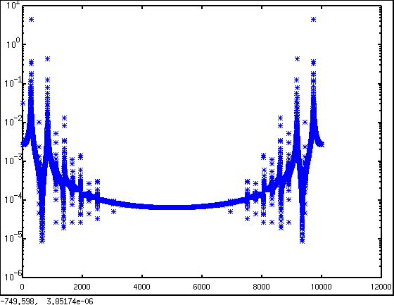
Coupling = 0, Poincare plot and fft, deltap = +0.005, 16sigmax,

Slide 18
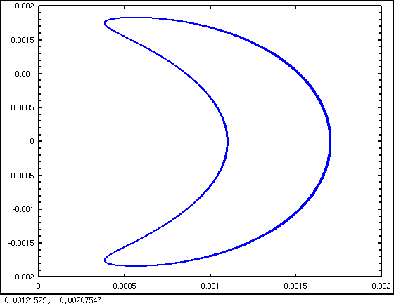
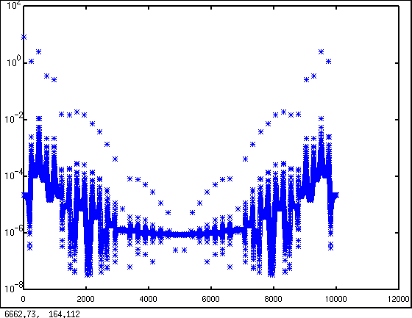
Coupling = 0, Poincare plot and fft, deltap = +0.005, 17sigmax,

Slide 19
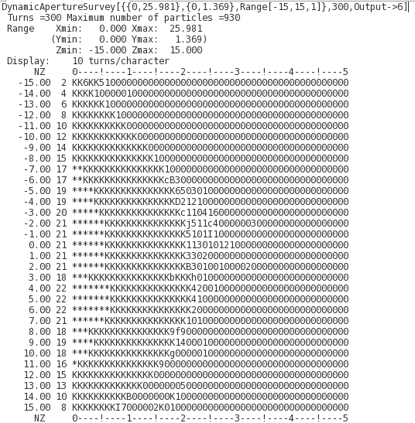
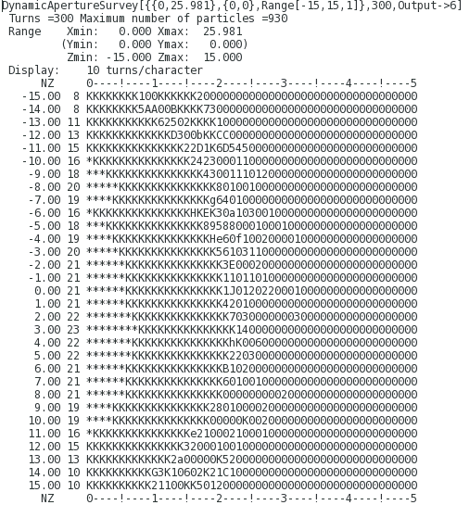
Higher multipoles – Decapole
Interleave Decapole (F/D)
DA limitation comes from oscillation in X

Slide 20
Tuneshift, decapole

Slide 21
Tuneshift, decapole, anhx300 included

Slide 22
We want to answer what limit the dynamic aperture. But it seems the cause is not clear.
One way is to control the tune shift well, and constrain the geometric terms at the same time. We did some try, but failed to find a good solution.
It is very slow to calculate the nonlinear parameters using MADX for such a large machine.
Another way is to optimize the DA directly using algorithm
A parallel code is implemented
Differential evolution algorithm is used (Suggested by Qiang Ji@LBNL)

Slide 23
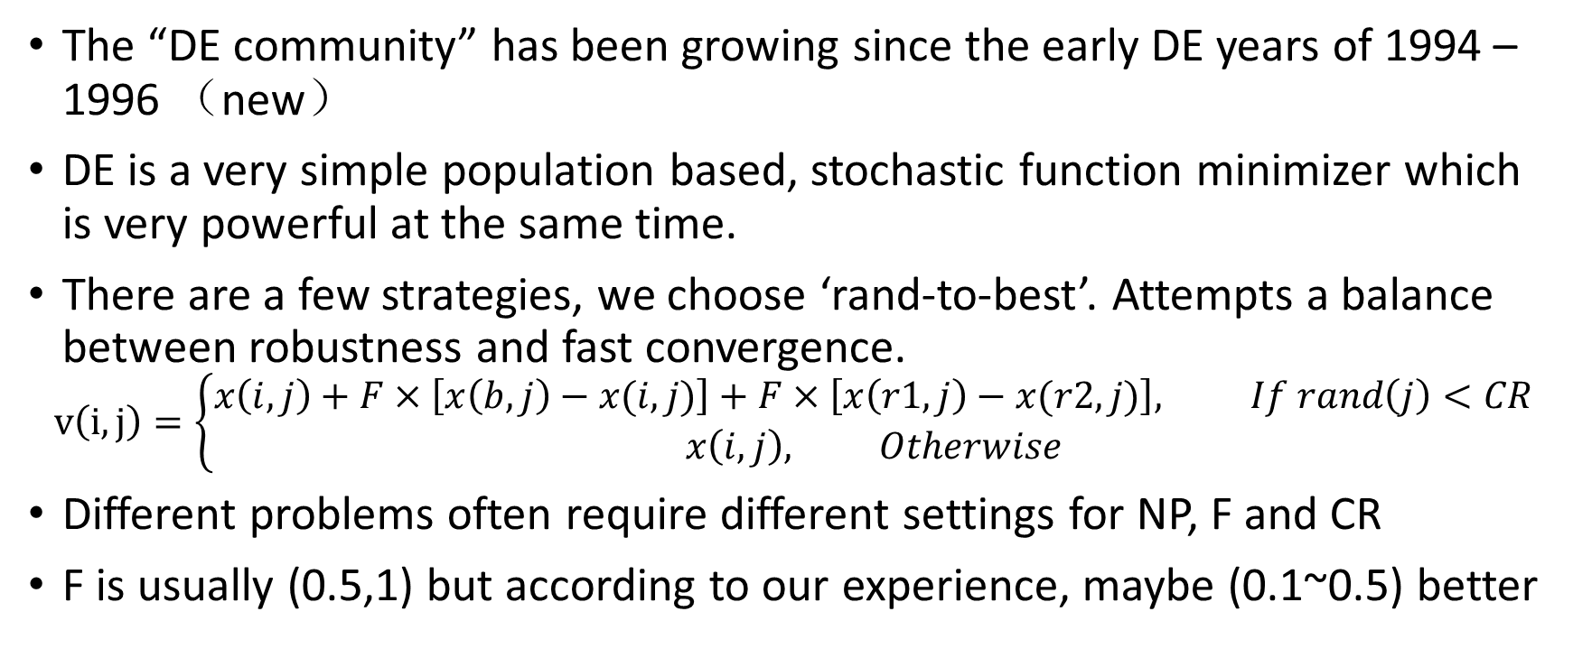
Differential Evolution
The “DE community” has been growing since the early DE years of 1994 – 1996 （new）
DE is a very simple population based, stochastic function minimizer which is very powerful at the same time.
There are a few strategies, we choose ‘rand-to-best’. Attempts a balance between robustness and fast convergence.
$$v\left(i,j\right)=\left\{\begin{matrix}x\left(i,j\right)+F×\left[x\left(b,j\right)−x(i,j)\right]+F×\left[x\left(r1,j\right)−x(r2,j)\right], If rand\left(j\right)<CR \\ x\left(i,j\right), Otherwise\end{matrix}\right.$$
Different problems often require different settings for NP, F and CR
F is usually (0.5,1) but according to our experience, maybe (0.1~0.5) better

Slide 24
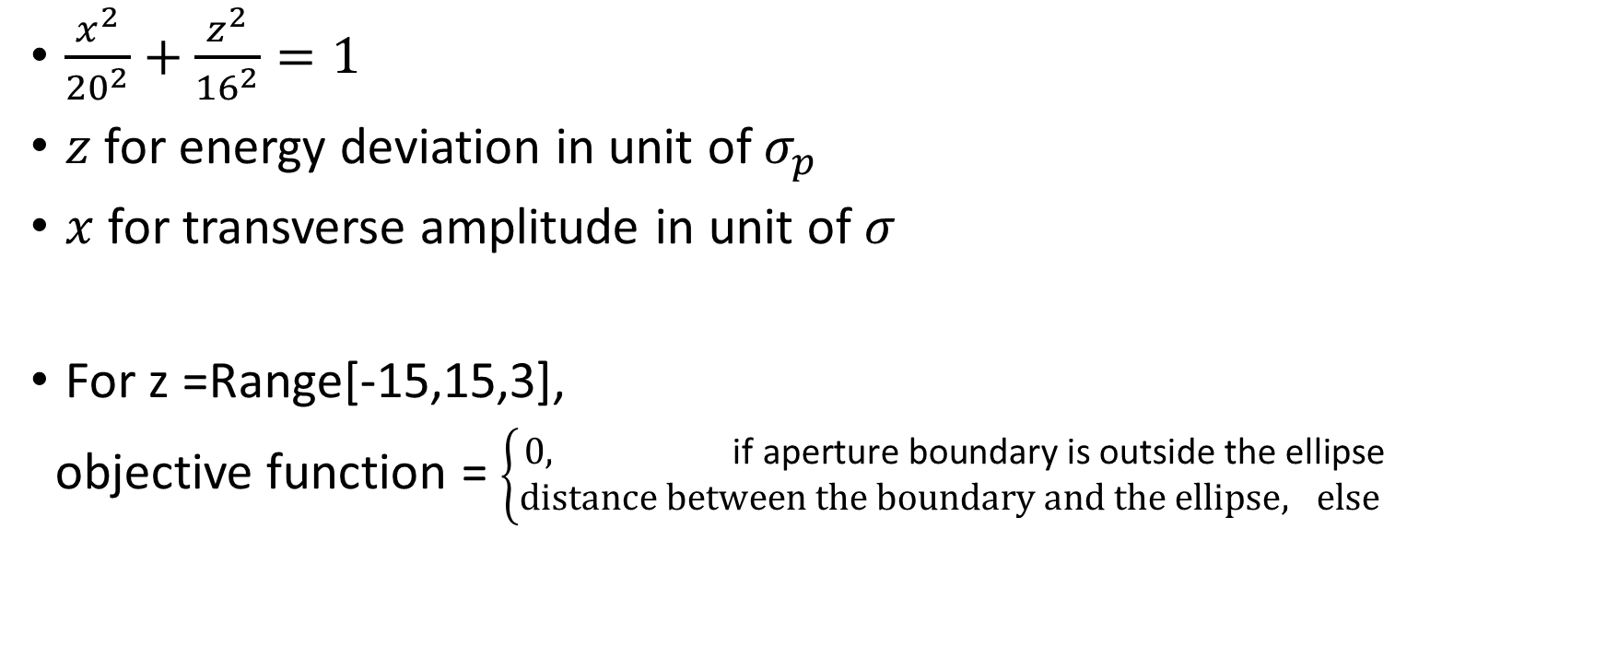
Objective function
$\frac{x^{2}}{{20}^{2}}+\frac{z^{2}}{{16}^{2}}=1$
$z$ for energy deviation in unit of $σ_{p}$
$x$ for transverse amplitude in unit of $σ$
For z =Range[-15,15,3],
objective function = $\left\{\begin{matrix}0, \text{if} \text{aperture} \text{boundary} \text{is} \text{outside} \text{the} \text{ellipse} \\ distance between the boundary and the ellipse, else \end{matrix}\right.$

Slide 25
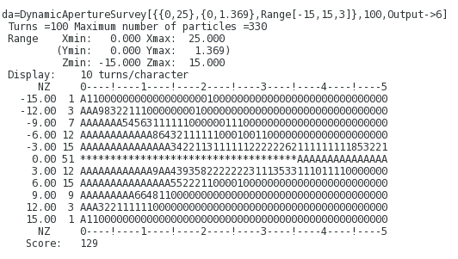
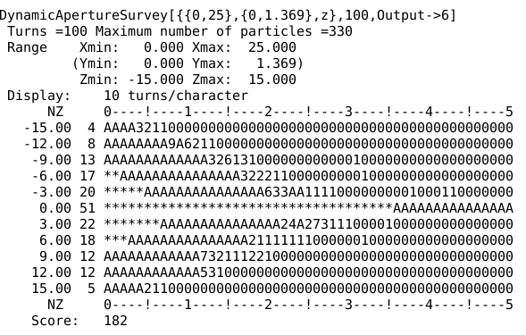
The first test, with 240 sextupoles, 100turns
V1, 100 turns

Slide 26
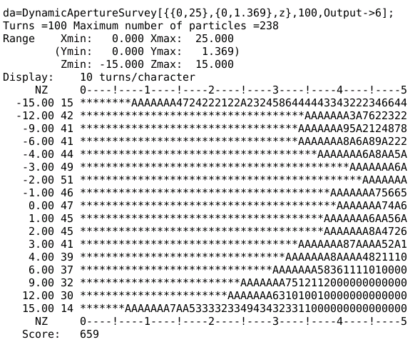
Optimization – 1, with 240 sextupoles, 100turns, DAPWIDTH=7

Slide 27
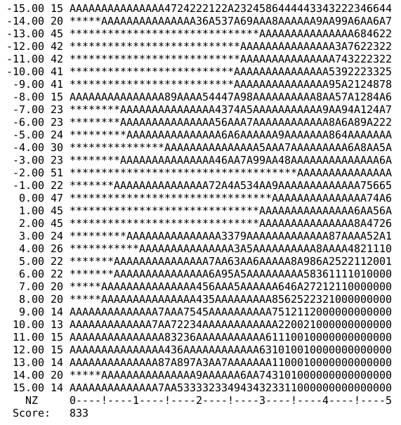
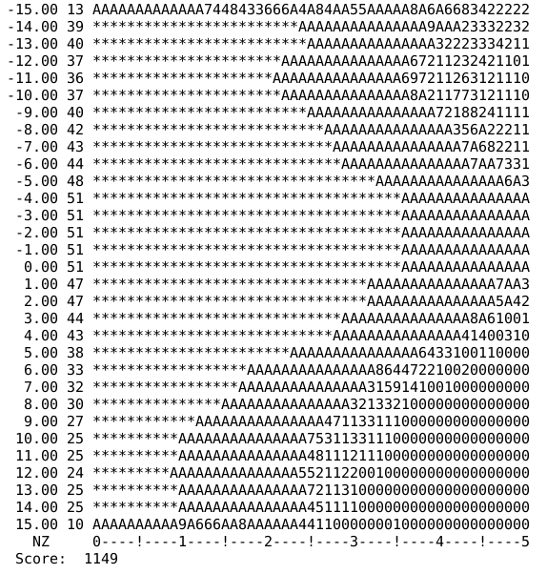
Optimization – 1, with 240 sextupoles, 100turns, DAPWIDTH=15, z=Range[-15,15,1]

Slide 28
Optimization result
100turns, DAPWIDTH=15, z=Range[-15,15,1], coupling: 0.3%

Slide 29
Check DA for different coupling (2)

Slide 30
Check DA with Radiation

Slide 31
Check DA with radiation (2)
Rad Off
Rad On

Slide 32
Optimization – 1, with 240 sextupoles, with different initial phase

Slide 33
Summary
We could enlarge the DA using Differential Evolution algorithm
Objective function should be classified (turns number, radiation, coupling, sawtooth orbit, and… )
Multiple object optimization will be developed.

