Slide 1
CEPC Booster
Cui Xiaohao, Zhang Chuang,Bian Tianjian
January 12,2016

Slide 2
Outline
1.General Description
2.Lattice
3.Dynamic Aperture Issues
4.Low Energy Injection
5.Injection and Ejection
6.Summary

Slide 3
1.General Description
Energy Ramp
6 ->120GeV
6 GeV
Electron
Linac
Booster
Positron
Collider
120 GeV

Slide 4
Booster is in the same tunnel of the CEPC collider
Low Energy: 6 GeV, High Energy: 120 GeV
Bypass lines are added to keep away from detectors
Acceptance should be large enough

Slide 5
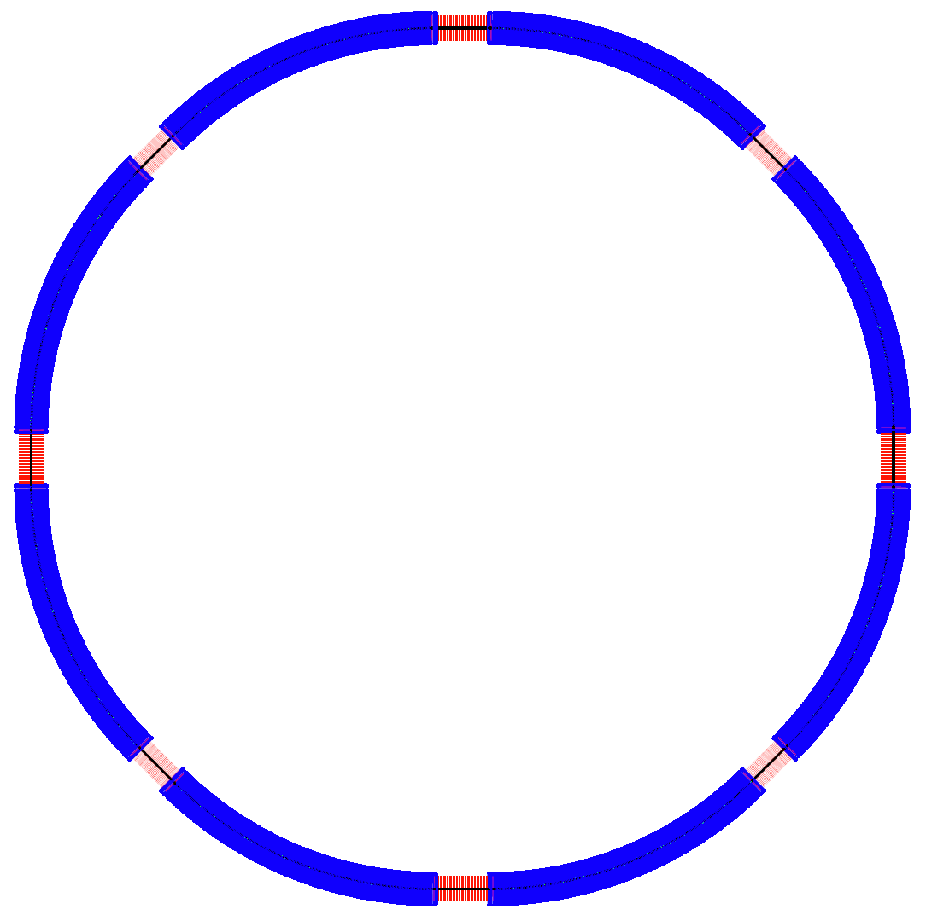
It has
8 Arcs

Slide 6
It has
4 straight sections

Slide 7
It has
4 Bypass Lines

Slide 8
Main Parameters
Parameter | Symbol | Unit | Value
Injection Energy | Einj | GeV | 6
Ejection Energy | Eej | GeV | 120
Bending Radius | ρ | m | 6089
Bending Field | Bej/Binj | T | 0.0657/0.00329
Bunch Number | Nb |  | 48
Bunch Population | Nb | 10¹⁰ | 2.1
Beam Current | Ibeam | mA | 0.83
SR power@120 GeV | PSR | MW | 2.5
Emittance@120 GeV | εej | nm.rad | 6.3
Emittance@6 GeV | εinj | nm.rad | 0.0157
Transverse DampingTime@ 6GeV | Tdamp | s | 115.5967s

Slide 9
2.Lattice: Different FODO cell

Slide 10
2.Lattice: Lattice Structrue
FODO cell
ARC
DIS
n FODOs
DIS
Bypass
ARC
Straight
ARC
Bypass
¼ Ring

Slide 11
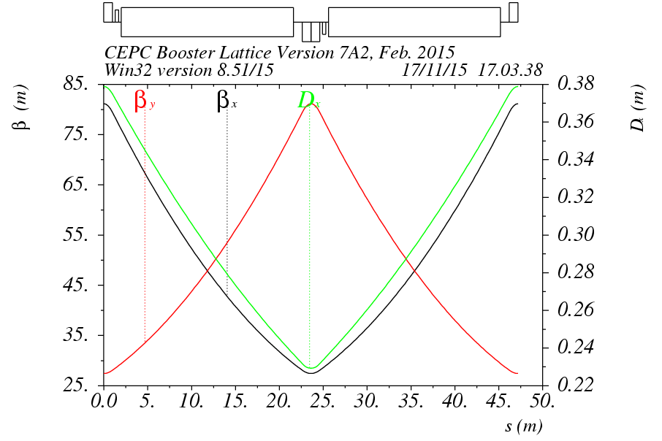
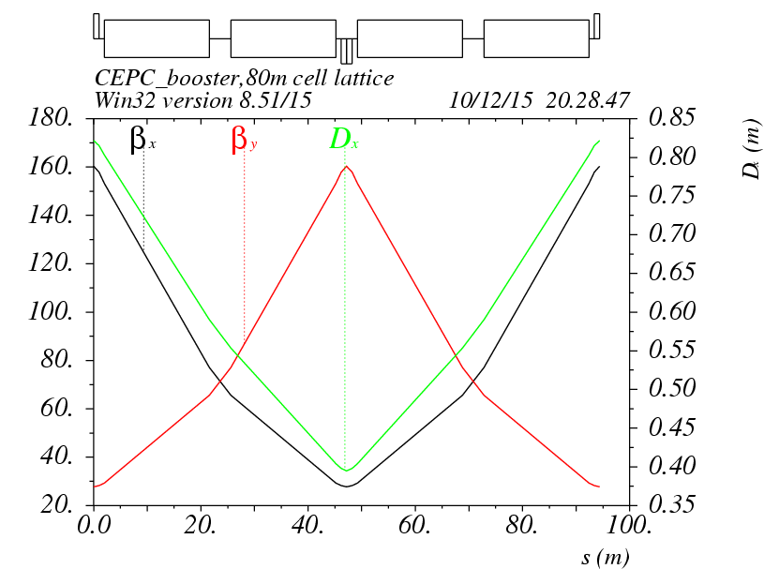
2.Lattice: Beta functions
47.2 FODO cell
94.4 cell

Slide 12
Beta Functions
SUP
RING

Slide 13

Bypass Lattice
6(5)L_{c}
4L_{c}+2ΔL
6(5)L_{c}
6(3)L_{c}
6(3)L_{c}
20(14)L_{c}
s
4(3)L_{c}
4(3)L_{c}

Slide 14
3. Dynamic Aperture Issues
Large dynamic aperture is very important for the Booster!
Due to the weak damping at Low Energy, electrons in the booster should be stable at least during the time ramping to 120 GeV, 2s(12000Turns).
The beam size at low energy is determined by the injection. In the booster, on center injection is adopted, and the Linac emittance is 0.3mm.mrad. At the DA tracking point, σx=5mm,σy=3mm。For injection, 5 Sigma Dynamic aperture is needed.
Energy Spread of the Linac beam is 0.1%, so maybe a 0.5% energy acceptance is enough?
We should consider tune footprint in the dynamic aperture.

Slide 15
FMA result at first

Slide 16
FMA for the booster --- Not crossing half integer

Slide 17
3.Dynamic Aperture Issues:optimization
Different ideas have been tried to enlarge the dynamic aperture.
The one with Noninterleaved sextupoles is the best at present.
π

Slide 18
FMA result at present for on-momentum particles

Slide 19
Dynamic Aperture for 0.5% off-momentum particles
Problem: Second Order Chromaticity!

Slide 20
4. Low Energy injection issues
The bending field of CEPC booster is 614Gs at 120 GeV; To reduce the cost of linac injector, the injection beam energy for booster is chosen as low as 6 GeV with the magnetic field of 31 Gauss.
Field errors at low energy and its effects on beam dynamics
Try to find a way to increase the bending field at injection-> See Bian Tianjian’s Talk.

Slide 21
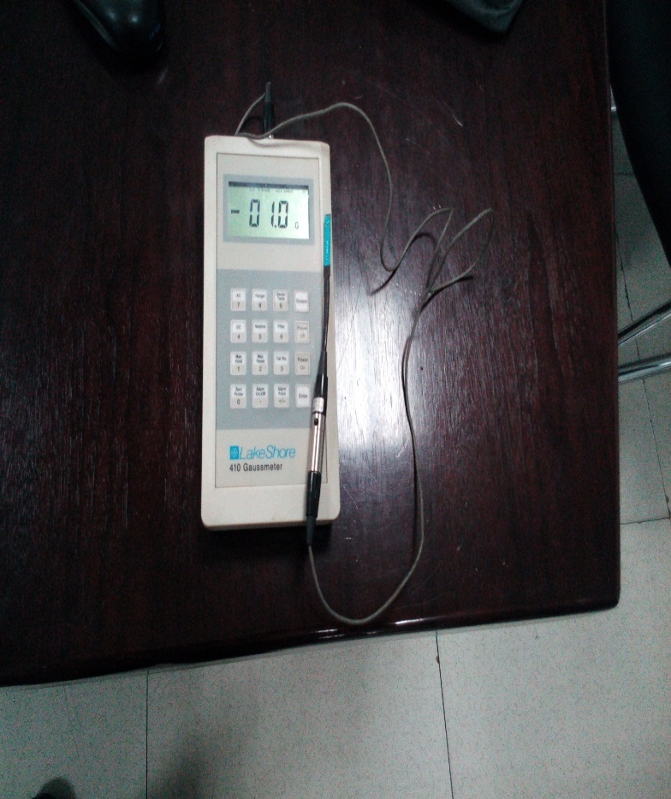
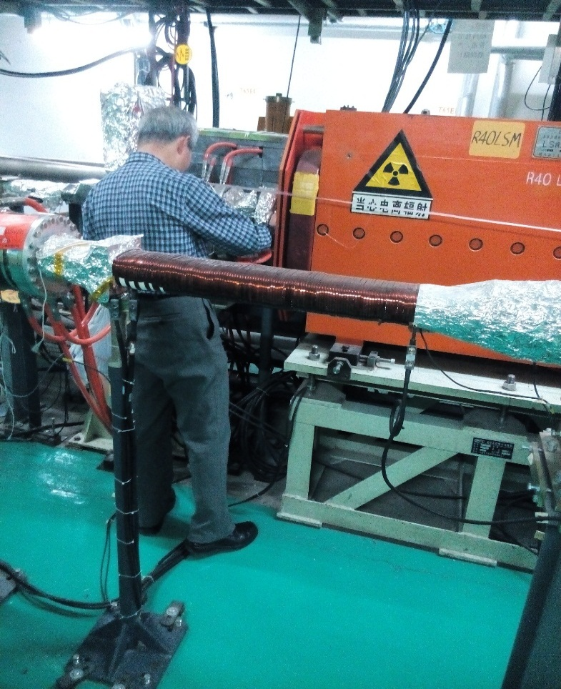
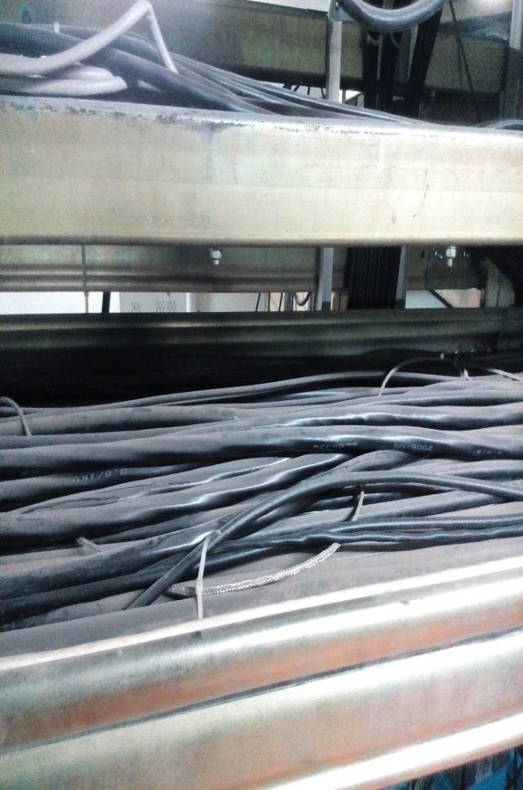
Magnetic Field measurement in BEPC II tunnel
A 1.6 ~ 2 Gauss Magnetic Field is found at all places far from accelerator magnets

Slide 22
5. Injection and Ejection
e± beams are injected from outside of the booster ring;
Horizontal septum is used to bend beams into the booster;
A single kicker downstream of injected beams kick the beams into the booster orbit.

Slide 23
Single kicker + 4 orbit bumps are used for beam extraction vertically from the booster;
Septum magnets are applied to bend beams vertically into BTC;

Slide 24
Summary
A preliminary CEPC booster design is given.
The dynamic aperture is good enough for on-momentum particles with non-interleaved sextupoles.
For off-momentum particles, more families of sextupoles should be added to correct second order chromaticity.
Low magnetic field is a central concern in the design of the booster.

Slide 25
To do list
Higher order chromaticity correction in the booster
Machine errors and correction (low field)
Collective instability

Slide 26
End

