Slide 1
CEPC DA due to magnets' error
Institute of High Energy Physics
Chinese Academy of Sciences
Budker Institute of Nuclear Physics
Sha Bai, Dengjie Xiao, Yiwei Wang, Huiping Geng,
Dou Wang, Tianjian Bian, Feng Su, Jie Gao
The first IHEP-BINP CEPC Accelerator Collaboration Workshop
2016-01-12

Slide 2
Error study motivation
To provide physical design for magnet manufacture, including bending magnet, quadrupole, sextupole and correctors……, and also the magnet alignment during installation.
To give the optimal DA after error correction.

Slide 3
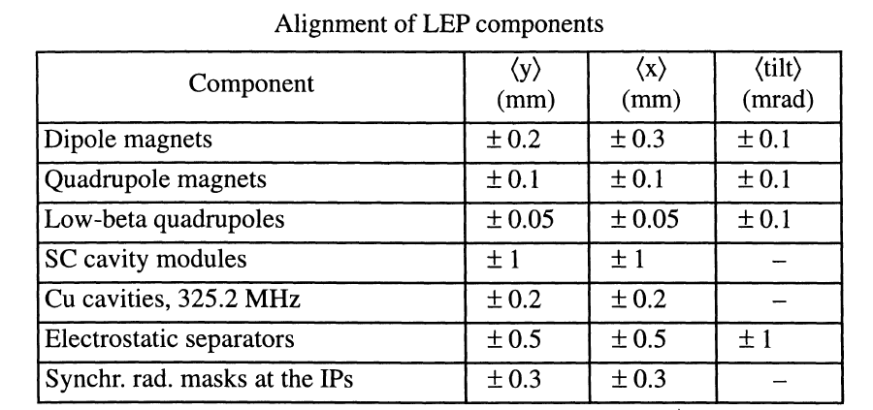
LEP Alignment parameters
From: LEP Design Report---------LEP2 P177

Slide 4
Magnet Field error 1
From: LEP Design Report---------LEP P18

Slide 5
Magnet Field error 2
From: LEP Design Report---------LEP P19

Slide 6
Magnet Field error 3
From: LEP Design Report---------LEP P19

Slide 7
BEPCII
CEPC
 | bend | quad | sext | bend | quad | sext
Dx(mm) | 0.2 | 0.15 | 0.15 | 0.3 | 0.1 | 0.15
Dy(mm) | 0.2 | 0.15 | 0.15 | 0.2 | 0.1 | 0.15
Tilt(mrad) | 0.1 | 0.2 | 0.5 | 0.1 | 0.1 | 0.5
B*L | 3e-4 | 3e-4 | 2e-3 | 5e-4 | 5e-4 | 4e-3
quadrupole(s) | 3e-4 |  |  | 8e-4
sextupole(s) | 6e-4 | 5e-5 |  | 2e-4 | 6e-4
Octupole(s) |  | 7e-5 | 6e-4 | 7e-5 | 5e-4 | 1.7e-3
Decapole(s) | 5e-4 | 9e-5 | 2e-4 | 1.3e-4 | 6.9e-4 | 3.4e-3
Dodecapole(s) |  | 6e-4 | 5e-4 | 1.4e-4 | 1e-3 | 6.5e-3
Quadrupole(r) | 1e-4 | 3e-4 |  | 2e-4
Sextupole(r) | 1e-4 | 1e-4 | 3e-3 | 2.9e-4 | 1.2e-3
Multipole(r) | 1e-4 | 1e-4 | 3e-4 | 2e-4 | 1e-3 | 2e-2

Slide 8
CEPC DA with misalignment errors
Coupling factor κ=0.003 for emitty
Without error
With dipole misalignment
With sextupole misalignment
With quadrupole misalignment

Slide 9
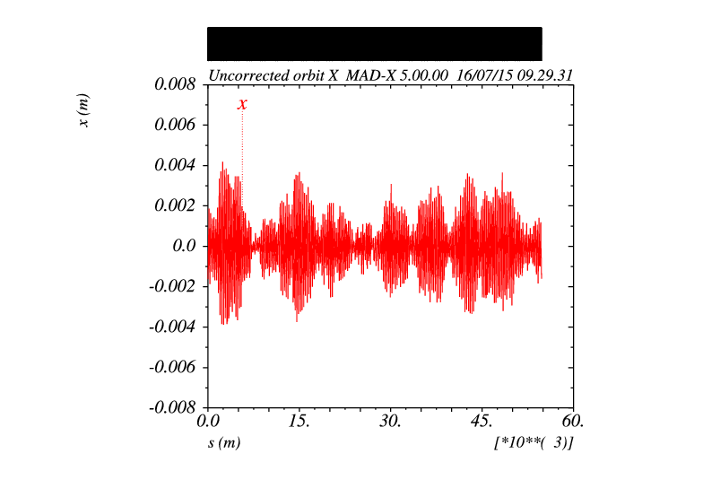
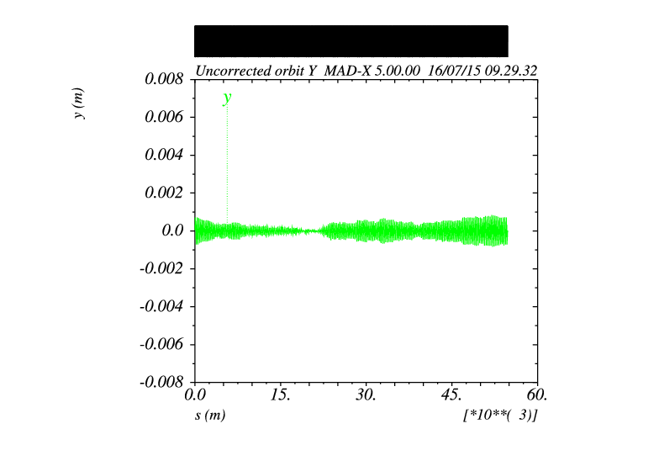
With only horizontal misalignment in quads main ring without FFS
with only vertical misalignment in quads, there is no orbit.

Slide 10
Quadrupole alignment error analysis main ring without FFS
DX, DY, DS=1e-5
DX, DY, DS=7e-5, beyond this, orbit disappear.

Slide 11
Main error source
Solution
Horizontal and vertical misalignment in Quadrupoles
Quadrupoles with their centers misaligned to the reference orbit cause dipole error, which will cause an angular deflection of the beam, causing the closed orbit to oscillate around the design orbit.
Move the tune far from the resonance line
Reduce the error source

Slide 12
Orbit correction result in CEPC main ring without FFS without pretzel
Before correction
After correction

Slide 13
BPM readings statistics
X CORRECTION
SUMMARY:
RMS before correction
2.020892 mm
RMS after correction
0.009701 mm
Y CORRECTION
SUMMARY:
RMS before correction
1.520581 mm
RMS after correction
0.006212 mm

Slide 14
Orbit correction result in CEPC main ring without FFS with pretzel
Target pretzel orbit
Pretzel orbit after correction
After orbit correction, pretzel orbit can be recovered.

Slide 15
Correctors strength statistics
X CORRECTION:
1800 correctors used
Max strength ~ 43urad
RMS ~ 3.9urad
Y CORRECTION:
1800 correctors used
Max strength ~ 16urad
RMS ~ 3.7urad

Slide 16
Misalignment error analysis – whole ring
DA with 10 ⁻⁴ m quad misalignment error
Horizontal orbit with
10 ⁻⁴ m quad misalignment error
Vertical orbit with
10 ⁻⁴ m quad misalignment error
DA with 10 ⁻¹⁵ m quad misalignment error
Horizontal orbit with
10 ⁻¹⁵ m quad misalignment error
Vertical orbit with
10 ⁻¹⁵ m quad misalignment error

Slide 17
Misalignment error analysis – FFS & ring
DA with 10 ⁻⁴ m FFS quad misalignment error
Horizontal orbit with
10 ⁻⁴ m FFS quad misalignment error
Vertical orbit with
10 ⁻⁴ m FFS quad misalignment error
DA with 10 ⁻⁴ m ring quad misalignment error
Horizontal orbit with
10 ⁻⁴ m ring quad misalignment error
Vertical orbit with
10 ⁻⁴ m ring quad misalignment error

Slide 18
CEPC DA with field errors two multipoles at each side of quadrupole model in SAD(with only ¾ ring)
Coupling factor κ=0.003 for emitty
With ¾ ring (B,Q,S) B*L errors
2% (1σx, 3.5σy)
With ¾ ring (B,Q,S) B*L and multipole errors
1.5%, 2% (0, 0)

Slide 19
CEPC DA with field errors two multipoles at each side of quadrupole model in SAD(with only ¾ ring)
Coupling factor κ=0.003 for emitty
With all FFS B*L and multipole errors
enlarge
with ¾ ring and FFS (B,Q,S) B*L errors & multipole errors
1.5%, 2% (0, 0)

Slide 20
Magnet field error on DA Quad and Sextupole are set to be MULT model in SAD (whole ring including FFS)
With Bend B*L error
(whole ring including FFS)
μ_{x}= 0.0720634 μ_{y}= 0.2261286
Orbit in X & Y
With Bend B*L error
(whole ring including FFS)
With Quad B*L error
(whole ring including FFS)
μ_{x}= 0.0815080 μ_{y}= 0.1937457
With Sext B*L error
(whole ring including FFS)
Tune no change
With Bend magnet field errors, orbit is changed, and tune is also changed a little bit
Orbit correction is needed
With Quadrupole and sextupole field errors, orbit has no change.
With Quad field errors, tune is change.
Bend is set to be bend, but Quad and Sextupole are set to be MULT
Tracking in 240 turns, coupling factor κ=0.003 for ε_{y}

Slide 21
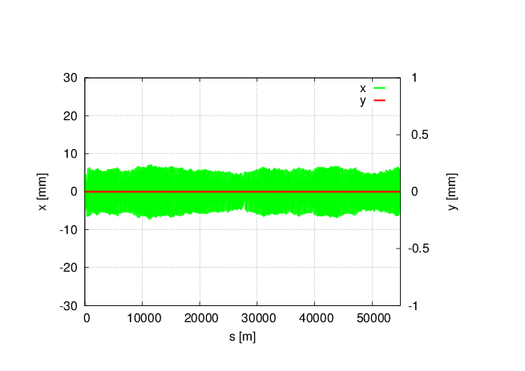
Magnet field error on DA Quad and Sextupole are set to be MULT model in SAD (whole ring including FFS)
With all (B,Q,S) B*L field errors, whole ring including FFS.
Tune has changed a lot: μ_{x}=0.0510854 μ_{y}= 0.1526778
Orbit correction and tune adjust are needed
Bend set to bend, and Quad and Sext set to be MULT in SAD
Tracking in 240 turns, coupling factor κ=0.003 for ε_{y}

Slide 22
Multipole errors effect on DA quadrupole/sextupole multipole model in SAD
Bend multipole errors (whole ring including FFS)
Quad multipole errors
(whole ring including FFS)
Sextupole multipole errors(whole ring including FFS)
(B,Q,S)multiple errors
(whole ring including FFS)
Off-momentum DA is not changed obviously, with 2% (1σ_{x}, 10σ_{y})
Tune is kept, no effect on tune
Orbit is kept to be zero, no effect on orbit
Bend is set to be bend, but quadrupole and sextupole are set to be MULT
When bend set to be MULT, it doesn’t work in SAD
Tracking in 240 turns, Coupling factor κ=0.003 for emitty

Slide 23
Multipole error analysis quadrupole/sextupole multipole model in SAD
(B,Q,S)multipole error 10⁻⁴
(order of magnitude)
(B,Q,S)multipole error
5x10⁻⁵(order of magnitude)
(B,Q,S)multipole error 10⁻⁵
(order of magnitude)
Multipole error can not be corrected.
The DA due to multipole error can be only depended on the DA which is without error
The magnet design requirement is from: the maximum DA limit. If the maximum DA limit is not satisfied, we can reduce the multipole error, this may put forward higher requirements on the magnet design

Slide 24
Tune correction globally
DA with Quad B*L error
DA after tune correction globally
With all quad B*L errors in CEPC whole ring including FFS, correct tune of whole ring with the six quads in straight line
Dynamic aperture is not improved
Reason: the quad B*L error destroy the period and the chromaticity correction.
Solution: correct tune in part, both in cell and straight line, refit sextupole to do chromaticity correction

Slide 25
CEPC field error summary
The multipole errors in the main ring seems to have a large effect on the 2% off-momentum DA.
The field errors in the FFS seems to have a large effect on the vertical on-momentum DA.
With all B,Q,S multipole errors in CEPC whole ring including FFS, the 2% off-momentum DA reduced to about 1/3~1/2.
Method 1： Optimization of DA (precondition: best DA without error）
orbit correction（for misalignment errors）
tune correction（for quad B*L error）
FMA analysis , add octupole, decapole, dodecapole…….
Cure DA
Although could be corrected in simulation, may not the case in real situation……
Method 2： Reduce errors (maybe high level requirement in magnet manufature）
reduce the errors to the DA that we can accept

Slide 26
Error correction
Error correction
Misalignment & bending magnet strength error
Quad strength error
Multipole error
Orbit correction with correctors & BPM
Tune correction & chromaticity correction
Impossible to correct
& adjust level to requirement

Slide 27
Magnet requirement in manufacture common level of magnet manufacture in world
The misalignment for dipole, quadruple and sextupole could be dozens of microns (30 microns is high level)
Corrector dipoles requirement : uniformity of magnetic field ~ 1%
No requirement on magnet field strength error (since could be tuned by current)
Multipole error at a level of 2e-4 is the best, different order has difference, lower order is more difficult.

Slide 28
Summary
Misalignment errors ~ 10⁻⁴m of CEPC main ring without FFS could be corrected by adding correctors and BPMs. For whole ring with FFS, situation could be complex, but needs to be tried to do orbit correction.
With correctors and BPMs adding in the beam line, SAD harsh table has no space. SAD can not deal with large ring. MAD can’t give correct DA. We have to change to other program.
Tune correction and chromaticity correction are not needed for magnet design requirement, but needs to do in DA optimization.
Multipole errors can not be corrected in real situation, it depends on the DA optimization without errors, but the results are not unbearable with 2% reduced to about 1/3~1/2.

Slide 29
Thank you !

