Slide 1
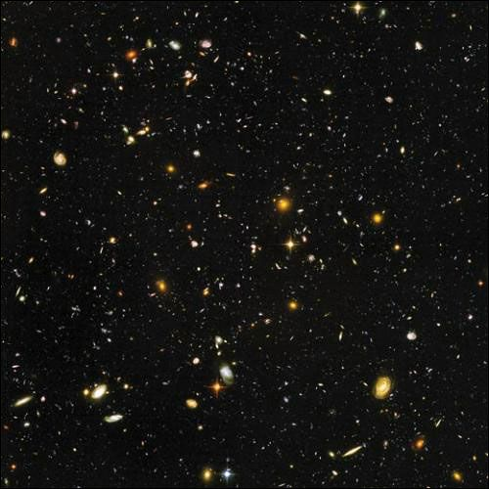
The Performance of BGO Calorimeter of DAMPE in Orbit
Yunlong Zhang Zhiyong Zhang, Yifeng Wei, Changqing Feng
Shubin Liu, Guangshun Huang
On behalf of DAMPE Collaboration
第十二届全国粒子物理学术会议

Slide 2
Outline
DArk Matter Particle Explorer
BGO Calorimeter
Status of Calorimeter in Space
Summary

Slide 3
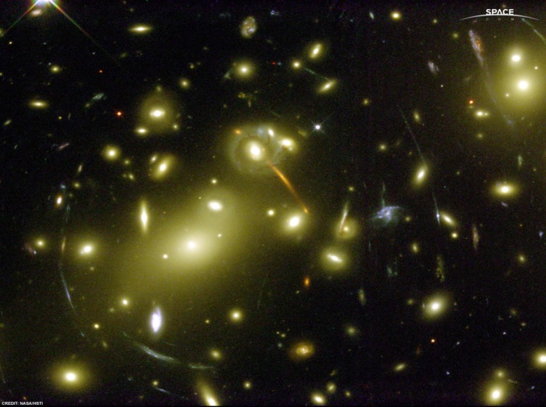
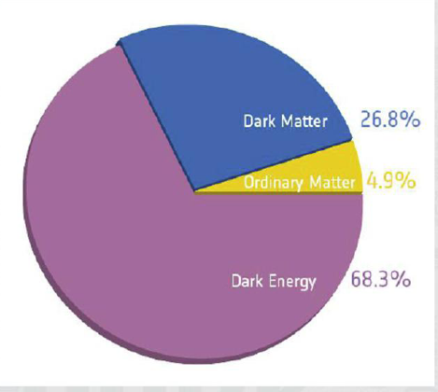
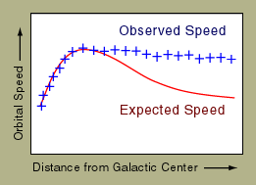
Dark Matter
天文观测的种种证据，已经可以肯定暗物质的存在，然而暗物质粒子是什么，人们却仍然一无所知。近年来，粒子物理学家试图通过直接或者间接方法去寻找暗物质粒子。

Slide 4
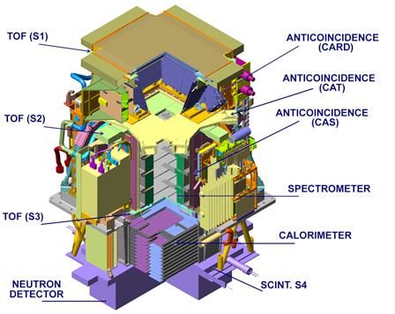
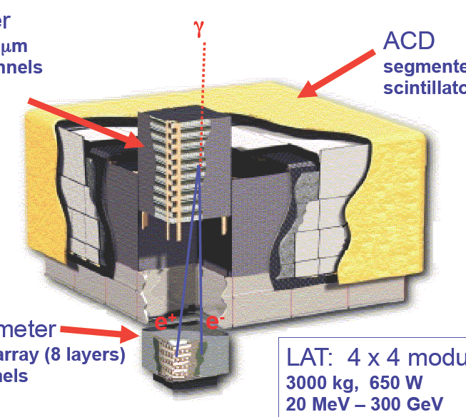
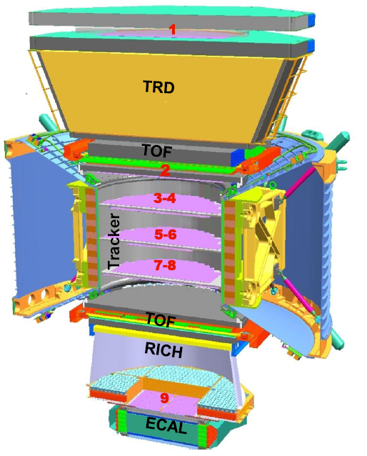
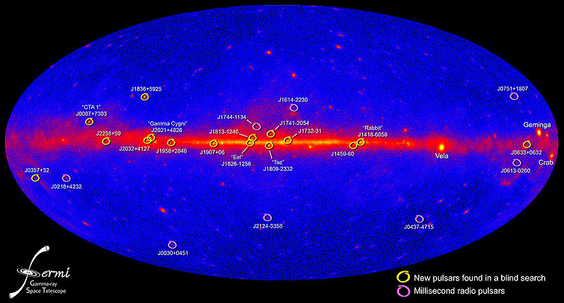
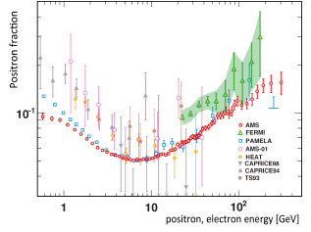
Space Particle Explorer

Slide 5
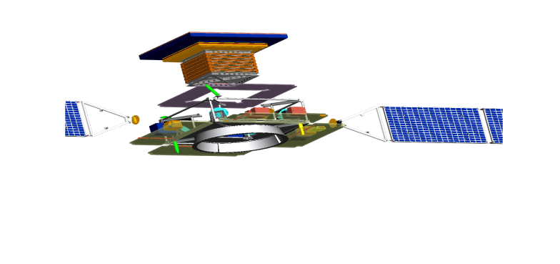
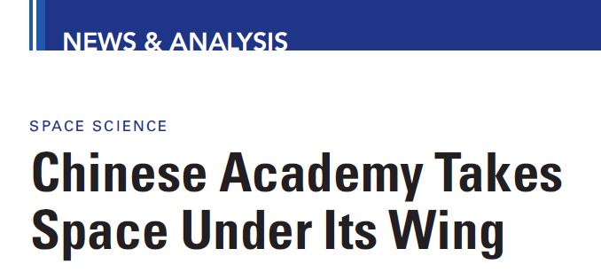
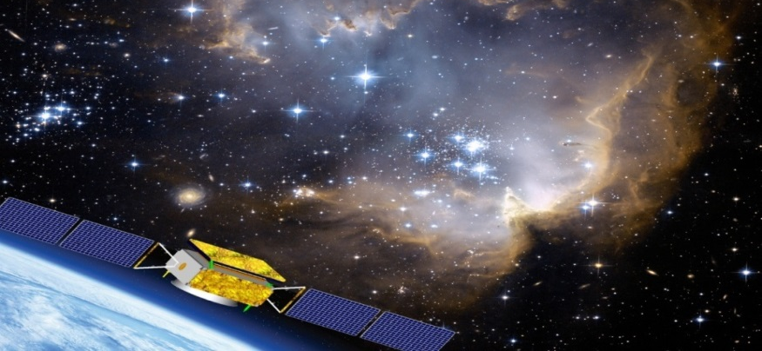
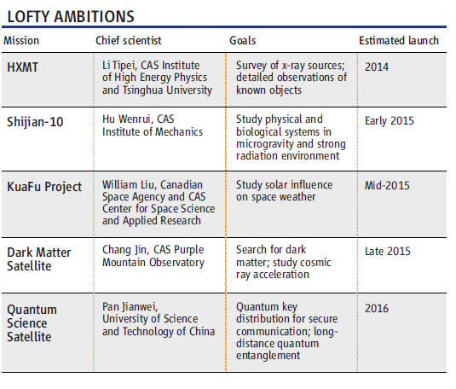
Dark Matter Particle Explorer
Science, 20 May 2011
Dark Matter Particle Explore
测量e+/-， γ射线等
能区：5GeV～10TeV
视野更大
高能区更灵敏
Strategic Priority Research Program in Space Science

Slide 6
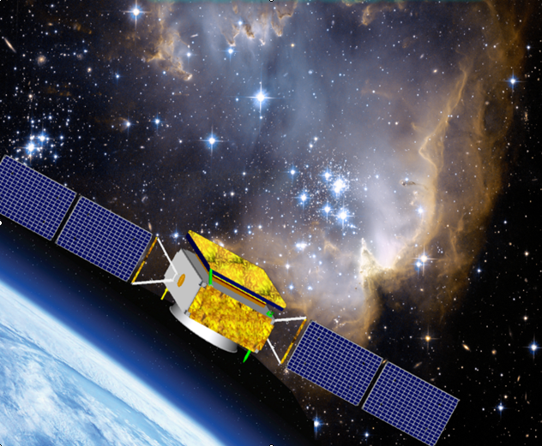
DArk Matter Particle Explorer
An instrument on the DAMPE Satellite
500km orbit
e+/-,gamma-rays
5GeV to 10TeV
1.5%@800GeV
Total weight:~1400kg

Slide 7
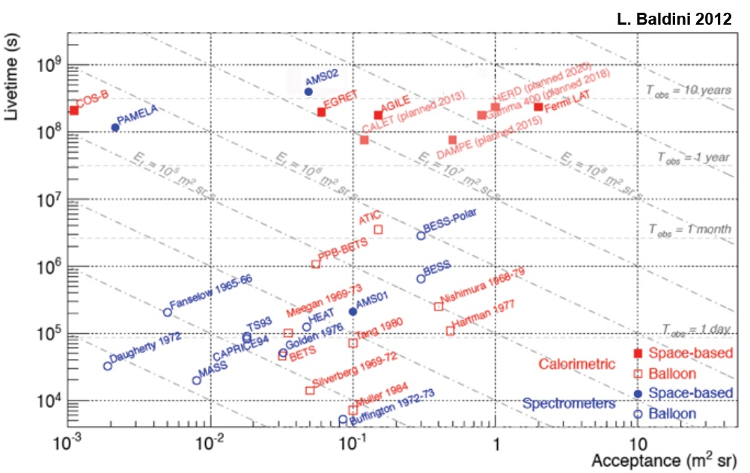
Acceptance vs. Livetime

Slide 8
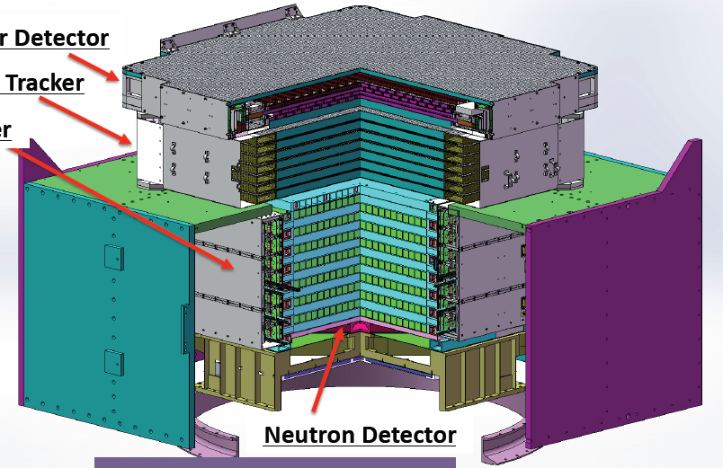
DArk Matter Particle Explorer
Plastic Scintillator Array
  Response : Z=1~20
Silicon Tungsten Tracker
  12 layers Si-strip detectors
BGO Calorimeter
  14 layers BGO crystals
  ~32X₀
Neutron Detector
  Plastic scintillator with Boron

Slide 9
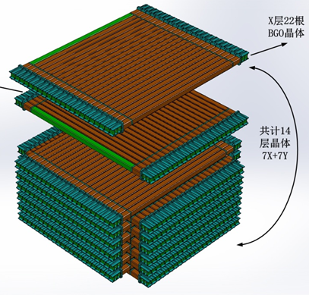
BGO Calorimeter
14 layers of 22 BGO crystals
  Dimension of BGO bar: 2.5×2.5×60cm³
  Hodoscopic stacking alternating orthogonal layers
  r.l: ~32X₀
  NIL:1.6
Two PMTs coupled with each BGO crystal bar in two ends
Electronics boards attached to each side of module

Slide 10
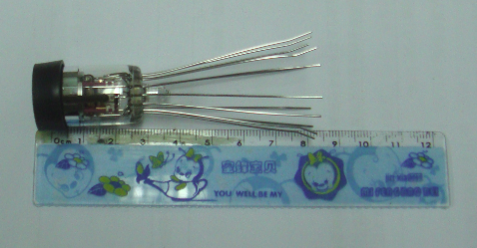
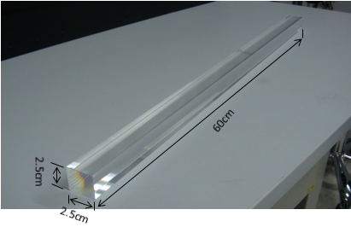
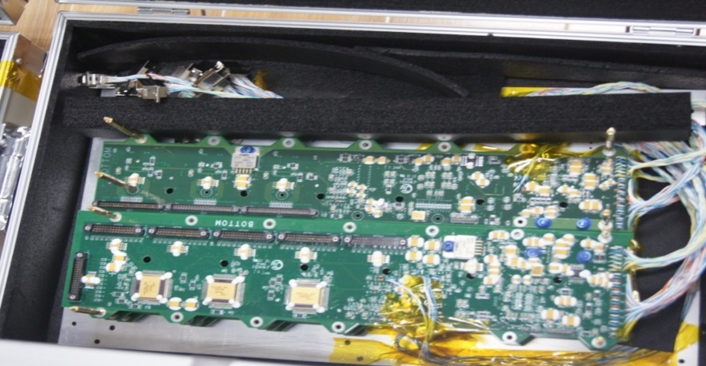
Calorimeter Elements
308 BGO bars
616 PMTs
16 FEE boards
All of the elements should be tested before installed in the calorimeter

Slide 11
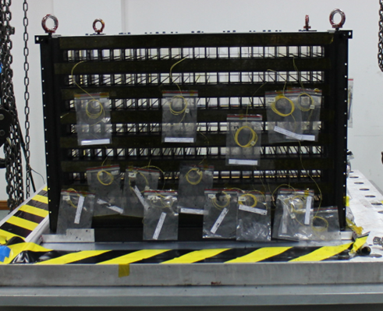
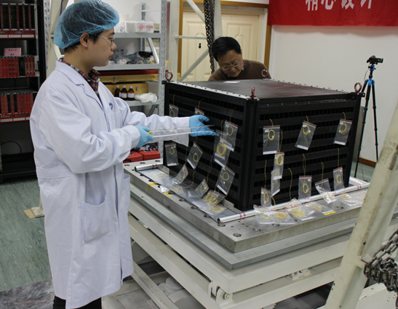
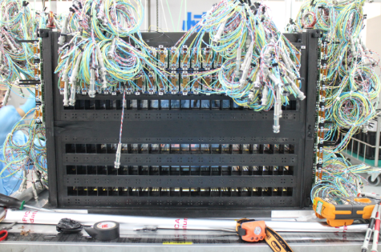
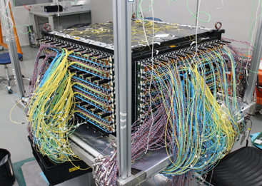
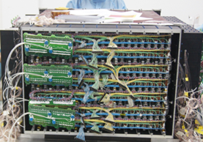
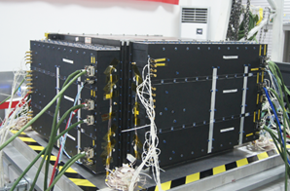
Calorimeter Assembly
Carbon Fiber Structure
BGO crystal install
PMT install
Cable arrange
Cable connector
BGO Cal

Slide 12
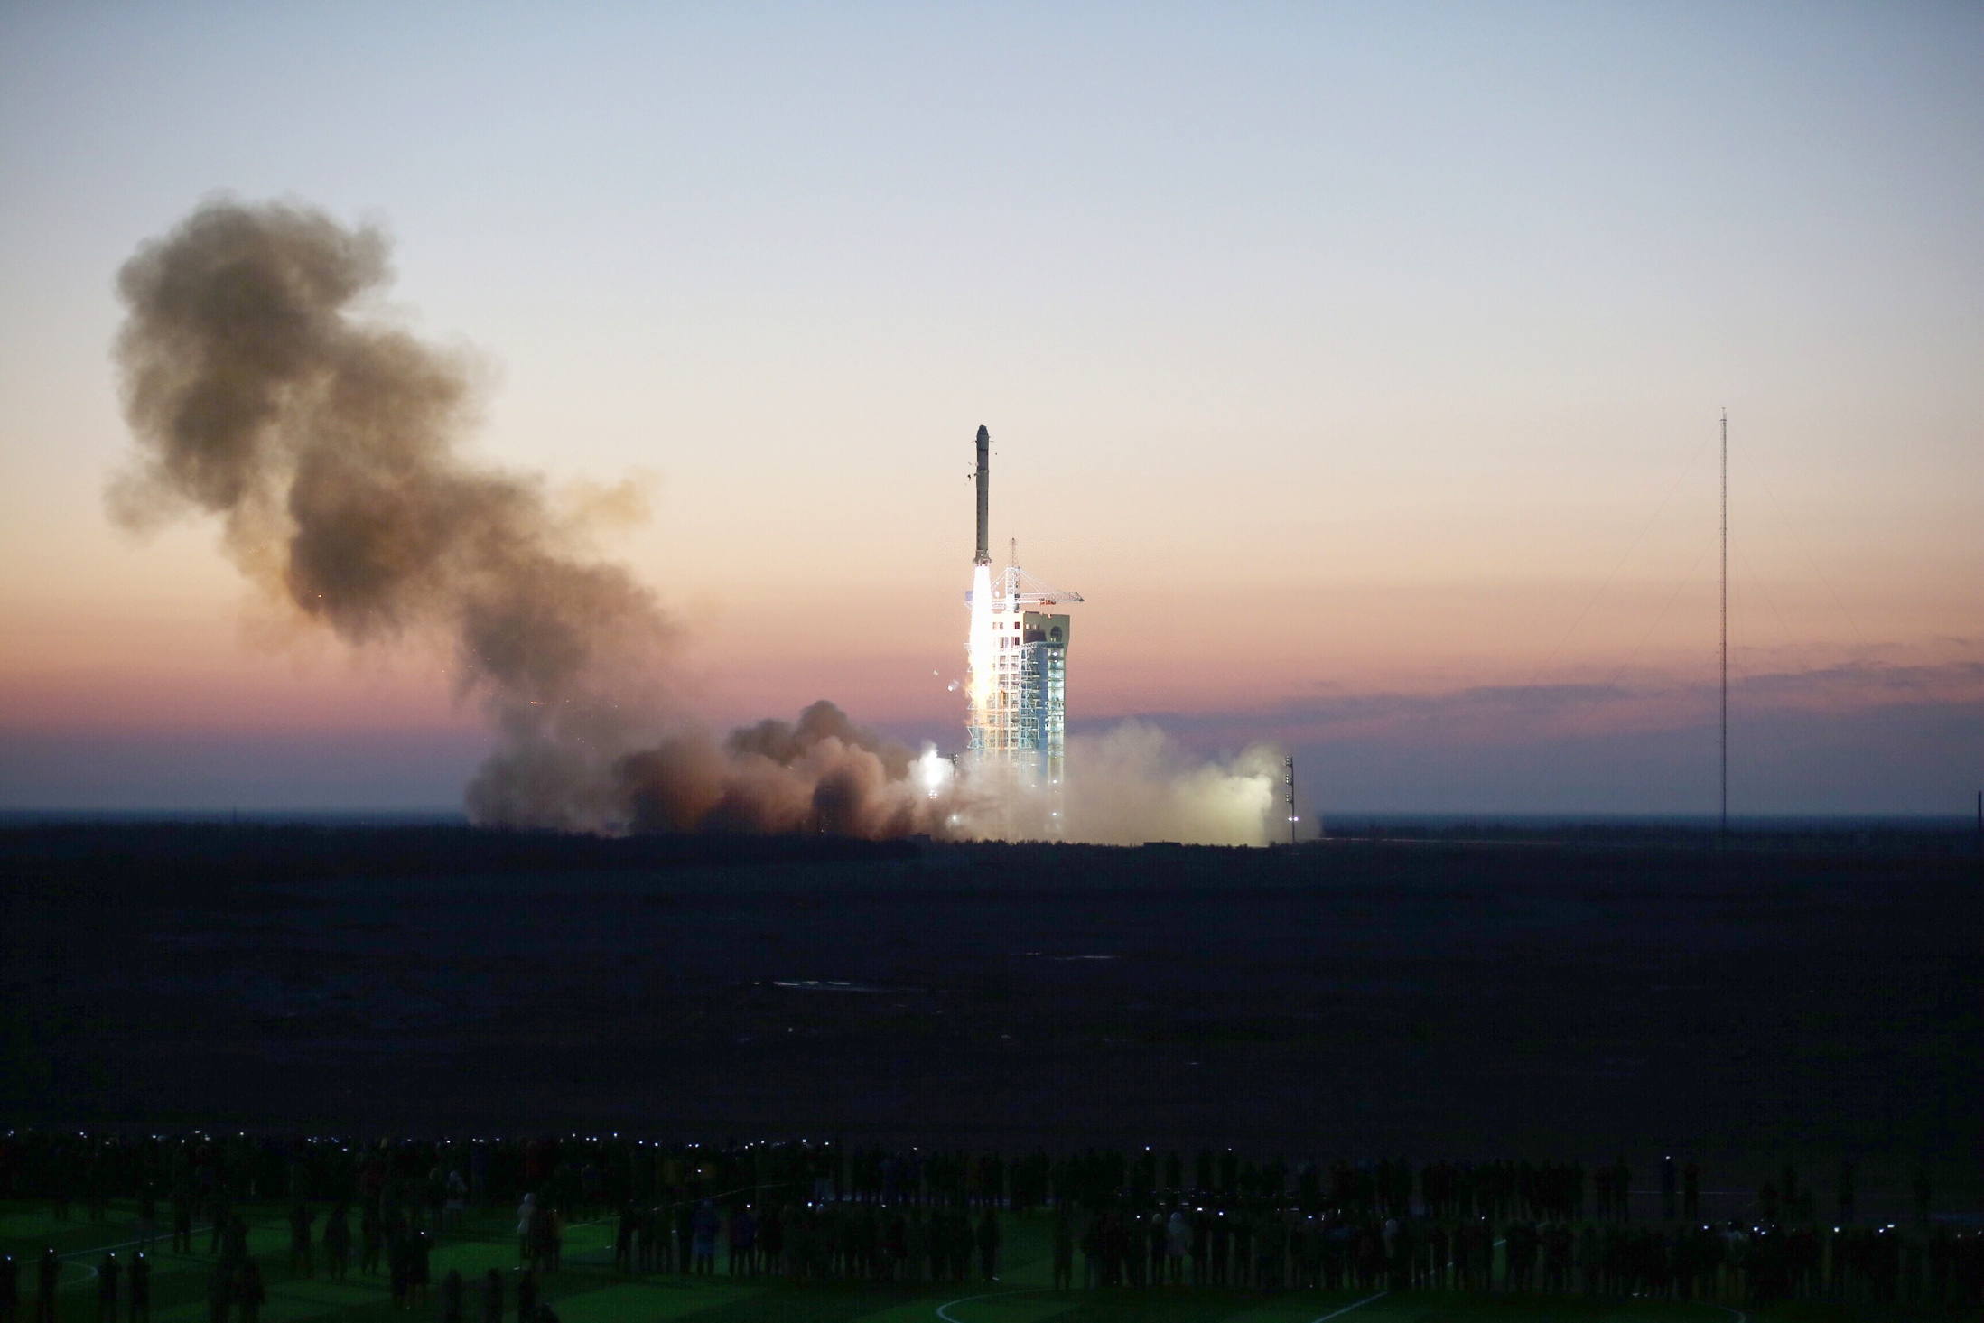
12/17/2015 in Jiuquan

Slide 13
2015年12月20日，低压电源通电
  7时18分02秒，第46轨，FEE加电，指令首次上注并正确执行
  8时45分48秒，第47轨，喀什站首次接收到下传数据，
  各项指标与地面一致，证明BGO量能器所有通道的电路工作正常
2015年12月24日，高压电源开机
  5时43分，第106轨，高压加第1工作档位（450伏）
  8时55分，第108轨，高压加第2工作档位（840伏）
  第109轨，喀什站接收到首批科学数据

Slide 14
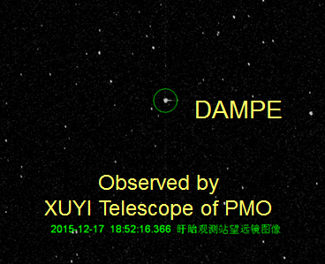
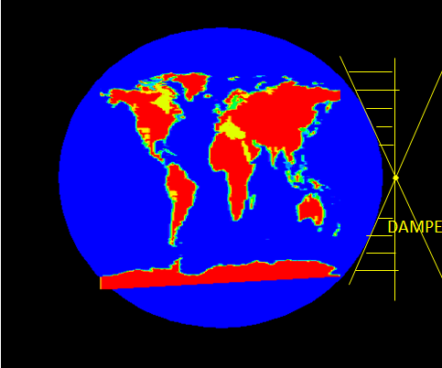
DAMPE in Orbit
~4 solid angle was shielded by the earth

Slide 15
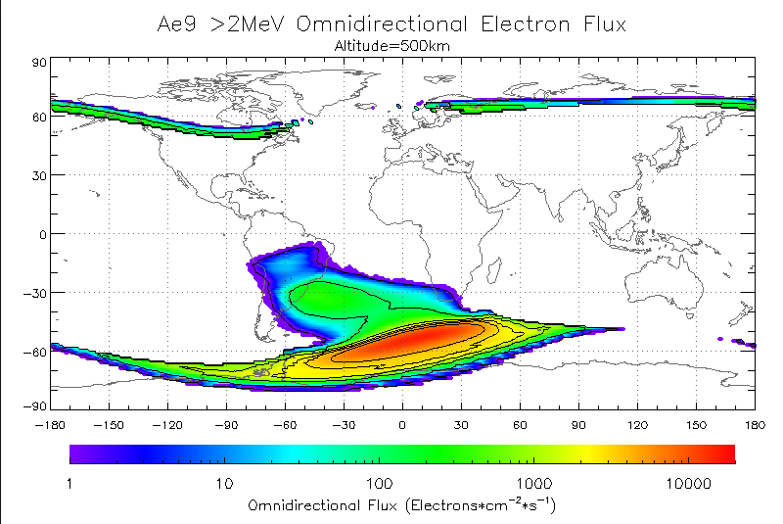
Space Environment

Slide 16
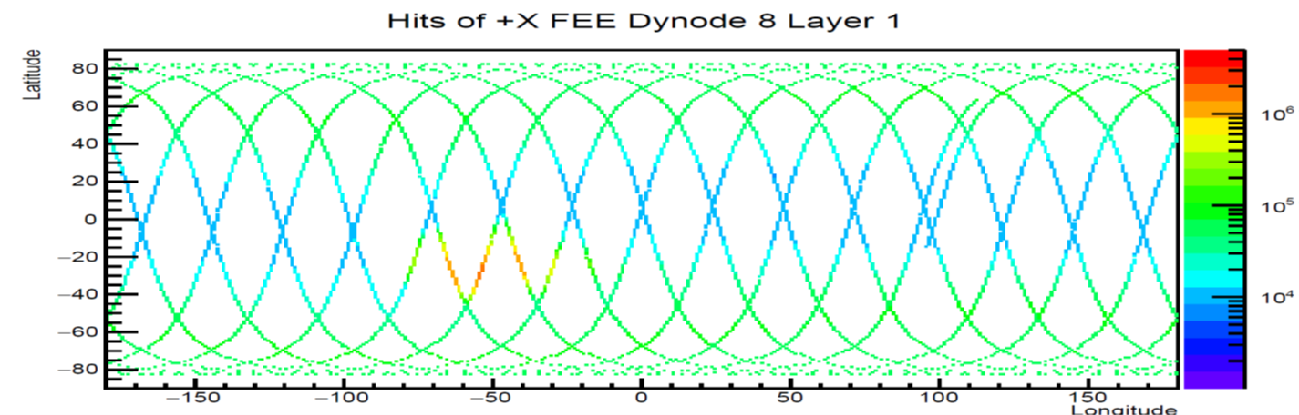
15 orbits per day,~16GB raw data

Slide 17
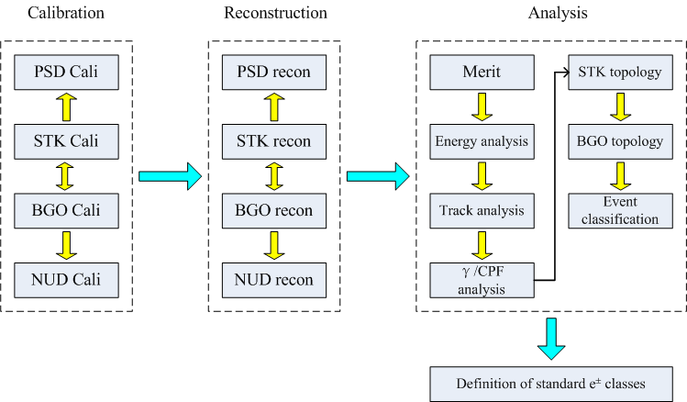
Reconstruction Overview
Processing of the raw data
  Calibration Constants
Application of reconstruction algorithms
  Energy, Track..
Event Classification
  calorimeter topology

Slide 18
Some Parameters
Temperature
DAC Calibration
Pedestal
Dynodes Ratio of PMT
The Attenuation Length of BGO Crystal
Minimum Ionizing Particles

Slide 19
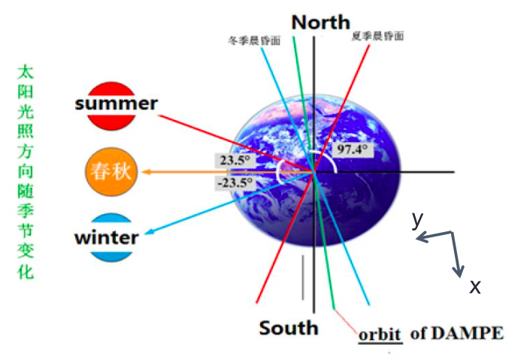
Temperature Environment in Orbit

Slide 20
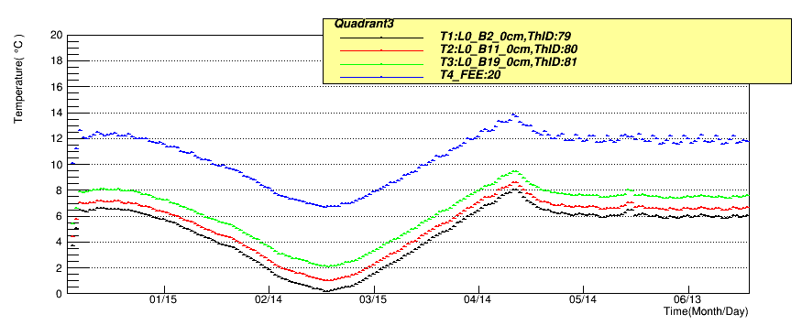
Temperature Environment in Orbit
Temperature of BGO Calorimeter

Slide 21
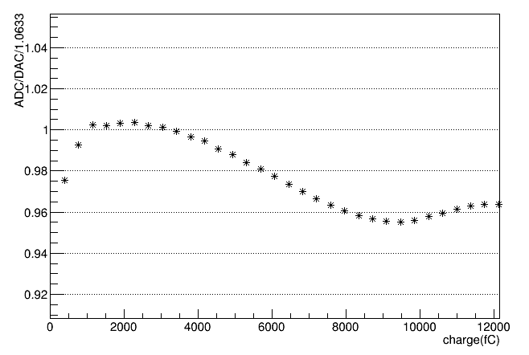
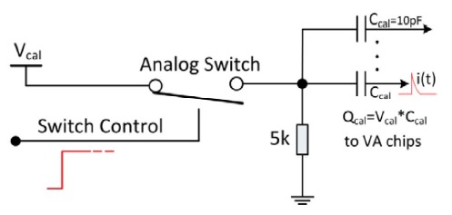
DAC
Charge injection calibrations are used to characterize the nonlinear behavior of the electronics chain.
+/-2.5%
After applying the measured non-linearity calibration, residual non-linearity is better than 1%

Slide 22
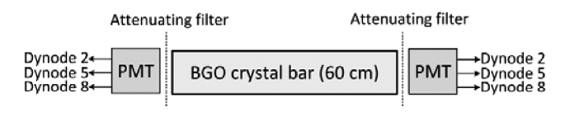
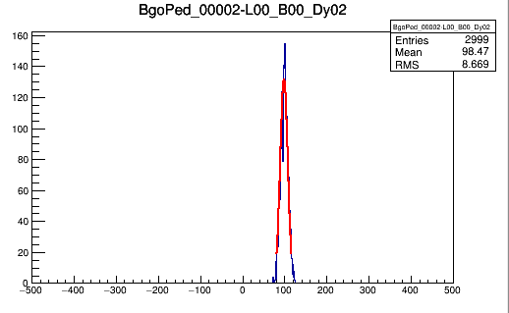
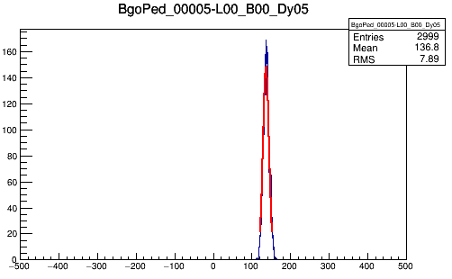
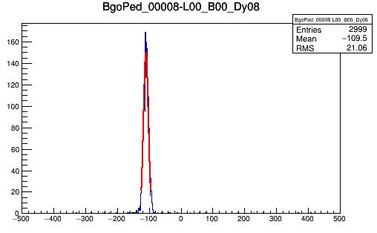
Pedestal
  Pedestals are the offset voltages for each output channel
dy5
dy2
dy8

Slide 23
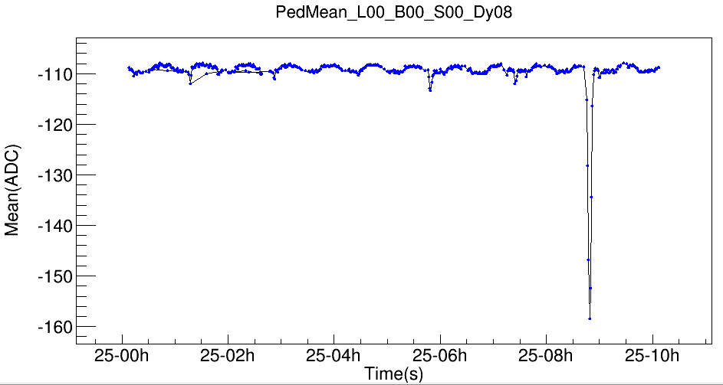
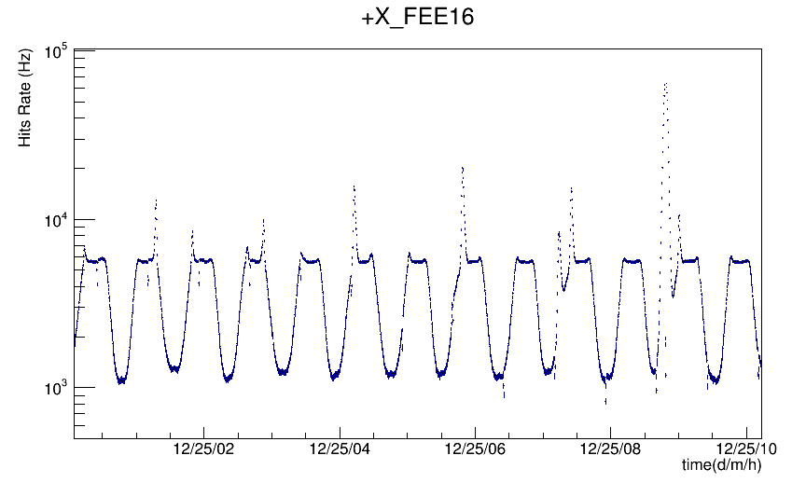
Pedestal vs. Time (Event Rate)
Radiation belt in N/S
SAA

Slide 24
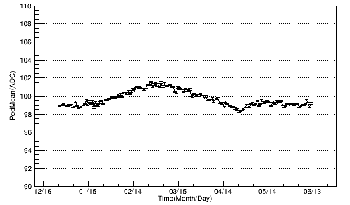
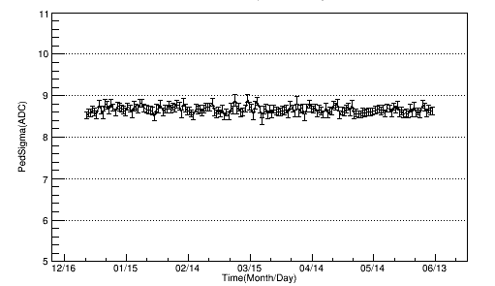
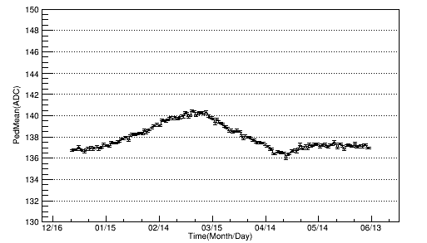
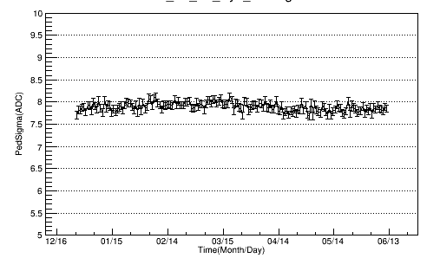
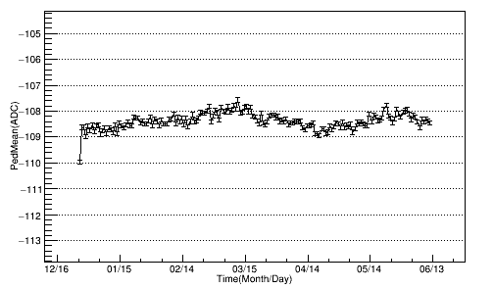
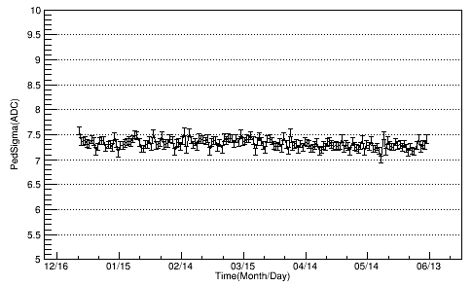
Pedestal vs. Time (Temp)
mean
sigma
dy2
dy5
dy8
the pedestal constants were calibrated every day

Slide 25
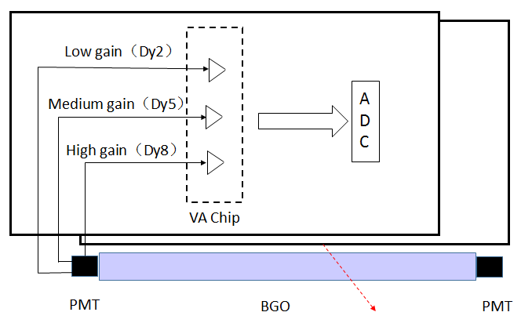
The Readout of Sensitive Element
Front End Electronics

Slide 26
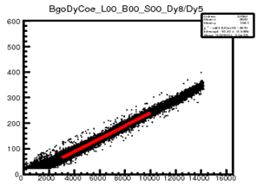



Dynode Ratio

Slide 27


Dynode Ratio vs. Time (Temprature)
The dynode ratio constants were calibrated every 5 days

Slide 28
Attenuation Length of BGO bar
BGO bar

Slide 29
Attenuation Length of BGO bar
particle

Slide 30

Attenuation Length of BGO bar
λ= 1.4 m

Slide 31

Minimum Ionizing Particles
The MIPs signals were used as the reference of the energy reconstruction

Slide 32


MIPs

Slide 33

MIPS Signal of Heavy ions
P
He
B
C
O
Be
N

Slide 34



MIPs spectrum in different latitude
The MIPs calibration work just carry out in the -20deg~20deg

Slide 35

MIPs vs. Time (Temperature)
The MIPs constants were calibrated per 5 days

Slide 36

Raw Data to BgoHits

Slide 37

7 TeV e+/- candidate

Slide 38
Summary
The DAMPE satellite was lunched in the end of last year successfully
The Calorimeter of DAMPE works well in Space
  Pedestal, Dynode-Ratio, MIPs..
The preliminary track and energy from BGO calorimeter could be reconstructed
The data analysis work is in progress

Slide 39
THANKS

Slide 40
Backup

Slide 41



Cosmic-ray Calibration
Use Cosmic-ray (muons) in lab to calibrate BGO Calorimeter
X-D
Y-D

Slide 42

Beam Test in CERN
PS：protons Momentum 24 GeV/c， Secondary hadrons and electrons
SPS: protons Momentum 400GeV/c， Secondary hadrons and electrons，Pure electrons from 5GeV to 300GeV

Slide 43








Electron Energy Rec（SPS）
5, 10, 20, 50, 100, 149, 197, 243 GeV electrons

Slide 44


Energy Response

Slide 45


Reconstruction Algorithm
The calorimeter direction Reconstruction
  A method called neighbor Cell Deposited Energy Ratio (NCDER) is applied to the Calorimeter direction reconstruction

Slide 46


Compared to the barycenter method,
the NCDER is much better

Slide 47

Energy
A method was applied to correct the energy deposition in BGO Calorimeter
Beam Test

