Slide 1

X(16.7) as the solution of NuTeV Anomaly
Yi Liang
Longbin Chen
Prof. Congfeng Qiao
第十二届全国粒子物理学术会议
Aug 25th 2016
Y. Liang, L.-B. Chen, and C.-F. Qiao, arXiv:1607.08309

Slide 2
Outline
Discovery by Atomki collaboration
Dawn of NP or a farce?
Experimental anomalies up in the air
A possible solution?
Conclusion

Slide 3
Atomki collaboration

Slide 4
Atomki Experiment
Krasznahorkay and others, PRL 116, (2016) 042501

Slide 5
The ${}_{}^{8}{Be}$ Decay Anomaly

Slide 6
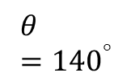


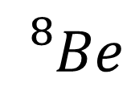
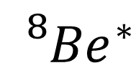
The ${}_{}^{8}{Be}$ Decay Anomaly
Solved by introducing a U(1) vector boson X
$$e^{−}$$
$${{}_{}^{8}{Be}}^{∗}$$
$${{}_{}^{8}{Be}}^{}$$
X
$$θ={140}^{°}$$
$$e^{+}$$

Slide 7
A Force or a Farce?
Atomki 2012 vs 2015

Slide 8
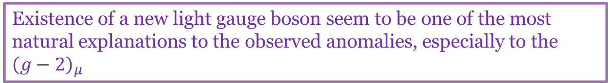
A Force or a Farce?
Experiments seems point to the same direction, that there is contribution from new physics in electroweak interactions
F. Reines, and others, PRL 37, 315-318 (1976)
P. Vilain and others, PLB 335, 246 (1994)
R. Casalbuoni and others, hep-ph/0001215
G. W. Bennett and others PRL 92, 161802 (2004)
Existence of a new light gauge boson seem to be one of the most natural explanations to the observed anomalies, especially to the ${\left(g−2\right)}_{μ}$
W. Altmannshofer, and others, PRL 113, 091801 (2014)
S. N. Gninenko and others, PRD 91, 095015 (2015)

Slide 9


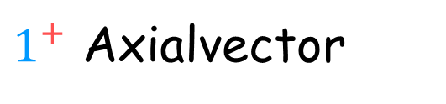


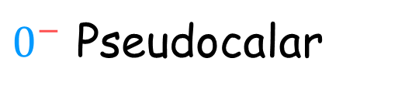
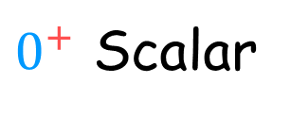

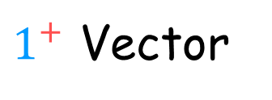
The ${U(1)}_{X}$ model
$$J^{P}$$
$0^{+}$ Scalar
Excluded by parity violation (Dark Higgs) $1^{+}→0^{+}+0^{+}$; $L=1$
$0^{−}$ Pseudocalar
Excluded by other experiments
$1^{+}$ Axialvector
Large uncertainty in NME
$1^{+}$ Vector
$SU(3)×{SU(2)}_{L}×U(1)×{U(1)}_{X}$ model:
J. L. Feng, and others, PRL 117, 071803 (2016)

Slide 10

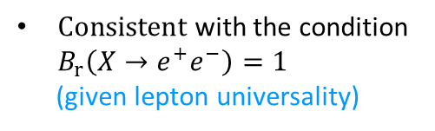


Gauge Boson Couplings
$$B_{r}\left(X→e^{+}e^{−}\right)=1$$
Atomki + NA48/2 limit
Anomalous magnetic moment of e g-2
}
SLAC E141
${|ε}_{ν_{e}}|≪|ε_{e}|$
TEXONO Neutrino electron scattering requires:
$Consistent$ with the condition $B_{r}\left(X→e^{+}e^{−}\right)=1$
(given lepton universality)

Slide 11
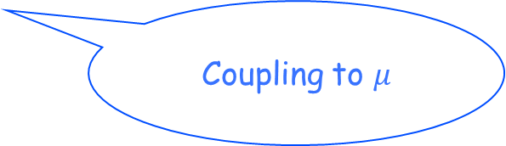
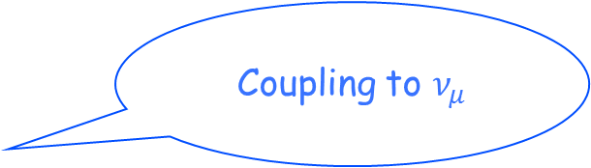

The solution to older experimental anomalies?
What would happen if we give up “lepton universality”?
$$B_{r}\left(X→e^{+}e^{−}\right)<1$$
NuTeV
Coupling to $ν_{μ}$
Muon g-2
Coupling to $μ$

Slide 12
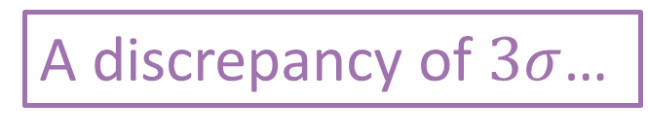
NuTeV anomaly
Standard Model fit (LEPEWWG) value is $0.2227±0.00037$
A discrepancy of $3σ$…
Strange sea asymmetry
Nothing conclusive due to large uncertainties…
Isospin violation
QCD corrections

Slide 13
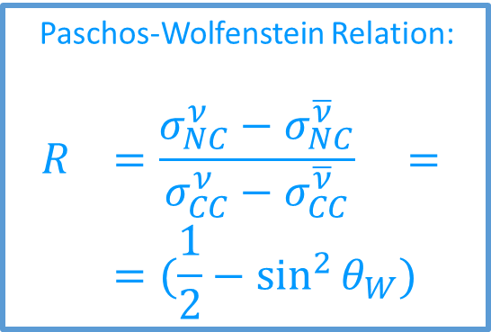

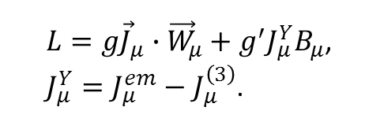
NuTeV anomaly
Paschos-Wolfenstein Relation:
$$R =\frac{σ_{NC}^{ν}−σ_{NC}^{\overline{ν}}}{σ_{CC}^{ν}−σ_{CC}^{\overline{ν}}} =$$
$$=(\frac{1}{2}−\sin^{2}{θ_{W}})$$
Electroweak Lagrangian:
$L=g{\vec{J}}_{μ}∙{\vec{W}}_{μ}+g^{′}J_{μ}^{Y}B_{μ}$,
$J_{μ}^{Y}=J_{μ}^{em}−J_{μ}^{\left(3\right)}$.
Physical particles:
$W_{μ}^{±}\text{=}\frac{1}{\sqrt{2}}\left(W_{μ}^{\left(1\right)}±iW_{μ}^{\left(2\right)}\right);$ $γ_{μ}=\frac{1}{\sqrt{g^{2}+g^{′2}}}\left(g^{′}W_{μ}^{\left(3\right)}+gB_{μ}\right);$ $Z_{μ}^{0}=\frac{1}{\sqrt{g^{2}+g^{′2}}}\left(gW_{μ}^{\left(3\right)}−g^{′}B_{μ}\right);$
$g=\frac{e}{\sin{θ_{W}}}$; $g^{′}=\frac{e}{\cos{θ_{W}}}$

Slide 14



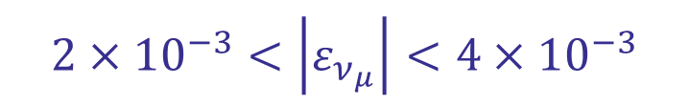

NuTeV anomaly
SM:
X:
X
$$2×{10}^{−3}<\left|ε_{ν_{μ}}\right|<4×{10}^{−3}$$
q
q
Coupling $∝ ε_{q}ε_{ν_{μ}}$

Slide 15
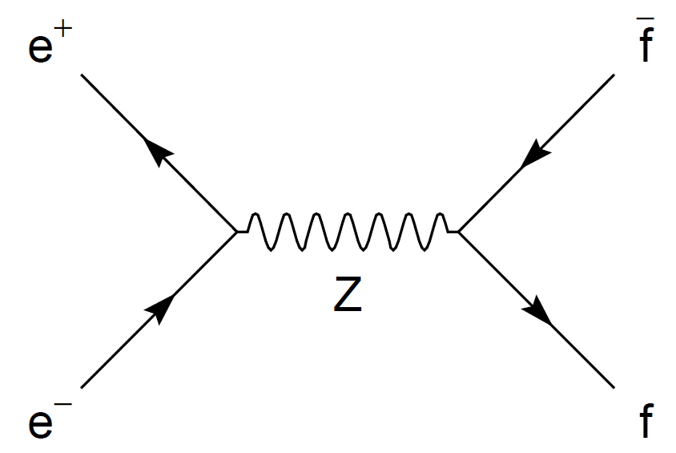



Number of Neutrino Families
The line shape method:
Assumeing lepton university
$Γ_{inv}=Γ_{z}−Γ_{h}−3Γ_{l}$
Using SM prediction $N_{ν}$ can be extracted
$N_{ν}=\frac{Γ_{inv}}{Γ_{l}}{\left(\frac{Γ_{l}}{Γ_{ν}}\right)}_{SM}$
$$N_{ν}=2.9835±0.0083(exp)±0.002(m_{t},m_{H})$$

Slide 16


Number of Neutrino Families
$$e^{+}$$
Cross-section shape after including the contribution form X boson:
Z,X
$$e^{−}$$
Lepton university
Upper bounds of the couplings

Slide 17
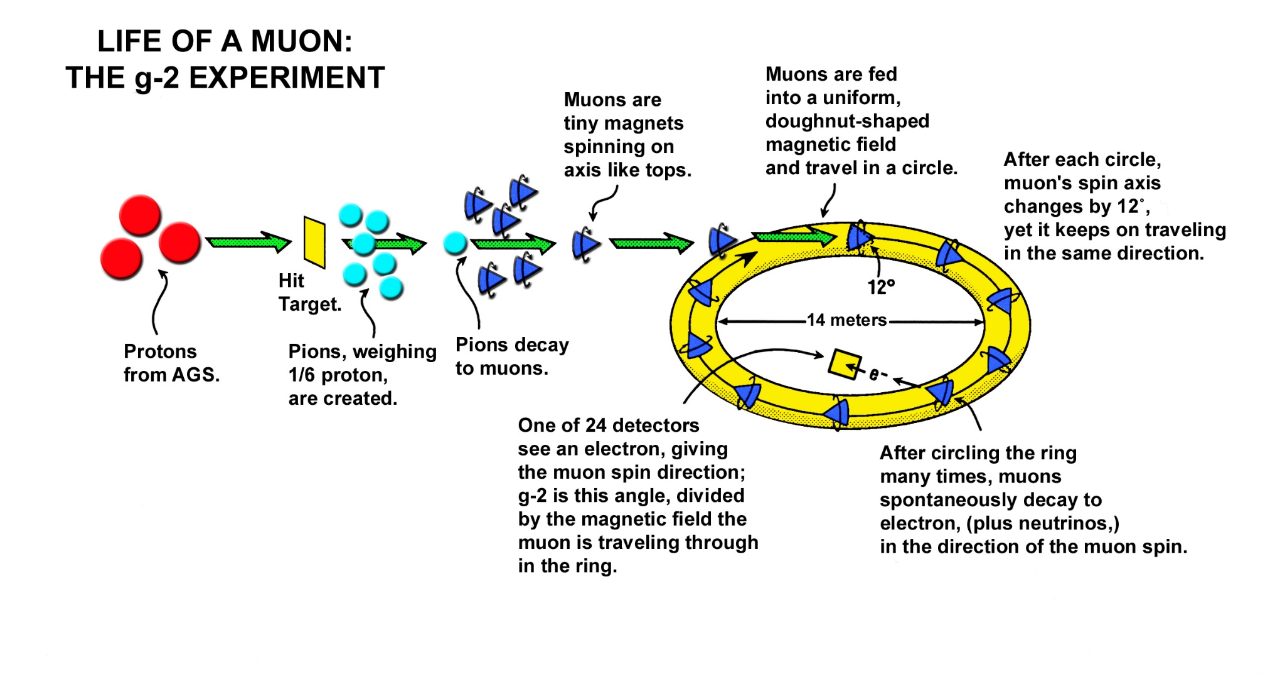

Muon $g−2$ Anomaly
E821 at Brookhaven

Slide 18

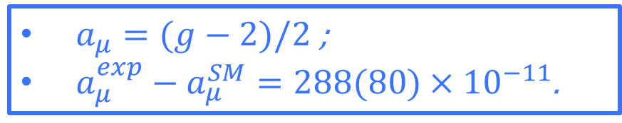
Muon $g−2$ Anomaly
$$g=2$$
L
Tree
NL
The experimental result is $3.6σ$ higher than the SM prediction
Can be related to a light vector boson
$a_{μ}=(g−2)/2$ ;
$a_{μ}^{exp}−a_{μ}^{SM}=288(80)×{10}^{−11}$.

Slide 19

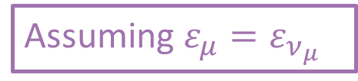




Neutrino Trident Production
Trident production:
Assuming $ε_{μ}=ε_{ν_{μ}}$
W, Z, or X
$$μ$$
$$ε_{μ}$$
$$μ$$
N
N
$$M_{X}$$

Slide 20

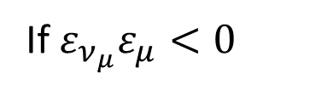



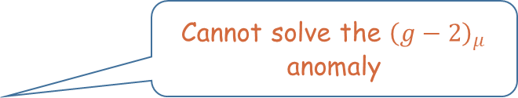
Neutrino Trident Production
Constraint:
$−2×{10}^{−5}<ε_{ν_{μ}}ε_{μ}<6×{10}^{−7}$
If $ε_{ν_{μ}}ε_{μ}>0$
Cannot solve the ${\left(g−2\right)}_{μ}$ anomaly
${|ε}_{μ}|<3×{10}^{−3}$
If $ε_{ν_{μ}}ε_{μ}<0$
X can be the answer to !
$|ε_{μ}|<5×{10}^{−3}$

Slide 21
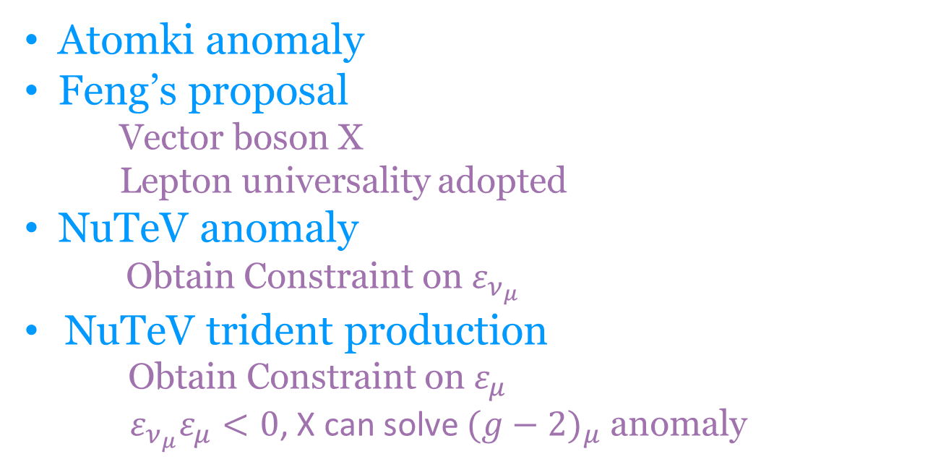
Conclusion
Atomki anomaly
Feng’s proposal
Vector boson X
Lepton universality adopted
NuTeV anomaly
Obtain Constraint on $ε_{ν_{μ}}$
NuTeV trident production
Obtain Constraint on $ε_{μ}$
$ε_{ν_{μ}}ε_{μ}<0$, X can solve ${(g−2)}_{μ}$ anomaly

Slide 22
Thank you!

Slide 23
Backup slides

Slide 24
Atomki 2012 vs 2015

Slide 25
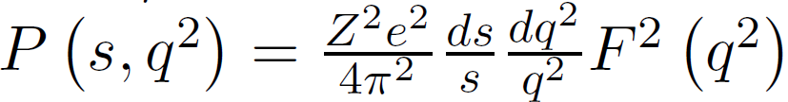
Neutrino Trident Production
Equivalent photon approximation (EPA):

